Slide 1


ADMIS Lab
先进数据与机器智能系统实验室
Indexing and Hashing
Chapter 14
Yichao Zhang
Email: yichaozhang@tongji.edu.cn
Department of Computer Science and Technology
Tongji University

Slide 2
Outline
Basic Concepts
Ordered Indexing
B⁺-tree & B-tree Indices
Static & Dynamic Hashing
Ordered Indexing vs. Hashing
Index Definition in SQL
Multiple-key Access

Slide 3
Index vs. Data (索引块与数据块)
索引可提高检索效率，其结构(二叉树、B⁺树等)占用空间小，访问速度快
  如果表中一条记录在磁盘上占用 1000字节，对其中10字节的一个字段建立索引，那么该记录对应的索引项的大小只有10字节。如SQL Server的最小空间分配单元是“页Page”，一个页在磁盘上占用8K空间，可以存储上述记录8条，但可以存储索引800条
  从一个有8000条记录表中检索符合某个条件的记录，如没有索引，可能需要遍历8000条×1000字节/8K字节=1000个页面才能找到结果。如果在检索字段上有上述索引，则可以在8000条×10字节/8K字节=10个页面中检索到满足条件的索引块，然后根据索引块上的指针逐一找到结果数据块，这样I/O访问量要少很多

Slide 4
Basic Concepts
Indexing mechanisms
  speed up the access to desired data
  index files are typically much smaller than the original file
Search Key(搜索码/关键字)
  the set of attributes used to look up records in a file/table
  an index file consists of records (called index entries, 索引项) of the form (search-key, pointer)
Two kinds of indices
  ordered index (顺序索引): search keys are stored in sorted order
  hash index (散列索引): search keys are distributed uniformly across “buckets” using a “hash function”

Slide 5
Index Evaluation Metrics
数据访问类型
  能支持的访问类型，如找到具有特定属性值的所有记录（Equal Query等值查询）、找到其属性值在某个特定范围内的所有记录(Range Query范围查询)
数据访问时间
  在查询中使用索引找到一个特定数据所需时间
数据插入时间
  插入一个新数据项时间，包括: 找到插入位置时间 + 更新索引结构时间
数据删除时间
  删除一个数据项时间，包括: 找到待删除项时间 + 更新索引结构时间
存储空间开销
  索引结构占用的额外存储空间

Slide 6
Outline
Basic Concepts
Ordered Indexing
B⁺-tree & B-tree Indices
Static & Dynamic Hashing
Ordered Indexing vs. Hashing
Index Definition in SQL
Multiple-key Access

Slide 7
Ordered Indexing-顺序索引
Ordered index
  Index entries are sorted on the search key value
  Primary index and secondary index
Primary index (主索引), clustering index 聚集索引
  包含记录的文件按某个搜索码指定的顺序排序，该搜索码对应的索引称为clustering index
Secondary index (辅助索引), no-clustering index (非聚集索引)
  An index whose search key specifies an order different from the sequential order of the file
Index-sequential file (索引顺序文件)
  Ordered sequential file with a primary index

Slide 8
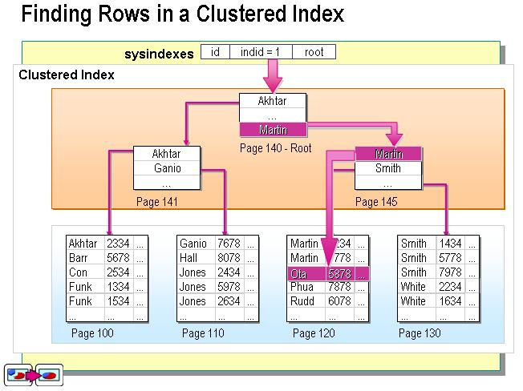
Primary Index：Clustering Index
聚集索引的叶节点就是数据节点，索引顺序就是数据物理存储顺序。一个表最多只能有一个聚集索引

Slide 9
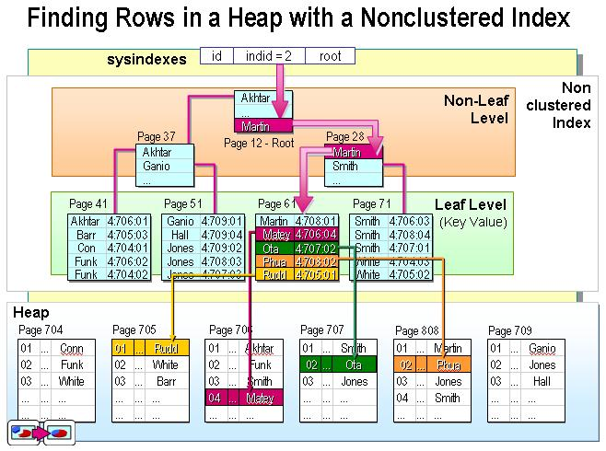
Secondary Index：Non-clustering Index
非聚集索引的叶节点仍然是索引节点，有一个指针指向对应的数据块。非聚集索引顺序与数据物理排列顺序无关

Slide 10
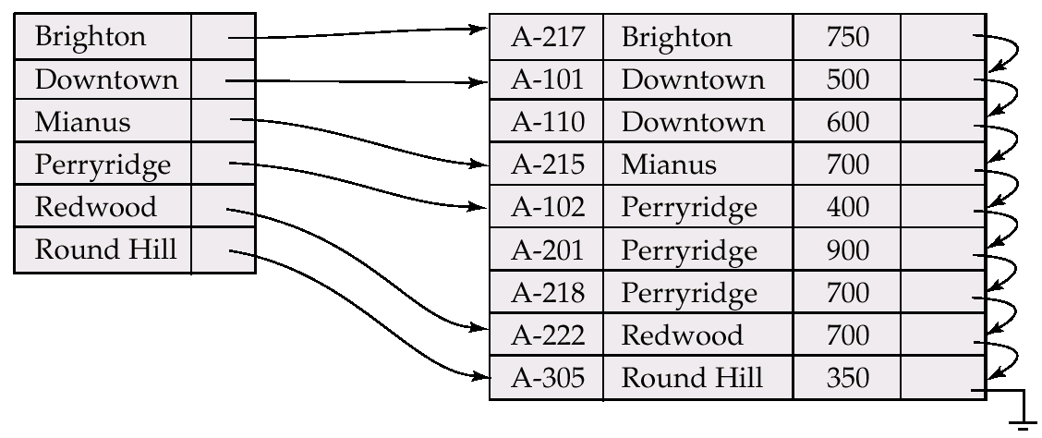
Dense Index
Dense index (稠密索引)
  Index record appears for every search-key value in the file

Slide 11
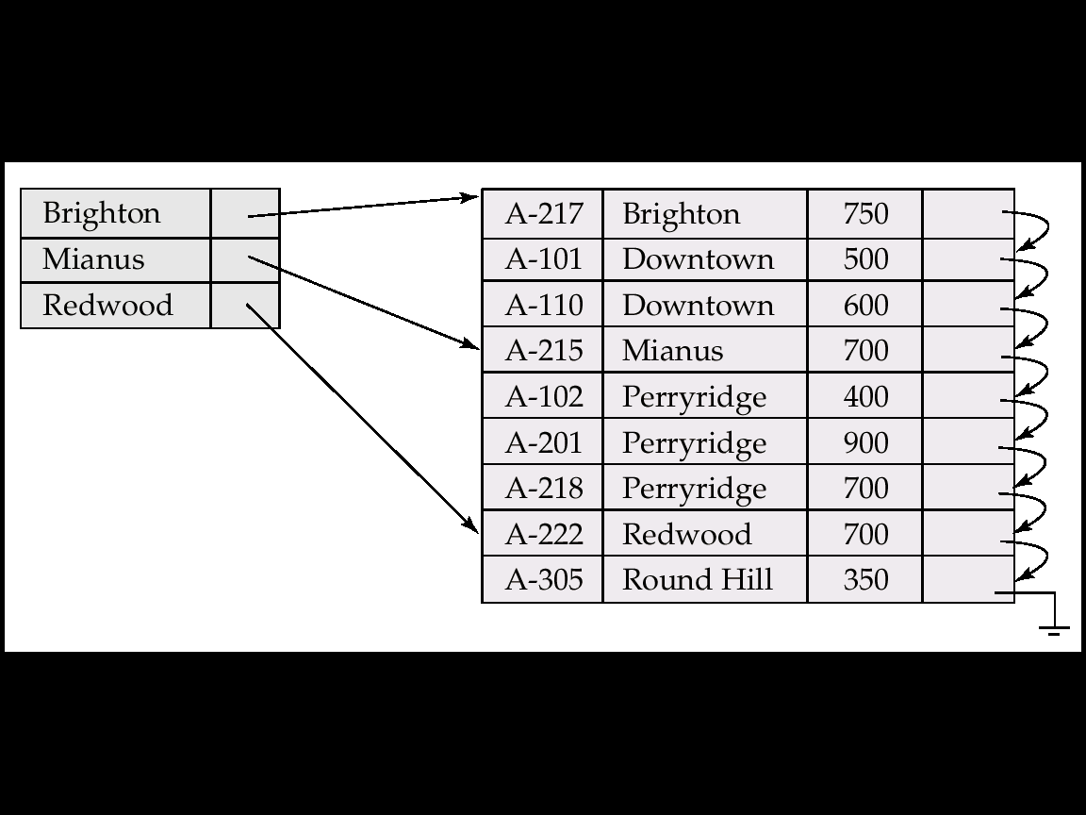
Sparse Index
Sparse Index (稀疏索引)
  Contain index records for only some search-key values when records are sequentially ordered on the search-key (why?)

Slide 12
Multilevel Index (多级索引)
If primary index does not fit in memory, data access becomes expensive
To reduce the number of disk accesses to index records, treat primary index as a sequential file and construct a sparse index on it
  outer index – a sparse index of primary index
  inner index – the primary index file
If outer index is still too large to fit in main memory, yet another level of index can be created, and so on

Slide 13
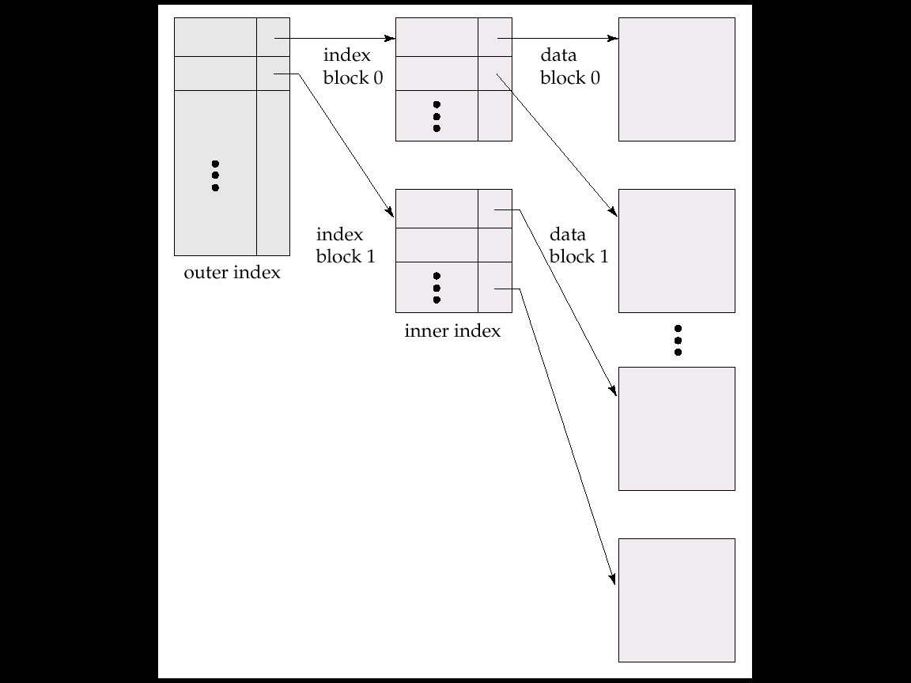
Multilevel Index (Cont.)

Slide 14
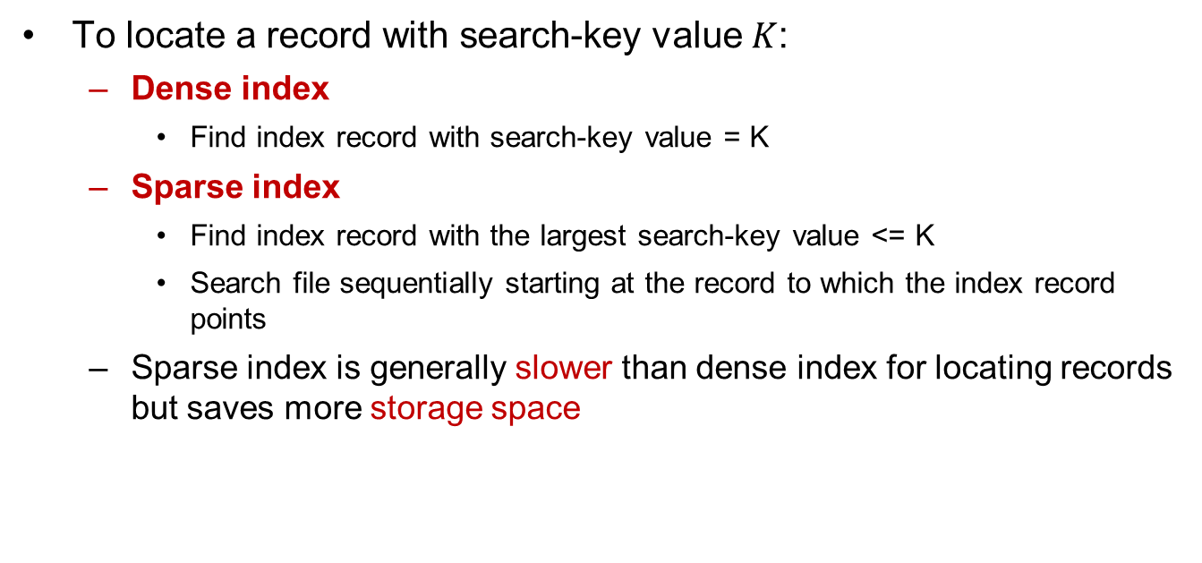
Dense vs. Sparse Index
To locate a record with search-key value $K$:
  Dense index
    Find index record with search-key value = K
  Sparse index
    Find index record with the largest search-key value <= K
    Search file sequentially starting at the record to which the index record points
  Sparse index is generally slower than dense index for locating records but saves more storage space

Slide 15
Index Update: Deletion
Single-level index deletion
  Dense indices – deletion of search-key in index is similar to file record deletion

Slide 16
Index Update: Deletion
Single-level index deletion
  Sparse indices
    if an entry for the search key exists in the index, it is deleted by replacing the entry in the index with the next search-key value in the file
    if the next search-key value already has an index entry, the entry is deleted instead of being replaced

Slide 17
Index Update: Insertion
Single-level index insertion
  Perform a lookup using the search-key value
  Dense indices – if the search-key value does not appear in the index, insert it
  Sparse indices – if index stores an entry for each block of the file, no change needs to be made to the index unless a new block is created. In this case, the first search-key value appearing in the new block is inserted into the index
Multilevel insertion/deletion
  Extensions of the single-level algorithms

Slide 18
Dense vs. Sparse Index
Space and maintenance for insertions and deletions
  Sparse index needs less space and less maintenance overhead for insertions and deletions
  Good tradeoff: sparse index with an index entry for every block in file, corresponding to the least search-key value in the block

Slide 19
Secondary Indices
To find all the records with values in a certain range
  Example 1: In the account relation stored sequentially by account number, we may want to find all accounts in a particular branch
  Example 2: to find all accounts with a specified balance or range of balances
Secondary index
  Build a secondary index with an index record for each search-key value
  Index record points to a bucket that contains pointers to all the actual records with that particular search-key value

Slide 20
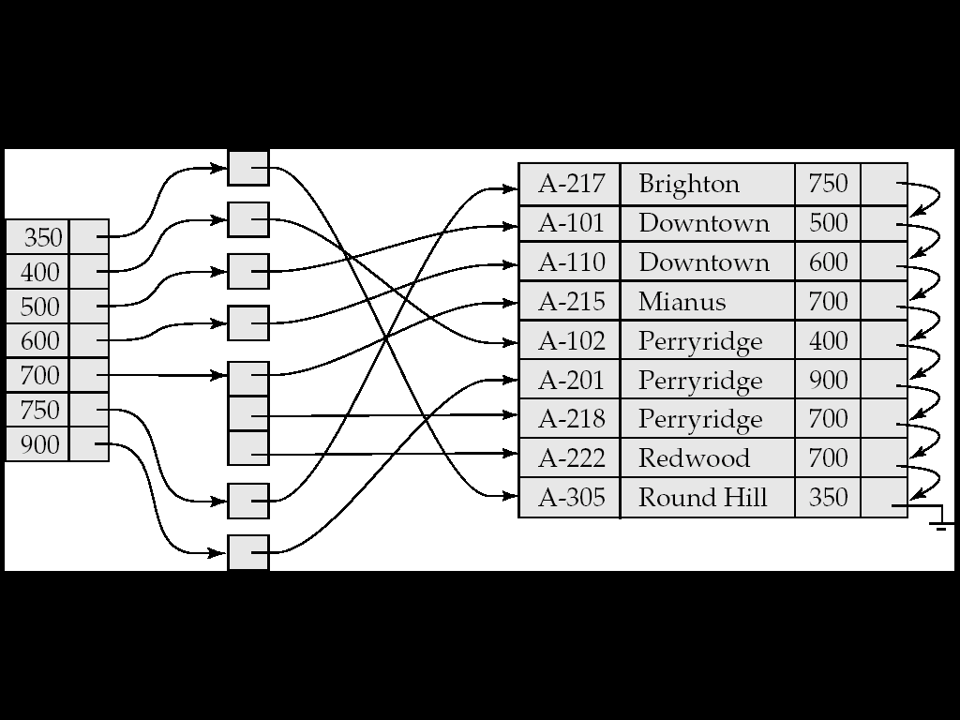
Secondary Index on Balance Field of Account
bucket

Slide 21
Primary and Secondary Indices
Secondary indices have to be dense (why?)
When a file is modified, every index on the file must be updated. Updating indices imposes overhead on database modification
Sequential scan using primary index is efficient, but a sequential scan using a secondary index is expensive
  each record access may fetch a new block from disk

Slide 22
Outline
Basic Concepts
Ordered Indexing
B⁺-tree & B-tree Indices
Static & Dynamic Hashing
Ordered Indexing vs. Hashing
Index Definition in SQL
Multiple-key Access

Slide 23
B⁺-Tree Index Files
B⁺-tree is an alternative to indexed-sequential file
Disadvantage of indexed-sequential file
  Performance degrades as file grows, since many overflow blocks (溢出块) get created. Periodic reorganization of entire file is required
B⁺-tree index file
  Advantage: automatically reorganizes itself with small and local changes, in the face of insertions and deletions. Reorganization of entire file is not required to maintain performance
  Disadvantage: extra insertion and deletion overhead, space overhead
  B⁺-tree is used widely since its advantages outweight the disadvantages

Slide 24
Example of B⁺-Tree

Slide 25
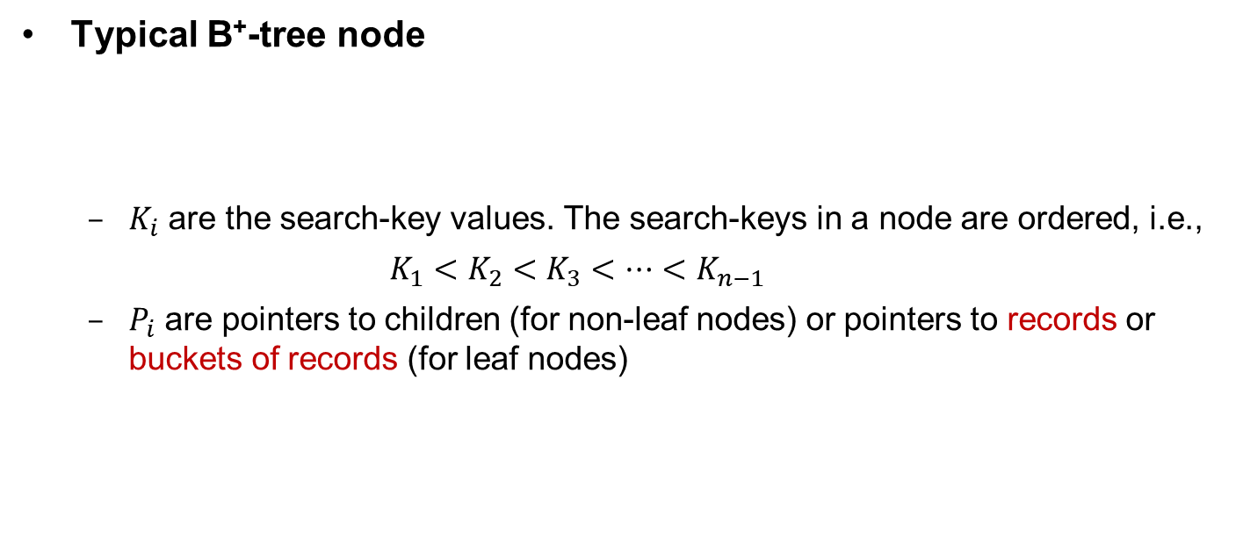
B⁺-Tree Index Files (Cont.)
Typical B⁺-tree node
  $K_{i}$ are the search-key values. The search-keys in a node are ordered, i.e.,
  $K_{1}<K_{2}<K_{3}<⋯<K_{n−1}$
  $P_{i}$ are pointers to children (for non-leaf nodes) or pointers to records or buckets of records (for leaf nodes)

Slide 26
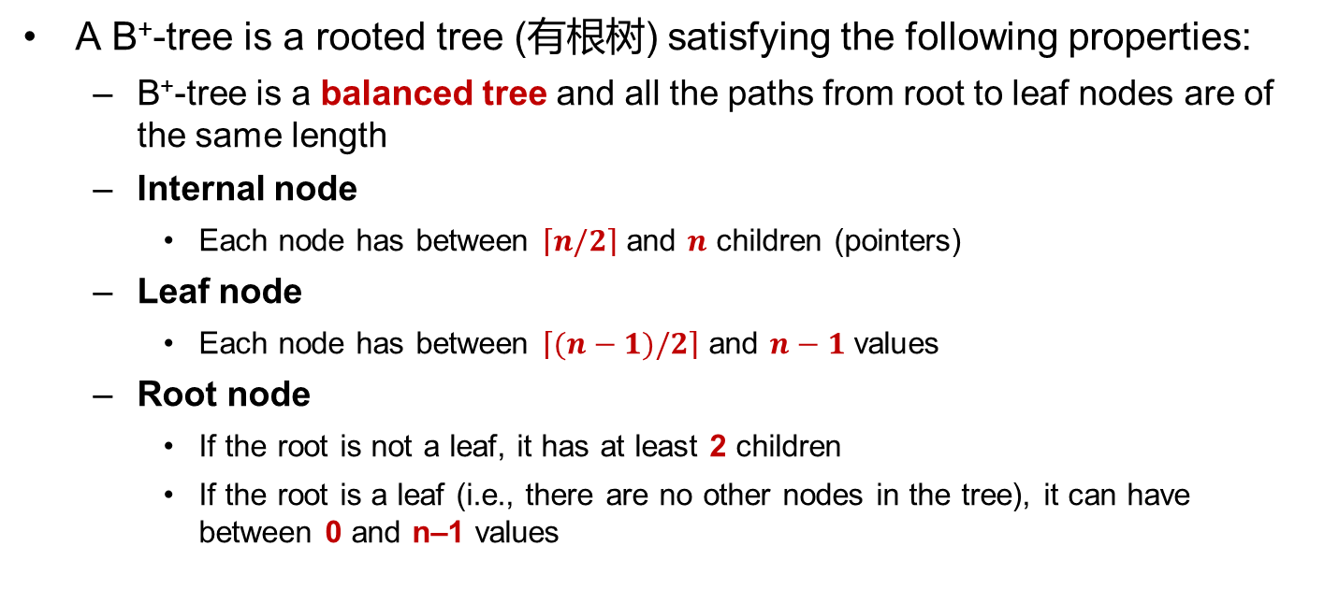
B⁺-Tree Index Files (Cont.)
A B⁺-tree is a rooted tree (有根树) satisfying the following properties:
  B⁺-tree is a balanced tree and all the paths from root to leaf nodes are of the same length
  Internal node
    Each node has between $\left\lceil n/2\right\rceil$ and $n$ children (pointers)
  Leaf node
    Each node has between $\left\lceil (n−1)/2\right\rceil$ and $n−1$ values
  Root node
    If the root is not a leaf, it has at least 2 children
    If the root is a leaf (i.e., there are no other nodes in the tree), it can have between 0 and n–1 values

Slide 27
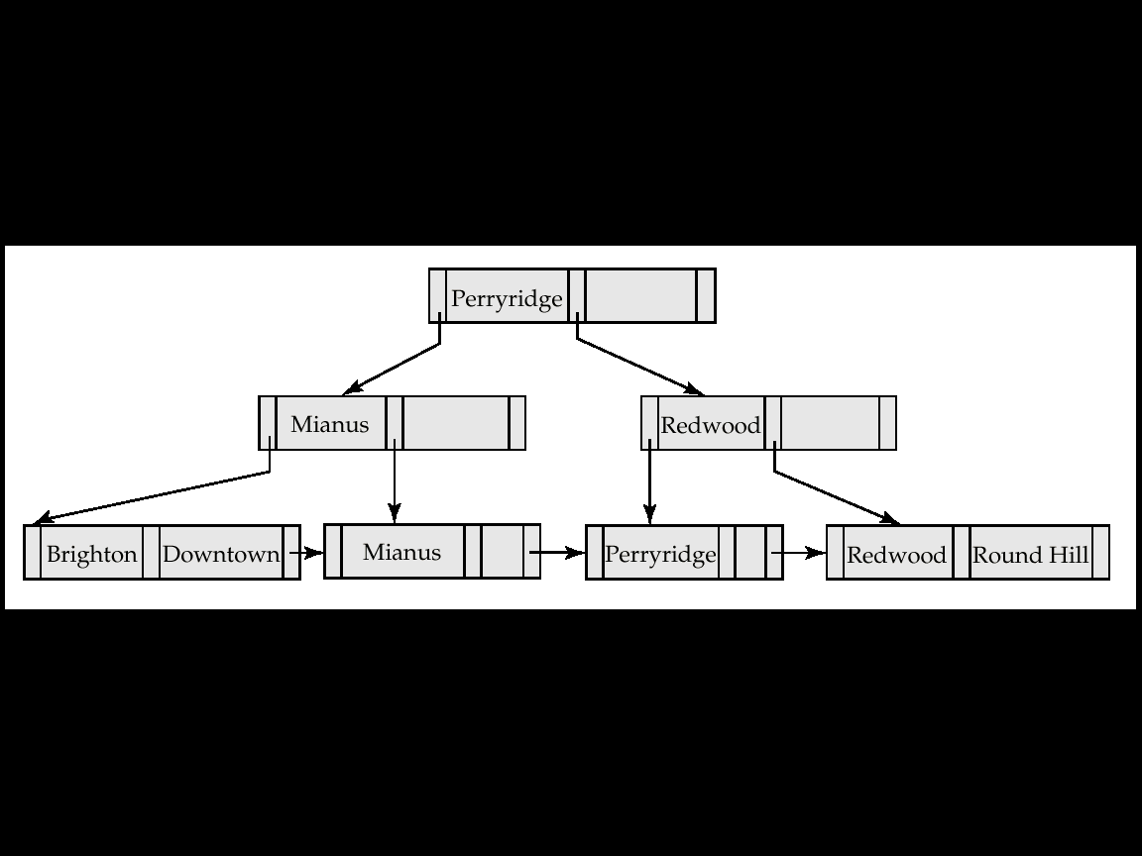
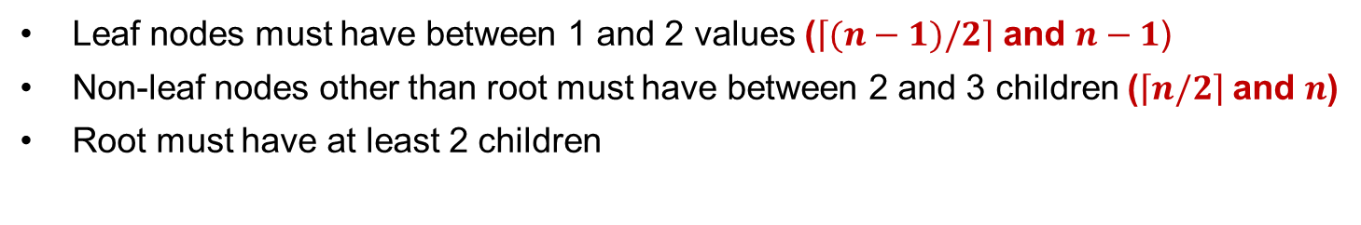
Example of a B⁺-tree
B⁺-tree for account file (n = 3)
Leaf nodes must have between 1 and 2 values ($\left\lceil (n−1)/2\right\rceil$ and $n−1$)
Non-leaf nodes other than root must have between 2 and 3 children ($\left\lceil n/2\right\rceil$and $n$)
Root must have at least 2 children

Slide 28
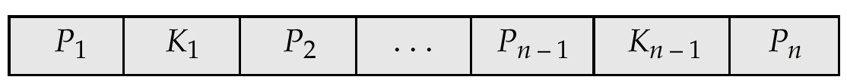


Leaf Node in B⁺-Tree
Properties of a leaf node
  Pointer $P_{i}$ either points to a file record with search-key value $K_{i}$, or to a bucket of pointers to file records, each record having search-key value $K_{i}$. Only need bucket structure if the search-key does not form a primary key (why?)
  $P_{n}$ points to next leaf node in search-key order
instructor file
$n$=4

Slide 29
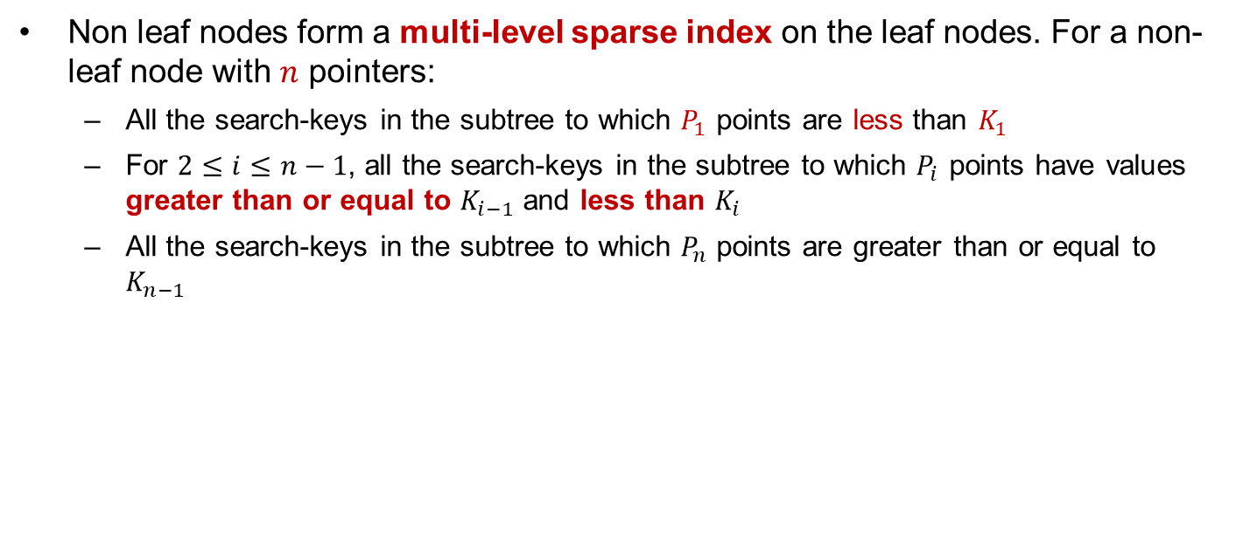
Non-Leaf Nodes in B⁺-Tree
Non leaf nodes form a multi-level sparse index on the leaf nodes. For a non-leaf node with $n$ pointers:
  All the search-keys in the subtree to which $P_{1}$ points are less than $K_{1}$
  For $2≤i≤n−1$, all the search-keys in the subtree to which $P_{i}$ points have values greater than or equal to $K_{i−1}$ and less than $K_{i}$
  All the search-keys in the subtree to which $P_{n}$ points are greater than or equal to $K_{n−1}$

Slide 30
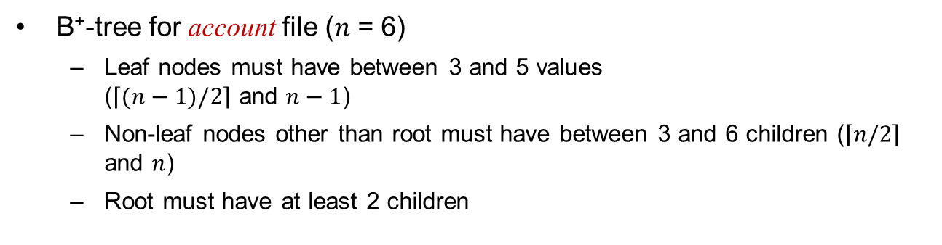
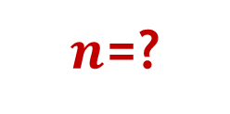
Example of B⁺-tree
$n$=?
B⁺-tree for account file ($n$ = 6)
  Leaf nodes must have between 3 and 5 values
  ($\left\lceil (n−1)/2\right\rceil$ and $n−1$)
  Non-leaf nodes other than root must have between 3 and 6 children ($\left\lceil n/2\right\rceil$ and $n$)
  Root must have at least 2 children

Slide 31
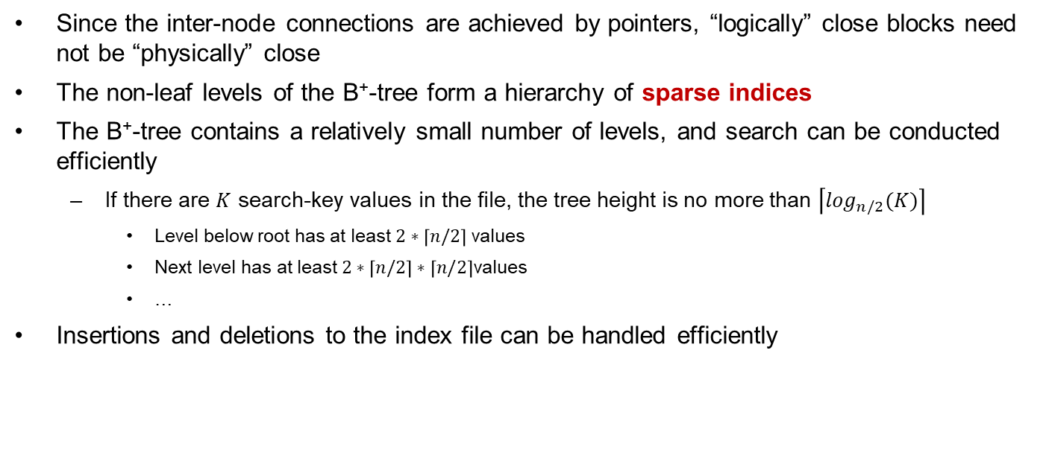
Observations about B⁺-tree
Since the inter-node connections are achieved by pointers, “logically” close blocks need not be “physically” close
The non-leaf levels of the B⁺-tree form a hierarchy of sparse indices
The B⁺-tree contains a relatively small number of levels, and search can be conducted efficiently
  If there are $K$ search-key values in the file, the tree height is no more than $\left\lceil \log_{n/2}(K)\right\rceil$
    Level below root has at least $2∗\left\lceil n/2\right\rceil$ values
    Next level has at least $2∗\left\lceil n/2\right\rceil ∗\left\lceil n/2\right\rceil$values
    …
Insertions and deletions to the index file can be handled efficiently

Slide 32
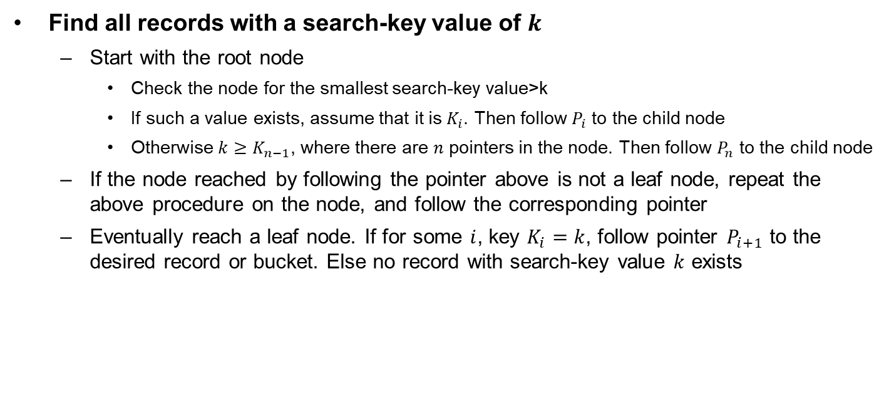
Queries on B⁺-Trees
Find all records with a search-key value of $k$
  Start with the root node
    Check the node for the smallest search-key value>k
    If such a value exists, assume that it is $K_{i}$. Then follow $P_{i}$ to the child node
    Otherwise $k≥K_{n−1}$, where there are $n$ pointers in the node. Then follow $P_{n}$ to the child node
  If the node reached by following the pointer above is not a leaf node, repeat the above procedure on the node, and follow the corresponding pointer
  Eventually reach a leaf node. If for some $i$, key $K_{i}=k$, follow pointer $P_{i+1}$ to the desired record or bucket. Else no record with search-key value $k$ exists

Slide 33
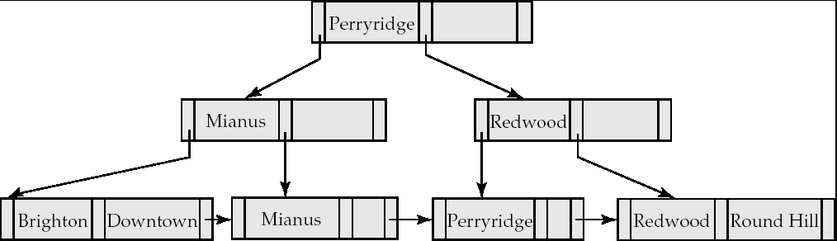
Example: Queries on B⁺-Tree
Search begins at root, and key comparisons direct it to a leaf
  Search for Perryridge

Slide 34
Example: Queries on B⁺-Tree
Search begins at root, and key comparisons direct it to a leaf
  Search for 5*, 15*, all data entries >= 24*
Root
13
17
24
30
2*
3*
5*
7*
14*
16*
19*
20*
22*
24*
27*
29*
33*
34*
38*
39*

Slide 35
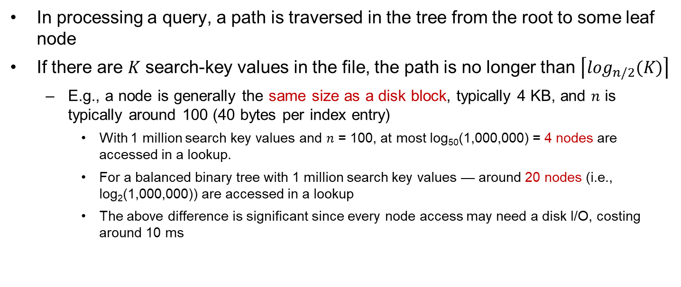
Queries on B⁺-Trees (Cont.)
In processing a query, a path is traversed in the tree from the root to some leaf node
If there are $K$ search-key values in the file, the path is no longer than $\left\lceil \log_{n/2}(K)\right\rceil$
  E.g., a node is generally the same size as a disk block, typically 4 KB, and $n$ is typically around 100 (40 bytes per index entry)
    With 1 million search key values and $n$ = 100, at most log₅₀(1,000,000) = 4 nodes are accessed in a lookup.
    For a balanced binary tree with 1 million search key values — around 20 nodes (i.e., log₂(1,000,000)) are accessed in a lookup
    The above difference is significant since every node access may need a disk I/O, costing around 10 ms

Slide 36
Insertion in B⁺-Tree
Find the leaf node in which the search-key value would appear
  If the search-key value is already in the leaf node
    record is added to file
    if necessary, a pointer is inserted into the bucket
  If the search-key value is not in certain node, add the record to the main file and create a bucket if necessary. Then:
    If there is room in the leaf node, insert (key-value, pointer) pair in the leaf node
    Otherwise, split the node along with the new (key-value, pointer) entry

Slide 37
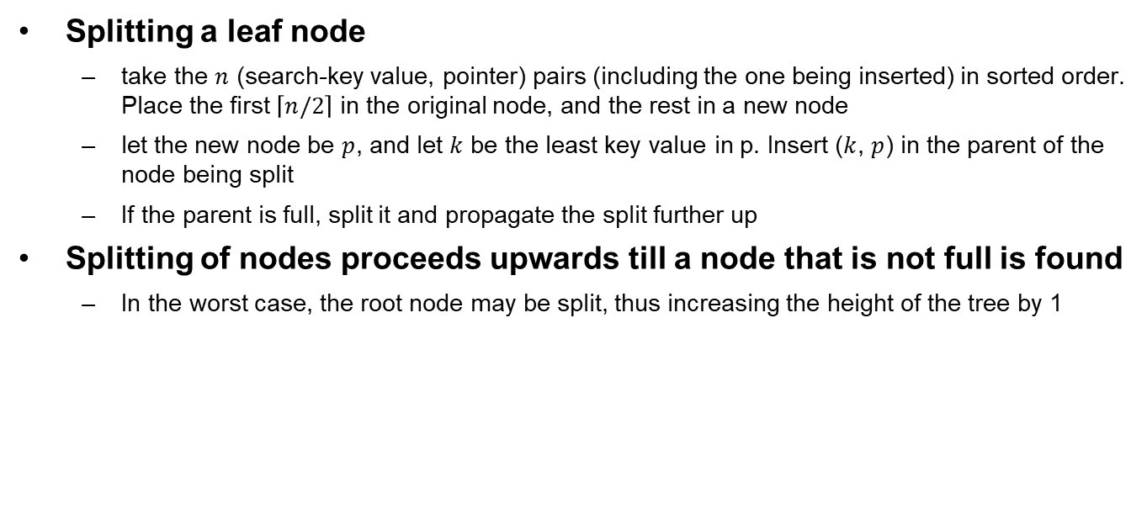
Insertion in B⁺-Tree (Cont.)
Splitting a leaf node
  take the $n$ (search-key value, pointer) pairs (including the one being inserted) in sorted order. Place the first $\left\lceil n/2\right\rceil$ in the original node, and the rest in a new node
  let the new node be $p$, and let $k$ be the least key value in p. Insert ($k$, $p$) in the parent of the node being split
  If the parent is full, split it and propagate the split further up
Splitting of nodes proceeds upwards till a node that is not full is found
  In the worst case, the root node may be split, thus increasing the height of the tree by 1

Slide 38
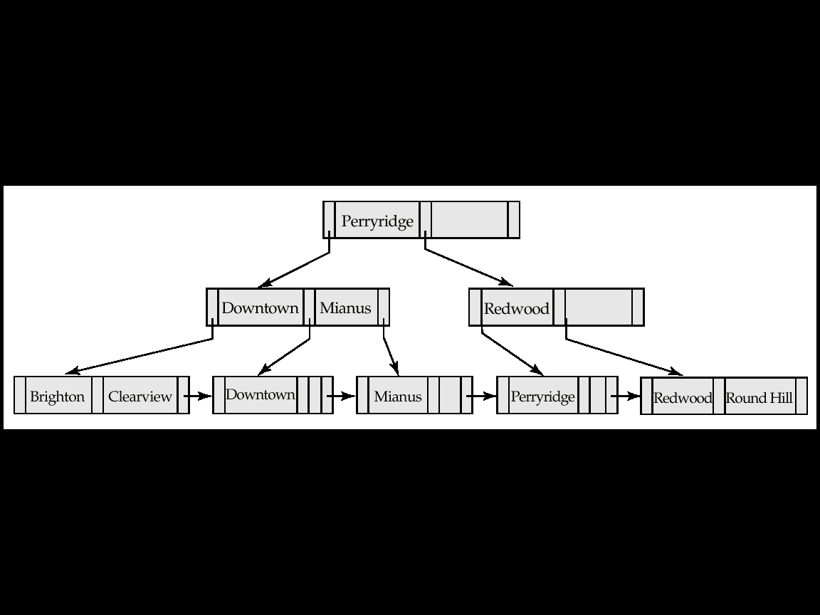
Insertion in B⁺-Tree (Cont.)
B⁺-Tree before and after the insertion of “Clearview”

Slide 39
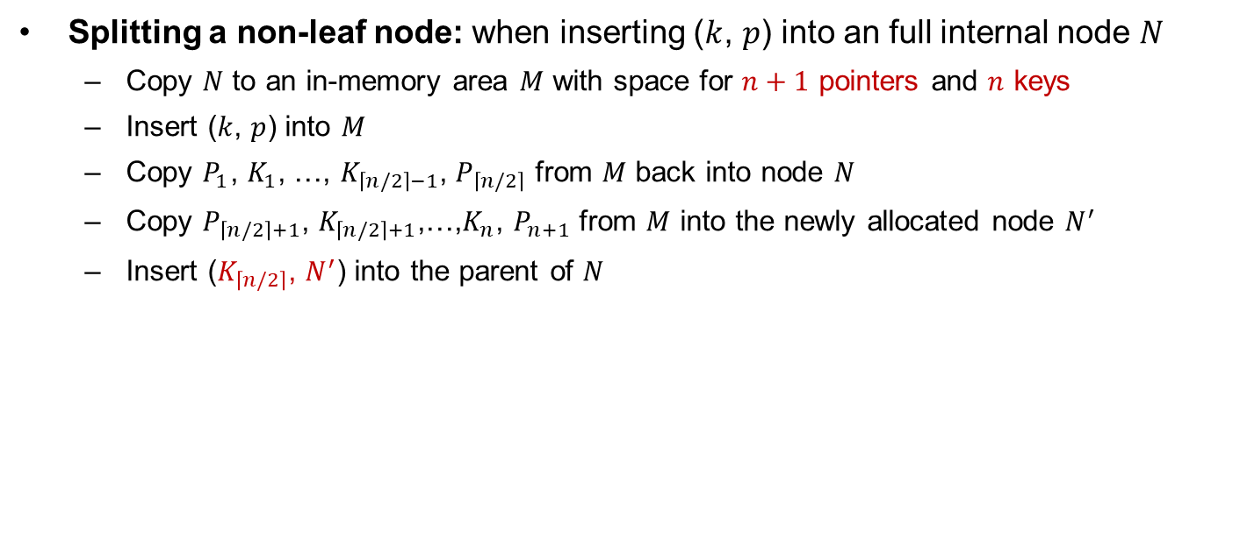
Insertion in B+-Tree (Cont.)
Splitting a non-leaf node: when inserting ($k$, $p$) into an full internal node $N$
  Copy $N$ to an in-memory area $M$ with space for $n+1$ pointers and $n$ keys
  Insert ($k$, $p$) into $M$
  Copy $P_{1}$, $K_{1}$, …, $K_{\left\lceil n/2\right\rceil −1}$, $P_{\left\lceil n/2\right\rceil }$ from $M$ back into node $N$
  Copy $P_{\left\lceil n/2\right\rceil +1}$, $K_{\left\lceil n/2\right\rceil +1}$,…,$K_{n}$, $P_{n+1}$ from $M$ into the newly allocated node $N^{′}$
  Insert ($K_{\left\lceil n/2\right\rceil }$, $N^{′}$) into the parent of $N$

Slide 40
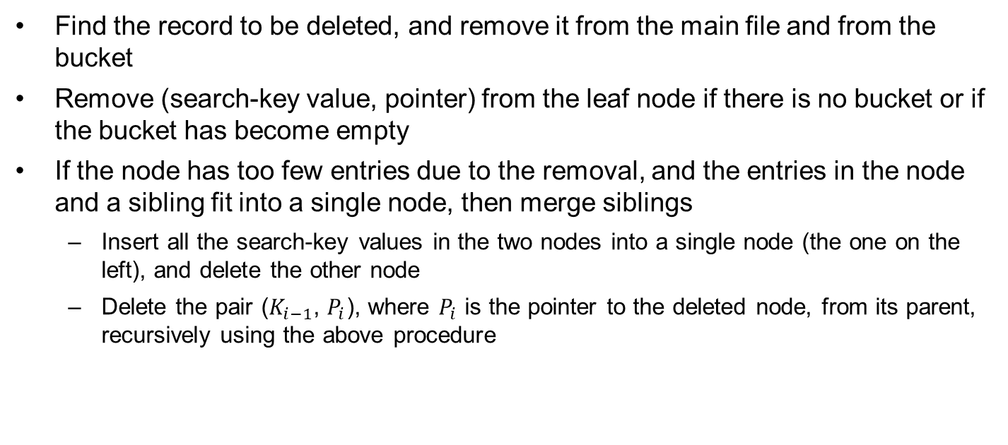
Deletion in B⁺-Tree
Find the record to be deleted, and remove it from the main file and from the bucket
Remove (search-key value, pointer) from the leaf node if there is no bucket or if the bucket has become empty
If the node has too few entries due to the removal, and the entries in the node and a sibling fit into a single node, then merge siblings
  Insert all the search-key values in the two nodes into a single node (the one on the left), and delete the other node
  Delete the pair ($K_{i−1}$, $P_{i}$), where $P_{i}$ is the pointer to the deleted node, from its parent, recursively using the above procedure

Slide 41
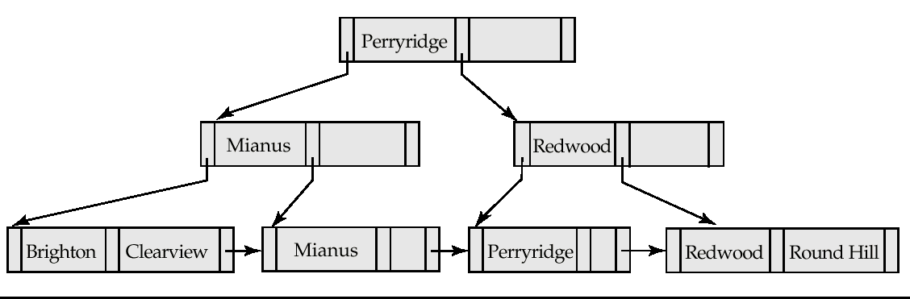

Examples of B⁺-Tree Deletion
Before and after deleting “Downtown”
$n$ = 3
Deleting “Downtown” causes merging of under-full leaves
The removal of the leaf node containing “Downtown” did not result in its parent having too little pointers. So the cascaded deletions stopped with the deleted leaf node’s parent
Notes:
参考27页的非叶节点定义

Slide 42
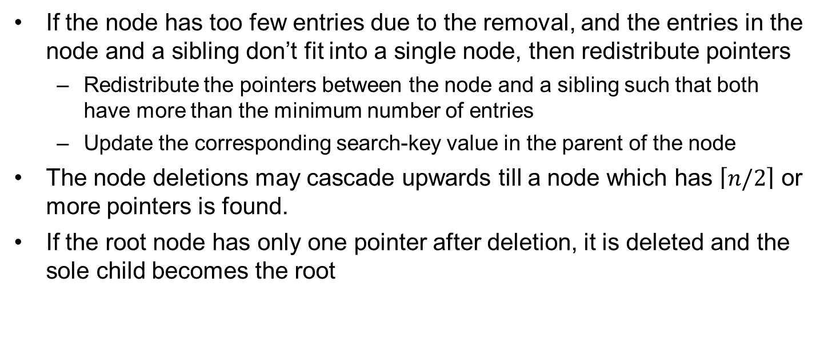
Deletion in B⁺-Tree (Cont.)
If the node has too few entries due to the removal, and the entries in the node and a sibling don’t fit into a single node, then redistribute pointers
  Redistribute the pointers between the node and a sibling such that both have more than the minimum number of entries
  Update the corresponding search-key value in the parent of the node
The node deletions may cascade upwards till a node which has $\left\lceil n/2\right\rceil$ or more pointers is found.
If the root node has only one pointer after deletion, it is deleted and the sole child becomes the root

Slide 43
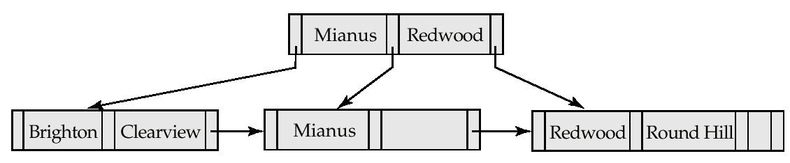
Examples of B⁺-Tree Deletion (Cont.)
n = 3
Deletion of “Perryridge”
Node with “Perryridge” becomes underfull (actually empty, in this special case) and merged with its sibling
As a result “Perryridge” node’s parent became underfull, and was merged with its sibling (and an entry was deleted from their parent)
Root node then had only one child, and was deleted and its child became the new root node

Slide 44
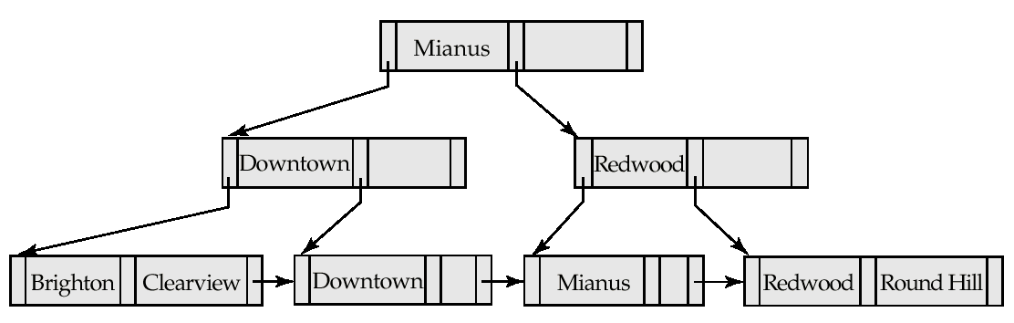
Example of B⁺-tree Deletion (Cont.)
Deletion of “Perryridge”
Parent of leaf containing Perryridge became underfull, and borrowed a pointer from its left sibling
Search-key value in the parent’s parent changes as a result

Slide 45
B⁺-Tree File Organization
Index file degradation (退化) problem is solved by using B⁺-Tree indices. Data file degradation problem is solved by using B⁺-Tree File Organization (B⁺树文件组织）
The leaf nodes in a B⁺-tree file organization store records, instead of pointers
Since records are larger than pointers, the maximum number of records that can be stored in a leaf node is less than the number of pointers in a non-leaf node
Leaf nodes are still required to be half full
Insertion and deletion are handled in the same way as the insertion and deletion of entries in a B⁺-tree index

Slide 46
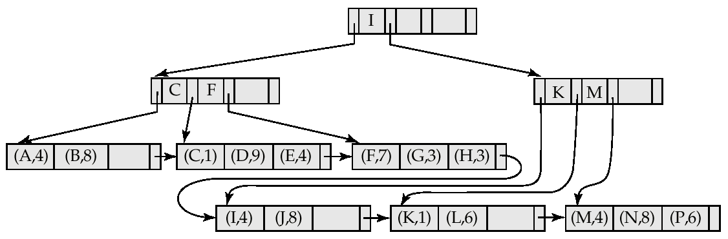
B⁺-Tree File Organization (Cont.)
Good space utilization is important since records use more space than pointers.
To improve space utilization, involve more sibling nodes in redistribution
  Involving 2 siblings or more in redistribution to avoid split / merge where possible

Slide 47
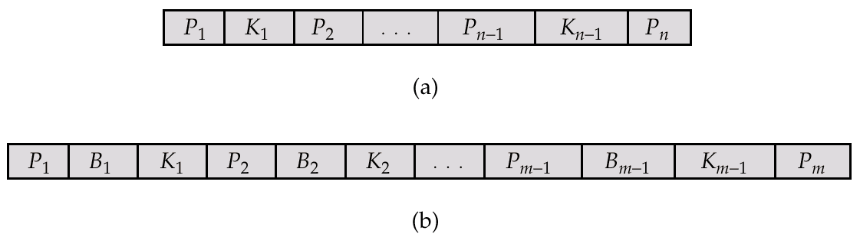

B-Tree Index Files
Similar to B⁺-tree, but B-tree allows search-key values to appear only once, thus eliminating redundant storage of search keys
Search keys in non-leaf nodes appear nowhere else in the B-tree; an additional pointer field for each search key in a non-leaf node is included
Generalized B-tree leaf node
Nonleaf node – pointers $B_{i}$ are the bucket or file record pointers
Leaf node
Non-leaf node

Slide 48
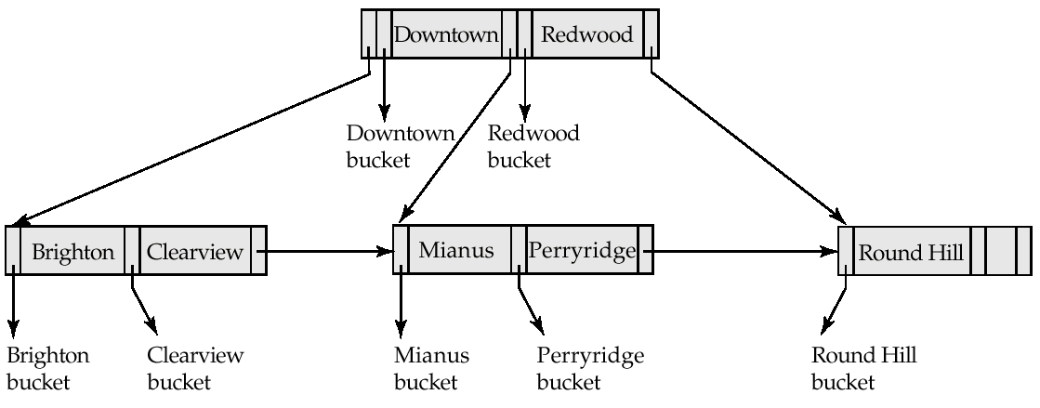
B-Tree Index File
B-tree (above) and B⁺-tree (below) on the same data

Slide 49
B-Tree Index Files (Cont.)
Advantages of B-tree indices
  Use less tree nodes than B⁺-Tree
  Sometimes possible to find the search-key value before reaching leaf nodes
Disadvantages of B-tree indices
  Only a small fraction of all search-key values are found early
  Non-leaf nodes are larger, so fan-out is reduced. Thus B-trees typically have greater depth than B⁺-tree
  Insertion and deletion are more complicated than in B⁺-trees
  Implementation is harder than B⁺-Trees
Typically, the advantages of B-trees do not outweigh disadvantages

Slide 50
Outline
Basic Concepts
Ordered Indexing
B⁺-tree & B-tree Indices
Static & Dynamic Hashing
Ordered Indexing vs. Hashing
Index Definition in SQL
Multiple-key Access

Slide 51
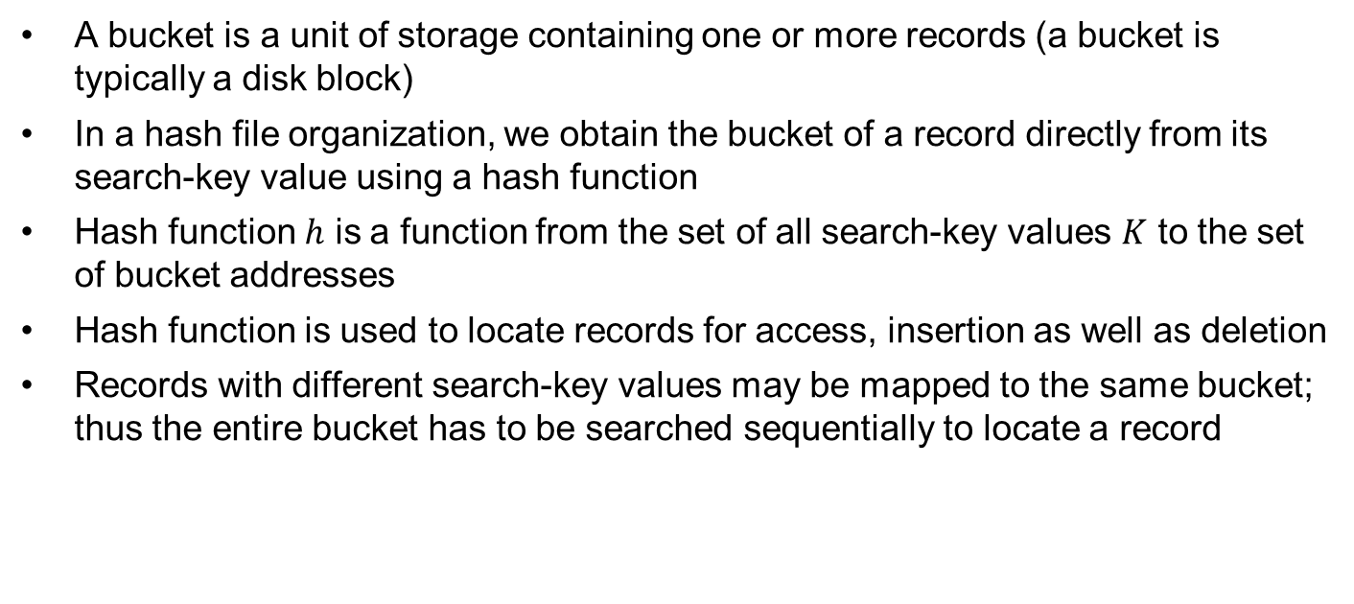
Static Hashing
A bucket is a unit of storage containing one or more records (a bucket is typically a disk block)
In a hash file organization, we obtain the bucket of a record directly from its search-key value using a hash function
Hash function $h$ is a function from the set of all search-key values $K$ to the set of bucket addresses
Hash function is used to locate records for access, insertion as well as deletion
Records with different search-key values may be mapped to the same bucket; thus the entire bucket has to be searched sequentially to locate a record

Slide 52
Example of Hash File Organization (Cont.)
Hash file organization of account file, using branch-name as key (See figure in next slide)
  There are 10 buckets
    The binary representation of the i-th character is assumed to be the integer i
    The hash function returns the sum of the binary representations of the characters mod 10
    E.g.
    h(Perryridge) = 125 mod 10 = 5
    h(Round Hill) = 113 mod 10 = 3
    h(Brighton) = 93 mod 10 = 3

Slide 53
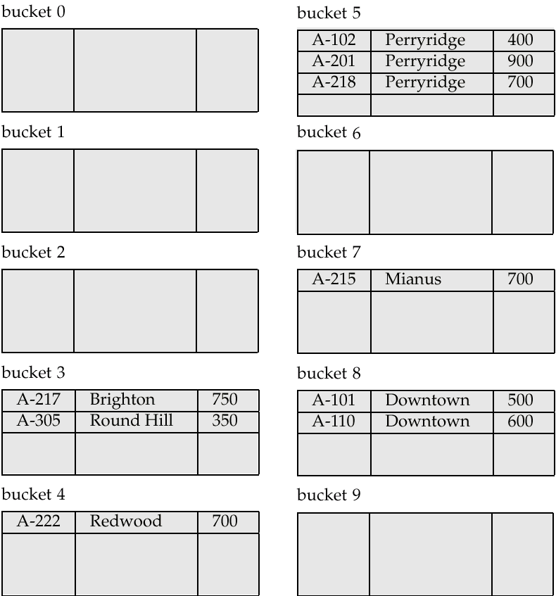
Example of Hash File Organization
Hash file organization of account file, using branch-name as key

Slide 54
Hash Functions
Worst hash function maps all search-key values to the same bucket
An ideal hash function is uniform, i.e., each bucket is assigned the same number of search-key values from the set of all possible values
Ideal hash function is random, so each bucket will have the same number of records assigned to it irrespective of the actual distribution of search-key values in the file
Typical hash functions perform computation on the internal binary representation of the search-key

Slide 55
Handling of Bucket Overflows
Bucket overflow can occur because of
  Insufficient buckets
  Skew in distribution of records. This can occur due to two reasons:
    multiple records have same search-key value
    chosen hash function produces non-uniform distribution of key values
Although the probability of bucket overflow can be reduced, it cannot be eliminated; it is handled by using overflow buckets

Slide 56
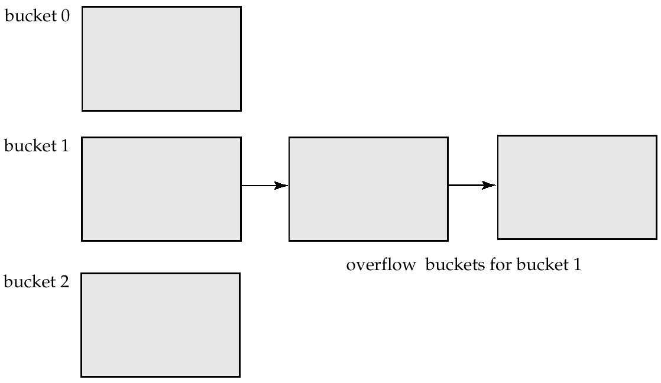
Handling of Bucket Overflows (Cont.)
Overflow chaining – the overflow buckets of a given bucket are chained together in a linked list

Slide 57
Hash Indices
Hashing can be used not only for file organization, but also for index-structure creation
A hash index organizes the search keys, with their associated record pointers, into a hash file structure
Strictly speaking, hash indices are always secondary indices
  if the file itself is organized using hashing, a separate primary hash index on it using the same search-key is unnecessary
  However, we use the term hash index to refer to both secondary index structures and hash organized files

Slide 58
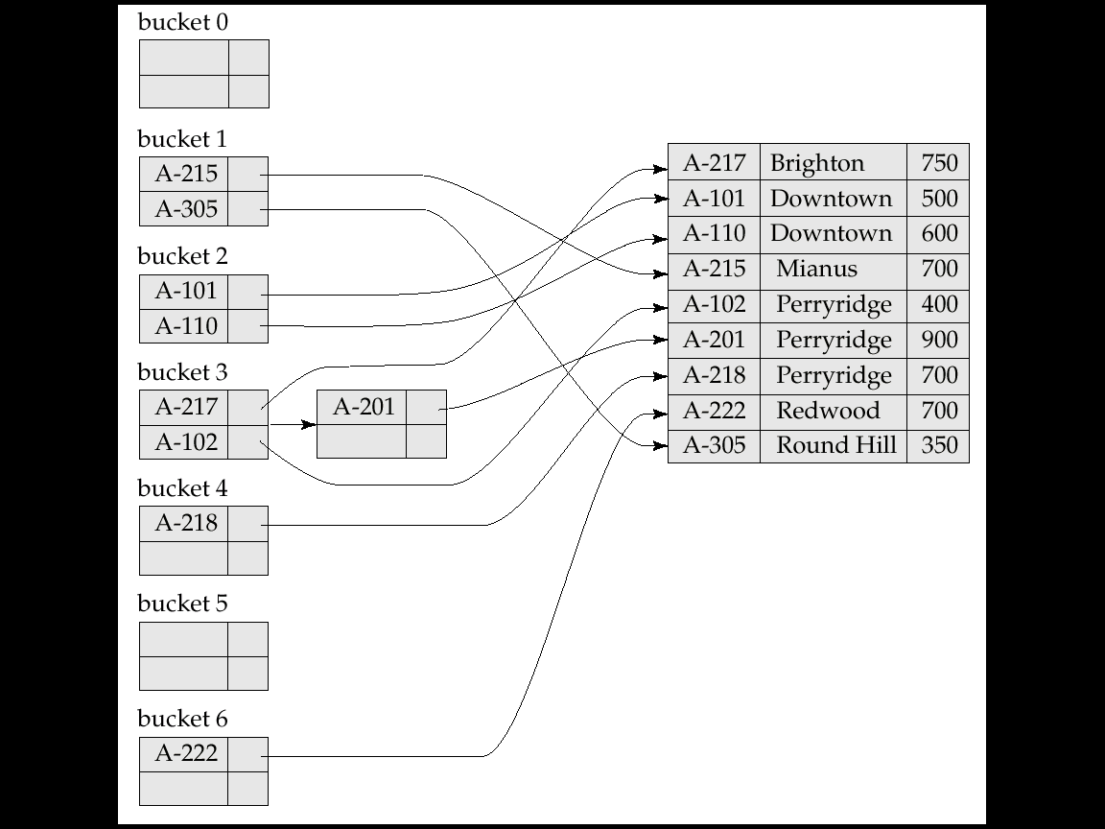
Example of Hash Index
A secondary hash index on the account file, for the search key account_number. The hash function computes the sum of the digits of the account number modulo 7. The hash index has 7 buckets, each of size 2. One has a overflow bucket.

Slide 59
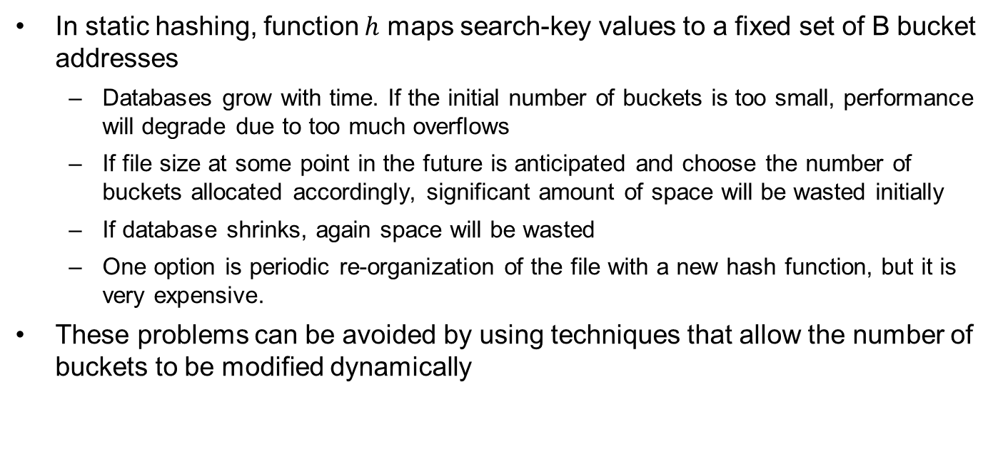
Deficiencies of Static Hashing
In static hashing, function $h$ maps search-key values to a fixed set of B bucket addresses
  Databases grow with time. If the initial number of buckets is too small, performance will degrade due to too much overflows
  If file size at some point in the future is anticipated and choose the number of buckets allocated accordingly, significant amount of space will be wasted initially
  If database shrinks, again space will be wasted
  One option is periodic re-organization of the file with a new hash function, but it is very expensive.
These problems can be avoided by using techniques that allow the number of buckets to be modified dynamically

Slide 60
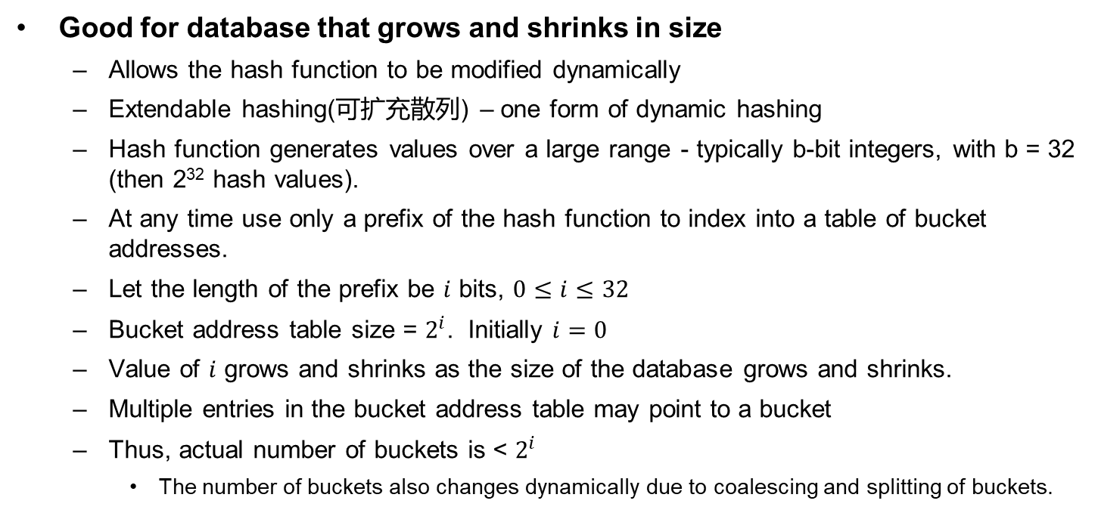
Dynamic Hashing
Good for database that grows and shrinks in size
  Allows the hash function to be modified dynamically
  Extendable hashing(可扩充散列) – one form of dynamic hashing
  Hash function generates values over a large range - typically b-bit integers, with b = 32 (then 2³² hash values).
  At any time use only a prefix of the hash function to index into a table of bucket addresses.
  Let the length of the prefix be $i$ bits, $0≤i≤32$
  Bucket address table size = $2^{i}$. Initially $i=0$
  Value of $i$ grows and shrinks as the size of the database grows and shrinks.
  Multiple entries in the bucket address table may point to a bucket
  Thus, actual number of buckets is < $2^{i}$
    The number of buckets also changes dynamically due to coalescing and splitting of buckets.

Slide 61
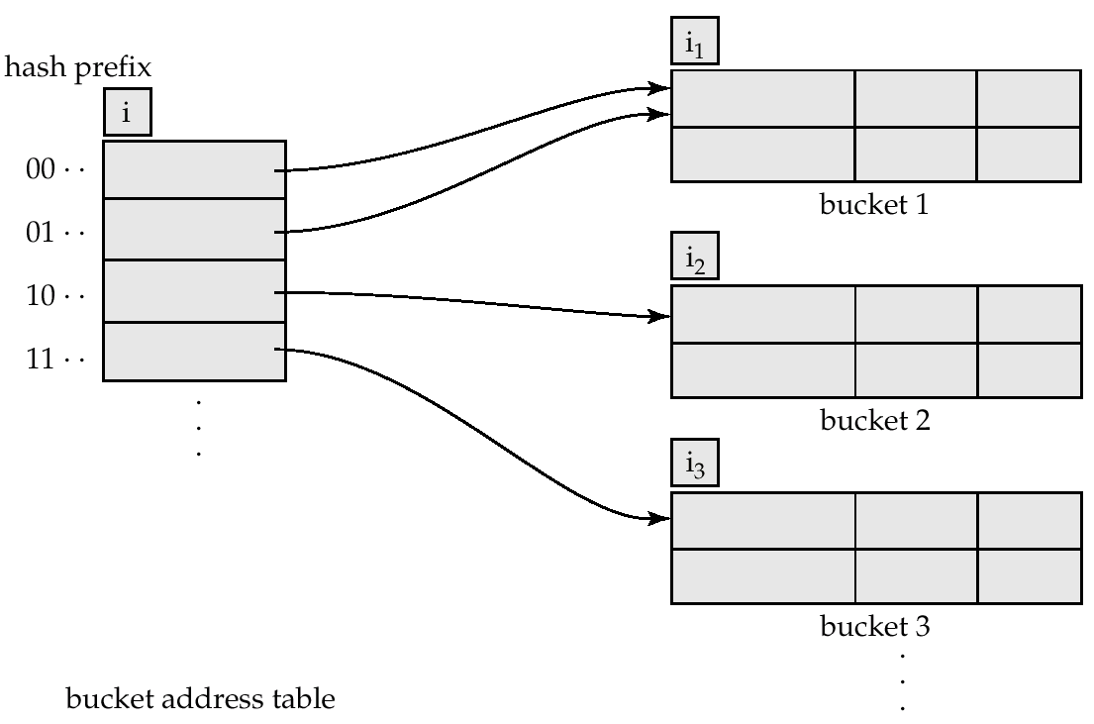
General Extendable Hash Structure

Slide 62
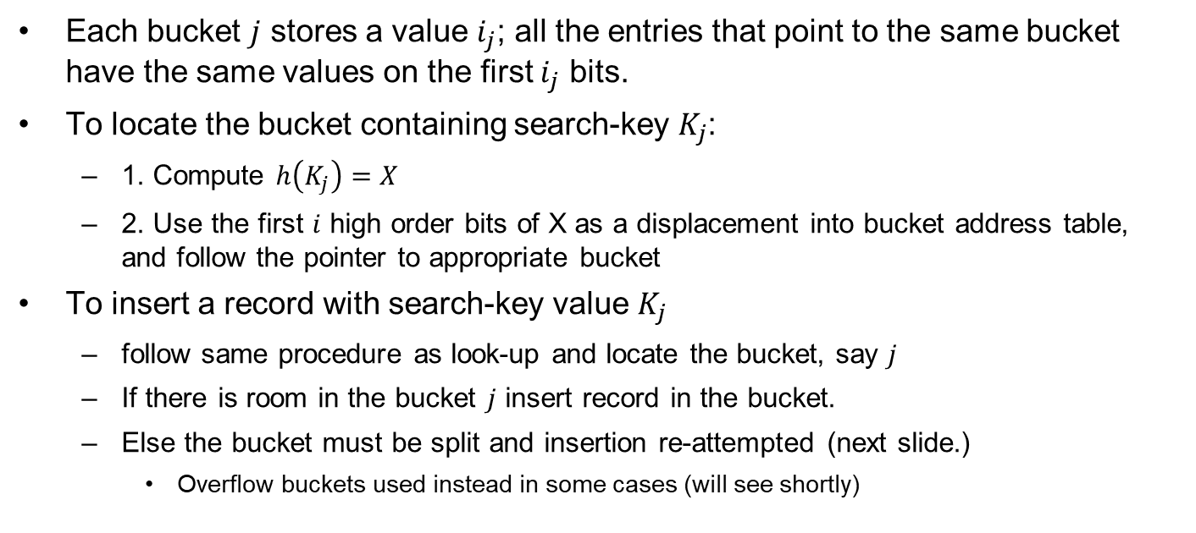
Extendable Hash Structure
Each bucket $j$ stores a value $i_{j}$; all the entries that point to the same bucket have the same values on the first $i_{j}$ bits.
To locate the bucket containing search-key $K_{j}$:
  1. Compute $h\left(K_{j}\right)=X$
  2. Use the first $i$ high order bits of X as a displacement into bucket address table, and follow the pointer to appropriate bucket
To insert a record with search-key value $K_{j}$
  follow same procedure as look-up and locate the bucket, say $j$
  If there is room in the bucket $j$ insert record in the bucket.
  Else the bucket must be split and insertion re-attempted (next slide.)
    Overflow buckets used instead in some cases (will see shortly)

Slide 63
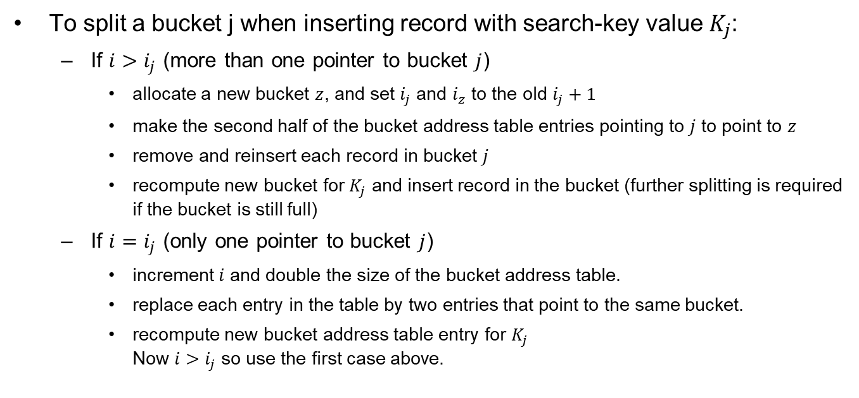
Updates in Extendable Hash Structure
To split a bucket j when inserting record with search-key value $K_{j}$:
  If $i>i_{j}$ (more than one pointer to bucket $j$)
    allocate a new bucket $z$, and set $i_{j}$ and $i_{z}$ to the old $i_{j}+1$
    make the second half of the bucket address table entries pointing to $j$ to point to $z$
    remove and reinsert each record in bucket $j$
    recompute new bucket for $K_{j}$ and insert record in the bucket (further splitting is required if the bucket is still full)
  If $i=i_{j}$ (only one pointer to bucket $j$)
    increment $i$ and double the size of the bucket address table.
    replace each entry in the table by two entries that point to the same bucket.
    recompute new bucket address table entry for $K_{j}$
    Now $i>i_{j}$ so use the first case above.

Slide 64
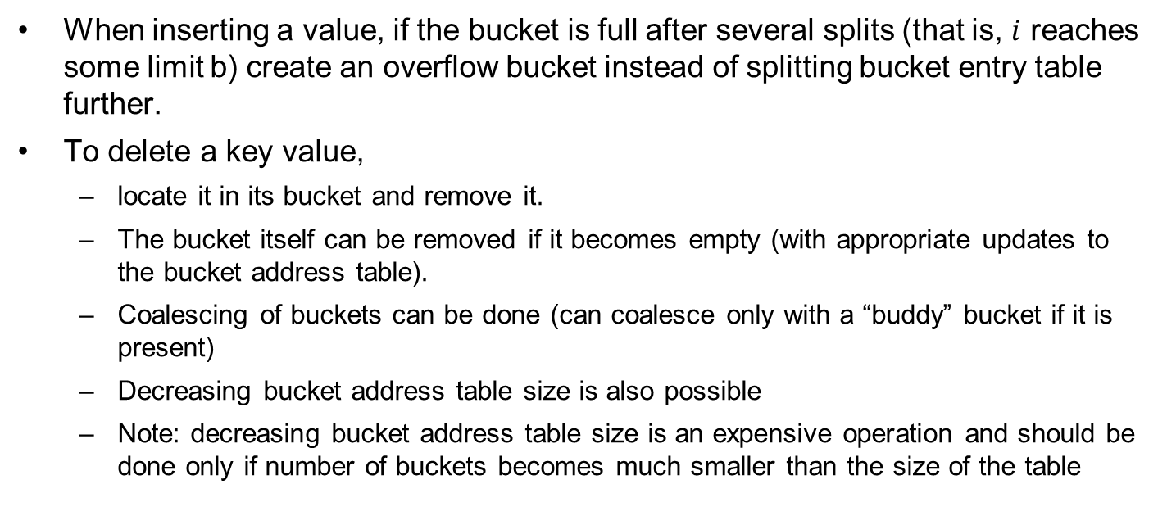
Updates in Extendable Hash Structure (Cont.)
When inserting a value, if the bucket is full after several splits (that is, $i$ reaches some limit b) create an overflow bucket instead of splitting bucket entry table further.
To delete a key value,
  locate it in its bucket and remove it.
  The bucket itself can be removed if it becomes empty (with appropriate updates to the bucket address table).
  Coalescing of buckets can be done (can coalesce only with a “buddy” bucket if it is present)
  Decreasing bucket address table size is also possible
  Note: decreasing bucket address table size is an expensive operation and should be done only if number of buckets becomes much smaller than the size of the table

Slide 65
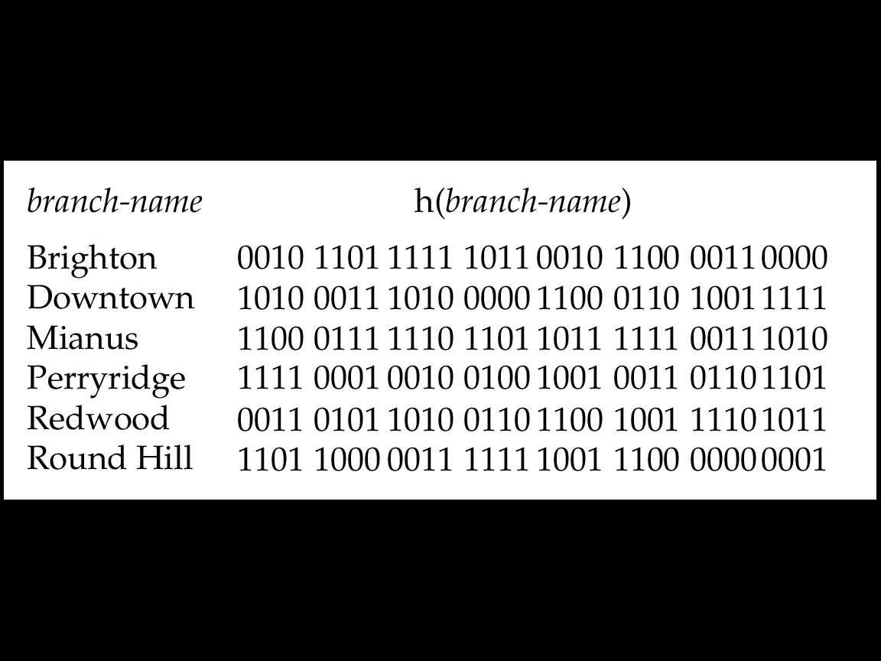
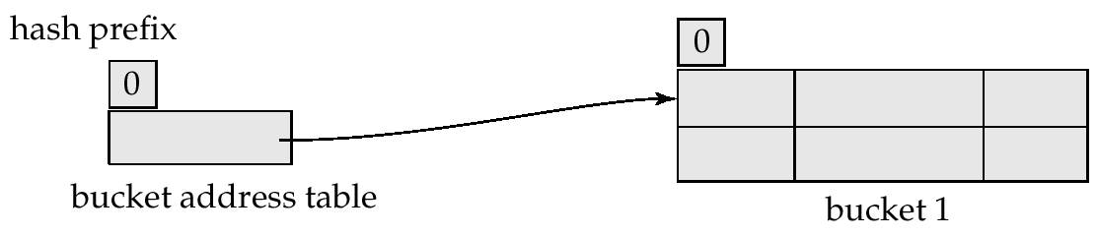
Extendable Hash Structure: Example
Initial Hash structure, bucket size = 2

Slide 66
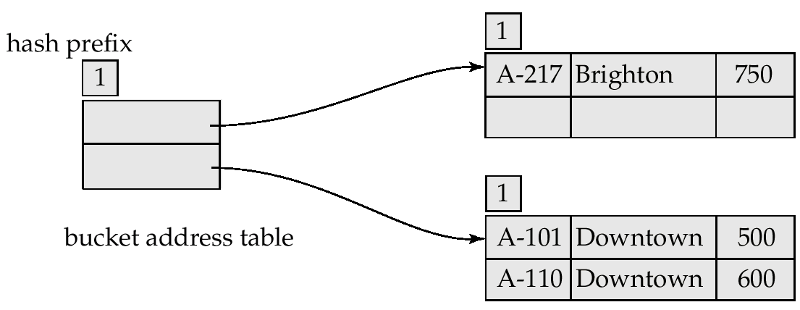
Example (Cont.)
Hash structure after insertion of one Brighton and two Downtown records

Slide 67
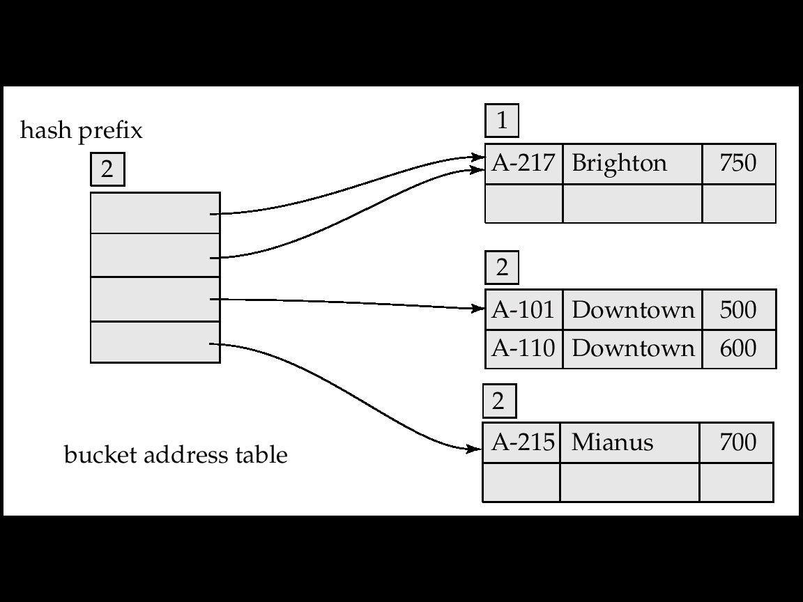
Example (Cont.)
Hash structure after insertion of Mianus record

Slide 68
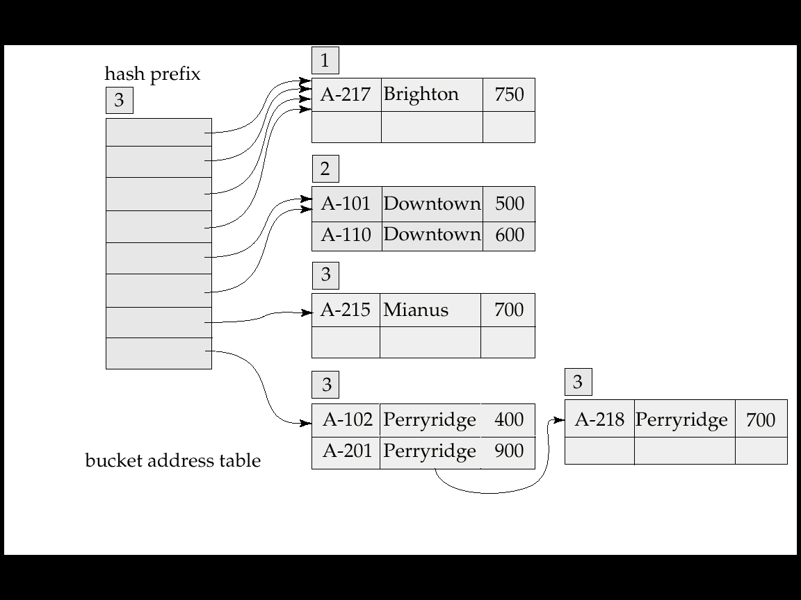
Example (Cont.)
Hash structure after insertion of three Perryridge records

Slide 69
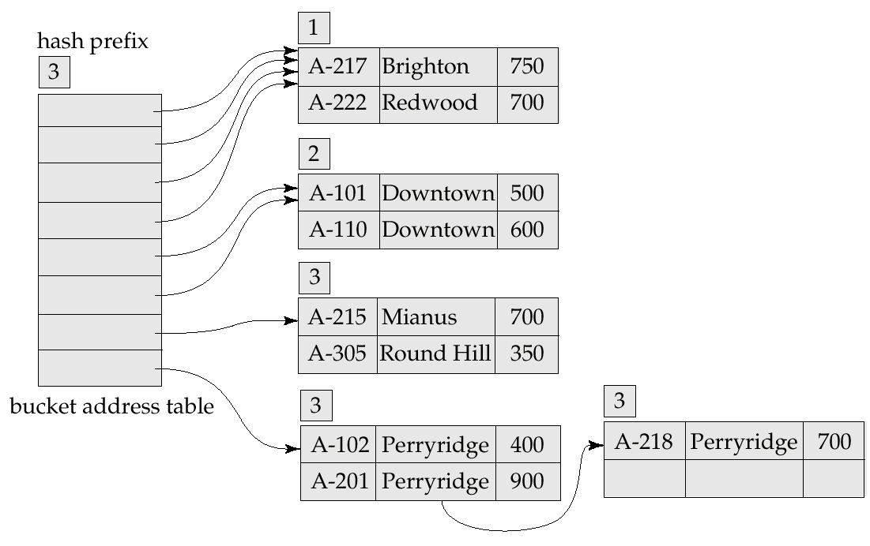
Example (Cont.)
Hash structure after insertion of Redwood and Round Hill records

Slide 70
Extendable Hashing vs. Other Schemes
Benefits of extendable hashing:
  Hash performance does not degrade with growth of file
  Minimal space overhead
Disadvantages of extendable hashing
  Extra level of indirection to find desired record
  Bucket address table may itself become very big (larger than memory)
    Need a tree structure to locate desired record in the structure!
  Changing size of bucket address table is an expensive operation
Linear hashing is an alternative mechanism which avoids these disadvantages at the possible cost of more bucket overflows

Slide 71
Outline
Basic Concepts
Ordered Indexing
B⁺-tree & B-tree Indices
Static & Dynamic Hashing
Ordered Indexing vs. Hashing
Index Definition in SQL
Multiple-key Access

Slide 72
Ordered Indexing vs. Hashing
Issues for file organizing and indexing
  Cost of periodic re-organization
  Frequency of insertions and deletions
  Whether optimizing average access time at the expense of worst-case access time
  Expected type of queries
    Hashing is generally better at retrieving records having a specified value of the key
    If range queries are common, ordered indices are preferred
Notes:
Ordered Indexing ：顺序索引

Slide 73
Outline
Basic Concepts
Ordered Indexing
B⁺-tree & B-tree Indices
Static & Dynamic Hashing
Ordered Indexing vs. Hashing
Index Definition in SQL
Multiple-key Access

Slide 74
Index Definition in SQL
Create an index
  create [UNIQUE] index <index-name> on <relation-name> (<attribute-list>)
  E.g., create index b_index on branch(branch_name)
  Use create unique index to indirectly specify and enforce the condition that the search key is a candidate key
    Not really required if SQL unique integrity constraint is supported
Drop an index
  drop index <index-name>

Slide 75
Outline
Basic Concepts
Ordered Indexing
B⁺-tree & B-tree Indices
Static & Dynamic Hashing
Ordered Indexing vs. Hashing
Index Definition in SQL
Multiple-key Access

Slide 76
Multiple-Key Access
Use multiple indices for certain types of queries
  E.g.,
  select account_number
  from account
  where branch_name = “Perryridge” and balance = 1000
Three possible strategies for processing query using indices on single attributes
  Use index on branch_name to find accounts with branch_name = “Perryridge”, test balances of $1000;
  Use index on balance to find accounts with balances of $1000; test branch_name = “Perryridge”.
  Use branch_name index to find pointers to all records pertaining to the Perryridge branch. Similarly use index on balance. Take intersection of both sets of pointers obtained

Slide 77
Indices on Multiple Attributes
Suppose we have an index on combined search-key (branch_name, balance)
With the where clause
where branch_name = “Perryridge” and balance = 1000
the index on the combined search-key will fetch only records that satisfy both conditions
Can also efficiently handle
where branch_name = “Perryridge” and balance < 1000
But cannot efficiently handle
where branch-name < “Perryridge” and balance = 1000
May fetch many records that satisfy the first but not the second condition, may lead to many I/Os

Slide 78
Grid Files
Structure used to speed up the processing of multiple search-key queries involving one or more comparison operators
The grid file has a single grid array and one linear scale for each search-key attribute. The grid array has the number of dimensions equal to number of search-key attributes
Multiple cells of grid array can point to same bucket
To find the bucket for a search-key value, locate the row and column of its cell using the linear scales and follow pointer

Slide 79
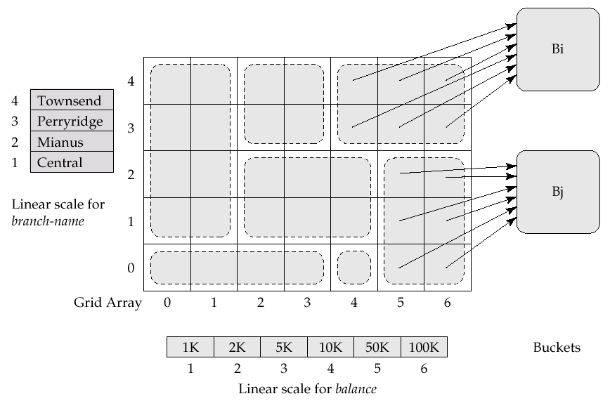
Example Grid File for account

Slide 80
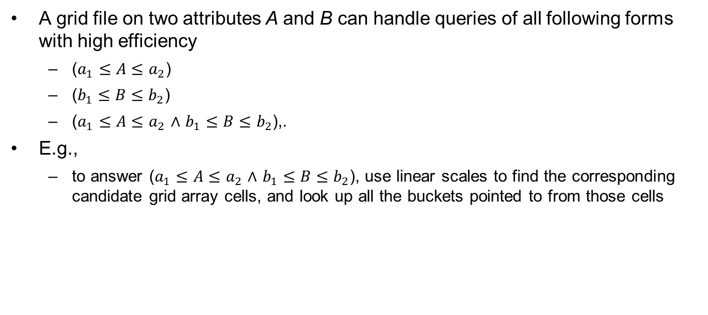
Queries on a Grid File
A grid file on two attributes A and B can handle queries of all following forms with high efficiency
  ($a_{1}≤A≤a_{2}$)
  ($b_{1}≤B≤b_{2}$)
  ($a_{1}≤A≤a_{2}$ $∧$ $b_{1}≤B≤b_{2}$),.
E.g.,
  to answer ($a_{1}≤A≤a_{2}$ $∧$ $b_{1}≤B≤b_{2}$), use linear scales to find the corresponding candidate grid array cells, and look up all the buckets pointed to from those cells

Slide 81
Grid Files (Cont.)
During insertion, if a bucket becomes full, new bucket can be created if more than one cell points to it
  Idea similar to extendable hashing, but on multiple dimensions
  If only one cell points to it, either an overflow bucket must be created or the grid size must be increased
Linear scales must be chosen to uniformly distribute records across cells.
  Otherwise there will be too many overflow buckets.
Periodic re-organization to increase grid size will help
  But reorganization can be very expensive.
Space overhead of grid array can be high.

Slide 82

Bitmap Indices
Bitmap indices are a special type of index designed for efficient querying on multiple keys
Records in a relation are assumed to be numbered sequentially from:
  Given a number $n$, it must be easy to retrieve record $n$
    Particularly easy if records are of fixed size
Applicable on attributes that take on a relatively small number of distinct values
  E.g., gender, country, state, …
  E.g., income-level (income broken up into a small number of levels such as 0-9999, 10000-19999, 20000-50000, 50000- infinity)
A bitmap is simply an array of bits

Slide 83


Bitmap Indices (Cont.)
In its simplest form, a bitmap index on an attribute has a bitmap for each value of the attribute
  Bitmap has as many bits as records
  In a bitmap for value $v$, the bit for a record is 1 if the record has the value $v$ for the attribute, and is 0 otherwise

Slide 84
Bitmap Indices (Cont.)
Bitmap indices are useful for queries on multiple attributes
  not particularly useful for single attribute queries
Queries are answered using bitmap operations
  Intersection (and)
  Union (or)
  Complementation (not)
Each operation takes two bitmaps of the same size and applies the operation on the corresponding bits to get the result bitmap
  E.g., 100110 AND 110011 = 100010
  100110 OR 110011 = 110111
  NOT 100110 = 011001
  Males with income level L1: 10010 AND 10100 = 10000
    Can then retrieve required tuples
    Counting number of matching tuples is even faster

Slide 85
Bitmap Indices (Cont.)
Bitmap indices generally very small compared with relation size
  E.g. if record is 100 bytes, space for a single bitmap is 1/800 of space used by relation.
    If the number of distinct attribute values is 8, bitmap is only 1% of relation size
Deletion needs to be handled properly
  Existence bitmap to note if there is a valid record at a record location
  Needed for complementation
    not(A=v): (NOT bitmap-A-v) AND ExistenceBitmap
Should keep bitmaps for all values, even null value
  To correctly handle SQL null semantics for NOT(A=v):
    intersect above result with (NOT bitmap-A-Null)
Notes:
Existence bitmap ：存在位图，如记录存在相应位取值为1，反之为0。如记录存在但A属性取值为Null，则需要用NOT bitmap-A-Null来补全位图检索语句：not(A=v)。

Slide 86
补充学习（索引相关）
商用数据库
  Oracle索引结构：B树索引，位图索引
    《Oracle索引技术》,人民邮电出版社
  IBM DB2索引结构：B⁺树
  Microsoft SQL Server索引结构：B树
开源数据库
  MySQL索引：B-Tree(B+Tree)、Hash索引
  Postgre SQL, MySQL, Ingres r3, MaxDB, Firebird (InterBase), MongoDB, SQLite, CUBRID, Cayley(Graph)
NoSQL数据库
  HBase, Cassandra, MongoDB, Redis
  OceanBase, openGauss, 人大金仓, X-DB, 达梦 ……

Slide 87
Quiz
Q1: Construct a B⁺-tree from an empty tree. Each node can hold four pointers
  The sequential values to be inserted are: 10, 7, 12, 5, 9, 15, 30, 23, 17, 26
  Then delete 9, 10, 15, respectively
  Please give the B⁺ trees after each insertion and each deletion
Q2: Compare B⁺-tree and B-tree and describe their difference

Slide 88
End of Chapter 14

