Slide 1
Meridian Mart Sales Analysis:
Discounting is eroding Meridian Mart's margin
Sales performance review, 2022 to 2025 · Executive Leadership Committee
Prepared by Mo Yusuf (POD ASTRA)
Notes:
Purpose: answer Rebecca Hayes's request to find the root cause of margin erosion and quantify its impact. Headline: deep discounts, not regions or customers, are the main driver.

Slide 2
$4.47M in sales returned only 10.7% profit over four years
$4.47M
$480K
10.7%
−$403K
Total sales, 2,100 orders
Total profit
Profit margin
Lost on lines discounted above 30%
Three findings
Discounts above 30% lose $402.9K, equal to 84% of total profit. Margin breaks even at about a 30% discount.
Profit depends on one product line: Copiers earn $410.3K (85% of profit). Tables and Machines lose $125.2K together.
West sells as much as East ($1.26M vs $1.27M) but earns $62.4K less profit. Denver is the only loss-making city.
Notes:
Lead with the number leadership cares about: profit is $480K, and nearly as much is being given away through deep discounts.

Slide 3
Every discount above 30% loses money
~30%
Break-even discount (30% = +0.8%, 40% = −17.8%)
999 lines
22.6% of order lines are discounted above 30%
Average discount is about 20% in every region, category and segment. The problem is not the average; it is the deep discounts on individual lines.
Notes:
Margin falls steadily as discount rises: 29.5% at no discount, 11.1% at 20%, near zero at 30%, and deeply negative from 40%. The 999 lines above 30% produce $402.9K of losses.

Slide 4
Copiers carry profit; Tables and Machines lose $125K
Biggest loss-making products
Product | Profit
Hon Rectangular Table | −$32,104
Chromcraft Round Table | −$19,339
Bevis Conference Table | −$19,127
Brother Fax Machine | −$18,854
Bretford Folding Table | −$18,173
Lexmark Laser Printer | −$17,733
Furniture sells $1.49M but loses $27.5K (−1.9% margin). 11 of 64 products lose money.
Notes:
Copiers earn $410K at 32% margin. Tables lose $88.7K and Machines $36.5K. Six products each lose more than $17K.

Slide 5
West sells like East but earns $62K less profit
Profit margin by region
East | 13.8%
South | 10.7%
Central | 9.3%
West | 8.9%
Cities to review
Denver: −$4,510 (−3.8%), the only loss city
Miami: 2.0% margin on $124K sales
Chicago: 3.0% margin on $142K sales
Best: Philadelphia, $41,947 at 20.5%
Notes:
Regional managers' concern is justified for the West. Delivery time is not the cause: all regions average 4.40 to 4.49 days.

Slide 6
Margin halved in 2023 and sales fell 17% in 2025
Year | Margin | Sales YoY
2022 | 12.1% | n/a
2023 | 6.4% | −1.9%
2024 | 12.5% | +9.4%
2025 | 11.9% | −17.0%
9 of 48 months were loss-making. The 2025 drop in sales needs a separate investigation by category and region.
Notes:
2023 sales were flat but profit nearly halved, from $137.7K to $71.0K. 2024 recovered. 2025 sales fell 17% while margin held near 12%.

Slide 7
Consumer drives half of sales at the lowest margin
Customers
139
$44.2K
of 510 customers are net loss-making
Top customer sales (Michelle Clark, MC-10500)
Top 10 by profit is led by Andrew Thomas (AT-10162, $13,946) and Michelle Clark ($11,253). 100 customer names are shared, so all rankings use Customer ID.
Consumer: 49.6% of sales ($2.22M). Home Office: 18.6% of sales but the best margin.
Notes:
Segments differ by only 2.4 margin points, so segment is not the root cause. The 139 loss-making customers are a target for discount controls.

Slide 8
Same Day shipping earns the weakest margin
Ship mode | Orders | Share | Profit | Margin | Avg days
Standard Class | 1,235 | 58.8% | $273,482 | 11.0% | 5.49
Second Class | 439 | 20.9% | $89,808 | 9.1% | 4.00
First Class | 310 | 14.8% | $93,337 | 12.8% | 2.43
Same Day | 116 | 5.5% | $23,418 | 8.8% | 0.54
4.40 to 4.49
Average delivery days in every region
Fulfilment is consistent across regions, so it is not behind the West's weak margin. The lever here is pricing Same Day shipping, not speeding up delivery.
Notes:
Standard Class carries almost 59% of orders. Same Day is small (5.5%) but earns the lowest margin, 8.8%.

Slide 9
Five actions to rebuild margin
1
Cap line discounts at 20%; require approval above 30%
$402.9K of losses sit on lines discounted above 30%
2
Reprice or delist the 6 worst Table and Machine SKUs
Each loses $17K to $32K; together they lose $125.3K
3
Protect Copiers pricing and bundle around it
Earns $410.3K, 85% of profit, at 32% margin
4
Pricing audit in West cities: Denver, Portland, Seattle
West margin is 8.9% vs East's 13.8%
5
Add a Same Day fee or minimum order value
Same Day margin is 8.8%, the lowest of 4 modes
Notes:
Action 1 has the biggest impact and can start immediately through the pricing approval workflow. Actions 2 and 3 address the product mix. 4 and 5 are targeted fixes.

Slide 10
Decision requested: approve the discount cap
Next 30 days: discount approval rule live · SKU review for Tables and Machines · West city pricing audit
Track monthly in the Tableau dashboard: margin, discount above 30% share, and profit by sub-category
Notes:
Close with the decision. The interactive dashboard lets regional managers track the effect of each action month by month.

Slide 11
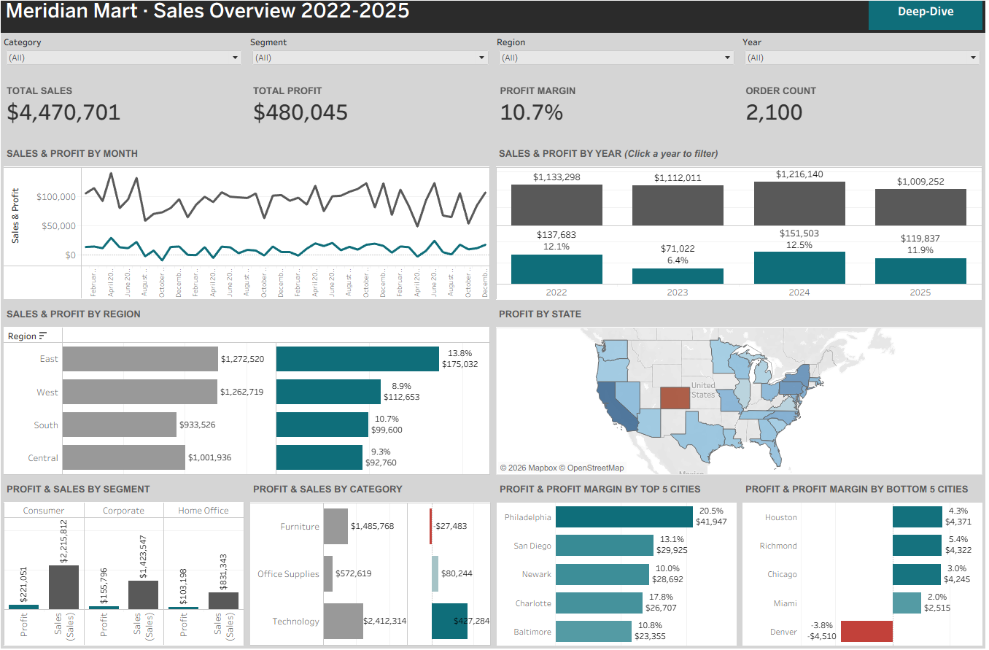
Appendix A · Tableau dashboard, Overview page

Slide 12
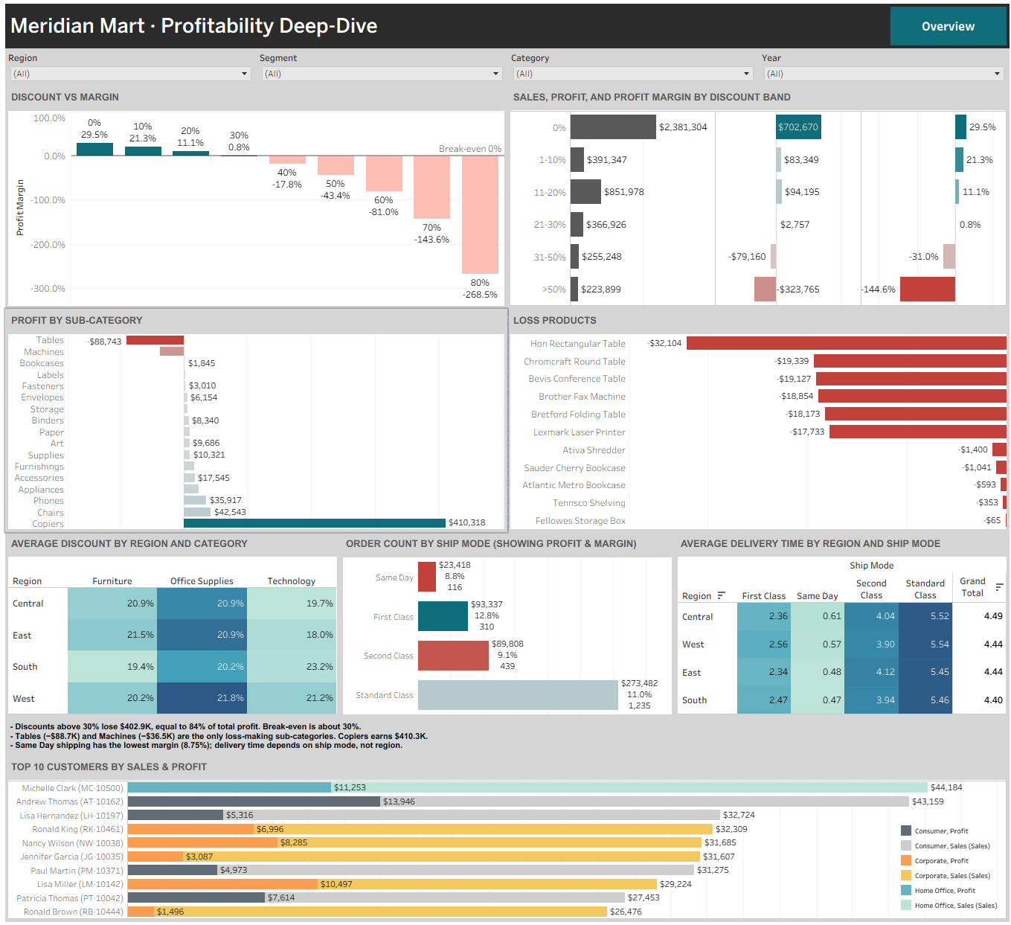
Appendix B · Tableau dashboard, Deep-Dive page

