Slide 1
AI AGENT COORDINATION
SWARM
Who coordinates
your AI agents?
A shared objective.
Visible responsibilities.
Results you can review.
Project overview
Fabrice Pizzi
01 / 10
Notes:
Source: https://github.com/mo0ogly/swarm
Actual interface screenshots from an isolated English demo. No AI calls or performance results claimed.

Slide 2
SWARM
When you become
the coordinator
01
Assign the work
Every agent needs a clear task and boundaries.
02
Hand over results
One task often needs the output of another.
03
Decide what is finished
A report alone cannot prove that everything works.
Swarm coordinates these handoffs.
Fabrice Pizzi
02 / 10
Notes:
Source: https://github.com/mo0ogly/swarm
Actual interface screenshots from an isolated English demo. No AI calls or performance results claimed.

Slide 3
SWARM
A team with
distinct roles
Orchestrator
Breaks down the objective and plans what comes next.
Workers
Carry out tasks using their tools.
Independent reviewer
Reviews reports in a separate session.
Swarm engine
Enforces configured rules and checks.
These responsibilities require explicit configuration.
Fabrice Pizzi
03 / 10
Notes:
Source: https://github.com/mo0ogly/swarm
Actual interface screenshots from an isolated English demo. No AI calls or performance results claimed.

Slide 4
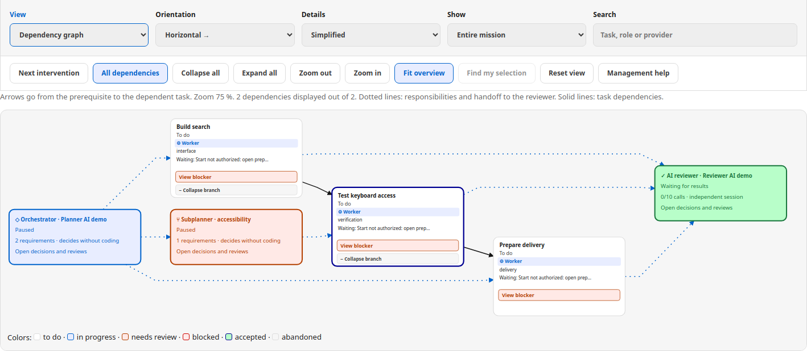
SWARM
Dependencies
you can see
What depends on what? Who receives the result?
Solid arrows
Dotted arrows
Task dependencies
Ownership and review
Actual interface. Paused demonstration team.
Fabrice Pizzi
04 / 10
Notes:
Source: https://github.com/mo0ogly/swarm
Actual interface screenshots from an isolated English demo. No AI calls or performance results claimed.

Slide 5
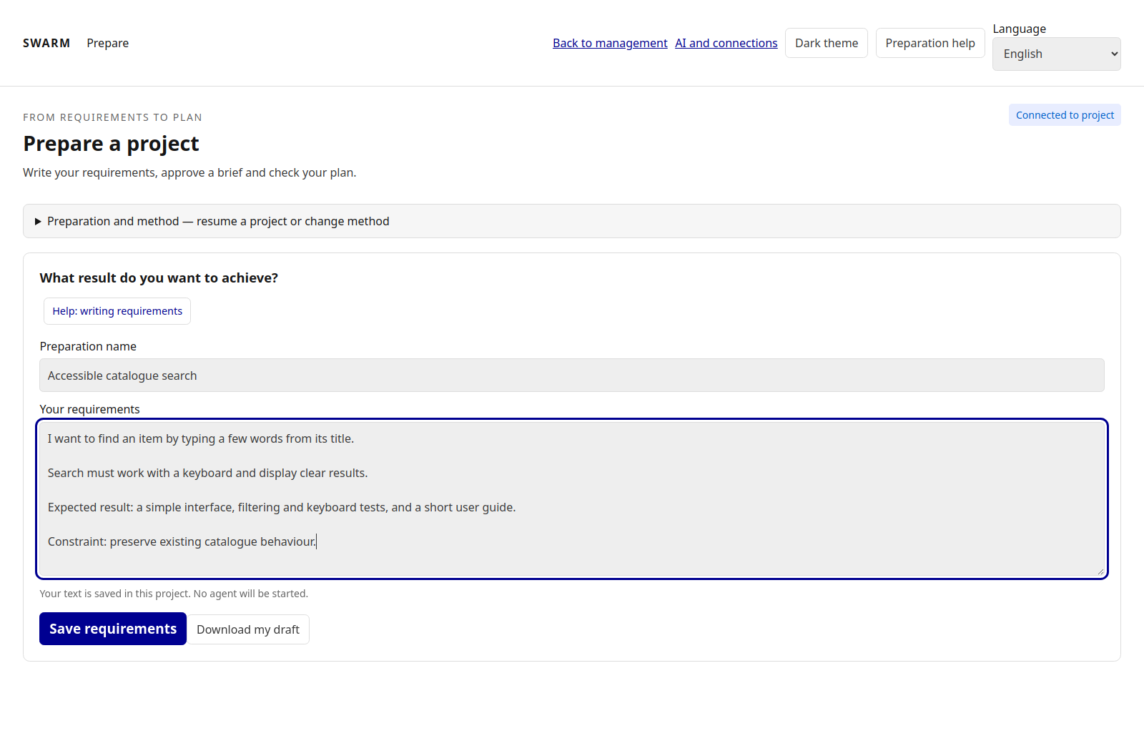
SWARM
A clear requirement
to start with
“Add catalogue search
that works with a keyboard.”
Demo requirement, followed by a brief and a plan.
Fabrice Pizzi
05 / 10
Notes:
Source: https://github.com/mo0ogly/swarm
Actual interface screenshots from an isolated English demo. No AI calls or performance results claimed.

Slide 6
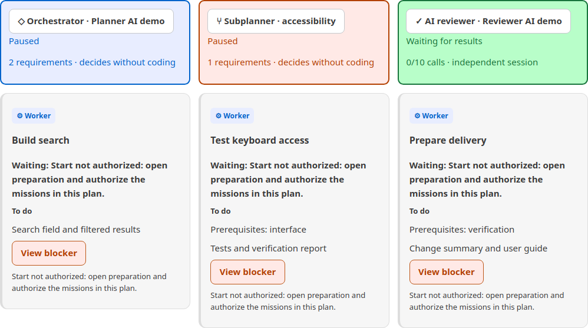
SWARM
Every role
stays visible
The list complements the graph with
responsibilities, deliverables and launch conditions.
Paused demonstration. No agents launched.
Fabrice Pizzi
06 / 10
Notes:
Source: https://github.com/mo0ogly/swarm
Actual interface screenshots from an isolated English demo. No AI calls or performance results claimed.

Slide 7
SWARM
Execution, reports
and acceptance
Process finished
The agent has stopped working.
Report available
A deliverable is ready for review.
Result accepted
The result meets the applicable
acceptance conditions.
Task validation requires more than a finished attempt.
Fabrice Pizzi
07 / 10
Notes:
Source: https://github.com/mo0ogly/swarm
Actual interface screenshots from an isolated English demo. No AI calls or performance results claimed.

Slide 8
SWARM
Rules for
autonomous work
01
Authorized starts
Dependencies and available workspaces determine what can start.
02
Explicit checks
An AI opinion alone cannot prove that tests actually ran.
03
Bounded retries
A persistent error may need a correction or your decision.
The aim: fewer manual restarts, with clear control.
Fabrice Pizzi
08 / 10
Notes:
Source: https://github.com/mo0ogly/swarm
Actual interface screenshots from an isolated English demo. No AI calls or performance results claimed.

Slide 9
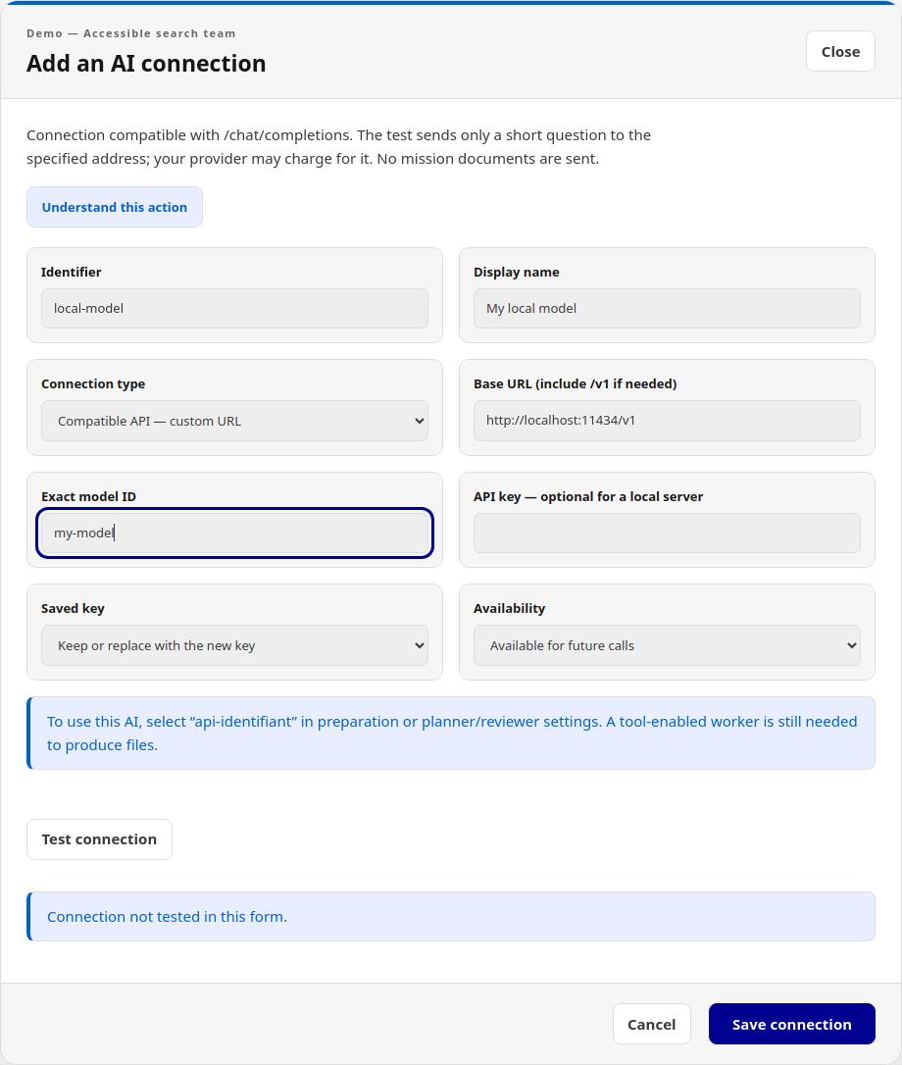
SWARM
Choose an AI
for its role
An API connection can prepare a plan
or review a report.
To modify files, a worker needs
the appropriate tools.
Demonstration form. Connection not tested.
Fabrice Pizzi
09 / 10
Notes:
Source: https://github.com/mo0ogly/swarm
Actual interface screenshots from an isolated English demo. No AI calls or performance results claimed.

Slide 10
SWARM
Help me
improve Swarm
Web interface and CLI
in English and French.
github.com/mo0ogly/swarm
Source available under the
PolyForm Noncommercial licence.
Try it, challenge the workflow,
and tell me what still gets in your way.
Fabrice Pizzi
10 / 10
Notes:
Repository: https://github.com/mo0ogly/swarm
Licence: PolyForm Noncommercial 1.0.0. Earlier Apache 2.0 releases retain their rights. See https://github.com/mo0ogly/swarm/blob/main/docs/LICENSING.md
Capabilities depend on providers and configuration.

