Slide 1
ELE 241
ARM ISA
Workshop #1
Eng. Mo’men Abdelhady
Canadian International College
Spring 2018, 2/27/2018
Courtesy of Prof. Onur Mutlu

Slide 2
What is Computer Architecture?
ISA+implementation definition: The science and art of designing, selecting, and interconnecting hardware components and designing the hardware/software interface to create a computing system that meets functional, performance, energy consumption, cost, and other specific goals.
Traditional (only ISA) definition: “The term architecture is used here to describe the attributes of a system as seen by the programmer, i.e., the conceptual structure and functional behavior as distinct from the organization of the dataflow and controls, the logic design, and the physical implementation.” Gene Amdahl, IBM Journal of R&D, April 1964

Slide 3
ISA vs. Microarchitecture
ISA
  Agreed upon interface between software and hardware
    SW/compiler assumes, HW promises
  What the software writer needs to know to write and debug system/user programs
Microarchitecture
  Specific implementation of an ISA
  Not visible to the software
Microprocessor
  ISA, uarch, circuits
  “Architecture” = ISA + microarchitecture
Problem
Algorithm
Program
ISA
Microarchitecture
Circuits
Electrons
Notes:
ISA is the interface between hardware and software… It is a contract that the hardware promises to satisfy.
Builder/user interface

Slide 4
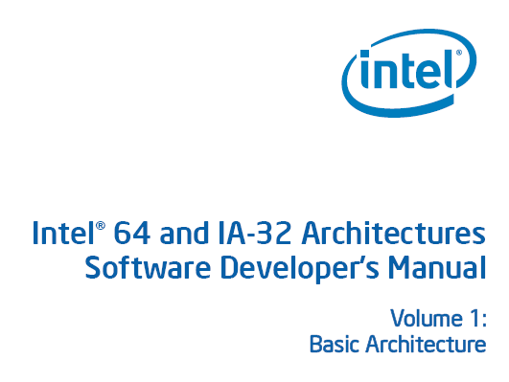
ISA
Instructions
  Opcodes, Addressing Modes, Data Types
  Instruction Types and Formats
  Registers, Condition Codes
Memory
  Address space, Addressability, Alignment
  Virtual memory management
Call, Interrupt/Exception Handling
Access Control, Priority/Privilege
I/O: memory-mapped vs. instr.
Task/thread Management
Power and Thermal Management
Multi-threading support, Multiprocessor support

Slide 5
ARM ISA – What is it?
ARM is a RISC architecture
Used for mobile computing
Features
  Load/Store Architecture
  Conditional Execution
  Inline barrel shifter
  Multiple execution modes involving banked registers
  Many different addressing modes
  Thumb mode (16-bit mode)

Slide 6

ARM Basics - Registers
16 General Purpose Registers
  R15 is the PC
  R14 is the linker addr
  R13 is the stack pointer
CPSR and SPSP
You will only implement the following Condition code flags
  N = Negative result from ALU
  Z = Zero result from ALU
  C = ALU operation Carried out
  V = ALU operation oVerflowed

Slide 7
Program Counter (r15)
When the processor is executing in ARM state:
  All instructions are 32 bits wide
  All instructions must be word aligned
  Therefore the pc value is stored in bits [31:2] with bits [1:0] undefined (as instruction cannot be halfword or byte aligned)
Thumb state (16-bit instructions) or Jazella state (8-bit)
  Will not be supported by our processor

Slide 8
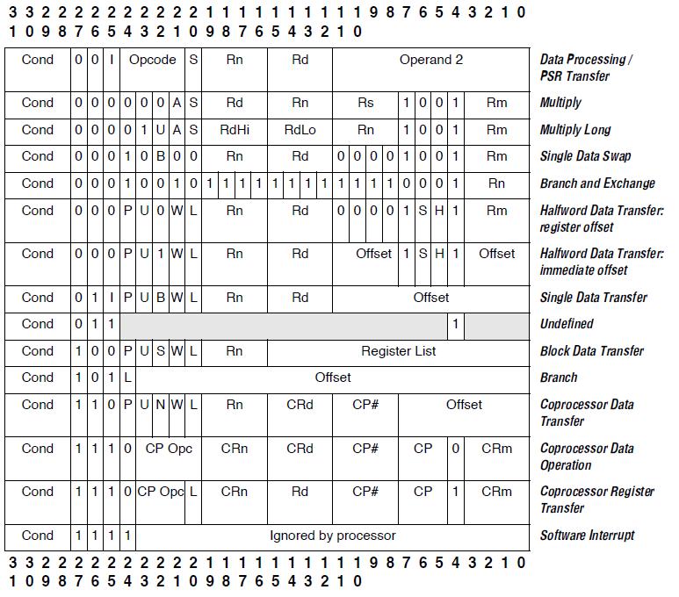
ARM Basics – Instruction Encodings

Slide 9
Conditional Execution and Flags
ARM instructions can be made to execute conditionally by postfixing them with the appropriate condition code field.
  This improves code density and performance by reducing the number of forward branch instructions.
  CMP r3,#0 CMP r3,#0
  BEQ skip ADDNE r0,r1,r2
  ADD r0,r1,r2
  skip
By default, data processing instructions do not affect the condition code flags but the flags can be optionally set by using “S”. CMP does not need “S”.
  loop
  …
  SUBS r1,r1,#1
  BNE loop
decrement r1 and set flags
if Z flag clear then branch
Notes:
Unusual but powerful feature of the ARM instruction set. Other architectures normally only have conditional branches.
Core compares condition field in instruction against NZCV flags to determine if instruction should be executed.

Slide 10
Condition Codes
The possible condition codes are listed below
  Note AL is the default and does not need to be specified
Suffix
Description
Flags tested
EQ
Equal
Z=1
NE
Not equal
Z=0
CS/HS
Unsigned higher or same
C=1
CC/LO
Unsigned lower
C=0
MI
Minus
N=1
PL
Positive or Zero
N=0
VS
Overflow
V=1
VC
No overflow
V=0
HI
Unsigned higher
C=1 & Z=0
LS
Unsigned lower or same
C=0 or Z=1
GE
Greater or equal
N=V
LT
Less than
N!=V
GT
Greater than
Z=0 & N=V
LE
Less than or equal
Z=1 or N=!V
AL
Always
Notes:
Condition codes are simply a way of testing the ALU status flags.
This slide is for reference only.

Slide 11
Conditional execution examples
C source code
ARM instructions
unconditional
conditional
if (r0 == 0)
{
r1 = r1 + 1;
}
else
{
r2 = r2 + 1;
}
CMP r0, #0
BNE else
ADD r1, r1, #1
B end
else
ADD r2, r2, #1
end
...
CMP r0, #0
ADDEQ r1, r1, #1
ADDNE r2, r2, #1
...
5 instructions
5 words
5 or 6 cycles
3 instructions
3 words
3 cycles

Slide 12
Data Processing Instructions
Consist of :
  Arithmetic: ADD ADC SUB SBC RSB RSC
  Logical: AND ORR EOR BIC
  Comparisons: CMP CMN TST TEQ
  Data movement: MOV MVN
These instructions only work on registers, NOT memory.
Syntax:
  <Operation>{<cond>}{S} Rd, Rn, Operand2
    Comparisons set flags only - they do not specify Rd
    Data movement does not specify Rn
Second operand is sent to the ALU via barrel shifter.
Notes:
BIC bit clear
ORR bit set
AND bit mask
EOR bit invert
Comparisons produce no results - just set condition codes.
CMP like SUB
CMN like ADD (subtract of a negative number is the same as add)
TST like AND
TEQ like EOR (eor of identical numbers gives result of zero)
Generally single-cycle execution (except write to PC and register-controlled shift). Mention ARM NOP & Thumb NOP.
Explain RSB and RSC which do subtract in other order (e.g. y-x not x-y)
Does not include multiply (separate instr format). No divide - compiler uses run-time library or barrel shifter to perform division.
Can combine “S” bit with conditional execution, e.g.
ADDEQS r0, r1, r2

Slide 13
Using a Barrel Shifter:The 2nd Operand
Register, optionally with shift operation
  Shift value can be either be:
    5 bit unsigned integer
    Specified in bottom byte of another register.
  Used for multiplication by constant
Immediate value
  8 bit number, with a range of 0-255.
    Rotated right through even number of positions
  Allows increased range of 32-bit constants to be loaded directly into registers
Operand 1
Operand 2
Barrel
Shifter
ALU
Result

Slide 14
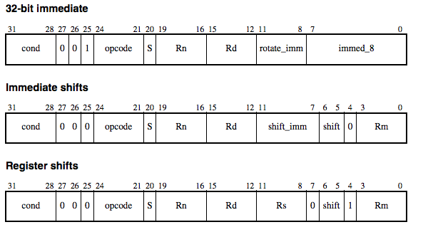
ARM ISA - Barrel Shifter
4 Different types of shifts: LSL, LSR, ASR, ROR (special case RRX)
Assembler code:
Encoding:
More info on page A5-3 of ARM Architecture Reference Manual

Slide 15
Single register data transfer
  LDR STR Word
  LDRB STRB Byte
  LDRH STRH Halfword
  LDRSB Signed byte load
  LDRSH Signed halfword load
Memory system must support all access sizes
Syntax:
  LDR{<cond>}{<size>} Rd, <address>
  STR{<cond>}{<size>} Rd, <address>
  e.g. LDREQB
Notes:
Instruction cycle timing:
STR LDR
7TDMI 2 cycles 3 cycles
9TDMI 1 cycle 1 cycle - interlock if used in next cycle
StrongARM1 1 cycle 1 cycle - interlock if used in next cycle
Xscale 1 cycle 1 cycle - interlock if used in next 2 cycles
Note size specifier comes after condition code.
Link: <address> explained on next slide.
Note that load/store instructions never set condition codes.

Slide 16
ARM ISA - Addressing Mode
Address accessed by LDR/STR is specified by a base register with an offset
For word and unsigned byte accesses, offset can be:
  An unsigned 12-bit immediate value (i.e. 0 - 4095 bytes)
  LDR r0, [r1, #8]
  A register, optionally shifted by an immediate value
  LDR r0, [r1, r2]
  LDR r0, [r1, r2, LSL#2]
This can be either added or subtracted from the base register:
LDR r0, [r1, #-8]
LDR r0, [r1, -r2, LSL#2]
Choice of pre-indexed or post-indexed addressing
Choice of whether to update the base pointer (pre-indexed only)
  LDR r0, [r1, #-8]!
Notes:
Halfword access and signed halfword/byte accesses were added to the architecture in v4T, this is the reason the offset field is not as flexible as the normal word/byte load/store - not a problem because these accesses are less common.
Link: diagram on next slide
No “!” for post-indexed because post-increment of base register always happens (otherwise the offset field would not be used at all).

Slide 17
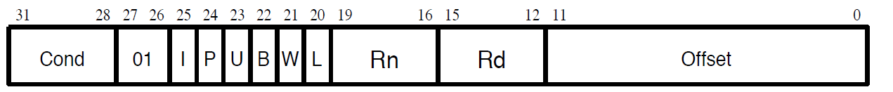
ARM ISA - Addressing Mode
Many different modes (about 9)
  Only worry about 2 for this class (immediate or register offset.)
Assembler Code:
Encoding:
More info on ARM Architecture Reference Manual

