Slide 1

FLUTTER • DART
Inputs & Navigation
Handling User Input with Forms & Text Fields — Navigating
Between Screens and Passing Data
Flutter Development Course

Slide 2
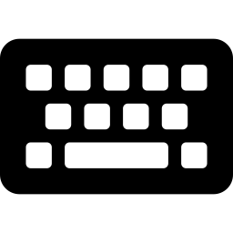

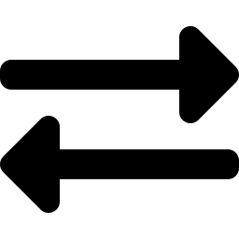

What We'll Cover
From capturing user input to moving cleanly between screens
TextField & Controllers
01
Capturing and reading what the user types
Forms & Validation
02
Grouping inputs and validating them together
Navigator Basics
03
Pushing and popping screens on the stack
Passing Data Forward
04
Sending data to a new screen
Returning Data Back
05
Getting a result back from a screen
Flutter Development Course • Inputs & Navigation
2

Slide 3
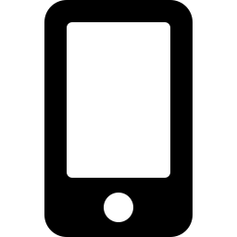

Capturing User Input
TextField reads what's typed; TextEditingController gives you access to it
TextField Widget
Renders an editable box; onChanged fires on every keystroke
login_form.dart
final TextEditingController
emailController = TextEditingController();
TextField(
controller: emailController,
decoration: InputDecoration(
labelText: 'Email',
),
onChanged: (value) {
print('Typed: \$value');
},
)
TextEditingController
Attach with the controller property to read .text anytime
Always Dispose
Call controller.dispose() in the State's dispose() method
Flutter Development Course • Inputs & Navigation
3

Slide 4

Forms & Validation
Form groups fields together; GlobalKey<FormState> validates them all at once
How it works
signup_form.dart
Form wraps related fields into a single validatable unit
final _formKey = GlobalKey<FormState>();
Form(
key: _formKey,
child: TextFormField(
validator: (value) {
if (value == null || value.isEmpty) {
return 'Required field';
}
return null;
},
),
);
if (_formKey.currentState!.validate()) { ... }
Each TextFormField declares its own validator logic
validate() runs every validator and returns true only if all pass
Returning a String from validator shows it as an error message
Flutter Development Course • Inputs & Navigation
4

Slide 5
Navigator: Push & Pop
Screens live on a stack — Navigator controls what's added and removed
Navigator.push()
Navigator.pop()
Adds a new screen on top of the stack
Removes the current screen from the stack
Typically wraps the route in MaterialPageRoute
Returns to whatever screen was underneath
The user moves forward — e.g. list to detail
Can optionally carry a result value back
Previous screen stays underneath, still in memory
Matches the back button / back gesture behavior
Flutter Development Course • Inputs & Navigation
5

Slide 6

Passing Data Forward
Send data to the next screen through its constructor
Key idea
product_screen.dart
The destination widget's constructor is just a normal parameter list
// 1. Navigate and pass the product
Navigator.push(
context,
MaterialPageRoute(
builder: (context) => ProductDetailScreen(
product: selectedProduct,
),
),
);
// 2. Receive it in the new screen
class ProductDetailScreen extends StatelessWidget {
final Product product;
const ProductDetailScreen({required this.product});
}
Pass any type — a String, a Map, or a full model object
The receiving screen stores it in a final field
Flutter Development Course • Inputs & Navigation
6

Slide 7
Returning Data Back
await the push call, then pop with a result — the caller receives it directly
Key idea
add_note_flow.dart
push() returns a Future — await it to pause until pop() runs
// Caller: waits for a result
final result = await Navigator.push(
context,
MaterialPageRoute(
builder: (context) => AddNoteScreen(),
),
);
if (result != null) {
setState(() => notes.add(result));
}
// AddNoteScreen: sends the result back
Navigator.pop(context, newNoteText);
pop(context, value) sends value back as that Future's result
Always null-check before using the returned result
Flutter Development Course • Inputs & Navigation
7

Slide 8
Recap
TextField + TextEditingController capture what users type
Form and GlobalKey<FormState> validate multiple fields together
Navigator.push() and .pop() move screens on and off the stack
Constructors send data forward; await push + pop(context, value) sends it back
Next Up: State Management Across Screens

