Slide 1

Khamseena
Team Members
Mo'men Aref
Marley Medhat
Ramez Asham

Slide 2
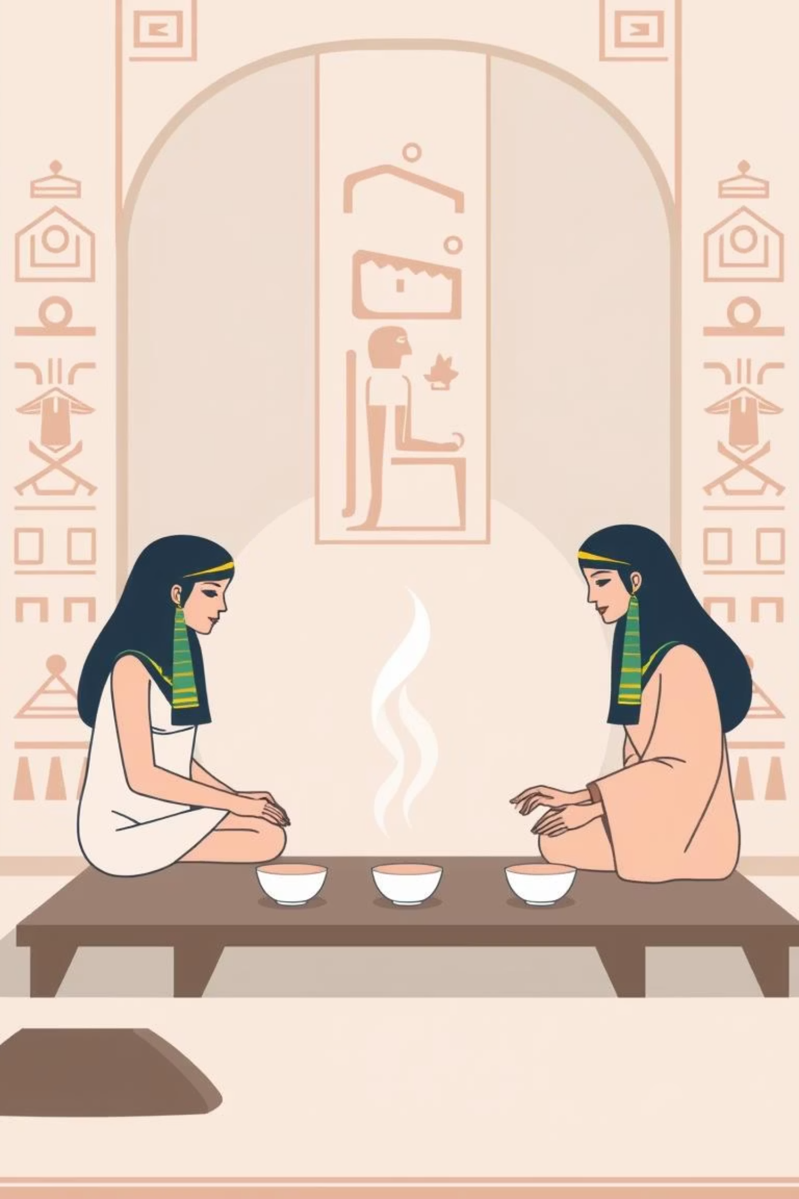
Khamseena Programming Language
Tagline: "Code it simple, brew it smooth!"
Khamseena is a beginner-friendly programming language inspired by the Egyptian "khamseena tea" – small, simple, and effective. It uses everyday English words related to making tea and simple actions to make programming intuitive and fun for kids and beginners.

Slide 3
Khamseena Keywords: Brewing Code
brew
recipe
Program start (main)
Function definition (function/def)
count
measure
Integer variable (int)
Float/Double variable (float/double)
label
switch
String variable (string)
Boolean variable (boolean)

Slide 4
Khamseena Keywords: Actions & Logic
serve
pour
Output/Print
Input/Read
taste
retaste
If condition
Else condition
stir
mix
While loop
For loop

Slide 5
Khamseena Keywords: Advanced & Utilities
deliver
fetch
# note:
Return value
Include library
Single line comment
hot
cold
True value
False value

Slide 6
Data Types in Khamseena
count
Integer number
count score = 10;
measure
Decimal number
measure price = 25.5;
label
Text string
label name = "Ahmed";
switch
Boolean value
switch ready = hot;

Slide 7

Code Example: Hello World
fetch basics
recipe brew() {
serve "Welcome to Khamseena!";
deliver 0;
}
This simple program fetches basic functionalities, defines the main "brew" function, serves a welcome message, and then delivers 0 to indicate successful execution.

Slide 8
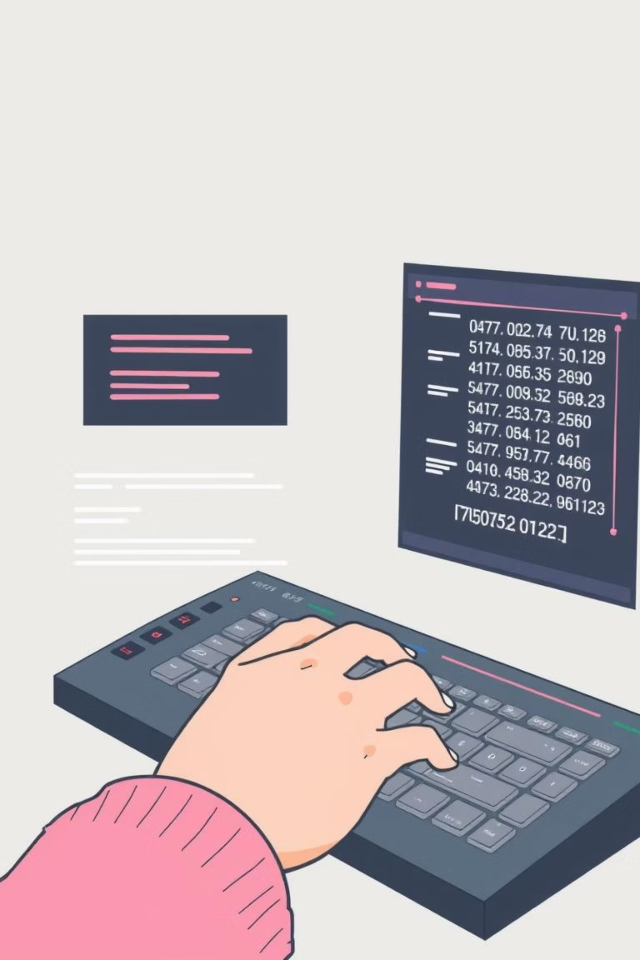
Code Example: Variables & I/O
fetch basics
recipe brew() {
label name;
count age;
serve "What's your name? ";
pour name;
serve "How old are you? ";
pour age;
serve name + " is " + age + " years old";
deliver 0;
}
This example demonstrates declaring variables, taking user input with pour, and displaying combined output using serve.

Slide 9

Code Example: Conditions (taste & retaste)
fetch basics
recipe brew() {
count grade = 85;
taste (grade >= 50) {
serve "Congratulations! You passed";
}
retaste {
serve "Try again next time";
}
deliver 0;
}
The taste keyword checks a condition, executing the first block if true. If false, retaste provides an alternative path.

Slide 10

Code Example: Loops (stir & mix)
While Loop (stir)
For Loop (mix)
fetch basics
recipe brew() {
count counter = 0;
stir (counter < 5) {
serve "Count: " + counter;
counter = counter + 1;
}
deliver 0;
}
fetch basics
recipe brew() {
mix (count i = 1; i <= 3; i = i + 1) {
serve "Round number " + i;
}
deliver 0;
}
stir repeats actions while a condition is true, like stirring tea. mix iterates a set number of times, similar to a for loop.

Slide 11
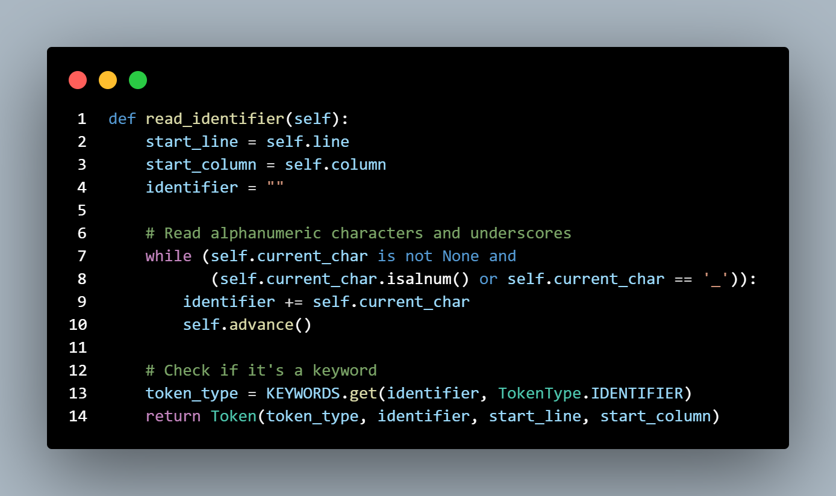
Scanner
Scanner/Lexical Analyzer for Khamseena Programming Language
Converts source code into a stream of tokens

Slide 12
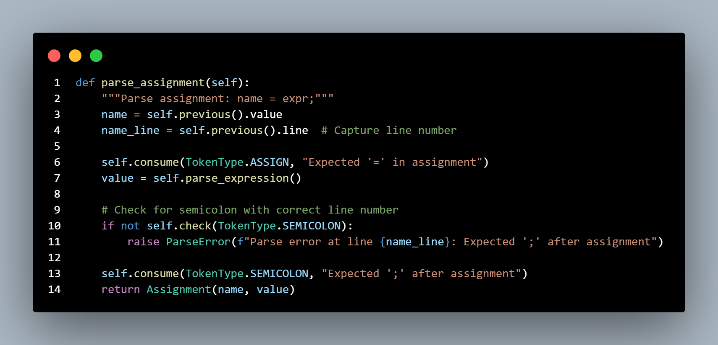
Parser
The phase of the compiler that checks if the code follows the grammatical rules of the programming language

Slide 13
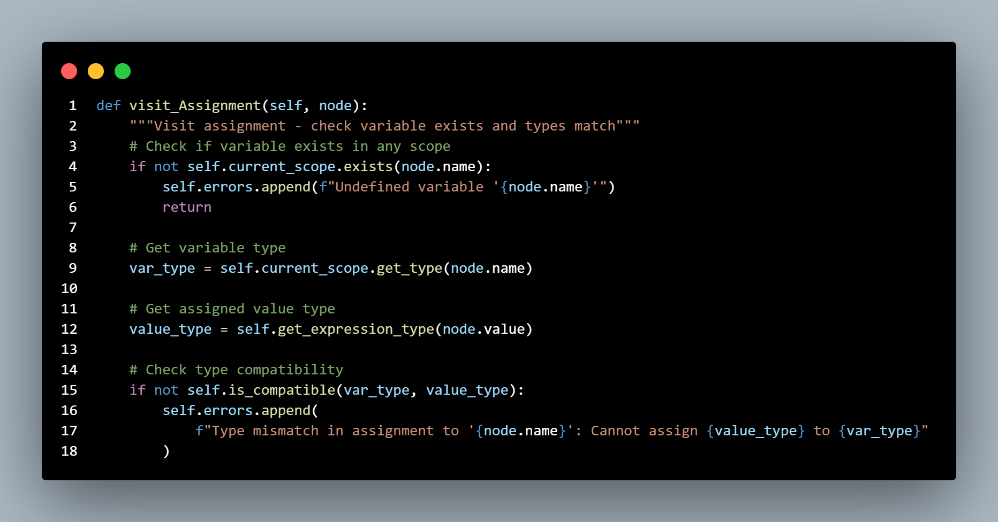
Semantic Analyzer
The phase of the compiler that checks if the code is logically consistent and meaningful, even if it is grammatically correct.

Slide 14
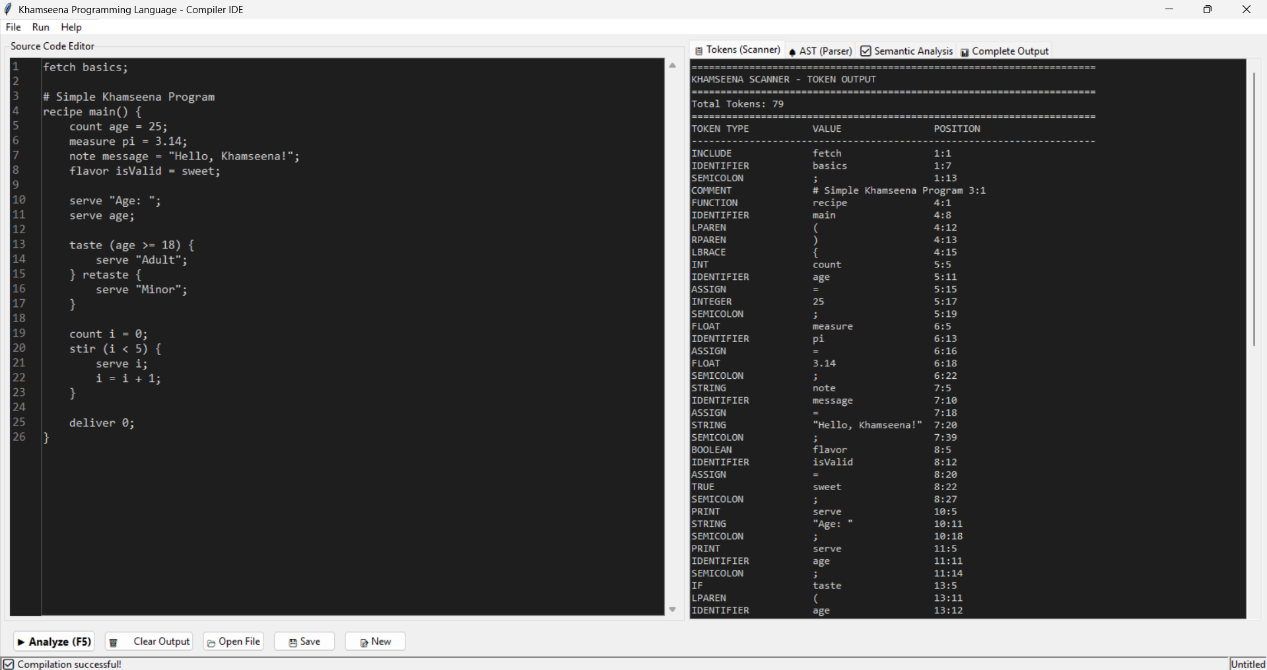

Slide 15
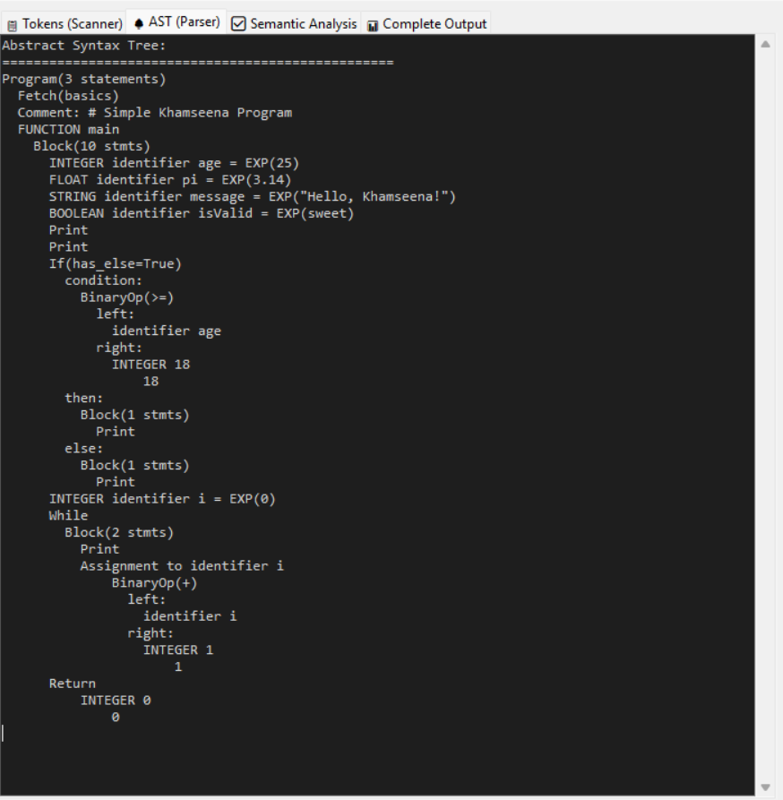
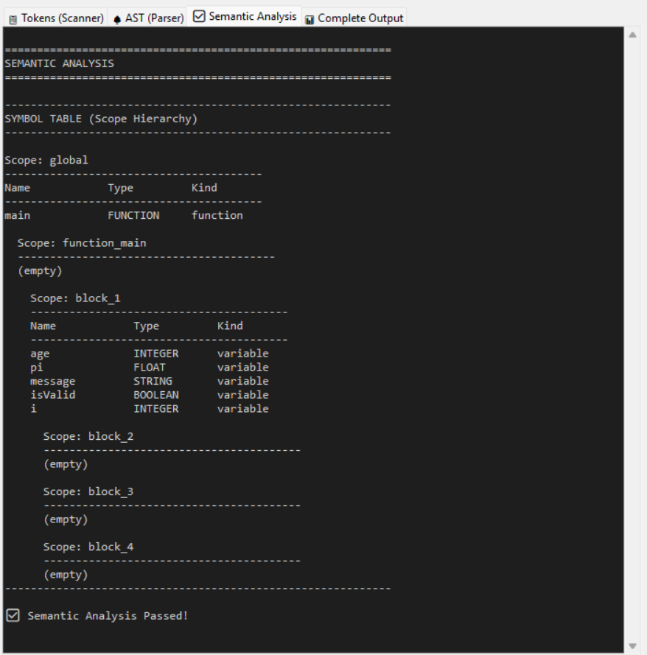

Slide 16

Thanks

