Slide 1
Machine Learning Projekt
Erstellung von Testfunktionen für Optimierungsalgorithmen mit Hilfe von Machine Learning Methoden

Slide 2
Workflow
Ground Truth Function Selection
BBOB (Black-box Optimization Benchmarking) function suite
Sampling
Random
Model Selection & Training
Parameter Selection and Tunging
Evaluation
Graphical (qualitative)
Metric-based (quantitative)
Optimization using different approaches (gradient, evolutionary, …)
Loss Definition (not distance-based)
Optimization-Based

Slide 3
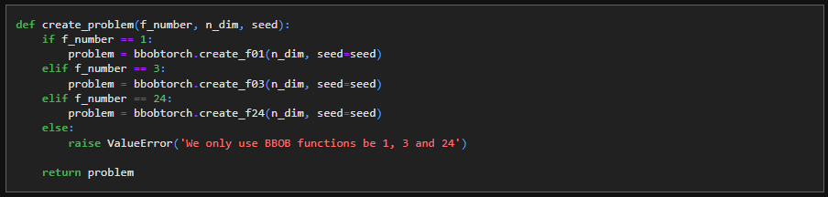
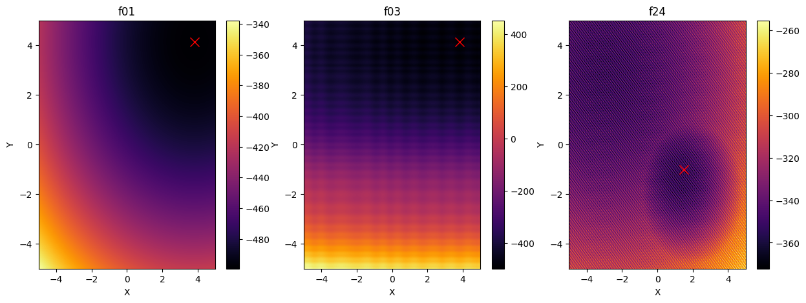
Ground Truth Selection
Ground Truth Function Selection
BBOB (Black-box Optimization Benchmarking) function suite
Sampling
Random
Model Selection & Training
Parameter Selection and Tunging
Evaluation
Graphical (qualitative)
Metric-based (quantitative)
Optimization using different approaches (gradient, evolutionary, …)
Loss Definition (not distance-based)
Optimization-Based

Slide 4
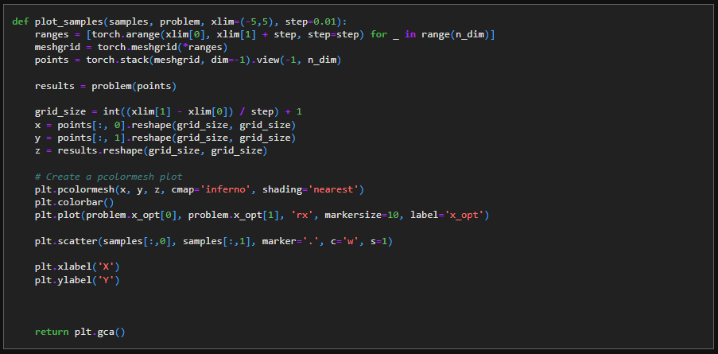
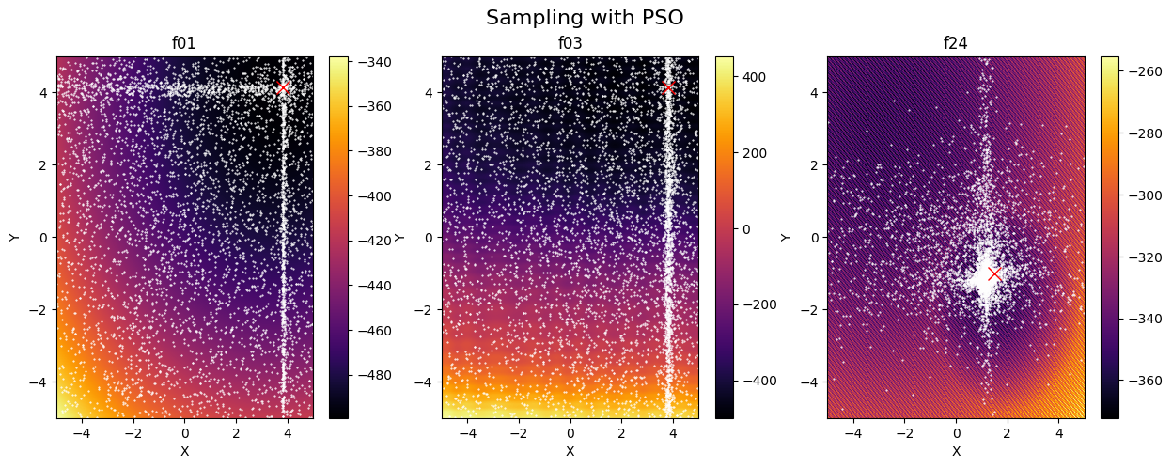
Sampling - PSO
Ground Truth Function Selection
BBOB (Black-box Optimization Benchmarking) function suite
Sampling
Random
Model Selection & Training
Parameter Selection and Tunging
Evaluation
Graphical (qualitative)
Metric-based (quantitative)
Optimization using different approaches (gradient, evolutionary, …)
Loss Definition (not distance-based)
Optimization-Based

Slide 5

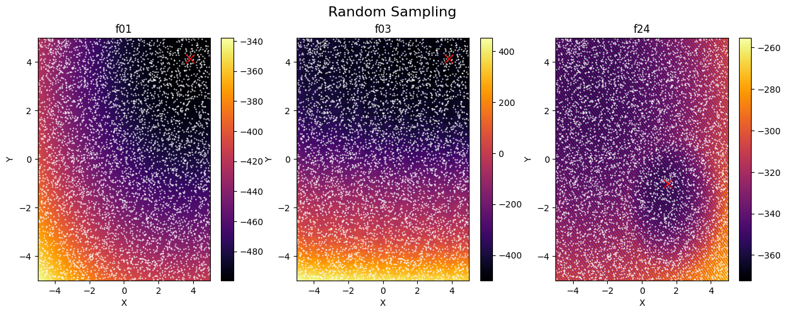
Sampling - Random
Ground Truth Function Selection
BBOB (Black-box Optimization Benchmarking) function suite
Sampling
Random
Model Selection & Training
Parameter Selection and Tunging
Evaluation
Graphical (qualitative)
Metric-based (quantitative)
Optimization using different approaches (gradient, evolutionary, …)
Loss Definition (not distance-based)
Optimization-Based

Slide 6
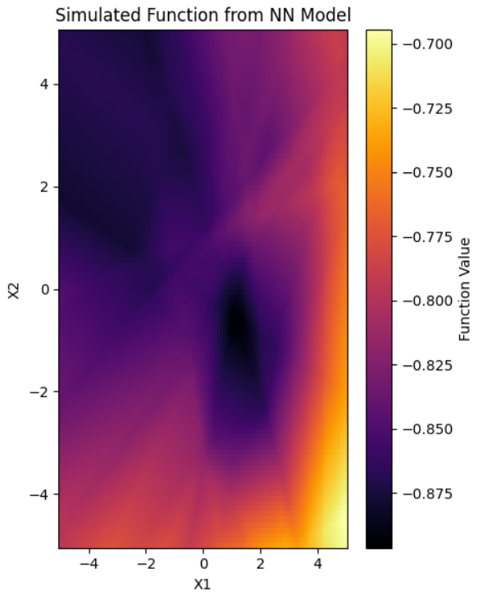
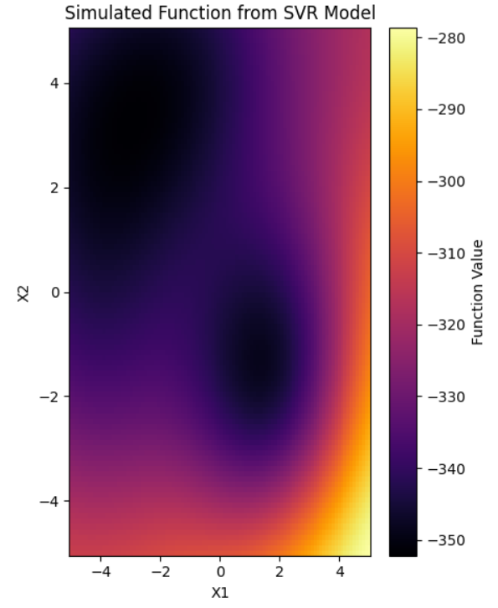
Model Selection & Training
Ground Truth Function Selection
BBOB (Black-box Optimization Benchmarking) function suite
Sampling
Random
Model Selection & Training
Parameter Selection and Tunging
Evaluation
Graphical (qualitative)
Metric-based (quantitative)
Optimization using different approaches (gradient, evolutionary, …)
Loss Definition (not distance-based)
Optimization-Based
Probleme: Struktur (lokale Minimas), Wahl der richtigen Loss-Funktion (SoftDTW, MSE, GaussianNLL, BCE, etc.)

Slide 7
Evaluation
Ground Truth Function Selection
BBOB (Black-box Optimization Benchmarking) function suite
Sampling
Random
Model Selection & Training
Parameter Selection and Tunging
Evaluation
Graphical (qualitative)
Metric-based (quantitative)
Optimization using different approaches (gradient, evolutionary, …)
Loss Definition (not distance-based)
Optimization-Based

