Slide 1
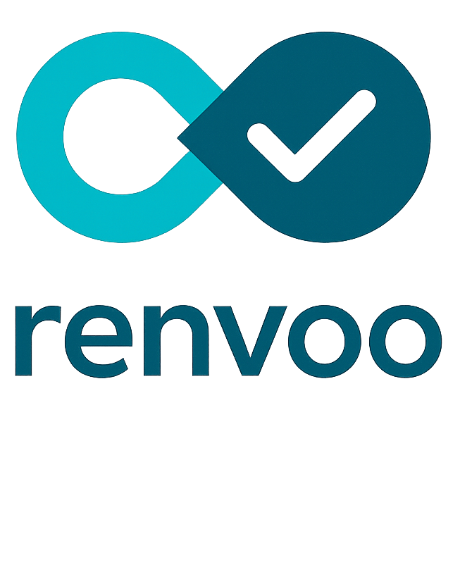
For Dutch dental clinics
Calendar view
Reduce no-shows. Recover lost appointments.
high-risk slots
Renvoo helps dental clinics reduce no-shows, handle late cancellations earlier, and recover lost appointment capacity without adding front-desk work.
Why the problem matters
Dental clinics lose money when booked chair time goes unused, and staff absorb the uncertainty through manual confirmations, rescheduling, and short-notice recovery work.
No-shows turn booked time into lost revenue
Late cancellations still leave chair time empty
Reminders exist. Prevention does not.
Booked chair time only creates value if the patient actually attends the appointment.
Late notice can still leave too little time to recover the slot.
Standard reminders still leave clinics reacting too late around risk.
Illustrative clinic scenario
2 missed appointments/day can translate into roughly EUR 8k/month in lost revenue if the slots are not recovered.
What Renvoo changes operationally
1
Identify higher-risk appointments
2
Trigger stronger confirmation or rescheduling earlier
3
Track patient response centrally
4
Recover otherwise lost capacity when possible
Low-friction for clinics by design
Administrative data only
Lightweight onboarding
Clinic control
No diagnoses or clinical notes.
CSV-first and read-only paths first.
Operational visibility without heavy disruption.
Preliminary pilot pricing
Preliminary pilot pricing starts at EUR 2.49 per appointment, plus a fixed fee depending on the clinic. Final pricing is still being shaped with pilot partners.
Renvoo is being built by Mohamed Ibrahim, former Electrical Subteam Lead for Team Polar at TU/e and part of the NVIDIA 6G Developer Program.
We are looking for a short validation meeting with a dental clinic owner or practice manager to review your current no-show and rescheduling workflow.
Notes:
One-page leave-behind aligned to the clinic deck.

