Slide 1


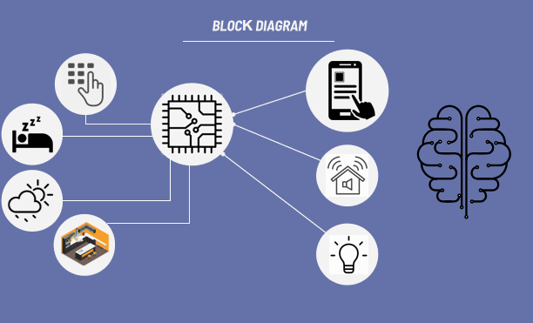
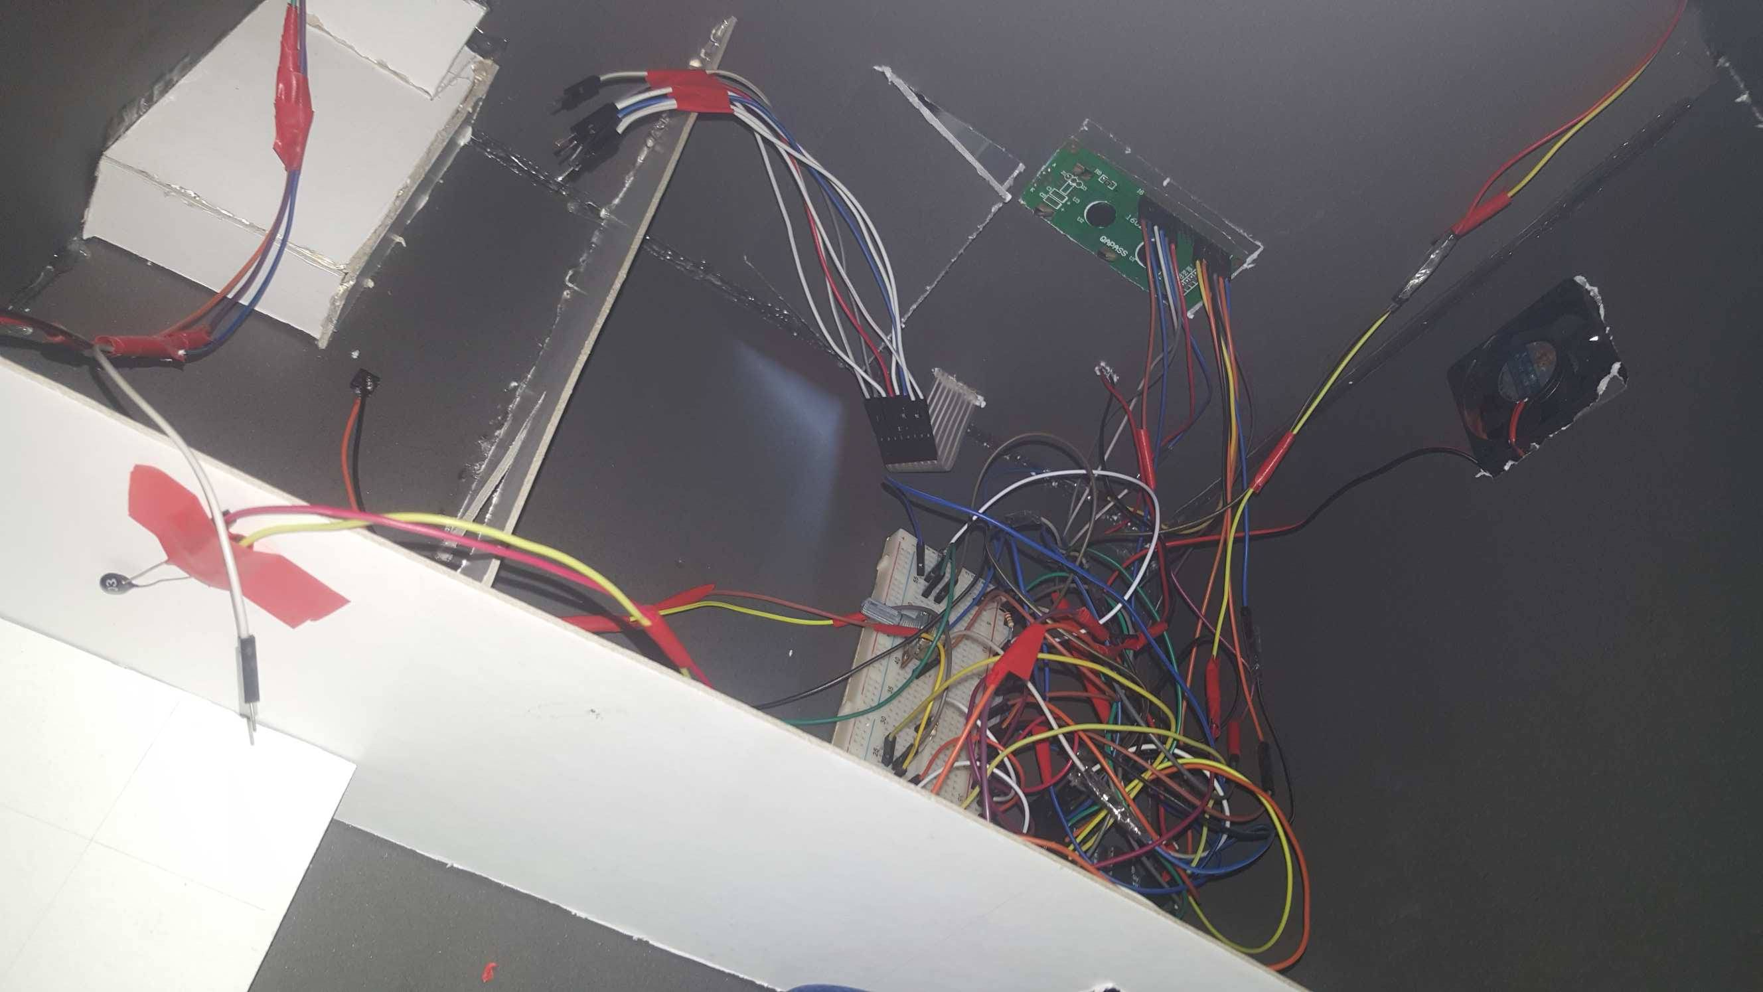
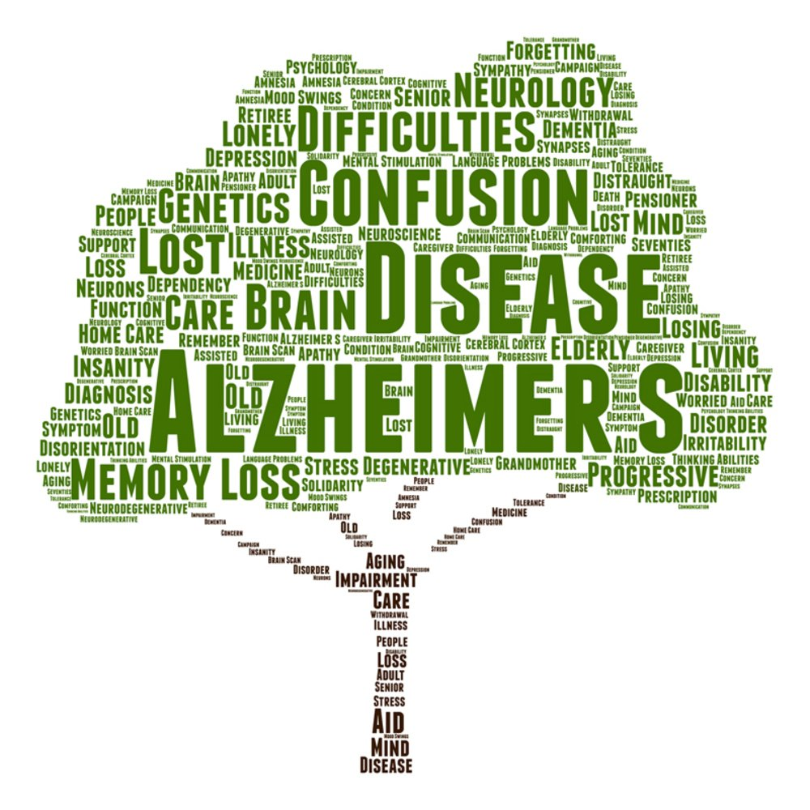


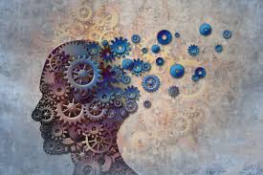
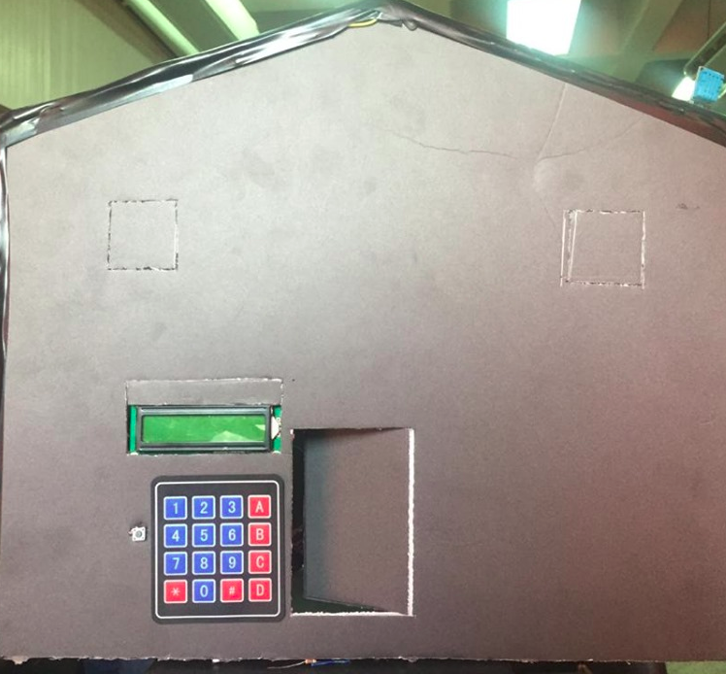
SMART HOME FOR ALZHEIMER’S PATIENTS
TEAM 12
ABSTRACT
INTRODUCTION
BLOCK DIAGRAM
Alzheimer's disease is a progressive disorder that causes brain cells to waste away (degenerate) and die. Alzheimer's disease is the most common cause of dementia — a continuous decline in thinking, behavioral and social skills that disrupts a person's ability to function independently.
The early signs of the disease may be forgetting recent events or conversations. As the disease progresses, a person with Alzheimer's disease will develop severe memory impairment and lose the ability to carry out everyday tasks.
Current Alzheimer's disease medications may temporarily improve symptoms or slow the rate of decline. These treatments can sometimes help people with Alzheimer's disease maximize function and maintain independence for a time. Different programs and services can help support people with Alzheimer's disease and their caregivers.
There is no treatment that cures Alzheimer's disease or alters the disease process in the brain. In advanced stages of the disease, complications from severe loss of brain function — such as dehydration, malnutrition or infection — result in death.
Everyone has occasional memory lapses. It's normal to lose track of where you put your keys or forget the name of an acquaintance. But the memory loss associated with Alzheimer's disease persists and worsens, affecting the ability to function at work or at home.
People with Alzheimer's may:
Repeat statements and questions over and over
Forget conversations, appointments or events, and not remember them later
Routinely misplace possessions, often putting them in illogical locations
Get lost in familiar places
Eventually forget the names of family members and everyday objects
Have trouble finding the right words to identify objects, express thoughts or take part in conversations
So in our project we hopefully try to help any patient with Alzheimer’s to live his life normally by this smart home.
METHODS AND MATERIALS
This smart home reminds the patient with almost all details in his day by using the following methods :
An FSR sensor is put on the door’s side to indicate if the door is opened or closed and if it’s opened, a message will be sent to the mobile application to remind him to close the door if it’s opened for a long time.
A switch is put on the pillow of the bed to switch off the lights and fans immediately once the patient puts his head on the bed. So there’s no problem at all to forget the lights on in the rest of the house.
A humidity sensor DHT11 is put on the outside of his home’s door to inform him with the humidity percentage of each day.
A keypad is put on the door’s side so that each person has a code that he’ll type on the keypad when he visits the patient, so the mobile application will send all the data saved about this person to the patient. This data includes the relation and some information and a picture of the visitor.
The application is provided with a timer to remind the patient with the time to take the medicine.
A temperature sensor (thermistor) is put in the kitchen to alarm the patient if there’s a fire.
The application reminds the patient with all the appointments and schedule of the day.
Figure 2.
Memory fade
Figure 1.
Alzheimer’s Symptoms
Figure 6.
Detailed view of our circuit
CONCLUSION
This smart home will let the patient live his life normally as much as possible.
He won’t forget the door opened for a long time not to get robbed. It won’t be a hassle if he forgot the lights on in other rooms. He’ll never forget to take his medicine which is very essential for his health.
He can easily recognize the people who came to his door, remember all his schedule and appointments. The food won’t be over burnt. Finally, a patient with Alzheimer’s won’t be that depressed because of forgetting anymore.
Figure 3.
No treatment for Alzheimer’s disease
Figure 4.
A patient who forgets his medicine
Team 12
Abdullah ElSayed
Abdullah Reda
Renad Taher
Reham AbdelFattah
Mohammed Omar
REFERENCES
Phillips, Moraima. "Geriatric Diseases and Mental Health."
Kyselova, A. A., E. S. Kravtsova, D. O. Mishchenko, and E. R. Chernishova. "The Modern View on Alzheimer’s Disease." Український журнал медицини, біології та спорту 3,№ 4 (2018): 169-173.
IP, David Hellens MPharm PgD. "Management of Alzheimer's disease in the UK."
Figure 5.
Overall view of our smart home

