Slide 1
E-SPORTS
TOURNAMENT MANAGEMENT SYSTEM
Managing player rankings, team rosters, and multi-stage match results
ERD
Relational Schema
SQL Server
GUI(python flask)
Presented by :
Moamen Hamdi Gabr Malhat
152300123
Level 2
Database Systems Project • 2025/2026

Slide 2
PROJECT OVERVIEW
What Is This System?
The E-Sports Tournament Bracket Logic project is designed to manage and organize e-sports tournaments efficiently.
🏟️
Team Management
🎮
Player Profiles
🏆
Tournament Engine
Store team profiles, rankings, coaches
Track nationality & stadium info
Full player records with global rank
Active/Inactive status tracking
Multi-stage bracket support
Prize pool & game title tracking
⚔️
Match & Results
📊
Player Stats
Match scheduling & winner tracking
Game-by-game score breakdowns
Goals, assists & MVP points per game
Linked to individual game results

Slide 3
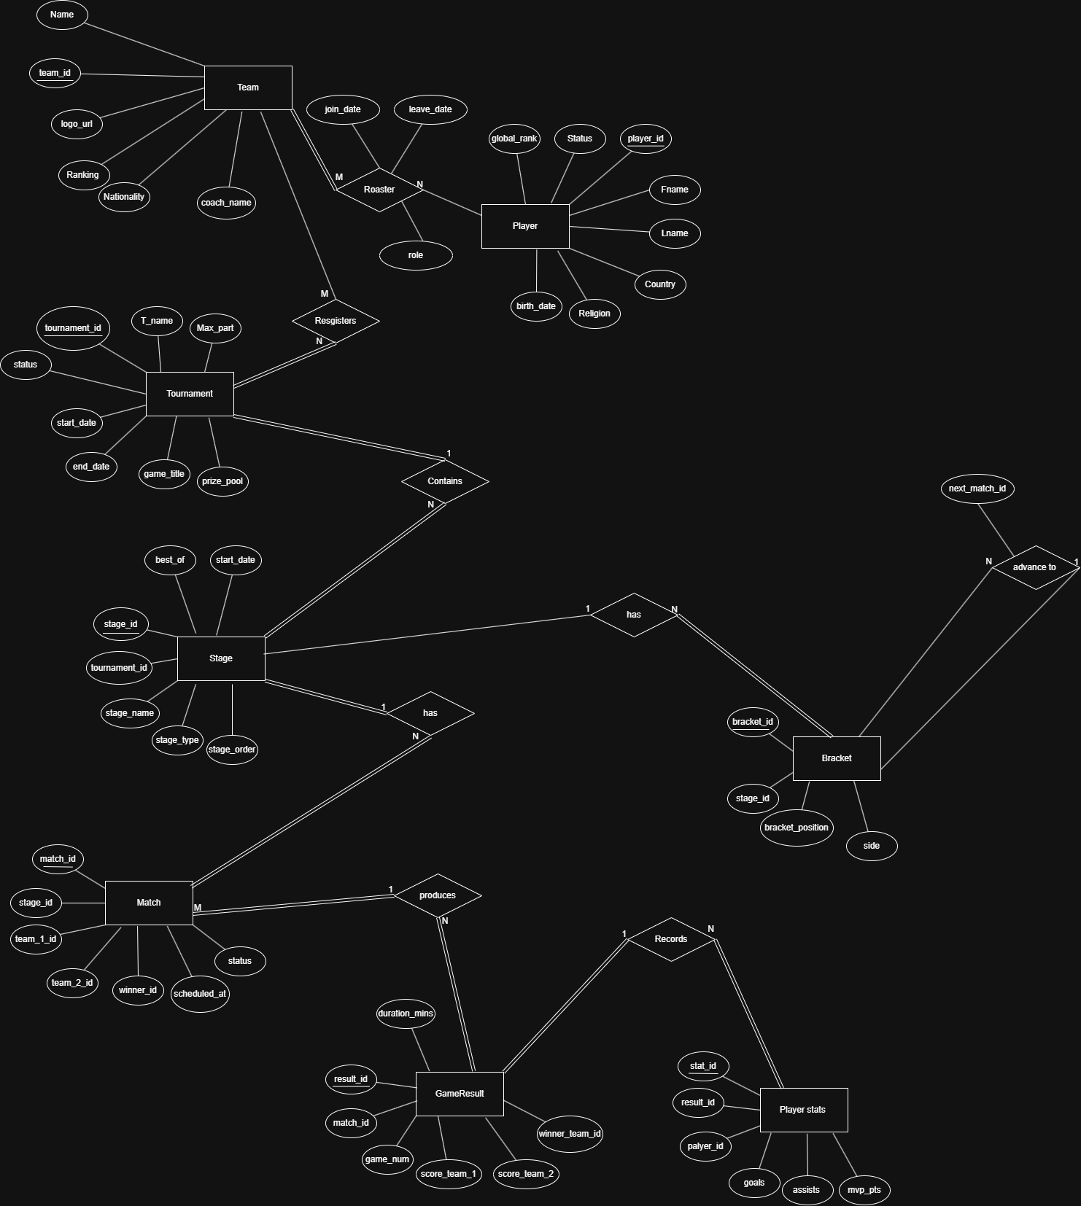
DATABASE DESIGN
Entity Relationship Diagram(ERD)

Slide 4
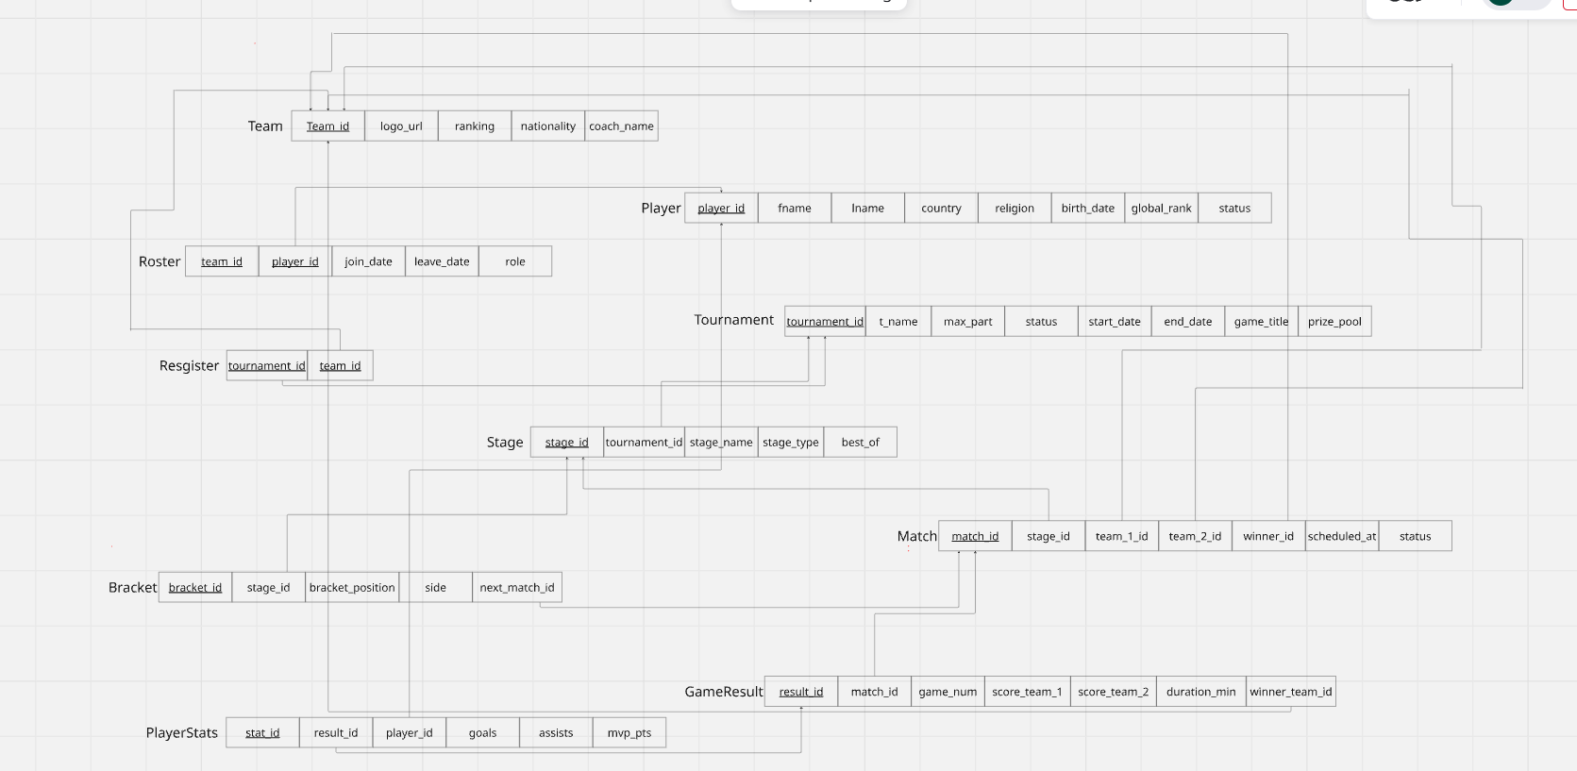
Database design
Relational Mapping Schema

Slide 5
SQL Code
DDL – Create Database & Tables
USE master;
GO
IF EXISTS (SELECT * FROM sys.databases WHERE name = 'eSports')
BEGIN
DROP DATABASE eSports;
END
GO
CREATE DATABASE eSports;
GO
USE eSports;
GO
CREATE TABLE Team (
team_id INT PRIMARY KEY,
name VARCHAR(100) NOT NULL,
logo_url VARCHAR(255),
ranking INT CHECK (ranking >= 0),
nationality VARCHAR(50),
coach_name VARCHAR(100)
);
CREATE TABLE Player (
player_id INT PRIMARY KEY,
fname VARCHAR(50) NOT NULL,
lname VARCHAR(50) NOT NULL,
country VARCHAR(50),
religion VARCHAR(50),
birth_date DATE,
global_rank INT CHECK (global_rank >= 0),
status VARCHAR(30)
);
CREATE TABLE Roaster (
team_id INT,
player_id INT,
join_date DATE,
leave_date DATE,
role VARCHAR(50),
PRIMARY KEY (team_id, player_id),
FOREIGN KEY (team_id)
REFERENCES Team(team_id),
FOREIGN KEY (player_id)
REFERENCES Player(player_id)
);

Slide 6
SQL Code
DDL – Create Database & Tables
CREATE TABLE Tournaments (
tournament_id INT PRIMARY KEY,
t_name VARCHAR(100) NOT NULL,
max_part INT,
status VARCHAR(30),
start_date DATE,
end_date DATE,
game_title VARCHAR(100),
prize_pool DECIMAL(12,2)
);
CREATE TABLE RegisterTeam (
tournament_id INT,
team_id INT,
PRIMARY KEY (tournament_id, team_id),
FOREIGN KEY (tournament_id)
REFERENCES Tournaments(tournament_id),
FOREIGN KEY (team_id)
REFERENCES Team(team_id)
);
CREATE TABLE Stage (
stage_id INT PRIMARY KEY,
tournament_id INT,
stage_name VARCHAR(100),
stage_type VARCHAR(50),
best_of INT CHECK (best_of IN (1,3,5)),
FOREIGN KEY (tournament_id)
REFERENCES Tournaments(tournament_id)
);
CREATE TABLE Matches (
match_id INT PRIMARY KEY,
stage_id INT,
team_1_id INT,
team_2_id INT,
winner_id INT,
scheduled_at DATETIME,
status VARCHAR(30),
FOREIGN KEY (stage_id)
REFERENCES Stage(stage_id),
FOREIGN KEY (team_1_id)
REFERENCES Team(team_id),

Slide 7
SQL Code
DDL – Create Database & Tables
FOREIGN KEY (team_2_id)
REFERENCES Team(team_id),
FOREIGN KEY (winner_id)
REFERENCES Team(team_id)
);
CREATE TABLE Bracket (
bracket_id INT PRIMARY KEY,
stage_id INT,
bracket_position INT,
side VARCHAR(20),
next_match_id INT,
FOREIGN KEY (stage_id)
REFERENCES Stage(stage_id),
FOREIGN KEY (next_match_id)
REFERENCES Matches(match_id)
);
CREATE TABLE GameResult (
result_id INT PRIMARY KEY,
match_id INT,
game_num INT,
score_team_1 INT,
score_team_2 INT,
duration_min INT,
winner_team_id INT,
FOREIGN KEY (match_id)
REFERENCES Matches(match_id),
FOREIGN KEY (winner_team_id)
REFERENCES Team(team_id)
);

Slide 8
SQL Code
DML (insert – update – select )
CREATE TABLE PlayerStats(
stat_id INT PRIMARY KEY,
result_id INT,
player_id INT,
goals INT,
assists INT,
mvp_pts INT,
FOREIGN KEY (result_id)
REFERENCES GameResult(result_id),
FOREIGN KEY (player_id)
REFERENCES Player(player_id)
);
ALTER TABLE Player
ADD email VARCHAR(100);
GO
ALTER TABLE Team
ADD stadium VARCHAR(100);
Go
INSERT INTO Team VALUES
(1, 'Real Madrid', 'realmadrid.png', 1, 'Spain', 'Carlo Ancelotti'),
(2, 'Manchester City', 'mancity.png', 2, 'England', 'Pep Guardiola'),
(3, 'Al Ahly', 'alahly.png', 3, 'Egypt', 'Marcel Koller'),
(4, 'Barcelona', 'barcelona.png', 4, 'Spain', 'Xavi Hernandez'),
(5, 'Liverpool', 'liverpool.png', 5, 'England', 'Jurgen Klopp'),
(6, 'Bayern Munich', 'bayern.png', 6, 'Germany', 'Thomas Tuchel'),
(7, 'Juventus', 'juventus.png', 7, 'Italy', 'Massimiliano Allegri'),
(8, 'PSG', 'psg.png', 8, 'France', 'Luis Enrique’);
INSERT INTO Player VALUES
(101, 'Mohamed', 'Salah', 'Egypt','Muslim', '1992-06-15', 1, 'Active', 'salah@gmail.com'),
(102, 'Lionel', 'Messi', 'Argentina','Christian', '1987-06-24', 2, 'Active', 'messi@gmail.com'),
(103, 'Cristiano', 'Ronaldo', 'Portugal','Christian', '1985-02-05', 3, 'Active', 'ronaldo@gmail.com'),
(104, 'Kylian', 'Mbappe', 'France','Christian', '1998-12-20', 4, 'Active', 'mbappe@gmail.com'),
(105, 'Neymar', 'Junior', 'Brazil','Christian', '1992-02-05', 5, 'Inactive', 'neymar@gmail.com'),
(106, 'Kevin', 'De Bruyne', 'Belgium','Christian', '1991-06-28', 6, 'Active', 'kevin@gmail.com'),
(107, 'Harry', 'Kane', 'England','Christian', '1993-07-28', 7, 'Active', 'kane@gmail.com'),
(108, 'Vinicius', 'Junior', 'Brazil','Christian', '2000-07-12', 8, 'Active', 'vinicius@gmail.com'),
(109, 'Jude', 'Bellingham', 'England','Christian', '2003-06-29', 9, 'Active', 'jude@gmail.com'),
(110, 'Erling', 'Haaland', 'Norway','Christian', '2000-07-21', 10, 'Active', 'haaland@gmail.com');

Slide 9
SQL Code
DML (insert – update – select )
INSERT INTO Roaster VALUES
(1, 108, '2025-01-01', NULL, 'Forward'),
(1, 109, '2025-01-01', NULL, 'Midfielder'),
(2, 106, '2025-01-05', NULL, 'Midfielder'),
(2, 110, '2025-01-05', NULL, 'Striker'),
(5, 101, '2025-01-10', NULL, 'Right Wing'),
(8, 102, '2025-01-15', NULL, 'Forward'),
(8, 104, '2025-01-15', NULL, 'Attacker'),
(7, 103, '2025-01-20', NULL, 'Forward'),
(6, 107, '2025-01-25', NULL, 'Striker'),
(8, 105, '2025-02-01', NULL, 'Playmaker’);
INSERT INTO Tournaments VALUES
(201, 'UEFA Champions League', 32, 'Open','2025-09-01', '2026-05-30','Football', 200000000),
(202, 'FIFA Club World Cup', 16, 'Closed','2025-06-15', '2025-07-13','Football', 100000000),
(203, 'Premier League Cup', 20, 'Open','2025-08-10', '2026-05-20','Football', 80000000);
INSERT INTO RegisterTeam VALUES
(201, 1),
(201, 2),
(201, 4),
(201, 5),
(202, 1),
(202, 3),
(202, 8),
(203, 2),
(203, 5);
INSERT INTO Stage VALUES
(301, 201, 'Group Stage', 'Groups', 1),
(302, 201, 'Quarter Final', 'Knockout', 1),
(303, 201, 'Semi Final', 'Knockout', 1),
(304, 201, 'Final', 'Knockout', 1),
(305, 202, 'Semi Final', 'Knockout', 1),
(306, 202, 'Final', 'Knockout', 1),
(307, 203, 'League Stage', 'League', 1);
INSERT INTO Matches VALUES
(401, 301, 1, 2, 1,'2025-09-10 20:00:00', 'Finished'),
(402, 301, 4, 5, 5,'2025-09-11 21:00:00', 'Finished'),
(403, 302, 1, 5, 1,'2025-10-02 22:00:00', 'Finished'),
(404, 303, 1, 8, 8,'2025-11-05 21:00:00', 'Finished'),
(405, 304, 8, 2, 8,'2026-05-30 22:00:00', 'Finished'),
(406, 305, 1, 3, 1,'2025-06-20 19:00:00', 'Finished'),
(407, 306, 1, 8, 8,'2025-07-13 22:00:00', 'Finished');

Slide 10
SQL Code
DML (insert – update – select )
INSERT INTO Bracket VALUES
(501, 301, 1, 'Upper', 403),
(502, 301, 2, 'Upper', 403),
(503, 302, 3, 'Upper', 404),
(504, 303, 4, 'Upper', 405),
(505, 304, 5, 'Final', NULL),
(506, 305, 6, 'Upper', 407),
(507, 306, 7, 'Final', NULL);
INSERT INTO GameResult VALUES
(601, 401, 1, 3, 1, 90, 1),
(602, 402, 1, 1, 2, 90, 5),
(603, 403, 1, 2, 0, 90, 1),
(604, 404, 1, 1, 3, 90, 8),
(605, 405, 1, 2, 4, 90, 8),
(606, 406, 1, 3, 1, 90, 1),
(607, 407, 1, 0, 2, 90, 8);
INSERT INTO PlayerStats VALUES
(701, 601, 108, 2, 1, 9),
(702, 601, 110, 1, 0, 7),
(703, 602, 101, 1, 1, 8),
(704, 603, 109, 1, 2, 9),
(705, 604, 102, 2, 1, 10),
(706, 604, 104, 1, 0, 8),
(707, 605, 102, 2, 1, 10),
(708, 606, 108, 1, 1, 8),
(709, 607, 104, 1, 1, 9);
UPDATE Team
SET coach_name = 'Alvaro Arbeloua'
WHERE team_id = 1;
UPDATE Team
SET ranking = 10
WHERE team_id = 2;
UPDATE Player
SET global_rank = 1
WHERE player_id = 102;
UPDATE Matches
SET status = 'Completed'
WHERE match_id = 405;

Slide 11
SQL Code
DML (insert – update – select )
INSERT INTO Bracket VALUES
(501, 301, 1, 'Upper', 403),
(502, 301, 2, 'Upper', 403),
(503, 302, 3, 'Upper', 404),
(504, 303, 4, 'Upper', 405),
(505, 304, 5, 'Final', NULL),
(506, 305, 6, 'Upper', 407),
(507, 306, 7, 'Final', NULL);
INSERT INTO GameResult VALUES
(601, 401, 1, 3, 1, 90, 1),
(602, 402, 1, 1, 2, 90, 5),
(603, 403, 1, 2, 0, 90, 1),
(604, 404, 1, 1, 3, 90, 8),
(605, 405, 1, 2, 4, 90, 8),
(606, 406, 1, 3, 1, 90, 1),
(607, 407, 1, 0, 2, 90, 8);
INSERT INTO PlayerStats VALUES
(701, 601, 108, 2, 1, 9),
(702, 601, 110, 1, 0, 7),
(703, 602, 101, 1, 1, 8),
(704, 603, 109, 1, 2, 9),
(705, 604, 102, 2, 1, 10),
(706, 604, 104, 1, 0, 8),
(707, 605, 102, 2, 1, 10),
(708, 606, 108, 1, 1, 8),
(709, 607, 104, 1, 1, 9);
UPDATE Team
SET coach_name = 'Alvaro Arbeloua'
WHERE team_id = 1;
UPDATE Team
SET ranking = 10
WHERE team_id = 2;
UPDATE Player
SET global_rank = 1
WHERE player_id = 102;
UPDATE Matches
SET status = 'Completed'
WHERE match_id = 405;

Slide 12
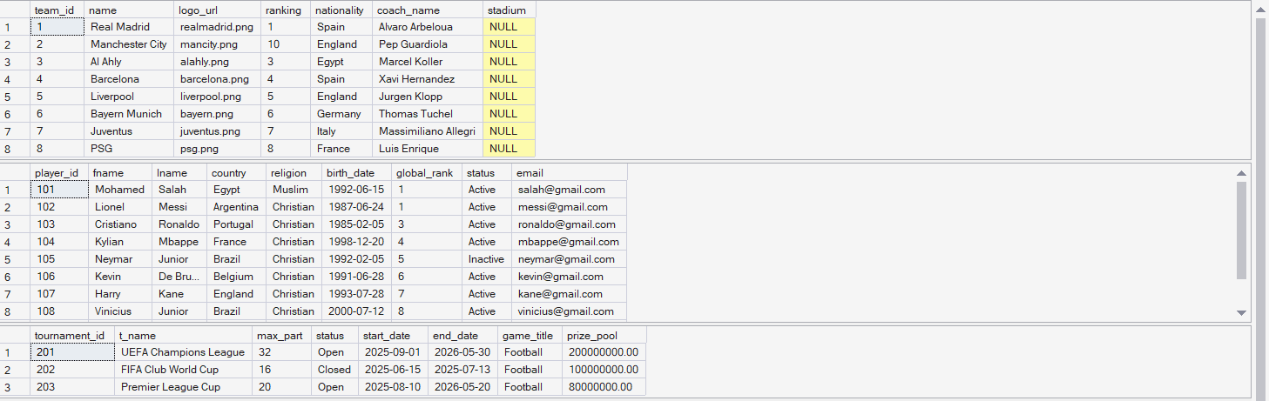
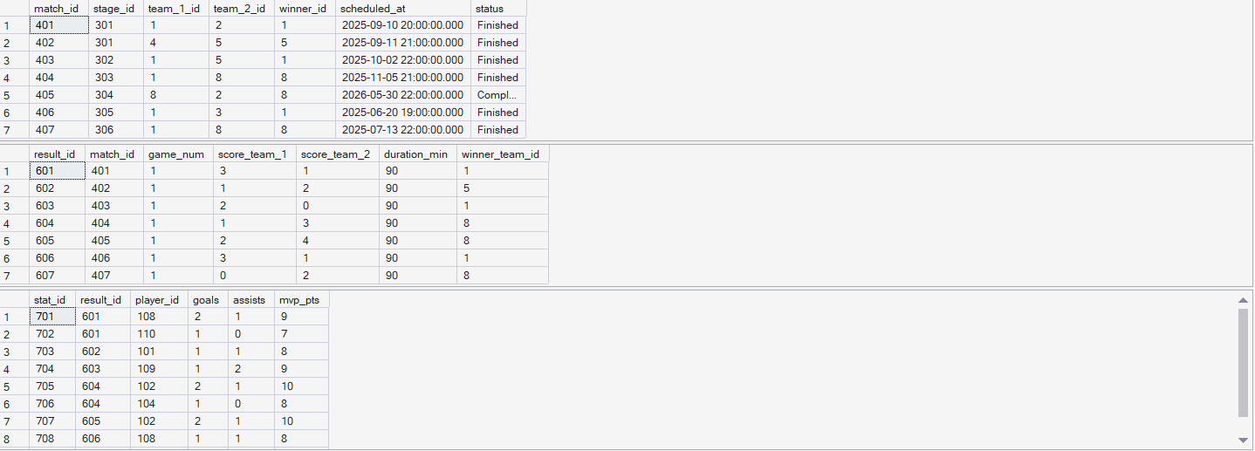
SQL Code
DML (insert ) ---- view Tables
SELECT * FROM Team;
SELECT * FROM Player;
SELECT * FROM Tournaments;
SELECT * FROM Matches;
SELECT * FROM GameResult;
SELECT * FROM PlayerStats;

Slide 13
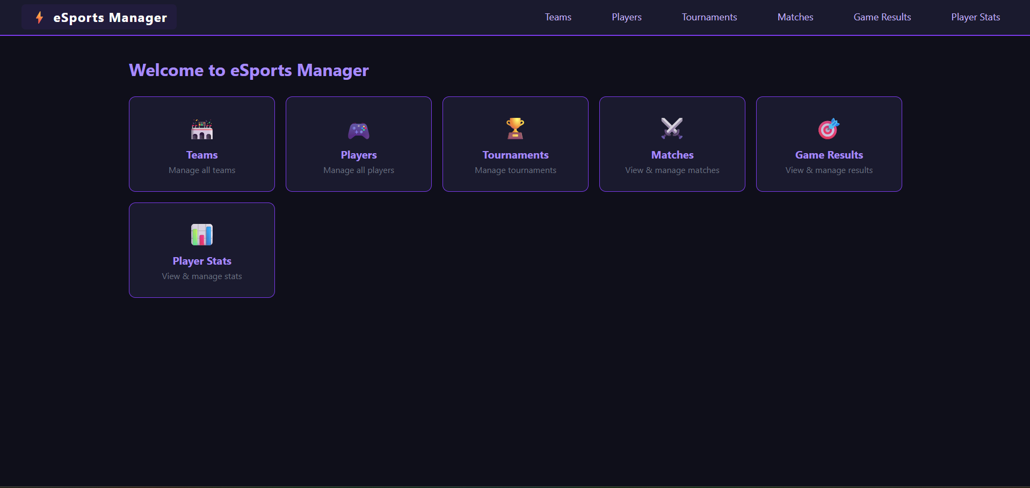
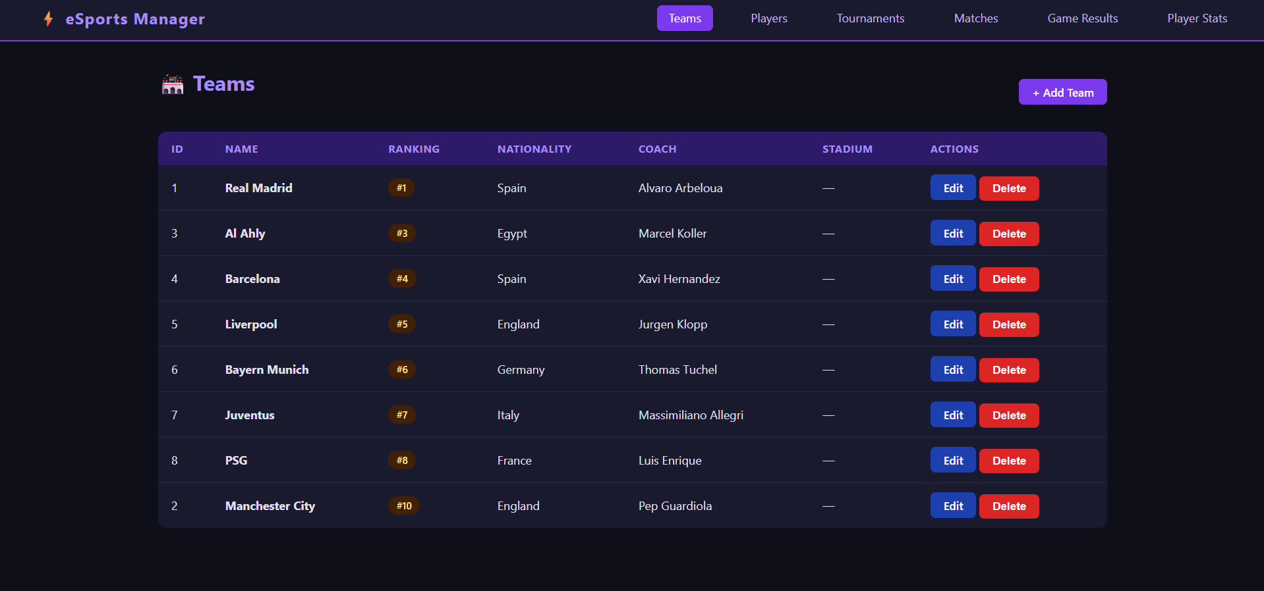
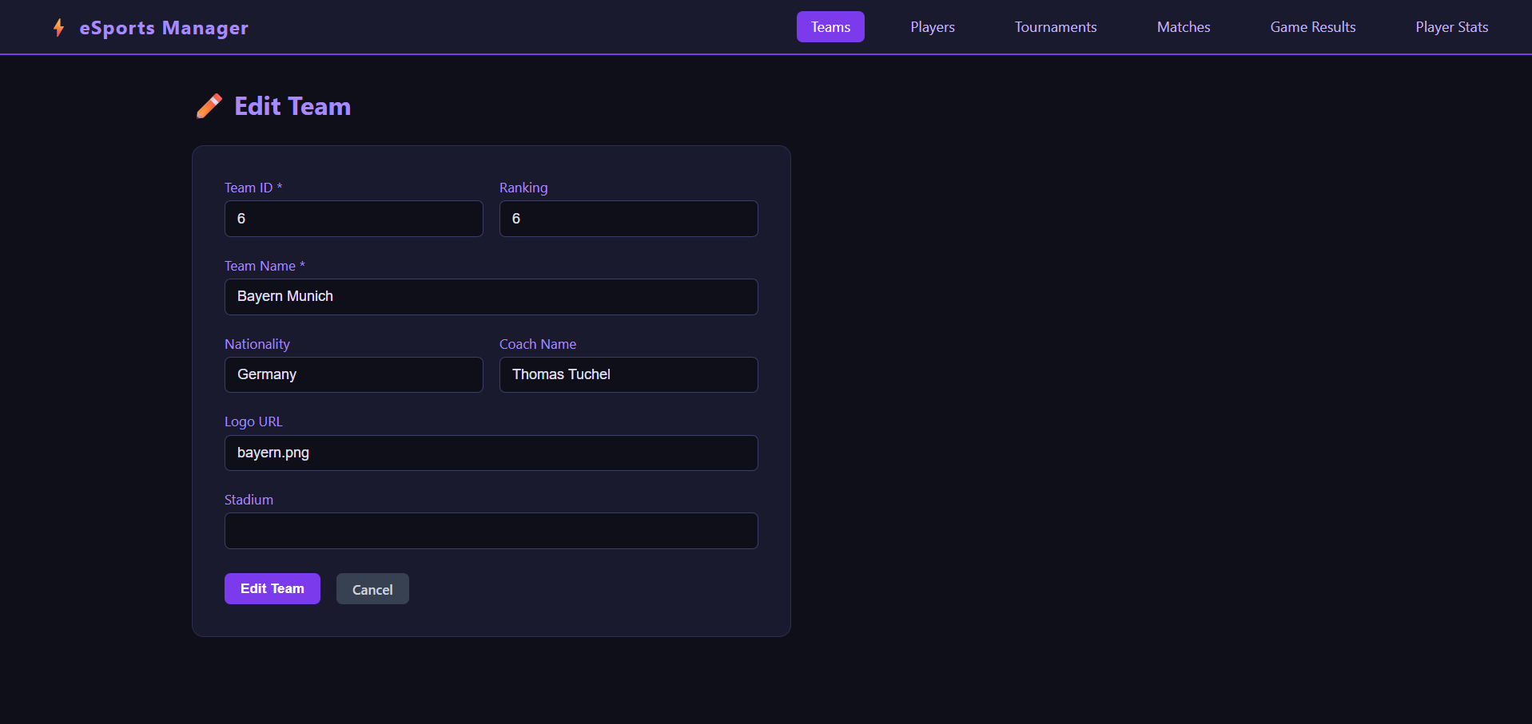
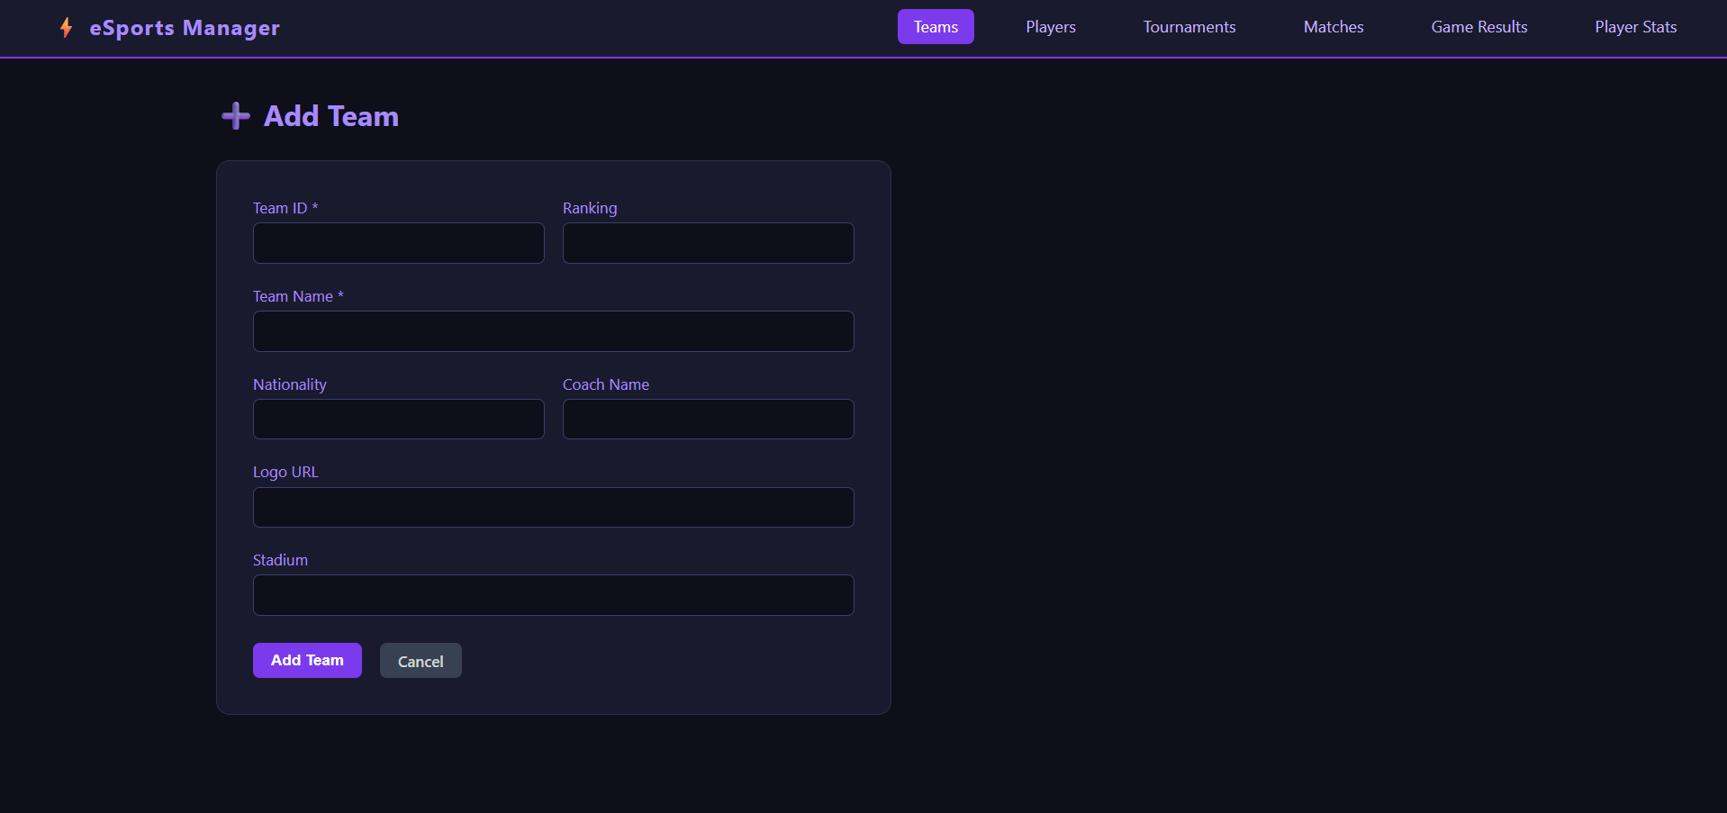
GUI ARCHITECTURE
GUI
Python Flask + html + css → SQL Server

Slide 14
Thank you
For your patience

