Slide 1
Power BI Report Update Notification Automation
Dynamic subscribers, SharePoint source of truth, and automated update emails.
No hardcoded emails
Recipients now come from SharePoint.
2 connected flows
Subscriber capture + report update notification.
Web App
Power Automate
SharePoint
Outlook
Power Automate + SharePoint + Power BI | 1

Slide 2
BEFORE THE UPDATE
The problem: fixed recipients created noise
Daily Flow
Report Check
Static Email
Inbox Noise
Old flow behavior
• Email recipients were fixed inside the Outlook action.
• Users could not opt in or opt out from the web app.
• Frequent checks risked repeated notifications and noisy inboxes.
• The flow was hard to explain because action names were generic.
Goal
Make notifications subscription-based and readable for review.
Power Automate + SharePoint + Power BI | 2

Slide 3
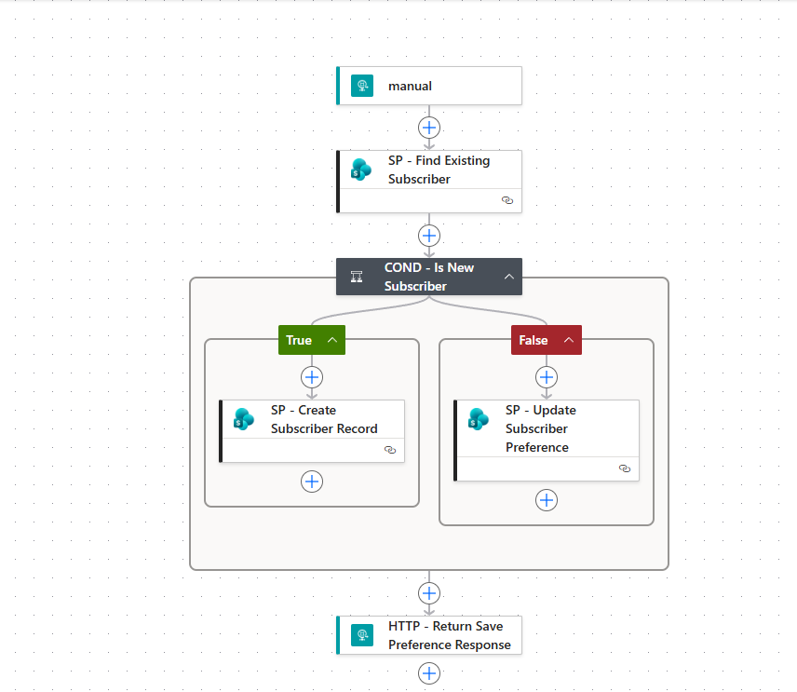
SOLUTION OVERVIEW
The new architecture: user-driven notifications
Flask Web App
Opt in / out
Subscriber Flow
HTTP Trigger
ReportSubscribers
SharePoint List
Daily Update
Flow
Two flows, one subscriber source
1. Subscriber registration flow receives email preferences from the web app.
2. Daily report-update flow reads active subscribers before sending notifications.
3. SharePoint becomes the single source of truth for notification recipients.
Power Automate + SharePoint + Power BI | 3

Slide 4
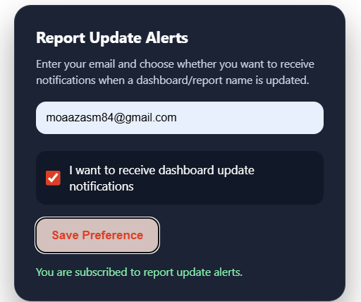
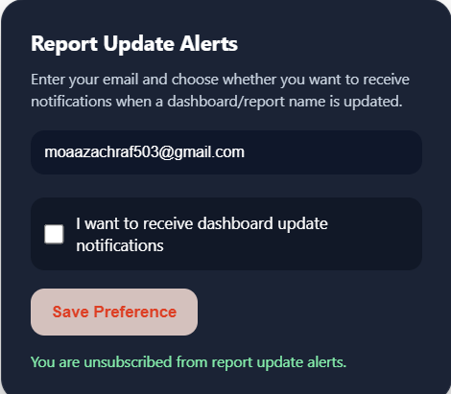
FRONT-END UPDATE
Web app: users control their notification preference
Subscribe
Checkbox checked → IsActive = true in SharePoint.
Unsubscribe
Checkbox unchecked → IsActive = false in SharePoint.
Power Automate + SharePoint + Power BI | 4

Slide 5
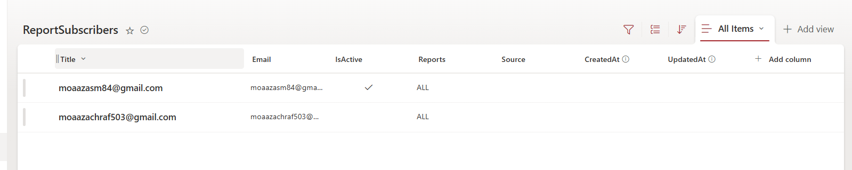
DATA LAYER
SharePoint List: dynamic audience management
ReportSubscribers schema
Email
Recipient address
IsActive
Opt-in / opt-out flag
Reports
Scope of interest
No fixed recipients
The email list is generated at runtime from SharePoint.
Power Automate + SharePoint + Power BI | 5

Slide 6
POWER AUTOMATE FLOW 1
New flow: save web app email preferences
Logic
• Receives POST payload from Flask web app: email, isActive, reports, source.
• Searches SharePoint by Email to avoid duplicates.
• Creates a new record or updates the existing preference.
• Returns a clean response to the web app.
Power Automate + SharePoint + Power BI | 6

Slide 7
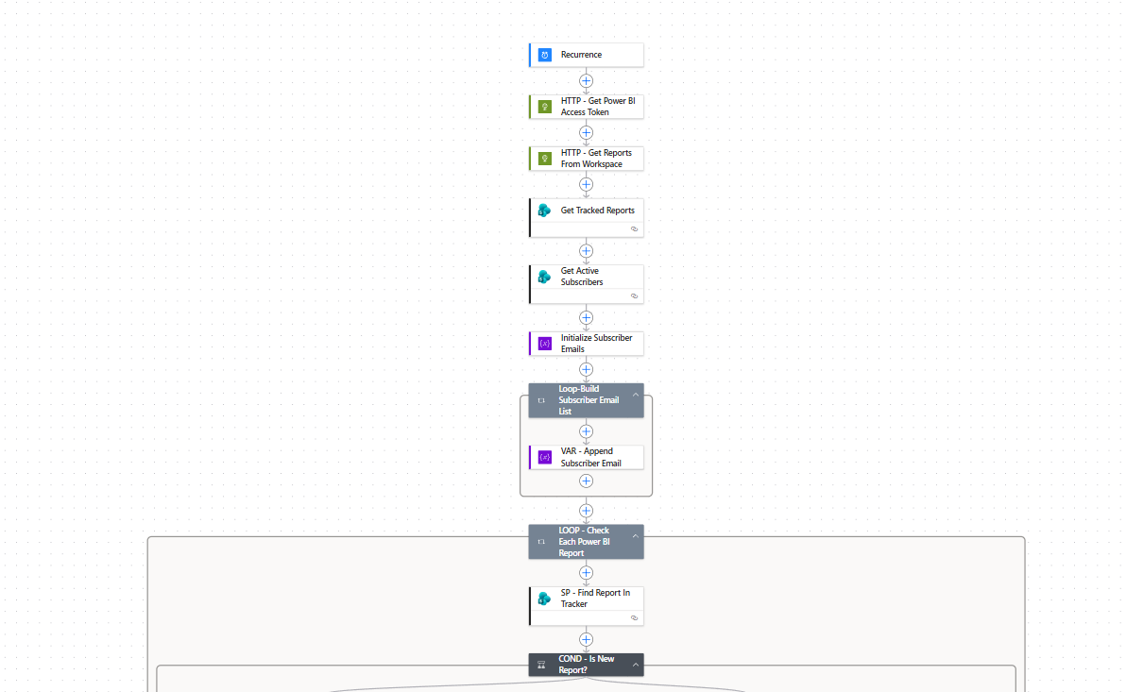
POWER AUTOMATE FLOW 2
Updated flow: build the subscriber list dynamically
What changed
• Reads active subscribers from SharePoint before checking reports.
• Initializes SubscriberEmails as a string variable.
• Appends each active Email with a semicolon separator.
• Outlook To field now uses variables(SubscriberEmails).
Power Automate + SharePoint + Power BI | 7

Slide 8
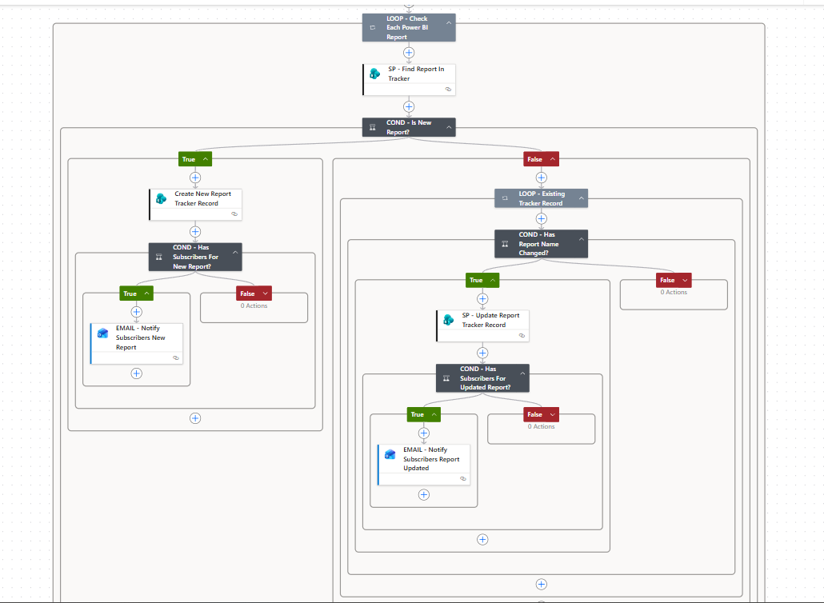
CONDITIONAL ROUTING
Notification logic: new reports vs updated reports
New report
No tracker record → create record → notify subscribers.
Updated report
Same report ID but changed name → update record → notify.
If there are no active subscribers, the email action is skipped.
Power Automate + SharePoint + Power BI | 8

Slide 9
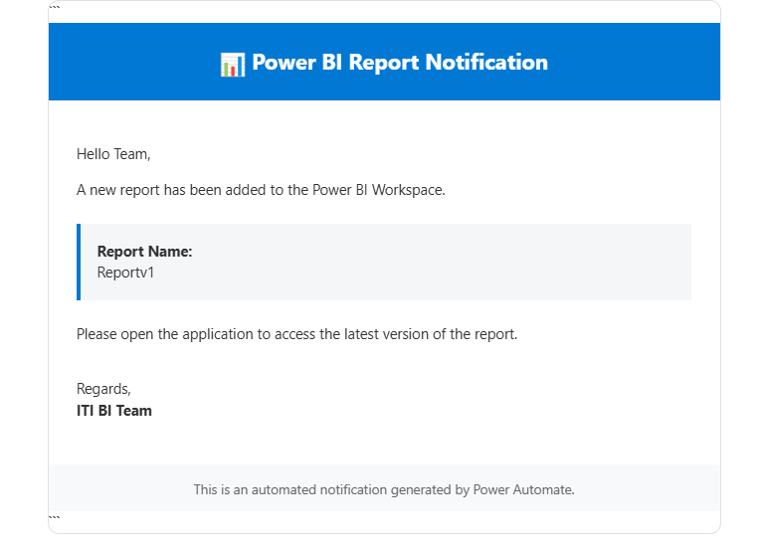
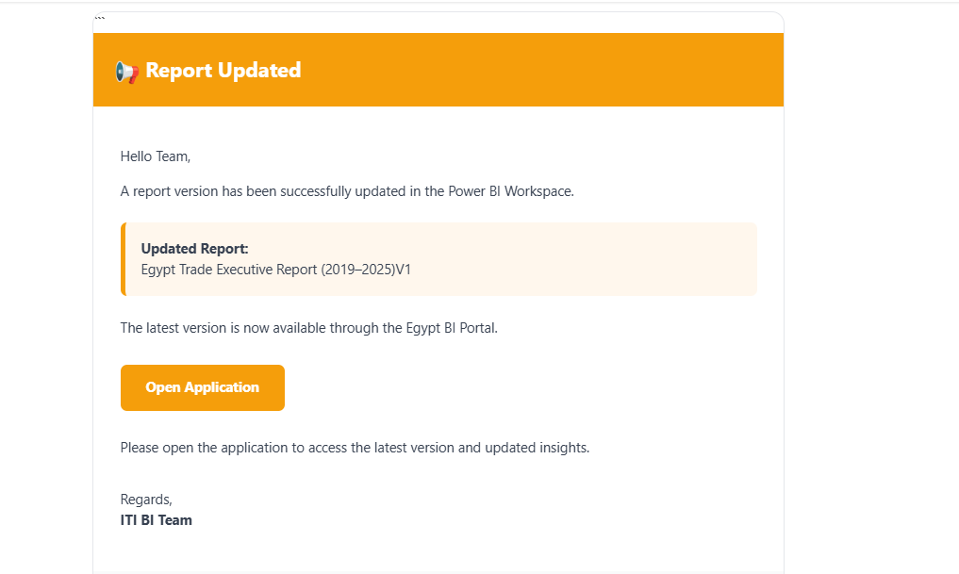
OUTPUT
Result: clean, targeted email notifications
Less spam
Daily recurrence + change detection prevent repeated notifications.
User-controlled
Only active subscribers receive the report alerts.
Final value delivered
• Dynamic audience from SharePoint
• Web app subscription preference integrated with Power Automate
• Clear flow names and maintainable automation structure
Power Automate + SharePoint + Power BI | 9

Slide 10
From static email alerts to a scalable notification system.
Built with Power BI, Power Automate, SharePoint, Outlook, and a Flask web app.
User Preference
SharePoint Registry
Report Change Detection
Key takeaways
• Better user experience: opt-in, opt-out, and targeted updates.
• Better automation: no hardcoded recipients and clearer flow naming.
• Better governance: SharePoint is the source of truth for subscribers.
Next: production deployment and persistent hosting.
Power Automate + SharePoint + Power BI | 10

