Slide 1
E-Commerce Real-Time
Analytics Pipeline
A Lambda Architecture with Kafka, Spark, Hive, ClickHouse & Power BI
Historical batch (70%) and live streaming (30%) unified into one analytics warehouse

Slide 2
1
Two Paths, One Warehouse
A Lambda-style pipeline: historical batch and live streaming converge in ClickHouse
BATCH PATH · 70% HISTORICAL
STREAM PATH · 30% LIVE
HDFS — Raw Storage (CSV)
Python Producer → Kafka Topic
↓
↓
Spark Batch Job — Clean & Enrich
Spark Structured Streaming (5s batches)
↓
↓
Hive Table — orders_batch (Parquet)
Validated JSON Events
↓
↓
ClickHouse — orders_batch + orders_realtime
↓
orders_all — Unified SQL View (UNION ALL)
↓
Power BI — Live DirectQuery Dashboard

Slide 3
2
Batch Path: History at Scale
368,296
Cleaning rules applied by Spark:
1
Drop cancelled invoices (Invoice numbers starting with “C”)
raw rows ingested from HDFS
Keep only positive quantity and price
2
284,417
Valid 5-digit stock codes only — drops POST, fees, adjustments
3
clean rows loaded into Hive → ClickHouse
4
Enrich with category and payment method (shared rules)
Written once to Hive as an external Parquet table, re-run safe

Slide 4
3
Stream Path: Orders as They Happen
How the stream stays consistent with batch:
3,000
1
Kafka topic “ecommerce-orders”, 3 partitions
2
Spark Structured Streaming, 5-second micro-batches
orders streamed & verified end-to-end
3
Same cleaning, category & payment rules as batch
121,878 orders available for a full live replay
4
Each micro-batch inserted via ClickHouse HTTP (JSONEachRow)

Slide 5
4
One Source of Truth for Both Paths
retail_common.py
orders_all View
1
Same cleaning rules for pandas and PySpark
1
UNION ALL of orders_batch and orders_realtime
2
Same category keyword lookup table
2
Tagged with a source column: batch / stream
3
Same payment-method hashing (CRC32)
3
One query surface for every report
4
Used identically by the producer and the batch job
4
Power BI reads it live via DirectQuery
One file, two runtimes — batch and stream can never drift apart.

Slide 6
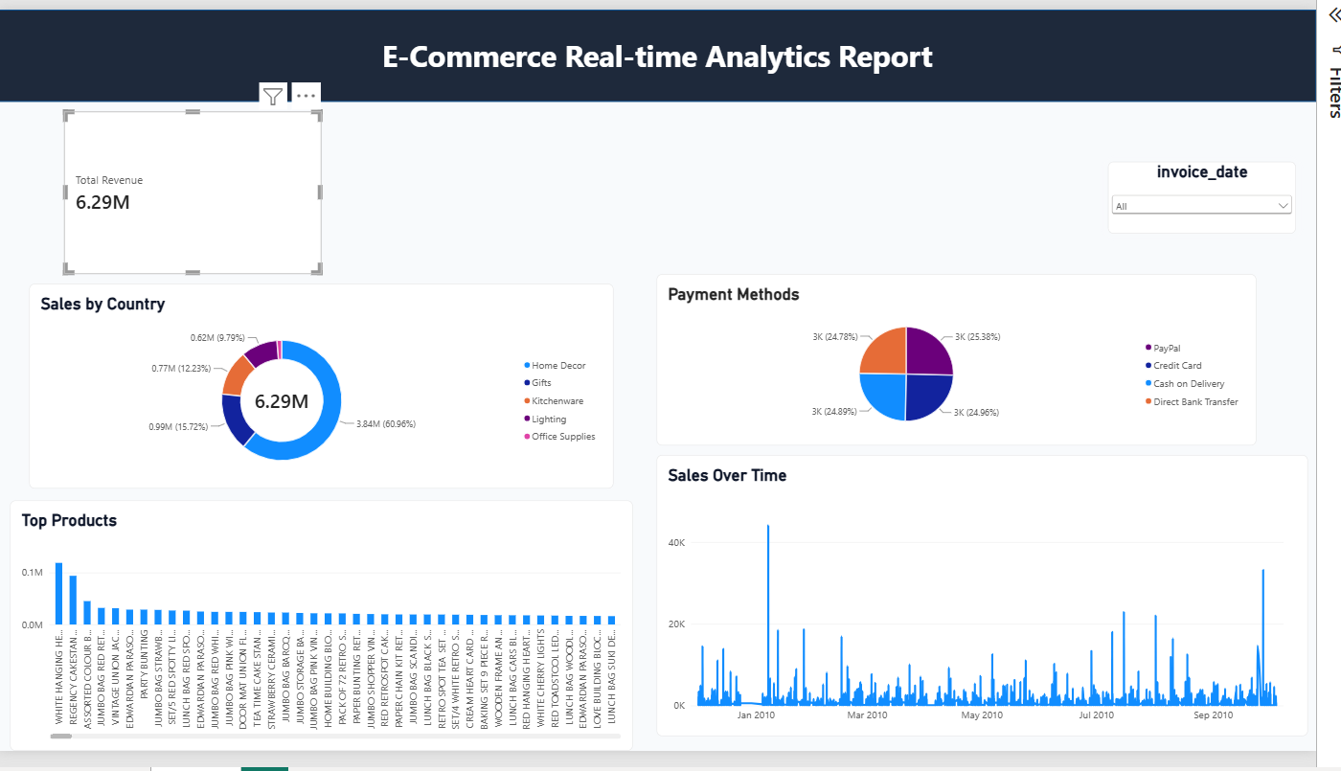
5
Live in Power BI
6.29M
total revenue, all-time
287,417
unified orders — batch + stream
1
DirectQuery view powering every visual

