Slide 1
Comparison 2 and 3 dimensions
LSM1 & LSM2

Slide 2
Comparison 1, 2 or 3 clusters
LSM2, LSM10 & LSM11

Slide 3
Comparison sender and receiver effects
LSM10, LSM14, LSM15 & LSM16

Slide 4
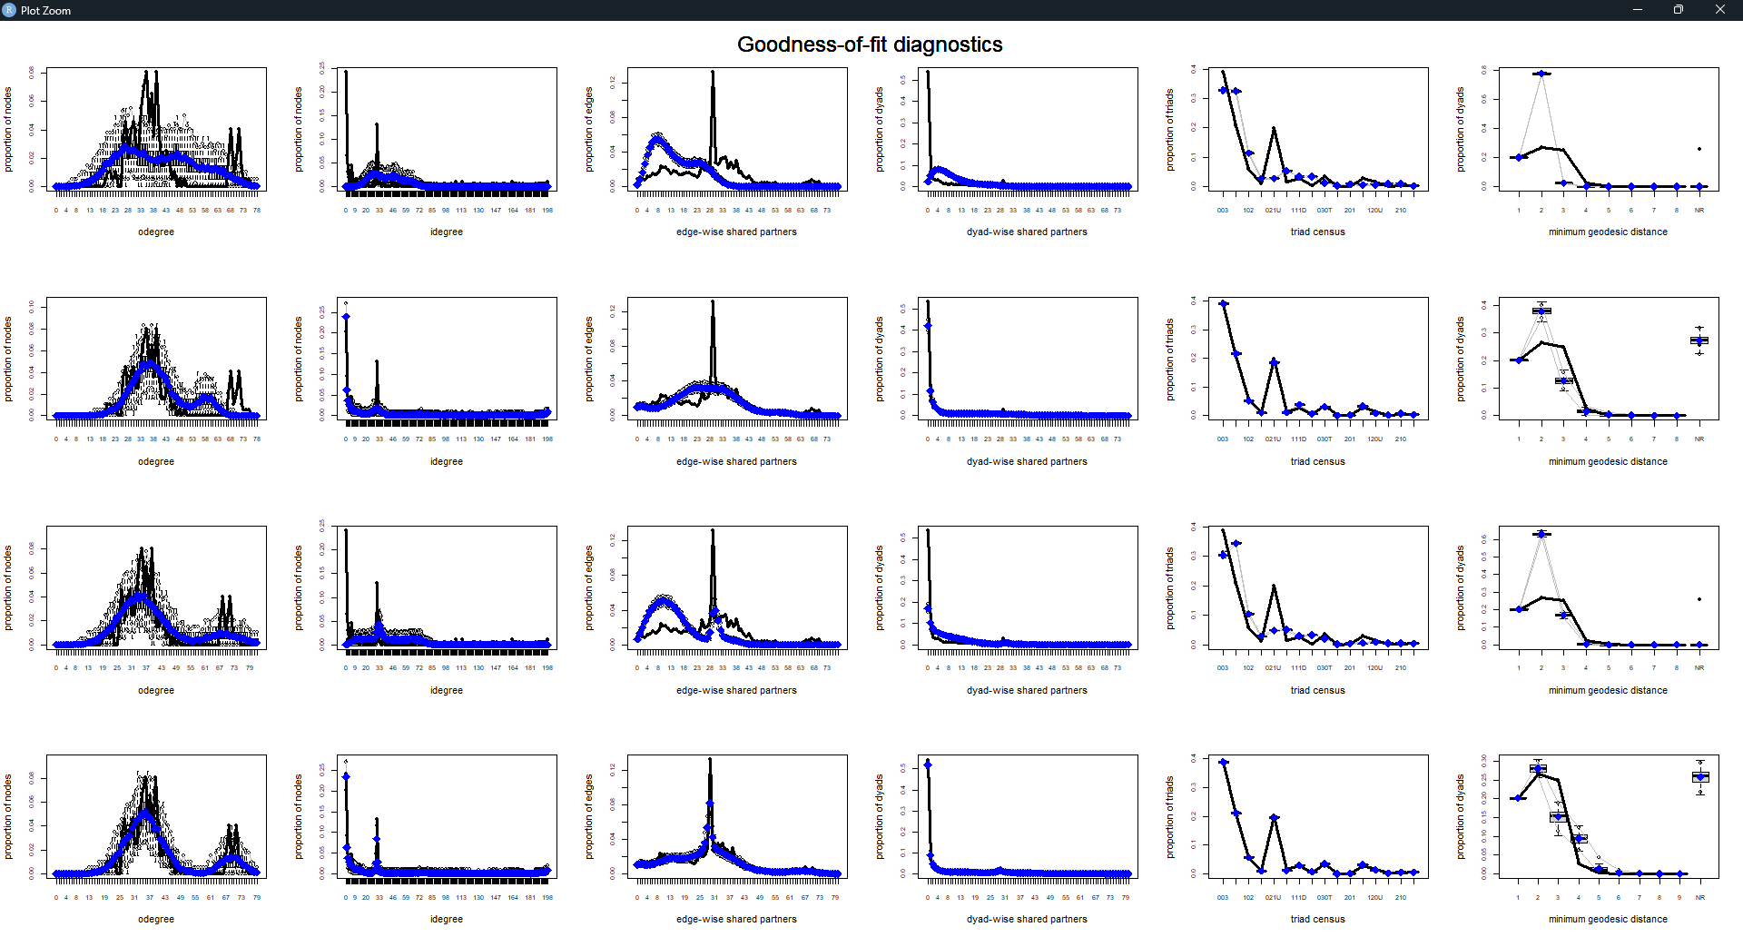

Slide 5
Validation of clusters
LSM16, LSM17 & LSM18

Slide 6
Validation of clusters
LSM26, LSM16, LSM17 & LSM18

Slide 7
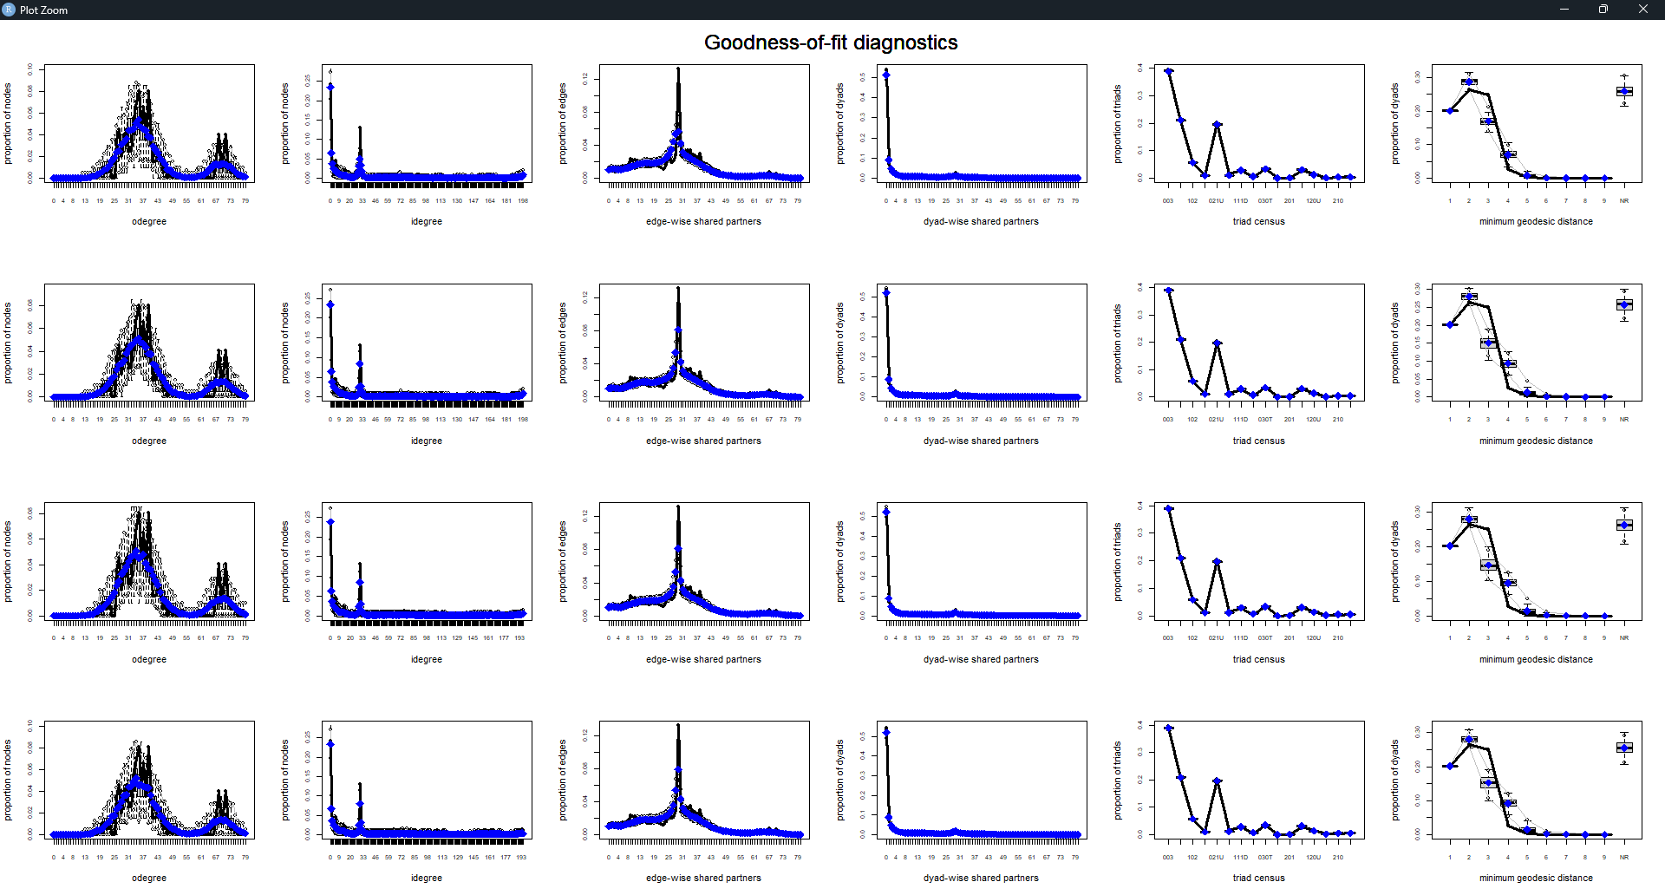

Slide 8
Comparison NONE and 3 dimensions
LSM16 & LSM25

