Slide 1
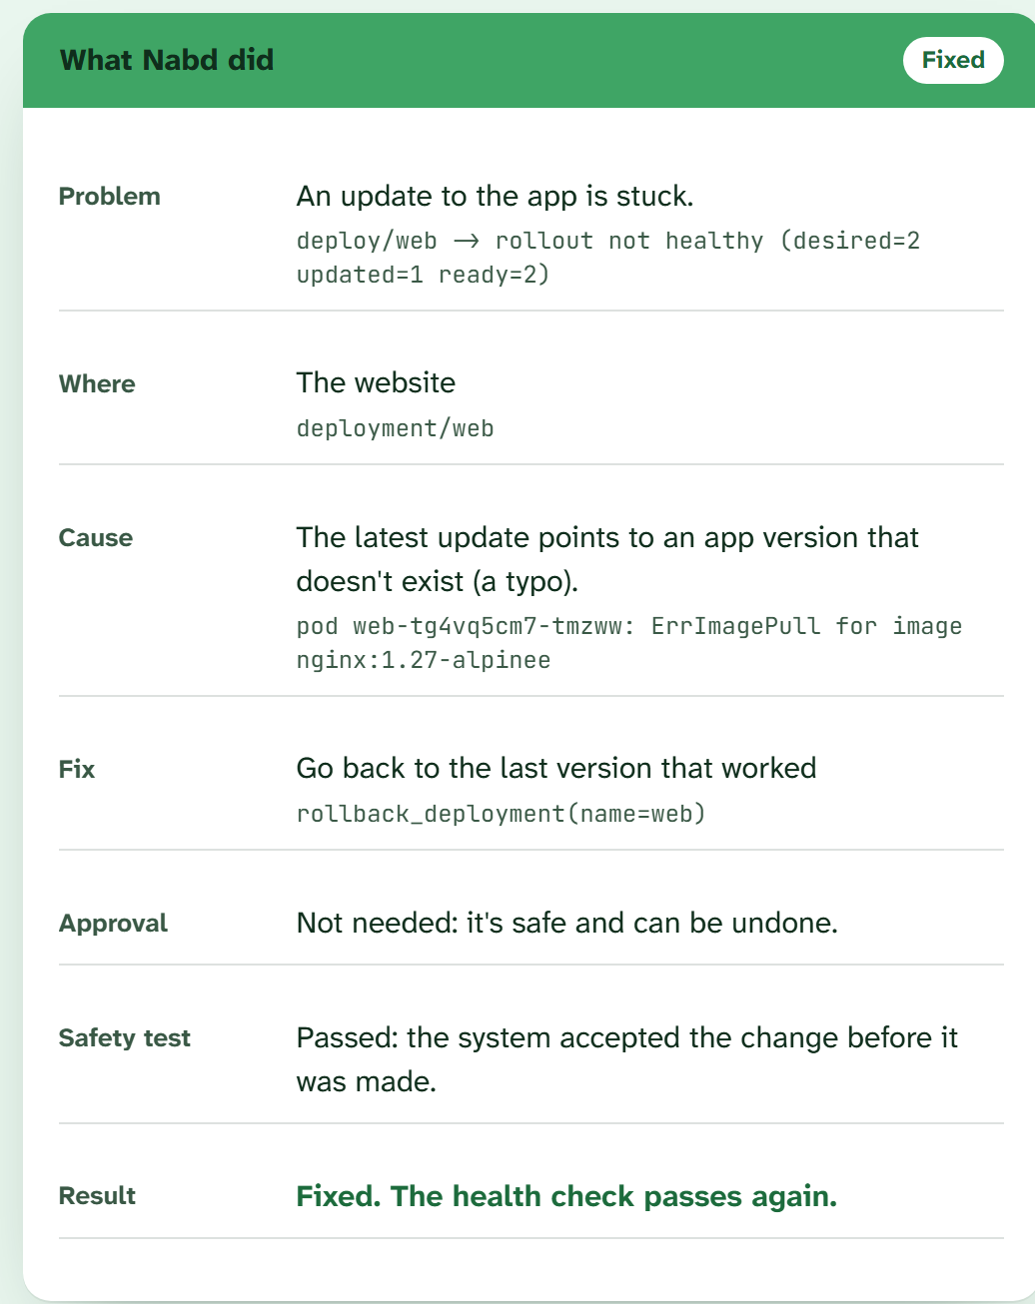
Nabd نبض
When an app breaks, Nabd finds out why and fixes it safely.
Hi, I'm Muath معاذ
DevOps training at Tahakom
Cloud and Customer Engineering intern at CNTXT
HUMAIN × Misk Future AI Builders · Challenge 1: Agentic Recovery of a Failing System
A real result card from the live demo
Notes:
Hi, I'm Muath. I did my DevOps training at Tahakom, and I'm now a cloud and customer engineering intern at CNTXT. This is Nabd, which means pulse in Arabic. It's an AI agent that finds out why a Kubernetes app broke and fixes it safely. On the right is a real result card from the live demo.

Slide 2
Most outages start with something small
Most cloud apps run on Kubernetes. It keeps apps running, but it cannot tell a crash from a configuration mistake.
1
A small change slips in
A typo in a version number, a wrong port, a renamed setting, a deleted password.
2
The app goes down
Users see errors. Kubernetes restarts it again and again, but restarting can't fix a wrong setting.
3
Someone has to dig
An engineer is paged, reads logs and events, finds the one wrong line, and fixes it carefully while users wait.
Notes:
Most outages are not dramatic. They are a typo, a wrong port, a renamed setting. Kubernetes keeps restarting the app, but a restart cannot fix a wrong setting, so an engineer has to find the one wrong line.

Slide 3
So why not just let an AI fix it?
Finding the fix isn't the hard part.
Trusting the fixer is.
It can run any command, including delete
It can read, or leak, passwords
A confident wrong guess makes the outage worse
It can retry forever instead of asking for help
Notes:
An AI agent could do this work. But an agent that can run any command can also delete data or leak a password, and a confident wrong guess makes things worse. The challenge itself warns about agents that retry forever. The hard part is trust.

Slide 4
A pharmacist with a short list
A pharmacist can only hand out what's on the approved list, and some medicines need a doctor's signature. Nabd is built the same way.
Does on its own
Asks you first
Never does
Go back to the last version that worked
Change where traffic is sent
Delete anything
Bring back the right number of copies
Fix the name of a setting
Read, guess or invent passwords
Restart to pick up a corrected setting
Touch anything outside its area
Retry the same fix again
Five fixes in total. Anything else is handed to a person with the diagnosis, and nothing is changed.
Notes:
Nabd works like a pharmacist with a short list. Three safe, reversible fixes it does on its own. Two that change configuration need your approval, and you see the exact change and the reason. And a never list: it cannot delete anything, it never sees password values, and it never retries the same fix twice.

Slide 5
How Nabd works: five steps, every time
1
2
3
4
5
Notice
Investigate
Diagnose
Safety checks
Fix and verify
An independent health check sees the app failing.
Errors, logs, events, settings. Never password values.
Proven rules first. Claude only when the rules have no answer.
On the list? Needs a human? Dry-run passes? Matches the evidence?
Apply, re-check, undo if it didn't help, write a report.
Step 4 is where safety decides, not the AI. The model can only suggest one of the five fixes; code checks everything else.
Notes:
Five steps, every time. Notice, investigate, diagnose, safety checks, fix and verify. Step four is the important one: the AI can only suggest; code decides whether the fix is allowed, whether a human must approve, and whether a dry-run accepts it. After the fix, an independent health check must pass, or Nabd undoes its change.

Slide 6
One real incident, start to finish
0 s
The website stops answering
reports/20261030-190908-service-web.md
Health check: connection refused.
Outcome Resolved
Duration 77.3 s
Change patch_service(web)
Approvals asked 1
AI calls 0
DIAGNOSE service/web -> networking
- selector {'app':'frontend'}
matches no pod labels
- last-applied selector: {'app':'web'}
APPROVAL granted
DRY-RUN ok -> APPLY ok -> VERIFIED
4 s
Nabd finds the cause
Traffic goes to 'frontend'; the app is 'web'.
4 s
It proposes the fix and asks
Changing traffic needs a human, so it waits.
76 s
A human approves
Dry-run, apply, check.
77 s
Healthy again
Nabd's own work: about 5 seconds.
Notes:
Here is one real run on our test cluster. The website stopped answering. In four seconds Nabd found that traffic was sent to a label no app has. Changing traffic needs a human, so it waited. I approved at 76 seconds, and one second later the health check passed. Nabd writes an incident report like this one every time.

Slide 7
We broke it 14 ways. Nabd handled all 14
Faults handled, out of 14
14 / 14
faults handled, including the 5 kept secret
0
unsafe changes, in every version tested
2
AI calls: rules handle known faults, AI the rest
18 s
average fix time; 4 fixes waited for approval
Real kind cluster, 3 versions × 14 faults = 42 runs. Handled = fixed and verified, or correctly handed to a human without changing anything. Time is for Nabd (rules + AI), measured on the 12 runs that ended in a fix.
Notes:
We tested it on fourteen faults, five of them kept secret while we built the rules. Rules alone handled thirteen. The AI model alone handled twelve: it once fixed a setting but forgot to restart the app, and once it was too cautious. Together, rules first and AI only when needed, Nabd handled all fourteen, with zero unsafe changes and only two AI calls. A fix takes eighteen seconds on average; two faults take about a minute because Kubernetes must fail its own checks first. Four fixes waited for a person to approve, and two faults were correctly handed to a human.

Slide 8
Built for GitOps teams: Argo CD and Flux
With GitOps, Git is the source of truth. A fix made directly on the cluster is undone at the next sync. So in GitOps mode, Nabd fixes Git, not the cluster.
Nabd diagnoses
Opens a pull request
An engineer merges
Argo CD / Flux syncs
Nabd verifies
→
→
→
→
Same rules, same safety checks.
Reverts the commit that broke it, and explains why.
The approval is a normal code review.
The cluster follows Git, as always.
Same health check, then the incident report.
If the cluster differs from Git, or the commit reaches outside the app, Nabd reverts nothing and calls a human.
Added for teams like HUMAIN's. Tested with real Git repositories (12 automated tests). A live Argo CD run is next.
Notes:
HUMAIN's teams deploy with GitOps, using Argo CD and Flux, so I built a GitOps mode. In GitOps, Git is the source of truth, so a fix made directly on the cluster gets undone at the next sync. When Nabd sees that Argo CD or Flux deploys the broken app, it keeps the same diagnosis and safety checks, but the fix becomes a pull request that reverts the commit that broke things. The approval becomes a normal code review. Argo CD syncs, and Nabd verifies with the same health check. If the cluster differs from Git, or the commit touches anything outside the app, it reverts nothing and calls a human.

Slide 9
Honest limits, and what's next
Limits today
Next
Tested on a small cluster with three apps, not yet in a real company
GitOps on a live Argo CD
Built, test pending
Different rules per environment
Designed
The browser demo simulates the cluster and runs the rules; the AI runs from the command line
AI model servers: vLLM, SGLang
Idea
Some faults take about 90 seconds to show, because Kubernetes must fail its checks first
Silent failures, like lost orders
Idea
With Argo CD or Flux, it fixes only problems that came from a commit
Start from existing alerts
Idea
Each item, with its status: nabd.duraym.com/next
Notes:
Some honest limits: it was tested on a small cluster, the browser demo is a simulation, and some faults take a minute and a half to show up. And here is what is next. I know about each of these, and I'm telling you where each one stands. GitOps is built and tested offline, but I haven't run it on a live Argo CD yet. Different rules per environment is designed, not built. Running on AI model servers like vLLM, catching silent failures, and starting from existing alerts are ideas that mentors suggested or that I see as the next step. They're next steps, not claims. Every one is on the What's next page with its status.

Slide 10
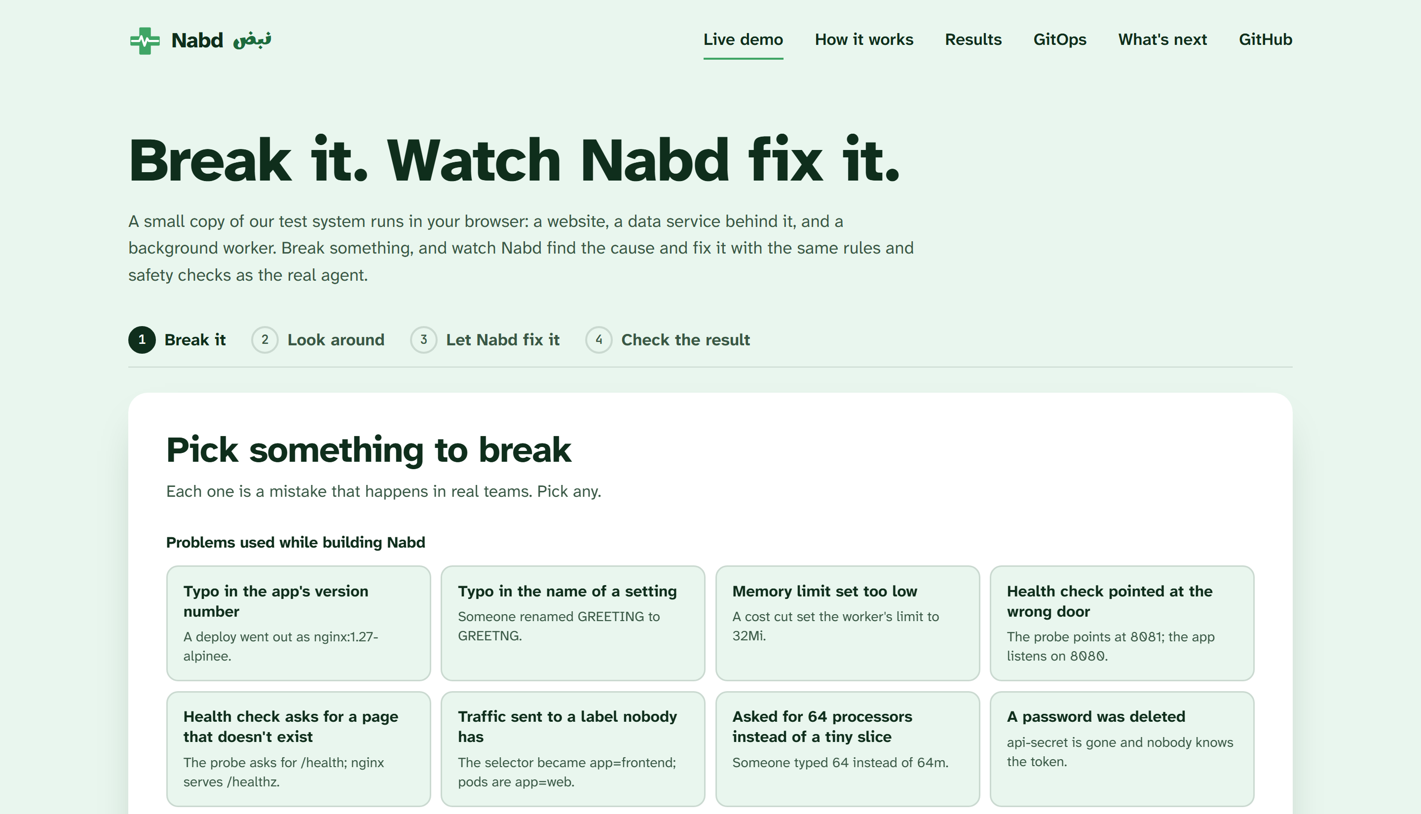
Break it yourself
Pick a fault, look around like an engineer, and watch Nabd fix it. Nothing to install.
Live demo
nabd.duraym.com/demo
The live demo, nabd.duraym.com/demo
Code
github.com/moaddreem/k8s-healing-agent
Muath معاذ
Notes:
You can try it yourself at nabd.duraym.com. Break a fault, look around, and watch Nabd fix it, with nothing to install. The code, the lab and the benchmark are all on GitHub. Thank you.

