Slide 1


Hospital IoT Simulation HomeLab for Cybersecurity & Machine Learning Research
David G. Moad
Computer Engineering
University of Cincinnati
Fall, 2025

Slide 2


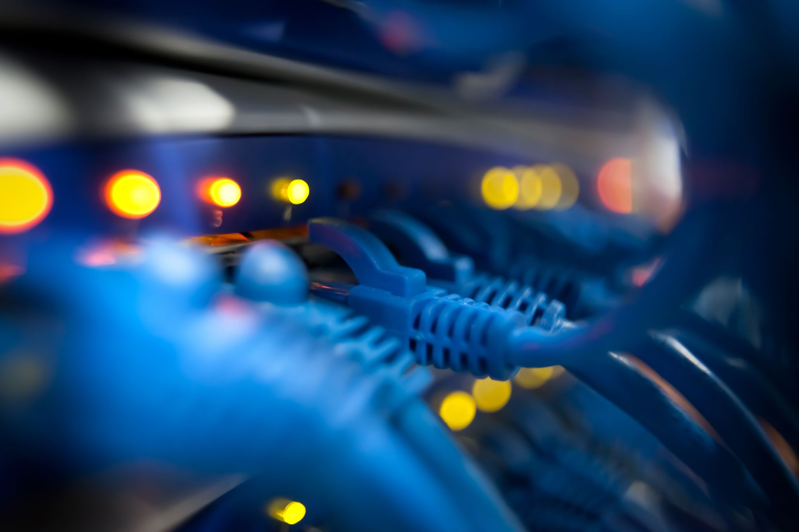
Team:
David Moad – Solo Project
  Computer Engineering
  Roles: System Designer, Network Engineer, Security Analyst, ML Developer.

Slide 3
Problem Statement:
Hospitals are prime ransomware targets.
  45% more cyberattacks than avg. industry
  Cannot safely test defenses on live patient systems
  Students lack realistic training labs

Slide 4
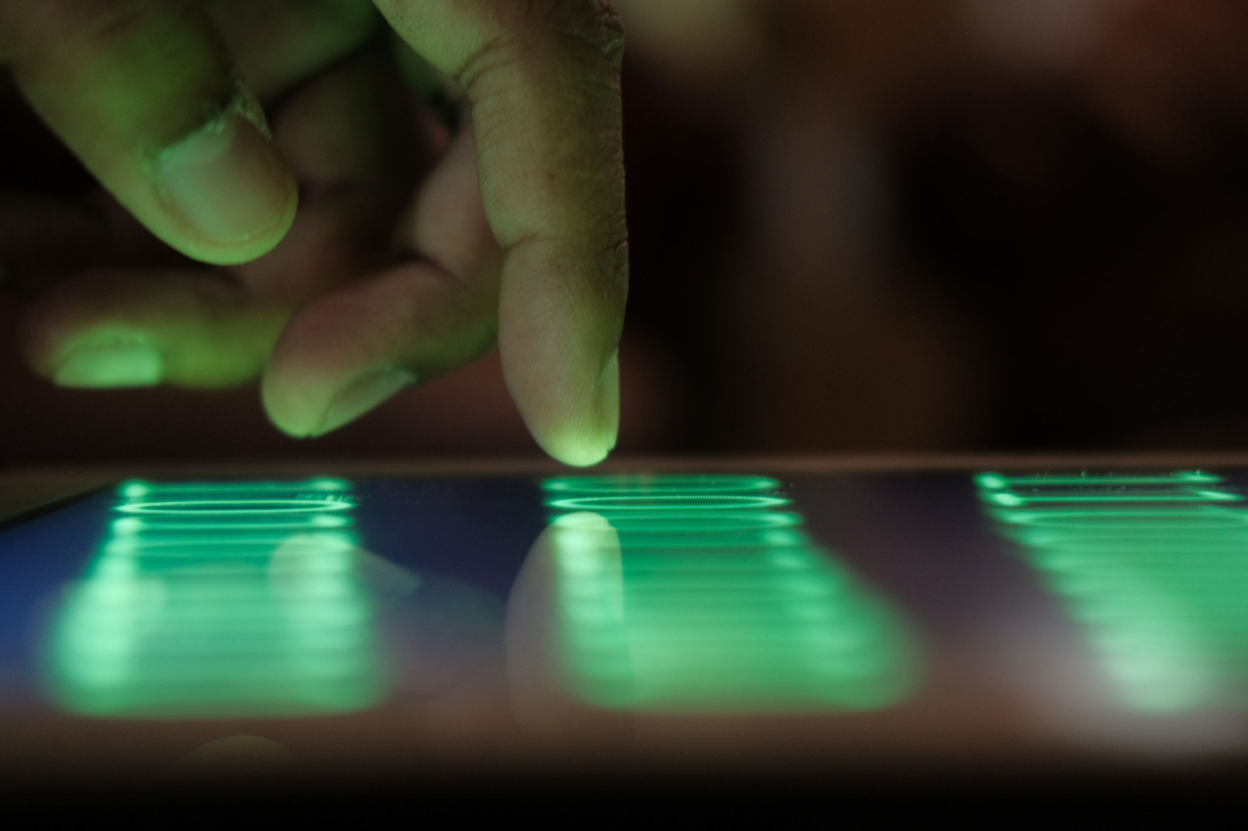
Why This Matters
Hospital IoT Attack Surfaces:
Patient Monitors
Ventilators
IV Controllers
Infusion Pumps
MRI/CT Scanners
Temperature Sensors

Slide 5
Real-World Consequences
Ransomware encrypts Monitors → can’t see vitals
Tampered dosage data → Patient overdose
Network spread → Widespread device failure
Compromised networks → Sensitive data leaks

Slide 6
Key Components
Hardware:
  Dell R740XD Server (TrueNAS)
  UniFi Dream Machine SE (Firewall)
  UniFi USW Pro Max 24 PoE (Switch)
  4 Raspberry Pi 5s (IoT Sensors)
Software (Open-Source):
  Node-Red (Data Pipeline)
  PostgreSQL (Time-Series DB)
  Grafana (Visualization)
  Wazh SIEM (Security Monitoring)

Slide 7
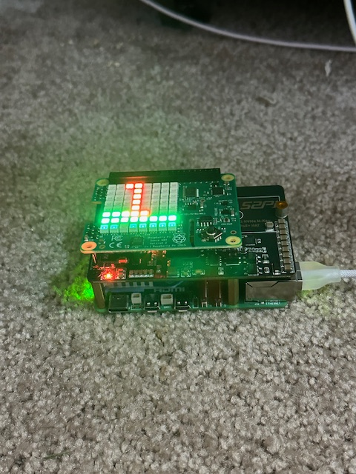
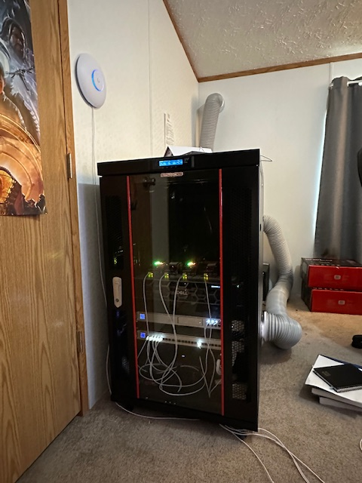
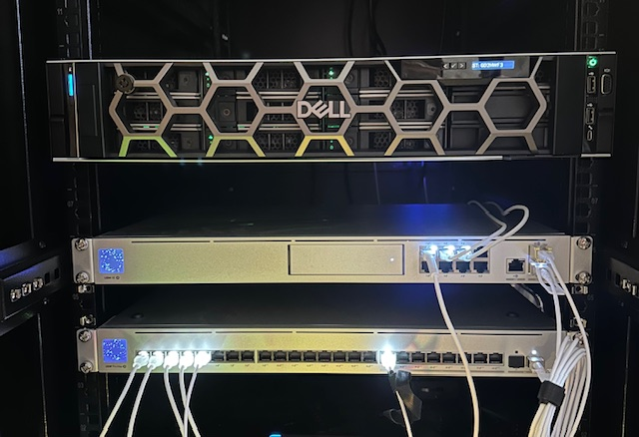
Server Rack Components
Hardware:
  Raspberry Pi 5
  Rack
  Server
  UDM-SE
  Switch
  AC Unit

Slide 8


Proposed Solution & Alternatives
Cloud Lab: Ongoing Costs, no Air-Gap
Real Medical Devices: Too Expensive
Software-Only: Lacks Realism
Hybrid Physical/Virtual: Optimal

Slide 9

Standards & Compliance
1: HIPPA Security Rules:
Encryption
Access Control
Auditing
2: NIST Cybersecurity Framework:
Identify, Protect, Detect, Respond
3: NIST SP 800-53:
20 Control Families Implemented
5: IOC/IEC 27001: InfoSec Mgnt
ISMS Documentation
Risk Assessment
4: IEC 62443:
Zone Segmentation
Device Hardening

Slide 10
Results:
1 – Comprehensive Compliance Training
2 – Environment for Future Healthcare IT Professionals
3 – Robust and Realistic Testing Platform
4 – Familiarization with Professional Regulations

Slide 11

Budget Comparison:
Budget Breakdown: Alternatives:
  Dell R740XD: $4,860 Cloud Lab: $18,000 (3 years)
  10x8TB Dell HDD: $ 1,532 Commercial Hardware: $45,000
  2x960GB Dell SSD: $1,331 Software Only: $ “free”
  UniFi UDM-SE: $499
  UniFi 24 PoE PRO: $799
  5x Raspberry Pi 5s: $600
  Cables, Rack, UPS: $~1000
  Total: $10,621 (indefinite)

Slide 12
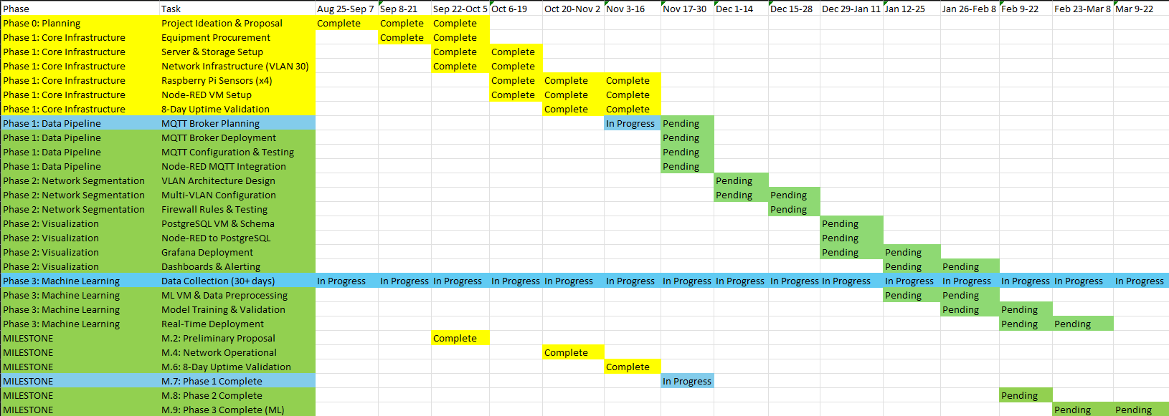
Timeline:

Slide 13
Progress to Date
Achievements:
  Network Infrastructure Operational Portable for Demo
  10GB/s SFP+ Backbone 64TB RAID-Z2
  4 Active IoT Sensors running AES-256 Encryption
  2.7 M+ Data Points Collected 2-Disk Failure Tolerance
  3 “Normal” Sensors Air-Gap Capability Validated
  1 “AFib” Sensor Fully Operational Without internet

Slide 14
Future Plans:
Phase 2: Network Segmentation Phase 5: Attack Simulations
  Multiple VLAN Architecture Kali Linux Penetration Testing
  Grafana Real-Time Dashboard Documented Attack Scenarios
  Phase 3: Machine Learning HoneyPot Deployment
  Anomaly Detection Model Long-Term Goals:
  Differentiate Medical Vs. Cyber Anomalies Replicate for Healthcare Edu
  Phase 4: Security Tools Open-Source Documentation
  Wazuh SIEM Deployment Conference Presentation
  Zeek + Suricata IDS/IPS

