Slide 1

Global Optimised Portfolio
Mohammed Al-Adnani
May 2025

Slide 2
Portfolio Overview
The final portfolio is made up of 14 assets:
Comprised of equities, fixed income and alternatives.
Combined with the 5-year gilt, our risk-free asset.
~ £4.4 million will be allocated to the risky portfolio according to the weights below:
AstraZeneca (AZN) | Costco (COST) | Deutsche Telekom (DTE) | Ferrari (RACE) | Nintendo (7974) | Nvidia (NVDA) | Siemens (SIE) | Waste Management (WM) | Wesfarmers (WES) | Xiaomi (1810) | Bond ETF (BNDX) | Gold ETF (GLDM) | Commodity ETF (CMOP) | Bitcoin (BTC)
0.08 | 0.12 | 0.12 | 0.01 | 0.02 | 0.07 | 0.02 | 0.07 | 0.07 | 0.03 | 0.15 | 0.12 | 0.06 | 0.05
With the remaining ~£5.6 million in the UK government bond.
UK 5Y GILT (28/02/2025) | 4.175%

Slide 3
Asset Selection
Equity | Fixed Income | Alternatives
LON:AZN | NASDAQ:BNDX | NYSEARCA:GLDM
NASDAQ:COST | NASDAQ:TLT | LON:CMOP
ETR:DTE | LON:VGOV | NYSEARCA:VNQ
BIT:RACE |  | NYSEARCA:DBMF
BME:IBE |  | BTC/GBP
NYSE:JPM
TYO:7974(Nintendo)
NASDAQ:NVDA
LON:RIO
ETR:SIE
KRX:000660(Hynix)
HKG:0700(Tencent)
NYSE:WM
ASX:WES
HKG:1810(Xiaomi)
LON:WOSC
LON:EMXC
A large basket of diversified assets were used in the optimisation process:
Initial selection of 25 assets comprised of equity, fixed income and alternatives.
Large cap equity diversified across developed nations and ETFs used for emerging markets/small cap representation.
ETFs allow for easy exposure to fixed income (gilts, treasuries and corporate bonds) and alternatives (gold, commodities, REIT, managed futures).
Exposure to digital asset innovation through Bitcoin.

Slide 4
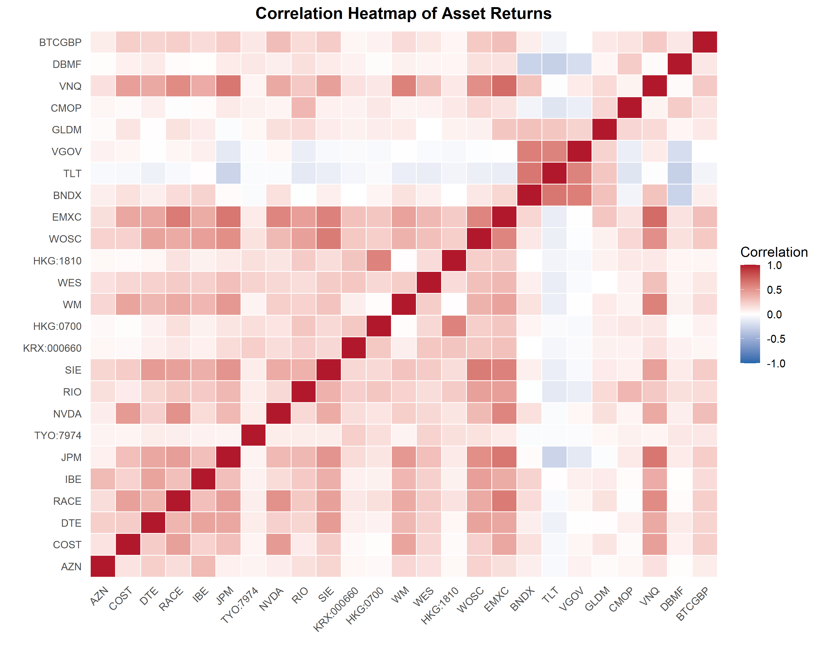
Correlation Analysis
This heatmap illustrates one of our core strategies: investing in assets that don’t move together.
Higher correlations between assets of the same classes - red quadrants bottom left and top right - Need for asset class diversification.
Equities within the same region show high correlations - Need for Geographical diversification.
Close to zero correlation between equities/fixed income and equities/commodities.

Slide 5
Optimisation Process
Initially, we maximised Sharpe ratio, finding a tangency portfolio with expected annual return of 23.41% and a standard deviation of 14.10%, giving us an exceptional Sharpe ratio of 1.36.
However, notice the lack of diversification - almost 70% is equity with the remainder being alternatives - there is no fixed income exposure.
We impose constraints on our portfolio to improve multiple facets of our diversification:
Minimum 15% in each asset class.
No more than 20% of the equity portion to a single sector.
The result is a much better diversified constrained portfolio, with expected return of 17.36% and volatility of 11.82%, and a lower Sharpe ratio of 1.11.

Slide 6
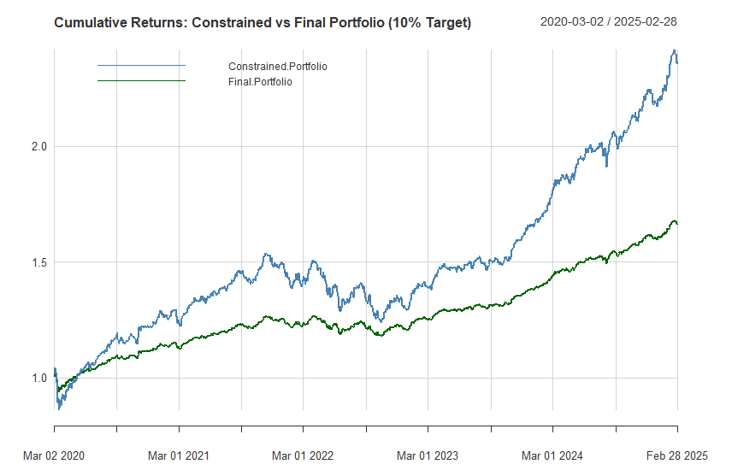
Final Portfolio Formation
Tangency
Maximum Sharpe portfolio not diversified enough
Constrained
Portfolio successfully diversified however expected return/risk too high for target.
Final
Combined with the risk-free asset to attain target return while maintaining Sharpe ratio

Slide 7
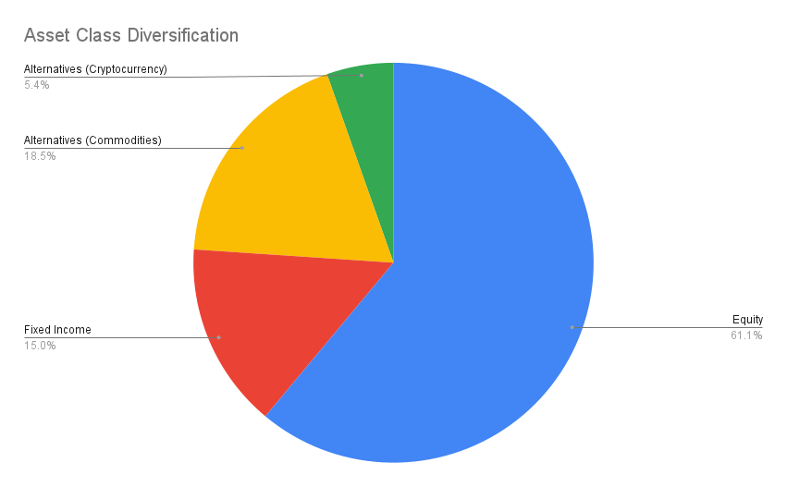

Asset Class Diversification
Equity and crypto exposure drives portfolio growth while the inclusion of bonds and commodities provides downside protection.
Risk-free asset further dampens volatility.

Slide 8
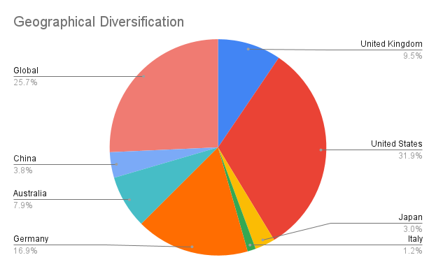

Geographical Diversification
Global exposure spreads macroeconomic and geopolitical risks, enhancing the portfolio’s ability to weather localised downturns.

Slide 9
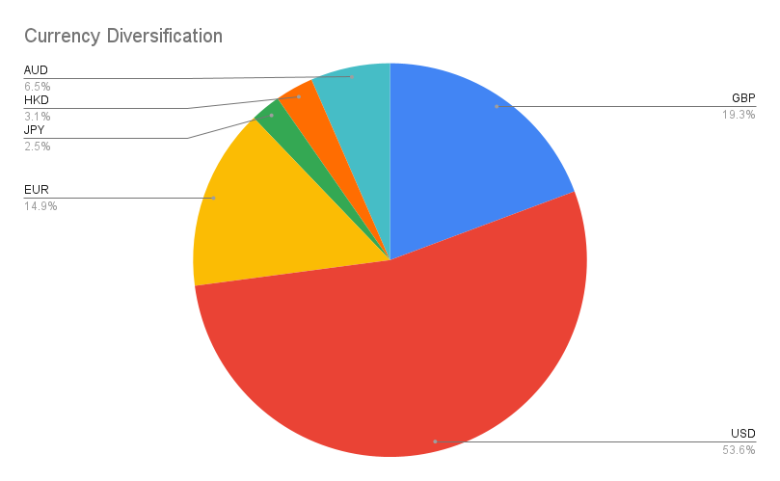

Currency Diversification
Currency hedging reduces the risk of value erosion from adverse FX movements and adds a layer of protection during regional economic shocks.

Slide 10
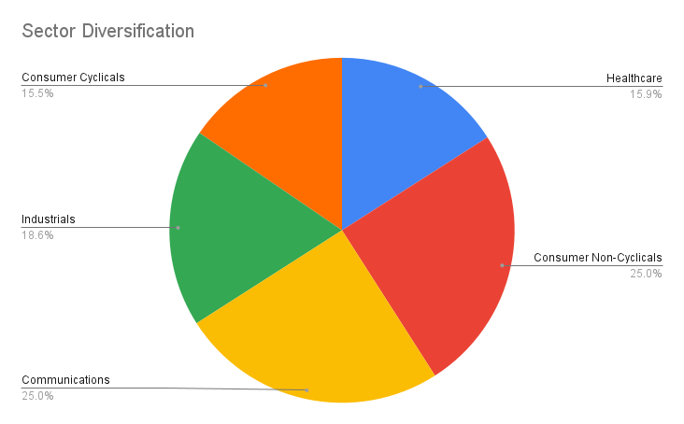


Sector Diversification
Portfolio performs consistently across economic cycles, avoiding reliance on market timing.

Slide 11
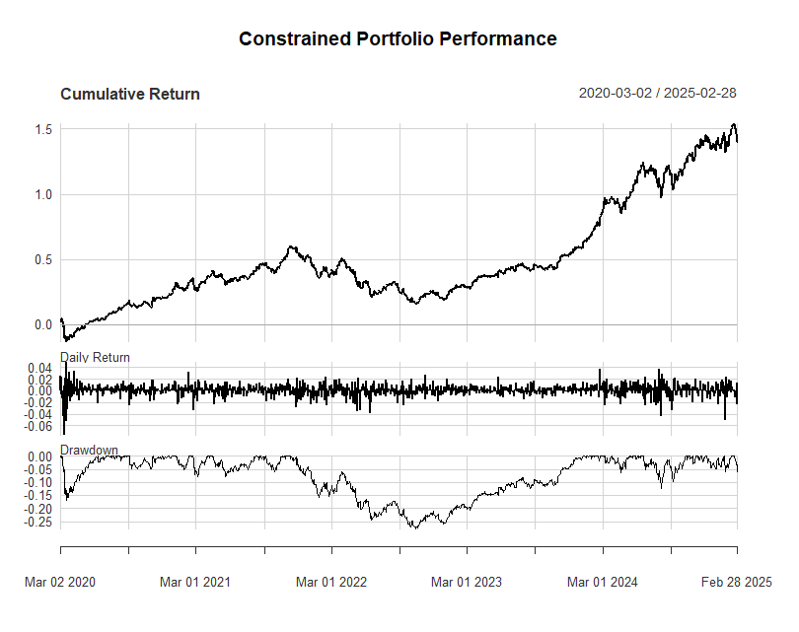
Portfolio Performance
Annual return of 10% with a volatility of 5.23%.
Compared to the benchmark over the same period (S&P 500):
Returns are similar - benchmark returns on average ~11.6%.
Benchmark volatility much higher ~18%.
Portfolio max drawdown of -25% while benchmark saw a fall of ~33.9%.
Sharpe Ratio of portfolio far surpasses benchmark - 1.11 against 0.41 - far superior risk-adjusted returns.

Slide 12
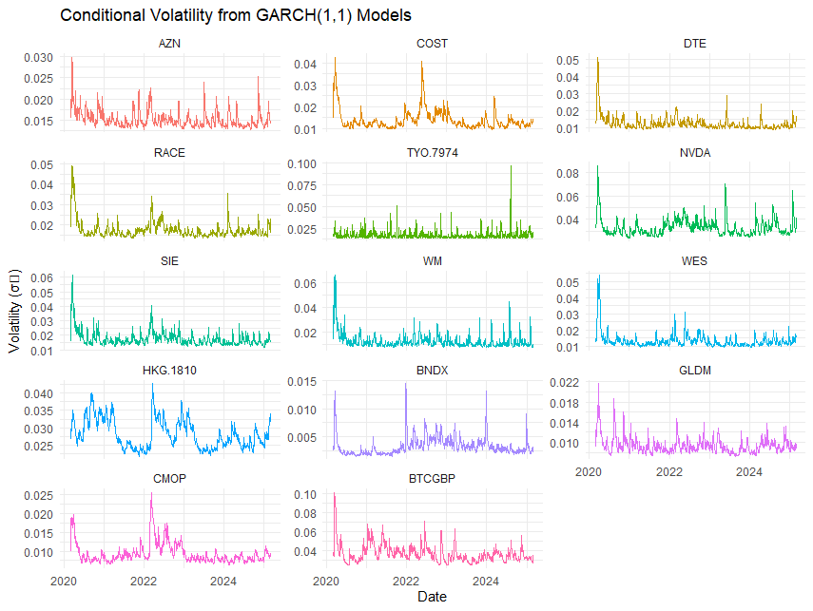
Portfolio Risk Profile
equities exhibit high risk compared to fixed income and commodities
Interest rate risk
Commodity market risk
Market and company risk
FX risk
bonds exhibit lower volatility overall - potential growth if interest rates decrease
exposure to multiple currencies minimises this risk
Crypto risk
geopolitics, trade disruptions - allocation diversified across numerous types
Bitcoin is the highest volatility asset - regulatory uncertainty, market sentiment

Slide 13
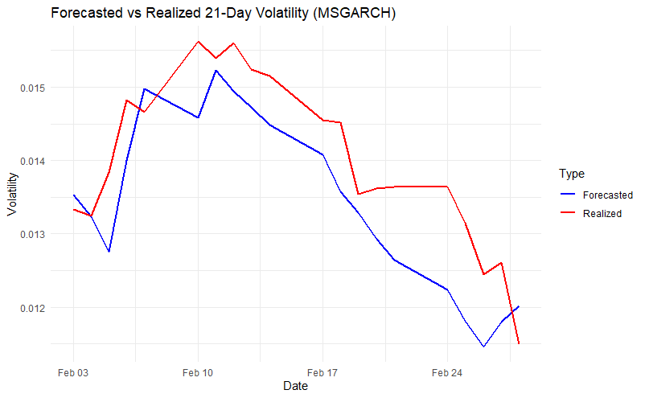
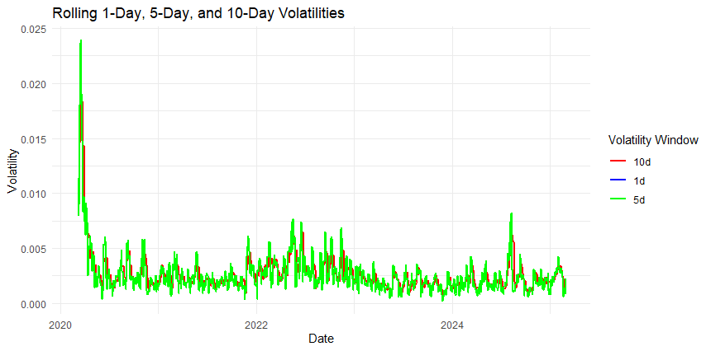
Volatility Forecasting
Model
Fit
MSGARCH & student t-distribution: Markov chain allows for regime changes, t-distribution heavy tails allow for extreme events.
Mitigation
MAPE = 5.02% vs standard GARCH 10%
Potential pivot to safe-haven assets during regime switches.
 | Regime 1 | Regime 2
Regime 1 | 0.9928 | 0.0072
Regime 2 | 0.0079 | 0.9921

Slide 14

Closing Thoughts
Target achieved: 10% expected return with extremely low expected volatility
Diversified across asset classes, regions, sectors and currencies
Superior risk-adjusted performance when compared to benchmarks
This portfolio delivers more than returns — it delivers resilience, flexibility, and confidence over a full market cycle

