Slide 1
Opioid Crisis in New York State
the relationship between to socioeconomics, lack of economic opportunity and opioid abuse

Slide 2
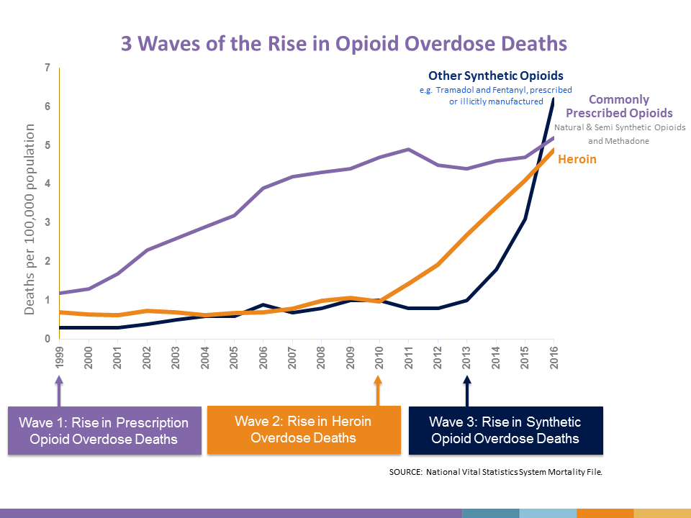
115 people die in the US per day due to an opioid overdose.
Since 1999 more than half a million people have died from an opioid overdose.
The opioid crisis is one of the worst contemporaneous health crisis only rivaled by the AIDS epidemic of the 1990s.
In New York State the age adjusted rate of death per 100,000 from an opioid overdose was 15.1 compared to the national rate of 13.3 in 2016

Slide 3
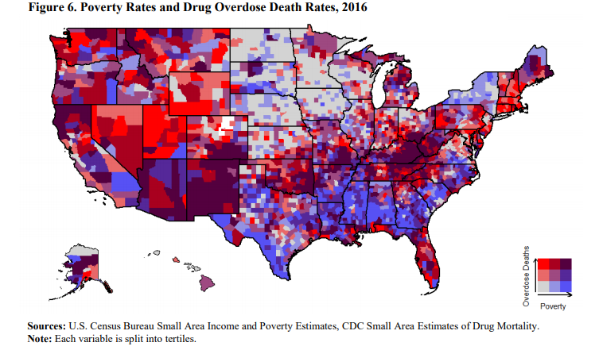
Socioeconomic Link
Various studies have linked indicators of economic opportunity
and poverty to the prevalence of
opioids and substance use in the
United States.

Slide 4
Can we create a predictive model using indicators of socioeconomic status, government investment, and economic opportunity for opioid abuse in New York State?

Slide 5
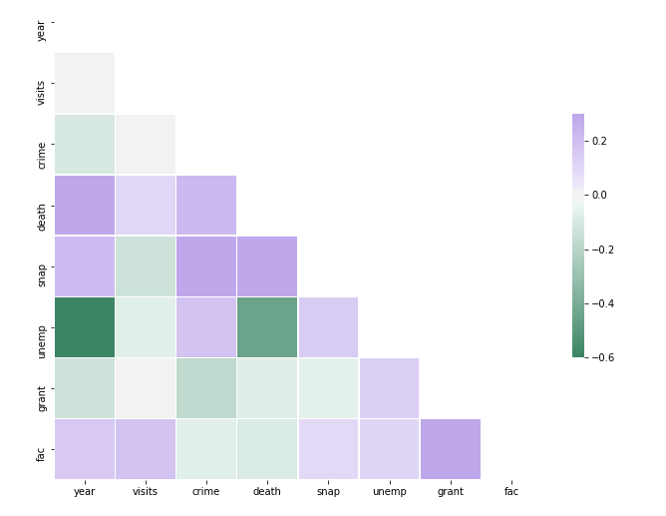
Correlation Matrix for our Variables
Using data.ny.gov we gather our variables:
Year
County
Overall Opioid Visit Rate Per 1000
Crime Rate Per 1000
Opioid Death Rate per 1000
SNAP Persons per 1000
Unemployment Beneficiaries per 1000
Block Grant Dollars per 1000
Facility Number per 1000

Slide 6
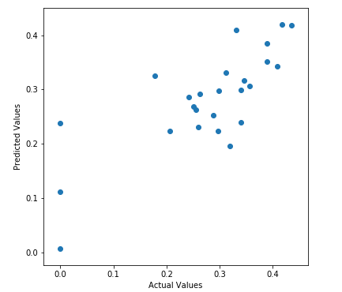
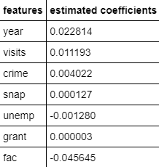
Linear Regression Model
R-squared: 0.5982641504574718
About 60% of the variance in the data
is explained by our model

Slide 7
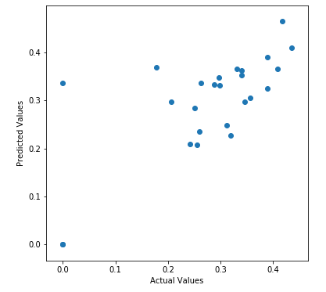
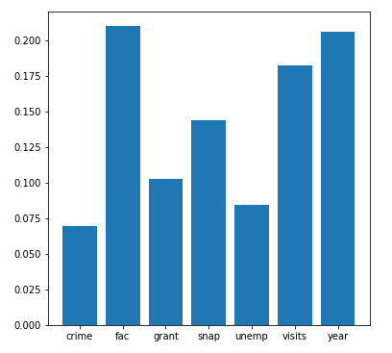
Decision Tree Model
Feature Importance
R-Squared: 0.4385951285371835
The model explains about 44% of the variance in
our data

Slide 8
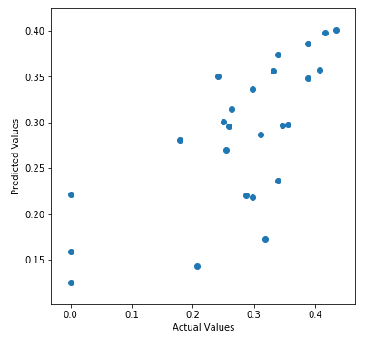
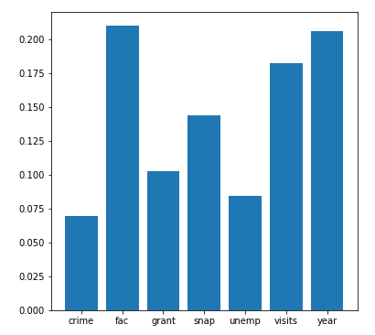
Random Forest Model
Feature Importance
R-Squared: 0.4969928946152287
The model explains about 50% of the variance in
our data

Slide 9
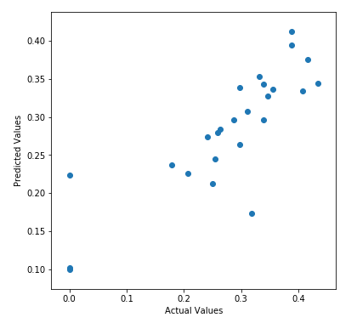
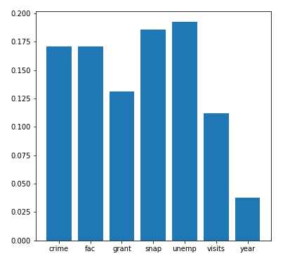
Gradient Boosting Model
Feature Importance
R-Squared: 0.6645348548311623
The model explains about 66% of the variance in
our data

Slide 10
TAKEAWAYS
Our gradient boosting regressor has the best R-squared score of our four models.
R-squared is not a perfect metric for determining how well a model will work. Gradient boosting models also have a tendency to overfit though so we need to check it against future data.
Can improve model by collecting data more directly related to socioeconomics, lack of economic opportunity and opioid abuse.
Improving model is crucial. We’re due for an economic downturn and need to be able to prepare preventative measures and invest in resources to aid with the crisis proactively.

