Slide 1
Group7
Principles of Info & Data Management Fall 2017
Brian Monticello, Mhammed Alhayek, Sean Olejar

Slide 2



Group7
Problem Statement
The lack of statistics and analytical data for bar owners is hindering potential business growth.
Example:
Bar owner wonders how
their ad campaign
affects sales
Bar owner does not have good statistics about their bartenders
Bar owner can’t determine what music to play to attract the most drinkers
3

Slide 3


Group7
Our Solution
Provide an intuitive dashboard for bar owners showing important statistics that can augment business growth.
Some example dashboard statistics (not limited to):
View the efficacy of ad campaigns
Monthly/daily earnings reports
Bartender average revenue generation per shift
Music trends amongst drinkers that frequent the bar
Group7
Bar owners
select their bar
We display valuable
business statistics
Bar owner uses
statistics to
increase sales
4

Slide 4
Group7
How do we do this?
Granular Transaction Data
Keep track of data for every transaction that occurs in the bar
bartender who sold the drink
What the drink was
What price
When was it sold
Our table only includes past year’s transactions
5 Million Tuples! Indexed for efficiency
Combine this with other data to generate advanced statistics
Examples: Find out how much profit a given beer produced
Which bartender generates the most revenue on Saturday Nights? During Happy Hour?
5

Slide 5
Group7
Data Set
Patterns in Our Data
All drinkers are 21 and older
A drinker’s daily spending is not greater than half their daily earnings
Bars generate more revenue at night and on weekends
Bartenders don’t work at multiple bars
Older drinkers have higher average salaries
Younger drinkers prefer more crowdedness
Drinkers with higher salaries spend more per day
Beers must be priced high enough to make a profit
5

Slide 6
Group7
Update Constraints
Bar Owner
Adds a Drinker
Check Constraints
Allow/Deny Update
Constraints for Adding a Drinker:
Drinker must be 21 years of age or older
Drinker’s spending per day must not be greater than half their daily earnings
Constraints for adding a new beer to be sold at a bar:
Beer must be priced high enough to generate a profit
5

Slide 7
Group7
GUI Screenshots
2

Slide 8
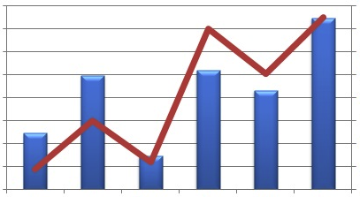
Group7
Recap of Key Deliverables
Bar owners lack viable business statistics
Solution is to provide bar owners with a dashboard displaying engaging and useful data points
Using these statistics, bar owners can adjust their business model to see increases in sales
6

Slide 9
Group7
Questions

