Slide 1

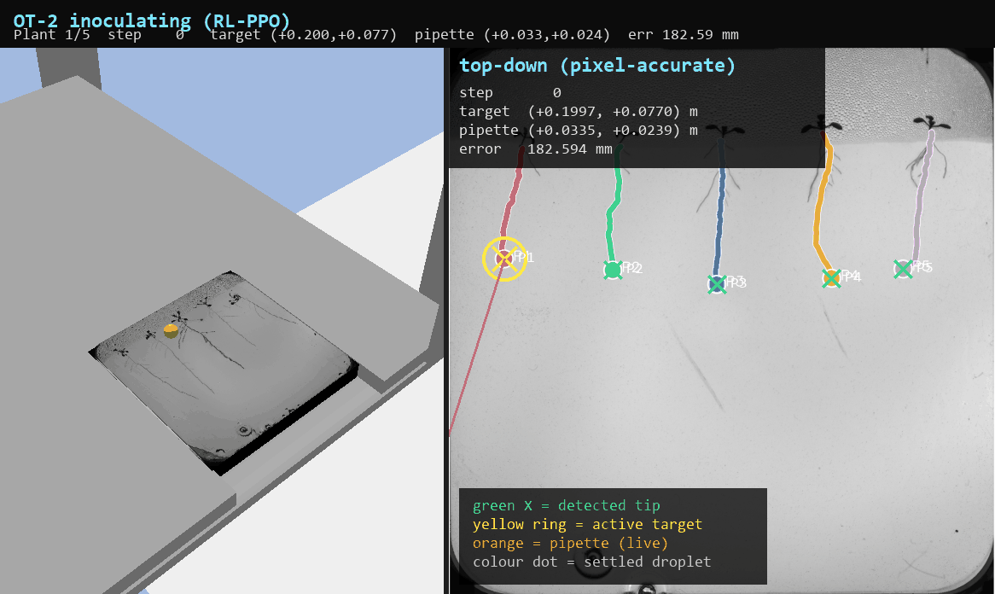
BLOCK B · CREATIVE BRIEF · RETAKE
From Petri Dish to Pipette
Automated root phenotyping and robotic inoculation, end to end
Mohammadali Jaberi 244437 Breda University of Applied Sciences

Slide 2




THE PROBLEM · ILO 5.1
Measuring and treating roots, one seedling at a time
Plant scientists grow seedlings on agar plates, study how the roots develop, then inoculate each root tip with bacteria or compounds, for example to test which genotypes resist disease.
Both steps are done by hand today: measuring root length off photos, and pipetting onto each tiny tip under a microscope.
It is slow, tiring and hard to reproduce, which caps how many plants and conditions a lab can ever screen.
slow
minutes of microscope work per plant
variable
hand placement drifts run to run
doesn't scale
to the hundreds of plants needed

Slide 3



WHY IT HELPS THE CLIENT · ILO 5.1
What automation unlocks for plant science
Screen far more plants
Spot resistant genotypes
Reproducible inoculation
Photograph a plate and find every root automatically — throughput jumps from a handful to hundreds per session.
More plants measured means cleaner comparisons between lines, so disease-resistant candidates surface sooner.
The robot dispenses on the same spot every time, removing the hand-to-hand variation that muddies results.
In short: one scientist can do in an afternoon what used to take a week of microscope time.

Slide 4







THE SOLUTION · ILO 8
One pipeline: photo in, inoculated root out
>
>
>
>
>
Photo
Find roots
Root tip
Calibrate
OT-2 robot
Inoculate
raw plate image
U-Net segments roots
pixel of each tip
pixel → robot mm
PID or RL drives
droplet on tip
Two halves: computer vision finds the targets, robotics hits them. Calibration is the bridge between a pixel and a millimetre.

Slide 5

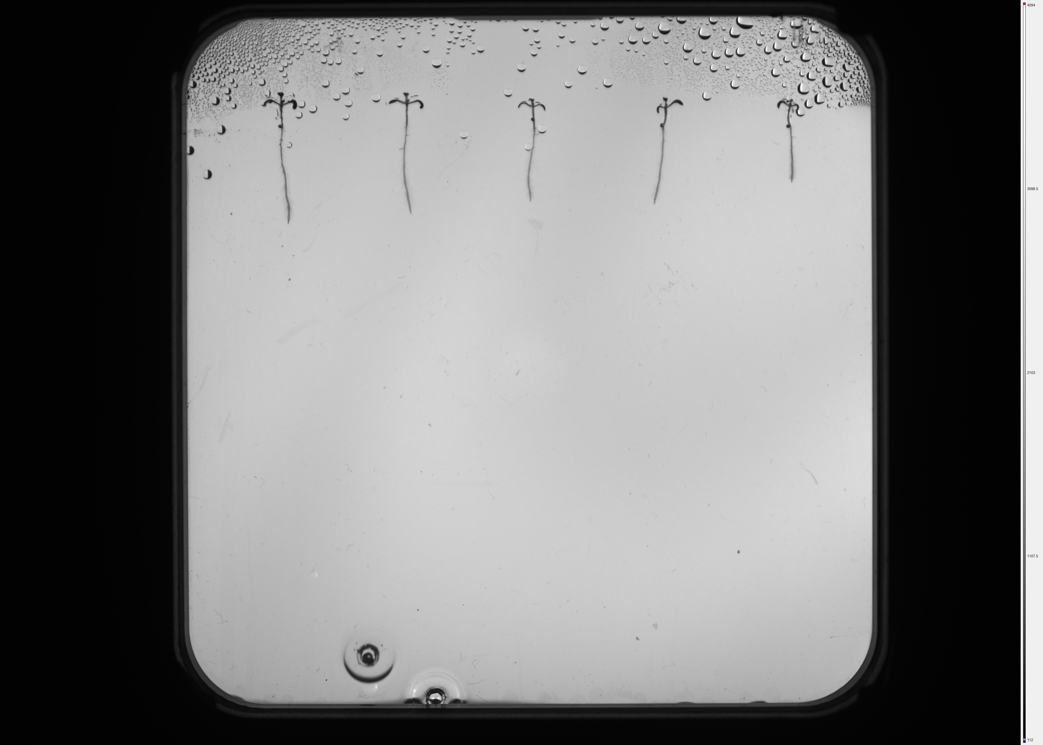
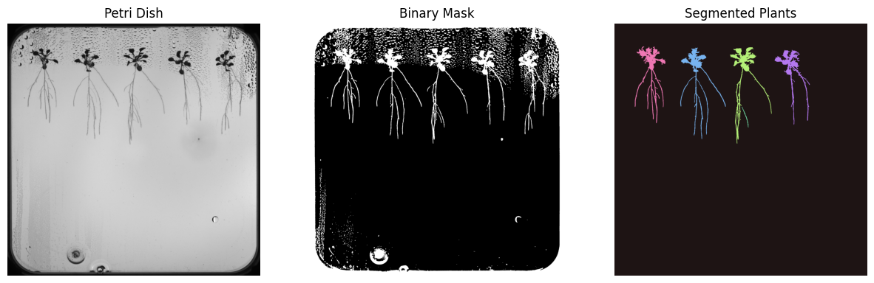
COMPUTER VISION · ILO 6.4 · TASKS 2–3
Traditional CV: crop the dish, separate the plants
Classic image processing first, as the brief asks — enough to isolate the working area before any model runs.
Task 2 — petri dish cropped from the raw image (threshold + contours)
Task 3 — the five plants separated as instances, no deep learning

Slide 6
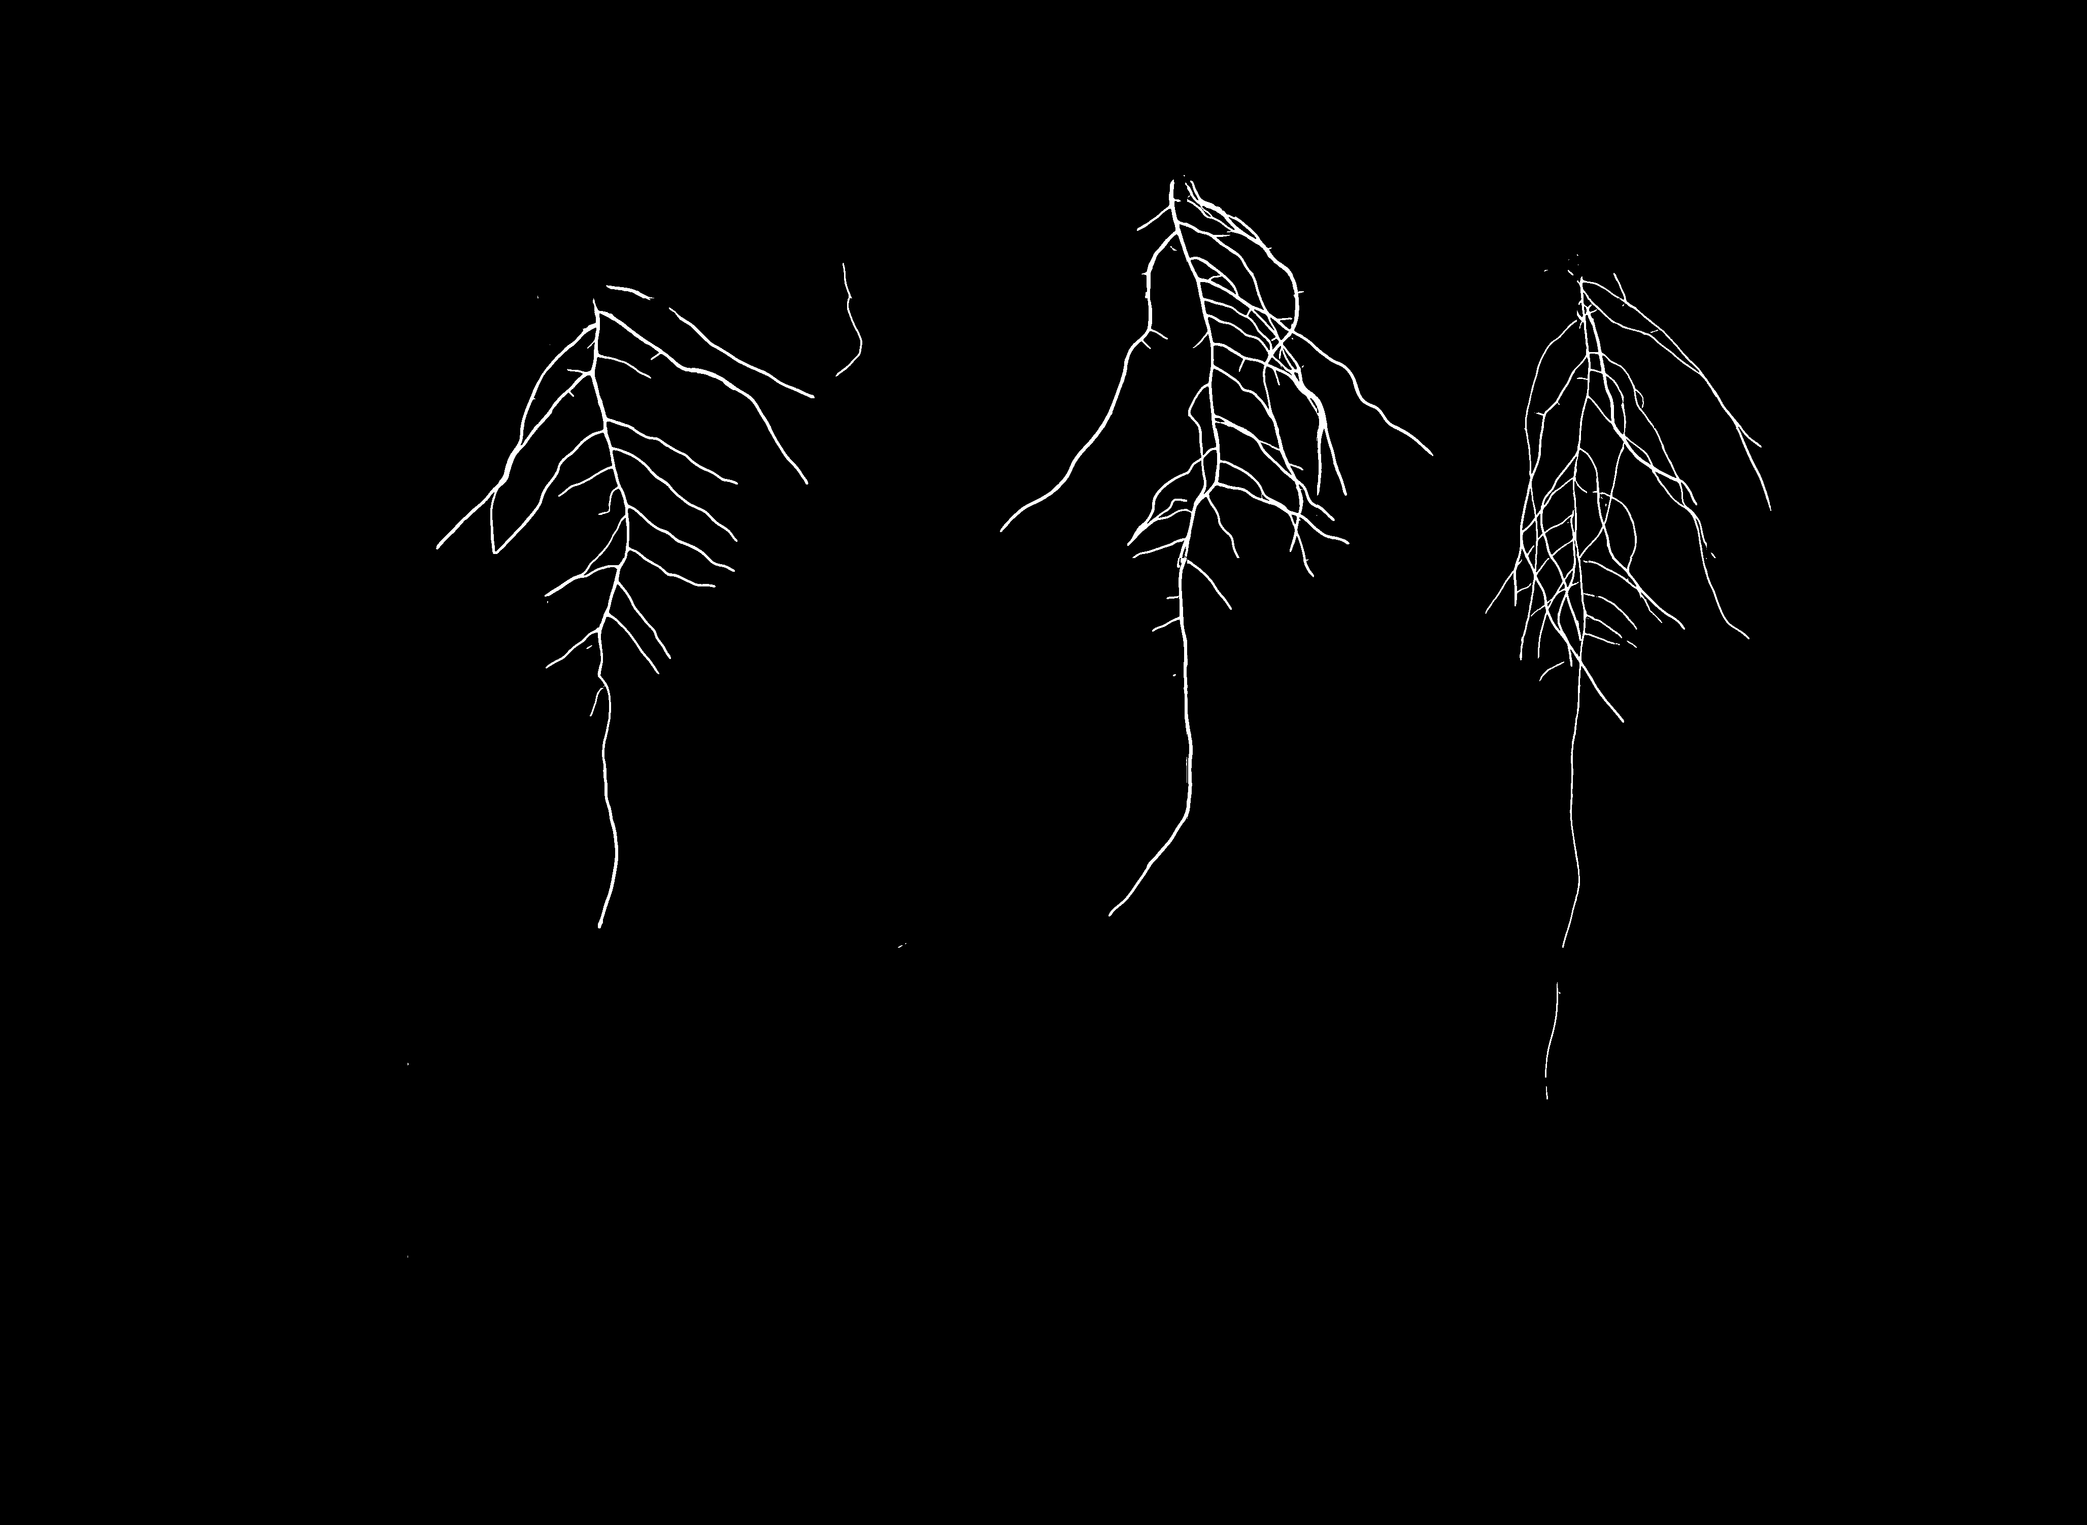

COMPUTER VISION · ILO 8.5 · TASKS 5 & 8
Deep learning: a U-Net that segments roots
F1 = 0.877
validation score of the root U-Net (Task 5)
Task 8 — full Kaggle pipeline:
dish crop → U-Net → skeletonise the root system → measure primary-root length for every plant.
These tip coordinates feed straight into the robot.
Task 5 — U-Net root mask predicted on a test plate

Slide 7
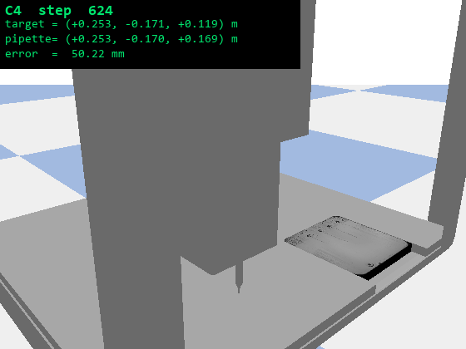

ROBOTICS · ILO 8.6A · TASK 9
Meet the robot and learn its reach
The OT-2 is a real 3-axis pipetting robot (here, its digital twin). Before controlling it, I mapped what it can actually reach.
Key finding: only 5 of the 8 workspace corners are reachable — the chassis floor blocks the lowest layer.
So every later task targets a practical envelope, not the full box. Saved a lot of failed runs.
Driving the pipette to the corners of the workspace

Slide 8

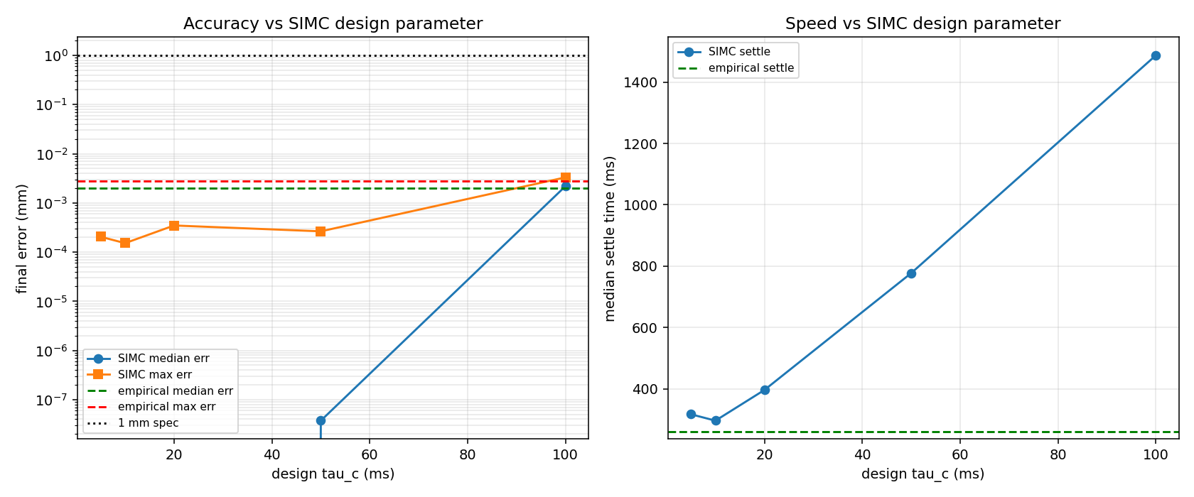
ROBOTICS · ILO 8.6B · TASK 10
Classic control: a PID tuned from physics
Instead of guessing gains, I measured how each axis responds, fit a first-order model, and computed the PID directly with the SIMC rule.
sub-micron
worst-case error in simulation (0.3 µm) — far inside the 1 mm spec
Step-response fit (system ID) → SIMC tuning rule → PID gains

Slide 9
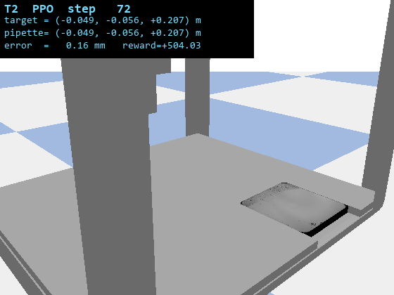

ROBOTICS · ILO 8.6C · TASK 11
Reinforcement learning: a policy that learns to aim
A PPO agent learns control purely from trial and reward — no physics model handed to it.
The reward design was the whole game: three proximity wells at 10 mm, 0.3 mm and 0.05 mm pull it from coarse approach down to sub-millimetre.
60 / 60
random targets hit under 1 mm (trained policy)
PPO policy steering the pipette to a target

Slide 10

INTEGRATION · ILO 8.6D · TASK 12
Putting it together: see a root, hit a root
The autonomous loop
U-Net finds each primary-root tip
calibration turns the tip pixel into robot mm
the controller drives there and dispenses
repeat for all five plants
▶ plays live in slideshow

Slide 11

RESULTS & EVALUATION · ILO 8.6D · TASK 13
PID vs RL across 19 dishes, 82 root tips
100%
sub-µm
0.47 mm
tips < 1 mm — both controllers
PID median error
RL median error
Both meet the spec under a fair test (same start, same horizon). PID wins on raw precision because it has a plant model; RL needs no model and still clears 1 mm on every tip — at a bit more effort.

Slide 12

ERROR ANALYSIS & ITERATION · ILO 2.6
Three fixes that actually moved the numbers
For each: what broke, what I changed, and the before / after.

Slide 13

ASSUMPTIONS
What I took as given
Five plants per dish
Known dish geometry
Detection keeps the five largest root blobs, ordered left to right.
The plate is a fixed 150 mm square at a known spot on the deck.
Idealised specimen
Hover-and-drop dispense
In the sim the plant is a flat target — no occlusion, condensation or 3-D roots.
The pipette inoculates from just above the agar, not by touching it.

Slide 14


NEXT STEPS · ILO 8
Where I'd take it next
Add a shoot model
Hybrid controller
Segment shoots too, so plant localisation no longer depends on the root mask alone.
RL for the fast coarse approach, hand off to PID for the final sub-mm settle.
Tighter RL
Real hardware
Re-train against a 0.5 mm target; early signs suggest it can roughly halve its error.
Re-calibrate on a physical OT-2 and switch to a touch-dispense at the agar.

Slide 15
IN ONE LINE
A camera finds every root tip, and the robot inoculates all of them — autonomously, under a millimetre.
100%
0.877
5 of 5
tips hit < 1 mm (PID & RL, 82 tips)
U-Net root-segmentation F1
plants found per dish after the fix
Mohammadali Jaberi 244437 Thank you — questions welcome

