Slide 1
CAIRO UNIVERSITY
Faculty of Graduate Studies for Statistical Research
Software Engineering Program — Professional Master's Degree
Predicting CI/CD Pipeline
Build Failures Using
Machine Learning Techniques
Presented by: Moamen Mohamed Aly Hussein
Student ID: 202401681
Supervisor: Dr. Maged Mamdouh
Date: Friday, September 11, 2026

Slide 2
Agenda
What we will cover in the next 25 minutes
1
The Problem
Why CI/CD failures matter — financially and operationally
2
Literature Gap
What prior research did, and what it left undone
3
Proposed Solution
The Hybrid ML Pipeline architecture
4
Methodology
Data, features, models, and evaluation regime
5
Results
Headline metrics, ablation study, threshold optimization
6
Business Impact
Translating model performance into dollar savings
7
Conclusions & Future Work
What we proved, what remains
Moamen M. Aly · MSc Thesis Defense · September 11, 2026
2 / 29

Slide 3
What Is CI/CD? And What Is GitHub?
The two ideas that everything else in this talk depends on
GITHUB
CI/CD
The shared archive
The automatic checking machine
Where the world keeps its software:
Every change to the code is recorded
Who changed what, and when
A "commit" is one saved change
Used by roughly 100 million developers
Think: a very careful version-controlled filing cabinet
Runs every time anyone saves a change:
Rebuilds the entire program from scratch
Runs thousands of automated tests
Reports back "passed" or "failed"
No human involvement at any point
Think: an automatic examiner that marks every draft
⚠ WHY THIS COSTS MONEY
Each check takes minutes to hours and costs real compute. When one fails, a developer must stop and fix it.
✓ THE QUESTION THIS THESIS ASKS
At the moment the change is saved — before the checking machine even starts — can we predict that it is going to fail?
Moamen M. Aly · MSc Thesis Defense · September 11, 2026
3 / 29

Slide 4
How One Check Actually Runs
The whole mechanism end to end — and the exact moment this thesis makes its prediction
1 · T H E C O M M I T
2 · T H E C H E C K I N G M A C H I N E R U N S
✓ P A S S E D
89% of the time
A developer saves
one change
Files touched, lines added,
the message they wrote,
the branch, the hour.
Fetch code
0.3–2 min
Install tools
1–15 min
Build it all
2–40 min
Run the tests
5–90 min
✗ F A I L E D
11% of the time
No human is involved at any point. The machine decides on its own.
⬆ T H I S T H E S I S P R E D I C T S H E R E
At stage 1 — the instant the change is saved, before the machine has started. Everything to the right has not happened yet.
Predicting after stage 2
saves nobody anything:
the money is already spent.
Why the prediction has to happen at stage 1
Anything measurable only after the machine starts — how long the run took, how many times it was retried — is a consequence of the failure, not a cause of it.
Feeding those back in would raise every number in this thesis and predict nothing anyone can act on. They are excluded by design, and that constraint is the central claim of the work.
Moamen M. Aly · MSc Thesis Defense · September 11, 2026
4 / 29

Slide 5
Why This Problem Is Hard
One number shapes every methodological decision in this thesis
89%
11%
3.45
of runs simply succeed
actually fail
runs per commit
so guessing "it will pass" is already right 89% of the time
1,072 failures out of 9,772 collected runs
one saved change triggers many checks — this matters later
Why Accuracy Is The Wrong Measure Here
A model that predicts "success" every single time scores 89% accuracy and has learned absolutely nothing. This thesis therefore reports F1 on the failure class, which rewards only catching failures.
Moamen M. Aly · MSc Thesis Defense · September 11, 2026
5 / 29

Slide 6
The Problem
CI/CD failures are expensive — in time and money
11%
$0.008
10–20 min
of all GitHub Actions runs
per minute
developer interruption
end in failure (observed in our dataset)
GitHub Actions compute cost (Linux runner)
context-switch penalty per failure
The Cumulative Cost
For a mid-sized organization running 1,000 pipeline executions per day, that is approximately 110 failed builds daily, consuming compute resources and developer time that cannot be recovered after the fact.
Moamen M. Aly · MSc Thesis Defense · September 11, 2026
6 / 29

Slide 7
Literature Gap
What prior research did — and what it missed
PRIOR WORK
THIS PROJECT
Patel (2019) and related studies
Pre-execution prediction
Uses post-execution telemetry:
Run duration
Resource utilization (CPU, memory)
Step-level intermediate status
Retry count and patterns
Useful for retrospective anomaly detection
Uses only pre-execution features:
Commit-level metadata
Lines added / deleted / files changed
Commit message (NLP via TF-IDF)
Repository, branch, event context
Enables proactive resource conservation
⚠ CRITICAL LIMITATION
By the time the predictor has its input, the resources have already been spent.
✓ THE CONTRIBUTION
Predict at commit time, before the runner starts. Decisions can prevent the cost rather than diagnose it.
Moamen M. Aly · MSc Thesis Defense · September 11, 2026
7 / 29

Slide 8
Research Objectives
Four specific, measurable goals
01
02
Build a Hybrid ML Pipeline
Compare Three Classifiers
Combine numerical, categorical, binary, and textual commit features into a single end-to-end classifier using scikit-learn's ColumnTransformer.
Evaluate Logistic Regression (baseline), Random Forest (ensemble), and XGBoost (gradient boosting) under identical conditions.
03
04
Validate Under Realistic Conditions
Quantify Business Impact
Test the model on both stratified random and chronological splits to verify robustness to temporal data drift.
Translate precision and recall metrics into estimated annual cost savings under a documented operational scenario.
Moamen M. Aly · MSc Thesis Defense · September 11, 2026
8 / 29

Slide 9
The Dataset
Real GitHub Actions data — not synthetic
Sampled Repositories
DATASET PROFILE
facebook/react
microsoft/vscode
tensorflow/tensorflow
pytorch/pytorch
rust-lang/rust
python/cpython
elastic/elasticsearch
prisma/prisma
...and 10 more
9,772
Real workflow runs collected
18
Popular open-source repositories
89% / 11%
Success / Failure class balance
6
Why real data, not synthetic?
Programming languages covered
7,817 / 1,955
Initial experiments on a 45K-row synthetic Kaggle dataset revealed that columns were statistically independent — essentially random noise. Pivoting to real GitHub Actions data was the most important methodological decision in the project.
Train / Test split (stratified)
~2 hours
Collection time (rate-limited)
Moamen M. Aly · MSc Thesis Defense · September 11, 2026
9 / 29

Slide 10
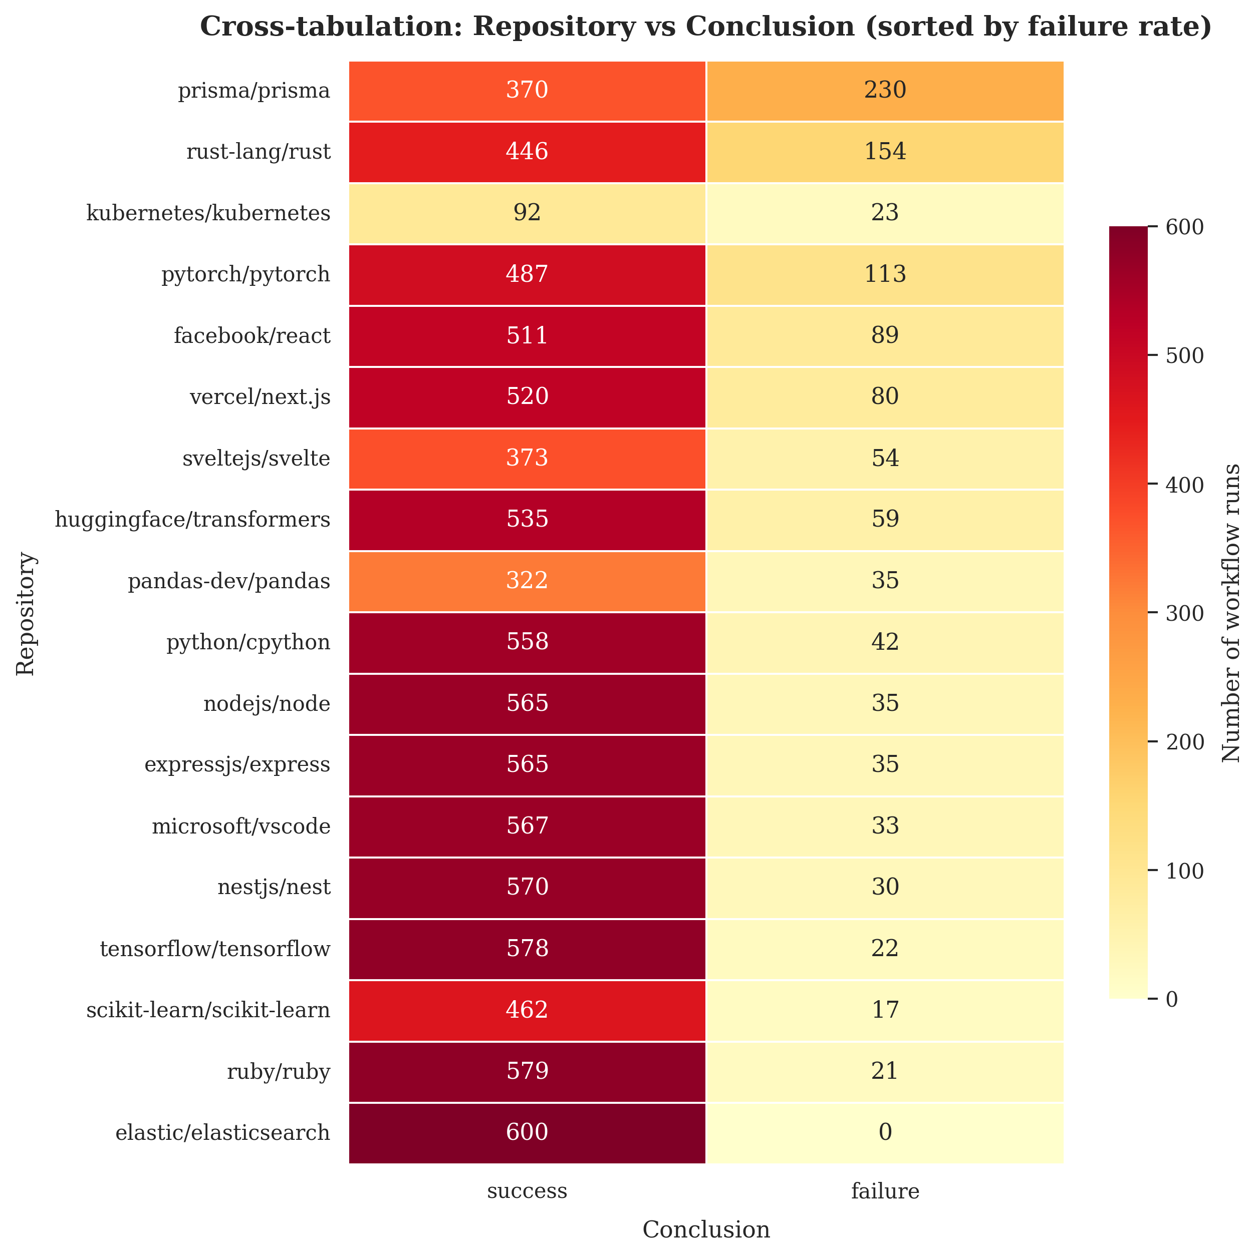
Failure Is A Property Of The Project
The same dataset, broken down per repository — the single most important pattern in the data
0% → 38.3%
the full range of failure rate across the 18 projects
elastic/elasticsearch: 600 runs, not one failure. prisma/prisma: 230 of 600. Elevenfold spread across the seventeen that fail at all.
What this explains
Knowing only which project a run belongs to already tells you a great deal about whether it will fail. That is why the categorical-only experiment beats the full model — and it is the reason I call this system a project-level risk estimator.
⚠ W H A T I T A L S O L I M I T S
An unseen project has no history for the model to lean on, so these results should not be read as transferring to a repository outside the eighteen sampled here. Cross-project generalisation is stated as future work, not as a claim.
Moamen M. Aly · MSc Thesis Defense · September 11, 2026
10 / 29

Slide 11
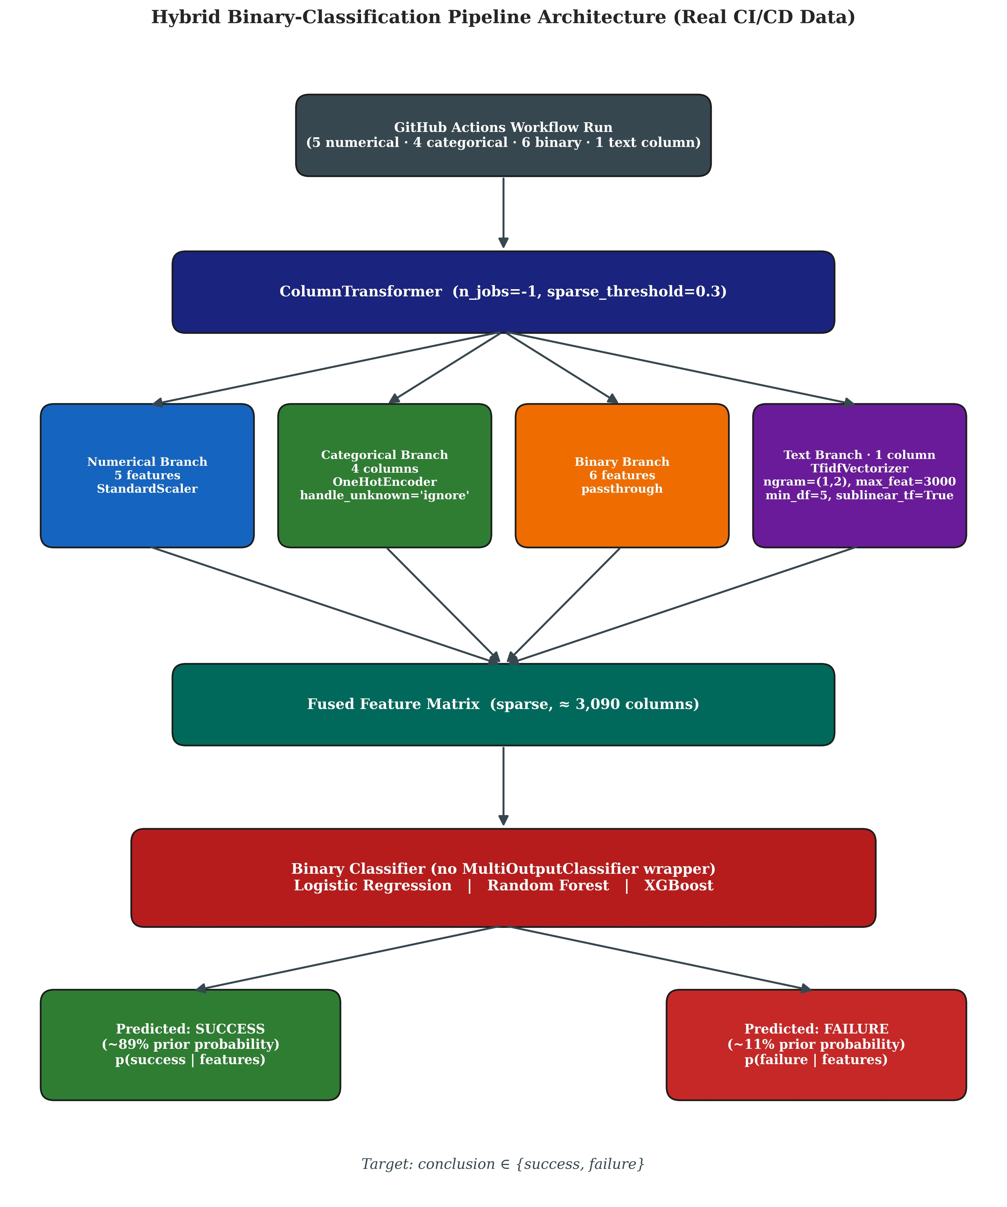
Hybrid Pipeline Architecture
Four parallel branches fused via ColumnTransformer
Key Design Choices
Parallel branches
Numerical (scaled), categorical (one-hot), binary (passthrough), text (TF-IDF) — processed independently then fused.
Sparse matrix
~3,090 columns total. Sparse-aware classifiers (LR, XGB) consume directly without densification.
Single classifier head
Binary output (no MultiOutputClassifier wrapper) — operational decision: success or failure.
Modular
Any branch can be swapped (e.g., TF-IDF → BERT) without touching the rest.
Moamen M. Aly · MSc Thesis Defense · September 11, 2026
11 / 29

Slide 12
Feature Engineering
16 features across 4 modalities
NUMERICAL
CATEGORICAL
BINARY
TEXTUAL
5 features
4 features
6 features
1 feature
log_lines_added
log_lines_deleted
log_files_changed
commit_message_length
avg_lines_per_file
repository
workflow_name
branch
event
is_large_commit
is_many_files
is_weekend_commit
is_off_hours_commit
is_bot_author
was_truncated
commit_message_clean
Treatment:
Treatment:
Treatment:
Treatment:
StandardScaler
OneHotEncoder (with rare-category bucketing)
Passthrough (already 0/1)
TF-IDF (ngram 1-2, max_features=3000, sublinear_tf)
Identity-leakage defense: 693-token stoplist (author logins + repo names + bot signatures) prevents TF-IDF from learning identifiers.
12 / 29

Slide 13
Evaluation Regime
Commit-grouped cross-validation, threshold chosen off the test set
COMMIT-GROUPED 5-FOLD CV
PER-REPOSITORY CHRONOLOGICAL
Primary: what the thesis reports
Secondary: deployment realism
Every run of one commit stays on one side
Threshold chosen on a validation fold, never on test
Every row predicted once, by a model that never saw its commit
Answers: "How well does this generalise to unseen commits?"
Each project cut at its own point in time
Train on that project's past, test on its future
Holds for all 18 of 18 projects; 57-day span
Answers: "Does it still work on later commits?"
Metrics: Failure F1 (primary) · Balanced Accuracy · ROC-AUC · PR-AUC · Precision · Recall
13 / 29

Slide 14
Results — Default Threshold of 0.5
Three classifiers, commit-grouped cross-validation, threshold = 0.5
Model
Accuracy
Bal. Acc.
Precision
Recall
F1
ROC-AUC
Logistic Regression
76.3%
74.1%
27.6%
71.3%
0.397
0.828
Random Forest
83.0%
70.8%
33.4%
55.1%
0.416
0.801
XGBoost
90.4%
59.2%
73.1%
19.2%
0.304
0.824
📊 Key Observation
XGBoost achieves the highest PR-AUC (0.480) — meaning it ranks failures best — but the worst F1 (0.304).
Translation: the model has good information but a miscalibrated decision rule. Only 19% of true failures are flagged, because the 0.5 threshold is implicitly designed for a balanced class prior.
This insight motivates the threshold optimization experiment ahead →
Moamen M. Aly · MSc Thesis Defense · September 11, 2026
14 / 29

Slide 15
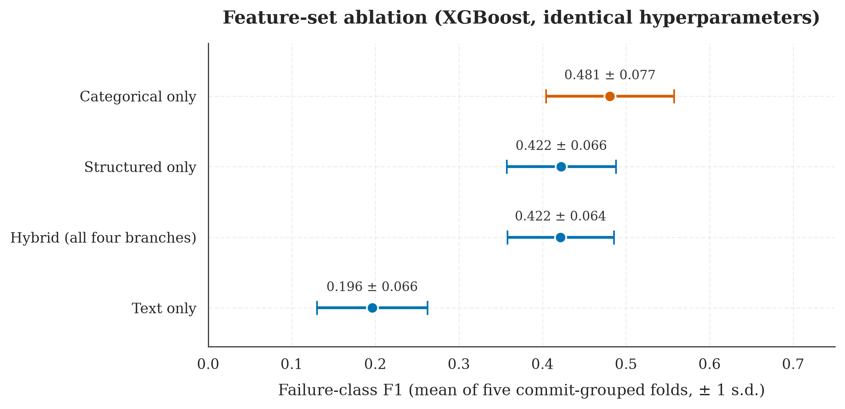
Ablation Study
Does the hybrid claim hold? Test each feature set in isolation
Four Configurations
Text-only (TF-IDF)
F1 = 0.196 — cannot overcome the 89:11 prior
Structured-only
F1 = 0.422 — matches the full hybrid
Hybrid (full)
F1 = 0.422 — no lift from adding text
⚠ Honest Finding
The hybrid claim is refuted on real data. Adding TF-IDF text to the structured features produces no measurable lift.
And note: the marginal ROC-AUC edge the hybrid held under the earlier protocol does not survive honest evaluation. Text does not improve ranking ability either. Means over five folds.
Moamen M. Aly · MSc Thesis Defense · September 11, 2026
15 / 29

Slide 16
The Discriminating Experiment
What if the model is told ONLY the project, workflow, branch and trigger?
Configuration
Failure F1
± s.d.
Precision
Recall
PR-AUC
ROC-AUC
Text only
0.196
0.066
0.313
0.156
0.208
0.665
Structured only
0.423
0.066
0.538
0.361
0.483
0.820
Hybrid (full)
0.422
0.064
0.520
0.369
0.480
0.824
Categorical only
0.481
0.077
0.591
0.432
0.547
0.865
🔑 The Central Finding
A model given no commit content at all — no size, no message — beats the full hybrid on every metric.
Honest reading: this system is largely a project-level risk estimator, not a commit-level one. Failure rates run from 0.0% to 38.3% across the eighteen projects — elevenfold across the seventeen that fail at all — and Elasticsearch contributes 600 runs with zero failures.
I ran this experiment because it is the sharpest question an examiner can ask. →
Moamen M. Aly · MSc Thesis Defense · September 11, 2026
16 / 29

Slide 17
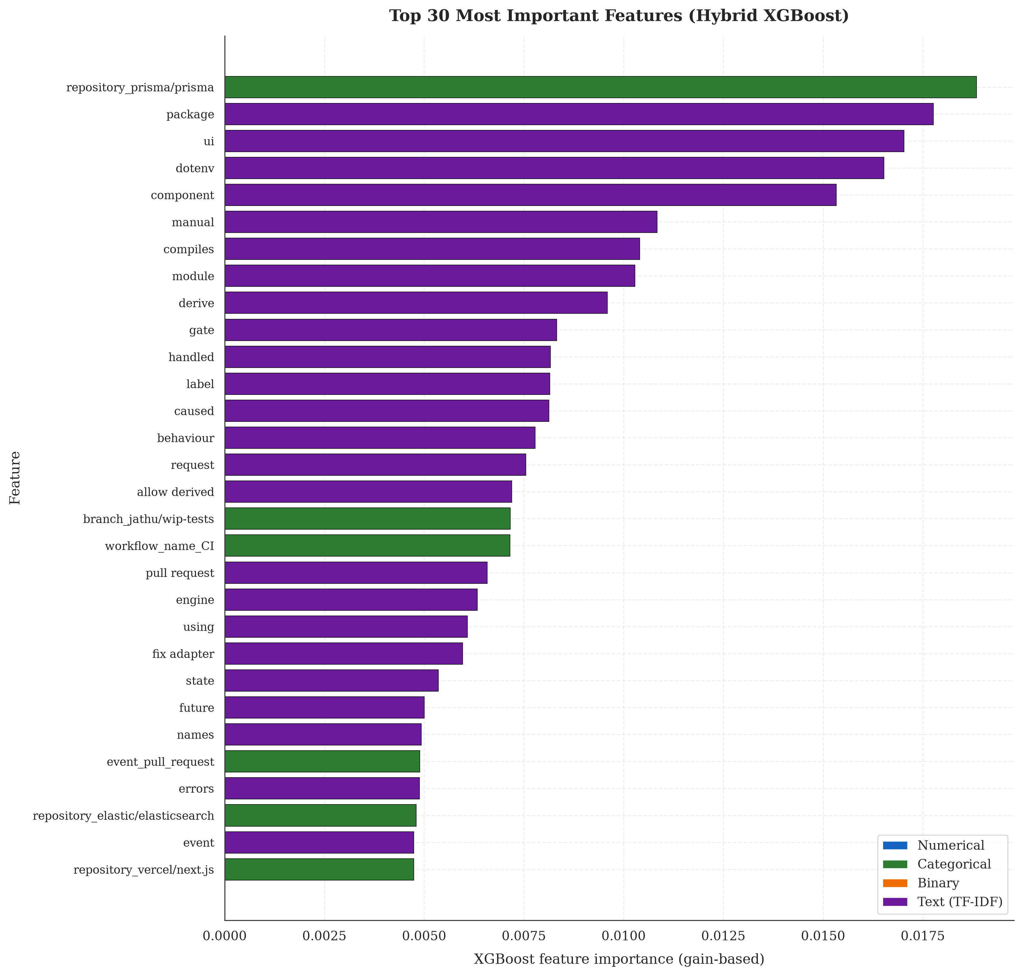
Feature Importance
What does the model actually rely on?
Top Features
Repository identity ranks first
The single most important feature under the corrected split, up from rank 3 before.
TF-IDF tokens fill ranks 2–10
package, ui, dotenv — which part of the code was touched.
💡 Consistent With The Ablation
Failure-discriminative vocabulary is not "fix", "bug" or "revert" — but timezone, utc, thresholds, borrow.
Developers do not know at commit time that their build will fail. Yet the ablation shows text adds nothing once project identity is known.
Moamen M. Aly · MSc Thesis Defense · September 11, 2026
17 / 29

Slide 18
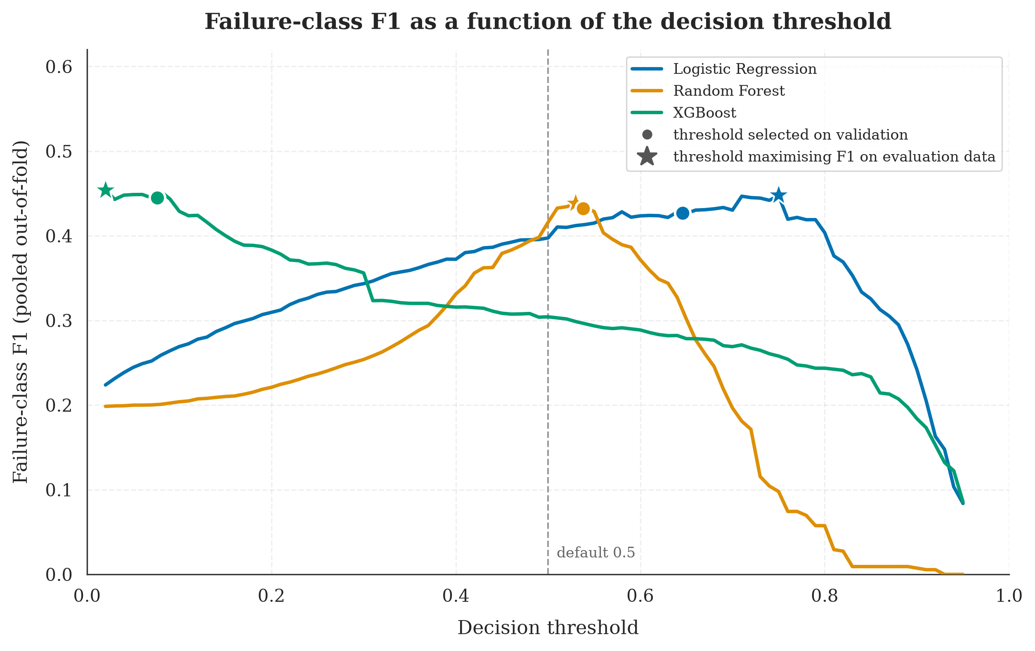
Threshold Optimization
A real lever — but far smaller than first reported
Why this matters
XGBoost threshold selected at 0.076
An order of magnitude below the default 0.5.
Logistic Regression selected at 0.646
Above the default — opposite-direction miscalibration.
Random Forest selected at 0.538
Marginally above default.
+9.3
percentage points
honest improvement in failure F1
XGBoost F1 lifts from 0.304 → 0.397 · chosen on validation, never on the test set. The +27pp figure came from picking it on the test set.
Moamen M. Aly · MSc Thesis Defense · September 11, 2026
18 / 29

Slide 19
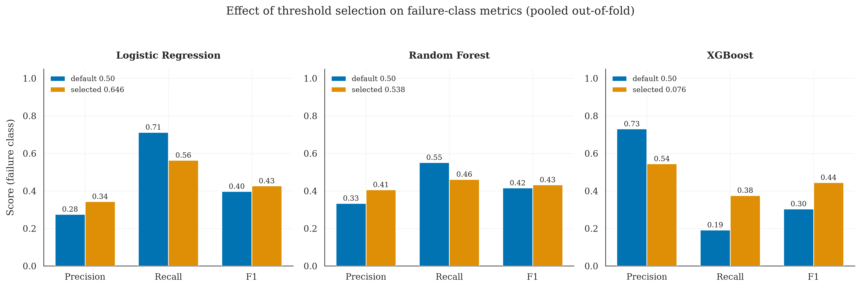
Before vs. After Threshold Optimization
Per-model transformation
✓ Methodological lesson
For imbalanced binary classification, probability calibration is a first-class hyperparameter, not a deployment-time afterthought. But it must be calibrated on data that is not then used to report the result — and the next slide shows exactly what ignoring that was worth.
Moamen M. Aly · MSc Thesis Defense · September 11, 2026
19 / 29

Slide 20
Where The Original Number Went
Same model, same data — only the measuring protocol changes
0.5924
−0.060
−0.126
0.4216
As reported in June
Commit leakage
Threshold on test
The honest result
row-level split, threshold picked on test
same commit on both sides of the split
chosen and reported on the same data
grouped CV, threshold on validation
The Result I Did Not Expect
Choosing the threshold on the test set cost more than twice what the data leakage did.
The leakage is the error everyone looks for; the threshold error is the one that actually cost more. I found it, measured it, corrected it, and published the correction.

Slide 21
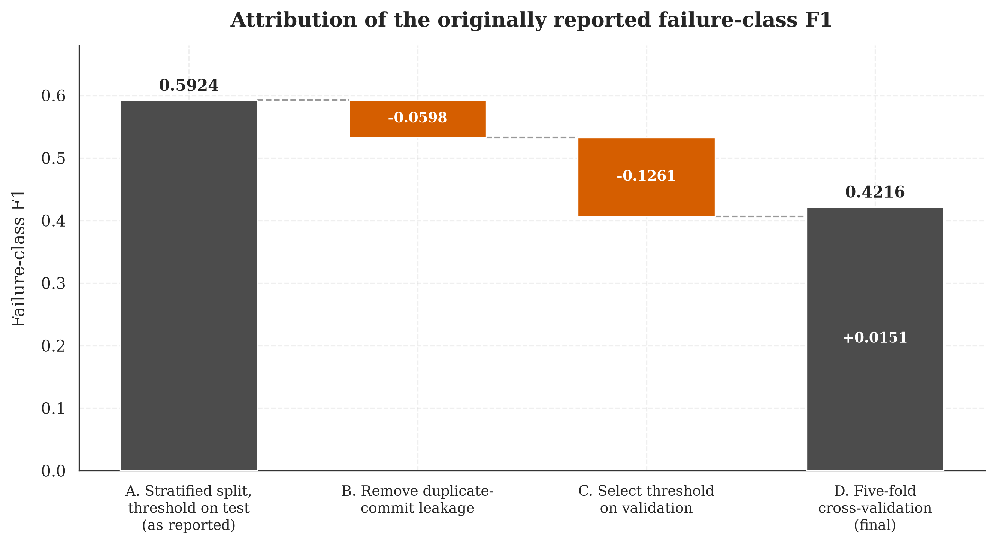
The Same Correction, Drawn
Each bar is one protocol change, applied on its own, measured on its own
The two corrections are separable because each was applied as a single controlled step, so the cost of each is measured rather than estimated. Choosing the threshold on the test set — the quieter of the two mistakes — cost more than twice what the leakage cost.
Moamen M. Aly · MSc Thesis Defense · September 11, 2026
21 / 29

Slide 22
FINAL RESULTS
XGBoost · threshold 0.076 · commit-grouped 5-fold cross-validation
0.422
66.9%
0.824
0.480
Failure F1
Balanced Accuracy
ROC-AUC
PR-AUC
± 0.064 across folds
imbalance-aware
ranking ability
selection criterion
Robustness Check (Per-Repository Chronological Split)
Failure F1 on the chronological test partition: 0.399 (−2pp)
Trained on each project's past and tested on its future, for all eighteen projects. The three classifiers are indistinguishable on F1; XGBoost is selected on PR-AUC.

Slide 23
Business Impact
From model metrics to dollar value
Operational Scenario
ESTIMATED ANNUAL NET SAVINGS
Mid-sized engineering organization
$243,670
1,000 pipeline executions per day
11% observed failure rate (~110/day)
$0.008/min compute cost (GitHub published)
$75/hr fully-loaded developer rate
per year, net of false alarms
15 min context-switch penalty per failure
Break-even false-alarm cost: $20.41
$2.50 false alarm triage cost
above which this configuration stops paying for itself. Logistic Regression looks better at $2.50 but breaks even at only $10.27.
$18.75 missed failure cost
Break-even > point estimate. It depends on a ratio I assumed, not measured.
Moamen M. Aly · MSc Thesis Defense · September 11, 2026
23 / 29

Slide 24
Objectives — Achieved?
Validation against the four stated goals
01
Build a Hybrid ML Pipeline ✓ ACHIEVED
Four-branch ColumnTransformer implemented, ~3,090-column sparse matrix, <10ms inference latency on commodity hardware.
02
Compare Three Classifiers ✓ ACHIEVED
LR / RF / XGBoost trained on identical features, evaluated under identical metric suite, winner selected by objective criterion.
03
Validate Under Realistic Conditions ◐ PARTIALLY ACHIEVED
F1 = 0.422 grouped vs 0.399 chronological, temporally valid for all 18 projects. But the 600-run cap makes this short-horizon only.
04
Quantify Business Impact ✓ ACHIEVED
$243,670 annual net saving with documented assumptions, plus the break-even false-alarm cost at which it reaches zero.
Moamen M. Aly · MSc Thesis Defense · September 11, 2026
24 / 29

Slide 25
Key Contributions
What this thesis adds to the field
📐
Pre-execution prediction protocol
🧪
Ablation identifying what actually drives the model
Strict feature-set discipline that distinguishes this work from post-execution telemetry approaches (Patel 2019).
Categorical identity alone outperforms the full hybrid. The system is a project-level risk estimator, and this is reported rather than obscured.
🎯
A measured account of two evaluation defects
🛡️
Identity-leakage defense for TF-IDF
Commit leakage cost 0.060 of F1 and test-set threshold selection cost 0.126 — isolated under otherwise identical conditions.
693-token stoplist algorithm that prevents the vectorizer from learning author/repo identifiers.
🔁
Full reproducibility
💰
Business-impact translation
Fixed seed, pinned versions, every artefact committed. One command reproduces every reported number in about three minutes.
Precision and recall converted to dollars under explicit assumptions, reported with the break-even cost at which the saving vanishes.
Moamen M. Aly · MSc Thesis Defense · September 11, 2026
25 / 29

Slide 26
Honest Limitations
What this work doesn't claim — and why that's important
Dataset scale
Open-source bias
9,772 runs from 18 projects. Larger samples would tighten the confidence intervals; the spread across folds is currently ±0.06 of F1.
Corporate CI/CD environments differ in commit cadence, branch policy, and tooling. Transfer is unverified.
TF-IDF text representation
Preprocessing fitted on all data
Lexical-overlap encoding misses semantic similarity — though the ablation shows text contributes almost nothing regardless.
Medians, vocabularies and the stoplist are computed before splitting. Target-independent, so mild, but they belong in the pipeline.
No production validation
Temporal features computed in UTC
Offline metrics ≠ deployed performance. A live deployment study would measure user behavior under predictions.
Computed in UTC across globally distributed projects — 18:00 UTC is mid-afternoon in California, midnight in Tokyo.
Moamen M. Aly · MSc Thesis Defense · September 11, 2026
26 / 29

Slide 27
Future Work
Eight directions for extension
1
Transformer-based text encoder
2
Scale to 1M+ workflow runs
CodeBERT / Sentence-BERT — may restore hybrid advantage
Hundreds of repos, broader generalization
3
Corporate dataset validation
4
Online learning capability
Test transfer to proprietary CI/CD environments
Continuous adaptation to evolving codebases
5
SHAP-based per-prediction explanations
6
Hyperparameter grid/Bayesian search
Individual-commit interpretability
Tighter optimization than current defaults
7
Live operationalized deployment
8
Multi-class failure stage prediction
Measure real user behavior under predictions
Build vs. test vs. deploy failure differentiation
Moamen M. Aly · MSc Thesis Defense · September 11, 2026
27 / 29

Slide 28
In Summary
01
Built a hybrid ML pipeline for pre-execution CI/CD failure prediction using only commit-time features available from the GitHub Actions API.
02
Measured F1 = 0.422 ± 0.064 under commit-grouped cross-validation with the threshold chosen off the test set — lower than the prior art, under stricter constraints and a stricter protocol.
03
Demonstrated through ablation that categorical identity alone outperforms the full hybrid, so the system is a project-level risk estimator rather than a commit-level one.
04
Quantified two evaluation defects in my own earlier results: 0.060 from commit leakage, 0.126 from threshold selection on test.
05
Estimated $243,670 annual net saving, reported alongside the break-even false-alarm cost of $20.41 at which it reaches zero.

Slide 29
Thank You
Questions & Discussion
Moamen Mohamed Aly Hussein
MSc Software Engineering · Cairo University
Defense: Friday, September 11, 2026
📎 Backup material available: thesis document, source code, Q&A reference card

