Slide 1

Amazon Sales Data Analysis Project
MOAMEN MONTASER

Slide 2
Data Inspection
The data contains several columns such as
Index: which describe the index of each order.
Order ID: describe the ID of each order.
Date: describe of the date of each order.
Status: the status of each order as Cancelled, Shipped - Delivered to Buyer, Shipped .
Fulfilment: Fulfilment by Merchant or Amazon.
Sales Channel: by amazon.
Ship-service-level: Standard, or Expedited.
Style: the style of each order.
SKU: the code of each product.
Category: such as Set, Kurta, Top Western Dress.
Size: the size of the order.

Slide 3
Courier Status: Shipped, or Cancelled.
Qty: the quantity of product.
Currency
Amount: the price of each.
Z-Score: this title is added for discovering the outlier and deal with them.
Outlier: describe if the price is outlier or not.
ship-city
ship-state
ship-postal-code
ship-country: India
promotion-ids: if there is any.
B2B
fulfilled-by: is it fulfilled by Easy Ship or not.

Slide 4
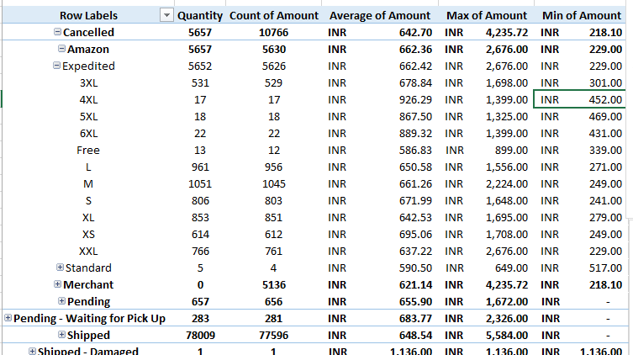
Summary Statistics
In the second shit of the xlsx file there is some statistics and pivot table
This pivot table shows status and fulfilment with their quantity, count, average of amount, min and max amounts

Slide 5
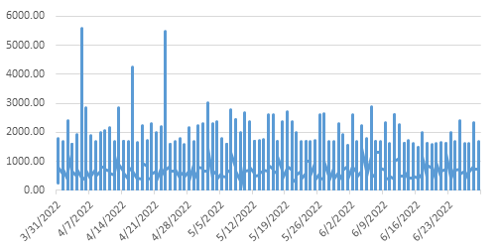
Here is a chart shows the average amount for each month

Slide 6
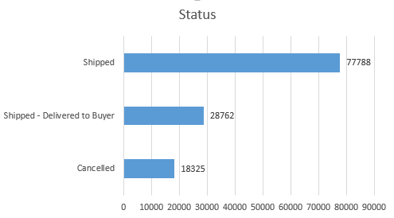
This chart shows how many times the status of every product shipped, and cancelled

Slide 7
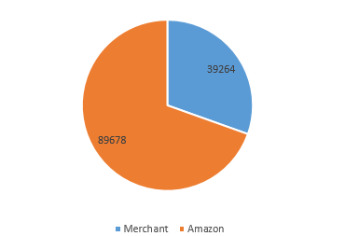
How many times Merchant and Amazon fulfilled the order

Slide 8
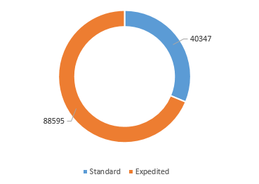
Standard VS Expedited count

Slide 9
Data Preprocessing 1-Handling Missing Values
Courier Status : Each cell filled just like the cell before it.
Currency: Filled all of missing values with INR as I noticed that all the data from India.
Amount: Filled with the mean value of the entire column.
Postal Code: removed all rows that have empty cell as in case of that we don’t know the postal code, we could never deliver it, so it’s not useful keeping it.
Ship Country: filled all empty cells with India, as I considered the entire data is collected for India.
Promotion IDs: filled the empty values with ‘Non’.
Fulfilled by: As I could not predict another company for Easy Ship, so I decided to fill them with ‘Not Easy Ship’.

Slide 10


2-Handling Missing Values
Converted Date column to Date Type instead of string.
Amount column from string to number.

Slide 11
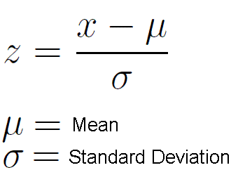
3-Dealing with outliers
In the second sheet of the file, I added two equations from the data, first is the average of amount, second is standard deviation…. That’s for using Z-Score method to get the outlier values from amount column.
Then, I added another column in the data describing if each Z-Score value higher than 3 if it is, it should be considered as outlier

Slide 12

Data Visualization
Using Pandas, Matplotlib, Seaborn I implemented a python code to visualize insights, and statistics.

Slide 13
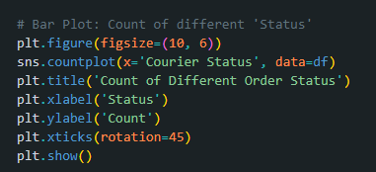
A part of the code that visualize count of different status

Slide 14
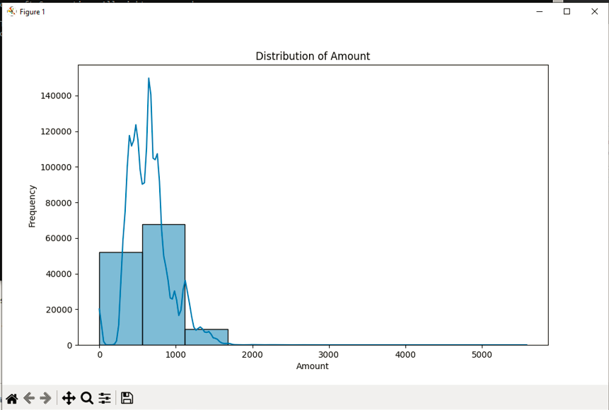
How many time each amount repeated

Slide 15
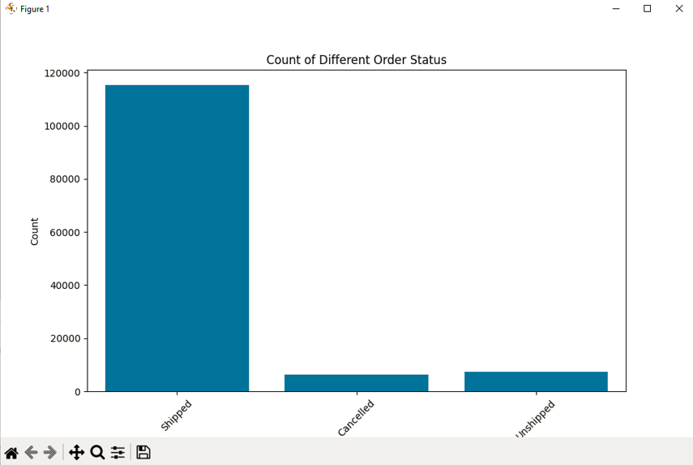
Count of order status

Slide 16
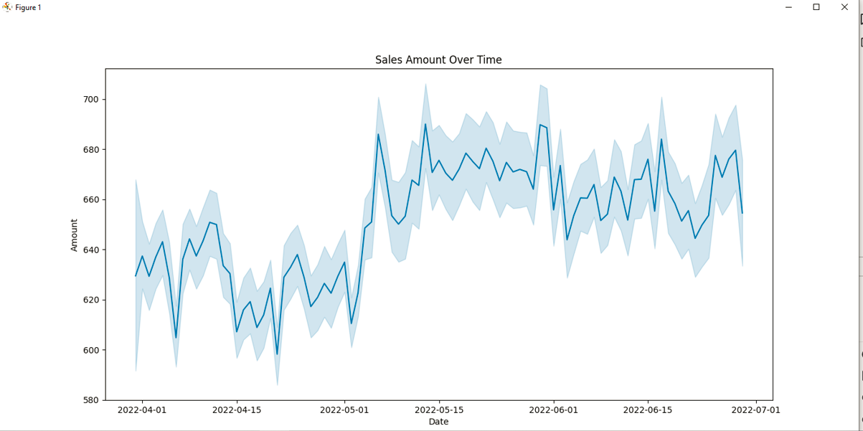
Sales amount over time

Slide 17
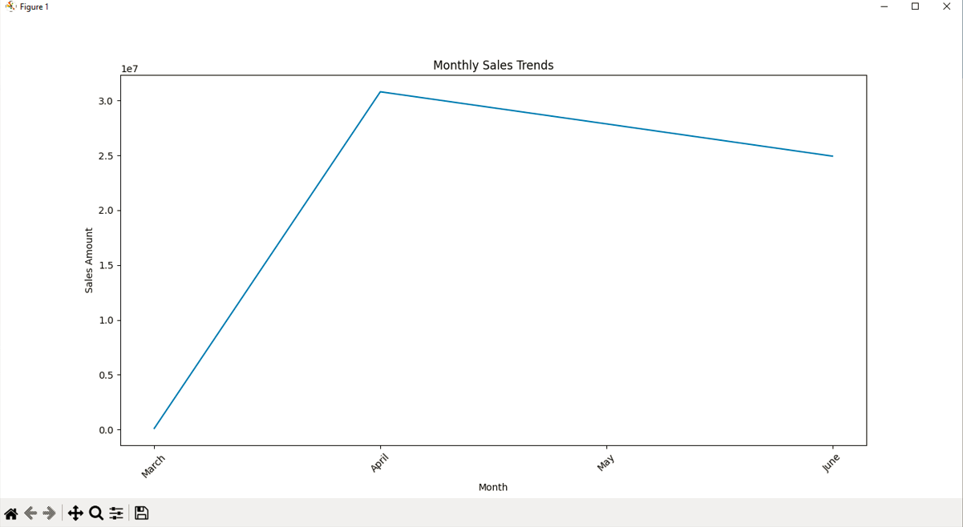
Monthly sales trends

Slide 18
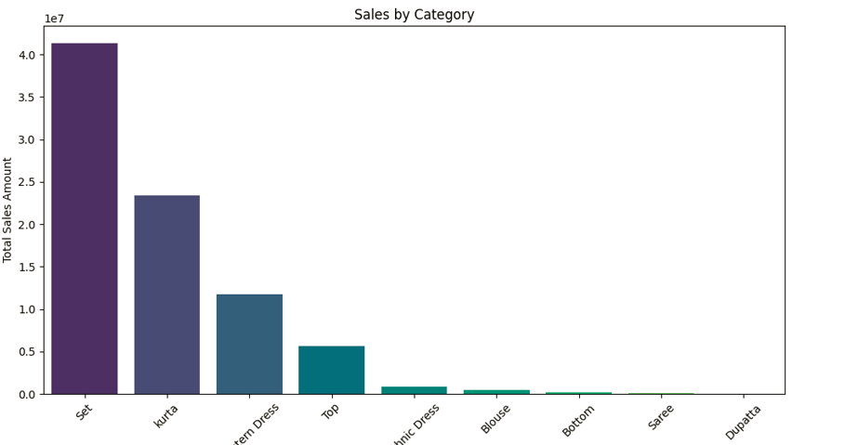
Sales by category

Slide 19
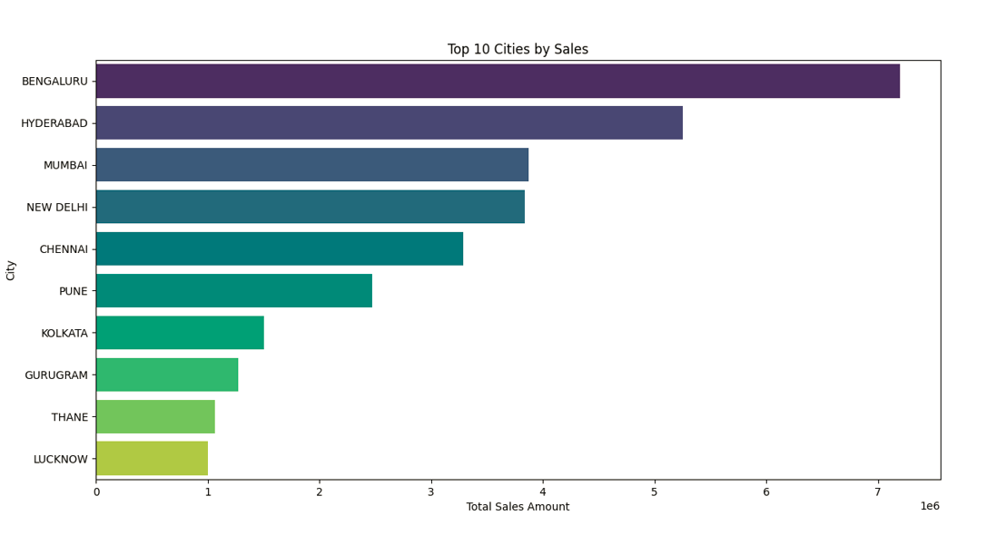
Top 10 cities by sales

Slide 20

Visualizations Using Dashboard
Using dash, plotly.express I implemented using the same Python file an html dashboard…. The dashboard visualize several insights with an interactive options.

Slide 21
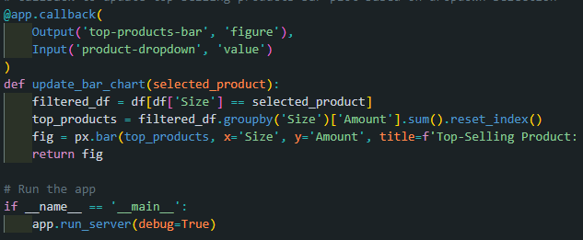
The Back-End part of the code which runs on port http://127.0.0.1:8050/ please use this port after compiling while testing the project

Slide 22
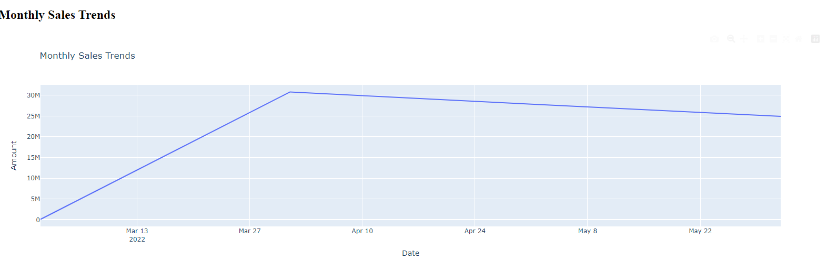
A screenshot shows monthly sales trends

Slide 23
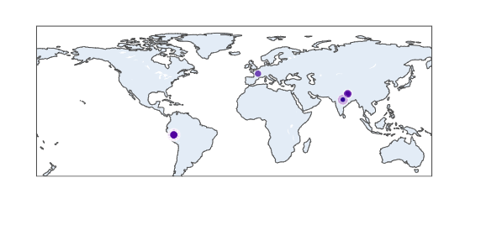
Geographical map shows the sales distribution by city

Slide 24
THE END

