Slide 1
Standard Template Library
● Pair
● Vector
● Stack
● Queue
● Deque
● Priority_queue
● Set
● Map
● Sort & Reverse

Slide 2
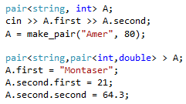
STL - pair

Slide 3
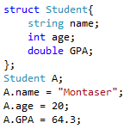
pair Vs. struct

Slide 4
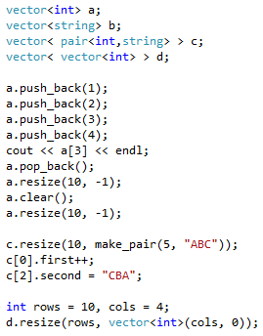
STL - vector

Slide 5
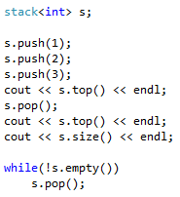
STL - stack

Slide 6
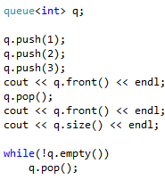
STL - queue

Slide 7
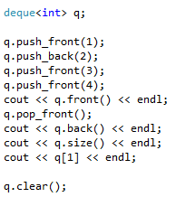
STL - deque

Slide 8
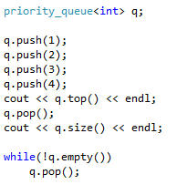
STL - priority_queue

Slide 9
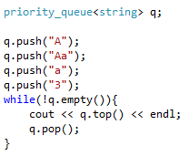
STL - priority_queue

Slide 10
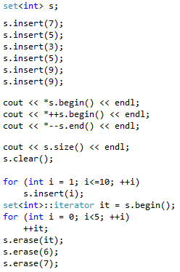
STL - set

Slide 11
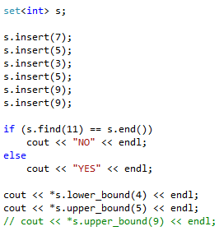
STL - set

Slide 12
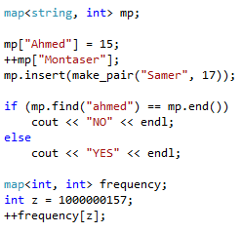
STL - map

Slide 13
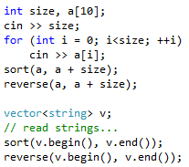
STL - sort & reverse

Slide 14
Problem #1
http://codeforces.com/contest/140/problem/C
Input
6
3 6 9 4 5 10
Output
2
3 6 9
4 5 10
3
6
9
4
10
5

Slide 15
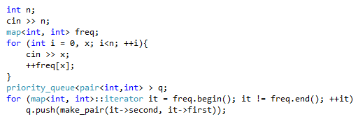
Problem #1

Slide 16
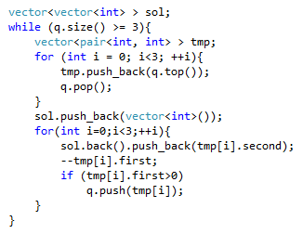
Problem #1

Slide 17
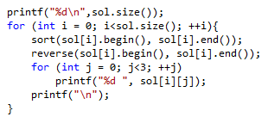
Problem #1

Slide 18
Problem #2
http://codeforces.com/contest/81/problem/A
Input
hhoowaaaareyyoouu
Output
wre

Slide 19
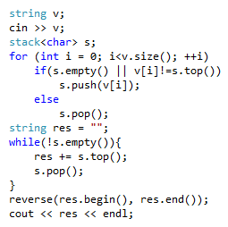
Problem #2

Slide 20
Problem #3
http://codeforces.com/contest/96/problem/B
Input
4500
Output
4747

Slide 21
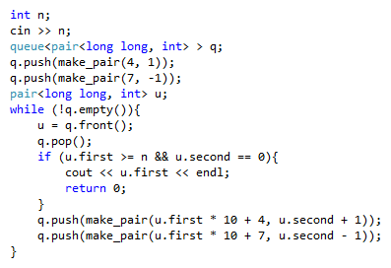
Problem #3

Slide 22
STL Problems
Problems solved during the training session + Contest problems:
● Dragons:
http://codeforces.com/problemset/problem/230/A
● Cards:
http://codeforces.com/problemset/problem/701/A
● Plug-in:
http://codeforces.com/problemset/problem/81/A
● Regular Bracket Sequence:
http://codeforces.com/problemset/problem/26/B
● Throwing cards away I:
https://uva.onlinejudge.org/index.php?option=onlinejudge&page=show_problem&problem=1876
● Lucky Numbers (easy):
http://codeforces.com/problemset/problem/96/B/
● Airport:
http://codeforces.com/problemset/problem/218/B
● 1D Cafeteria (B):
http://codeforces.com/problemset/gymProblem/100989/D
● Lecture:
http://codeforces.com/contest/499/problem/B

Slide 23
STL Problems
Extra problems:
● Mission:
http://a2oj.com/p.jsp?ID=327
● Seinfeld:
http://www.spoj.com/problems/ANARC09A/
● Running Median:
http://www.spoj.com/problems/RMID/
● I Can Guess the Data Structure:
https://uva.onlinejudge.org/index.php?option=onlinejudge&page=show_problem&problem=3146
● Glass Carving:
http://codeforces.com/contest/528/problem/A
● Homo or Hetero
http://www.spoj.com/problems/HOMO/
● Andy's First Dictionary:
https://uva.onlinejudge.org/index.php?option=onlinejudge&page=show_problem&problem=1756

