Slide 1
VACCINE R&D
Vaccine Research &
Development Database
A MySQL database for managing vaccine candidates, formulations, clinical studies, participants, laboratory results and safety data.
MY SQL 8.0+
13 TABLES
3 VIEWS
AUTOMATION
Presented by
Moamn Dwidar
ID: 221001481
Fundamentals of Databases
Notes:
Introduce the project as a database designed to support the full vaccine R&D lifecycle, from candidate and formulation data to clinical studies, lab tests and adverse events.

Slide 2
Project overview
What the database is designed to solve
The problem
The solution
Project objectives
Vaccine R&D creates connected data across researchers, sites, candidates, formulations, trials, participants, laboratory testing and safety monitoring.
Without a structured database, this information becomes duplicated, difficult to query and harder to validate.
A normalized MySQL database that links the main entities through primary and foreign keys.
It supports data integrity, reporting queries, automated validation and reusable business logic.
• Model the vaccine R&D workflow
• Store realistic test data
• Implement constraints and relationships
• Create analytical SQL queries and views
• Add triggers, a procedure and a function
• Verify the database with test cases
Notes:
Emphasize that the goal is not just storing data. The database also protects data quality and makes the information useful for analysis and reporting.

Slide 3
Database scope & core entities
13 tables organized around the vaccine development lifecycle
R&D foundation
Manufacturing
Studies & safety
researchers
vaccine_antigens
preclinical_studies
sites
formulations
clinical_study_phases
vaccine_candidates
batches
participants
antigens
participant_enrollments
lab_tests
adverse_events
Workflow: candidate → antigen/formulation → batch → preclinical → clinical phase → enrollment → lab tests / adverse events
Notes:
Walk through the three groups. The database follows a clear lifecycle from development and manufacturing through clinical testing and safety monitoring.

Slide 4
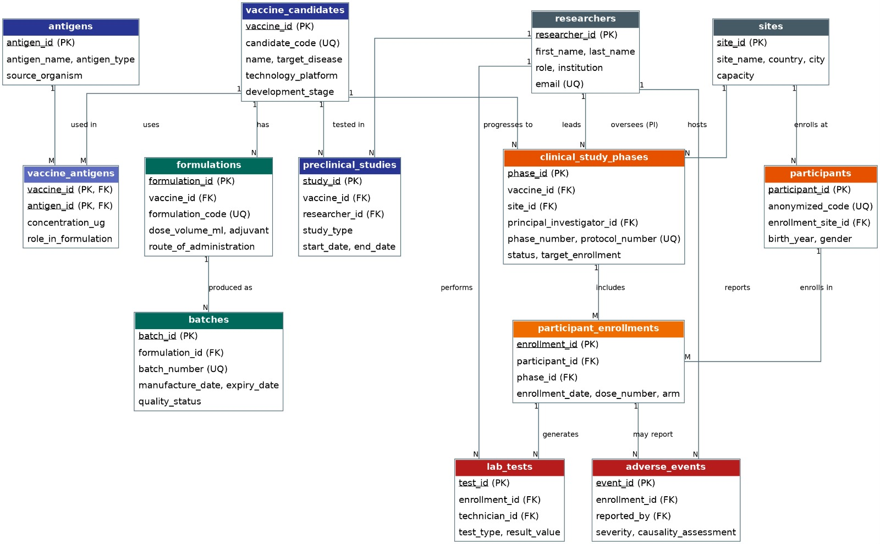
Entity-Relationship model
The ERD shows how the 13 entities connect
Key idea: relationships are explicit, not duplicated
Notes:
Use the ERD to explain that the model keeps relationships explicit through foreign keys and associative tables. Point out the two many-to-many relationships: vaccine candidates to antigens, and participants to clinical phases.

Slide 5
Relational design & normalization
How the schema avoids duplication and inconsistency
1. Many-to-many relationships
2. Integrity constraints
3. 3NF target
Vaccine ↔ Antigen is resolved by `vaccine_antigens`.
Participant ↔ Clinical Phase is resolved by `participant_enrollments`.
Primary keys identify records.
Foreign keys preserve valid relationships.
UNIQUE constraints prevent duplicate codes and protocols.
CHECK constraints validate numeric/date rules.
1NF: atomic values and no repeating groups.
2NF: non-key attributes depend on the whole key.
3NF: no unnecessary transitive dependencies.
Notes:
Explain that normalization is visible in the table structure, especially the associative tables. The design targets Third Normal Form to reduce redundancy and update anomalies.

Slide 6
Implementation in MySQL
Scripts are separated by responsibility
create_tables.sql
Database, tables, keys, indexes, constraints
01
load_data.sql
Realistic test records across all 13 tables
02
views.sql
Reusable reporting views
03
triggers_procedures.sql
Triggers + enrollment procedure + safety function
04
queries.sql
Retrieval, joins, aggregates, subqueries and updates
05
MySQL 8.0+ • InnoDB • utf8mb4
Notes:
Explain the execution order because each script depends on objects created earlier. The database can be rebuilt cleanly from the scripts.

Slide 7
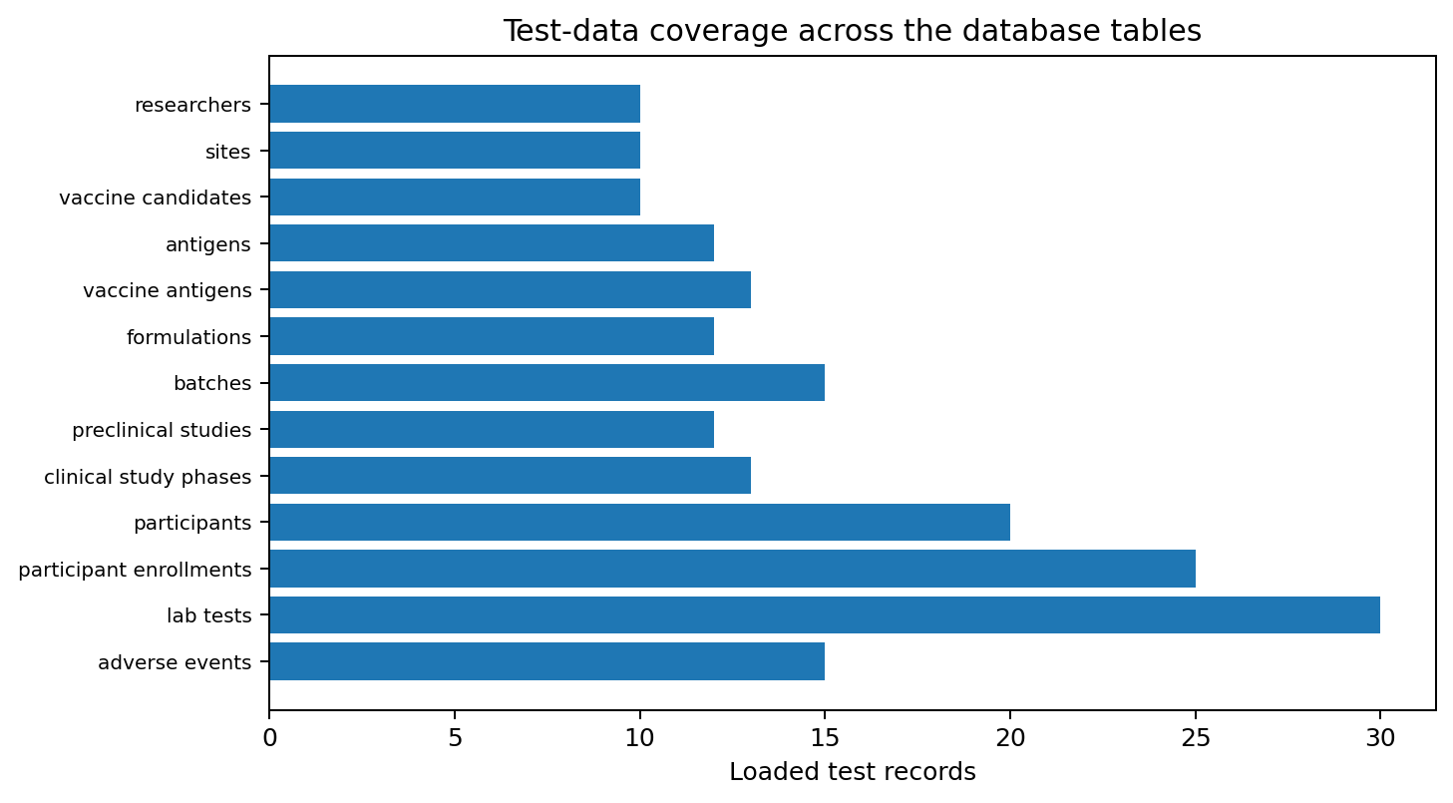
Test data coverage
The project includes populated records across every table
Coverage highlights
200 total test records
30 lab tests — largest dataset
25 participant enrollments
20 participants
15 batches
13 clinical phases
13 vaccine–antigen links
12 antigens
12 formulations
10 researchers
10 sites
10 vaccine candidates
15 adverse events
Notes:
Mention that the test dataset is distributed across all tables. The largest operational tables are lab_tests and participant_enrollments, which supports realistic query and reporting tests.

Slide 8
SQL querying & reporting
From simple retrieval to analytical queries
Basic & joins
Aggregation
Subqueries & derived logic
• Phase III candidates
• Active/recruiting phases
• Vaccine + antigen composition
• Full clinical phase details
• Candidate counts by stage
• Batch quantities by QC status
• Adverse-event rates
• Enrollment by site / trial arm
• Participants with abnormal tests
• Vaccines above average titer
• Sites hosting above-average trials
• Safety-oriented filtering
The query portfolio demonstrates SELECT, JOIN, GROUP BY, HAVING, subqueries and data modification.
Notes:
Focus on what the SQL enables: operational questions and analytical questions can be answered from the same normalized model.

Slide 9
Database automation
Business rules are enforced inside the database
Trigger 1
Trigger 2
Procedure + function
Safety flag
Batch control
Reusable logic
A severe adverse event automatically sets `serious_event = TRUE`.
A batch cannot be inserted directly as `Released` before the required QC flow.
`sp_enroll_participant` safely enrolls participants, while `fn_adverse_event_rate` calculates adverse events per 100 enrolled participants.
Result: important rules remain consistent even when data is changed outside a front-end application.
Notes:
Explain that these features move business rules into the database, which reduces dependence on application code for key integrity and safety behaviors.

Slide 10
Views & verification
Reusable reporting plus explicit test cases
Reporting views
Trigger test
Procedure / function tests
Three views provide reusable reporting logic, including active recruitment and other recurring operational summaries.
Views reduce repeated complex JOIN logic for end users.
A `Severe` adverse event is inserted and then checked to confirm the trigger automatically sets the serious-event flag.
The enrollment procedure is tested with valid and invalid phases / target conditions.
The safety-rate function is called and its calculated rate is verified.
Verification approach: test the rule → inspect the result → confirm expected behavior
Notes:
Present verification as evidence, not just claims. The project includes built-in test cases for the trigger, procedure and function.

Slide 11
Conclusion
What this project demonstrates
Future direction
A complete database solution
Role-based access control
Connected front-end dashboard
More advanced validation and audit trails
Models the complete vaccine R&D lifecycle in a structured relational schema.
Uses keys, constraints and normalization to protect data integrity.
Supports meaningful reporting through views and a broad SQL query portfolio.
Automates critical rules with triggers, a stored procedure and a function.
Includes realistic test data and verification cases across the database.
Thank you
Moamn Dwidar • 221001481
Notes:
Close by summarizing that the project demonstrates both database design fundamentals and practical SQL implementation.

