Slide 1
Sales report
All Data analysis types
Prepared by Eng Mohamed Anwar

Slide 2
Contents :
Executive summary
Data Description
Descriptive analysis
-Summary statistics
-Category analysis
-Product analysis
Diagnostic analysis
-Correlation analysis
Predictive analysis
-Forecasting model
Prescriptive analysis
-Best scenario for total revenue
-Best scenario for Headphones
-Goal seek
Prepared by Eng Mohamed Anwar

Slide 3
Executive summary
The sales dataset contains information about transactions, including the date, product details (name or identifier), category of the product, price per unit, quantity sold, total revenue generated, and the month in which the transaction occurred. This data set allows for analysis of sales performance, product popularity, revenue generation trends, and seasonal patterns over time. The data can be used to identify top-selling products, understand revenue distribution across product categories, and track sales trends on a monthly basis. Overall, the dataset provides valuable insights for decision-making and strategic planning within the business.
Prepared by Eng Mohamed Anwar

Slide 4
Data Description
Date: This column represents the date on which the sale was made or the transaction occurred. It typically includes the day, month, and year of the transaction.
Product: This column describes the specific product that was sold or involved in the transaction. It often includes details such as the product name, model number, or unique identifier.
Category: This column categorizes the product into a specific group or classification based on its characteristics or type. It helps in organizing and analyzing sales data by product categories.
Price: This column indicates the price at which the product was sold during the transaction. It represents the monetary value assigned to the product.
Quantity: This column shows the number of units or items of the product that were sold in the transaction. It tells how many units of the product were involved in the sale.
Total Revenue: This column calculates the total revenue generated from the sale of a specific product by multiplying the price per unit with the quantity sold. It represents the overall income from the sales transaction.
Prepared by Eng Mohamed Anwar

Slide 5
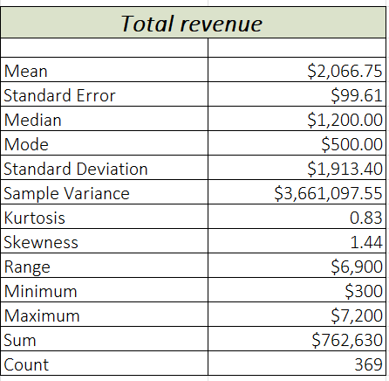
Descriptive analysis
Summary statistics
1- What are the summary statistics for total sales?
-The data in the column is right-skewed (skewness > 0), with a relatively high mean compared to the median, a considerable standard deviation, and slightly peaked (positive kurtosis).
" بيانات العامود لديها انحراف كبير ناحية اليمين و متوسط الايرادات كبير مقارنة بالوسيط مع معيار انحراف كبير الى حد ما بين قيم الايرادات والقيم لها توزيع متقارب "
Prepared by Eng Mohamed Anwar

Slide 6
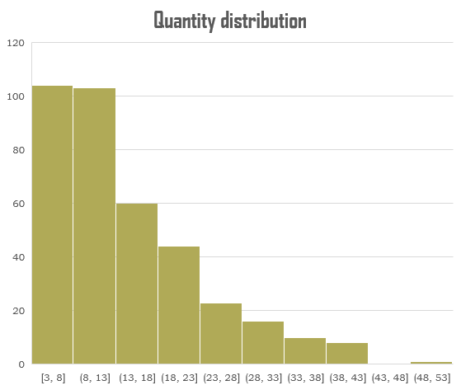
2-What is the quantity distribution?
-The Quantity distribution is right-skewed, the most quantities that we sell are between 3 and 13 pieces for each transaction and High quantities have fewer orders.
" توزيع الكميات المباعة له انحراف ناحية اليمين و معظم الكميات التي نبيعها تكون بين 3 و 13 قطعة لكل عملية شراء و الطلب على الكميات الكبيرة للمنتجات يكون اقل أثناء عملية الشراء "
Prepared by Eng Mohamed Anwar

Slide 7
Category analysis
1- What are the total sale processes for each category?
-We note that 35% of our sale processes are from the Electronics category, and 33% from the Clothing category which means these two categories have more demand, and 6% from Bags which indicates this category has fewer demand.
" لدينا حوالي 35% نسبة عمليات بيع من فئة الالكترونيات و 33% من فئة الملابس مما يعني ان معظم الطلب يكون على هاتان الفئتان و لدينا 6% نسبة عمليات بيع لفئة الحقائب مما يعني ان الطلب عليها اقل "
Prepared by Eng Mohamed Anwar

Slide 8
2-How does the price average vary across different categories?
-The Electronics category has the highest average price $440.77 and the Bags category has the lowest average price $50.
" فئة الالكترونيات لديها اكبر متوسط اسعار لمنتجاتها 440.77$ وفئة الحقائب لها اقل متوسط اسعار 50$ "
Prepared by Eng Mohamed Anwar

Slide 9
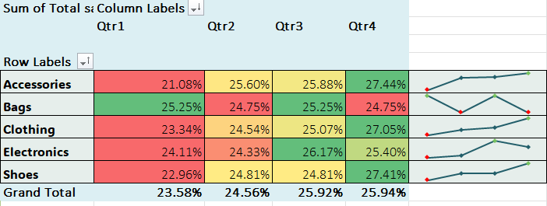
3-How do total revenue vary across different categories over time?
-All categories have the lowest total revenue in quarter 1 and increased in quarter 2 except the Bags category has the highest total revenue in quarter 1 and decreased in quarter 2.
-Electronics and Bags categories have the highest total revenue in quarter 3.
-Shoes, Clothing and Accessories have the highest total revenue in quarter 4.
“ جميع الفئات لها اقل ايردات في الربع الاول من العام ثم تزداد اجمالي الاريادات في الربع التاني ما عدا فئة الحقائب يحدث لها العكس كما ان فئات الالكترونيات و الحقائب لهما اكبر ايرادات في الربع الثالث و الاكسسوارات و الاحذية والملابس لهم اكبر اجمالي ايرادات في اربع الرابع من العام “
Prepared by Eng Mohamed Anwar

Slide 10
Product analysis
1-What are the top 5 products that generated total orders?
-We note that the T-Shirt product generates the highest orders by 1005 pieces.
" منتج ال T-Shirt له أكبر عدد من الطلبات من بين افضل خمس منتجات لهم اكبر عدد من الطلبات بأجمالي 1005 قطعة "
Prepared by Eng Mohamed Anwar

Slide 11
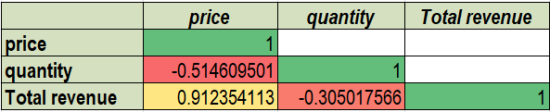
Diagnostic analysis
Correlation analysis
- We note that the price and quantity have a moderate inverse linear relationship, and the price and total revenue have a strong positive relationship.
" هناك علاقة خطية قوية طردية بين الاسعار و اجمالي الايرادات و علاقة خطية متوسطة عكسية بين الكميات و الاسعار "
Prepared by Eng Mohamed Anwar

Slide 12
1- Why there is a strong linear relationship between price and total revenue?
- Because when the sale processes increase then the demand for products increases then total revenue increases especially when the prices of the category’s products are high and have big orders like the Electronics category, clothing has the second-highest demand but its prices are cheap compared with Electronics.
" لأن عند زيادة عمليات البيع يزداد الطلب على المنتجات فتزداد الايرادات وبالاخص عندما يكون سعر المنتج كبير ولها طلب كبير مثلا الالكترونيات, أما الملابس لها ثاني اكبر طلب ولكن اسعارها رخيصة مقارنة بأسعار الالكترونيات"
-Total demand represent the bubble size
Prepared by Eng Mohamed Anwar

Slide 13
2- Why there is a moderate inverse linear relationship between price and quantity?
-Because the price increases, the quantities taken for one product during the purchasing process decrease. Products with high prices are sold in smaller quantities, such as in electronics products. The total demand for products also affects the quantities sold at different prices.
" لان بزيادة السعر تقل الكميات المأخوذة للمنتج الواحد اثناء عملية الشراء, فالمنتجات التي لها اسعار عالية تباع بكميات اقل كما في منتجات الالكترونيات, كما ان اجمالي الطلب على المنتجات يؤثر أيضا على الكميات المباعة باختلاف الاسعار "
-Total demand represent the bubble size
Prepared by Eng Mohamed Anwar

Slide 14
Predictive analysis
Forecasting model
What will happen to the total revenue in the next 4 months?
- We note that the total revenue will increase in the next 4 months and reach the highest total revenue by the end of March 2023, which means that the total revenue will increase by 2.8% from the highest total revenue in May 2022 and increase by 34% from the worst total revenue in Feb 2022.
" سوف تزداد الايرادات في الاشهر الاربعة القادمة و تصل الى القيمة العظمى بنهاية شهر مارس 2023 وهذا يعني ان اجمالي الايرادات ستزداد بنسبة 2.8% من اعلى ايرادات لدينا في شهر مايو 2022 و ستزداد بنسبة 34% من اقل ايرادات التي بشهر فبراير 2022 "
Prepared by Eng Mohamed Anwar

Slide 15
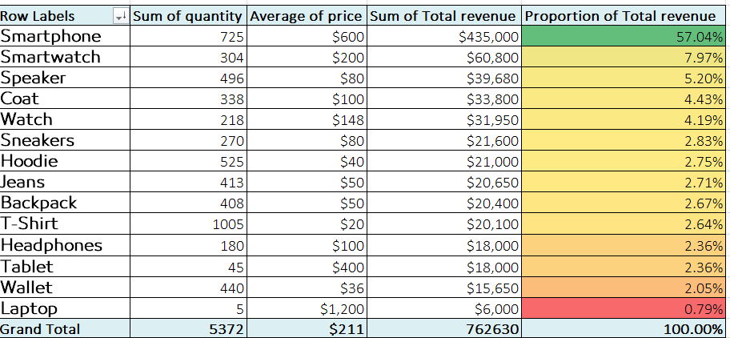
Prescriptive analysis
How can we simulate the best total revenue values for the products?
Prepared by Eng Mohamed Anwar

Slide 16
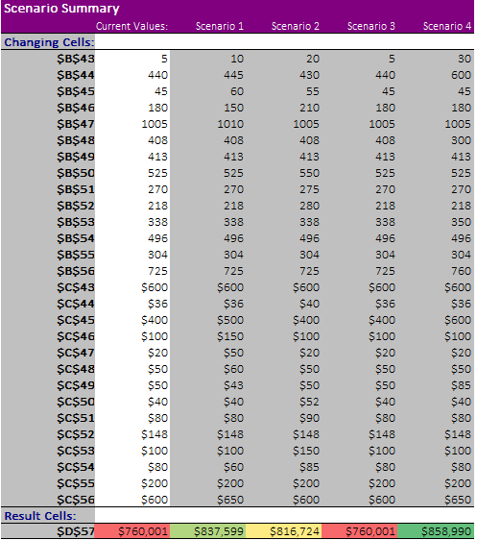
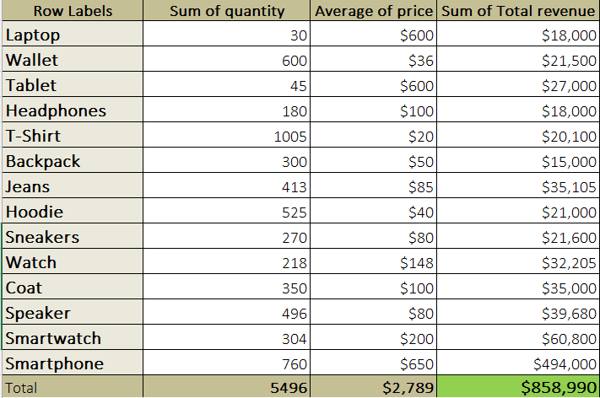
The best scenario for total revenue
- Scenario 4 has the highest total revenue $858,990 which increased by 13% from the old total revenue.
" السيناريو رقم 4 له افضل اجمالي ايرادات 858,990$ حيث ازدادت الايرادات بمعدل 13% من الايرادات الاخيرة "
Prepared by Eng Mohamed Anwar

Slide 17

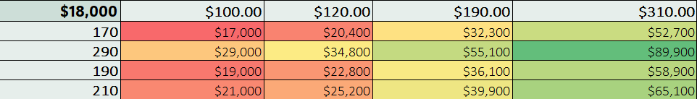
The best scenarios for headphones
What is the best price and quantity can we simulate to achieve the highest total revenue for the headphones?
- If we sell 290 pieces of headphones with a $310 price for each unit we will get the highest total revenue $89,900 which increased by 399.4% from the old total revenue.
" أذا قمنا ببيع 290 قطعة من منتج سماعات الرأس بسعر 310$ لكل وحدة سنحصل على اعلى اجمالي ايرادات من بيع سماعات الرأس 89,990$ حيث ازدادت الايرادات بمعدل 399.4% من الايرادات الاخيرة "
Prepared by Eng Mohamed Anwar

Slide 18
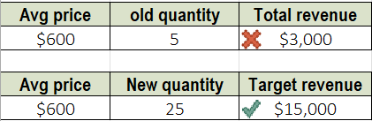
Goal seek
We want to reach the goal of 15,000 total revenue from selling the Laptops. How many quantities should we sell to achieve this target?
- We should increase the quantity to sell 25 pieces to increase the old total revenue from selling laptops by 5 times to achieve $15,000 total revenue.
" يجب علينا زيادة كميات اللابتوب المباعة الى 25 قطعة لزيادة اجمالي الايرادات الى 5 اضعاف قيمتها للوصول الى 15,000$ اجمالي ايرادات "
Prepared by Eng Mohamed Anwar

Slide 19
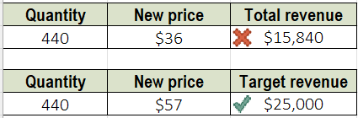
We want to reach the goal of 25,000 total revenue from selling the Wallet. What is the price of the wallet should we set to achieve this target?the
- We should increase the price to $57 to increase the old total revenue from selling wallets by 66.6% to achieve $25,000 total revenue.
" يجب علينا زيادة سعر المحفظة الى 57$ لزيادة اجمالي الايرادات بمعدل 66.6% للوصول الى 25,000$ اجمالي ايرادات "
Prepared by Eng Mohamed Anwar

Slide 20
Thank You
Prepared by Eng Mohamed Anwar

