Slide 1



The rise of robinhood: can millennial money move the market?
Camillo D’orazio, Greg Terrinoni, Todd shevlin, Daniel singer

Slide 2
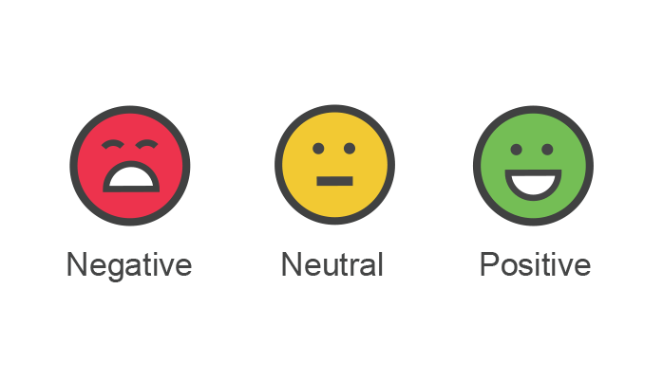





Q: Does social media chat impact momentum stock prices?
Stock basket – most popular
hypothesis
GME – Game stop
TLSA – Tesla
PLTR – PaLANTir
Plug – plugpower
Nio – nio inc.
Sentiment ( both positive and negative ) will have an observable impact on the movement of stock prices
Increase in millennial stock investing via platforms like robinhood is a driver

Slide 3
Modelled with NLP & neural network
DATA
NLP
LSTM
APIs via quandl/alpaca/yahoo finance, reddit (Wall Street Bets), stocktwits
NLTK & TEXTBLOB for ‘number of likes’ and sentiment scores
Tensorflow/Keras ➔LSTM RNN for stock price prediction,
3 feature model: 1. lagged prices & 2 sentiment scores
Two wrappers for reddit API, PRAW & PSAW

Slide 4
Data issues
Data Wrangling:
Data Structuring/Processing:
twitter had limited free access to twEEts (limit to most recent 100) per call
STOCKTWITS BACKEND API NOT working, so had to access it through the front end
only USED (30 twIts/day) over 3 months, ~we used 900 tweets total
Ended up creating CSV's as a work-around - in a prod environment we would use the API calls
Had to modify join, merge, etc - to get the data into a consistent format to read into the model.
Used NLTK and TextBlob to obtain sentiment - TB required some tuning to optimize the speed.
Built separate NLP import file to manage the differences in data structures, run the sentiment models, and output the dataframes
Built separate import file to run the LSTM model, including multiple features (price, and both sentiments)
Ran parameter sweeps to optimize the LSTM model

Slide 5
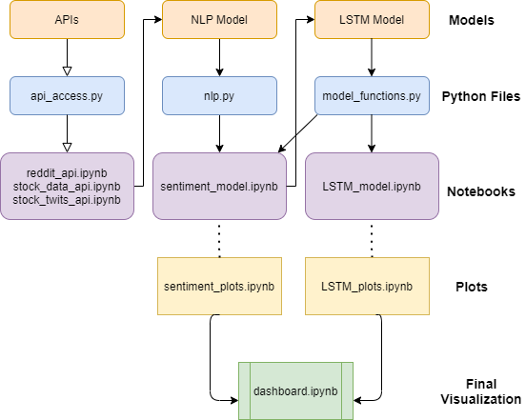
MODEL DEVELOPMENT
Process/document flowchart
Analytical method
Averaged nltk & TexTblob scores separately, grouped by day, to generate sentiment score
Given ‘Likes’, ‘upvote ratios’, ‘Bullish/bearish’ ➔plotted additional validation metrics
Built 2 LSTM models, 1-feature (lagged price), and 3-feature (+2 sentiment scores) to determine whether sentiment improved prediction accuracy
TRIAL & ERROR: Epochs, batch-size, window size

Slide 6
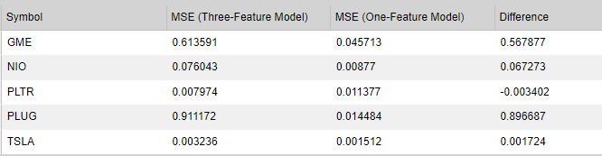
MODEL EVALUATION
Results interpretation
MSE weaker for most stocks
3-Feature model had sporadic improvement in some short term movements, but was overall hurting model performance
Model was under fit (lack of other features like P/E Ratio), but not biased
Training set too small due to data limitations (back to sept 2020], and only 30 tweets per day (hurt the score accuracy)
The nomenclature on those websites is so driven by slang, the NLP can’t process it correctly
Need to train on a large reddit corpus, also have to manually annotate the training data
Not robust enough to draw conclusion of whether or not there is predictive power
STOCK SPECIFIC:
For GME, NIO, both models exhibited weak accuracy
For PLUG, the 3-feature model performed much worse than 1-feature
For PLTR, the 3-feature improved the accuracy of predicting the trend
TSLA, 3-feature improved short term vol but WAS Weaker OVERALL

Slide 7
Post-MORTEM
referencing incorrect dataframe, overwriting one class with another
API limitations ON RETRIEVING more data caused there to be insufficient data to train
With 2 more weeks, would add more features, increase the comparisons to evaluate which features improve the model strength (e.g. PE Ratio, Institutional % ownership)
Compare with other modelling approaches (e.g. logit)
TWITTER more accurate than reddit because its more straightforward/Formal

