Slide 1
Development of Azure Service Bus application with base on Spring Integration

Slide 2
CONTENTS
1
What is Spring Integration
2
Involving Azure services(Partial)
3
Integrate Spring to connect to Service Bus

Slide 3
What is Spring Integration
Official Introduction
Extends the Spring programming model to support the well-known Enterprise Integration Patterns. Spring Integration enables lightweight messaging within Spring-based applications and supports integration with external systems via declarative adapters. Those adapters provide a higher-level of abstraction over Spring’s support for remoting, messaging, and scheduling. Spring Integration’s primary goal is to provide a simple model for building enterprise integration solutions while maintaining the separation of concerns that is essential for producing maintainable, testable code.
Important
Support enterprise integration patterns
Lightweight messaging within Spring-base apps
External system with declarative adapters(high-level abstraction)
Simple model
Refer links: Spring Integration

Slide 4
Involving Azure services(Partial)
Service Bus
Microsoft Azure Service Bus is a fully managed enterprise integration message broker. Service Bus can decouple applications and services.
Basic features: Topics and subscriptions
Advanced features: Message sessions, Auto forwarding, Dead-letter queue etc.
Event Hubs
Azure Event Hubs is a big data streaming platform and event ingestion service. It can receive and process millions of events per second. Data sent to an event hub can be transformed and stored by using any real-time analytics provider or batching/storage adapters.
Support for real-time and batch processing
Scalable(Auto-inflate)
Rich ecosystem(Kafka)
Refer links: Azure Service Bus Azure Event Hubs
Notes:
aaaa

Slide 5
Integrate Spring to connect to Service Bus
Method 1: Introduction
Interact with Spring JMS, use JmsTemplate to send message, and use JMS listener to listen the message.
Quick start for [azure-servicebus-jms-spring-boot-starter]:
Create Service Bus, Queue | Topic resource in Azure cloud
Create Namespace for Service Bus, then create entities(Queue or Topic)
Sample app properties
spring.jms.servicebus.connection-string
-- From namespace of service bus setting – Shared access policies – Primary Connection String
spring.jms.servicebus.idle-timeout
-- Millisecond value, default is 1800000
Inject JmsTemplate and use JmsListener annotation

Slide 6
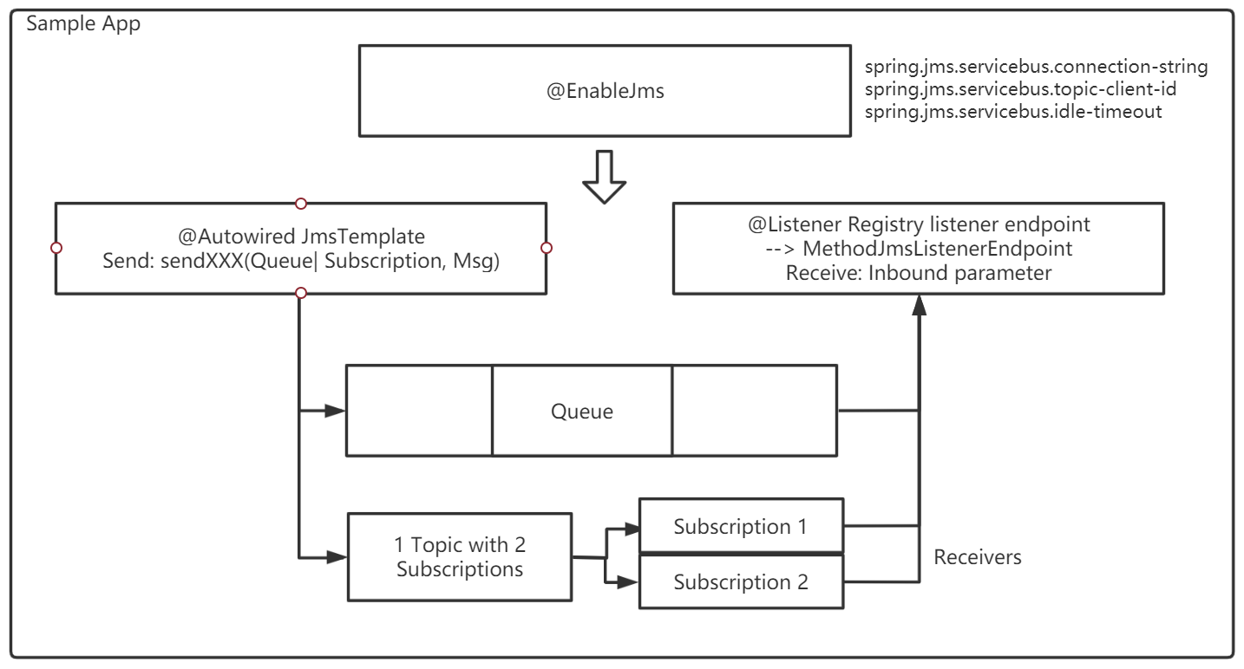
Integrate Spring to connect to Service Bus
Method 1: Source code analysis – Sample App

Slide 7
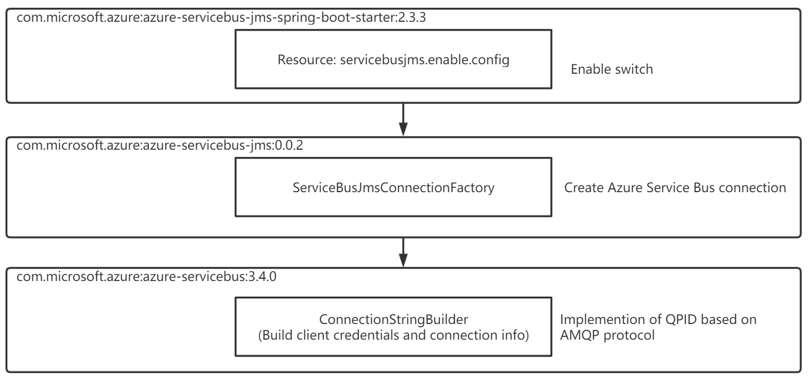
Integrate Spring to connect to Service Bus
Method 1: Source code analysis – azure-servicebus-jms-spring-boot-starter

Slide 8
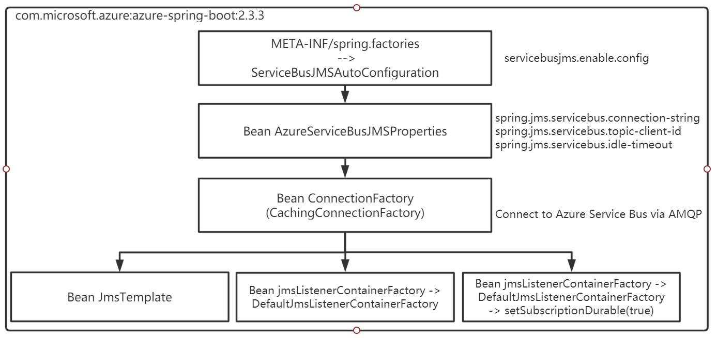
Integrate Spring to connect to Service Bus
Method 1: Source code analysis – azure-spring-boot

Slide 9
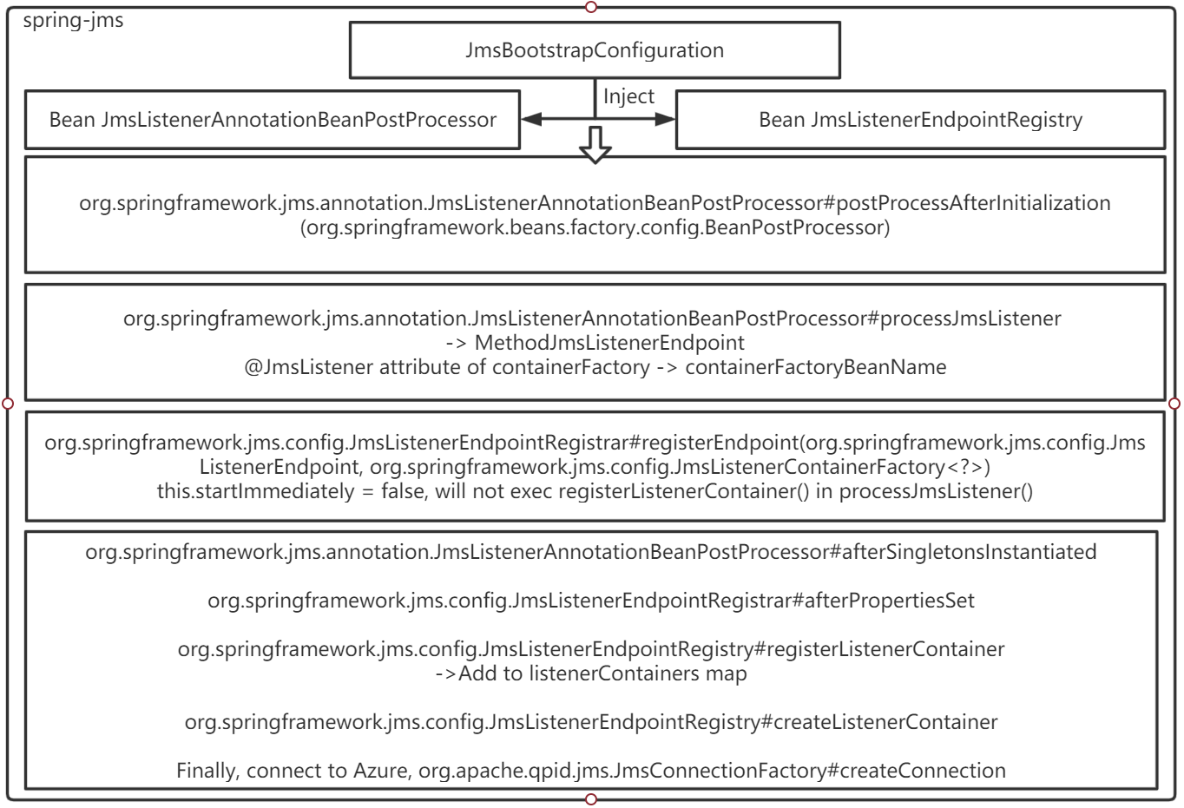
Integrate Spring to connect to Service Bus
Method 1: Source code analysis – spring-jms

Slide 10
Integrate Spring to connect to Service Bus
Method 2: Introduction
Azure Service Bus client library for Java, support Queue | Topic message process.
Quick start for [azure-messaging-servicebus]:
Create Service Bus, Queue | Topic resource in Azure cloud
Create Namespace for Service Bus, then create entities(Queue or Topic)
Sample app properties
azure.servicebus.connection-string
azure.servicebus.queue-name
azure.servicebus.queue-receive-mode (Default: PEEK_LOCK)
azure.servicebus.topic-name
azure.servicebus.subscription-name
azure.servicebus.subscription-receive-mode(Default: PEEK_LOCK)
Configure the sending and receiving client beans separately

Slide 11
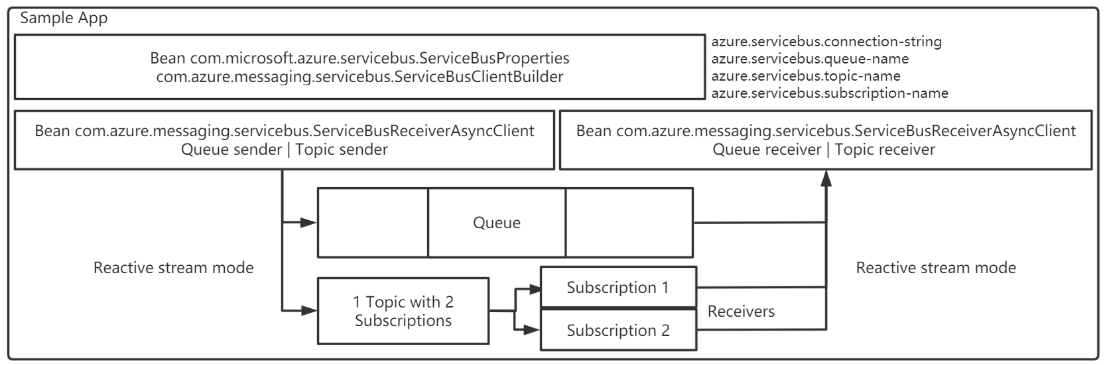
Integrate Spring to connect to Service Bus
Method 2: Source code analysis – Sample App

Slide 12
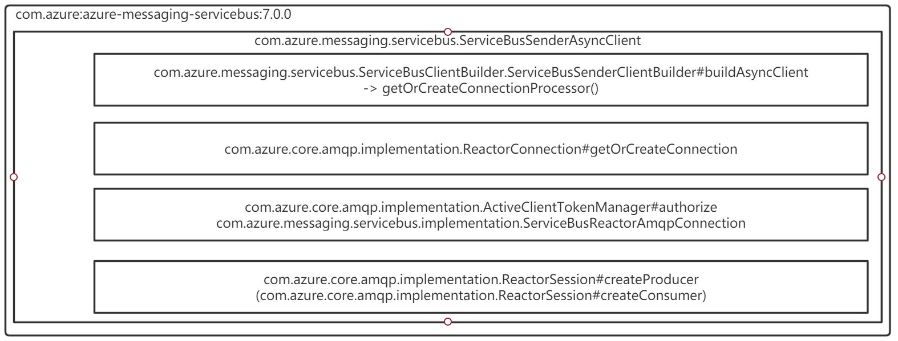
Integrate Spring to connect to Service Bus
Method 2: Source code analysis – azure-messaging-servicebus

