Slide 1
Handwritten Character Recognition
Using a From-Scratch NumPy Multi-Layer Perceptron
Mohamed Alaa Shebl Mohamed | 230504583
Artificial Neural Networks — Istanbul Atlas University
April 2025

Slide 2
Problem Statement & Objective
THE PROBLEM
PROJECT SCOPE
Automatically classify handwritten English letters A–Z from grayscale images using an Artificial Neural Network built entirely from scratch with NumPy — no TensorFlow or PyTorch.
Multi-class classification (26 classes: A–Z)
From-scratch NumPy implementation (no ML libraries)
MLP architecture: 784 → 256 → 128 → 26
ReLU hidden activation + Softmax output
Cross-entropy loss + mini-batch gradient descent
Tkinter GUI with live training visualization
Logic gate demonstrations (AND, OR, XOR)
OBJECTIVES
Build a complete MLP with backpropagation from scratch
Train and evaluate on 762K+ handwritten character images
Provide an interactive GUI for training and prediction
Demonstrate ANN concepts with logic gate examples

Slide 3
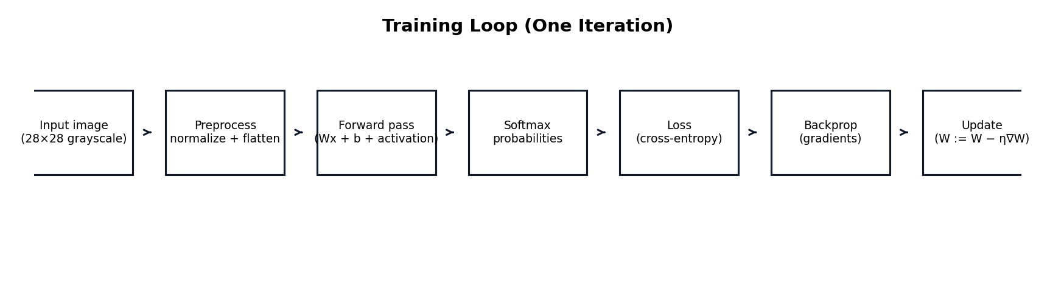
Project Pipeline Overview
01
02
03
04
05
Dataset (.npz)
Preprocessing
MLP Training
Evaluation
GUI Prediction
→
→
→
→
762K grayscale images, 28×28
Normalize, flatten, label remapping
Forward + Backprop mini-batch SGD
Accuracy, loss, confusion matrix
Draw or upload image to classify
KEY PROJECT FILES
src/ann/mlp.py
Core MLP neural network implementation
src/ann/data.py
Dataset loading, preprocessing, train/test split
src/ann/utils.py
One-hot encoding, metrics, confusion matrix
train_mlp.py
Command-line training and evaluation
gui_app.py
Interactive Tkinter GUI application

Slide 4
Dataset Overview
762,213
28 × 28
26
Grayscale
Total Images
Image Size (px)
Classes (A–Z)
Color Mode
DATASET DETAILS
PREPROCESSING PIPELINE
Source: Kaggle Alphabet Characters Fonts Dataset
Includes handwritten character samples
Stored as NumPy .npz format (images + labels)
Class imbalance: min 16,109 — max 72,816 per class
Stratified split preserves class proportions
Split: 80% train / 20% test (seed=42)
Resize to 28×28 (bilinear interpolation)
Normalize pixels: [0, 255] → [0.0, 1.0]
Flatten: 28×28 → 784-element vector
Remap labels to contiguous 0–25
GUI: auto-crop, center, autocontrast
GUI: dual polarity (normal + inverted)

Slide 5
MLP Architecture & Design
Input
Hidden 1
Hidden 2
Output
784 neurons
256 neurons
128 neurons
26 neurons
→
→
→
28×28 pixels flattened
ReLU activation
ReLU activation
Softmax (A–Z classes)
KEY EQUATIONS
PARAMETER COUNT
Forward: z = a·W + b, a = ReLU(z)
Softmax: P(class_i) = e^(z_i) / Σ e^(z_j)
Loss: L = -(1/m) Σ y·log(ŷ) (cross-entropy)
Backprop: δ = ŷ - y (output layer)
Update: W := W - η · ∇W
Layer 1 (784→256)
200,960
Layer 2 (256→128)
32,896
Layer 3 (128→26)
3,354
Total Parameters
237,210

Slide 6
Training Configuration
HYPERPARAMETERS
TRAINING FEATURES
Learning Rate
0.01
Mini-batch processing for memory efficiency
Data shuffling each epoch to prevent ordering bias
Epoch-level loss/accuracy tracking
Validation monitoring after each epoch
Early stopping with best-weights restoration
Reproducible splits with fixed random seeds
Epoch callbacks for GUI live updates
Background thread training (GUI stays responsive)
Batch Size
256
Max Epochs
20
Early Stopping
Patience = 5
Validation Split
10% of training data
Test Split
20% of full dataset
Activation (Hidden)
ReLU
Activation (Output)
Softmax
Initialization
He (ReLU) / Xavier (Sigmoid)
Optimizer
Mini-batch Gradient Descent
Random Seed
42

Slide 7
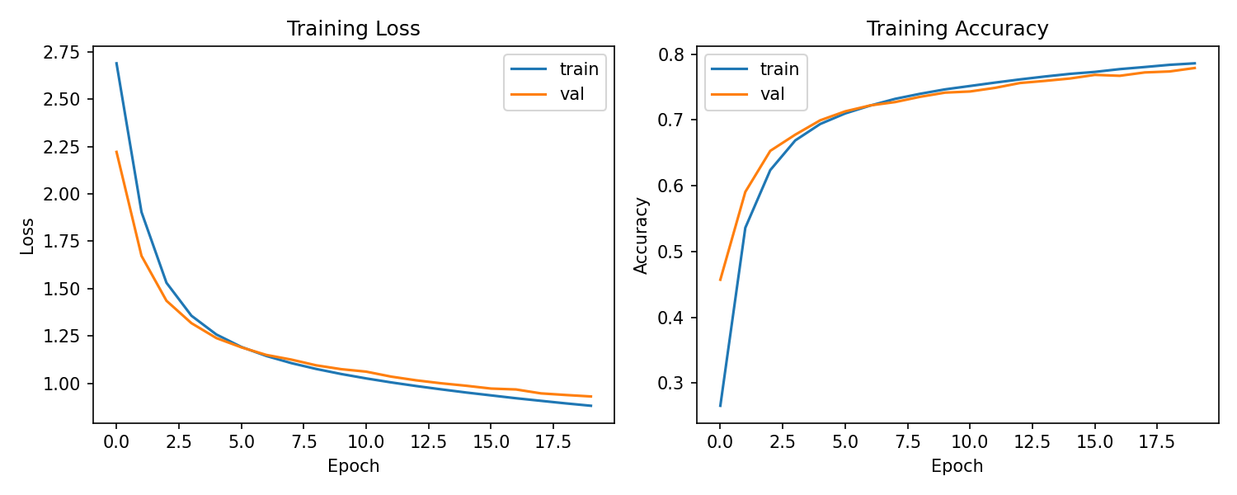
Results & Evaluation
78.15%
0.8996
152,452
237,210
Test Accuracy
Test Loss
Test Samples
Parameters
TRAINING CURVES

Slide 8
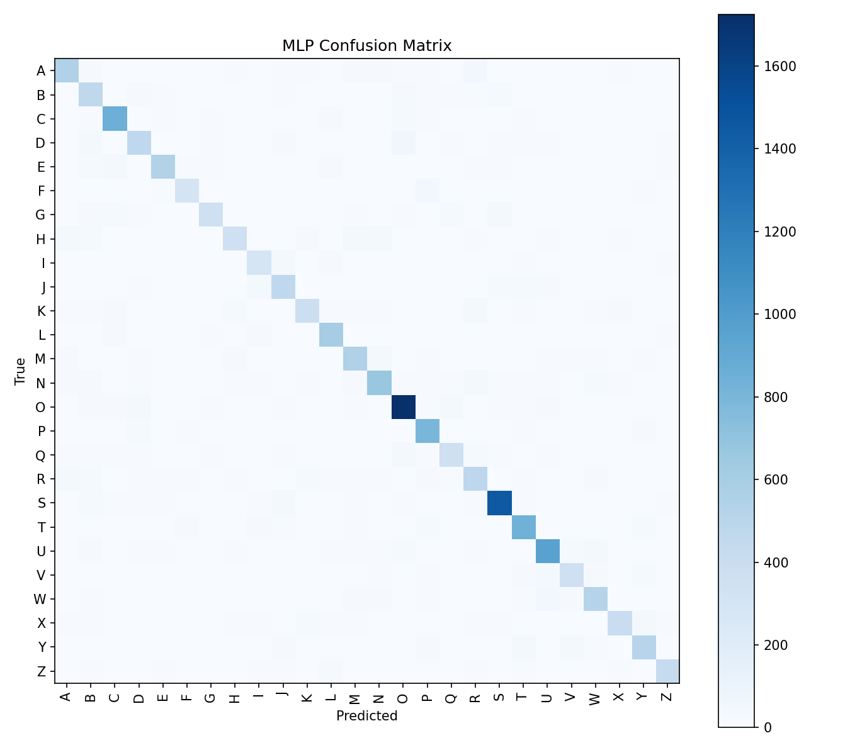
Confusion Matrix & Error Analysis
TOP CONFUSIONS
D → O
474
Similar round shapes
Y → V
336
Similar angular form
F → P
317
Similar top structure
I → J
315
Similar vertical strokes
Q → O
312
Q without tail = O
H → N
298
Similar stroke patterns
E → C
280
Similar curved shape
Visually similar letters are the primary source of errors.

Slide 9
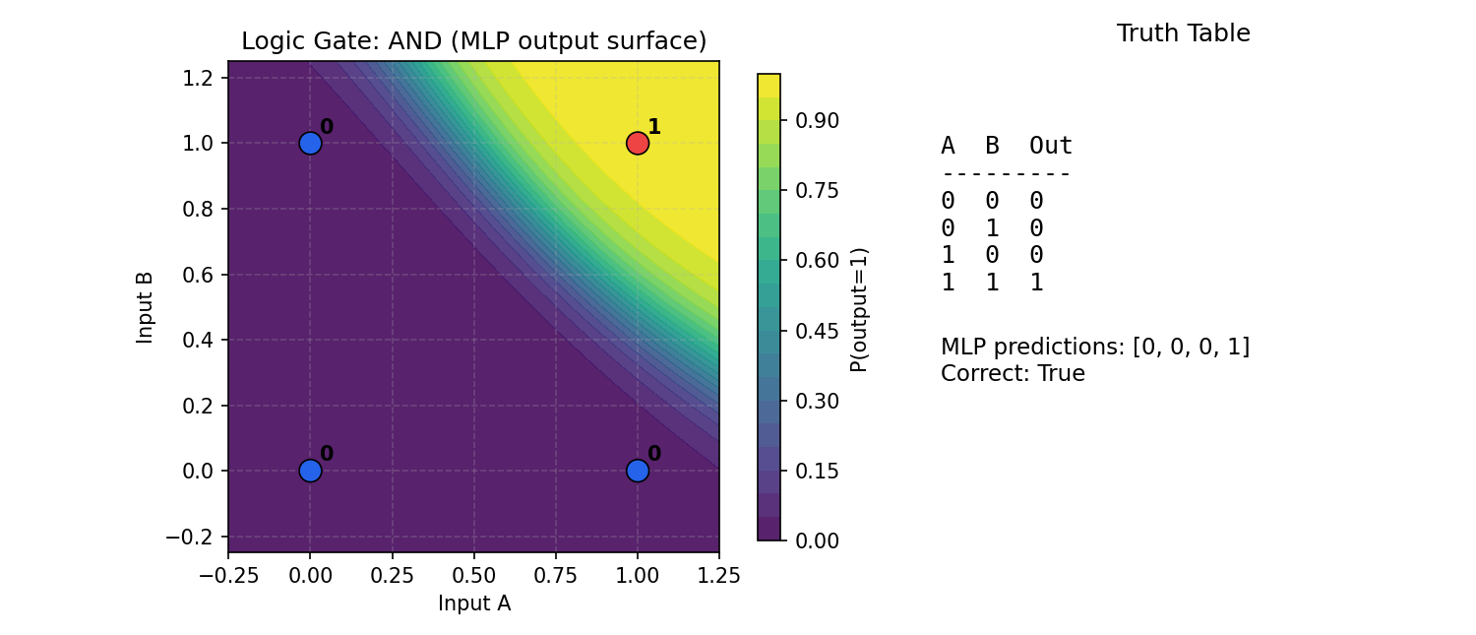
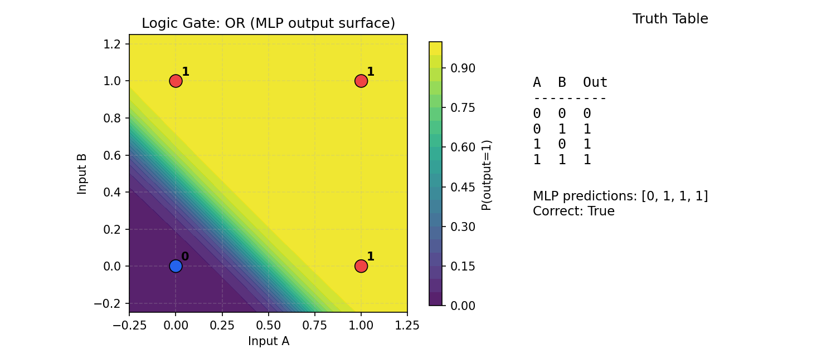
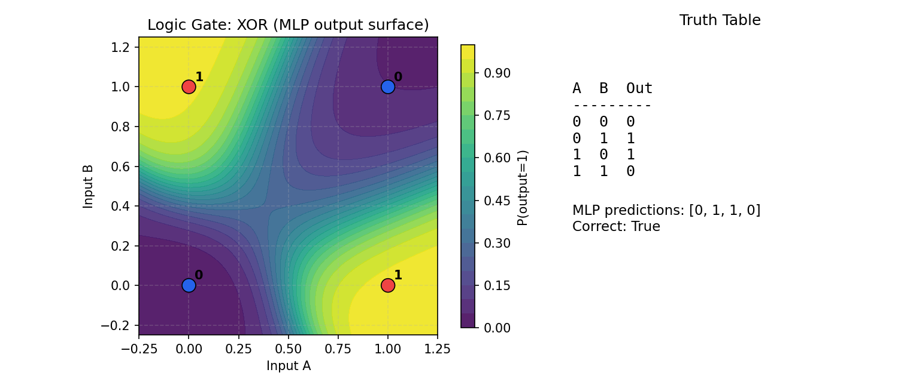
Bonus: Logic Gate Demonstrations
AND Gate
OR Gate
XOR Gate
Linearly Separable ✓
Linearly Separable ✓
NOT Linearly Separable ✗
XOR demonstrates why hidden layers are essential — a single-layer perceptron cannot solve non-linearly separable problems.

Slide 10
Interactive GUI Application
GUI FEATURES
TECHNICAL DESIGN
Browse and select any .npz dataset file
Configure all hyperparameters from the interface
Train model with live loss/accuracy curve updates
Drawing canvas (320×320) with adjustable brush
Upload external images for classification
Predicted class with confidence percentage
Top-k predictions displayed in table format
Probability bar chart visualization
Background thread training (GUI stays responsive)
Model save/load functionality
Built with Python Tkinter + Matplotlib embedding
Thread-safe queue-based event system
Worker thread for training, main thread for UI
Event polling via Tkinter after() every 80ms
PIL-based image preprocessing pipeline
Auto-detects dark/light background polarity
Dual prediction: tries normal + inverted input
Graceful error handling with user-friendly messages
Status log with automatic line trimming
Proper cleanup on window close

Slide 11
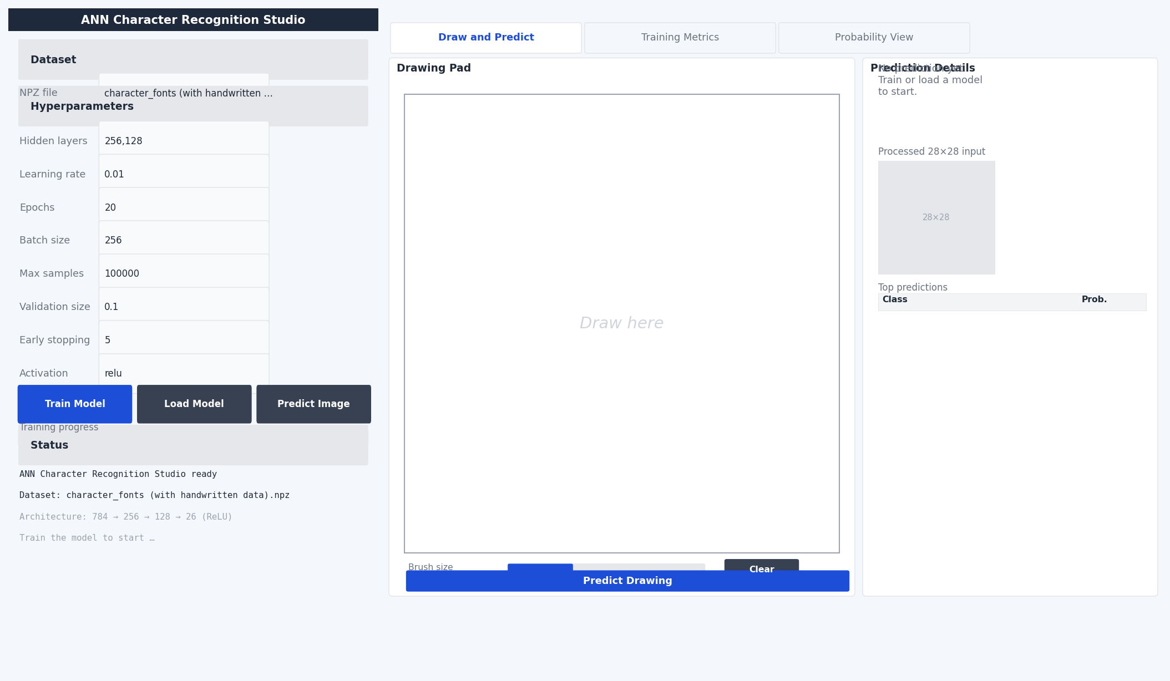
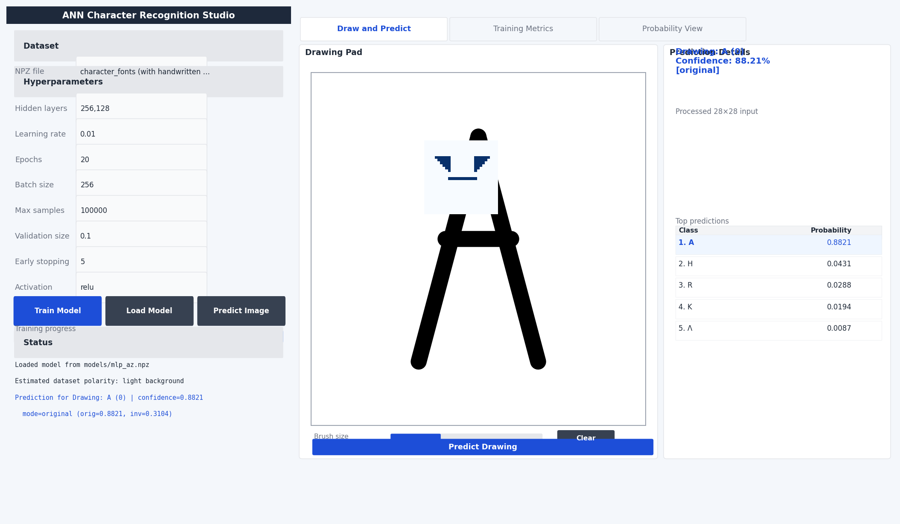
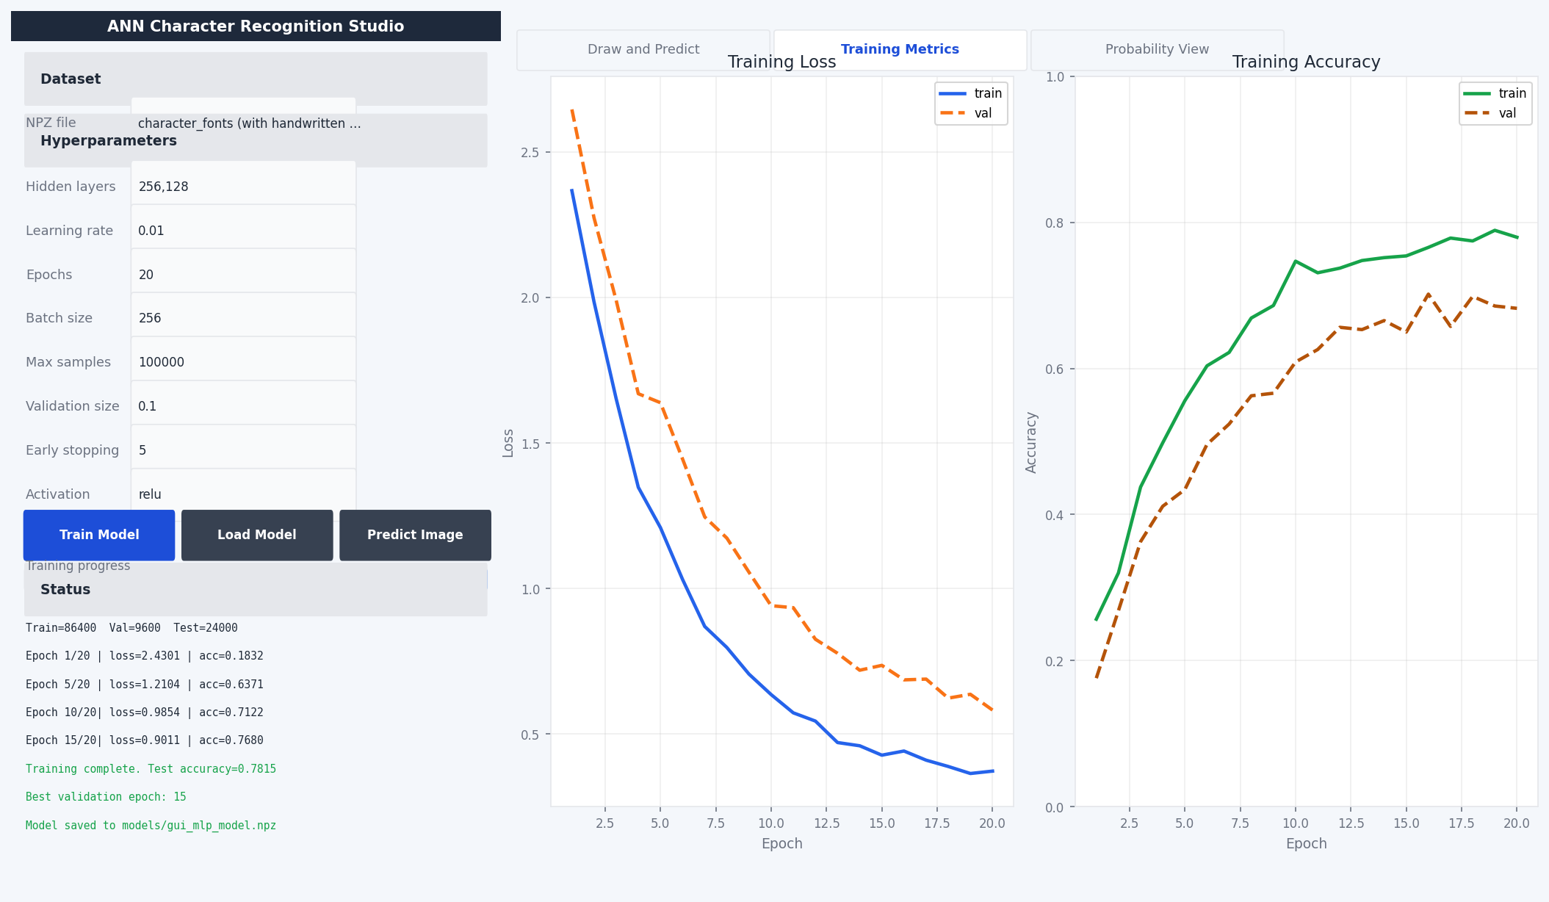
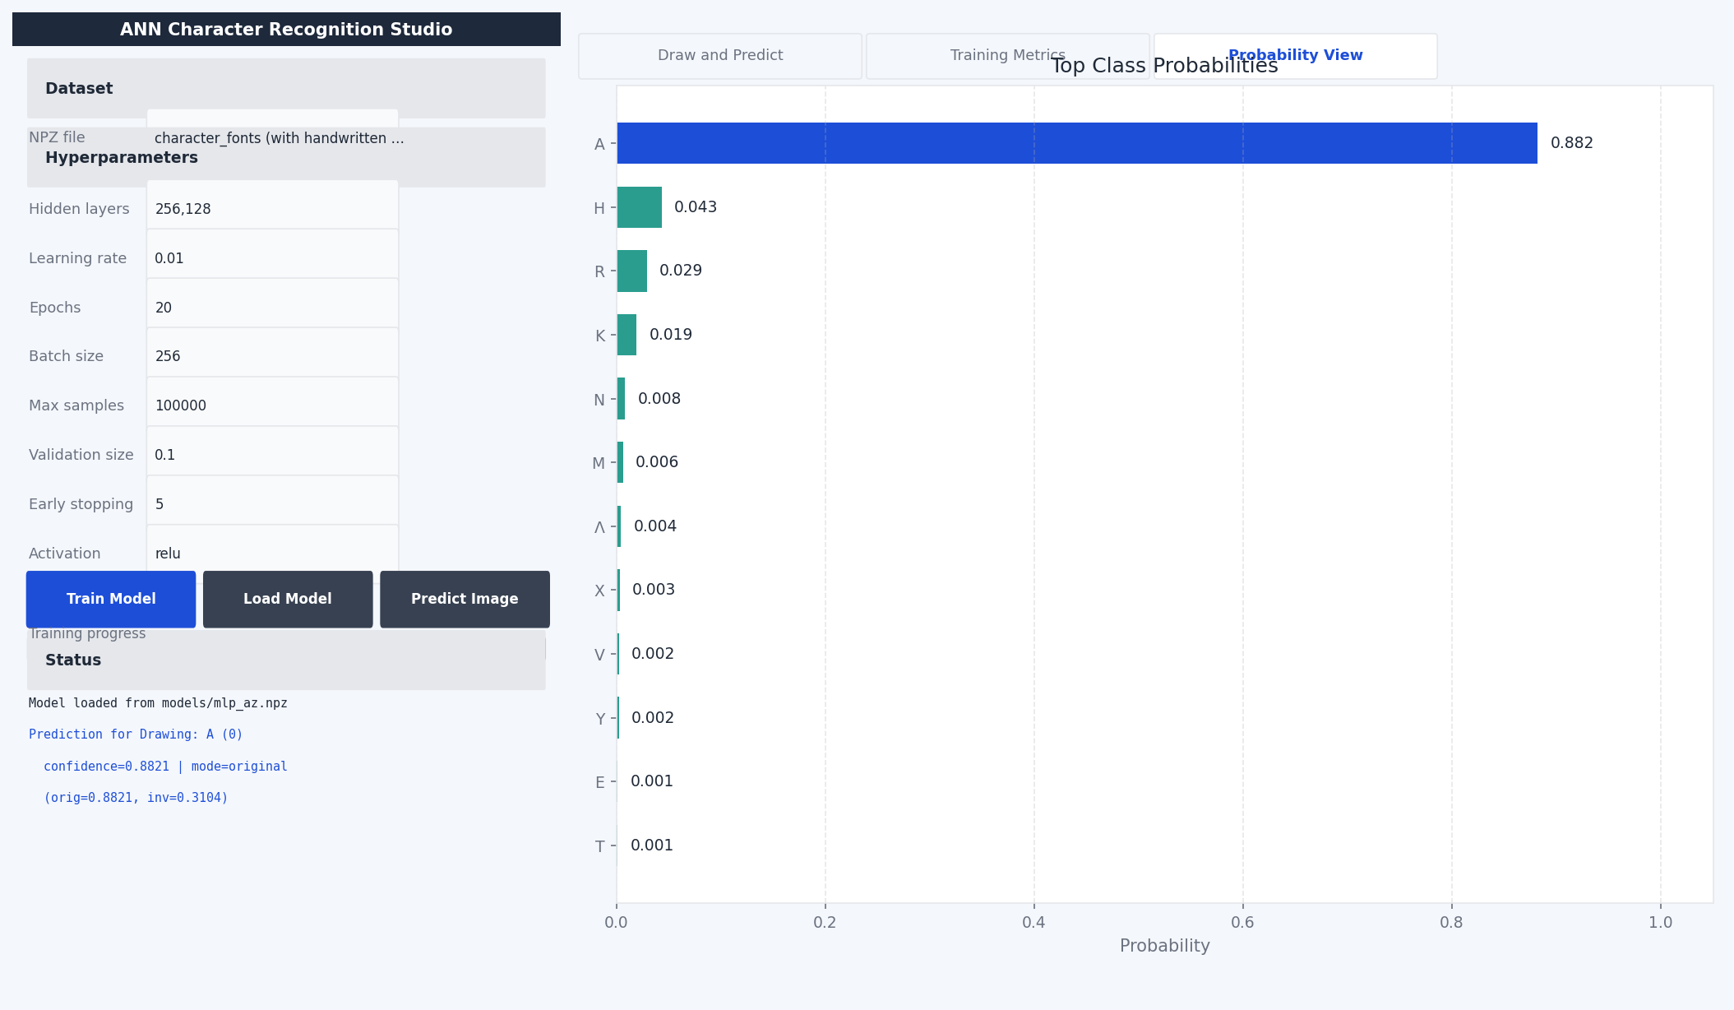
GUI Screenshots — Application in Action
Main Window — Draw & Predict Tab
After Prediction — Letter 'A' Drawn
Training Metrics — Live Loss/Accuracy
Probability View — Top Class Chart

Slide 12
Limitations & Future Work
CURRENT LIMITATIONS
FUTURE IMPROVEMENTS
MLP on raw pixels — no spatial feature extraction
CNNs significantly outperform MLPs on image tasks
Class imbalance biases predictions toward common classes
No data augmentation (rotation, shift, noise)
Fixed learning rate throughout training
No regularization (dropout, L2 penalty)
Upgrade to CNN architecture for spatial features
Add data augmentation pipeline (rotations, shifts)
Apply class weighting or focal loss for imbalance
Implement learning rate scheduling / Adam optimizer
Add dropout and L2 regularization
Extend to lowercase letters, digits, and symbols

Slide 13
Conclusion
From-Scratch ANN
78.15% Accuracy
Complete MLP implementation using only NumPy — forward pass, backpropagation, softmax, cross-entropy, mini-batch SGD
Trained on 762K images and evaluated on 152K test samples with reproducible stratified splits
Interactive GUI
ANN Concepts Demo
Full Tkinter application with live training plots, drawing canvas, image upload, and probability visualization
Logic gate examples (AND, OR, XOR) illustrate linear separability and the need for hidden layers
This project demonstrates a strong understanding of ANN fundamentals through a complete, functional, and well-documented implementation.

Slide 14
Thank You
Questions & Discussion
Mohamed Alaa Shebl Mohamed | 230504583
Artificial Neural Networks — Istanbul Atlas University

