Slide 1
VIPP FINAL PRESENTATION
Preview-based active suspension for rollover margin in cornering over road defects
September 2026
American University of Beirut
Moataz Maarouf
Notes:
Final results of VIPP. Two studies: what feedback active suspension does on a straight rough road with defects, and whether preview of the road and of the planned lateral acceleration protects the rollover margin when a defect is met in a corner.

Slide 2
VIPP Final Presentation
OUTLINE
01.
04.
Setup: model, metric, scenario
Study 2: baseline and statistical results
02.
05.
Study 1: feedback in straight-line driving
Study 2: generalisation, severity, actuator
03.
06.
Study 2: cornering limits and controllers
Discussion and conclusion

Slide 3
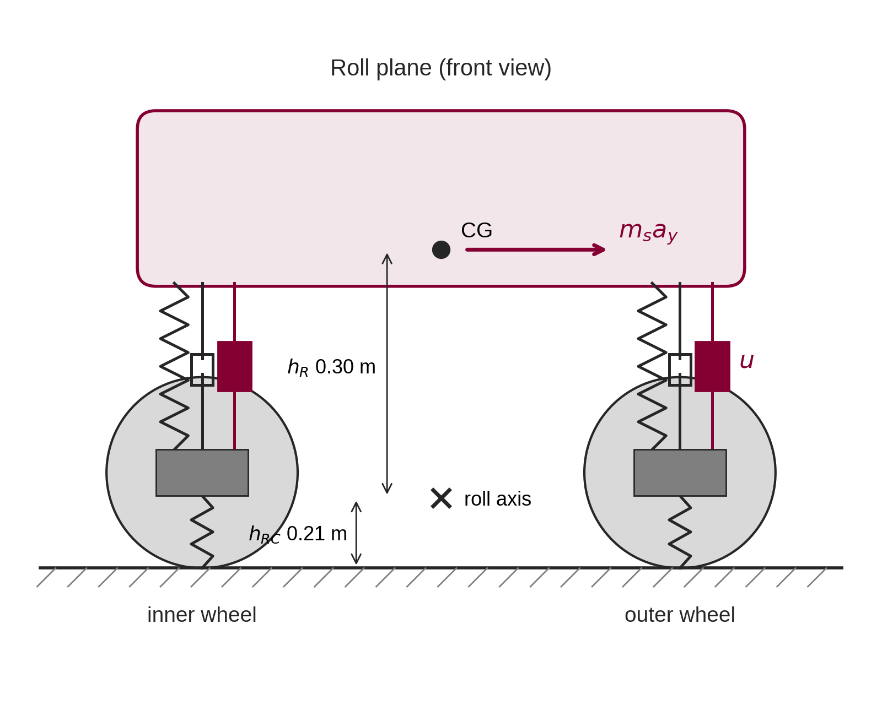
VIPP Final Presentation
1. SETUP: MODEL AND METRIC
Research question
How much rollover margin can active suspension protect when a defect has to be ridden over in a corner?
7-DOF full car: heave, pitch, roll and four wheel hops; 14 states, 1500 kg sprung mass
Tyres cannot pull: F_{n} = 0 means the wheel has left the road
Limits: ±100 mm travel with bump stops, ±15 kN actuator force
Corner input: a_{y} from the path planner; no lateral or yaw dynamics
Metric: load-transfer ratio
LTR = (ΣF_{outer} − ΣF_{inner}) / (ΣF_{outer} + ΣF_{inner})
0
level
0.6
incipient
1.0
trip condition
Trip condition = both inner wheels unloaded: necessary for untripped rollover, not a rollover event.
Notes:
Research question and the model in one slide. Seven-degree-of-freedom full car, tyres that cannot pull, travel and force limits. Lateral acceleration is an input from the path planner: it both creates the corner and is the signal the preview controller can use. The rollover metric is the load-transfer ratio; LTR = 1 means both inner wheels are unloaded, which is necessary for untripped rollover but is not a rollover.

Slide 4
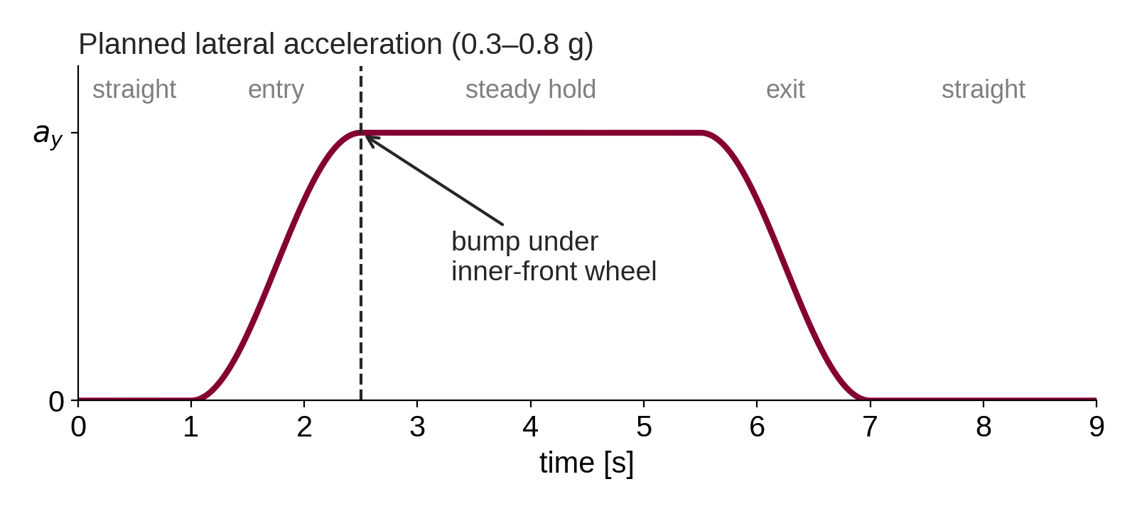
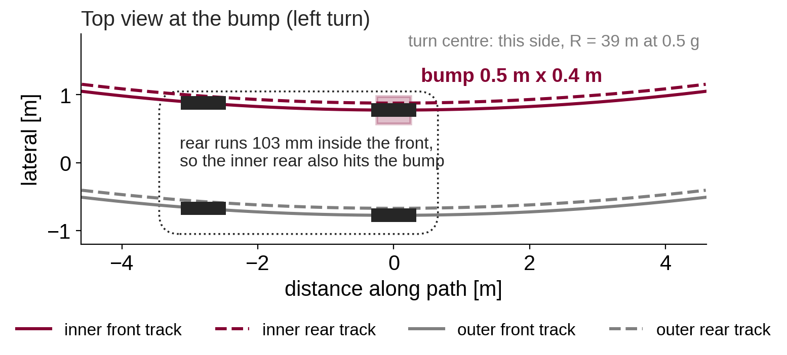
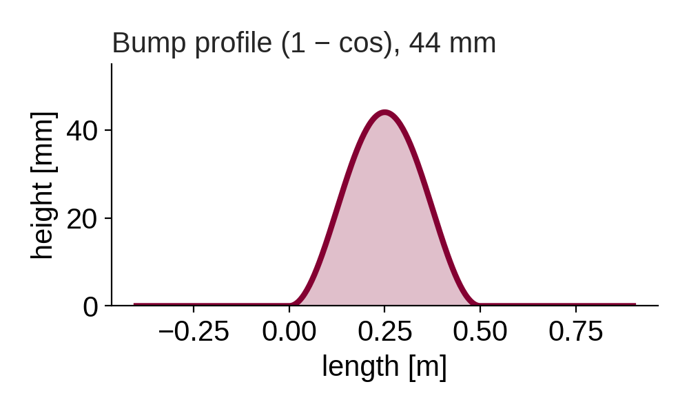
VIPP Final Presentation
1. SETUP: ROAD, CORNER, DEFECT
Road: ISO 8608 Class C, partially correlated left/right tracks, averaged over a 0.18 m tyre patch
Corner: 9 s manoeuvre with a 3 s steady hold; baseline 0.5 g, R = 39 m, 50 km/h
Defect: 44 mm × 0.5 m bump under the inner front wheel at the start of the hold; the inner rear meets it 0.2 s later
Twin defect: a second bump one wheelbase later unloads both inner wheels together
Notes:
Class C road at 50 km/h. Nine-second left turn: straight, 1.5 s ramp in, 3 s steady hold, ramp out. Baseline 0.5 g at 39 m radius; sweeps go from 0.3 to 0.8 g. A 44 mm, 0.5 m bump sits under the inner front wheel at the start of the hold. The rear axle runs 103 mm inside the front, so the footprint is widened and the inner rear also hits it about 0.2 s later. The twin-defect case adds a second bump one wheelbase later.

Slide 5
STUDY 1
Feedback control in straight-line driving
What output-weighted LQR achieves on a rough road and at a discrete defect: the baseline Study 2 departs from.
Notes:
Study 1 fixes the baseline: what a feedback active suspension can and cannot do before the corner is added.

Slide 6
VIPP Final Presentation
2. STUDY 1: PASSIVE CAR ON A DEFECT ROAD
Passive, 50 km/h, 60 s | Class C | + defects | change
W_{k} heave RMS [m/s²] | 0.679 | 0.723 | +6.5 %
VDV ratio | 1.31 | 1.40 | +7.4 %
Dynamic load coefficient | 0.181 | 0.193 | +6.4 %
Crest factor | 3.86 | 5.70 | +47.6 %
Suspension travel, max [mm] | 32.4 | 70.1 | +116 %
Minimum normal force [N] | 1048 | 0 | −100 %
Time off the road [s] | 0.000 | 0.140 | —
Lift events | 0 | 9 | —
LTR, max | 0.232 | 0.537 | —
+6.5 %
weighted heave acceleration with defects: comfort stays in the same ISO 2631-1 band
9 lifts
0.140 s off the road, longest 20 ms; minimum tyre load falls from 1048 N to 0
Averages barely move; road holding fails. The safety case sits at the discrete defect.
Baseline vehicle of Table I, ISO 8608 Class C. Static load 3973 N per corner.
Notes:
Straight line, 50 km/h, 60 s. On Class C alone the tyres stay loaded: minimum normal force 1048 N, DLC 0.181, no lift. Adding discrete defects barely moves the comfort averages but changes road holding qualitatively: nine lift events, 0.140 s off the road, travel doubles. Averaged metrics understate the defect.

Slide 7
VIPP Final Presentation
2. STUDY 1: PASSIVE TRADE-OFF AND LQR TUNING
Passive design sweep
Active LQR: selection rule
25 designs: ride frequency 1.00–1.60 Hz × damping ratio 0.15–0.45. 12 lie on the comfort / road-holding Pareto front.
1
90 candidate gains: comfort vs road-holding priority α × actuator-effort penalty ρ
Pareto endpoint | W_{k} [m/s²] | DLC
Best comfort | 0.512 | 0.249
Best road holding | 0.760 | 0.177
2
Each simulated on 9 nonlinear tuning cases, actuator saturated at ±15 kN
3
Admitted only if: travel limit held, no lift on Class C, ≤ 20 ms extra lift on defect roads, ≤ 1 % saturation, comfort and road holding within 5 % of passive
Endpoint to endpoint: DLC changes 40 %, working space 106 %
No tuning reaches the ISO 2631-1 “not uncomfortable” band
Reference for the active car: balanced point, 1.00 Hz, ζ = 0.30
Selected gain: α = 0.05, ρ = 300
Notes:
First the passive design itself: 25 spring/damper tunings, 12 on the Pareto front. No tuning reaches the 'not uncomfortable' band. The balanced point is the mechanical reference, so passive and active differ only by the actuator force. Then 90 LQR candidates were screened with a strict acceptance rule; the selected gain is alpha = 0.05, rho = 300.

Slide 8
VIPP Final Presentation
2. STUDY 1: WHAT FEEDBACK ACHIEVES
−0.4 %
−0.3 %
W_{k} heave RMS
dynamic load coefficient
+4 %
0.02 kN
pitch and roll RMS
actuator RMS (limit 15 kN)
No candidate prevents wheel lift at a defect. State feedback acts on the car’s own motion, so it responds only after the wheel is struck.
Same mechanics, roads and defect placements; only the actuator force differs. Gains up to ≈ 11 % on W_{k} exist but raise DLC or attitude above passive.
Notes:
Matched passive against the selected LQR on six road scenarios, ten roads each. Gains are fractions of a percent; the actuator barely works. Wheel lift at the defects is identical to the millisecond in every scenario: state feedback can only respond after the wheel is struck. That is the limitation preview removes.

Slide 9
VIPP Final Presentation
2. STUDY 1: WHAT CARRIES FORWARD
01
02
03
Class C: tyres stay loaded
Feedback cannot stop the lift
Roll matters only in a corner
On a maintained road, active control is a comfort and attitude tool. The safety case has to be made at discrete defects.
Lift time is unchanged to the millisecond at every weighting tested: a structural limit, not a tuning one.
Straight-line roll is small and road-induced. In a corner, roll and lateral load transfer set the rollover criterion.
→ focus on the defect
→ motivates preview
→ motivates cornering
Study 2 asks the cornering question with preview control.
Notes:
Three conclusions. On a maintained road the passive car keeps its tyres loaded, so the safety case is at defects. Feedback cannot stop the lift at a defect, for a structural reason: that motivates preview. Straight-line roll has no safety meaning; in a corner roll and lateral load transfer are the rollover criterion: that motivates the cornering scenario of Study 2.

Slide 10
STUDY 2
Preview control for rollover margin in cornering
Can the road ahead and the planned lateral acceleration protect the margin when a defect is met mid-corner?
Notes:
Study 2 is the core of the project: the cornering scenario, preview control, and the transient rollover metric.

Slide 11
VIPP Final Presentation
3. STUDY 2: WHAT CORNERING ALONE CAN DO
Steady corner: the car slides first
1.61 g
Linear statics: LTR = 0.6 at 0.97 g and LTR = 1 at 1.61 g, both above the tyre grip limit. In simulation the passive car crosses 0.6 only at 0.8 g and never trips.
lateral acceleration for LTR = 1 in a steady corner; tyres give about 0.8–0.9 g
What any suspension can change
(F_{out} − F_{in}) T/2 = m_{s} a_{y} h_{cg} + m_{u} a_{y} h_{u} + m_{s} g h_{R} sin φ
≈ 6 %
Actuator forces act between sprung and unsprung masses, so they drop out of this balance. Only the last term, the CG shift from body lean, is reachable.
of steady load transfer any suspension can remove at 0.5 g: ΔLTR ≈ 0.017 (0.307 → 0.288 without lean)
So target the transient peak at the defect.
Notes:
Two limits frame the study. Cornering alone cannot reach LTR = 1 on this car: that needs 1.61 g and the tyres saturate first. And in a steady corner the actuator forces are internal to the moment balance; only the CG shift from body lean is reachable, about 6 % of the load transfer. So the target is the transient peak at the defect.

Slide 12
VIPP Final Presentation
3. STUDY 2: CONTROLLERS COMPARED
P
A
B
Pv
Pa
Passive
Roll LQR
Roll + LTR LQR
Road preview
Road + a_{y} preview
ride-frequency springs and dampers
output-weighted feedback, roll angle weighted
A plus a load-transfer output in the cost
B plus 1.04 m of road ahead (75 ms)
Pv plus the planned lateral acceleration
BASELINE
FEEDBACK
FEEDBACK
PREVIEW
PREVIEW
Output-weighted LQR: body accelerations, travel, dynamic tyre load, roll angle and LTR as outputs; Bryson-normalised, rollover-led weights; discretised at 1 kHz
LQ preview: state augmented with a shift register of future disturbance samples, u_{k} = −K_{x} x_{k} − Σ K_{ff,j} w_{k+j}
Structure: K_{x} equals the ordinary LQR gain; preview gains follow a recursion and decay with lead time; the tail beyond the horizon is summed in closed form (matters for the steady a_{y})
Notes:
Five controllers. Passive is the ride-frequency design. A and B are output-weighted LQR on the full state with Bryson-normalised, rollover-led weights; B adds LTR as an output. Pv adds LQ preview of 1.04 m of road ahead; Pa also previews the planned lateral acceleration, which an automated vehicle has from its planner. The feedback part of the preview controllers equals the ordinary LQR gain.

Slide 13
VIPP Final Presentation
3. STUDY 2: CHOOSING THE PREVIEW HORIZON
0.28 m
1.04 m
0.499
cost knee: 96.9 % of the LQ cost reduction
where peak LTR stops improving; used (75 ms at 50 km/h)
clairvoyant peak LTR: the gap is information, not force
Notes:
Sweep of look-ahead distance at the baseline case. The LQ cost saturates early: 97 % of the reduction by 0.28 m. Peak LTR keeps improving to about 1.04 m. Since the reported metric is the transient margin, 1.04 m is used: 75 ms at 50 km/h, about one wheel-hop period. A clairvoyant controller given the whole road does no better and uses no more force: the limit is information, not actuator authority.

Slide 14
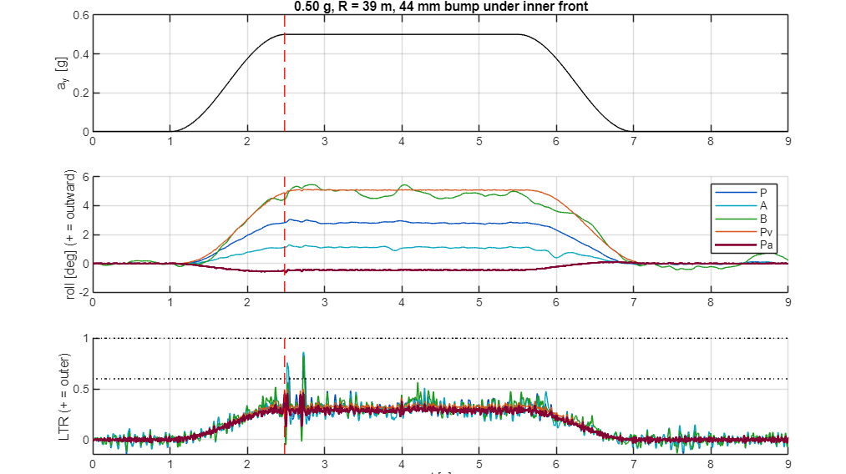
VIPP Final Presentation
4. STUDY 2: THE BASELINE CASE
0.5 g | peak LTR | roll [°] | past 0.6 [ms]
P | 0.742 | 3.04 | 33
A | 0.865 | 1.28 | 50
B | 0.822 | 5.44 | 22
Pv | 0.500 | 5.13 | 0
Pa | 0.457 | 0.61 | 0
Feedback raises the peak; B leans further than passive (5.4° vs 3.0°)
Road + a_{y} preview: peak 0.457, body held within 0.6°
Largest peak comes 0.2 s after the front strike, when the inner rear meets the bump
Preview retracts the wheel before impact: tyre impact force 10.0 → 6.4 kN
a_{y}, body roll and LTR; the dashed line marks the inner front wheel meeting the bump.
One road realisation, 50 km/h, R = 39 m, 44 mm × 0.5 m bump under the inner front wheel at the start of the hold.
Notes:
One road at 0.5 g. Passive peaks at 0.742. Both feedback controllers are worse, and B leans further than passive. Road preview brings the peak to 0.500; adding the planned lateral acceleration gives 0.457 and holds the body within 0.6 degrees. The largest peak comes when the inner rear wheel meets the bump, 0.2 s after the front. Preview retracts the wheel before impact, cutting the tyre impact force from 10.0 to 6.4 kN.

Slide 15
VIPP Final Presentation
4. STUDY 2: OVER 25 ROAD REALISATIONS
a_{y} | Ctrl | Δ vs passive [95 % CI] | better on
0.5 g | B | −0.027 [−0.063, +0.010] | 16/25
0.5 g | Pv | −0.190 [−0.210, −0.171] | 25/25
0.5 g | Pa | −0.236 [−0.256, −0.216] | 25/25
0.8 g | B | +0.056 [+0.013, +0.099] | 7/25
0.8 g | Pv | −0.099 [−0.130, −0.068] | 22/25
0.8 g | Pa | −0.194 [−0.218, −0.170] | 25/25
Pa lowers the peak on every road at both levels
Pv also helps but leaves 5–8° of lean; at 0.8 g it rides the bump stops for 2.9 s of 9 s
Feedback: no significant gain at 0.5 g; at 0.8 g it reaches LTR = 1 on 11 of 25 roads (passive: 1)
ISO 8608 Class C, 50 km/h, 44 mm bump under the inner front wheel. Differences paired by road.
Notes:
Twenty-five roads, differences paired by road. Road plus planned-a_y preview lowers peak LTR on every road at both levels: by 0.236 at 0.5 g and 0.194 at 0.8 g. Road preview alone helps but leaves the body leaning 5 to 8 degrees and rides the bump stops at 0.8 g. Feedback gives no significant gain at 0.5 g and at 0.8 g reaches the trip condition on 11 of 25 roads, where passive does on one.

Slide 16
VIPP Final Presentation
4. STUDY 2: IS THE GAIN REAL AND ROBUST?
Is the lower LTR real?
LTR is a ratio: it could fall if the whole car unloads.
Preview raises the minimum total tyre load and lowers the roll rate
Minimum inner-wheel load: 0 N (passive) → 500 N
A level body is not loaded tyres: A holds 1.3° yet raises the peak
Raising the LTR weight improves preview (0.520 → 0.425) but drives feedback to the trip condition.
SSF 2.58 → 1.29: preview still lowers the peak by 0.27–0.33 (redesigned at each height).
Notes:
LTR is a ratio, so a controller could lower it by unloading the whole car. It does not: preview raises the minimum total tyre load, lowers the roll rate, and the inner wheel keeps 500 N where passive reaches zero. Keeping the body level is not the same as keeping the tyres loaded: A holds 1.3 degrees yet raises the peak. A higher LTR weight helps preview and hurts feedback. The preview gain holds over CG heights 0.30 to 0.60 m.

Slide 17
VIPP Final Presentation
5. STUDY 2: GENERALISATION OVER 55 CELLS
51 / 55
10 / 10
0
0.10–0.37
scenario cells pass
roads improved in every cell
cells where preview trips (passive 11, feedback 15)
reduction in peak LTR across cells
Axis | cells | Δ peak LTR | pass
Vehicle (six, redesigned) | 12 | −0.32 to −0.15 | 12/12
Vehicle (mismatched gains) | 2 | −0.10, −0.04 | 0/2
Speed at fixed radius, 30–60 km/h | 4 | −0.37 to −0.22 | 4/4
Speed at fixed a_{y}, 30–70 km/h | 3 | −0.32 to −0.23 | 3/3
Radius, 100–25 m | 4 | −0.29 to −0.20 | 4/4
Defect type and length | 12 | −0.34 to −0.12 | 12/12
Defect location | 8 | −0.24 to −0.10 | 8/8
Defect height, 80 and 150 mm | 4 | −0.19 to −0.18 | 3/4
Point in the corner | 6 | −0.27 to −0.19 | 6/6
The four failures
SUV on the sedan’s gains (2): peak still falls on every road, but the lean stays near passive
Full-size van, 0.5 g: misses the roll criterion by 0.001
150 mm bump: exceeds travel; bump stops for 7 ms, roll rate 30°/s
Trends
Gain shrinks as a_{y} rises (steady share grows) and with speed at fixed a_{y} (fixed distance = shorter time).
Pass: lower peak LTR on ≥ 90 % of roads, no trip where passive has none, roll ≤ 25 % of passive, no bump-stop contact. 10 roads per cell.
Notes:
The same design procedure, applied without re-tuning: build the model from the vehicle parameters, same weights, 1.04 m of road plus the planned a_y. Six vehicles, speeds, radii, defect type, length, location, height and timing. 51 of 55 cells pass. Preview lowered peak LTR on 10 of 10 roads in every cell and never reached the trip condition. The four failures have clear causes, listed on the right.

Slide 18
VIPP Final Presentation
5. STUDY 2: DEFECT SEVERITY
Single bump: preview never reaches the trip condition up to 150 mm; passive first does at 80 mm (0.8 g)
Twin bump: passive trips on every road at every height; preview avoids it at 44 mm and cuts the dwell 4–10× above
0.5 g, mean of five road realisations. Twin bump: second identical bump one wheelbase later, a constructed worst case.
Notes:
Defect height from 44 to 150 mm at 0.5 g. With a single bump, preview never reaches the trip condition at any height tested; passive first reaches it at 80 mm at 0.8 g. The twin bump unloads both inner wheels together: passive trips on every road at every height, preview avoids it at 44 mm and cuts the time at LTR = 1 by four to ten times above that.

Slide 19
VIPP Final Presentation
5. STUDY 2: ACTUATOR REQUIREMENT
15–30 Hz
bandwidth: the gain survives to ≈ 15 Hz and is complete by 30 Hz
≈ 300 kN/s
slew rate keeps most of the gain; 150 kN/s removes it
≤ 10 Hz: force arrives after the 11.2 Hz wheel-hop event; worse than passive (gray bars)
Lean removal (roll ≈ 0.6–0.7°) survives at every bandwidth
First-order lag and slew limit on the nominal controller, not redesigned. Baseline case, mean of five roads.
Notes:
The nominal controller with a first-order lag and slew limit, not redesigned. The peak-LTR gain survives to about 15 Hz and is essentially complete by 30 Hz. At 10 Hz and below the force arrives after the 11.2 Hz wheel-hop event, so it is worse than passive. 300 kN/s slew keeps most of the gain; 150 kN/s removes it. Removing the lean is a low-frequency action and survives at every bandwidth.

Slide 20
VIPP Final Presentation
6. DISCUSSION
1
2
3
Why feedback degrades the margin
Two criteria for the horizon
What the vertical model cannot say
B leans 5.4° against passive 3.0°: lower effective roll stiffness. With no a_{y} term in its model it treats the steady corner load as a disturbance and softens roll against it. A higher LTR weight makes it worse. Hypothesis; closed-loop modal analysis pending.
LQ cost saturates at 0.28 m; peak LTR needs 1.04 m, about 4× longer. The cost is dominated by the near present; the peak is one instant that needs action before impact. Choose the horizon against the reported metric. 1 m is about one wheel-hop wavelength, within sensor range.
It resolves how tyre loads redistribute and whether the inner wheels unload. It cannot show tripped rollover: an outer-wheel pothole looks mild here, but the tyre can strike the far edge and trip the car.
Notes:
Why feedback degrades the margin: it leans further than passive, a lower effective roll stiffness. Its model has no lateral-acceleration term, so it cannot tell the steady corner load from a road disturbance. This is a hypothesis; closed-loop modal analysis is future work. The two horizon criteria differ by four times, so pick the horizon against the reported metric. The vertical model cannot represent tripped rollover, such as an outer tyre striking a pothole edge.

Slide 21
VIPP Final Presentation
6. LIMITATIONS AND NEXT STEPS
Limitations
Next steps
Prescribed a_{y}: no lateral or yaw dynamics, no tyre force saturation
Unsprung load transfer not modelled: LTR ≈ 7 % low, all controllers equally
Exact preview: no sensor noise, position error or delay
Weights and horizon chosen on the baseline scenario
Measured-vehicle suspension and tyre data assumed; limits not in the design
Model-error study: nominal design on similar-but-different vehicles
Sensor noise and defect-position error in the preview
Actuator dynamics inside the controller design
Constrained formulation (MPC) where travel or force limits act
CarSim validation with lateral tyre forces, incl. the pothole edge strike
Notes:
What the results rest on, and the work that follows from each limitation. All next steps will be run in CarSim for higher-fidelity, visual simulation.

Slide 22
VIPP Final Presentation
6. CONCLUSION
≈ 6 %
11 / 25
51 / 55
15–30 Hz
of steady-corner load transfer any suspension can change
roads where feedback reached LTR = 1 at 0.8 g (passive: 1)
cells passed by road + a_{y} preview, no re-tuning
actuator bandwidth needed, with ≈ 300 kN/s slew
Road preview handles the defect; a_{y} preview handles the corner. Together they lower peak LTR on every road, remove the lean and prevent the trip condition across the grid.
Feedback LQR degrades the margin: lower effective roll stiffness, and no way to tell the corner from the road.
Within a vertical model, information an automated vehicle already has protects a significant part of the rollover margin.
Notes:
An active suspension cannot change the load transfer of a steady corner; it can change the transient at a defect met in that corner. Feedback LQR does not: it leans further and at high lateral acceleration reaches the trip condition where passive does not. Previewing the road and the planned lateral acceleration does, on every road and in every cell tested, with an actuator of about 15 to 30 Hz and 300 kN/s.

Slide 23
THANK YOU · QUESTIONS

