Slide 1
📍
FixCity
A Digital Platform for Urban Problem Reporting
Badr University in Cairo — Faculty of Business
Business Information Systems Department • Academic Year 2025–2026

Slide 2
Agenda
01
Problem Statement
05
UN SDG Alignment
Why urban reporting is broken in Egypt
SDGs 3, 6, 9 and 11
02
Solution — FixCity
06
Business Model
What we built and how it works
Canvas, costs, revenue streams
03
System Architecture
07
Testing & Results
Flutter · Supabase · Google Gemini AI
UAT, performance, security
04
Key Features
08
Conclusion & Future Work
Citizen, Admin & Governor portals
Roadmap and next steps

Slide 3
The Problem
70%
🏛️
Inaccessible Channels
Physical visits, phone calls & personal connections are the only way to report issues
of urban problems go
unreported — too hard
to reach authorities
⚙️
Operational Chaos
No standardization — reports arrive with no location, photo, or category data
🔇
Zero Transparency
Citizens never hear back — eroding trust between the public and the municipality
Source: Project research survey (n=167 respondents, Egyptian urban residents)

Slide 4
The Solution — FixCity
A native Android mobile app that transforms chaotic citizen complaints into structured,
actionable data for municipal decision-makers — in under 3 minutes per report.
📝
AI-Powered Reporting
📍
GPS + Photo Evidence
Google Gemini classifies problem type automatically from the description
Geo-tagged reports with camera/gallery photo attachment
🏙️
District Routing
🔄
Real-Time Tracking
Reports automatically routed to the correct district governor
Citizens track status (Pending → In Progress → Resolved) with their code
👮
Admin Dashboard
🏛️
Governor Portal
Municipal staff manage all reports with live filters and status updates
District governors upload fix photos and close resolved issues

Slide 5
System Architecture
Client Layer
Flutter (Dart) · Android APK · Material Design 3 · RTL/LTR
Native Android app with bilingual Arabic/English support and role-based routing
AI Layer
Google Gemini 2.0 Flash API · Keyword Fallback Classifier
Dual-mode AI classification — cloud AI with offline keyword fallback for reliability
Backend Layer
Supabase · PostgreSQL · Row Level Security · Realtime
Zero-infrastructure BaaS — auth, database, storage, and real-time streaming
Map Layer
CartoDB Tiles · flutter_map · GPS (Geolocator package)
Unrestricted open-source map tiles with precise GPS location capture

Slide 6
Alignment with UN Sustainable Development Goals
🏥
SDG 3 — Good Health & Well-being
💧
SDG 6 — Clean Water & Sanitation
By accelerating reporting of environmental hazards — garbage, stagnant water, open sewage — FixCity reduces public health risks and contributes to cleaner, safer urban conditions.
The water and sewage problem categories enable citizens to report pipe leaks and drainage failures instantly, enabling faster municipal response to conserve water resources.
⚙️
SDG 9 — Industry, Innovation & Infrastructure
🏙️
SDG 11 — Sustainable Cities & Communities
FixCity applies digital innovation to modernize legacy infrastructure management — replacing reactive paper-based workflows with a proactive, data-driven platform.
The primary overarching goal. FixCity empowers citizens to actively participate in maintaining their environment, fostering safer, more inclusive, and resilient urban communities.

Slide 7
3-Role Workflow
👤 Citizen
👮 Admin
🏛️ Governor
1. Select problem category
2. AI suggests category automatically
3. Attach GPS location + photo
4. Submit → receive unique report code
5. Track status anytime with code
1. View all reports in dashboard
2. Filter by status (Pending/Active/Resolved)
3. Update status and add notes
4. Auto-routed back to dashboard after save
5. Monitor district breakdown live
1. Log in to district portal
2. See only their district's reports
3. View before-photo + GPS location
4. Upload after-fix photo
5. Mark as Resolved → citizen notified
→
→

Slide 8
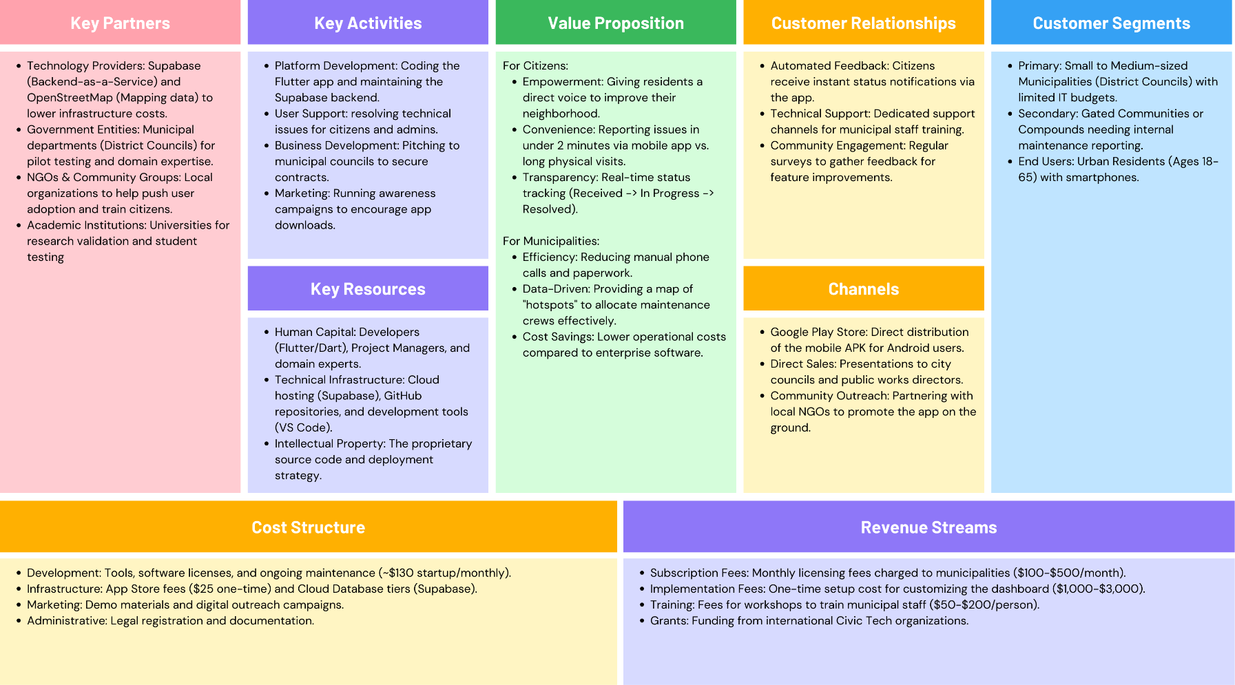
Business Model
$350
💼
Municipal Licensing
Revenue
$100–$500/month per municipality
🔧
Implementation Services
Revenue
$1,000–$3,000 one-time setup fee
Total startup cost
(cloud + dev + marketing)
🎓
Staff Training
Revenue
$50–$200 per participant workshop
🏆
Grant Funding
Revenue
$120/mo operational
Civic tech and digital gov programs
Year 1 KPIs
2
5,000
30%
80%+
Municipal Partners
Active Citizens
Faster Resolution
User Satisfaction

Slide 9
Testing & Results
12
14
6
5
Unit Tests
Integration Tests
UAT Participants
Android Devices
All PASS
All PASS
3 demographics
Android 9–14
Performance Benchmarks
Metric | Target | Result | Status
Cold App Launch | < 3 sec | 1.8 sec | PASS
Report Submission | < 10 sec | 4.2 sec avg | PASS
Gemini AI Classification | < 8 sec | 2.3 sec avg | PASS
Report Tracking Query | < 2 sec | 0.9 sec avg | PASS

Slide 10
Conclusion & Future Work
"FixCity proves that meaningful digital transformation in public services does not require massive budgets — just the right tools, applied thoughtfully."
✅ Full-stack Android app deployed on physical devices
Roadmap
✅ Google Gemini AI integration with offline fallback
Phase 2
Push notifications · Offline mode · AI photo analysis
✅ 3-role system: Citizen · Admin · Governor
✅ Accepted: Gemini for Graduation Projects — Cohort III
Phase 3
Multi-municipality · ERP integration · iOS support
✅ Bilingual Arabic / English with RTL support
Goal
Pilot with an Egyptian municipality within 12 months

Slide 11
📍
FixCity
Thank you — Questions?
github.com/moatazahmedshaker/Fixcity
Badr University in Cairo • Business Information Systems • 2025–2026

