Slide 1
FixCity Egypt
Smart Public Issue Reporting Platform
Badr University in Cairo – School of Business & Economics
Major: Business Information Systems (BIS)
Final Year Project – 2025

Slide 2
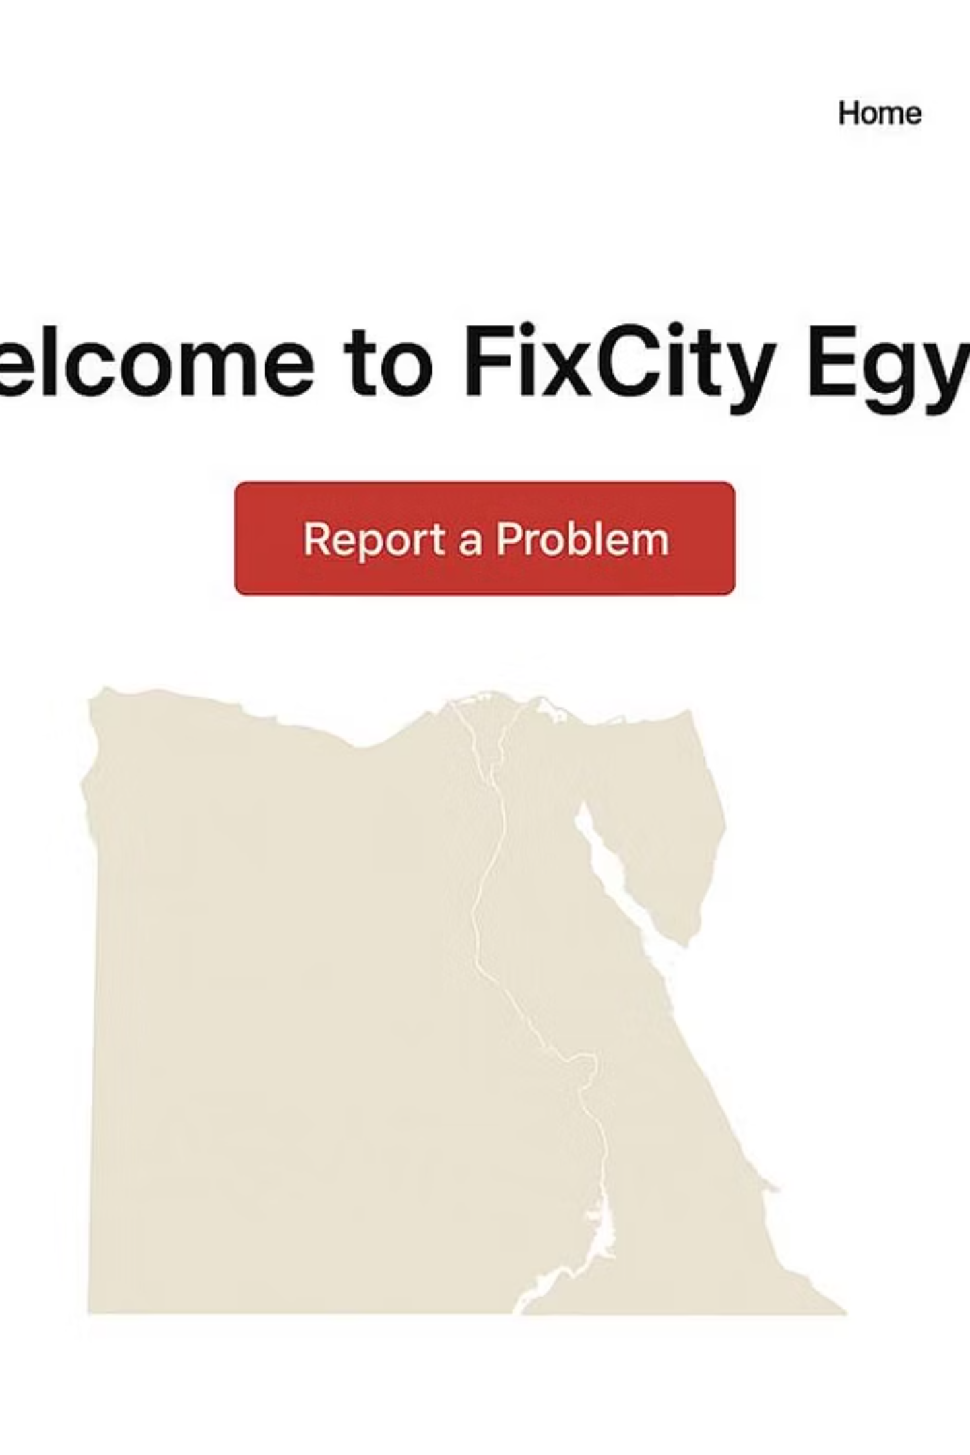
Introduction
FixCity Egypt is a digital platform that allows citizens to report public issues directly to government authorities.
The system enhances communication, improves city management, and supports Egypt's digital transformation vision 2030.

Slide 3
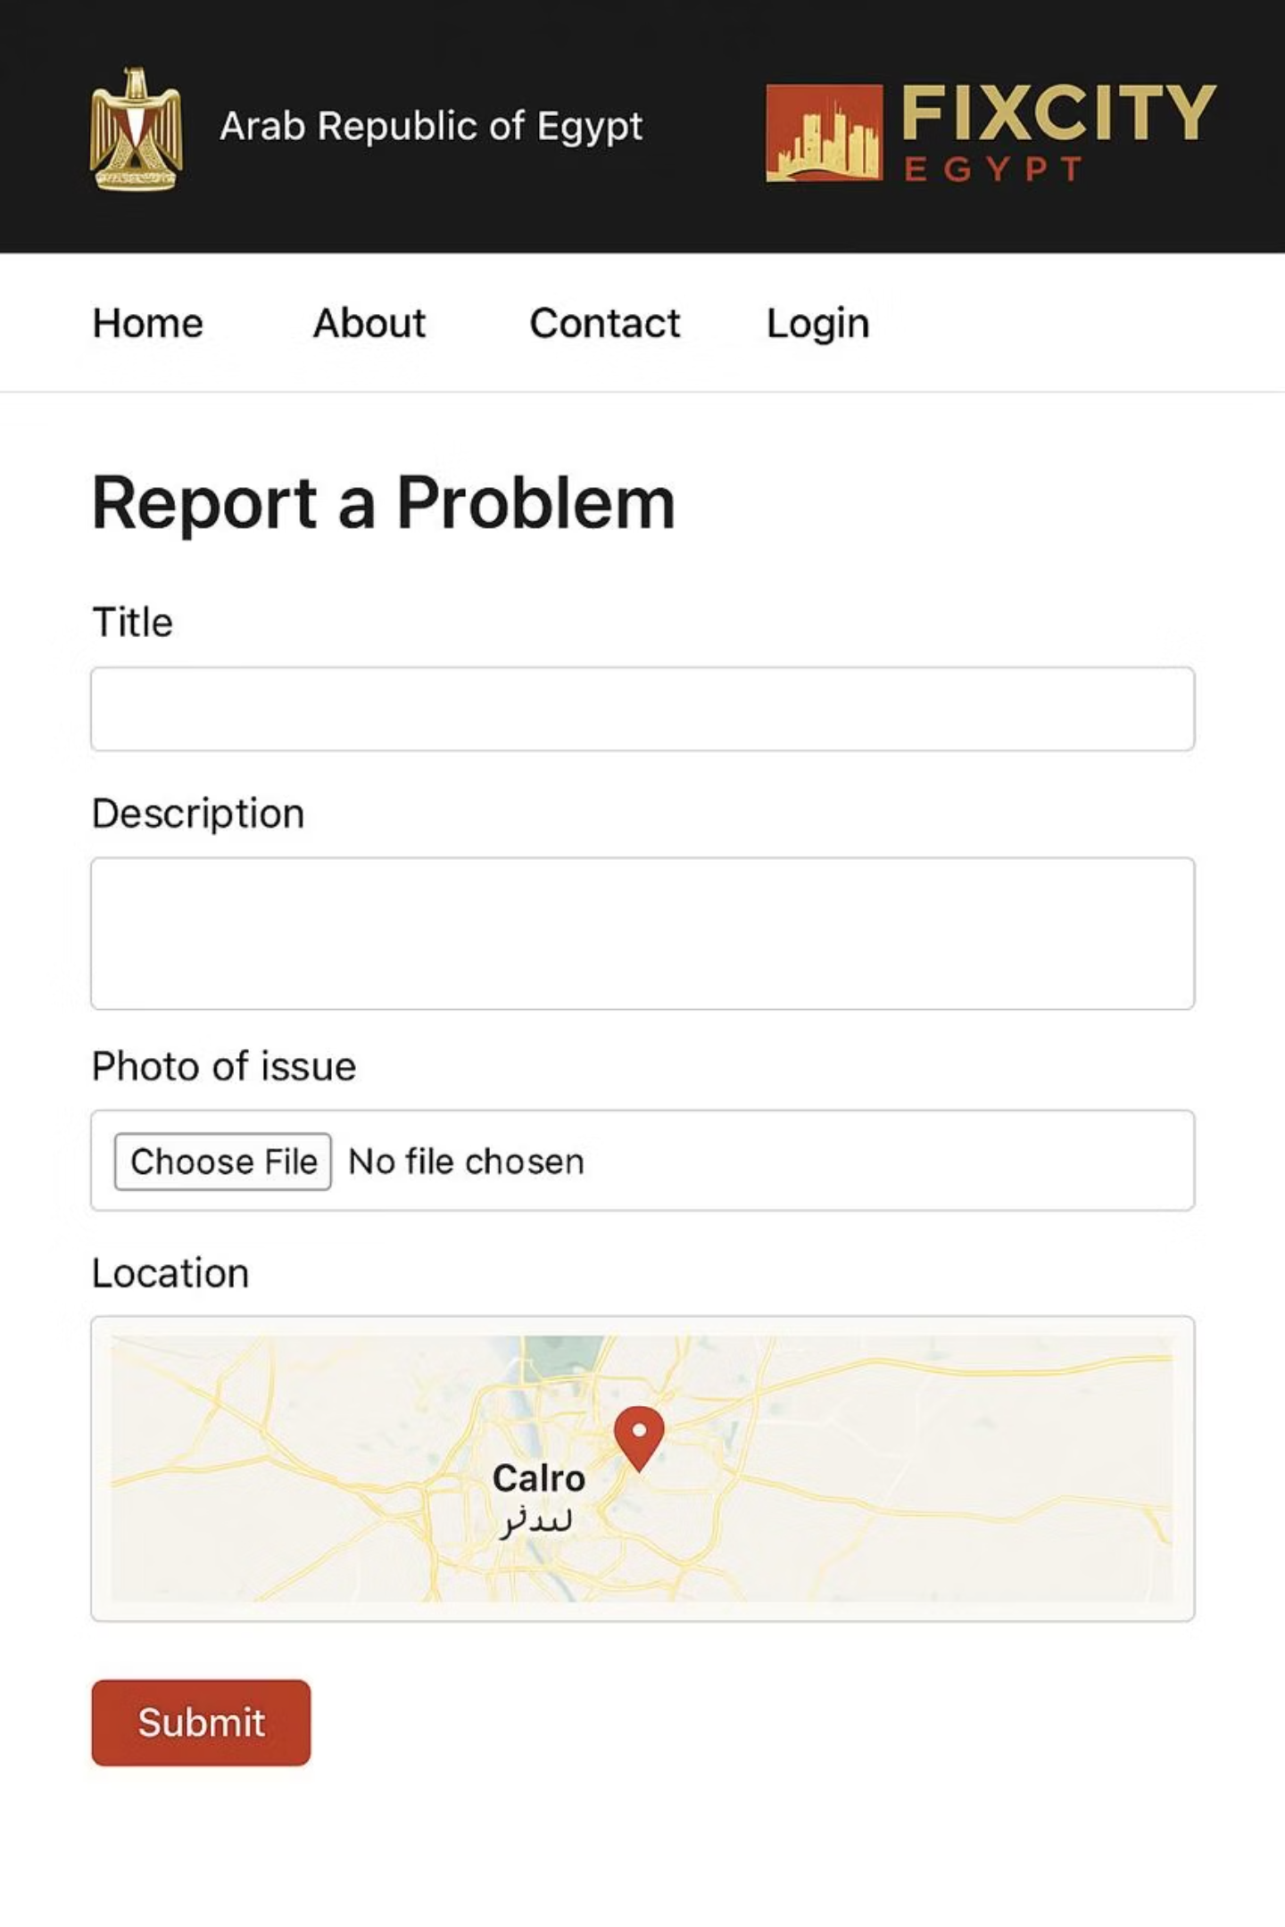
Problem Statement
In Egypt, many public problems like broken lights, damaged roads, and waste buildup go unreported.
Current communication channels are slow, manual, and inefficient, causing delays and reducing citizen trust.

Slide 4
Project Goals
Unified Platform
Automatic Routing
Create a unified web platform for submitting and tracking public issues.
Automatically send each report to the responsible ministry or authority.
Real-Time Tracking
Transparency & Speed
Allow citizens to track report status in real-time.
Promote transparency and faster government response.

Slide 5
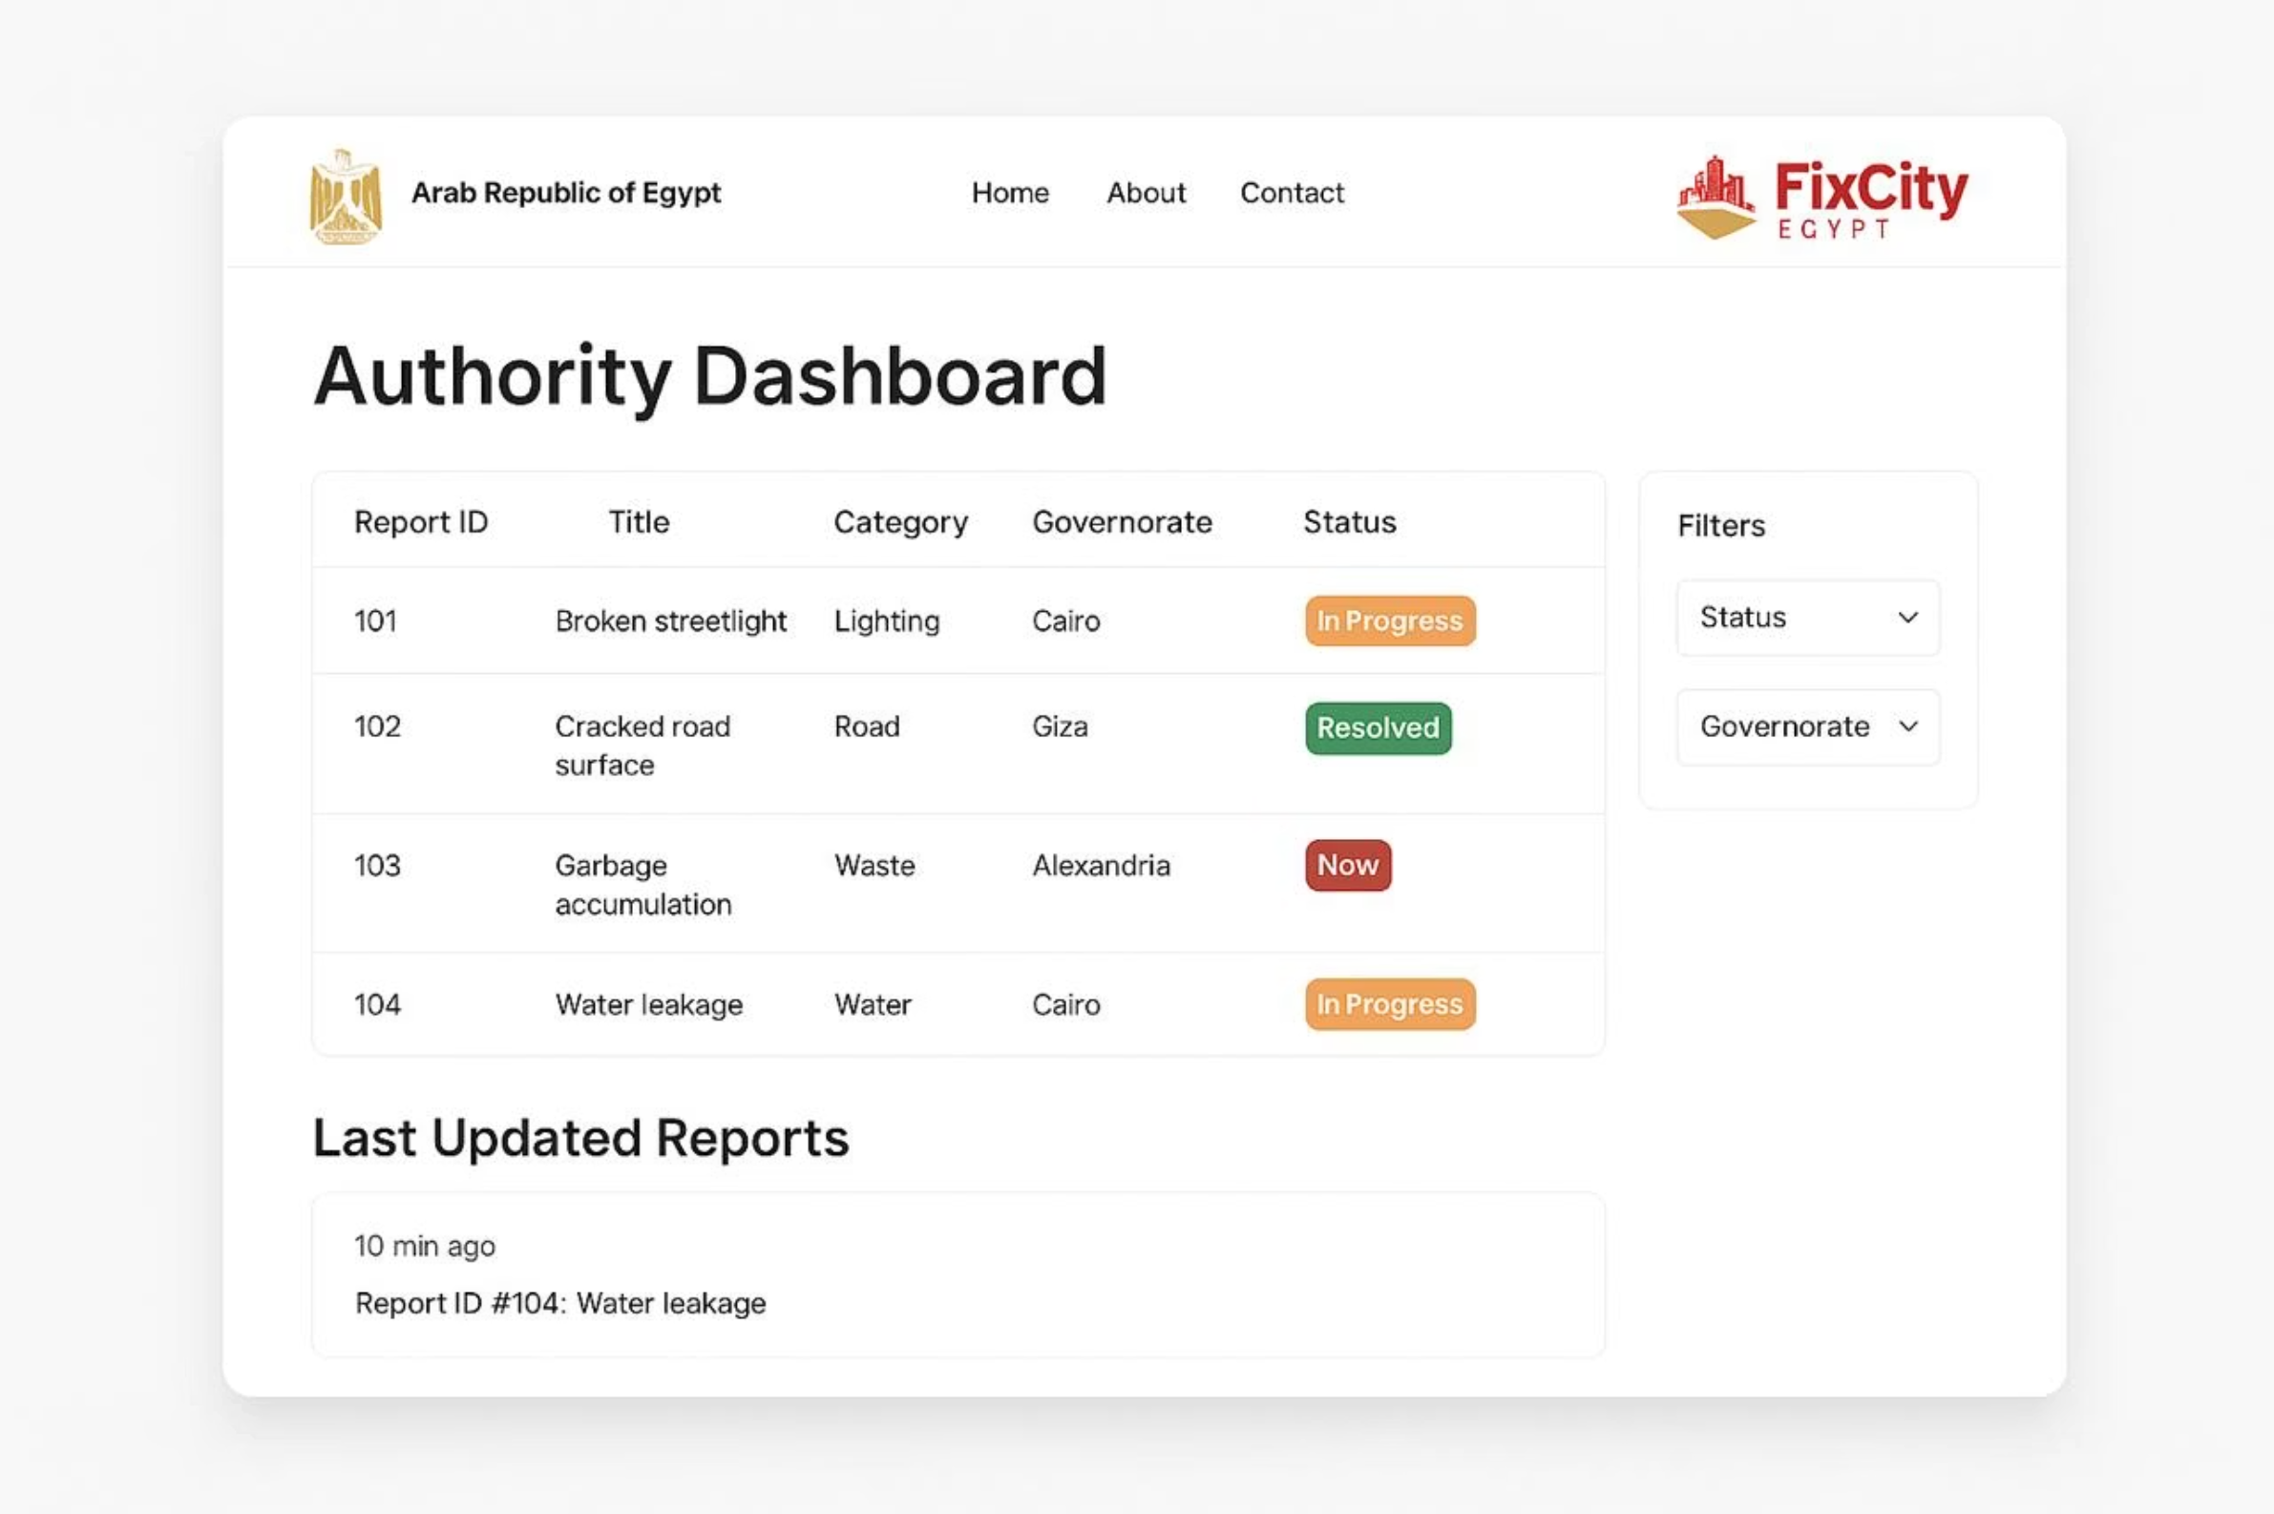
Main Features
Simple and user-friendly interface
Upload photo and location with each report
Dashboard for authorities to manage and update reports
Email notifications when status changes
Analytics dashboard for data-driven decisions

Slide 6
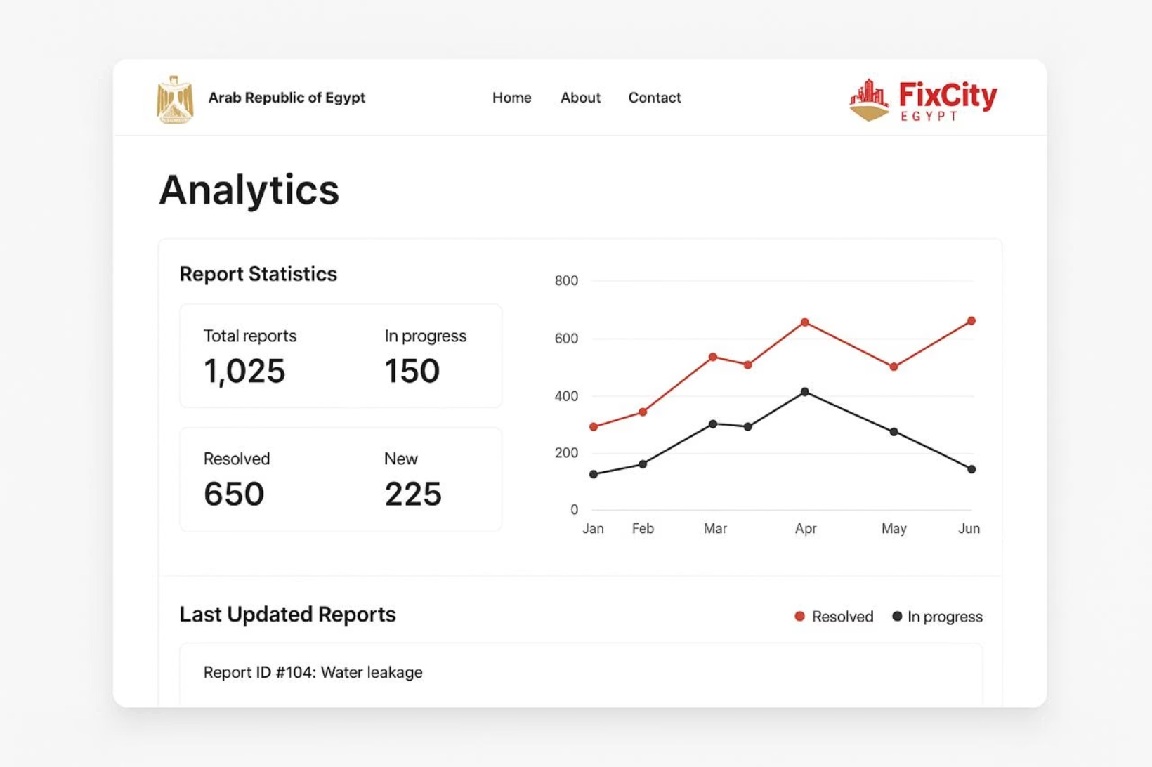
Analytics DashboardFootage

Slide 7
Tools & Technologies
Frontend
Backend
HTML, CSS, JavaScript
Python (Flask)
Database
Email Service
MySQL
SendGrid
Design
Figma / Canva

Slide 8
System Workflow
01
02
03
Citizen Submission
Automatic Categorization
Report Routing
Citizen submits an issue through the web form.
The system categorizes the report automatically.
Report is routed to the correct authority by type and location.
04
05
Authority Update
Citizen Notification
The authority updates the status after review.
Citizen receives an automatic email notification.

Slide 9
Design Mockups
Homepage
Report Form
Authority Dashboard
Analytics Dashboard
Email Notification Page

Slide 10
Similar Projects
Some similar local platforms exist but focus on limited regions.
FixCity Egypt is different — it integrates all regions and all authorities, automating communication and analysis for national scalability.
Existing Platforms
FixCity Egypt
Limited regional coverage
National integration
Manual processes
Automated workflows
Fragmented authorities
Unified system

Slide 11
Conclusion & Future Work
FixCity Egypt bridges the gap between citizens and government.
It helps create cleaner, safer, and smarter cities in Egypt.
Future Enhancements:
Launch a mobile app version.
Add AI-based issue detection.
Integrate with national data systems.

