Slide 1
Product information
Tooling information
Part Name :- REAR CASE
Tooling type :- 2PLATE
Index No :- ANRMTPT0002F
Hot Runner system :- NONE
Model :- TE-12XCME
Gate type :- SUB GATE
Plastic material :- ABS (assumed)
No. of cavities :- 1 X 2
Shrinkage :- 1.005
No. of slider :- NONE
Part Weight :- 31.88g
No. of lifters :- 10X / CAV
Main insert material :- NAK-80
Mold base material :- S50C
Mold base Standard :- LKM
Injection machine capacity :- 100T
Material not given on the TE-12XCME drawing: ABS assumed (same as the battery cover). Weight = DFM model volume x 1.05 g/cm3.
RESULT | OK | NG
APPD
DATE

Slide 2
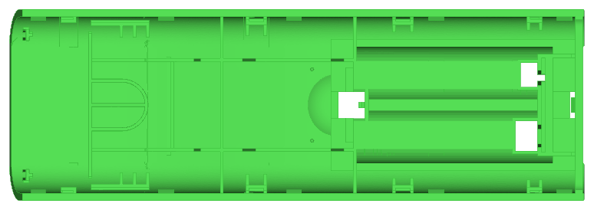

Product size
51.00
152.99
Core side (plan)
25.87
Side view (pull direction up)
RESULT | OK | NG
APPD
DATE

Slide 3
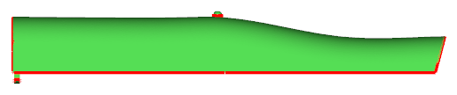
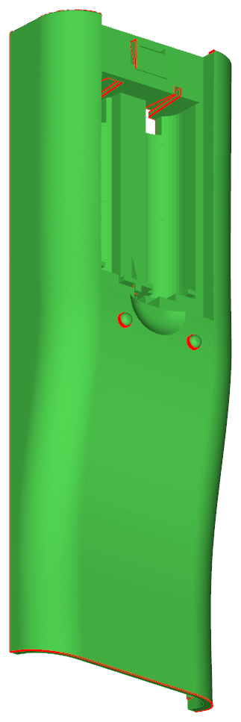
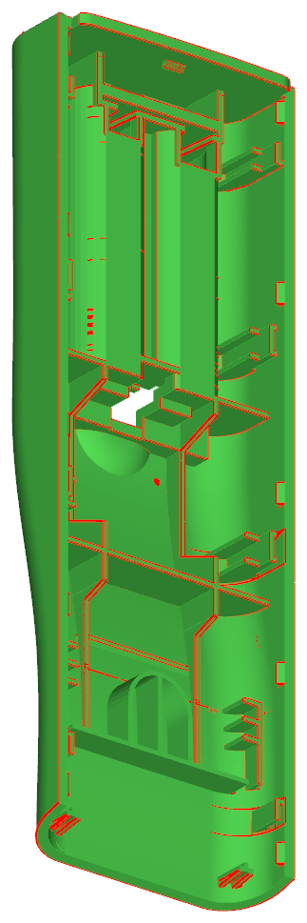
1.Parting Line
CAV
PL
COR
RESULT | OK | NG
APPD
DATE
Main PL flat at Y 4.34 (bottom of the side walls). PL steps down around the tongue at the top end and runs up the slanted open bottom end.

Slide 4
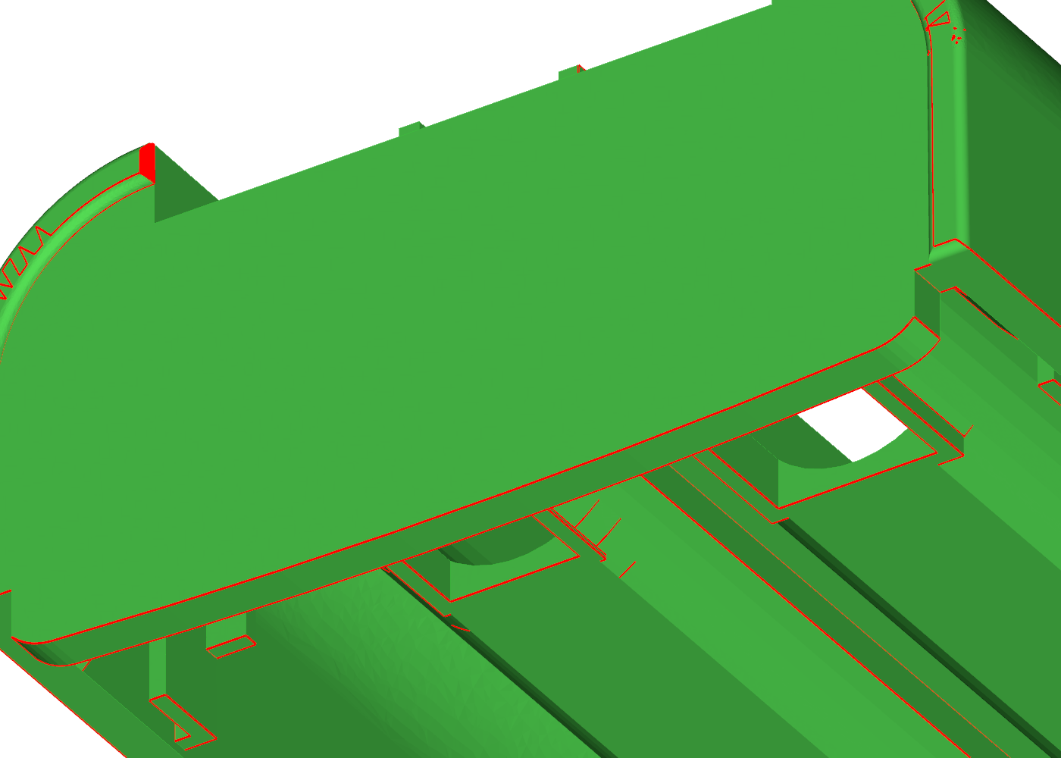
2.Parting Line
CAV
COR
RESULT | OK | NG
APPD
DATE
Tongue below PL (Y 0.41-4.34) at the top end: PL steps down; tongue formed in the core insert.

Slide 5
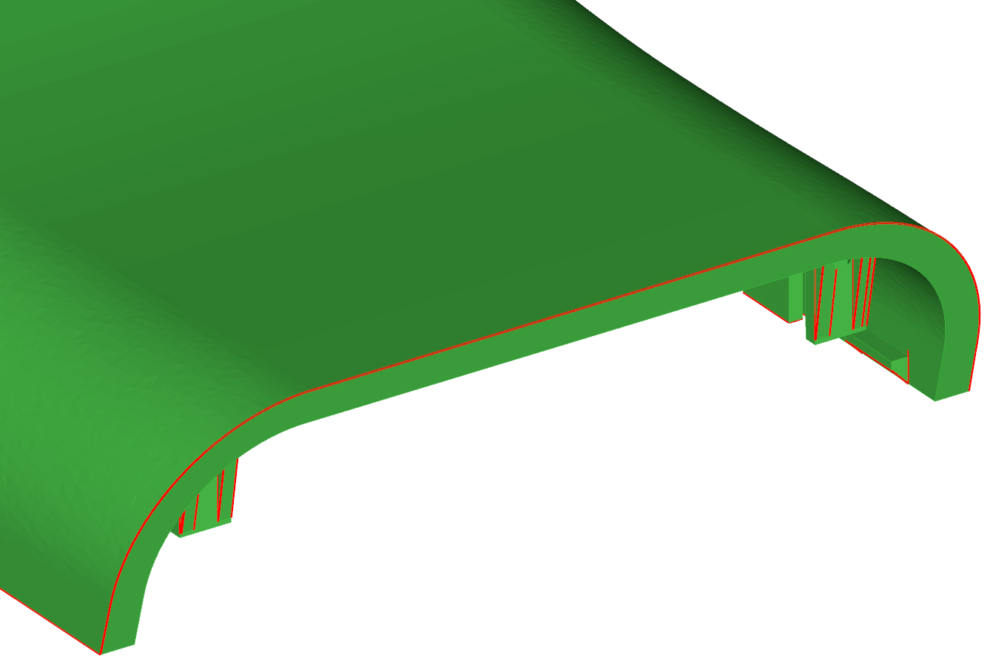
3.Parting Line
CAV
COR
RESULT | OK | NG
APPD
DATE
Open slanted bottom end (14.8 deg): end face on core side, PL follows the outer edge of the end face.

Slide 6
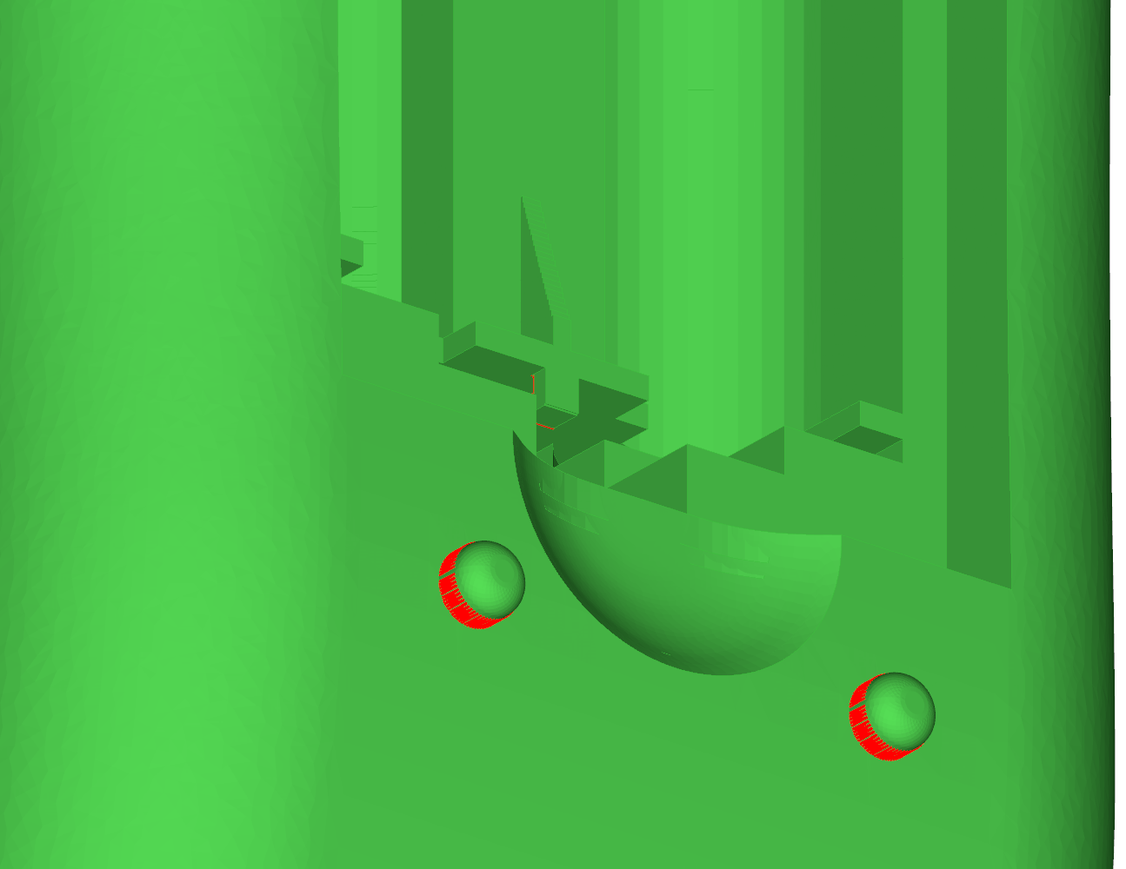
4.Parting Line
CAV
COR
RESULT | OK | NG
APPD
DATE
Battery opening + cover slot: cavity / core shut-off along the inner skin edge; rails and ledges on core side.

Slide 7
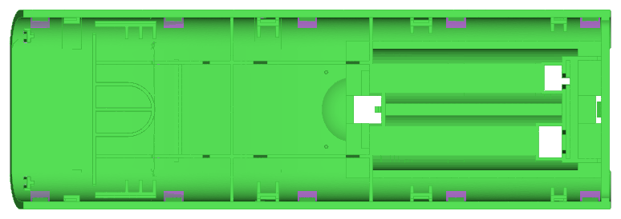
5.Lifter
Lifter 01L
Lifter 02L
Lifter 03L
Lifter 04L
Lifter 05L
Lifter 01R
Lifter 02R
Lifter 03R
Lifter 04R
Lifter 05R
10 lifters / cavity: one per PL catch tooth (1.0 x 1.5 x 4.0 mm, catch face Y 5.84).
Lifter travel 1.5 mm inward, angle 8 deg -> ejector stroke 10.7 mm min.
RESULT | OK | NG
APPD
DATE

Slide 8
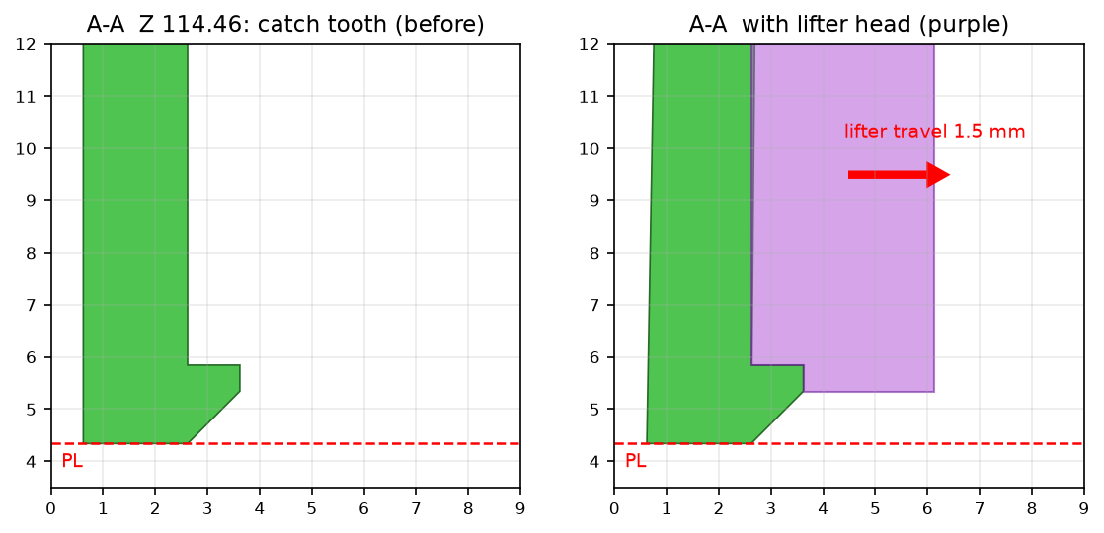
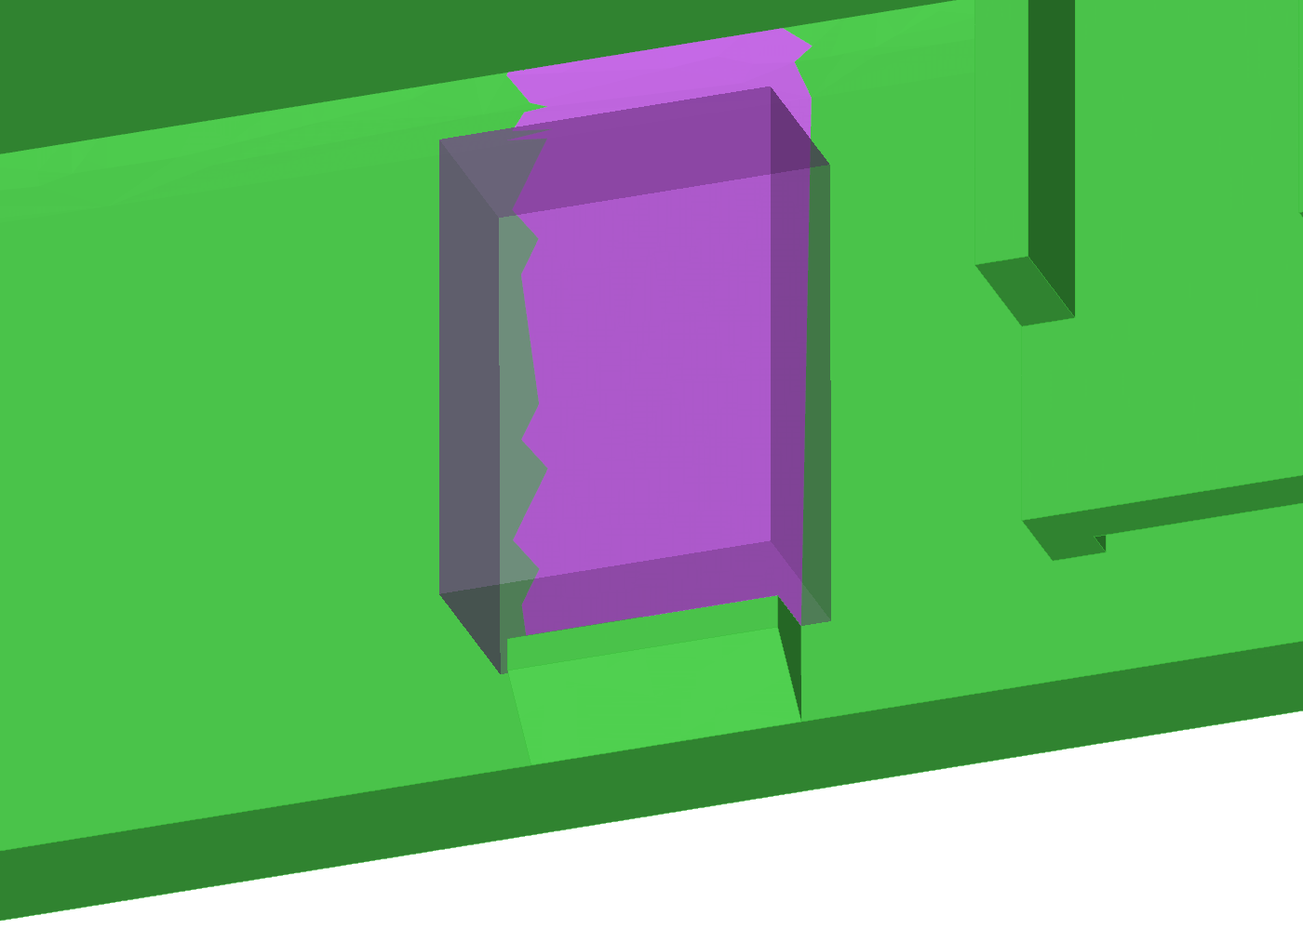
6.Lifter
Lifter 04L
Undercut faces in lifter zones: 419.7 mm2
Released within 1.5 mm travel: 419.7 mm2 (not released: 0.00 mm2)
Window through side wall rejected: cosmetic side wall + weak snap
Ray check on the DFM model: every lifter-zone undercut face is tested along the lifter travel direction (+X left side, -X right side).
RESULT | OK | NG
APPD
DATE

Slide 9
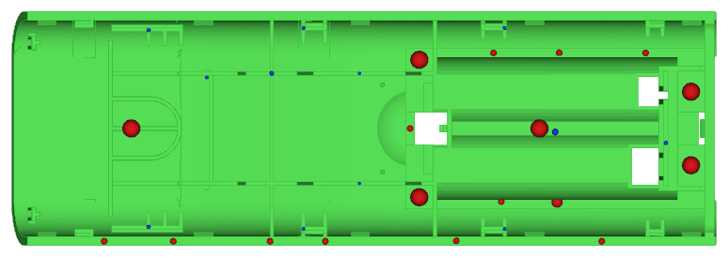
7.Ejector
EP 1.5 ( 12X )
EP 2.5 ( 1X )
EP 4.0 ( 6X )
EB 8.0 X 0.8 ( 2X )
EB 5.0 X 0.9 ( 4X )
EB 8.0 X 0.9 ( 1X )
EB 8.0 X 1.0 ( 3X )
EB 8.0 X 1.1 ( 1X )
EB 8.0 X 1.5 ( 1X )
Pins on flat core-side faces (disc check), none in lifter zones. Core depth 21.9 mm, ejector stroke 26.9 mm.
RESULT | OK | NG
APPD
DATE

Slide 10
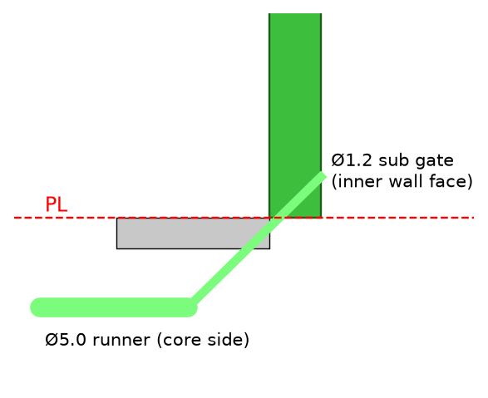
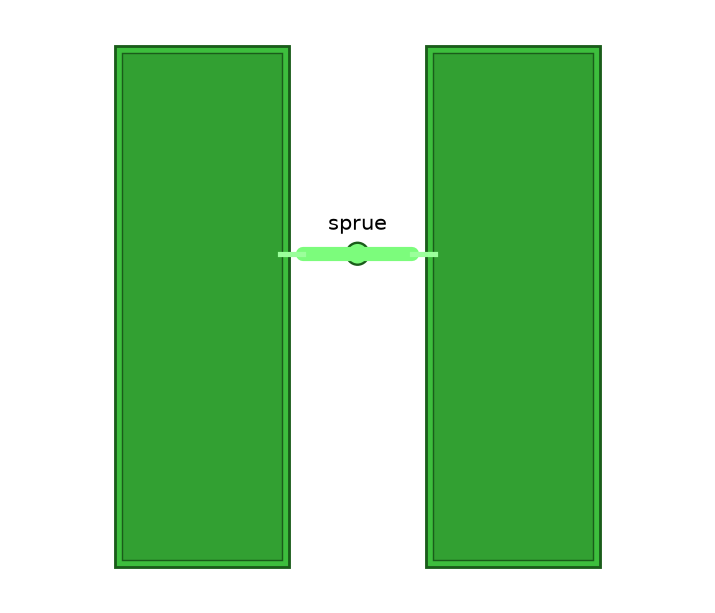
8.Gate
Cold Runner + Sub Gate
Ø1.2
G1: Side gate at PL, top end - max flow 191 mm (L/t 96)
G2: Side gate at PL, side wall mid-length - max flow 130 mm (L/t 65)
G3: Sub gate on inner side wall, mid-length - max flow 130 mm (L/t 65)
G4: Sub gate on inner side wall, bottom end - max flow 172 mm (L/t 86)
RESULT | OK | NG
APPD
DATE
Gate G3 chosen: no mark on the cosmetic skin, shortest practical flow 130 mm, away from lifters.

Slide 11
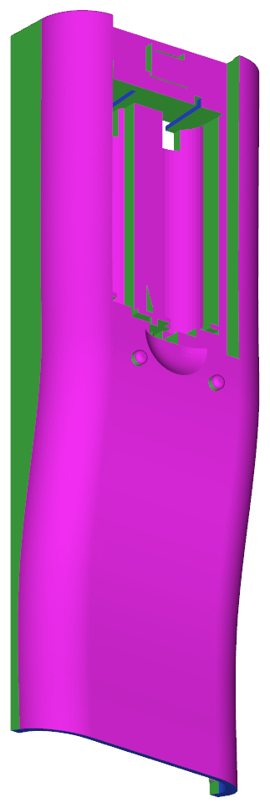
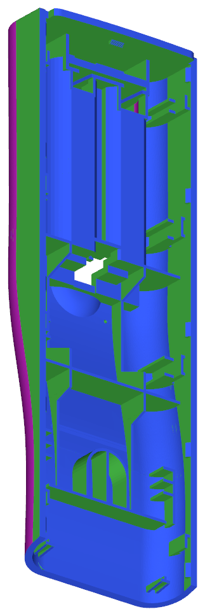
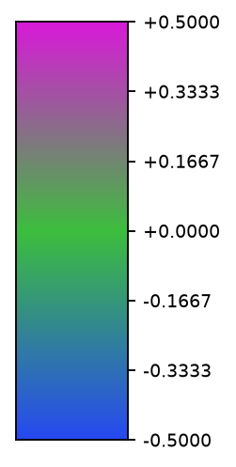
9.Draft angle analysis
All Green Surface Are 0º Propose To Add 1.0º For Cavity Side & Draft 0.5º For Core Side
RESULT | OK | NG
APPD
DATE
0º area 16,416 mm2 (of 35,978 mm2)

Slide 12
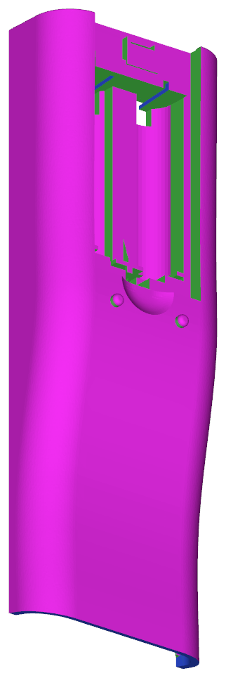
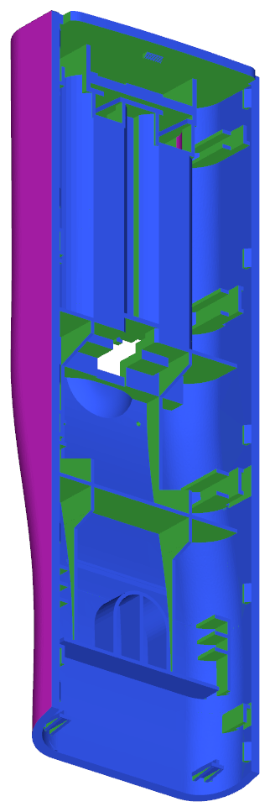
10.Draft angle analysis (DFM)
After DFM: side walls 1.0º cav / 0.5º core, thin ribs 0.5º. Remaining green = block/detail walls: add in tool design
RESULT | OK | NG
APPD
DATE
0º area 11,049 mm2 (of 35,700 mm2)

Slide 13
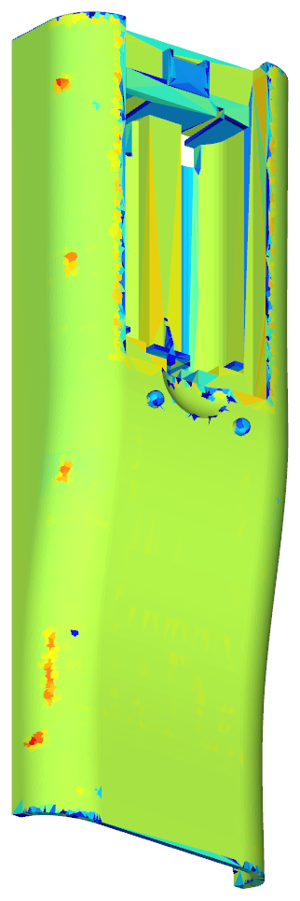
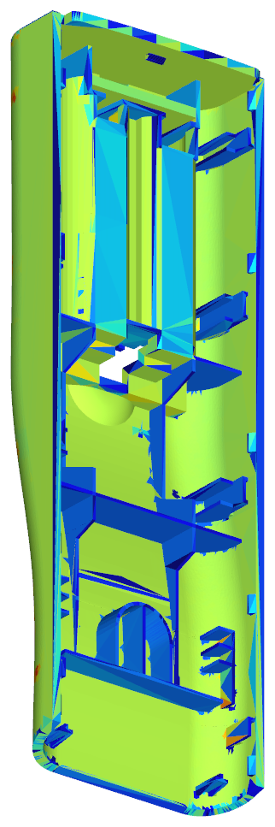
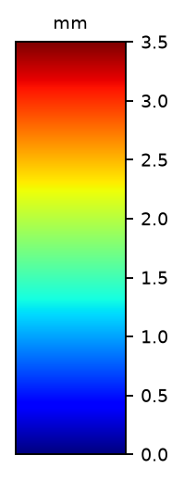
11.Thickness mark
Nominal wall 1.97 mm, ribs 0.8 mm. Red surface have thickness mark: contact walls Z 141-146 up to 3.0 mm.
RESULT | OK | NG
APPD
DATE

Slide 14
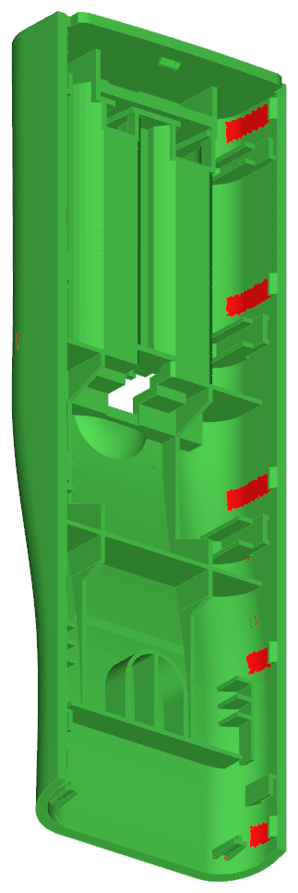
12.Suggest
CAV
Undercut
COR
Have undercut: 10 PL catch teeth (1.0 x 1.5 x 4.0) for the front-case snap.
Function part, keep shape. Suggest to make undercut with lifter (10X / CAV).
Window in side wall rejected (cosmetic + weak snap).
RESULT | OK | NG
APPD
DATE

Slide 15
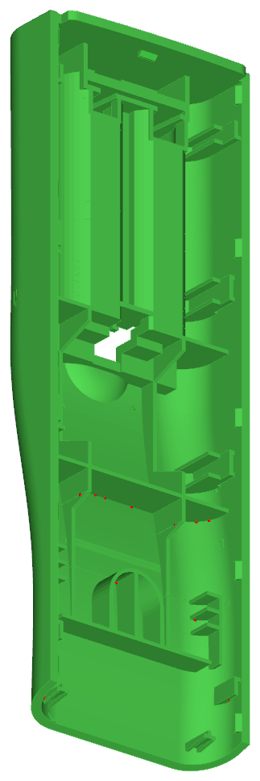
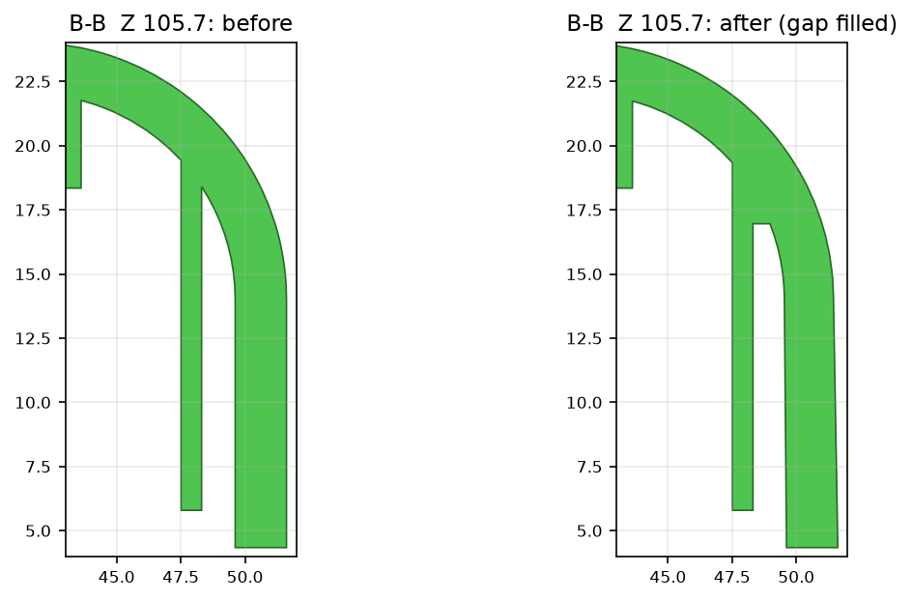
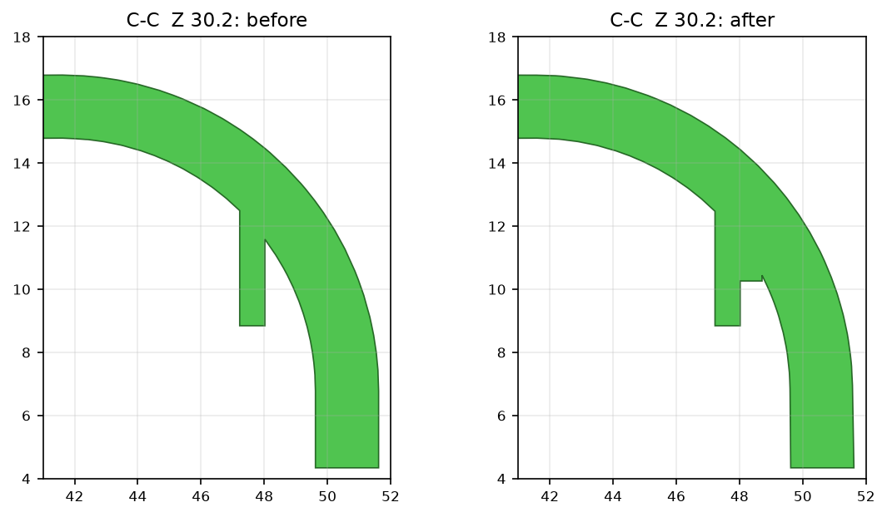
13.Suggest
Weak steel
Before
After
Weak steel 0-0.75 mm between side plates/ribs and R8 fillet, easy broken. Suggest to add plastic (fill gap), 19 places, slot below kept.
RESULT | OK | NG
APPD
DATE

Slide 16
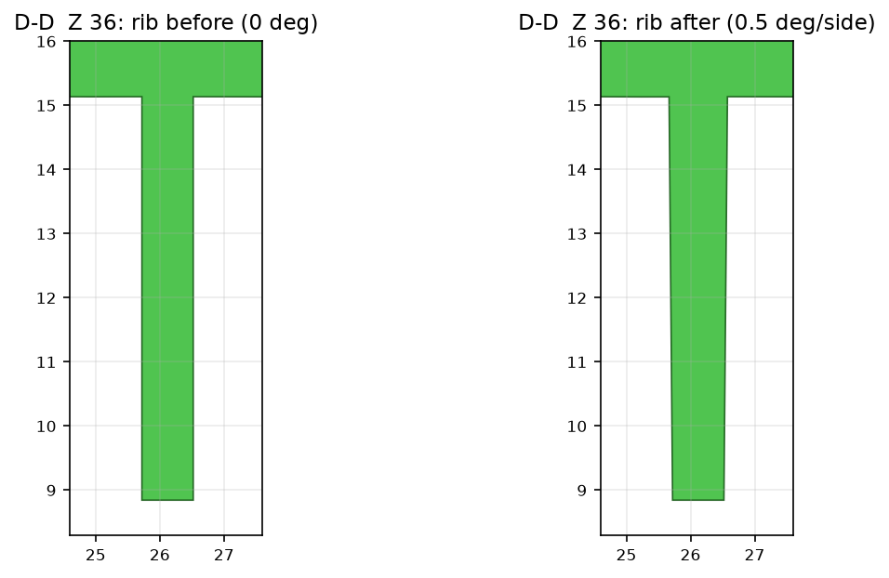
14.Suggest
Before
After
Ribs 0.8-1.0 mm (0.4-0.5 x wall): no thickness mark, but 0º draft -> sticking on core, ejection marks.
Suggest 0.5º draft each side, tip keep 0.8 mm, root grows: this rib 0.8 -> 0.91 mm over 6.5 mm. Keep 0º: side-wall slot plates, cover-rail rims, ribs under the opening (cavity-formed).
RESULT | OK | NG
APPD
DATE

Slide 17
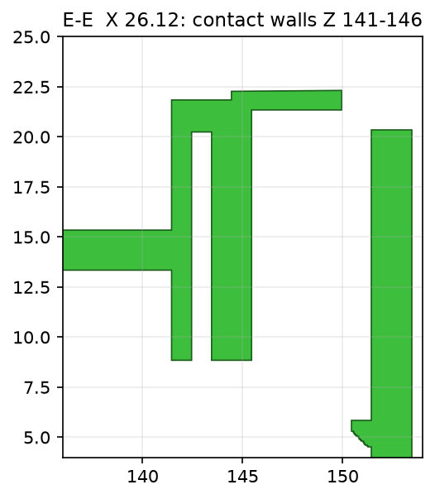
15.Suggest
Contact walls Z 141-146: up to 3.0 mm (1.5 x wall) -> thickness mark risk and 20 s cooling vs 9 s.
Suggest to core out to 2.0 mm if the battery contact allows (customer to confirm; not changed in STEP).
RESULT | OK | NG
APPD
DATE

Slide 18
16.Suggest
Remaining 0º faces after DFM (by area):
ribs, plates, blocks: 4,735 mm2
battery bay: 4,308 mm2
top end (wall, rim, tongue): 1,839 mm2
inner side walls: 126 mm2
PL catch teeth: 40 mm2
bottom end: 2 mm2
Add draft in tool design: blocks, battery bay walls, end walls, detail walls: 0.5º core / 1.0º cavity.
Keep 0º on: cover rails & rims (cover fit), catch faces (snap).
Add R0.3-R0.5 at rib roots (electrode radius).
The DFM STEP adds the draft on the parametric walls and the thin ribs; the section-driven detail prisms keep their measured 0º faces.
RESULT | OK | NG
APPD
DATE

Slide 19
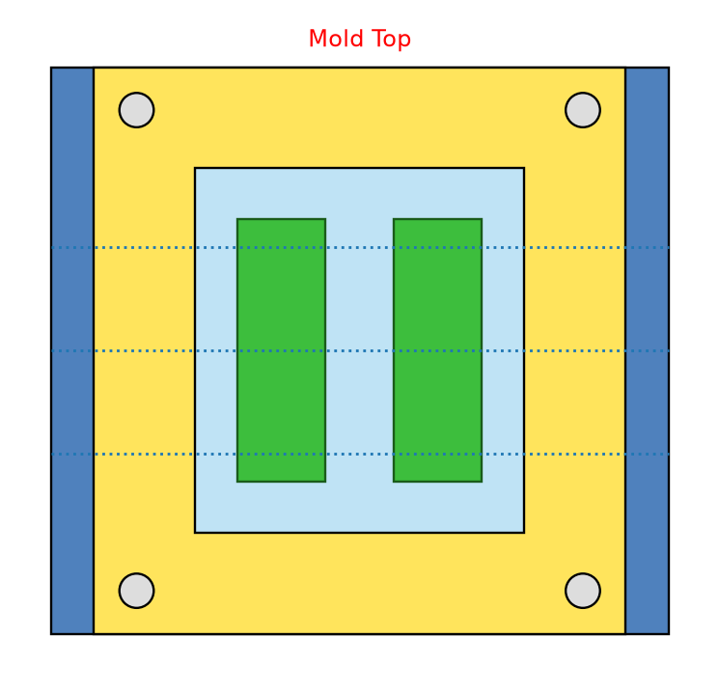
17.Mold Layout
Mold 310 X 330
Insert 192 X 213
100 TON
1 cav: clamp 39 t -> 50 T, shot 35 g, 127 pcs/h
2 cav: clamp 78 t -> 80 T, shot 70 g, 254 pcs/h
4 cav: clamp 155 t -> 180 T, shot 140 g, 509 pcs/h
Projected area 76.4 cm2/cav, cavity pressure 40 MPa, SF 1.2 (hand calc).
typical tie-bar distances (H x V): 80 T 310 x 310, 100 T 360 x 360, 120 T 410 x 410 - confirm with the moulder's machine list
Machine size need to change from 80T to 100T
(mold 330 mm > 310 mm tie bars)
RESULT | OK | NG
APPD
DATE

Slide 20
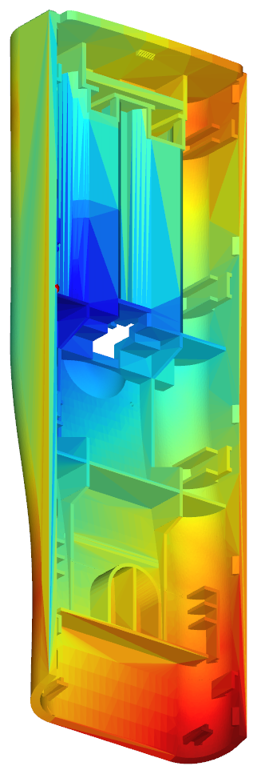
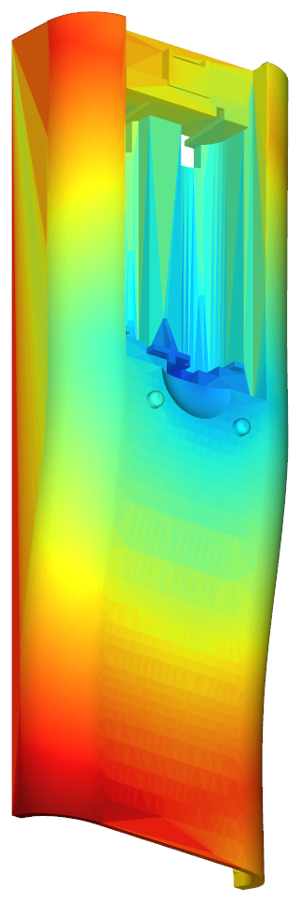
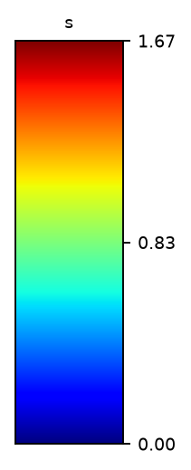
18.Fill Time
Filling time = 1.67sec
RESULT | OK | NG
APPD
DATE
estimate, geometric proxy, not Moldflow: flow-length map from the gate; time = shot volume / 40 cm3/s.

Slide 21
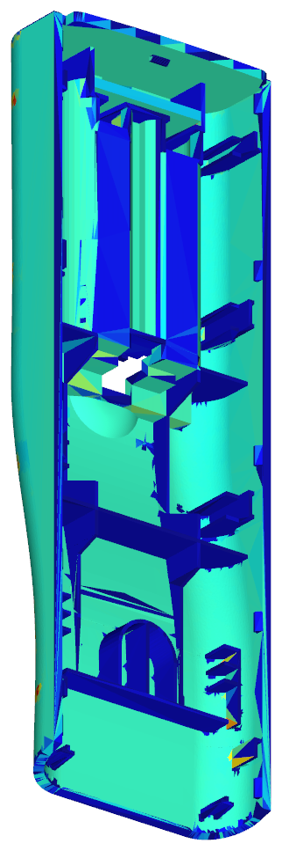
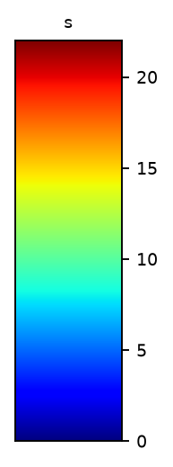
19.Ejection Temperature
Time to reach ejection temperature (85 °C): median 8.6 s, p99 12.4 s.
Slowest: 3.0 mm contact walls.
RESULT | OK | NG
APPD
DATE
estimate, 1-D plate cooling per local thickness, not Moldflow.

Slide 22
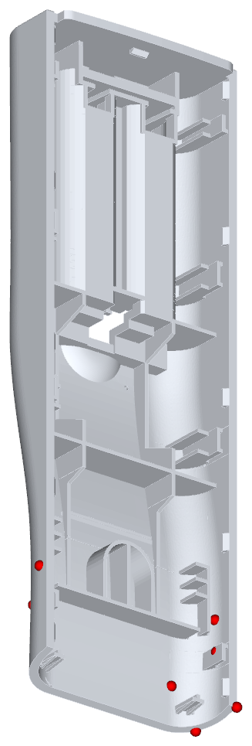
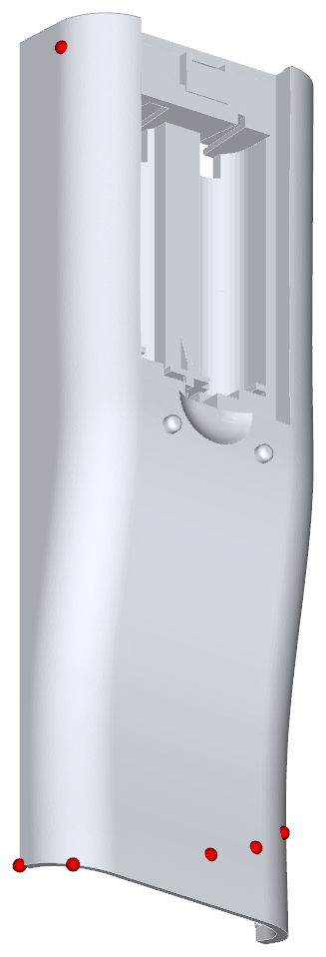
20.Air Traps
Make air vent around parts (last-fill points: red)
RESULT | OK | NG
APPD
DATE
estimate, geometric proxy, not Moldflow: local maxima of flow length from the gate.

Slide 23
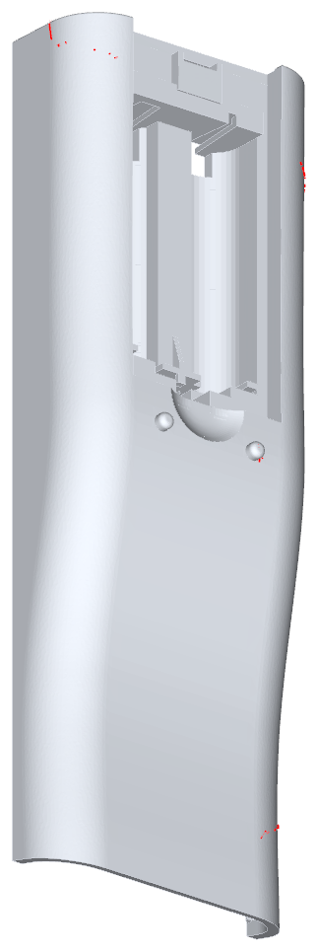
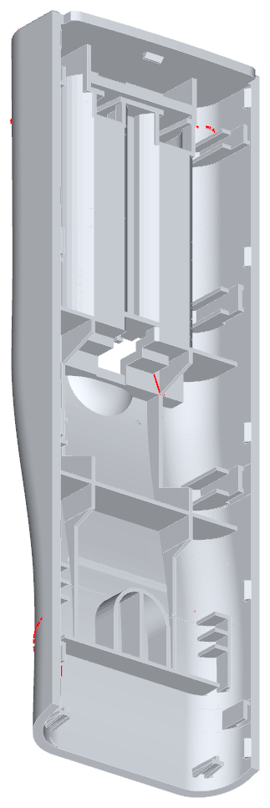
21.Weld Lines
Weld lines where flow fronts meet (red); check cosmetic side at the battery opening ends
RESULT | OK | NG
APPD
DATE
estimate, geometric proxy, not Moldflow: edges where the flow-front directions oppose.

Slide 24
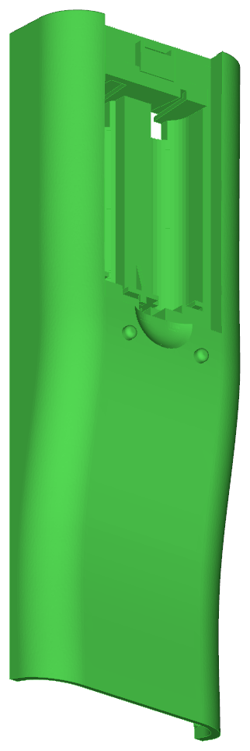
22.Cycle Time
1.Fill time = 1.670sec
2.Pack time = 8.0 sec
3.Cooling time = 13.6 sec
4.Mold open time = 5.0 sec
Cycle time = Fill + Pack + Cooling + Mold open = 28.270 sec
Cooling calculated (1-D plate, ABS, 2.46 mm = 99.5 % of the part); fill = estimate; pack 8.0 s and mold open 5.0 s = supplier defaults from the reference reports.
RESULT | OK | NG
APPD
DATE

