Slide 1
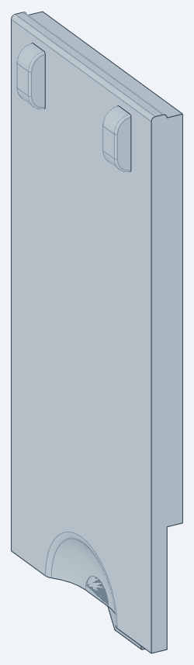
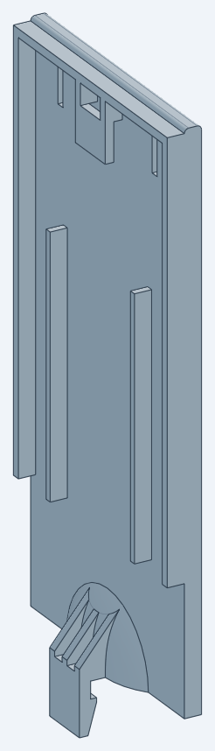
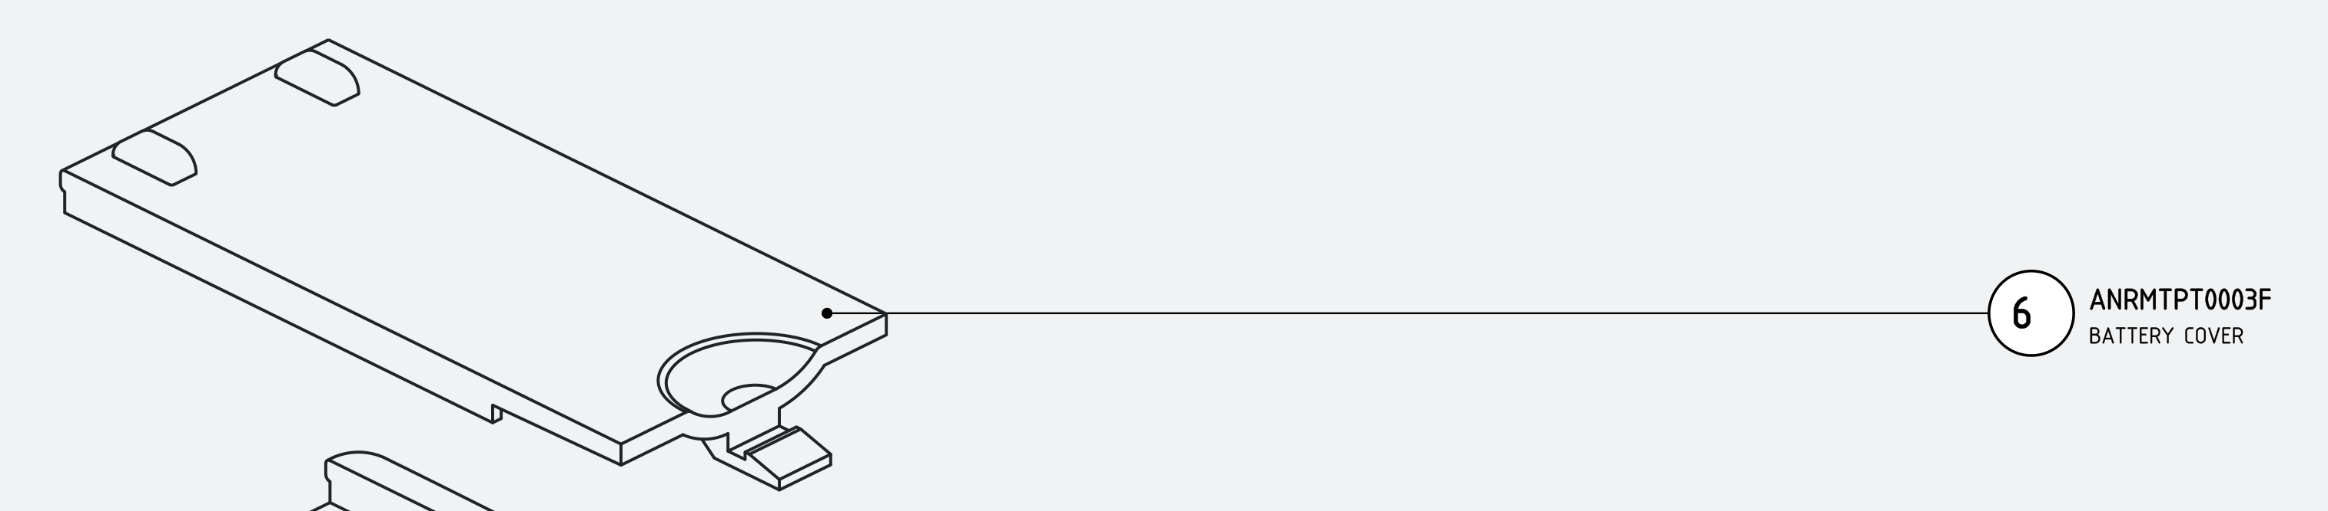
Battery Cover ANRMTPT0003F
DFM review for injection moulding · ABS
TE-12XCME remote control · assembly ANRMTAS0001F (item 6) · PhotonX R&D
71.5 × 31 × 9
4.61 cm³
envelope L × W × H [mm]
volume · 4.84 g in ABS
20.9 cm²
2.0 mm
projected area (pull ±Y)
nominal wall
Found in the as-received model
1,372 mm² of walls at 0° draft
57 mm² undercut (hook gap)
sharp internal corners (R0)
All three are fixed in part_DFM.step
As received: outer (cosmetic) face | inner face
Notes:
Input: input/part.step = design-intent battery cover rebuilt from the FreeCAD mesh (repo battery_cover_RE). Part identity from assembly drawing ANRMTAS0001F sheet 2 BOM item 6 (71.5 x 31.0 x 9.0 envelope). Material ABS general purpose, typical datasheet values used for all calculations; confirm with the chosen grade. All geometry numbers are measured from the STEP files by battery_cover_RE/dfm/run_dfm.py.

Slide 2
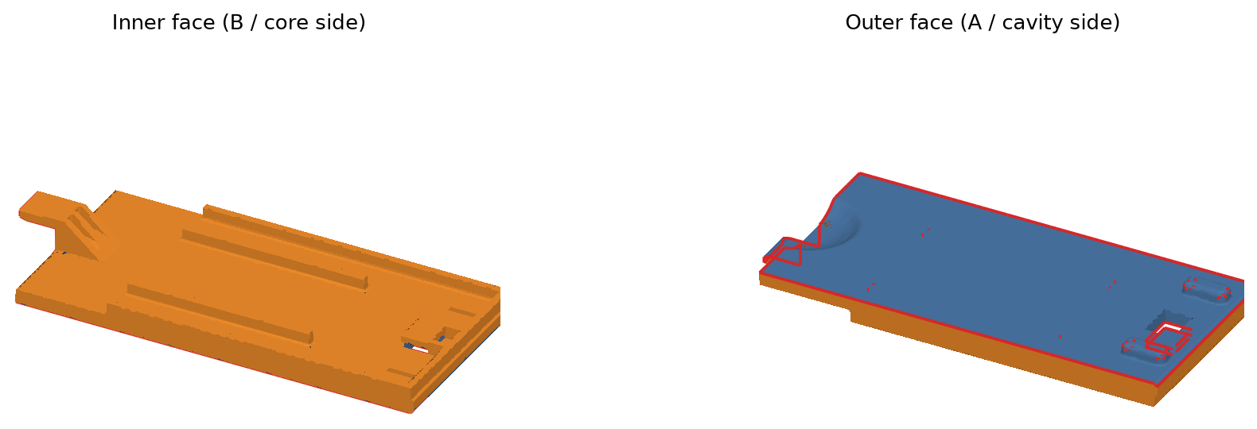
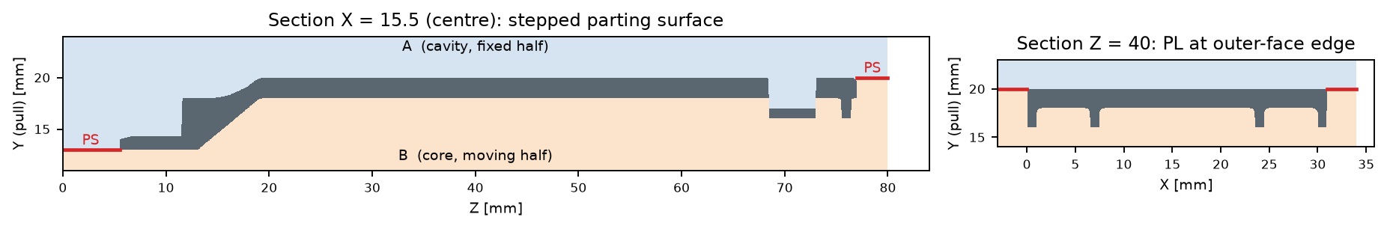
Parting line & parting surface
02 PL / PS
Flat PL on the outer-face edge; one 7 mm step around the snap latch. No side actions.
▸ Pull ±Y (plate normal). Part stays on the core (B) and is ejected from B.
▸ A / cavity: cosmetic outer face, bumps, thumb recess, latch catch faces (blue).
▸ B / core: ribs, rails, lip, hook, latch inner face (orange).
▸ Main PL: outer-face perimeter at Y 20 (red). The witness line sits on the hidden edge, not on the cosmetic face.
▸ Stepped PS: drops 7 mm to Y 13 around the snap arm. Tool shut-off faces ≥ 5°.
▸ Hook: local 3° shut-off through the new window, not a lifter.
▸ 422 PL edges found automatically at the A/B face boundary.
ANRMTPT0003F Battery cover · ABS · DFM review · Rev 01
2 / 12
Notes:
Faces are classified by the sign of the normal's Y component after drafting (A releases +Y, B releases -Y) and by a straight-pull ray test (undercut). The PL is the set of mesh edges between A and B faces. Section rasters: air reachable from +Y = A steel, from -Y = B steel, enclosed = undercut.

Slide 3
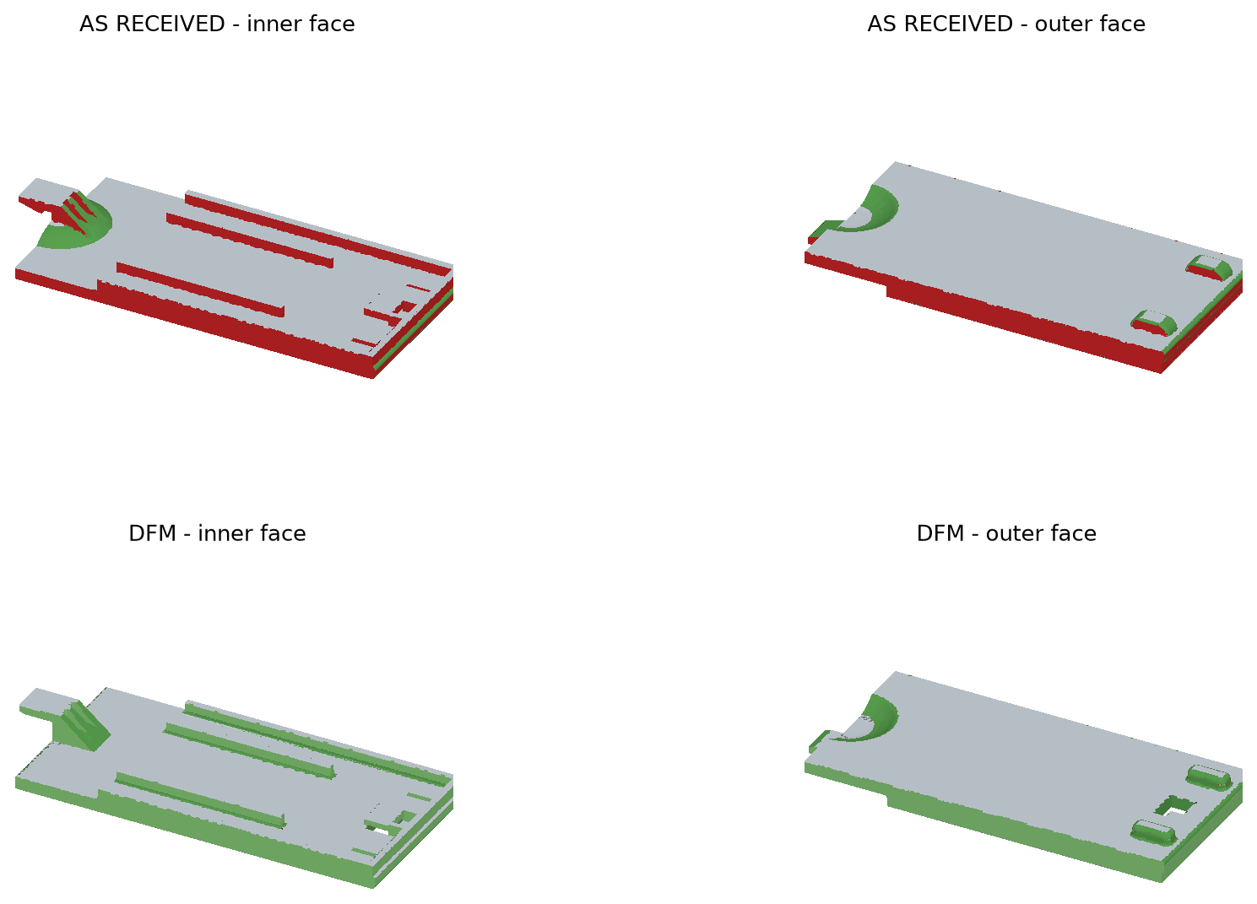
Draft analysis
03 DRAFT
As received: every wall at 0°. DFM: 1° core side, 3° cavity side and shut-off.
Draft band | As received | DFM
< 0.25° (zero draft) | 1,372 mm² | 0.3 mm²
0.25° – 1° | 0.2 | 1,206
1° – 3° | 0.7 | 77
3° – 80° (sloped) | 295 | 406
> 80° (flat to pull) | 3,953 | 3,824
▸ 1° core side: rails, lip, ribs, hook, latch, coring pins. The rib tip stays ≥ 0.93 mm.
▸ 3° cavity side: outer bumps, ready for texture (add 1° per 0.025 mm of texture depth).
▸ PL and shut-off edges stay sharp. The latch catch face tilts 1° for release and keeps its 0.7 mm catch.
▸ Remaining < 1 mm² are fillet end-caps (tessellation slivers), not moulded walls.
ANRMTPT0003F Battery cover · ABS · DFM review · Rev 01
3 / 12
Notes:
Draft = asin(|n . Y|) per mesh face; 0.25-1 deg band in the DFM model is the 1 deg drafted walls measured on a 0.02 mm tessellation (they read 0.99-1.0 deg). Colours: red <0.25, yellow <0.9, light green <2.9, green sloped, grey flat to the pull.

Slide 4
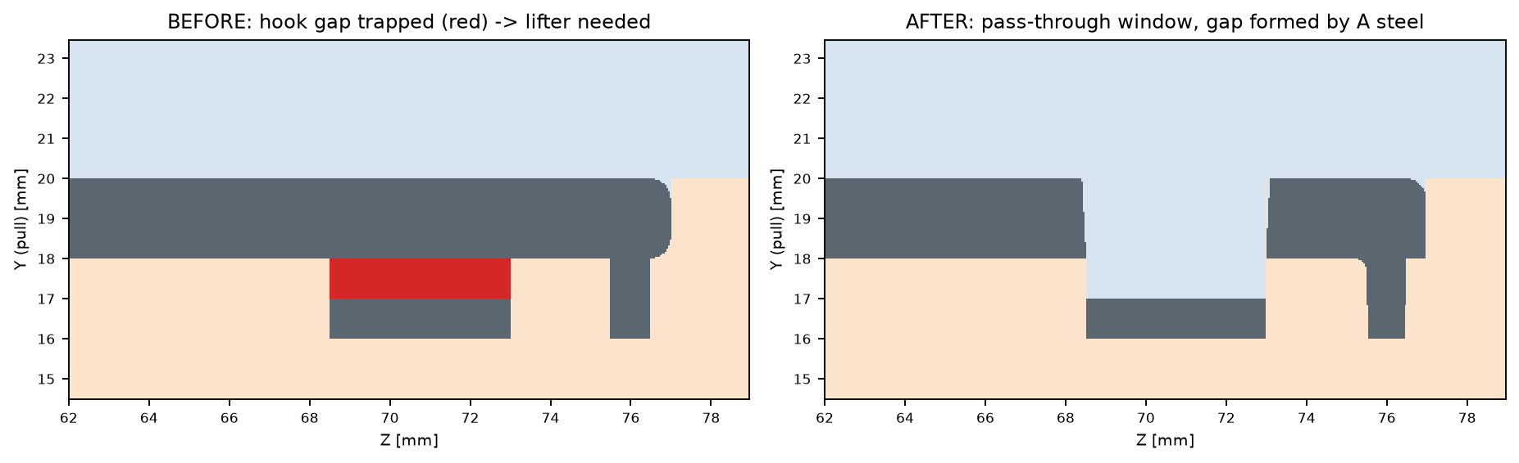
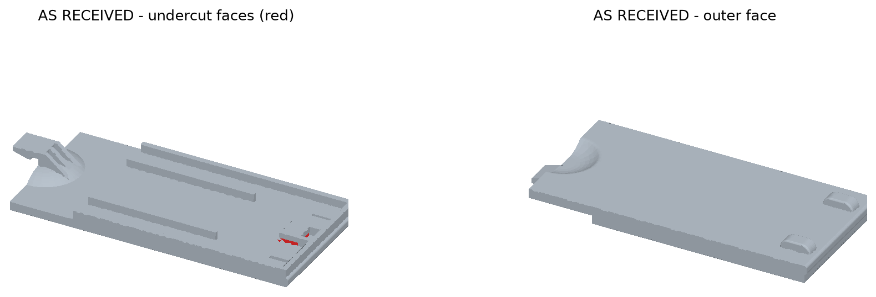
Undercut: retention hook
04 UNDERCUT
A 1.0 mm gap behind the hook block is shadowed by the plate: 57 mm² of undercut.
Option | Tooling | Part impact | Verdict
Angled lifter | 10°, 5.0 mm travel → 28 mm stroke | none | costly, wear
Side slider | gap opens toward the part interior (−Z) | — | not feasible
Pass-through window | A steel through a 6.0 × 4.5 window, 3° shut-off | hole in the outer face at the hook | SELECTED
57 mm²
≈ 0 mm²
undercut, as received
after (0.04 mm² numerical slivers)
Check with the rear case: the window sits at the hook end of the cover. If it has to stay invisible, keep the closed hook and budget the lifter instead.
ANRMTPT0003F Battery cover · ABS · DFM review · Rev 01
4 / 12
Notes:
Undercut test: every face must see free space along its own release direction (+Y for A, -Y for B); vertical faces must escape either way. Lifter sized for the gap depth 4.5 mm + 0.5 mm clearance at 10 deg max lifter angle.

Slide 5
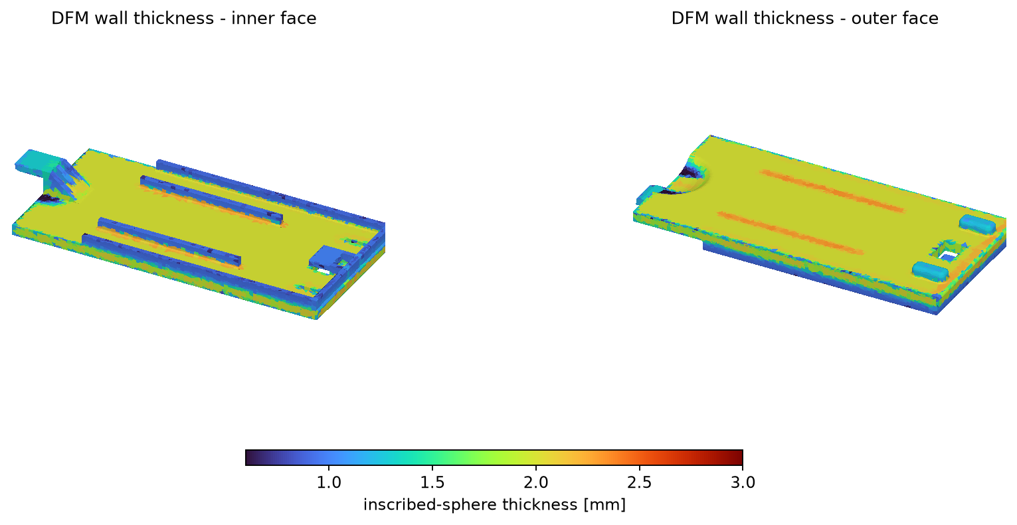
Wall thickness
05 THICKNESS
Nominal wall held at a uniform 2.0 mm; ribs at 50 % of wall. No thick nodes (max 2.31 mm).
Wall [mm] | As received | DFM
min (0.5 %) | 0.80 | 0.72
median | 2.00 | 2.00
max (99.5 %) | 2.10 | 2.31
rib root / wall | 0.8 / 2.0 (40 %) | 1.0 / 2.0 (50 %)
▸ Primary wall 2.0 mm everywhere (plate + recess shell): inside the 2–3 mm target and uniform.
▸ Ribs, rails and hook stay at 50–65 % of the wall so the class-A face does not show sink. Making them 2–3 mm would create 4 mm nodes.
▸ Thinnest section 0.8 → 1.0 mm at the rib root. Measured minimum is the drafted tip.
▸ Max 2.3 mm at radiused rib roots: +15 % only, so no local cooling problem.
ANRMTPT0003F Battery cover · ABS · DFM review · Rev 01
5 / 12
Notes:
Thickness = diameter of the largest inscribed sphere tangent at each of 30,000 surface samples, then a 0.7 mm local max-filter to remove the known under-read next to sharp convex edges.

Slide 6
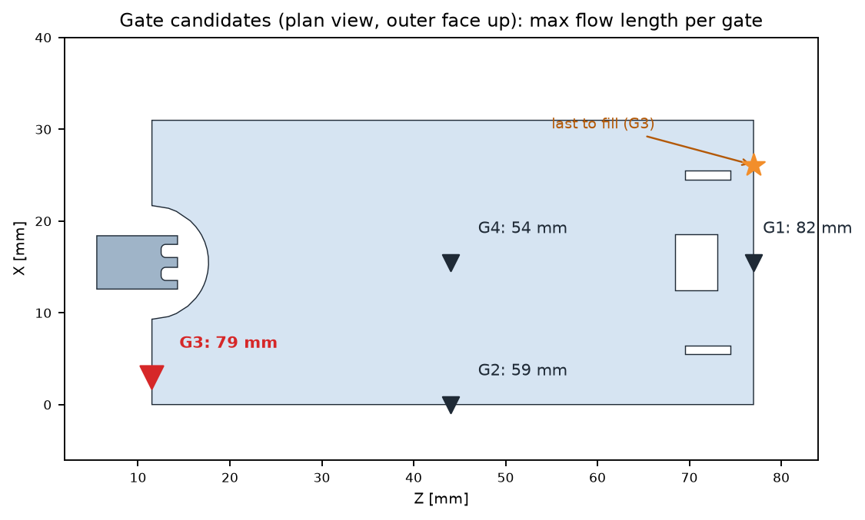
Gate location & type
06 GATE
Tunnel gate at the latch end: gate mark hidden, the snap arm fills first, weld line under the top lip.
Selected: G3
▸ Type: tunnel (submarine) gate from B, auto-degated on ejection. No manual trim.
▸ Size: Ø1.0 mm tip (0.5 × wall), 40° tunnel, 1.2 mm land.
▸ Where: bottom end face beside the thumb recess (X 3, Z 11.5), below the PL.
▸ Flow: L/t 40, far below the ABS limit of about 150:1 at 2 mm.
▸ Why not G2 / G4: shorter flow, but the weld line crosses the cosmetic face or needs a 3-plate tool.
Gate | Type | Max flow | L / t | Gate mark | Weld line | Verdict
G1 | edge gate | 82 mm | 41 | hidden | centre of cosmetic face | reject
G2 | tunnel gate | 59 mm | 29 | side wall | across cosmetic face | reject
G3 | tunnel gate | 79 mm | 40 | hidden (end face) | under top lip (Z 73–77) | SELECTED
G4 | pin-point (3-plate) | 54 mm | 27 | B face, 3-plate | above window | cost
ANRMTPT0003F Battery cover · ABS · DFM review · Rev 01
6 / 12
Notes:
Flow length = shortest surface path from the gate on a ~1.4 mm remeshed surface (Dijkstra). This is a geometric fill proxy, not a Moldflow result; confirm pressure/weld-line temperature in a fill simulation.

Slide 7
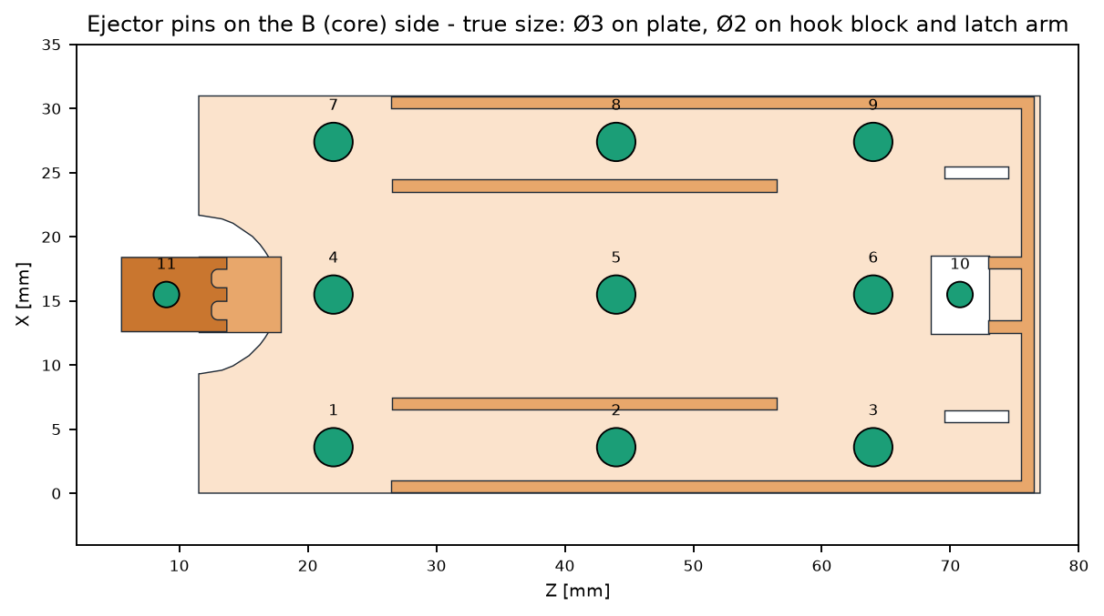
Ejection
07 EJECTION
11 round pins on flat B-side faces. With 1° draft, the part releases without scuffing the ribs.
# | Location | Face | Pin
1 | X 3.6 Z 22.0 | plate inner face | Ø3
2 | X 3.6 Z 44.0 | plate inner face | Ø3
3 | X 3.6 Z 64.0 | plate inner face | Ø3
4 | X 15.5 Z 22.0 | plate inner face | Ø3
5 | X 15.5 Z 44.0 | plate inner face | Ø3
6 | X 15.5 Z 64.0 | plate inner face | Ø3
7 | X 27.4 Z 22.0 | plate inner face | Ø3
8 | X 27.4 Z 44.0 | plate inner face | Ø3
9 | X 27.4 Z 64.0 | plate inner face | Ø3
10 | X 15.5 Z 70.8 | hook block | Ø2
11 | X 15.5 Z 9.0 | latch arm (inner face) | Ø2
11 pins
15 mm
▸ Pins are checked to land fully on flat faces.
▸ Ø2 pin on the latch arm stops the catch from dragging.
9 × Ø3 plate · 2 × Ø2 hook / latch
stroke (core depth 7 mm + 8)
ANRMTPT0003F Battery cover · ABS · DFM review · Rev 01
7 / 12
Notes:
Each Ø3 pin site is verified by casting 17 rays over a disc of radius 2.0 mm (pin + 0.5 mm) and requiring all to land on the Y 18 inner face. Ribs (1.0 mm) are too thin for pins; add blade ejectors at rib ends only if trials show sticking. Witness marks are on the non-cosmetic inner face.

Slide 8
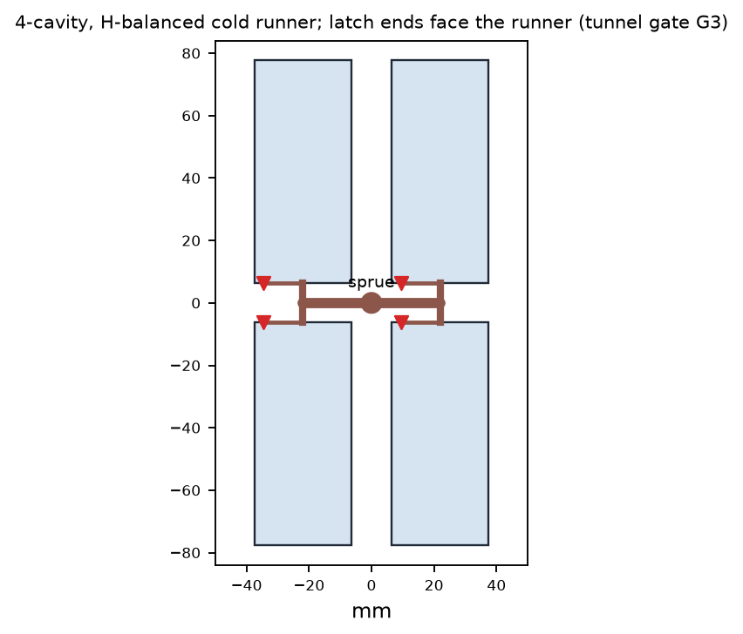
Cavitation & machine tonnage
08 CAVITIES
4 cavities: 42 t calculated clamp → 50 t machine, 22 g shot, 842 parts/h.
Cavities | Proj. area | Clamp (calc) | Machine | Shot | Parts / h
1 | 21.6 cm² | 10.6 t | 25 t | 5.5 g | 210
2 | 43.3 cm² | 21.2 t | 25 t | 11.0 g | 421
4 | 86.6 cm² | 42.4 t | 50 t | 22.1 g | 842
8 | 173.2 cm² | 84.7 t | 100 t | 44.1 g | 1,684
F = n · (Apart + Arunner) · pcavity · SF
A_part = 20.65 cm² (measured) · A_runner ≈ 1.0 cm²/cavity · p = 40 MPa (ABS, 2 mm wall) · SF = 1.2
▸ 4 cavities suit typical remote-control volumes (0.3–1 M/yr at 85 % OEE). Move to 8 cavities on 100 t above ~1.5 M/yr.
▸ Shot of 22 g should sit at 20–80 % of the barrel. A 50 t press with a Ø22–25 mm screw fits.
ANRMTPT0003F Battery cover · ABS · DFM review · Rev 01
8 / 12
Notes:
Part projected area is measured on the DFM STEP (sum of +Y-facing area x n_y). Runner allowance assumes Ø4/Ø3 H-balanced cold runner. Cycle time used for output: 17.1 s. Annual volume was not supplied; the cavitation choice is an assumption to confirm with planning.

Slide 9
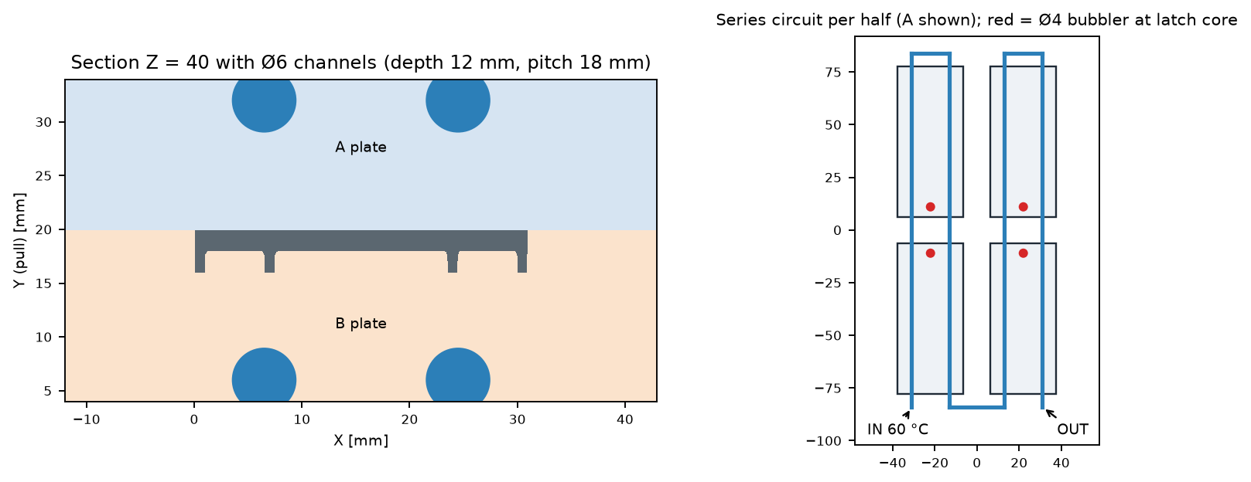
Cooling
09 COOLING
Cooling time 9.0 s at the 2.0 mm wall; cycle ≈ 17 s. Separate A and B circuits held within 5 K.
▸ t = s²/(π²α) · ln[(4/π)(Tm−Tw)/(Te−Tw)] s 2.0 mm, α 0.1 mm²/s, Tm 240, Tw 60, Te 85 °C.
▸ Layout: Ø6 channels, 12 mm below the surface, 18 mm pitch, 2 per cavity per half, series circuit.
▸ Latch core: Ø4 bubbler, where the 7 mm B-side step would otherwise run hot.
▸ Heat load: 626 W → 4.6 L/min total for a 2 K water rise.
▸ Thickest spot 2.3 mm needs 12 s, but it is local: size the cycle on the 2.0 mm wall.
9.0 s
17 s
2.3 L/min
Re 17,163
cooling time (2.0 mm)
cycle time
per circuit (Ø6)
turbulent (> 10,000)
ANRMTPT0003F Battery cover · ABS · DFM review · Rev 01
9 / 12
Notes:
1-D plate cooling (mid-plane to ejection temperature). Heat per shot = m*cp*(Tm-Te) for the 4-cavity shot; water at 60 C (nu 0.47e-6 m2/s). Values are hand calculations to size the layout; confirm with a cooling analysis.

Slide 10
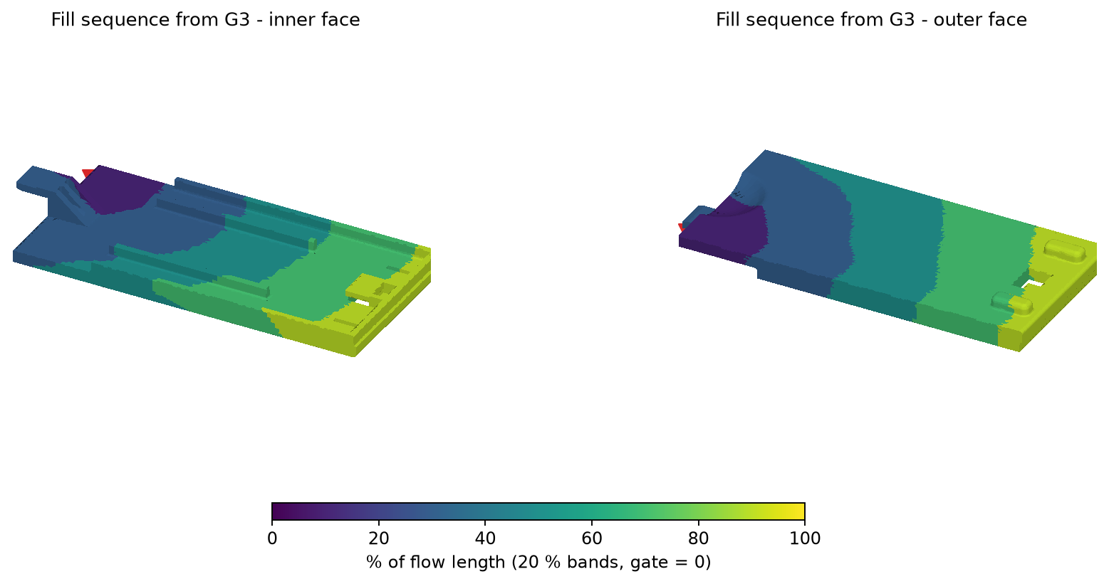
Fill sequence
10 FILL
From G3: latch and recess first, plate next, top lip and bumps last. Max flow 79 mm.
▸ 0–20 %: snap arm and recess fill first, so orientation runs along the arm (strongest direction).
▸ 20–80 %: the plate fills as a straight front; ribs fill along their length, with no hesitation.
▸ 80–100 %: top lip, hook and bumps. Last to fill: X 26, Z 77 (top corner).
▸ Vents: 0.02 mm deep at the top corners, bump tips and hook window.
▸ Weld line: short, just downstream of the hook window (Z 73–77), in the zone under the top lip.
▸ Fill time ≈ 0.6 s then pack at 50–70 % of fill pressure.
ANRMTPT0003F Battery cover · ABS · DFM review · Rev 01
10 / 12
Notes:
Bands = percent of the maximum shortest surface path from the gate (geometric flow-front proxy). A flow simulation should confirm weld-line position and temperature, pressure drop and venting.

Slide 11
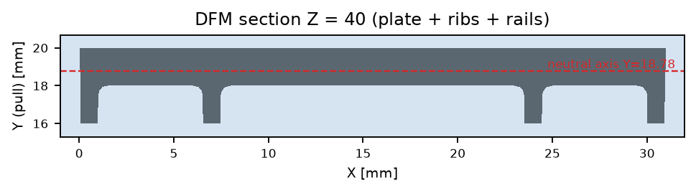
Warpage & deflection
11 WARPAGE
Bow ≈ 0.024 mm per K of A/B mould ΔT. The source model's 0.34 mm bow matches ≈ 14 K.
Check | As received | DFM
Bow at ΔT = 5 K | 0.12 mm | 0.12 mm
Shrink over 71.5 mm | 0.29–0.50 mm | same (tool +0.5 %)
I (Z = 40 section) | 48.9 mm⁴ | 50.0 mm⁴
10 N thumb, mid-span | 0.39 mm | 0.38 mm
Bending stress | 8.5 MPa | 8.2 MPa
Safety vs yield | 5.0 | 5.1
▸ Keep ΔT(A−B) ≤ 5 K to hold the bow ≤ 0.12 mm. Use separate A/B circuits and log the temperatures.
▸ ABS is amorphous: shrink is near-isotropic, so the risk of differential-shrink warp is low.
▸ Stiffness: span 59 mm (latch to hook). Deflection stays below 0.4 mm and stress sits at 1/5 of yield.
ANRMTPT0003F Battery cover · ABS · DFM review · Rev 01
11 / 12
Notes:
Thermal bow of a plate with a through-thickness mould-temperature difference: kappa = CTE*dT/t, delta = kappa*L^2/8 (L 65.5 mm plate, t 2.0 mm, CTE 90e-6/K). The 0.34 mm bow found in the reverse-engineered source mesh is consistent with about 14 K; this is an interpretation, not a measurement. Deflection: simply supported beam, 10 N at mid-span, E 2300 MPa, I from the measured Z=40 section.

Slide 12
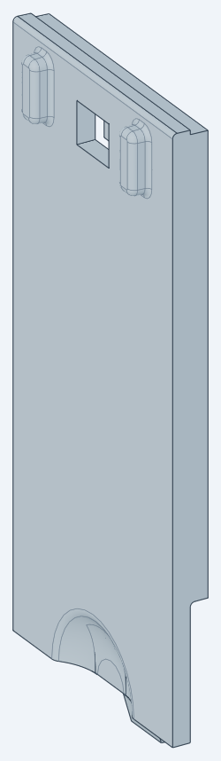

DFM changes: before / after
12 CHANGES
Straight-pull, 2-plate, 4-cavity tool: no lifters or sliders, every wall drafted, every internal corner radiused.
Item | Before | After (part_DFM.step)
Draft | 0° on all walls | 1° core · 3° cavity · 3° shut-off
Undercut | 57 mm² → lifter | 0 → pass-through window 6 × 4.5
Internal radii | R0 (sharp) | R0.5 rib / rail / lip / recess / bump roots
Thinnest section | rib 0.8 mm | rib 1.0 mm root (50 % t)
Nominal wall | 2.0 mm | 2.0 mm (uniform)
Outer bumps | R2 barrel ends, 0° sides | 3° drafted pad, R0.75 top, R0.5 root
Volume · mass | 4.61 cm³ · 4.84 g | 4.49 cm³ · 4.72 g
before · outer
before · inner
after · outer
after · inner
Open items
▸ Window visibility: confirm with the rear-case lip, or revert to the closed hook plus a lifter.
▸ Hook-leg side roots: 4 short edges left sharp (blend cannot close on the shut-off rim). Add R0.3 in native CAD.
▸ Simulation: run fill, pack and warp on the chosen ABS grade before tool release.
▸ Snap-fit: run FEA of latch release strain with the rear-case geometry.
ANRMTPT0003F Battery cover · ABS · DFM review · Rev 01
12 / 12
Notes:
part_DFM.step is generated by battery_cover_RE/src/battery_cover_dfm.py from lib/geometry_dfm.py, which reuses the reverse-engineered lib/geometry.py (same frame, same recess and latch profiles).

