Slide 1
Product information
Part Name :- HIDDEN_DISPLAY_HOLDER
Index No :-
Model :-
Plastic material :- HI-PS
Shrinkage :- 1.005
Part Weight :- 44.68g
Tooling information
Tooling type :- 2PLATE
Hot Runner system :- NONE
Gate type :- SIDE GATE
No. of cavities :- 1 X 4
No. of slider :- NONE
No. of lifters :- 7X / CAV
Main insert material :- NAK-80 ( BPM-HHH )
Mold base material :- S50C
Mold base Standard :- IKM
Injection machine capacity :- 180T
RESULT | OK | NG
APPD
DATE

Slide 2
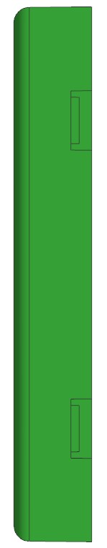

Product size
96.21
148.03
14.07

Slide 3
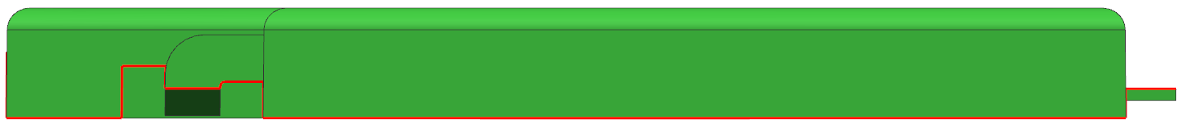
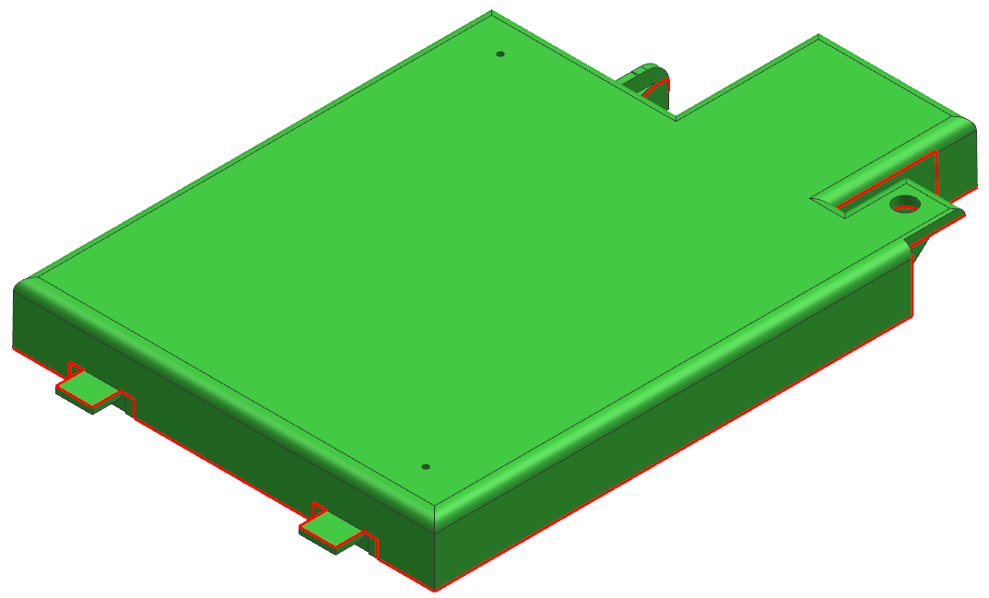
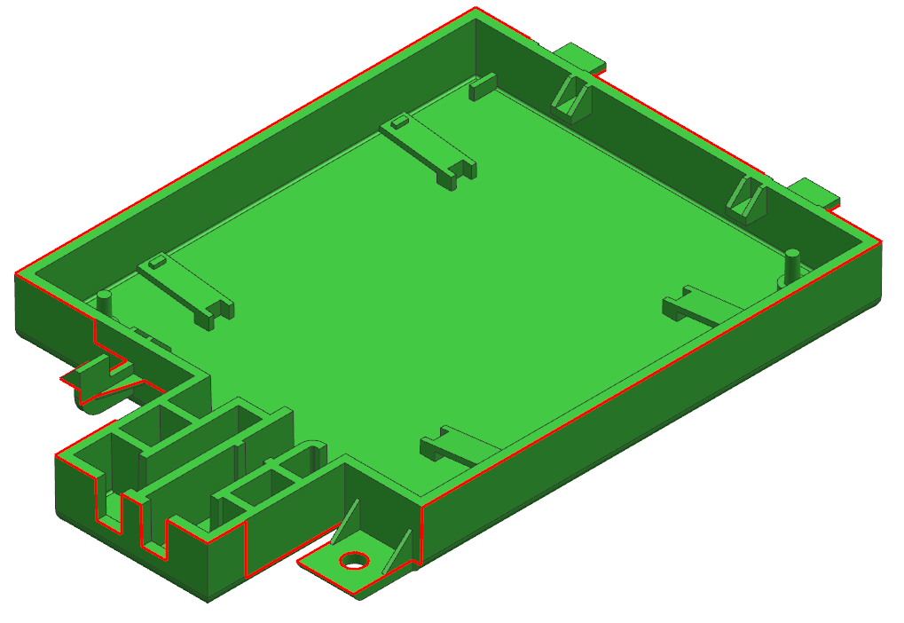
1.Parting Line
CAV
PL
COR
RESULT | OK | NG
APPD
DATE

Slide 4
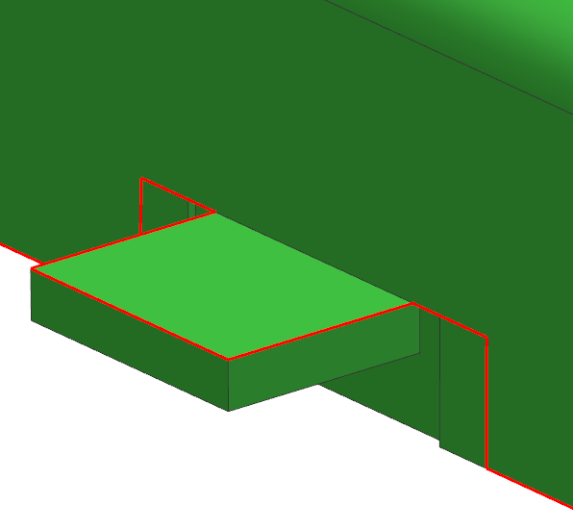
2.Parting Line
CAV
COR
RESULT | OK | NG
APPD
DATE

Slide 5
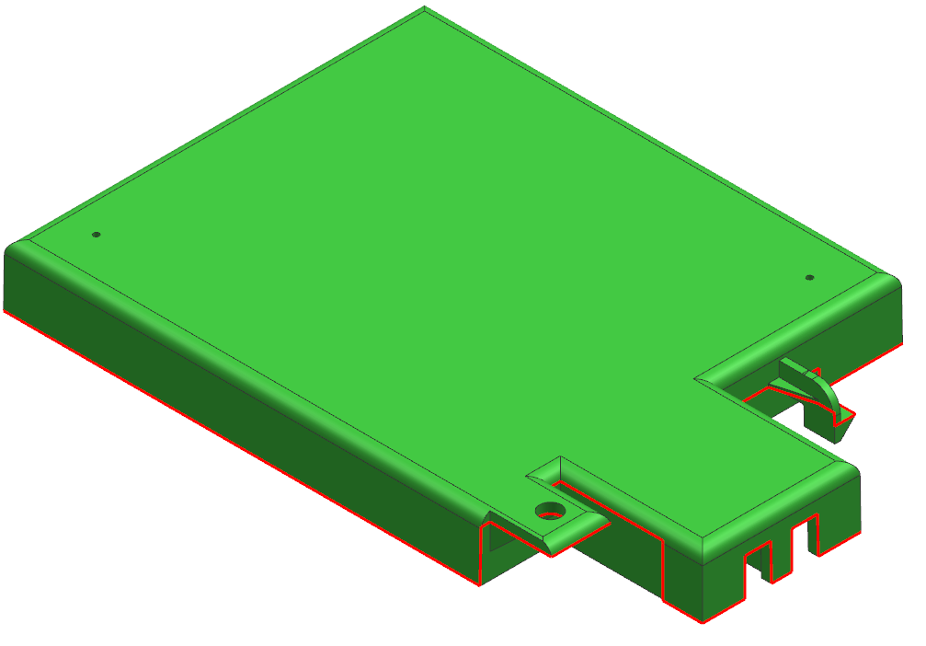
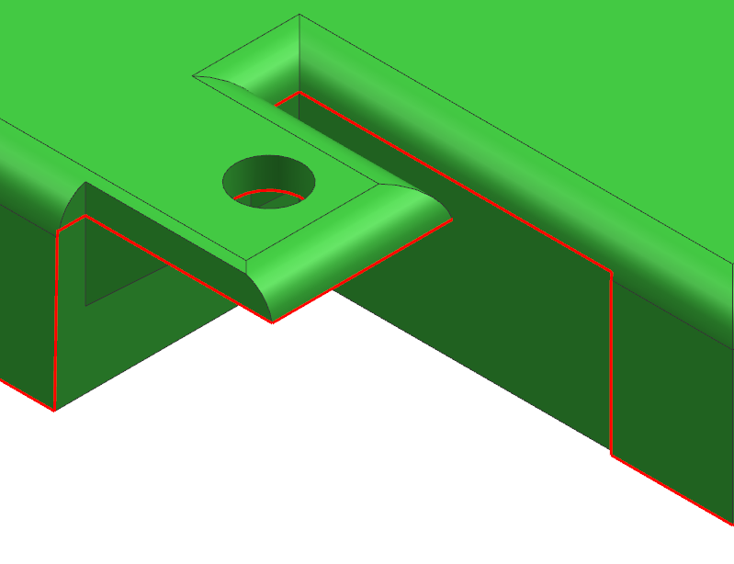
3.Parting Line
CAV
COR
RESULT | OK | NG
APPD
DATE

Slide 6
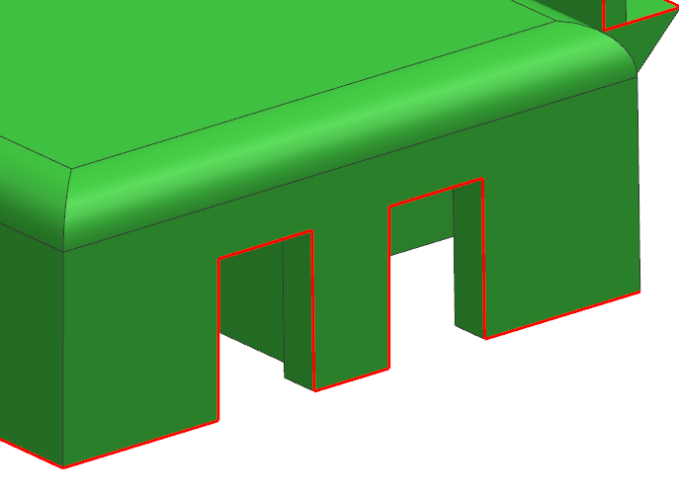
4.Parting Line
CAV
COR
RESULT | OK | NG
APPD
DATE

Slide 7
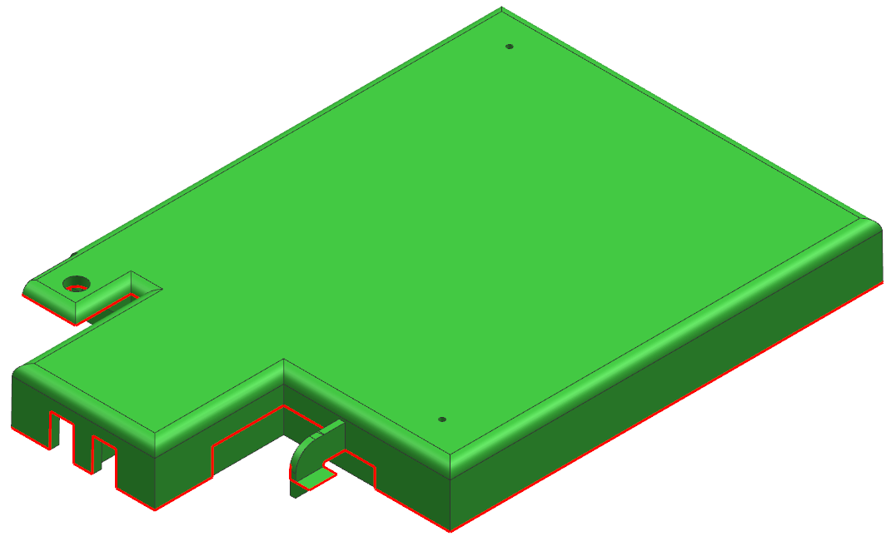
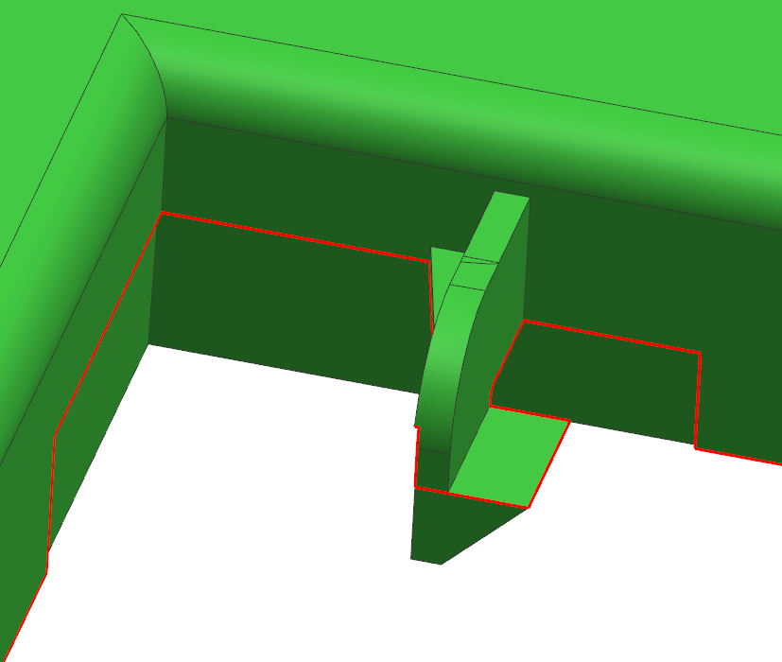
5.Parting Line
CAV
COR
RESULT | OK | NG
APPD
DATE

Slide 8
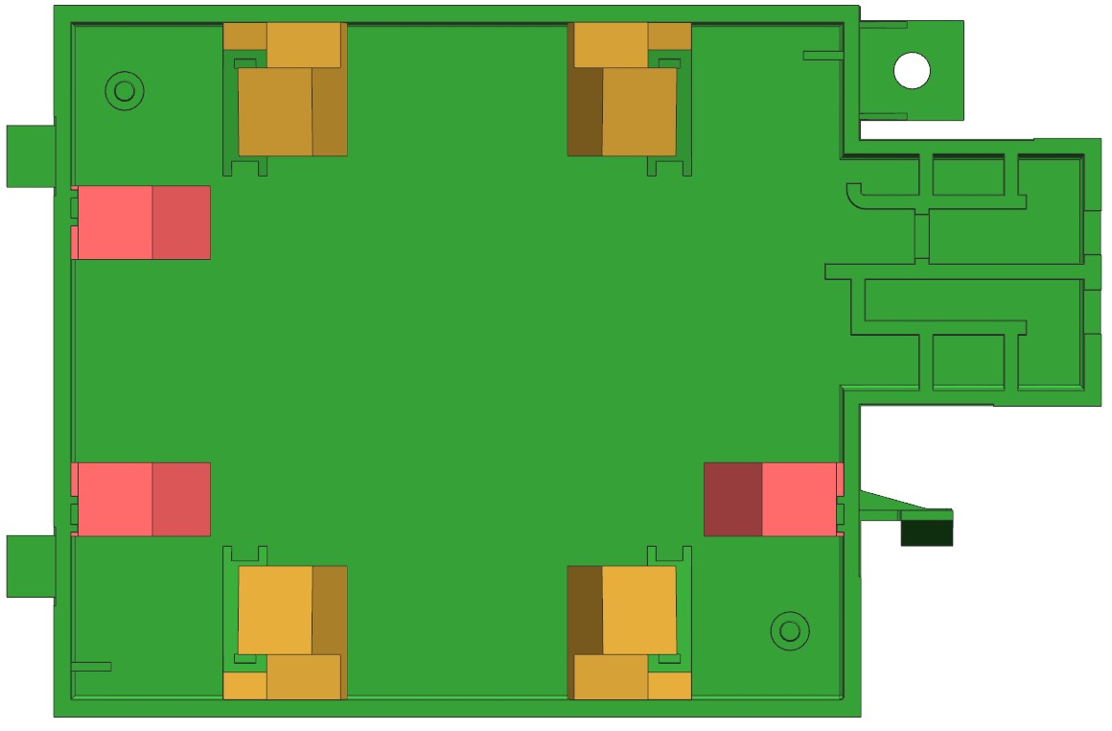
6.Lifter
Lifter 02
Lifter 02
Lifter 01
Lifter 01
Lifter 01
Lifter 02
Lifter 02
RESULT | OK | NG
APPD
DATE

Slide 9
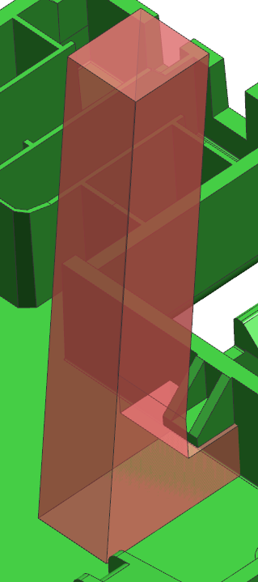
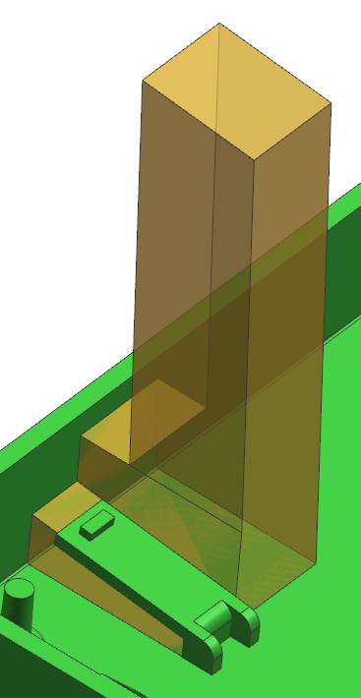
7.Lifter
Lifter 01
Lifter 02
RESULT | OK | NG
APPD
DATE

Slide 10
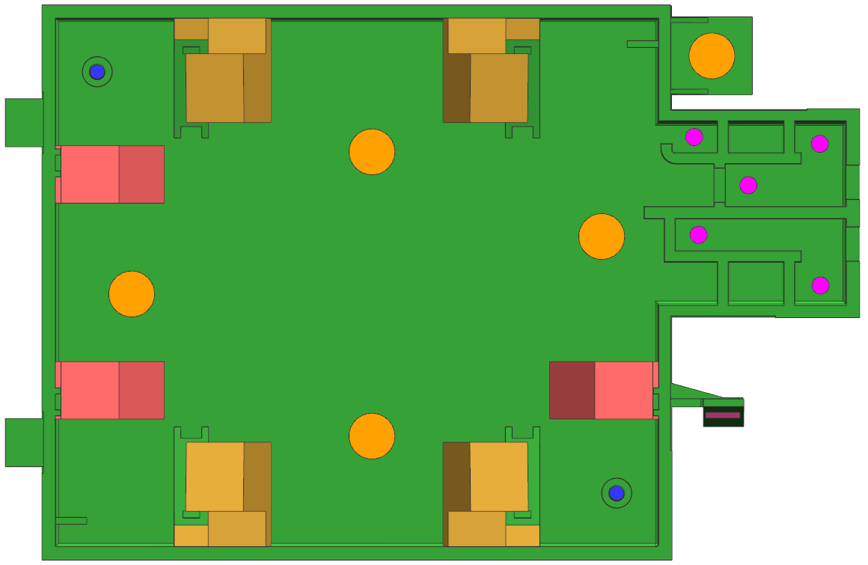




8.Ejector
EP 2.5 ( 2X )
EP 3.0 ( 5X )
EP 8.0 ( 5X )
EB 6.0 X 1.0 ( 1X )
RESULT | OK | NG
APPD
DATE

Slide 11
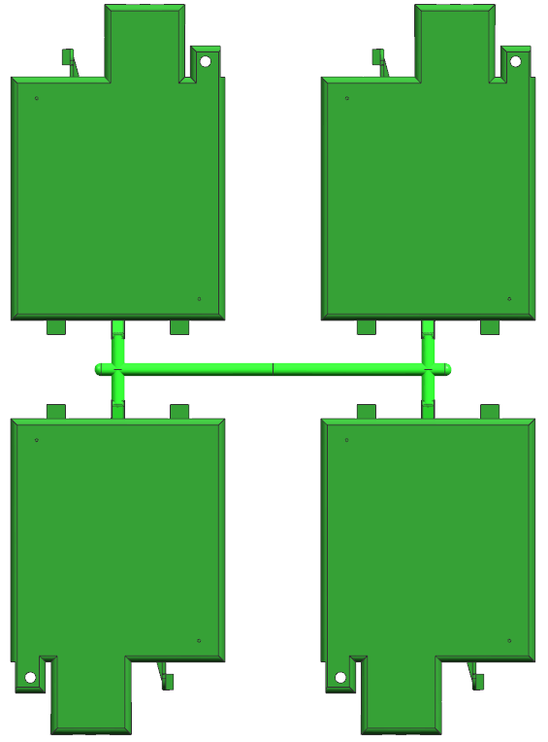
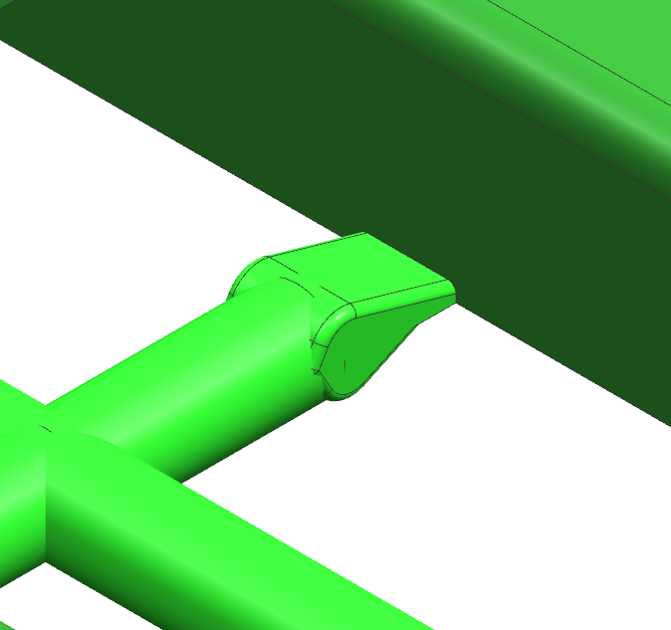
9.Gate
Cold Runner + Side Gate
6.0 X 1.0
RESULT | OK | NG
APPD
DATE

Slide 12

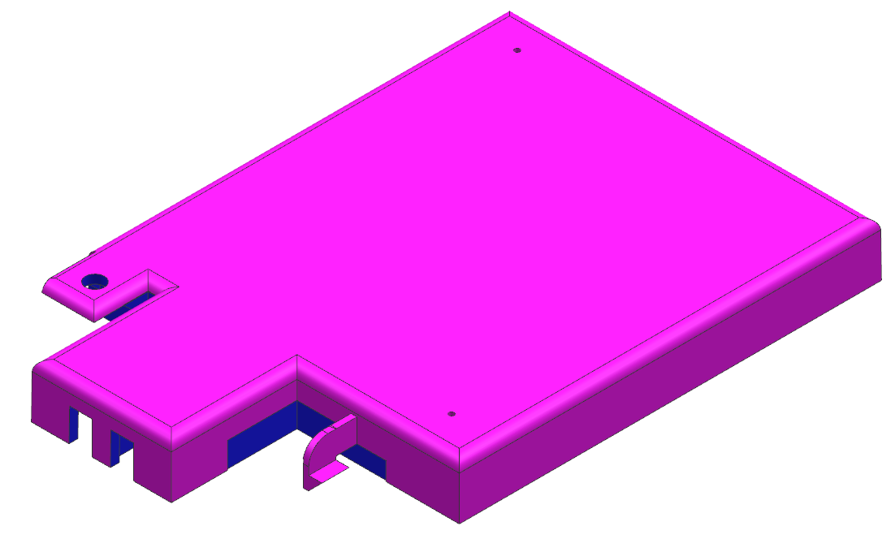
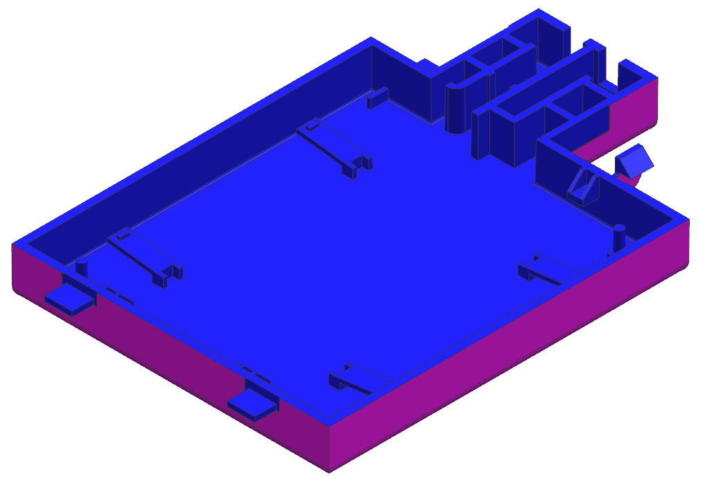
10.Draft angle analysis
RESULT | OK | NG
APPD
DATE
All Green Surface Are 0º Propose To Add 1.0º For Cavity Side &
Draft 0.5º For Core Side

Slide 13
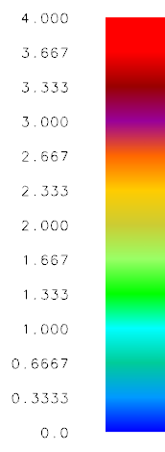
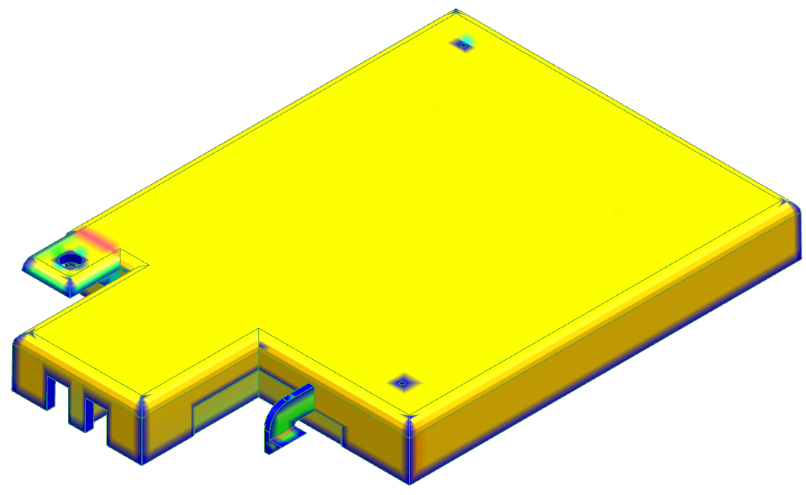
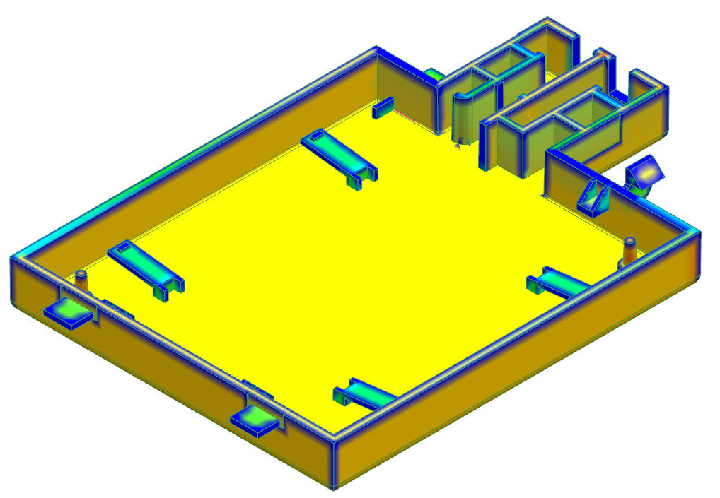
11.Thickness mark
RESULT | OK | NG
APPD
DATE
All Green Surface Are 0º Propose To Add 1.0º For Cavity Side &
Draft 0.5º For Core Side

Slide 14

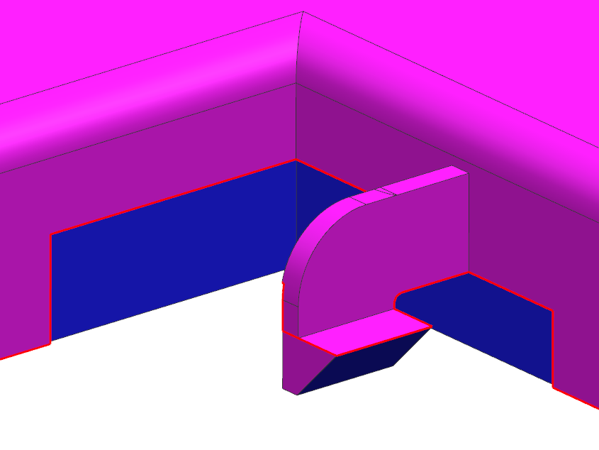
12.Suggest
COR
CAV
Have undercut,
Suggest to add draft 0.5º at core side
RESULT | OK | NG
APPD
DATE
Undercut

Slide 15
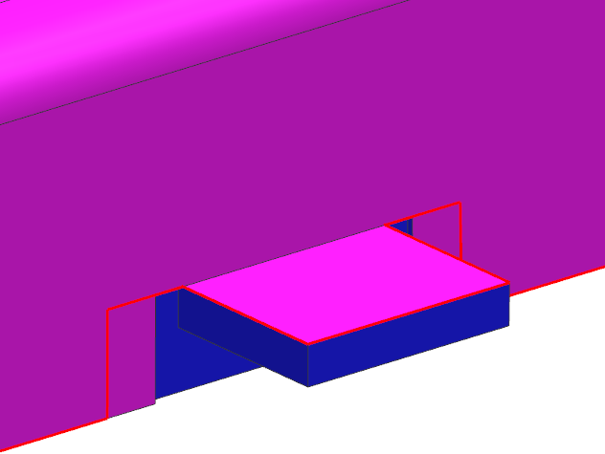
13.Suggest
COR
CAV
Undercut
Have undercut,
Suggest to add draft 0.5º at core side
RESULT | OK | NG
APPD
DATE

Slide 16
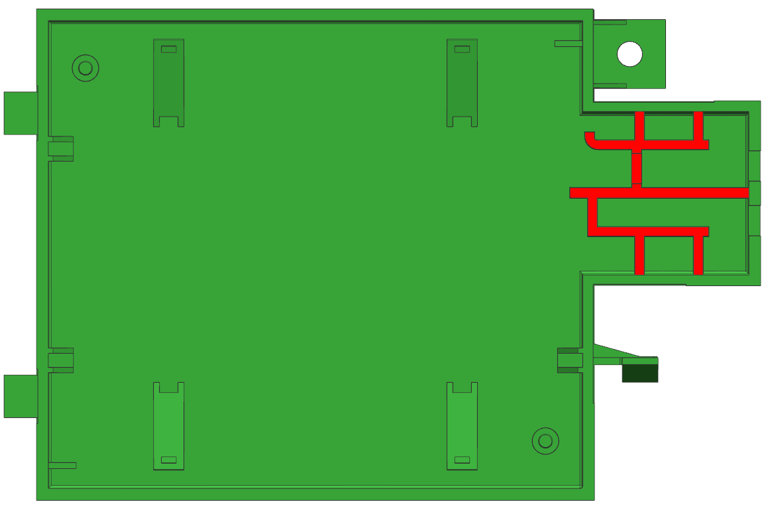

14.Suggest
A
A
2.2
Have thickness mark,
Suggest to change all rib’s
to 1.2mm from 2.2mm
RESULT | OK | NG
APPD
DATE
A - A

Slide 17
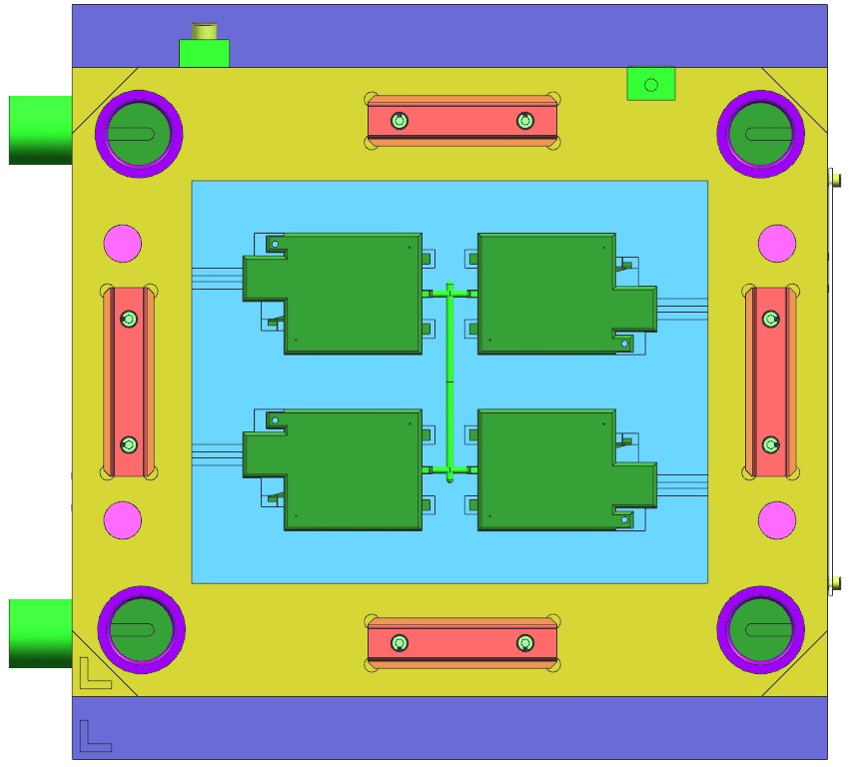
15.Mold Layout
600
500
600
320
Mold Top
410
RESULT | OK | NG
APPD
DATE
180 TON
Distance between tie rods (HXV) 560 X 510
Machine size need to change from 180T to 220T

Slide 18
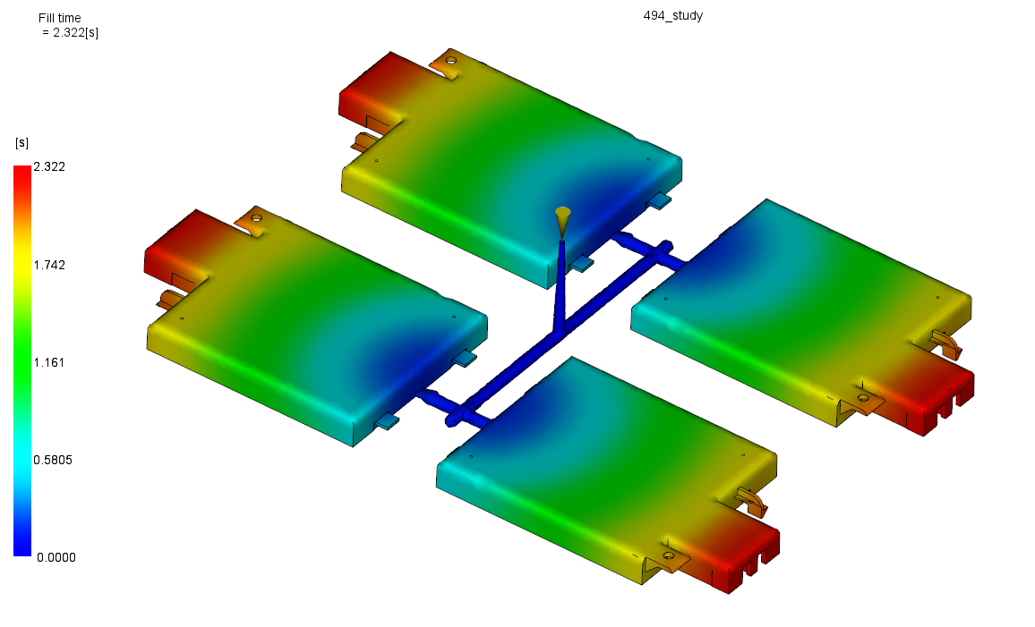
16.Fill Time
RESULT | OK | NG
APPD
DATE
Filling time = 2.322sec

Slide 19
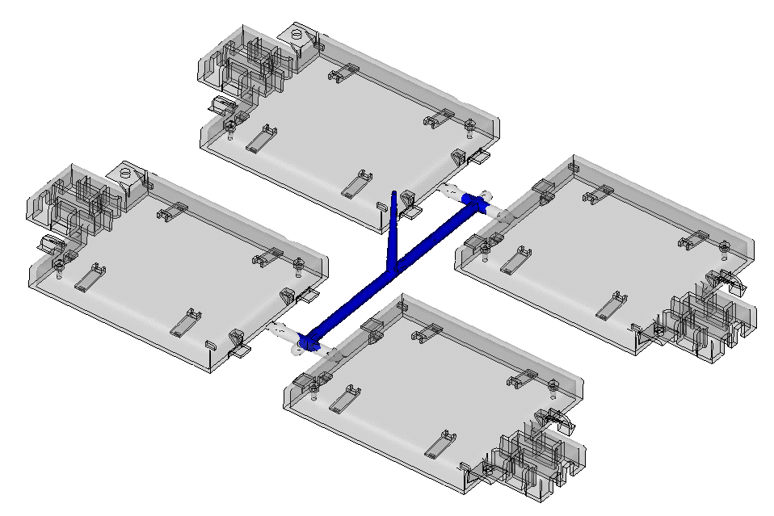
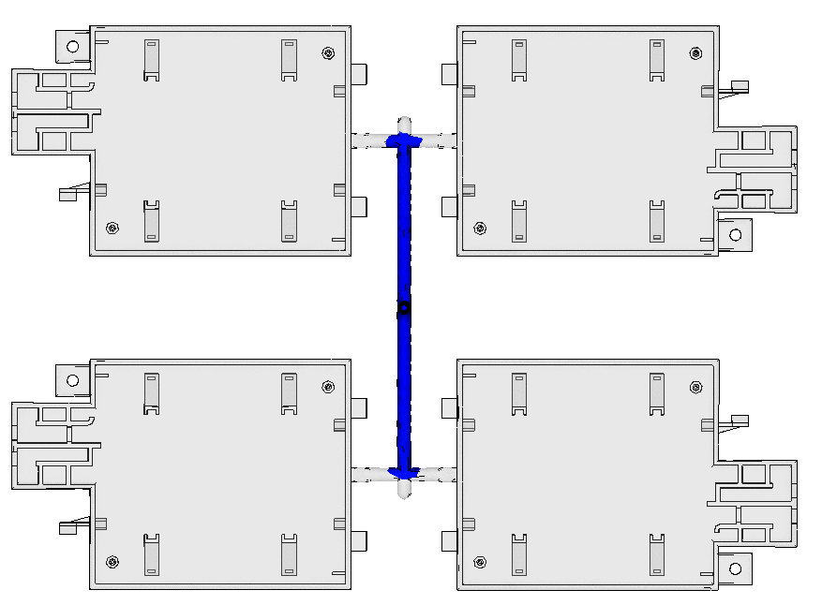
17.Fill Simulation
RESULT | OK | NG
APPD
DATE
(Press shift + F5 to watch animation )

Slide 20
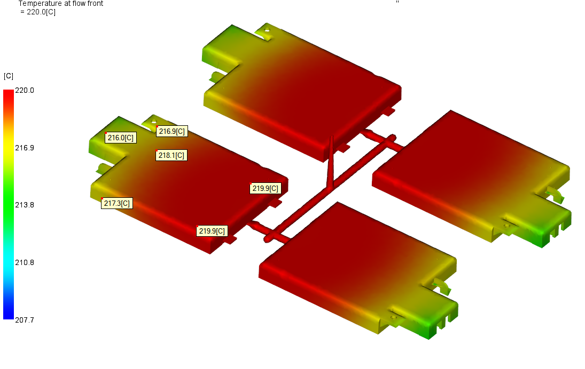
18.Temperature at flow front
RESULT | OK | NG
APPD
DATE

Slide 21
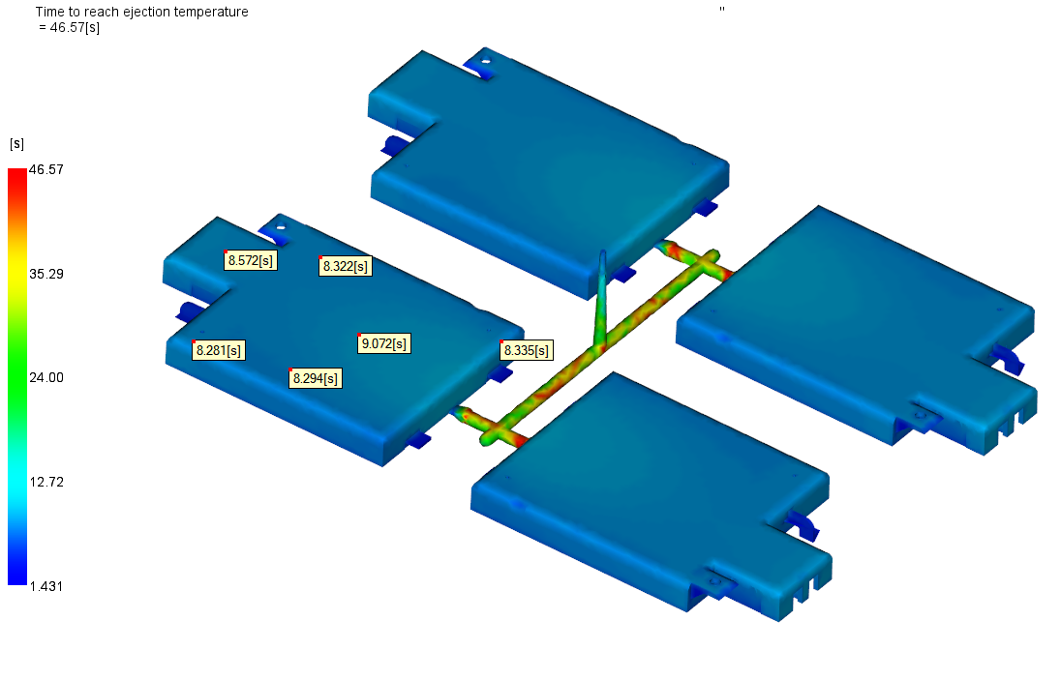
19.Ejection Temperature
RESULT | OK | NG
APPD
DATE

Slide 22
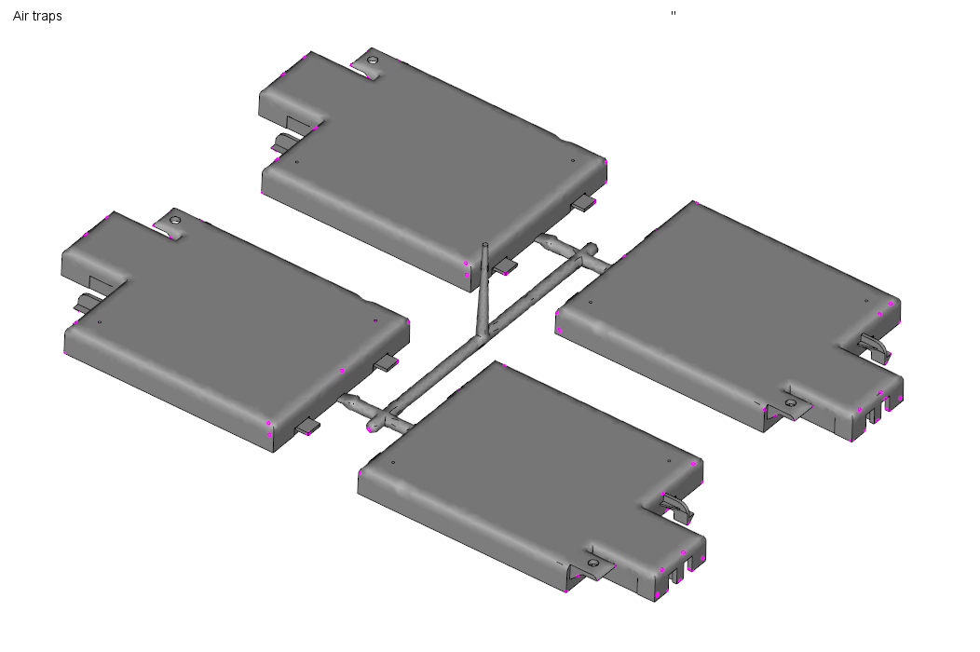
20.Air Traps
RESULT | OK | NG
APPD
DATE
Make air vent around parts

Slide 23
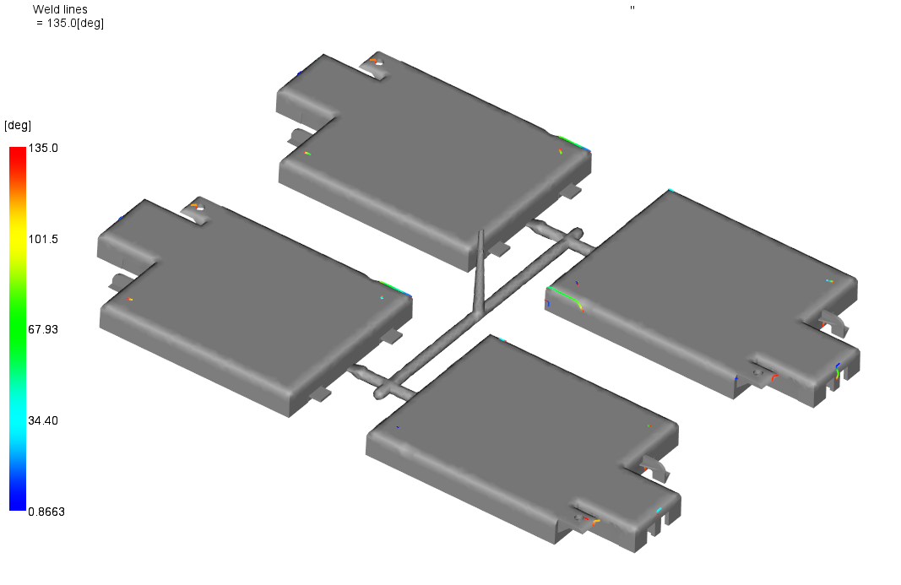
21.Weld Lines
RESULT | OK | NG
APPD
DATE
Visible weld lines

Slide 24
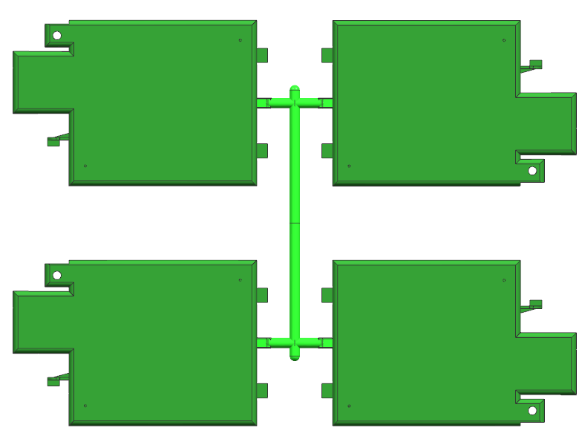
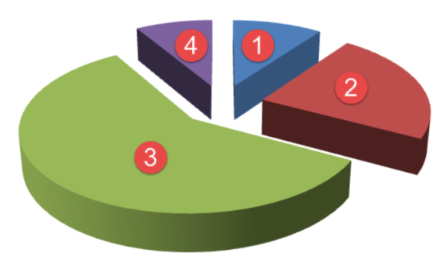
22.Cycle Time
1.Fill time = 2.322sec
2.Pack time = 8.0 sec
3.Cooling time = 15.0 sec
4.Mold open time = 5.0 sec
Cycle time = Fill + Pack + Cooling + Mold open
= 30.322 sec
RESULT | OK | NG
APPD
DATE

