Slide 1
Product information
Part Name :- TERMINAL_HOLDER
Index No :-
Model :-
Plastic material :- HI-PS
Shrinkage :- 1.005
Part Weight :- 94.75g
Tooling information
Tooling type :- 2PLATE
Hot Runner system :- YUDO
Gate type :- VALVE GATE
No. of cavities :- 1 X 1
No. of slider :- 1X / CAV
No. of lifters :- NONE
Main insert material :- NAK-80 ( BPM-HHH )
Mold base material :- S50C
Mold base Standard :- IKM
Injection machine capacity :- 230T
RESULT | OK | NG
APPD
DATE

Slide 2
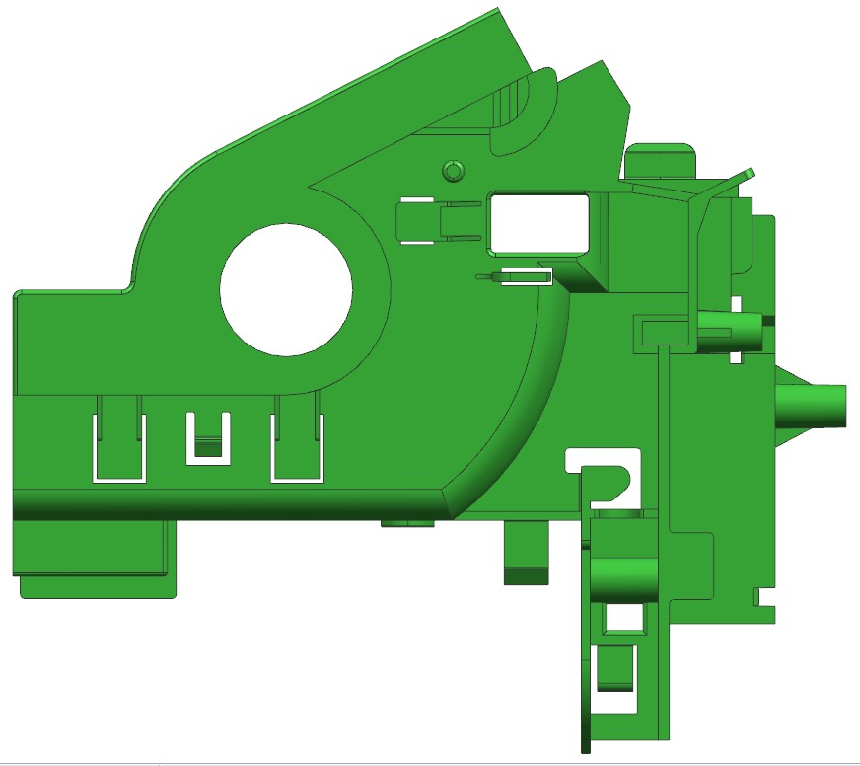
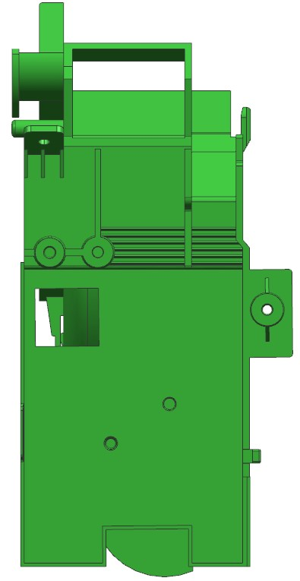
Product size
167.73
82.04
187.50

Slide 3
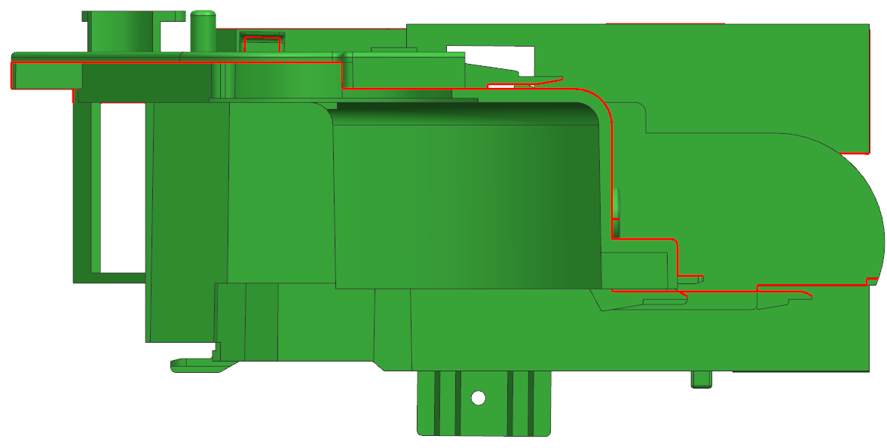
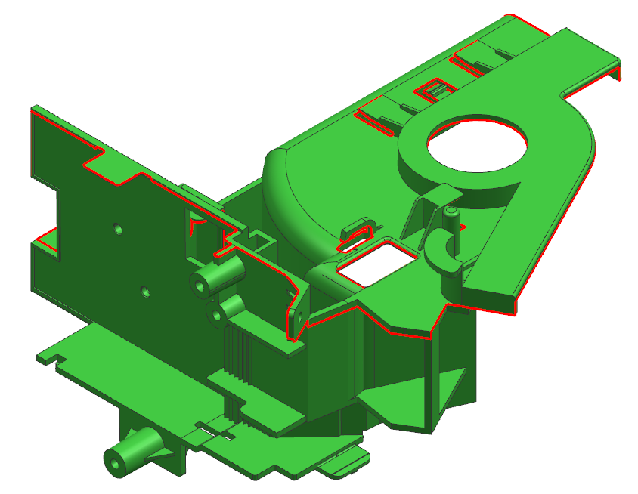
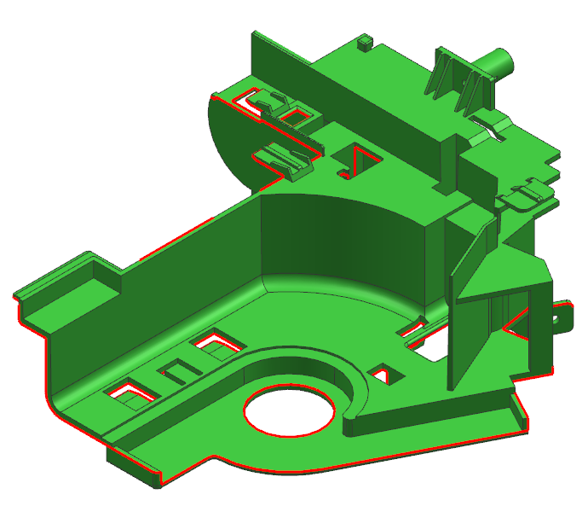
1.Parting Line
CAV
PL
COR
RESULT | OK | NG
APPD
DATE

Slide 4
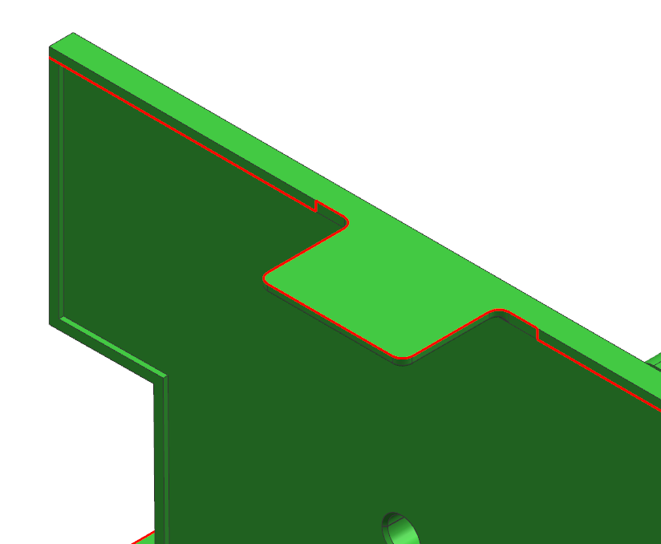
2.Parting Line
CAV
COR
RESULT | OK | NG
APPD
DATE

Slide 5
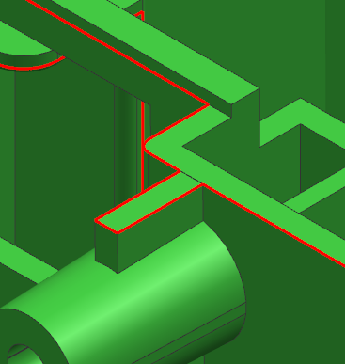
3.Parting Line
CAV
COR
RESULT | OK | NG
APPD
DATE

Slide 6
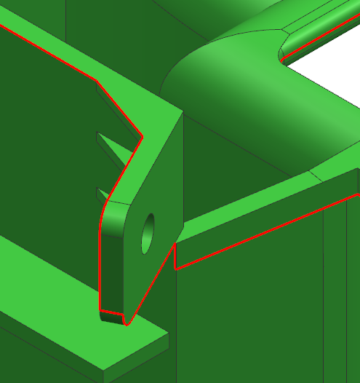
4.Parting Line
CAV
COR
RESULT | OK | NG
APPD
DATE

Slide 7
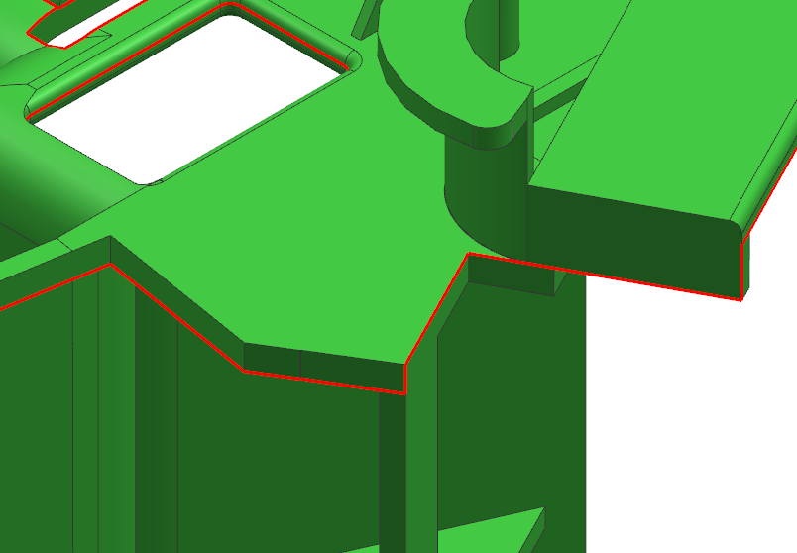
5.Parting Line
CAV
COR
RESULT | OK | NG
APPD
DATE

Slide 8
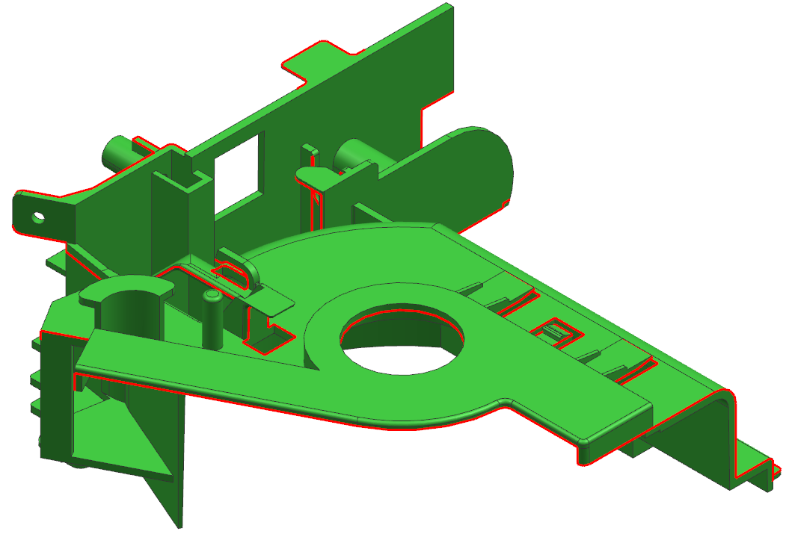
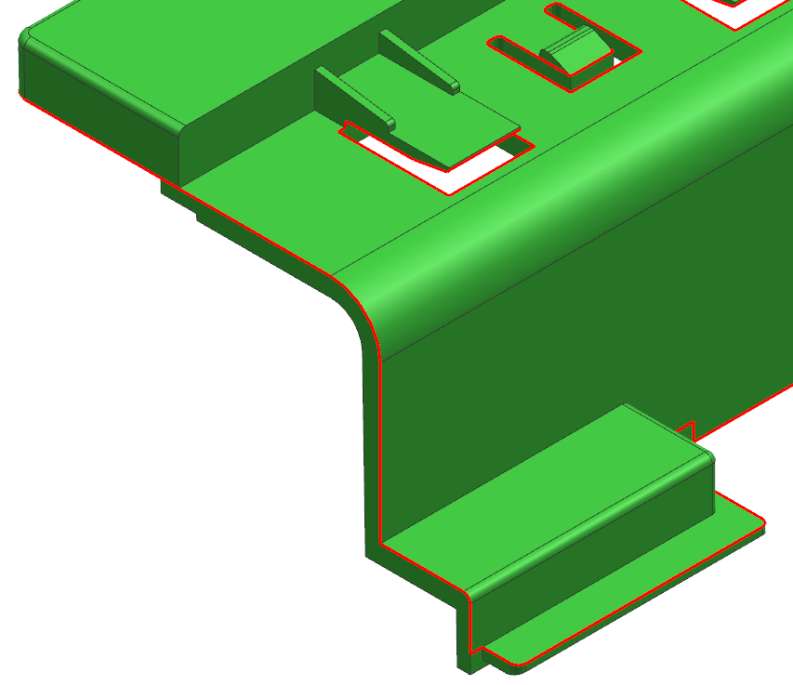
6.Parting Line
CAV
COR
RESULT | OK | NG
APPD
DATE

Slide 9
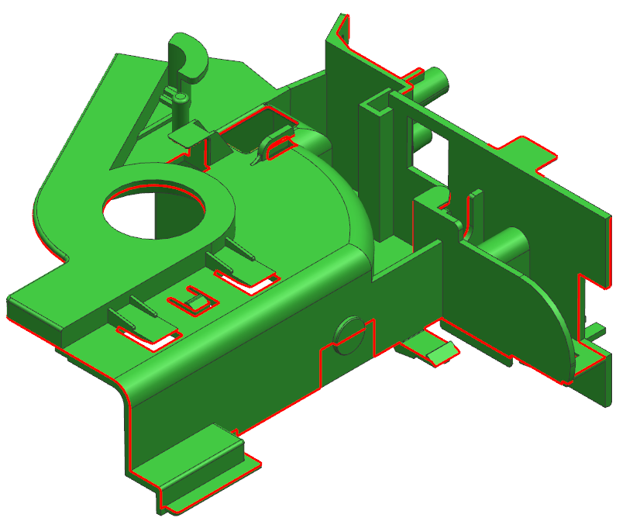
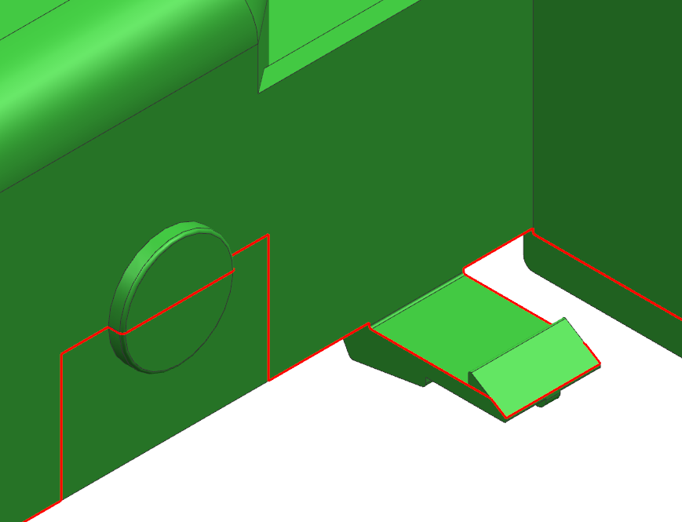
7.Parting Line
CAV
COR
RESULT | OK | NG
APPD
DATE

Slide 10
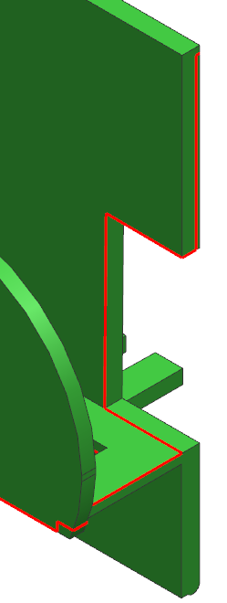
8.Parting Line
CAV
COR
RESULT | OK | NG
APPD
DATE

Slide 11
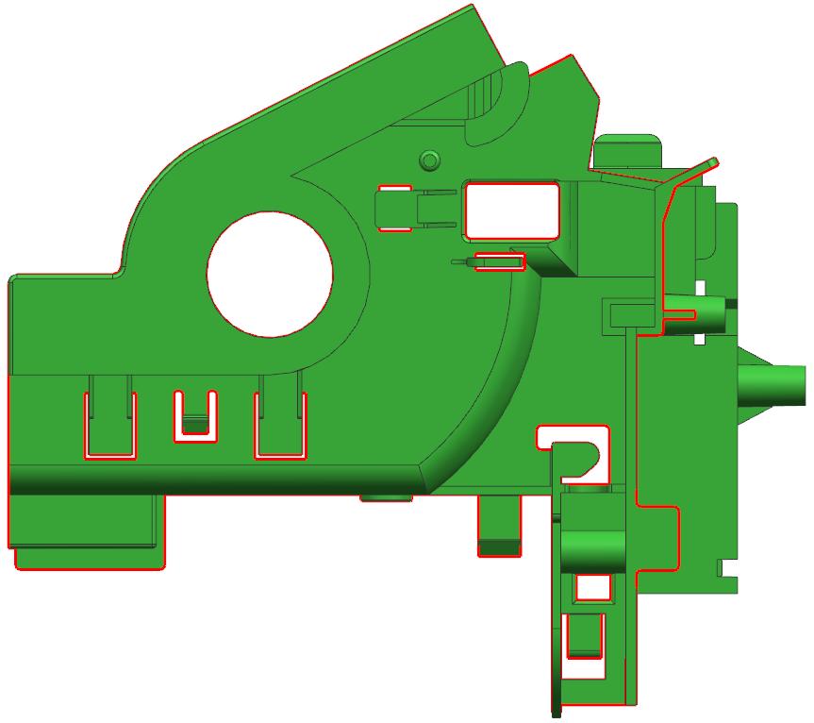
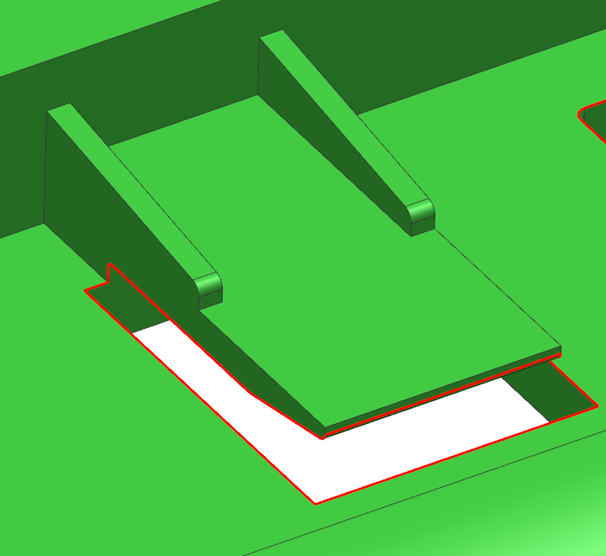
9.Parting Line
CAV
COR
RESULT | OK | NG
APPD
DATE

Slide 12
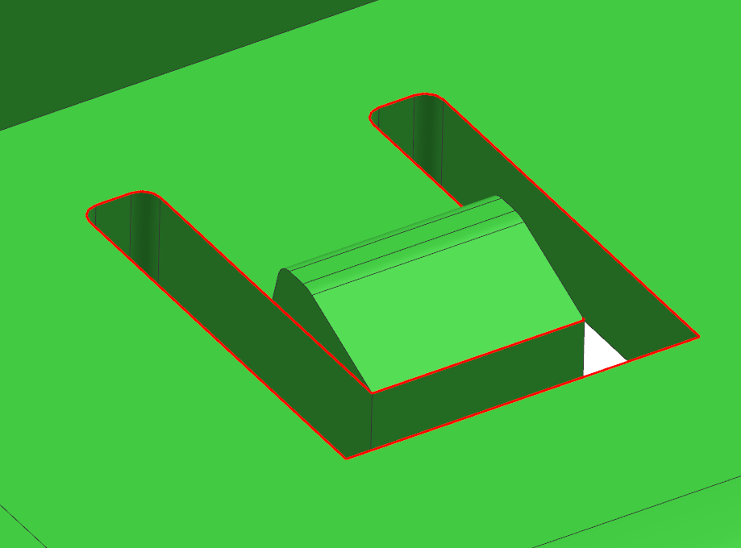
10.Parting Line
CAV
COR
RESULT | OK | NG
APPD
DATE

Slide 13
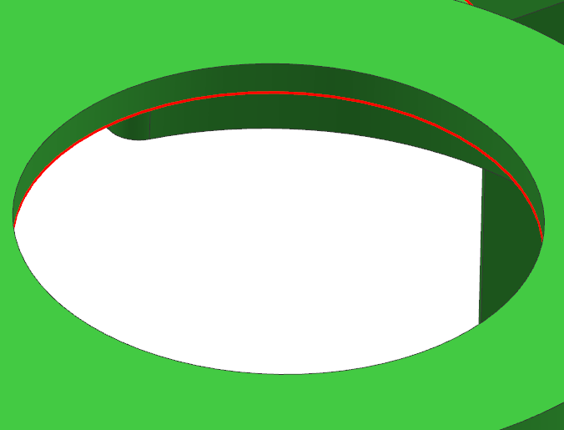
11.Parting Line
CAV
COR
RESULT | OK | NG
APPD
DATE

Slide 14
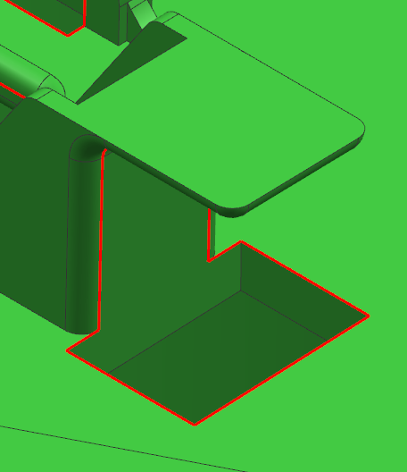
12.Parting Line
CAV
COR
RESULT | OK | NG
APPD
DATE

Slide 15
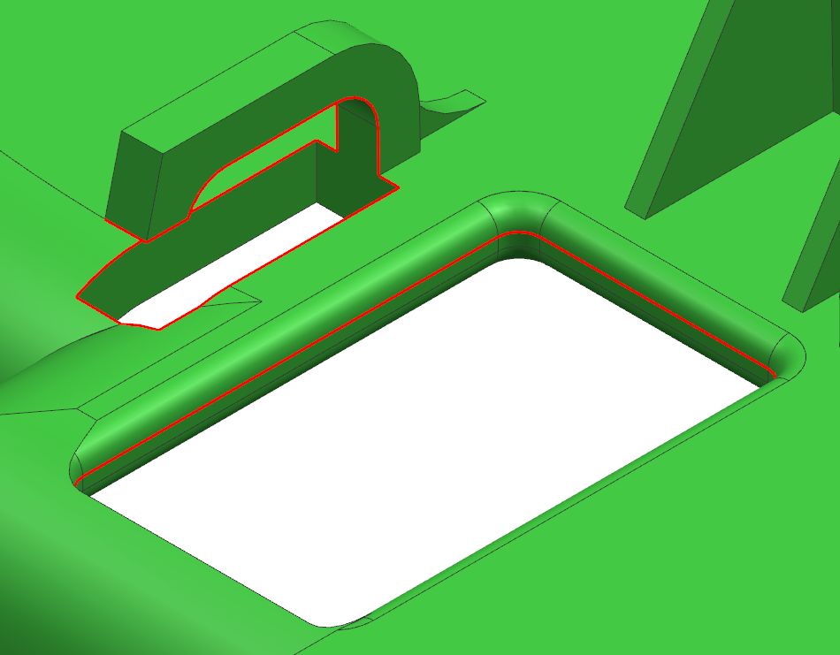
13.Parting Line
CAV
COR
RESULT | OK | NG
APPD
DATE

Slide 16
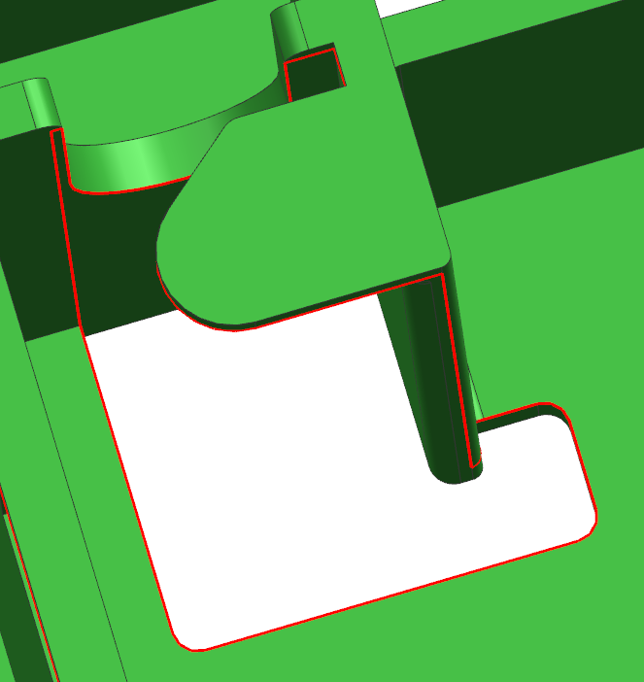
14.Parting Line
CAV
COR
RESULT | OK | NG
APPD
DATE

Slide 17
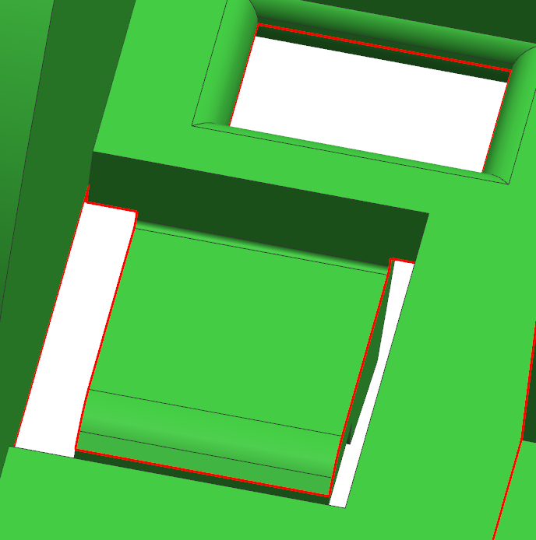
15.Parting Line
CAV
COR
RESULT | OK | NG
APPD
DATE

Slide 18
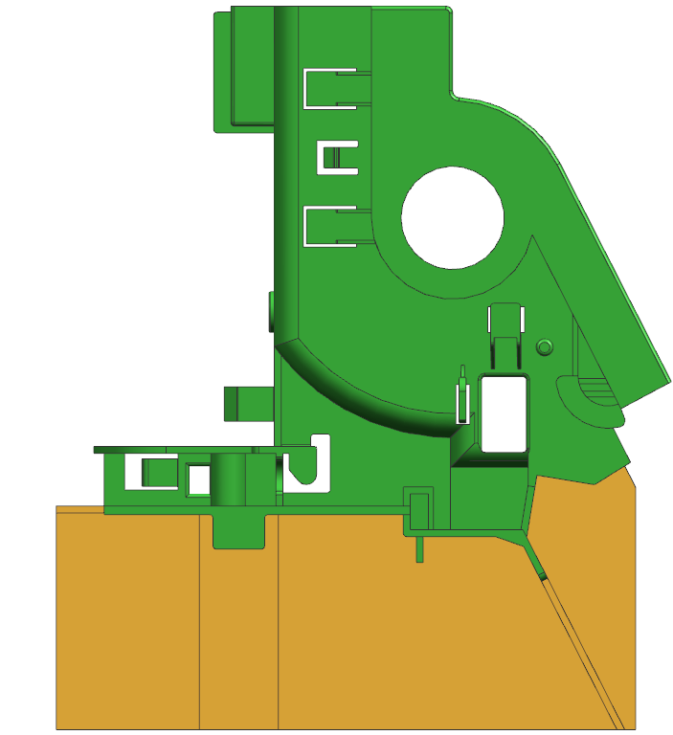
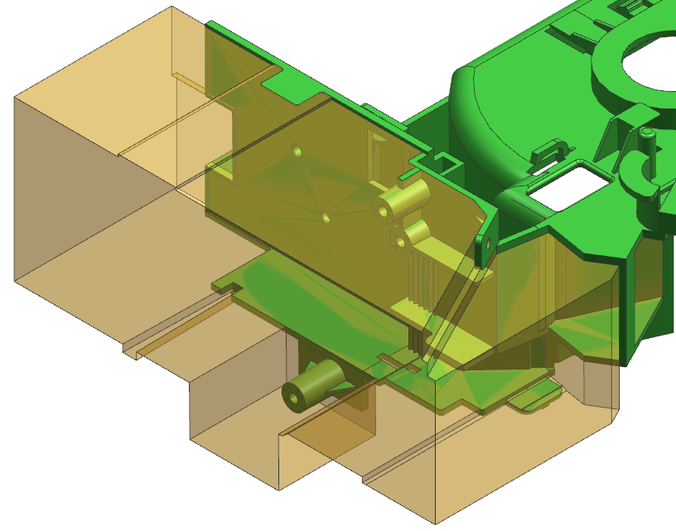
16.Slider
Slider
Slider
RESULT | OK | NG
APPD
DATE

Slide 19
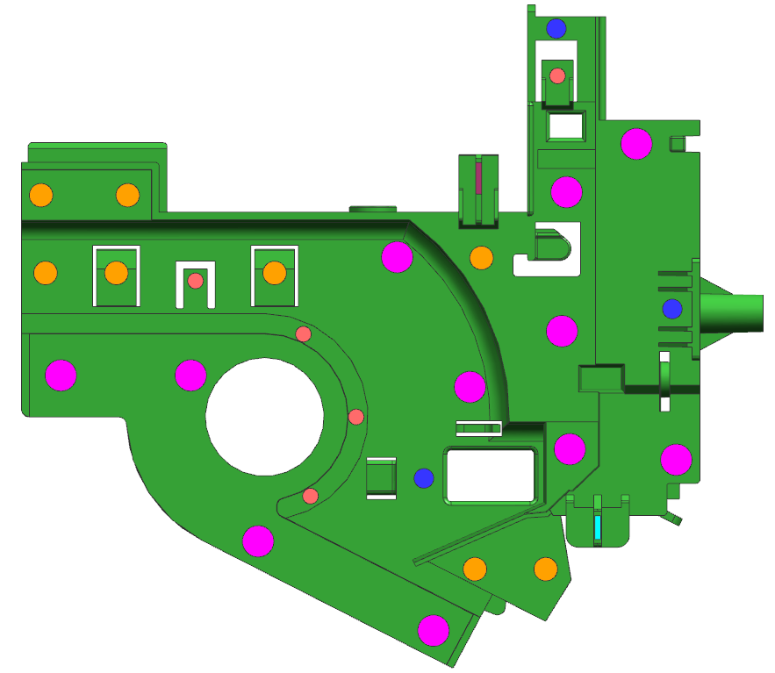






17.Ejector
EP 4.0 ( 5X )
EP 5.0 ( 3X )
EP 6.0 ( 8X )
EP 8.0 ( 11X )
EB 6.0 X 1.5 ( 1X )
EB 8.0 X 1.5 ( 1X )
RESULT | OK | NG
APPD
DATE

Slide 20
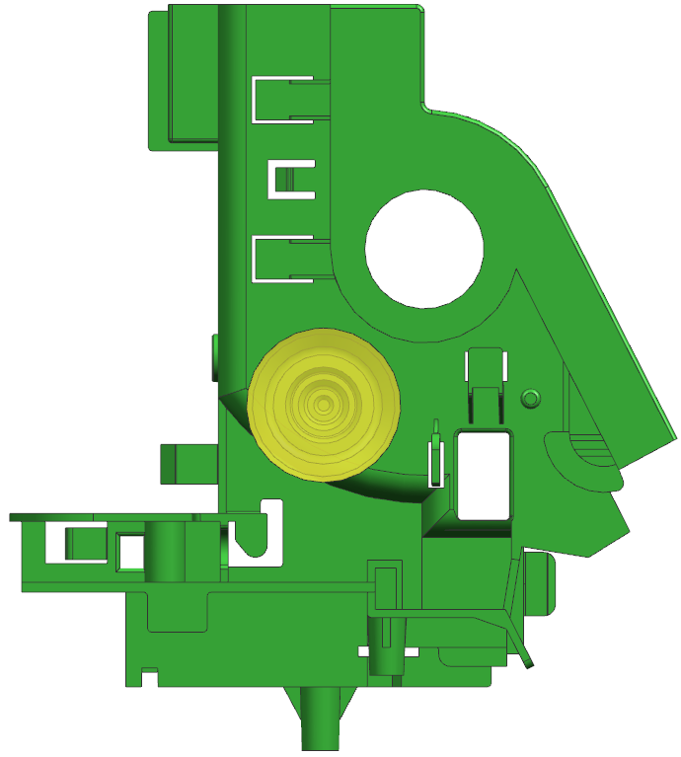
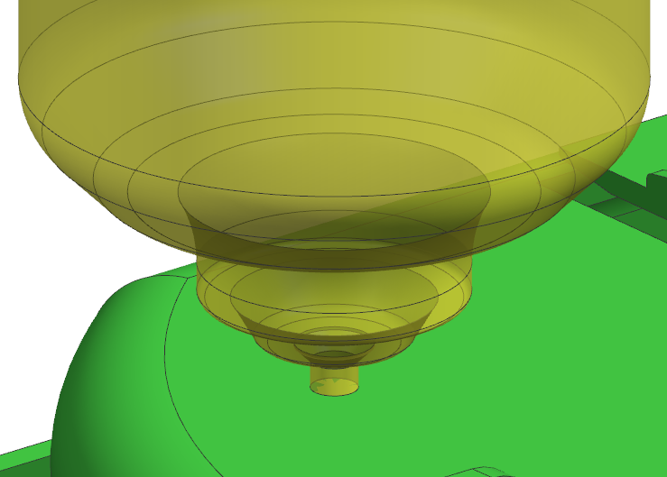
18.Gate
Hot Runner + Valve Gate
RESULT | OK | NG
APPD
DATE
Ø3.0

Slide 21

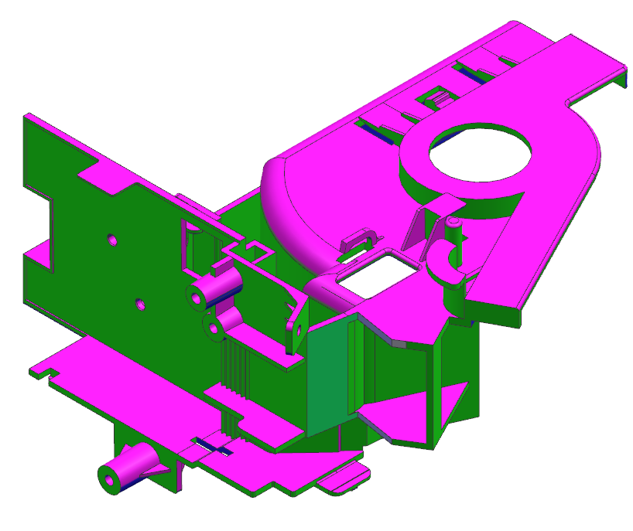
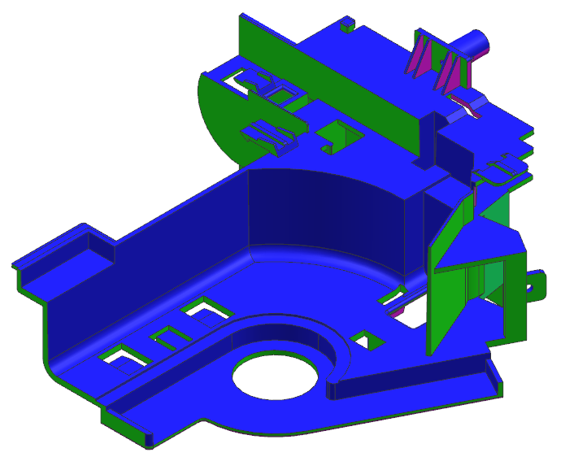
19.Draft angle analysis
RESULT | OK | NG
APPD
DATE
All Green Surface Are 0º Propose To Add 1.0º For Cavity Side &
Draft 0.5º For Core Side

Slide 22
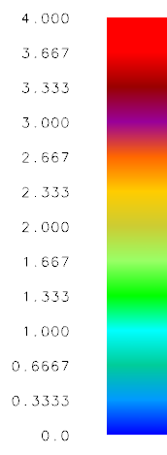
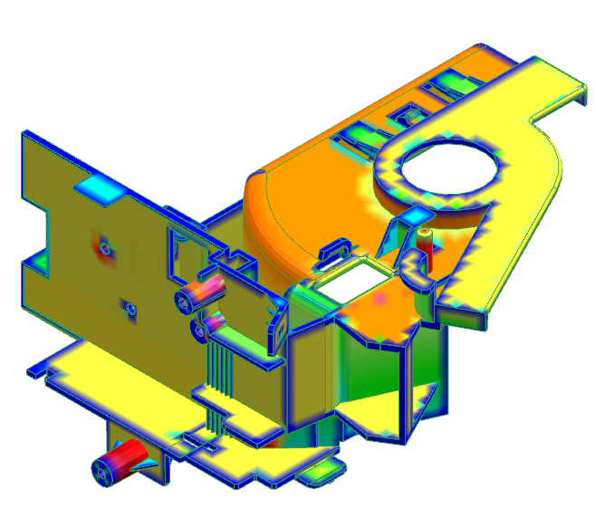
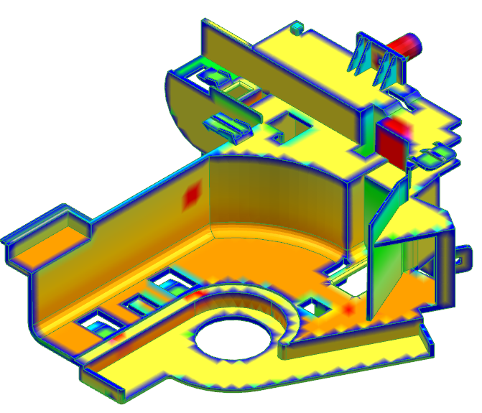
20.Thickness mark
RESULT | OK | NG
APPD
DATE
All Green Surface Are 0º Propose To Add 1.0º For Cavity Side &
Draft 0.5º For Core Side

Slide 23

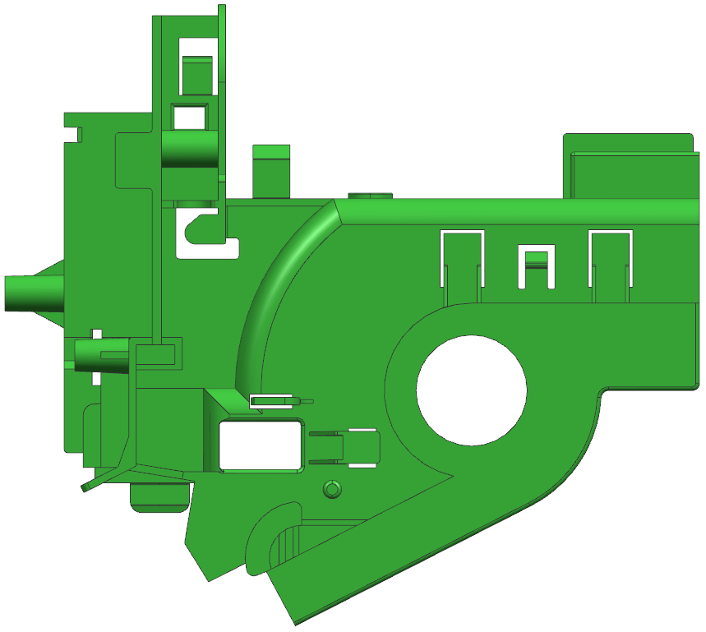
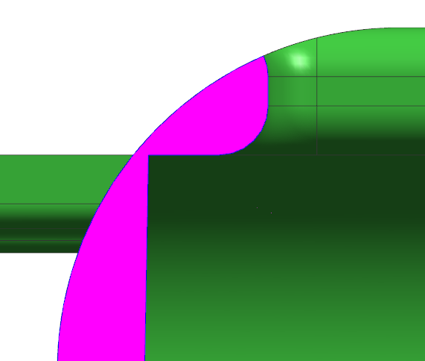
21.Suggest
E-laraby
19-5-2022
O.K
A
A
0.2
Suggest to modify part,
because of here part have only 0.2mm,
its difficult to filling
RESULT | OK | NG
APPD
DATE

Slide 24
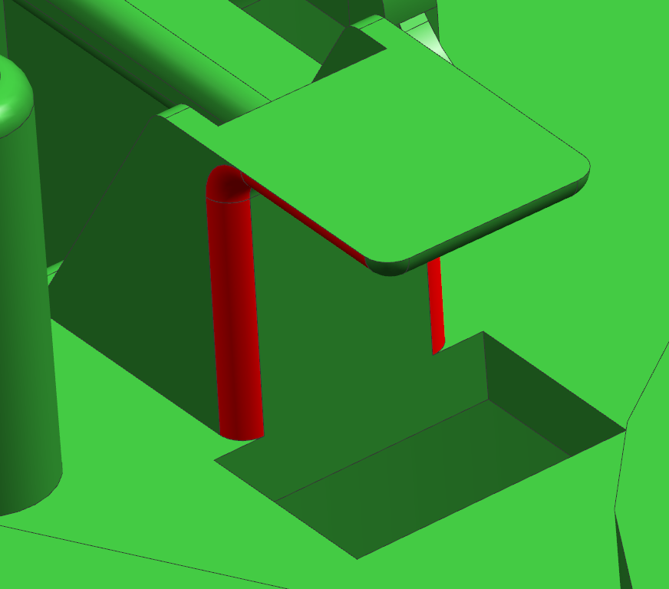
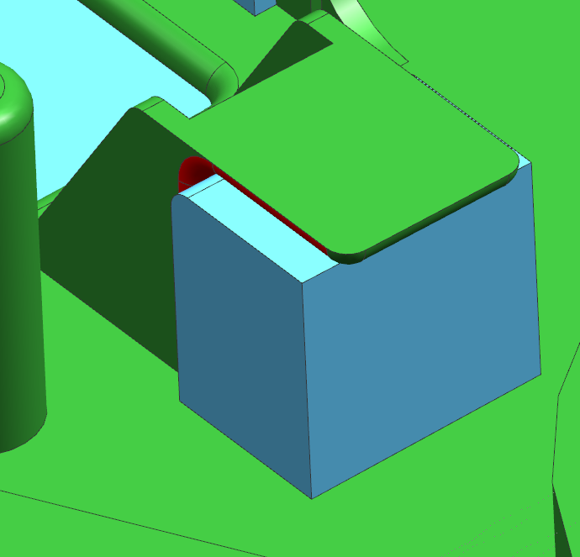
22.Suggest
Cancel ‘R’
E-laraby
19-5-2022
O.K
Suggest to modify part,
cancel ‘R’ for avoid core main ins undercut
RESULT | OK | NG
APPD
DATE
Core main ins

Slide 25
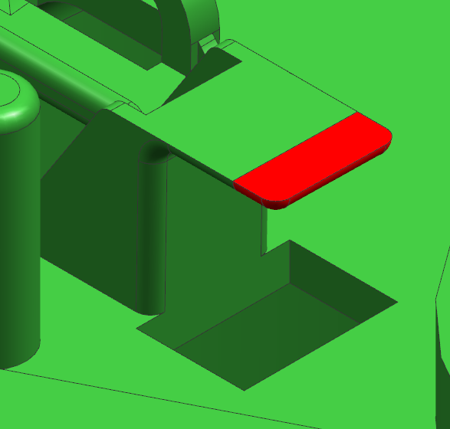
23.Suggest
3mm
Suggest to modify part,
cut plastic 3mm for make profile at core side
Cut plastic
E-laraby
19-5-2022
O.K
RESULT | OK | NG
APPD
DATE

Slide 26

24.Suggest
Surface ‘A’
Surface ‘B’
E-laraby
19-5-2022
O.K
Suggest to modify part,
make surface ‘A’ and surface ‘B’ at same surface
for avoid small step
RESULT | OK | NG
APPD
DATE

Slide 27
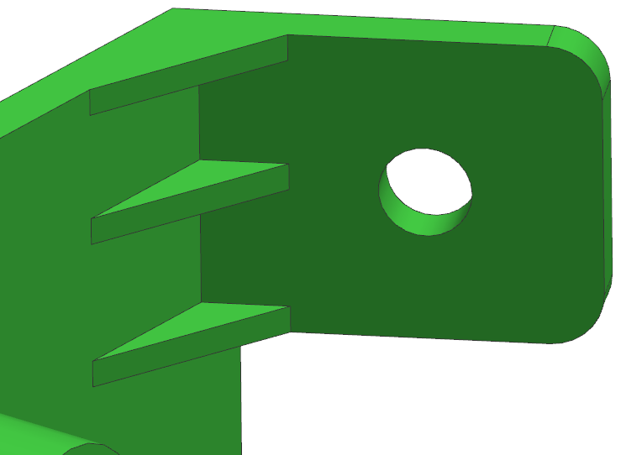
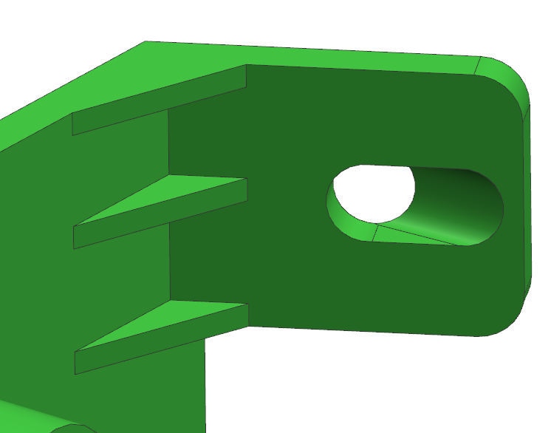
25.Suggest
E-laraby
19-5-2022
O.K
Before
Undercut
After
Suggest to modify part,
slider moving direction have undercut
RESULT | OK | NG
APPD
DATE

Slide 28

26.Suggest
Undercut
Suggest to modify part,
cancel shape ,
because of cavity main ins undercut
E-laraby
19-5-2022
If it is appliable to use a lifter ??
RESULT | OK | NG
APPD
DATE

Slide 29
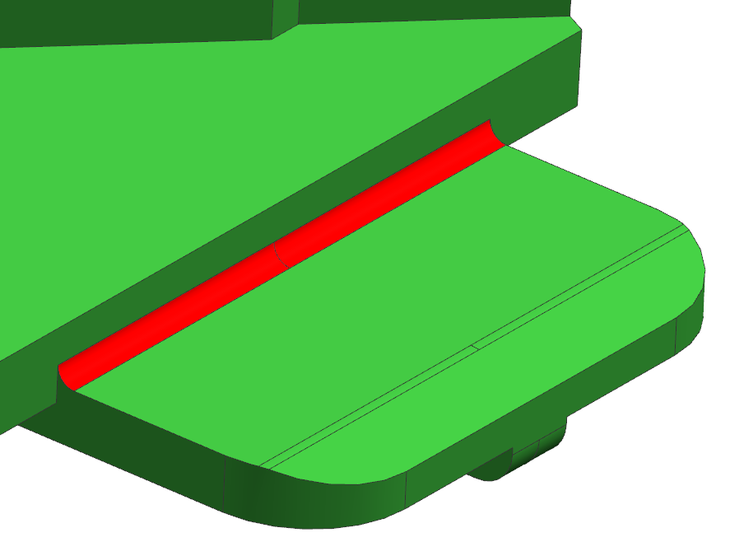
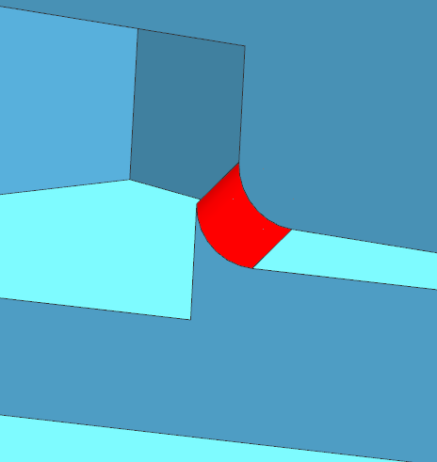
27.Suggest
Cancel ‘R’
Sharp steel
E-laraby
19-5-2022
O.K
Have sharp steel,
suggest to modify part,
cancel ‘R’
Because of core main ins sharp steel,
easy broken
RESULT | OK | NG
APPD
DATE

Slide 30
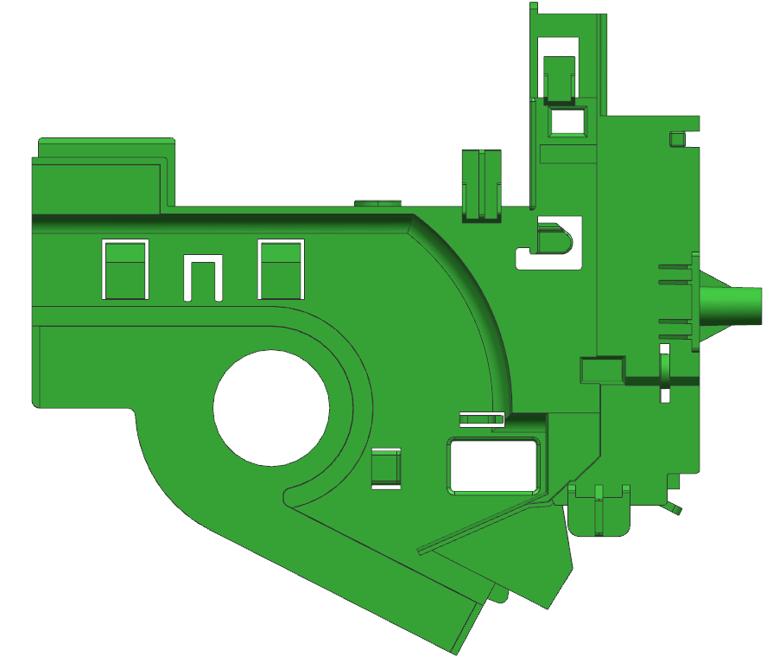
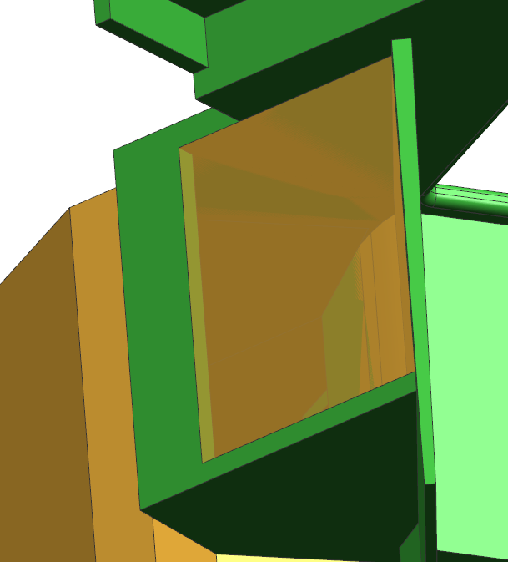
28.Suggest
Suggest to modify part,
Because of slider moving direction have undercut,
when slider open , slider can’t come from part
Undercut
RESULT | OK | NG
APPD
DATE
E-laraby
19-5-2022
O.K

Slide 31
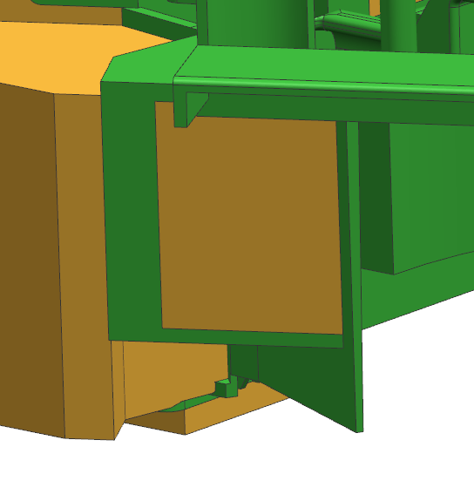
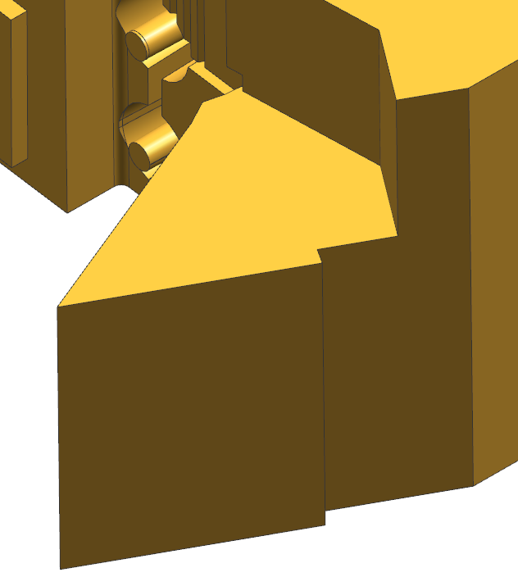
29.Suggest
Part
Slider
Sharp steel
Suggest to modify part,
Because of slider ins sharp steel,
easy broken
E-laraby
19-5-2022
O.K
RESULT | OK | NG
APPD
DATE

Slide 32
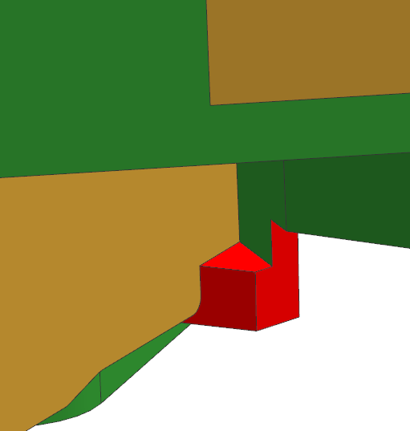
30.Suggest
Undercut
Suggest to modify part,
cancel undercut can’t possible to make at core
E-laraby
19-5-2022
O.K
RESULT | OK | NG
APPD
DATE

Slide 33


31.Suggest
E-laraby
19-5-2022
O.K
3.87
Before
Suggest to modify part,
because of cavity main ins weak steel,
easy broken
Cancel step
RESULT | OK | NG
APPD
DATE
After

Slide 34
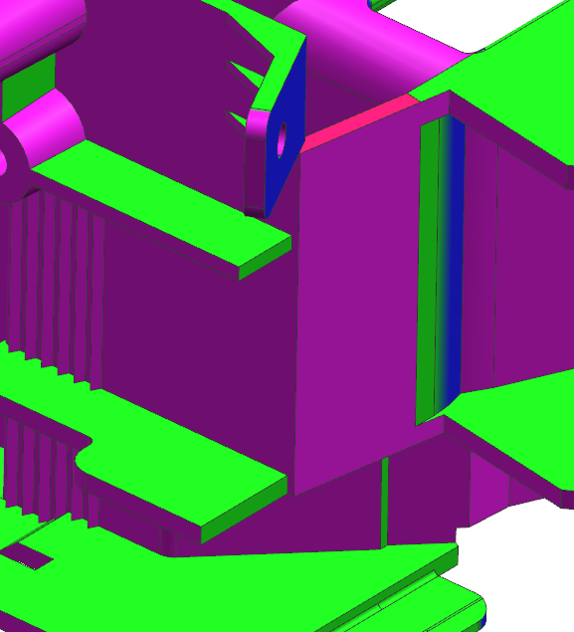
32.Suggest
Have undercut,
Suggest to modify part ,
Slider moving direction have undercut
Undercut
RESULT | OK | NG
APPD
DATE

Slide 35
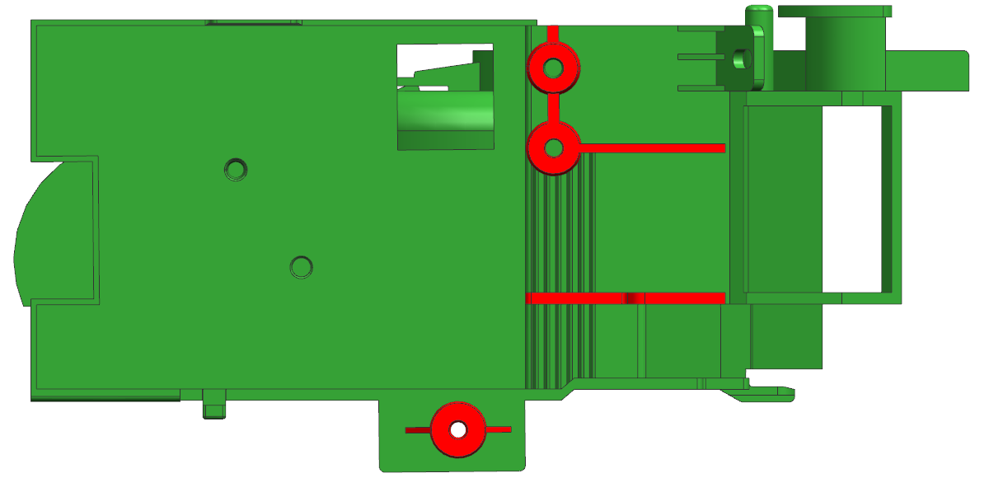

33.Suggest
B
B
2.0
Have thickness mark,
suggest to change the all rib’s thickness
from 2.0MM to 1.2MM
E-laraby
19-5-2022
O.K
RESULT | OK | NG
APPD
DATE
1.6
B-B

Slide 36
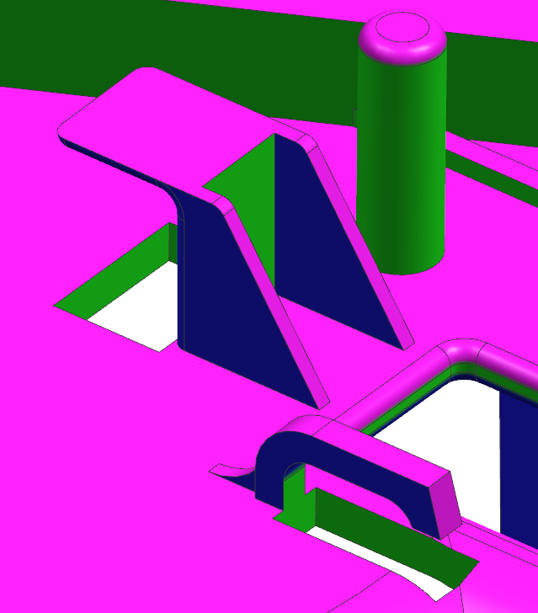
34.Suggest
E-laraby
19-5-2022
O.K
Have undercut,
Suggest to add 1.0º at cavity side
RESULT | OK | NG
APPD
DATE
Undercut

Slide 37
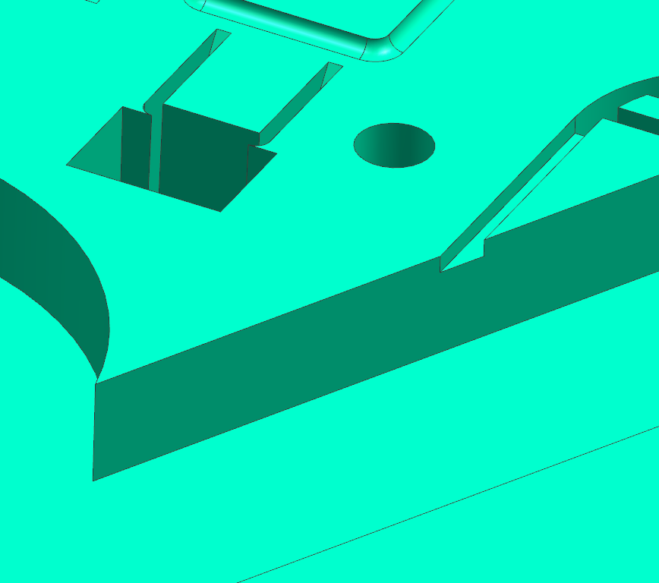
35.Suggest
Sharp steel
Have sharp steel,
suggest to modify part
for avoid cavity main ins sharp steel,
easy broken
E-laraby
19-5-2022
O.K
RESULT | OK | NG
APPD
DATE

Slide 38


36.Suggest
Undercut
Have undercut,
Suggest to add 0.5º at core side
E-laraby
19-5-2022
O.K
RESULT | OK | NG
APPD
DATE

Slide 39


37.Suggest
E-laraby
19-5-2022
O.K
CAV
COR
Undercut
RESULT | OK | NG
APPD
DATE
Have undercut,
Suggest to add 1.0º at cavity side

Slide 40


38.Suggest
E-laraby
19-5-2022
O.K
C
C
C-C
Have thickness mark,
suggest to change the all rib’s thickness
from 8.0MM to 2.0MM
RESULT | OK | NG
APPD
DATE
8.0

Slide 41

39.Mold Layout
500
450
550
250
Mold Top
250
RESULT | OK | NG
APPD
DATE
230 TON
Distance between tie rods (HXV) 610 X 560

Slide 42

40.Fill Time
RESULT | OK | NG
APPD
DATE
Filling time = 1.682sec

Slide 43


41.Fill Simulation
RESULT | OK | NG
APPD
DATE
(Press shift + F5 to watch animation )

Slide 44

42.Temperature at flow front
RESULT | OK | NG
APPD
DATE

Slide 45

43.Ejection Temperature
RESULT | OK | NG
APPD
DATE

Slide 46

44.Air Traps
RESULT | OK | NG
APPD
DATE
Make air vent around parts

Slide 47

45.Weld Lines
RESULT | OK | NG
APPD
DATE
Visible weld lines

Slide 48


46.Cycle Time
1.Fill time = 1.682sec
2.Pack time = 8.0 sec
3.Cooling time = 15.0 sec
4.Mold open time = 5.0 sec
Cycle time = Fill + Pack + Cooling + Mold open
= 29.682 sec
RESULT | OK | NG
APPD
DATE

