Slide 1
Product information
Part Name :- AIR_FILTER
Index No :-
Model :-
Plastic material :- PP
Shrinkage :- 1.015
Part Weight :- 51.0 g
Tooling information
Tooling type :- 3PLATE
Hot Runner system :- NONE
Gate type :- PINPOINT GATE
No. of cavities :- 1 X 1
No. of slider :- NONE
No. of lifters :- 8X / CAV
Main insert material :- NAK-80 ( BPM-HHH )
Mold base material :- S50C
Mold base Standard :- IKM
Injection machine capacity :- 280T
RESULT | OK | NG
APPD
DATE

Slide 2
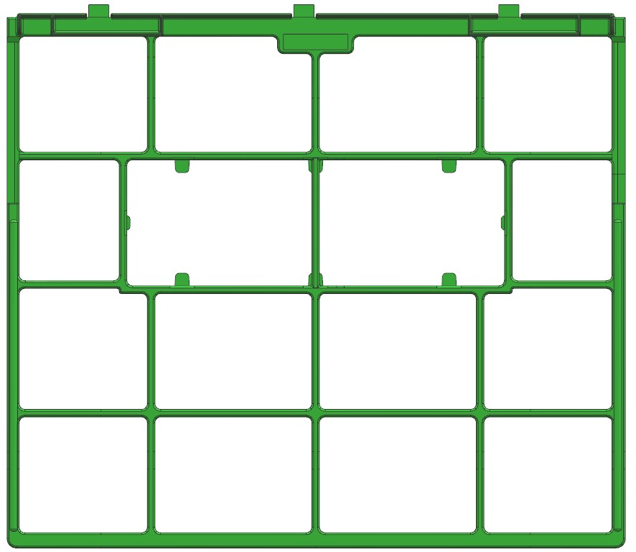
Product size
18.47
Elaraby
17-5-2022
Updated
286.62mm
284.59
324.28

Slide 3
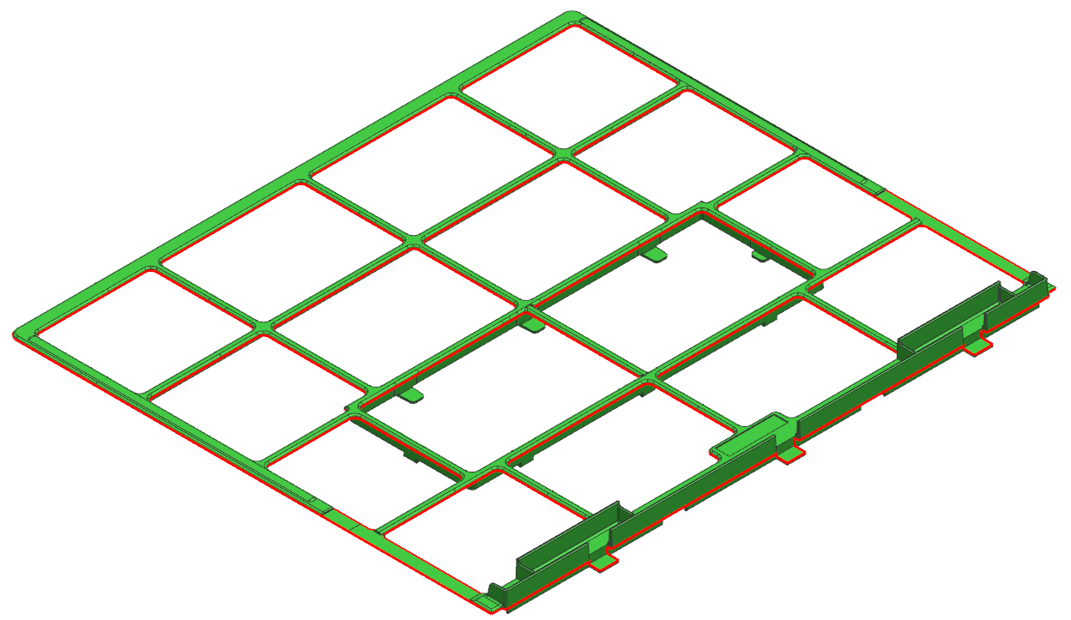
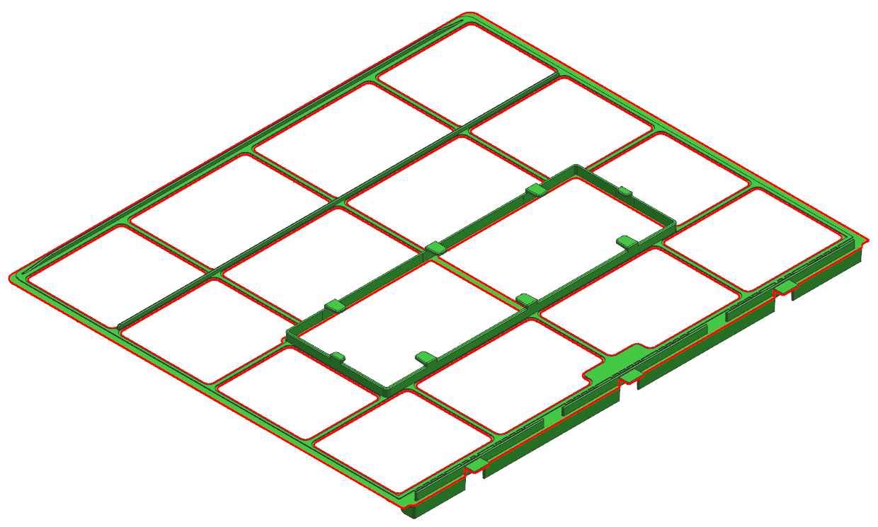
1.Parting Line
CAV
PL
COR
RESULT | OK | NG
APPD
DATE

Slide 4
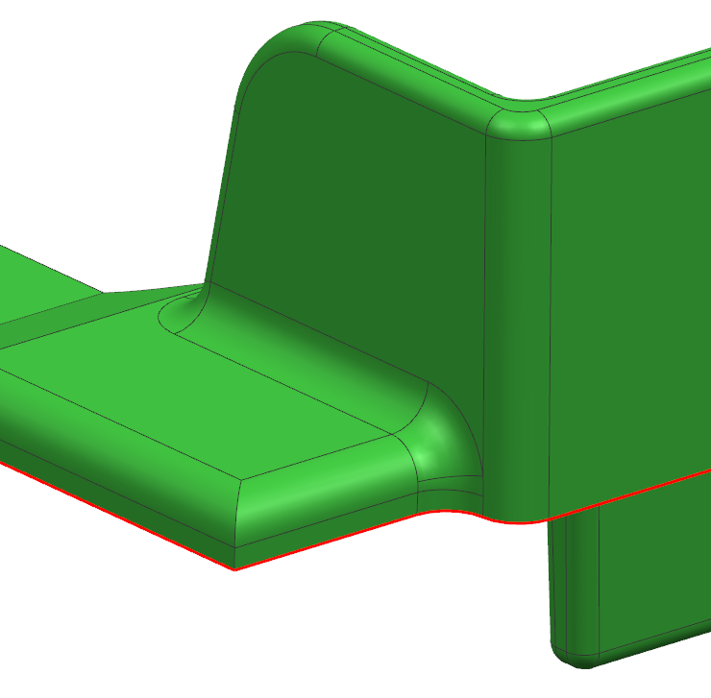
2.Parting Line
CAV
COR
RESULT | OK | NG
APPD
DATE

Slide 5
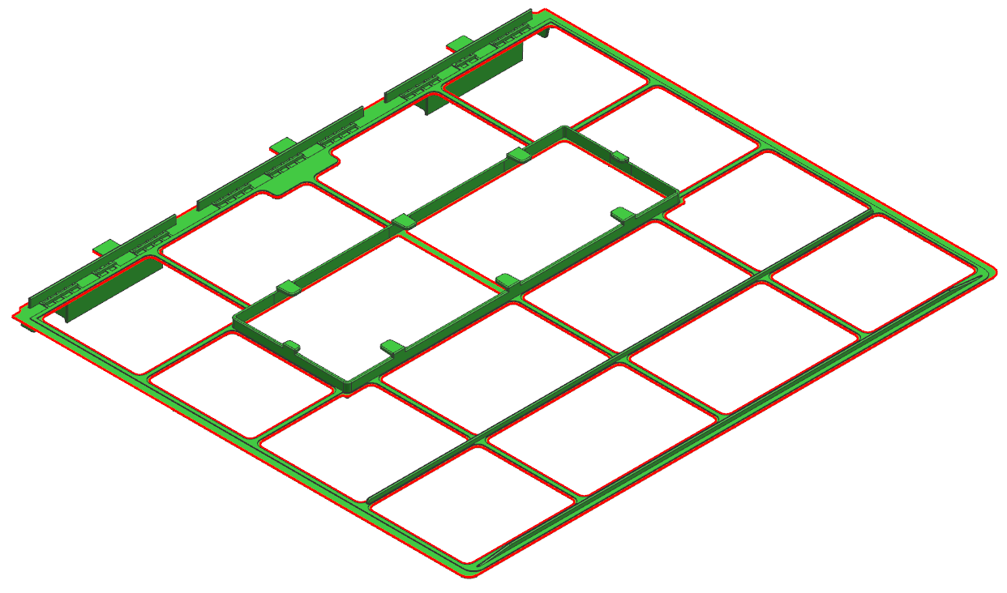
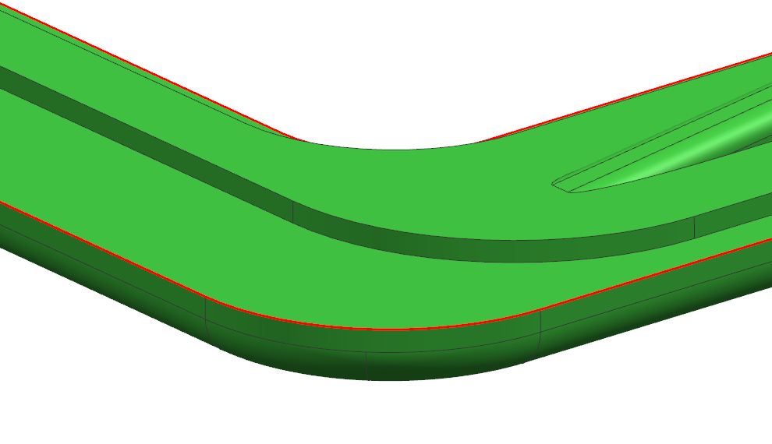
3.Parting Line
CAV
COR
RESULT | OK | NG
APPD
DATE

Slide 6
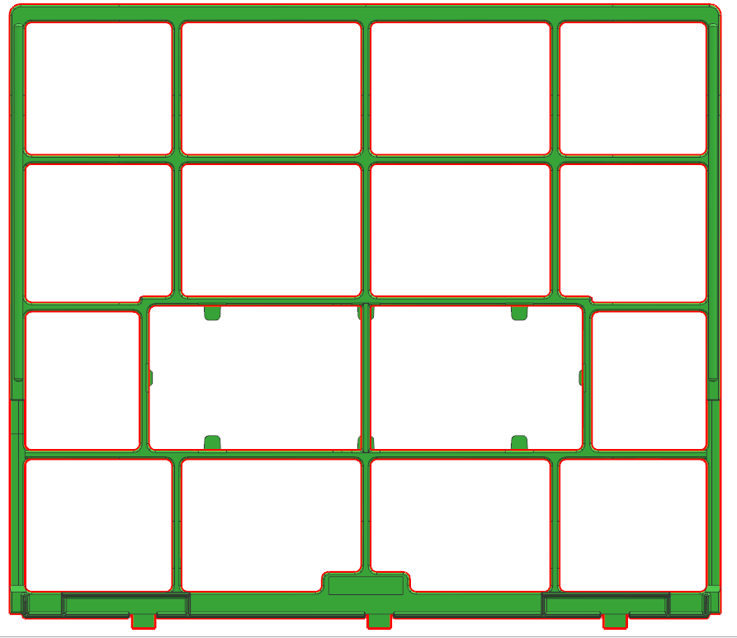
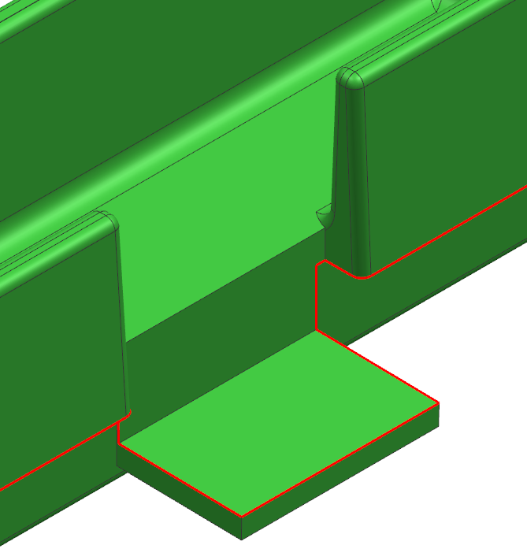
4.Parting Line
CAV
COR
RESULT | OK | NG
APPD
DATE

Slide 7
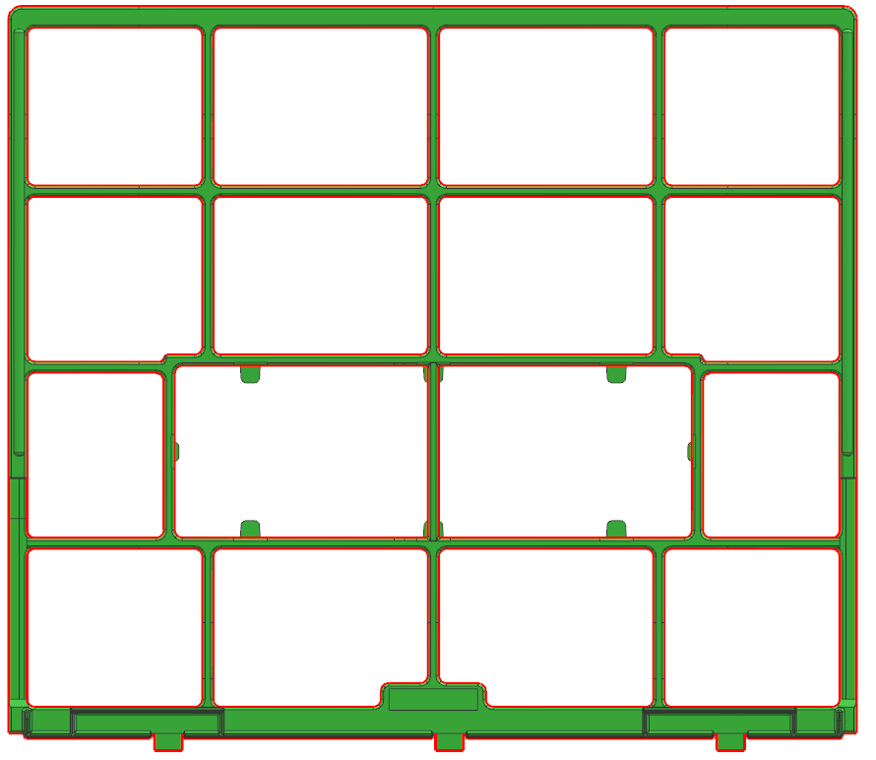
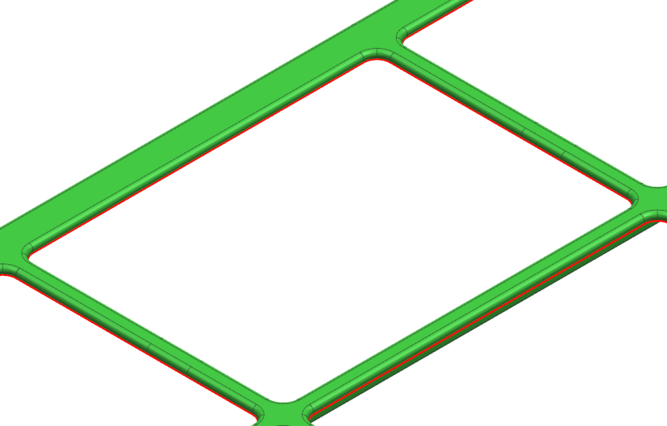
5.Parting Line
CAV
`
COR
RESULT | OK | NG
APPD
DATE

Slide 8
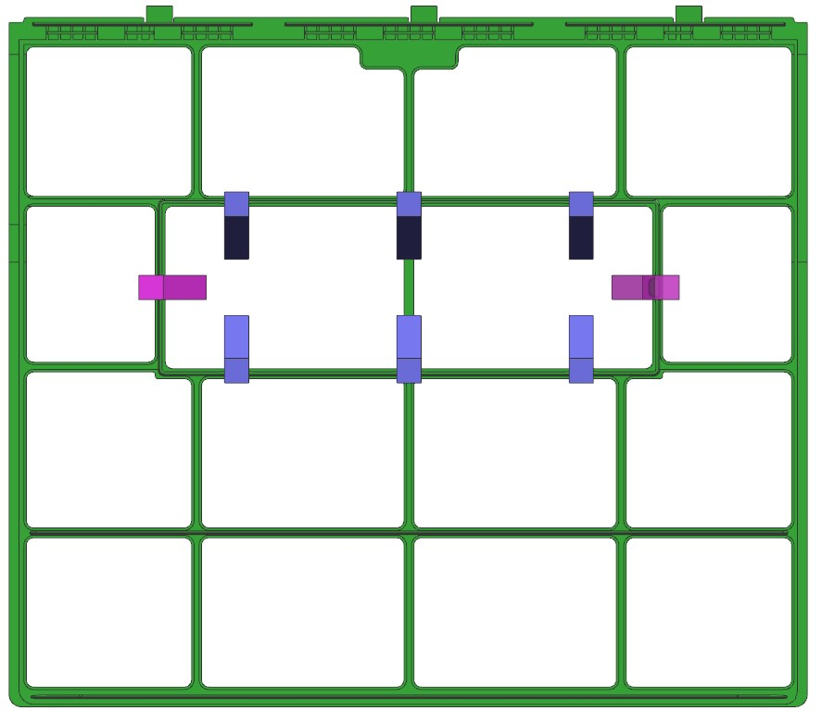
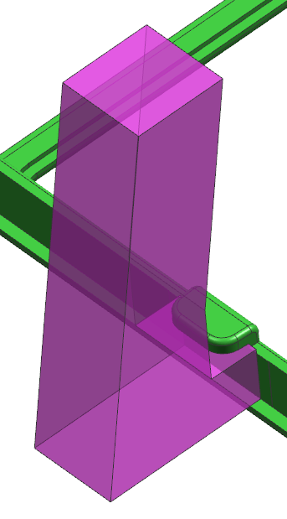
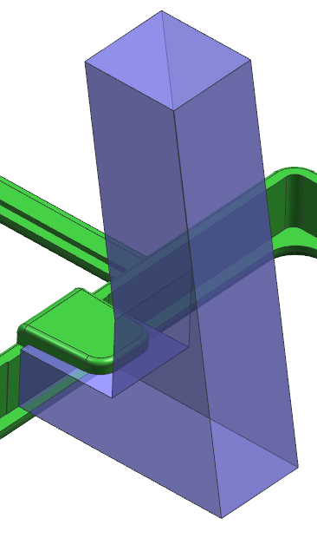
6.Lifter
Lifter 01
Lifter 02
Lifter 02
Lifter 02
Lifter 01
Lifter 01
Lifter 02
Lifter 02
Lifter 02
Lifter 02
RESULT | OK | NG
APPD
DATE

Slide 9
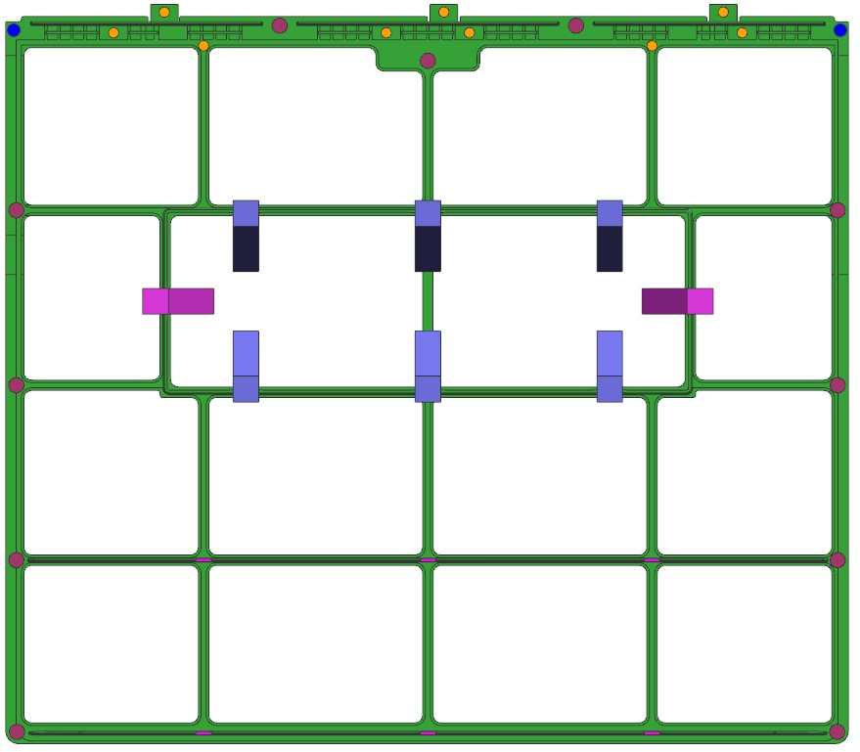




7.Ejector
EP 4.0 ( 9X )
EP 5.0 ( 2X )
EP 6.0 ( 11X )
EB 6.0 X 1.2 ( 6X )
RESULT | OK | NG
APPD
DATE

Slide 10
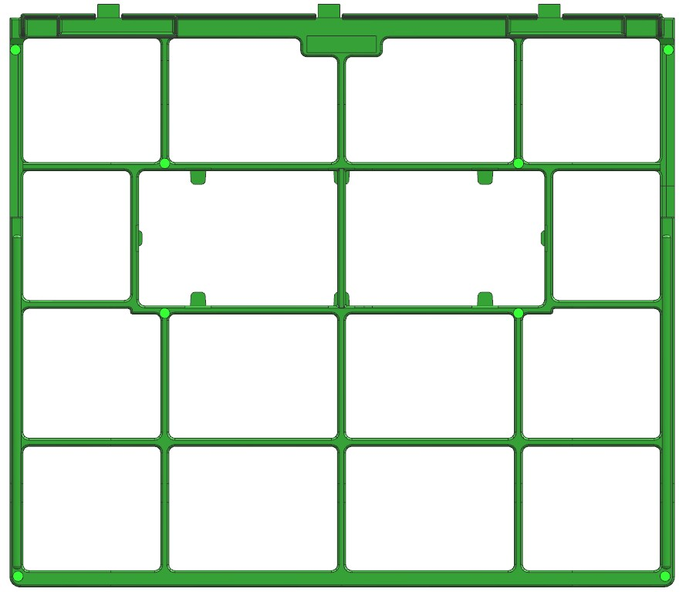
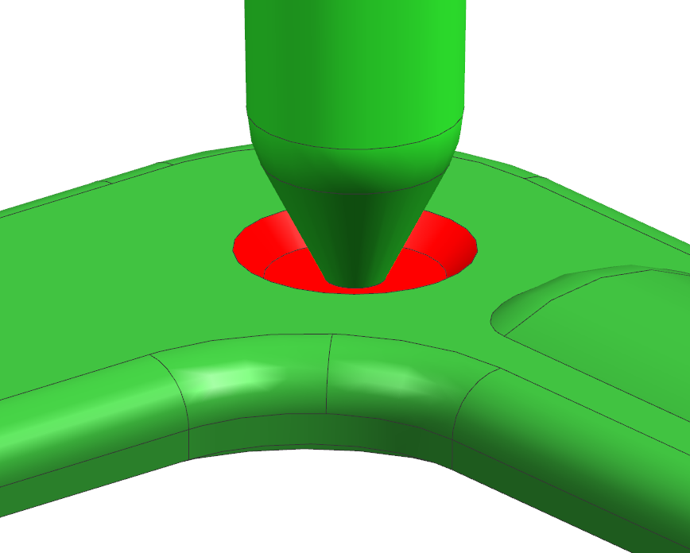
8.Gate
Cold Runner + Pin point Gate
Ø1.0
RESULT | OK | NG
APPD
DATE

Slide 11

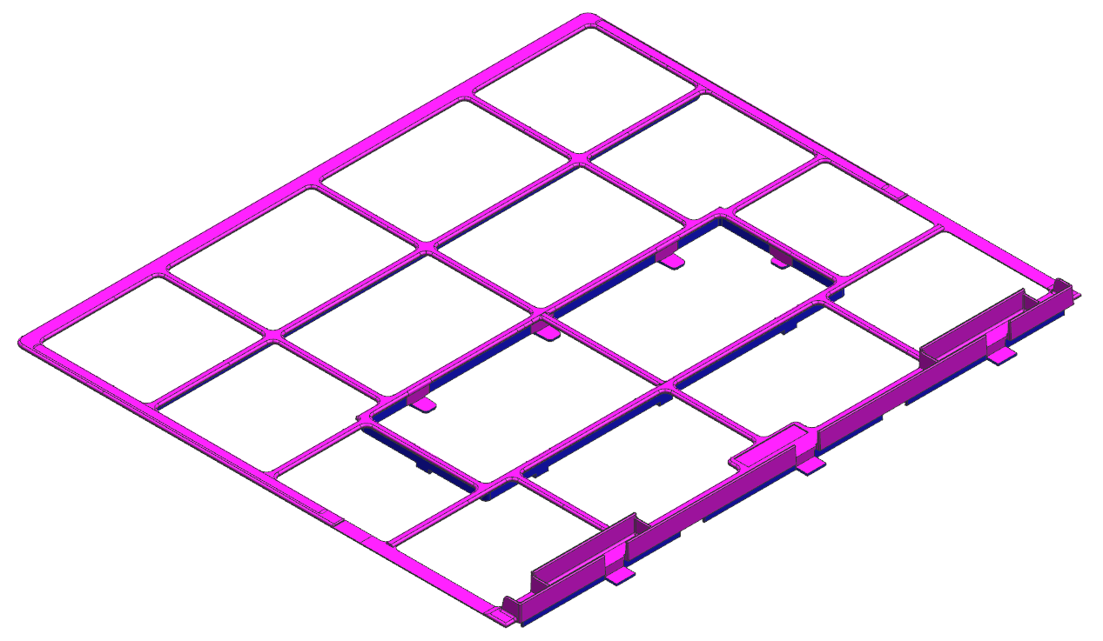
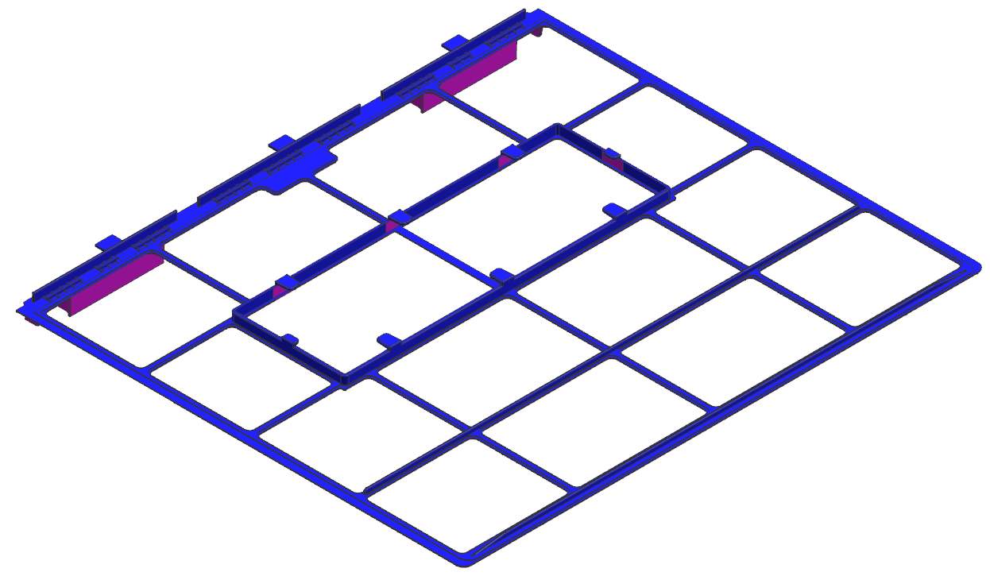
9.Draft angle analysis
RESULT | OK | NG
APPD
DATE
All Green Surface Are 0º Propose To Add 1.0º For Cavity Side &
Draft 0.5º For Core Side

Slide 12
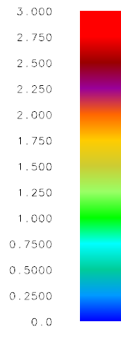
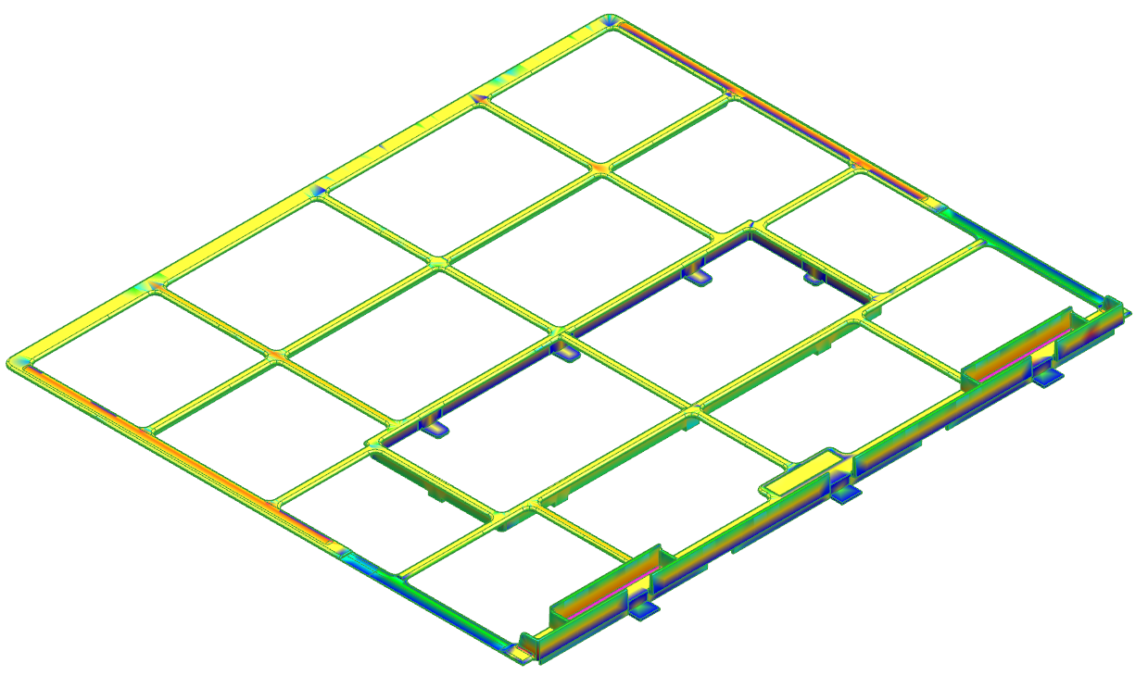
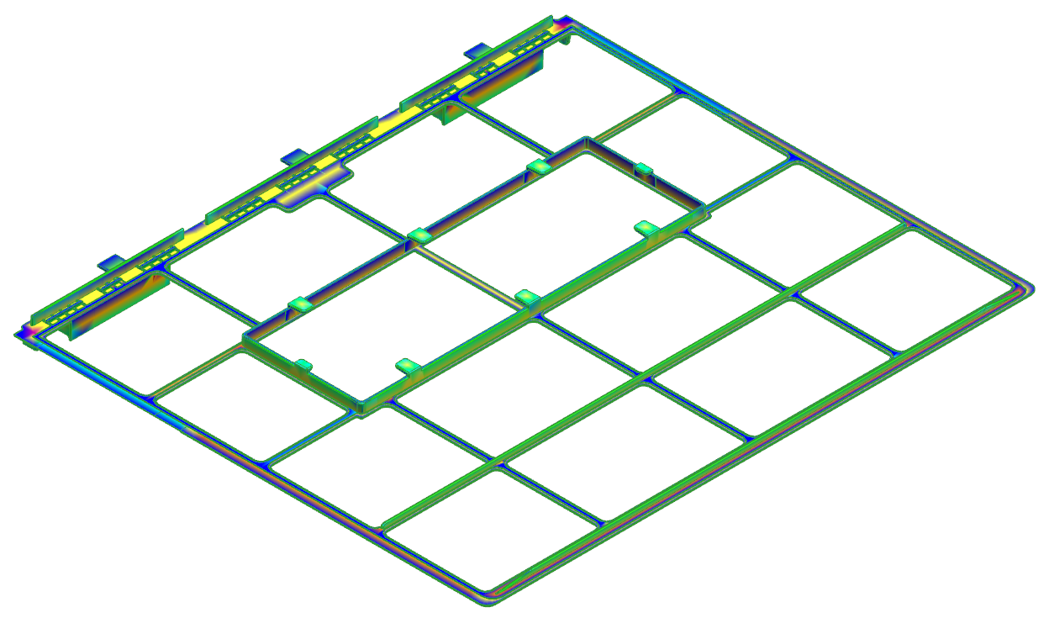
10.Thickness mark
RESULT | OK | NG
APPD
DATE
All Green Surface Are 0º Propose To Add 1.0º For Cavity Side &
Draft 0.5º For Core Side

Slide 13
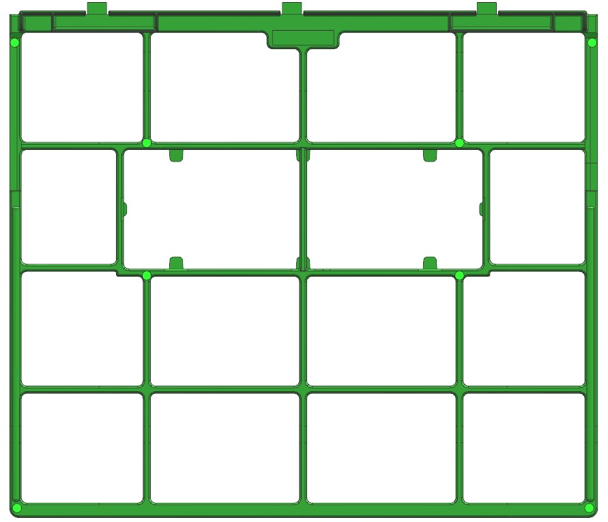
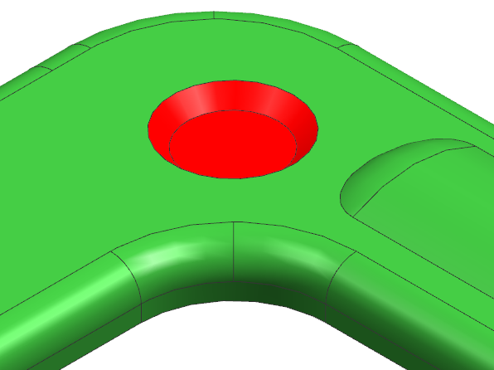

11.Suggest
Add shape
Add Shape,
suggest to add shape for support gate
Ø4.0
0.5
RESULT | OK | NG
APPD
DATE
Ø3.0

Slide 14
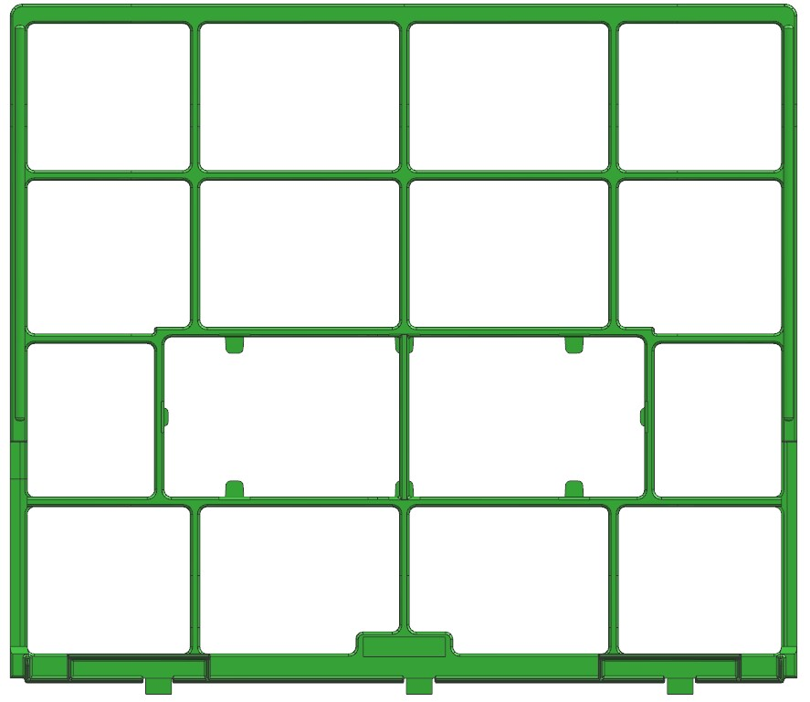
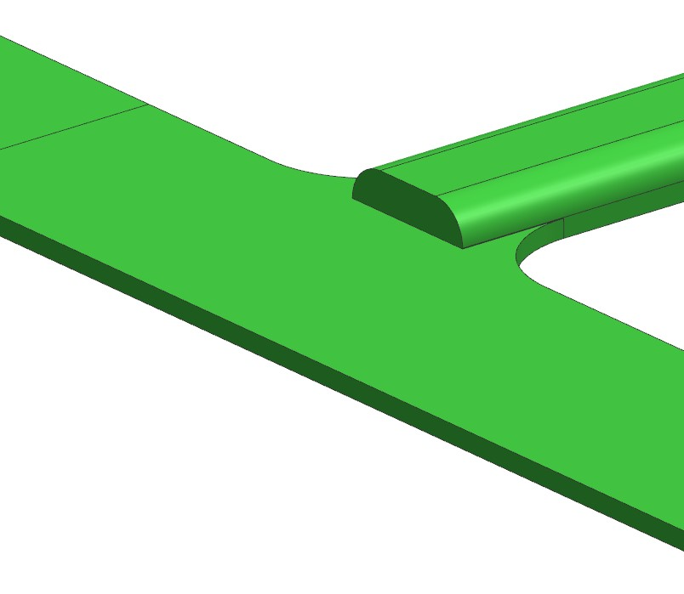
12.Suggest
Suggest to modify part because of
easy to filling
0.5
RESULT | OK | NG
APPD
DATE

Slide 15
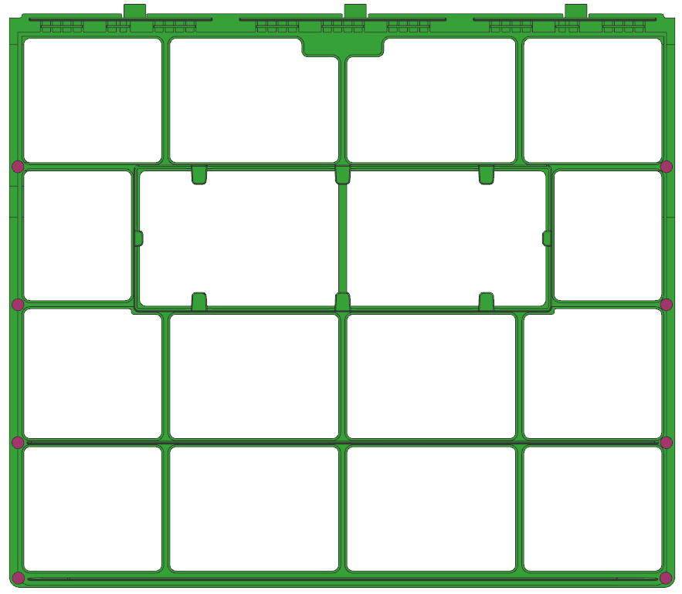
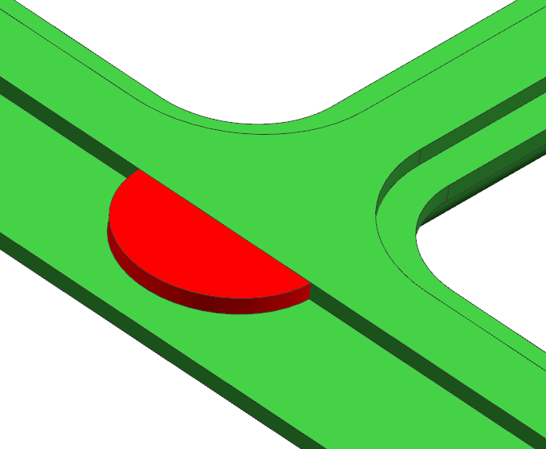
13.Suggest
Add shape
RESULT | OK | NG
APPD
DATE
suggest to add shape for support making ejector

Slide 16
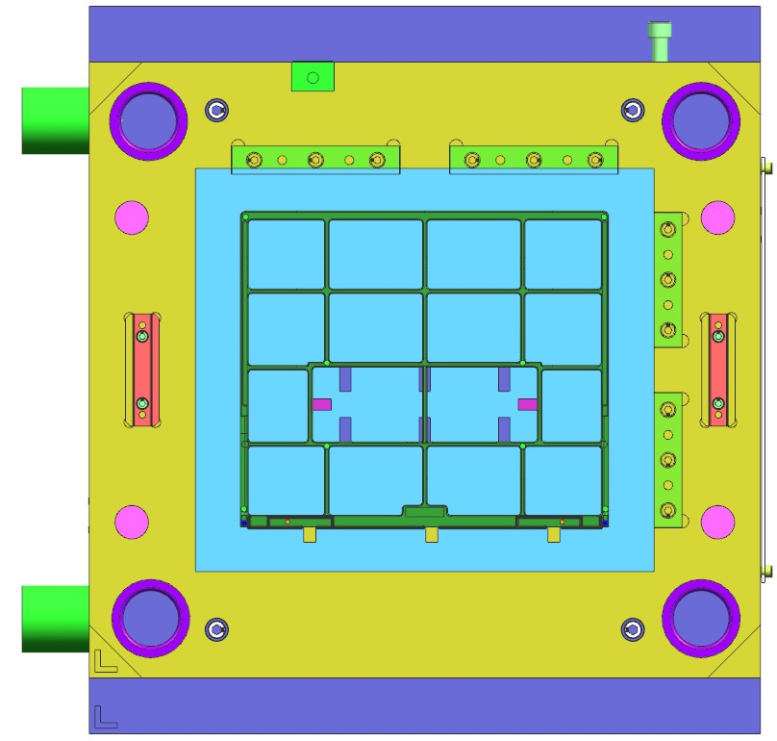
14.Mold Layout
600
550
360
Mold Top
650
410
RESULT | OK | NG
APPD
DATE
280 TON
Distance between tie rods (HXV) 610 X 610
Machine size need to change from 280T to 350T

Slide 17
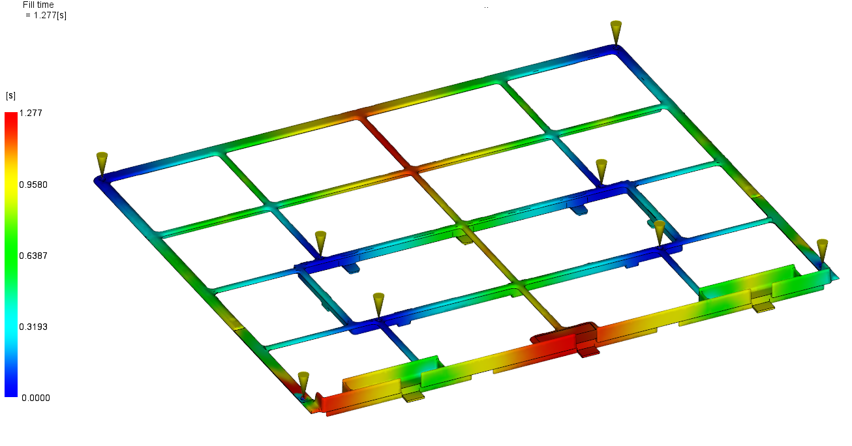
15.Fill Time
RESULT | OK | NG
APPD
DATE
Filling time = 1.277sec

Slide 18
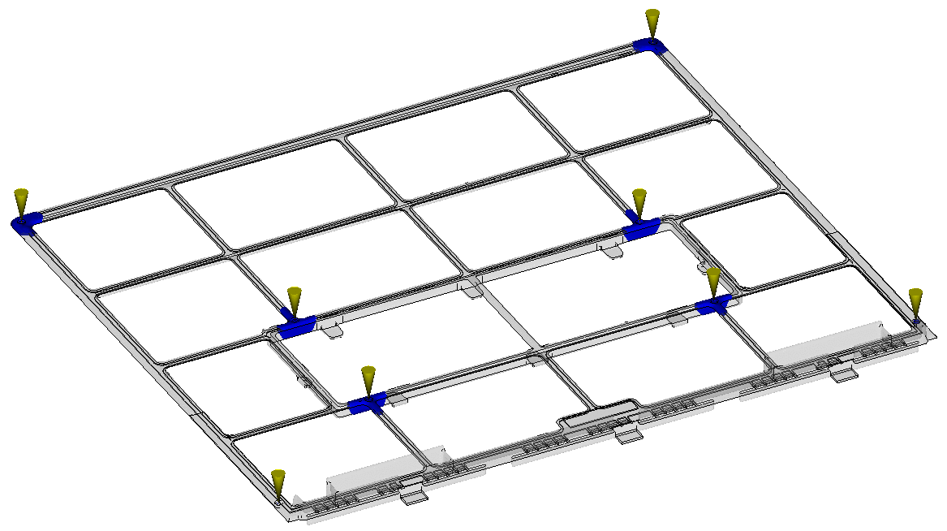
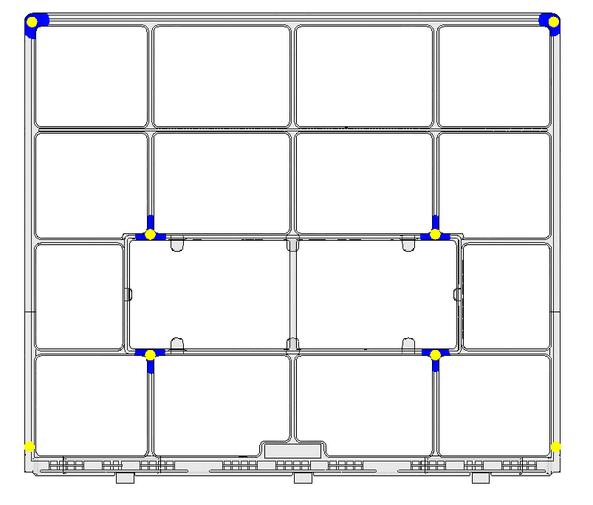
16.Fill Simulation
RESULT | OK | NG
APPD
DATE
(Press shift + F5 to watch animation )

Slide 19
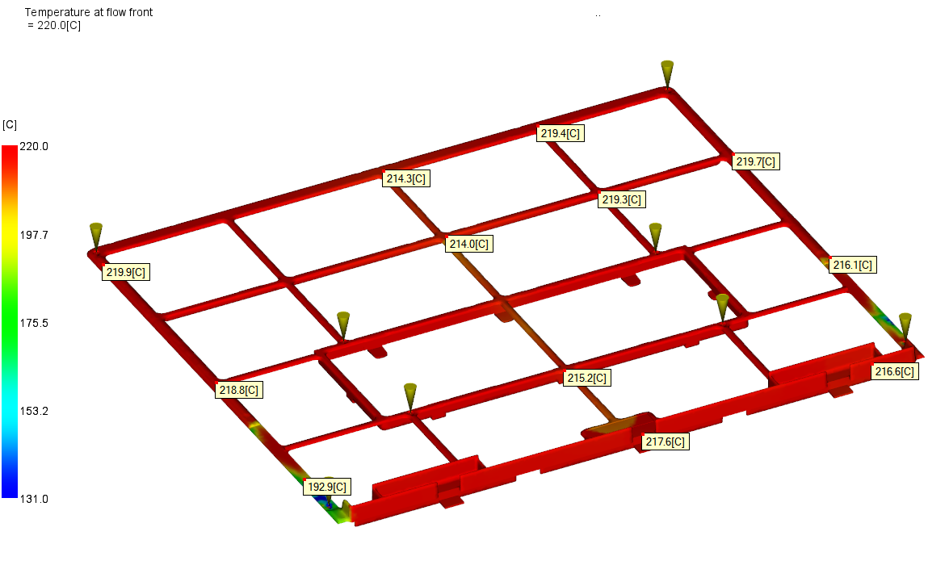
17.Temperature at flow front
RESULT | OK | NG
APPD
DATE

Slide 20
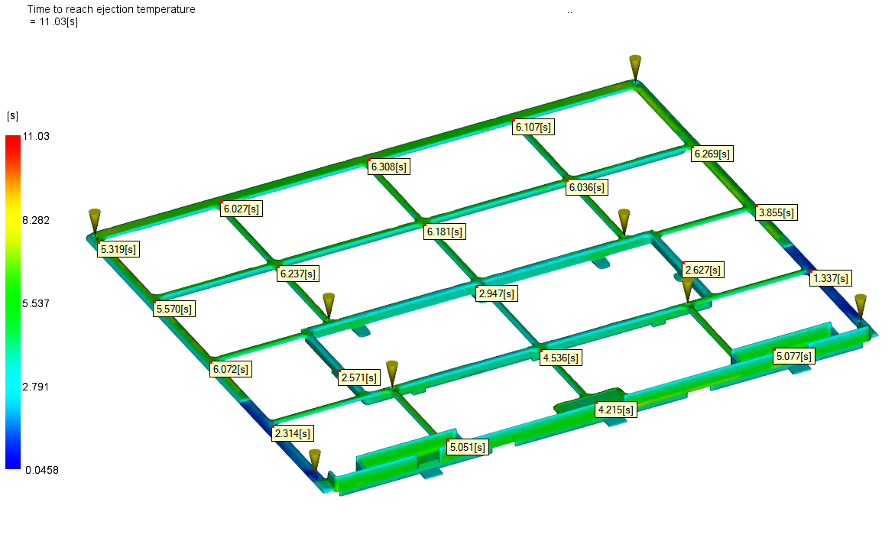
18.Ejection Temperature
RESULT | OK | NG
APPD
DATE

Slide 21
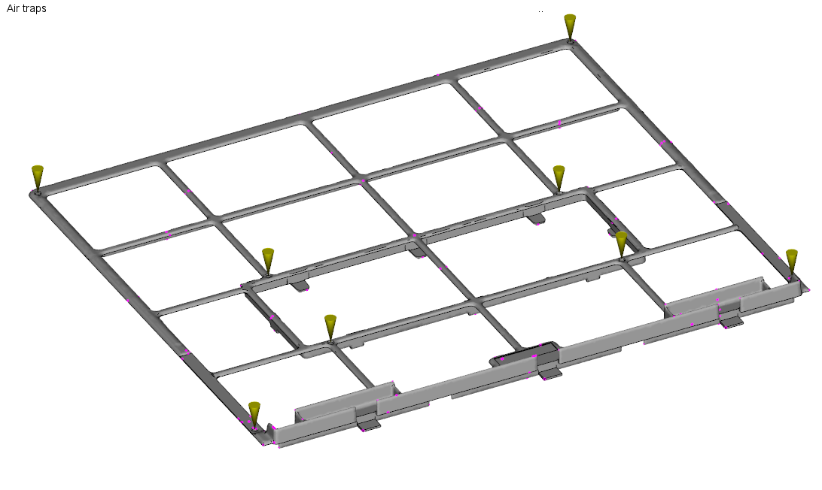
19.Air Traps
RESULT | OK | NG
APPD
DATE
Not serious air traps

Slide 22
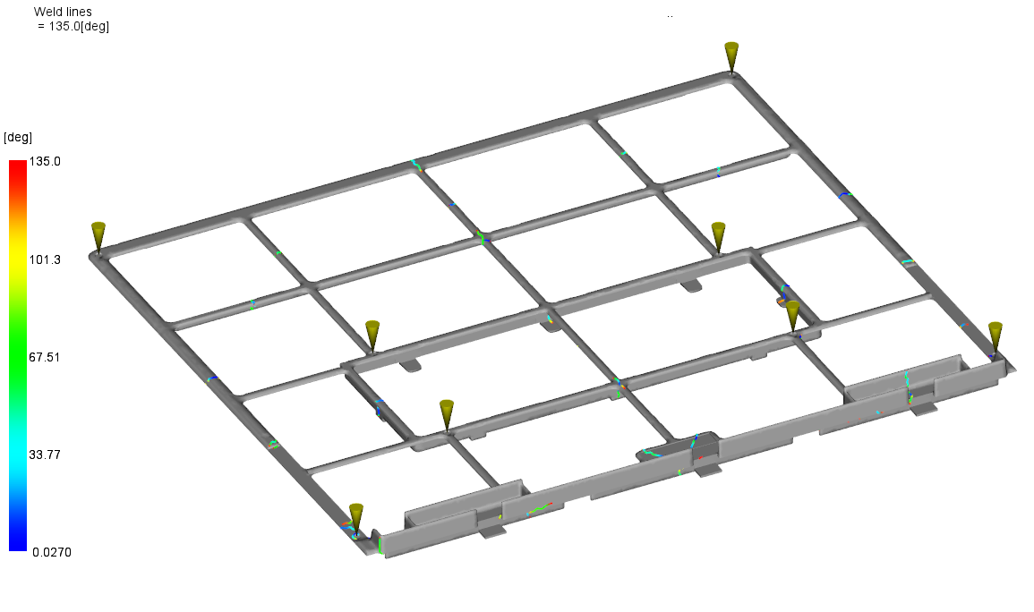
20.Weld Lines
RESULT | OK | NG
APPD
DATE

Slide 23
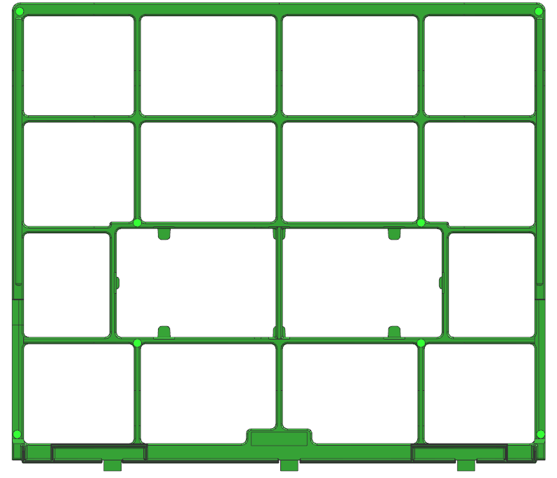
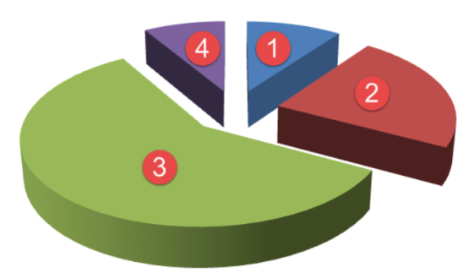
21.Cycle Time
1.Fill time = 1.277sec
2.Pack time = 8.0 sec
3.Cooling time = 15.0 sec
4.Mold open time = 5.0 sec
Cycle time = Fill + Pack + Cooling + Mold open
= 29.277 sec
RESULT | OK | NG
APPD
DATE

