Slide 1
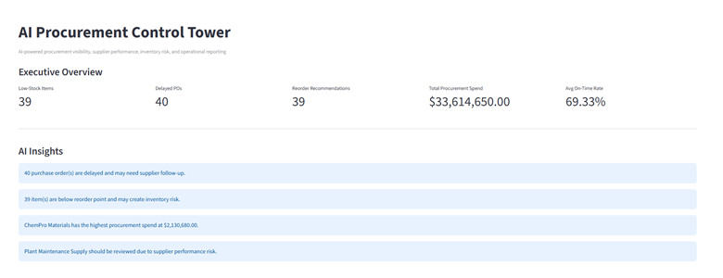
AI Procurement Control Tower
AI-powered procurement visibility, supplier intelligence, inventory risk monitoring, and automated operations reporting.
Real-time procurement monitoring
AI-generated operational insights
Supplier performance analytics
Automated reorder recommendations
Executive-ready reporting

Slide 2
Executive Dashboard
A unified view of procurement operations and operational risk.

Slide 3
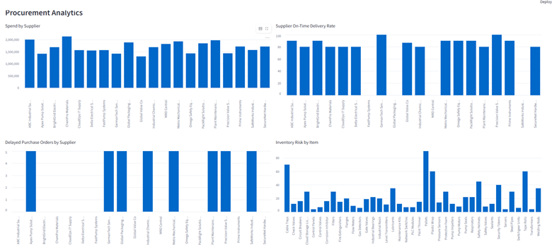
AI Insights & Recommended Actions
The platform converts operational data into actionable recommendations.

Slide 4
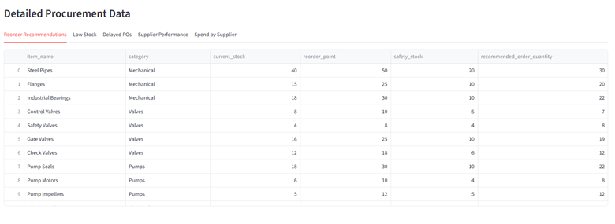
Procurement Analytics
Visual analytics for spend concentration, supplier performance, delayed orders, and inventory risk.

Slide 5
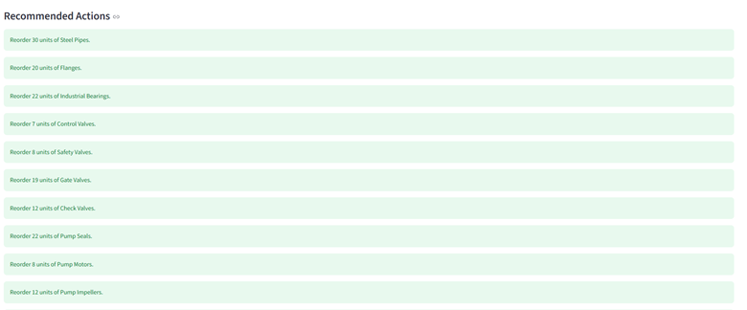
Detailed Procurement Data
Operational transparency through reorder recommendations and inventory details.

Slide 6

Automated Executive Reporting
Generate weekly operations reports instantly and distribute them through Slack workflows.

Slide 7
Business Impact
Improves procurement visibility and operational awareness
Accelerates supplier issue detection and follow-up
Supports faster replenishment decisions
Automates executive reporting workflows
Combines AI, analytics, automation, and dashboarding in one platform
AI Procurement Control Tower

