Slide 1
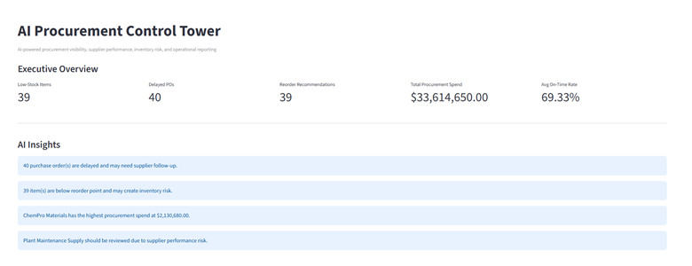
AI Procurement Control Tower
AI-powered procurement visibility, KPI reporting, supplier intelligence, and operational automation.
Real-time procurement visibility
AI-generated operational insights
Supplier performance monitoring
Automated KPI and operations reports
Slack automation and scheduling

Slide 2
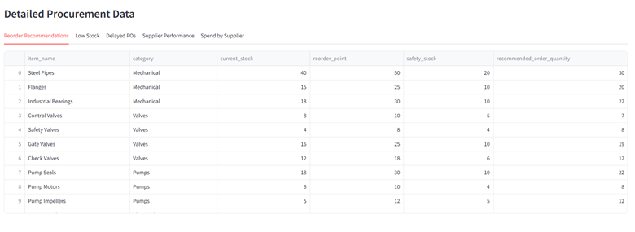
The Problem
Procurement teams often manage operations manually across multiple systems.
Delayed purchase orders
Low inventory visibility
Manual report generation
Slow operational decisions
Difficult supplier tracking

Slide 3
Executive Dashboard
Managers can monitor procurement operations from one unified dashboard.
Low-stock inventory items
Delayed purchase orders
Procurement spend tracking
Supplier on-time delivery rate
AI-generated insights

Slide 4
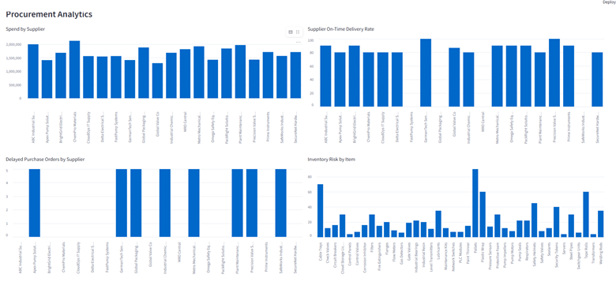
AI Insights & Recommended Actions
The system converts operational data into actionable recommendations.
Detects inventory risk automatically
Flags delayed suppliers
Recommends reorder quantities
Supports faster operational response

Slide 5
Procurement Analytics
Operational analytics help identify trends and supplier risks faster.
Spend by supplier
Supplier delivery performance
Delayed purchase orders
Inventory risk visualization

Slide 6
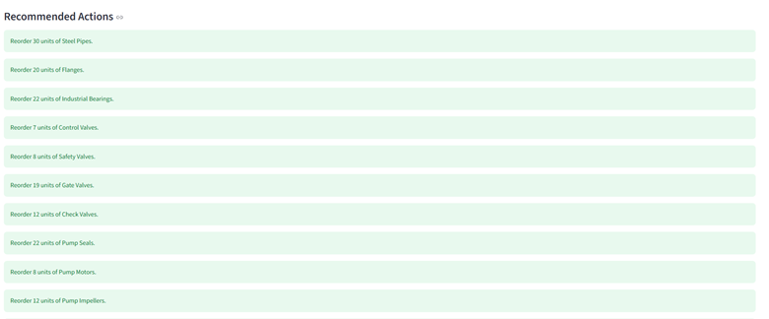
Detailed Procurement Data
Managers can drill into detailed procurement and inventory information.
Current stock
Reorder point
Safety stock
Recommended order quantity

Slide 7

KPI Reports & Slack Automation
The platform generates reports automatically and sends them to Slack.
Weekly KPI reports
Operations PDF reports
Automated Slack uploads
Cron-based scheduling

Slide 8
AI Agent
Managers interact with the platform using natural language.
“Which items need reorder?”
“Which suppliers are causing delays?”
“Generate weekly operations report”
“Where is procurement spend highest?”

Slide 9
Technology Stack
Built using modern AI and backend technologies.
FastAPI
PostgreSQL
Streamlit
MCP tools
Slack API
Python and ReportLab

Slide 10
Business Impact
The platform improves visibility, automation, and operational awareness.
Faster procurement decisions
Reduced manual reporting
Better supplier monitoring
Improved inventory management
Centralized operational visibility

Slide 11
Thank You
AI Procurement Control Tower

