Slide 1
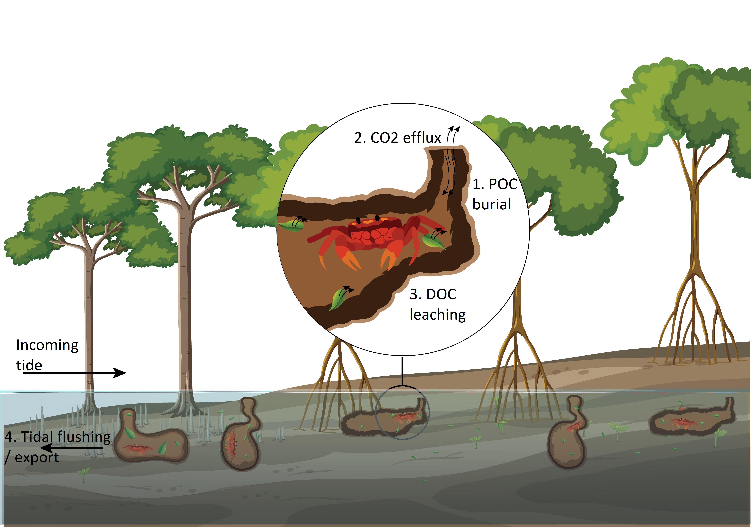
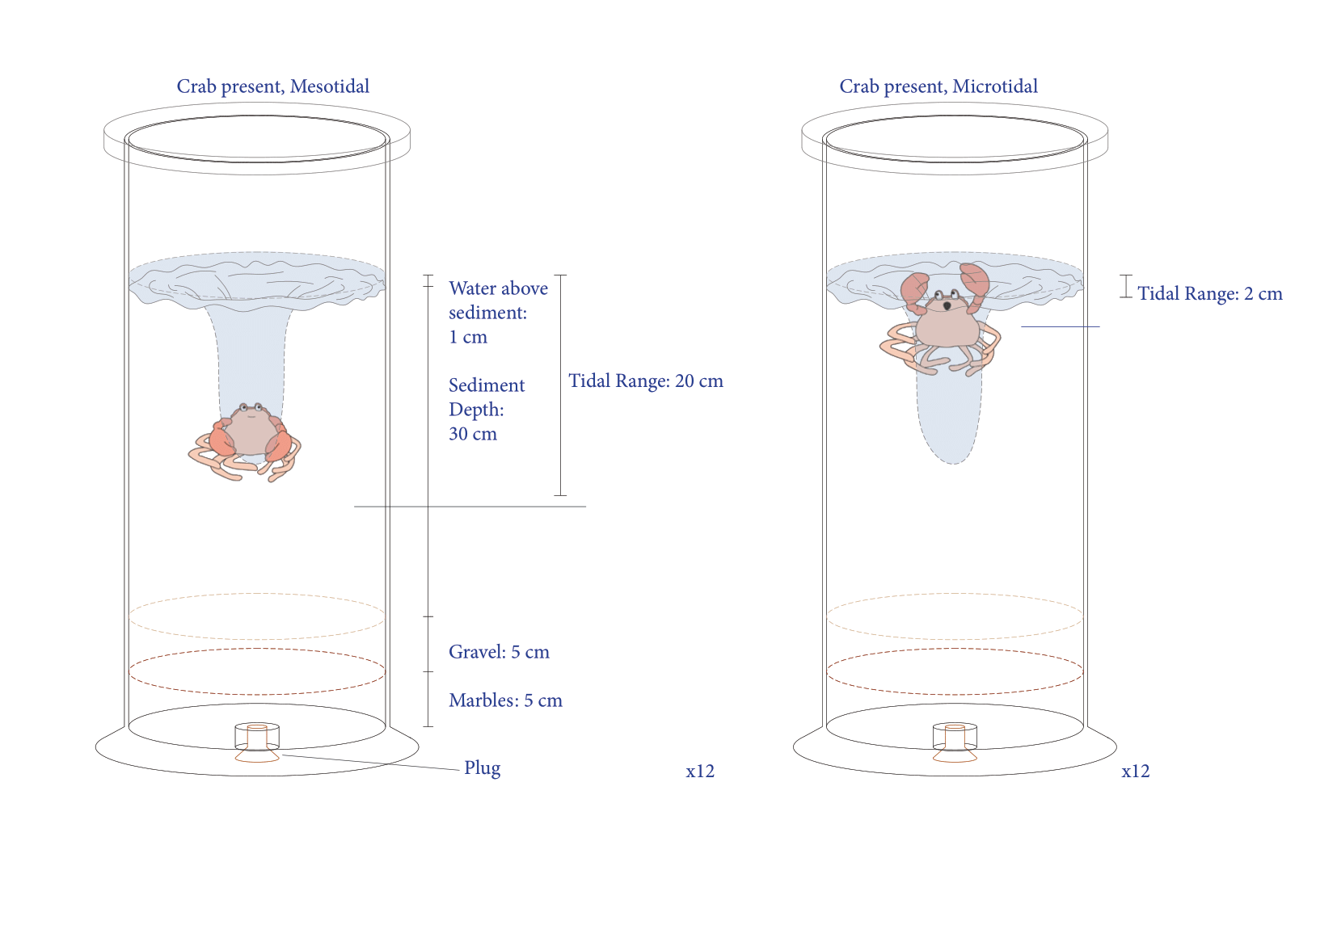

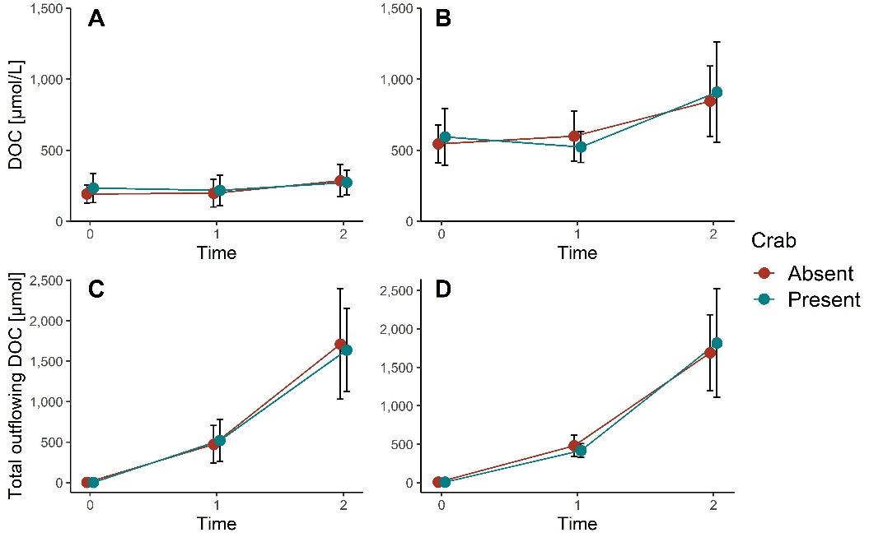

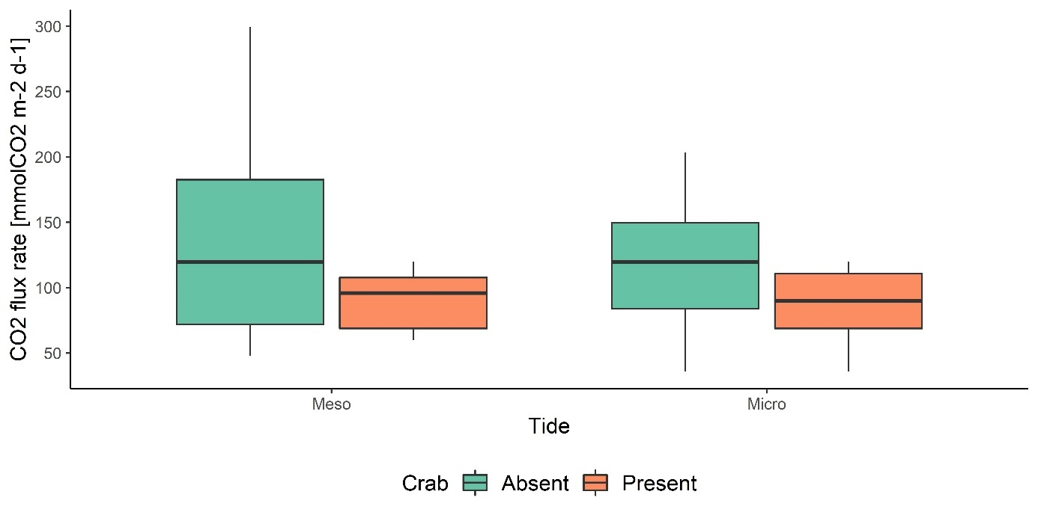

Combined effects of burrowing crabs and tides on carbon fluxes in sediments
Moritz Klaassen^{1,2,3)} – Nils Moosdorf^{1,4)} – Martin Zimmer^{1,2)}
Leibniz Centre for Tropical Marine Research, ZMT Bremen – 2) Universität Bremen, FB02 Biologie/Chemie – 3) current affiliation: Instituto Gulbenkian de Ciência, IGC Oeiras - 4) Christian-Albrechts-Universität zu Kiel
martin.zimmer@leibniz-zmt.de
The impact of burrowing crabs on carbon storage and stocks in mangrove systems is complex.
The burial of leaves by crabs may lead to enhanced carbon storage in mangroves (1).
Burrows increase the sediment-air interface, enhancing CO₂ fluxes from the sediment, potentially counteracting the effect of burial (2).
Further, burrows can act as preferential flow paths, facilitating tidal export of carbon (3,4)
Objective:
Assess the combined impact of burrowing crabs and tides on carbon storage in mangroves.
APPROACH
Experimental Design:
fully crossed design to examine effects of crabs and tides on dissolved organic carbon (DOC) and CO₂ flux:
Neosarmatium africanum present vs. absent
under
“mesotidal” vs. “microtidal” regime
Sampling & Analysis:
Pore-water samples collected and analyzed for DOC content
CO₂ flux measured using NDIR sensors
DOC
KEY FINDINGS
CO₂
DOC concentrations (A,B) higher and increasing over time in mesotidal treatments
Total outflowing DOC (C,D) increasing over time in both tidal treatments
No effects of crab presence on DOC dynamics and fluxes
CO₂ flux rates similar across tidal treatments
CO₂ flux rates significantly higher without crabs than with crabs in both tidal treatments
mesotidal microtidal
mesotidal microtidal
TAKE HOME
Previous studies commonly reported higher CO₂ fluxes in crab burrows; our findings contradict these observations:
Lower CO₂ fluxes when crabs present: leaf fragments trapped inside sediment upon burial and burrow collapse, reducing CO₂ emission from the sediment-air interface
Consider temporal variability of burrow stability: collapse can impact the positive coupling between burrowing crabs and CO₂ fluxes
Significant impact of tidal regime on porewater DOC: higher concentrations under microtidal conditions
Duration of submergence of POM: Higher tidal flushing under mesotidal conditions compensates for lower DOC concentrations, resulting in similar DOC export under different tidal regimes

