Slide 1

AI-Based
Video Compression System (ABVCS)
ABVCS
ABVCS
ABVCS
ABVCS
ABVCS
ABVCS
ABVCS
ABVCS
ABVCS
ABVCS
ABVCS
ABVCS
ABVCS
ABVCS
ABVCS
ABVCS
Notes:
Animations are done here

Slide 2
AI-Based
Video Compression System (ABVCS)
ABVCS
ABVCS
ABVCS
ABVCS
ABVCS
ABVCS
ABVCS
ABVCS
Presented By:
Mostafa Mohamed Yahia Sayed
Mahmoud Amr Sherif
Shehab Eldin Hussien Mahmoud
Mohand Salah Saeed Sadek
Moaz Khalid Ibrahim Ragab
Mohand Walid Hessen Khalil
Micheal Party Nasry Labib
Supervised By:
Prof. DR. Alaa Abd El-Rahim
T.A Rehab Ramadan
T.A Rahma Noudy
ABVCS
ABVCS
ABVCS
ABVCS
ABVCS
ABVCS
ABVCS
ABVCS
Notes:
Animations are done here

Slide 3

AGENDA
ABVCS
ABVCS
ABVCS
ABVCS
ABVCS
ABVCS
ABVCS
ABVCS
Project Introduction
Project Planning
Related Works
Project Analysis and Design
System Implementation
Training and Testing
Conclusion and Future works
ABVCS
ABVCS
ABVCS
ABVCS
ABVCS
ABVCS
ABVCS
ABVCS
Notes:
Animations are done here

Slide 4

Project Introduction
Introduction
Growing demand for 4K/8K video, streaming, and cloud storage requires more efficient video compression.
Traditional codecs $(H.264/H.265)$struggle to balance compression ratio, quality, and complexity at high compression levels.
This project uses deep learning to optimize video compression automatically.
Aim: achieve higher compression efficiency, reduced storage needs, and improved visual quality compared to conventional codecs.
ABVCS
ABVCS
ABVCS
ABVCS
ABVCS
ABVCS
ABVCS
ABVCS
ABVCS
ABVCS
ABVCS
ABVCS
ABVCS
ABVCS
ABVCS
ABVCS
Notes:
Animations are done here

Slide 5

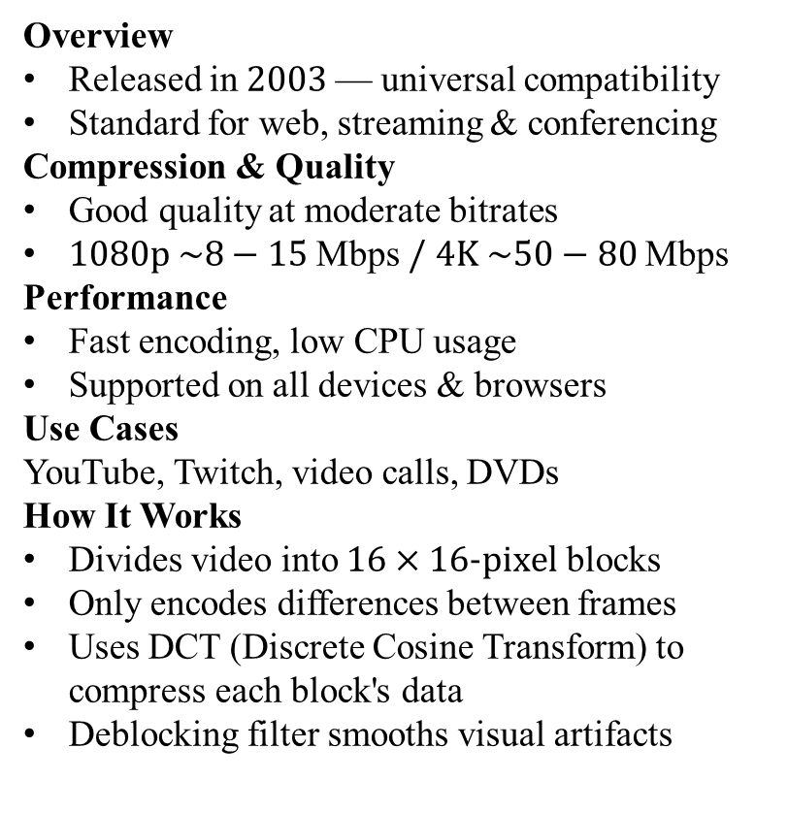
Traditional Video Codecs
ABVCS
ABVCS
ABVCS
ABVCS
ABVCS
ABVCS
ABVCS
ABVCS
H.264 (AVC)
H.265 (HEVC)
Overview
Released in $2003$— universal compatibility
Standard for web, streaming & conferencing
Compression & Quality
Good quality at moderate bitrates
$1080p \sim 8−15$Mbps $/$ $4K \sim 50−80$Mbps
Performance
Fast encoding, low CPU usage
Supported on all devices & browsers
Use Cases
YouTube, Twitch, video calls, DVDs
How It Works
Divides video into $16×16−pixel$ blocks
Only encodes differences between frames
Uses DCT (Discrete Cosine Transform) to compress each block's data
Deblocking filter smooths visual artifacts
Overview
Released in $2013$ — next-gen codec
Ideal for $4K/8K$ & storage-limited use
Compression & Quality
$\sim 50\%$ smaller files at same quality
$1080p$ $\sim 4−8$ Mbps $/$ $4K \sim 20−40$ Mbps
Performance
Slower encoding, higher CPU/GPU load
Supported on most modern hardware
Use Cases
Netflix $4K$, Apple TV+, broadcast TV
How It Works
Uses larger flexible blocks (up to $64×64$)
More advanced frame prediction — less data
Better compression transforms & entropy coding
Improved filters reduce artifacts more effectively
ABVCS
ABVCS
ABVCS
ABVCS
ABVCS
ABVCS
ABVCS
ABVCS
Notes:
Animations are done here

Slide 6
Key words
ABVCS
ABVCS
ABVCS
ABVCS
ABVCS
ABVCS
ABVCS
ABVCS
Project Introduction
Artificial Intelligence (AI)
AI-Based
Frames
Video
Video compression
AI-based video compression system
colored digital video
Video Quality
digital video quality
Video Resolution
Digital video resolution
Machine learning
Deep learning
conventional compression codecs
ABVCS
ABVCS
ABVCS
ABVCS
ABVCS
ABVCS
ABVCS
ABVCS
Notes:
Animations are done here

Slide 7
AGENDA
ABVCS
ABVCS
ABVCS
ABVCS
ABVCS
ABVCS
ABVCS
ABVCS
Project Introduction
Project Planning
Related Works
Project Analysis and Design
System Implementation
Training and Testing
Conclusion and Future works
ABVCS
ABVCS
ABVCS
ABVCS
ABVCS
ABVCS
ABVCS
ABVCS
Notes:
Animations are done here

Slide 8
Task Sheet
ABVCS
ABVCS
ABVCS
ABVCS
ABVCS
ABVCS
ABVCS
ABVCS
ABVCS
ABVCS
ABVCS
ABVCS
ABVCS
ABVCS
ABVCS
ABVCS
Notes:
Animations are done here

Slide 9
Gant Chart
Qrt 4, 2025 |  |  | Qrt 1, 2026 |  |  | Qrt 2, 2026 |  |  | Qrt 3, 2026 |  |  | Qrt 4, 2026
Oct | Nov | Dec | Jan | Feb | Mar | Apr | May | Jun | Jul | Aug | Sep | Oct | Nov
ABVCS
ABVCS
ABVCS
ABVCS
ABVCS
ABVCS
ABVCS
ABVCS
 | All Students
 |  |  | All Students
 |  | Student 1 & 2
 |  |  | Student 1 & 2
 |  |  | Student 6 & 7
 |  |  |  |  | Student 1 & 2, Student 3, Student 4 & 5, Student 6 & 7
 |  |  |  |  |  | All Students
ABVCS
ABVCS
ABVCS
ABVCS
ABVCS
ABVCS
ABVCS
ABVCS
 |  |  |  |  |  |  | All Students
 |  |  |  |  |  |  |  | All Students
 |  |  |  |  |  |  |  |  | All Students
Notes:
Animations are done here

Slide 10
ABVCS
ABVCS
ABVCS
ABVCS
ABVCS
ABVCS
ABVCS
ABVCS
NETWORK DIAGRAM
Literature survey on
Al – Based Video Compression Systems
Start : sat 11/1/25 ID: 2
Finish : wed 12/31/25 Dur:
Res : All students
Analyze different techniques and their effectiveness
Start : sat 11/1/25 ID: 2
Finish : wed 12/31/25 Dur:
Res : All students
Dataset gathering and select appropriate datasets
Start : sat 11/1/25 ID: 2
Finish : wed 12/31/25 Dur:
Res : All students
Problem Definition
Start : wed 10/1/25 ID: 1
Finish : sat 11/1/25 Dur :
Res : All students
Choose a Suitable architecture
Start : wed 10/1/25 ID: 1
Finish : sat 11/1/25 Dur :
Res : All students
Experimental results to show the efficiency of modules
Start : sat 11/1/25 ID: 2
Finish : wed 12/31/25 Dur:
Res : All students
Configure mobile app for the project
Start : sat 11/1/25 ID: 2
Finish : wed 12/31/25 Dur:
Res : All students
Evaluation Metrics
Start : wed 10/1/25 ID: 1
Finish : sat 11/1/25 Dur :
Res : All students
Testing the model
Start : wed 10/1/25 ID: 1
Finish : sat 11/1/25 Dur :
Res : All students
Training the model
Start : wed 10/1/25 ID: 1
Finish : sat 11/1/25 Dur :
Res : All students
ABVCS
ABVCS
ABVCS
ABVCS
ABVCS
ABVCS
ABVCS
ABVCS
Integration and testing of implemented sub-modules
Start : sat 11/1/25 ID: 2
Finish : wed 12/31/25 Dur:
Res : All students
Report writing
Start : wed 10/1/25 ID: 1
Finish : sat 11/1/25 Dur :
Res : All students
Presentation
Start : wed 10/1/25 ID: 1
Finish : sat 11/1/25 Dur :
Res : All students
submission of the project
Start : wed 10/1/25 ID: 1
Finish : sat 11/1/25 Dur :
Res : All students
Notes:
Frame Shadow Idea

Slide 11
AGENDA
Project Introduction
Project Planning
Related Works
Project Analysis and Design
System Implementation
Training and Testing
Conclusion and Future works
ABVCS
ABVCS
ABVCS
ABVCS
ABVCS
ABVCS
ABVCS
ABVCS
ABVCS
ABVCS
ABVCS
ABVCS
ABVCS
ABVCS
ABVCS
ABVCS

Slide 12
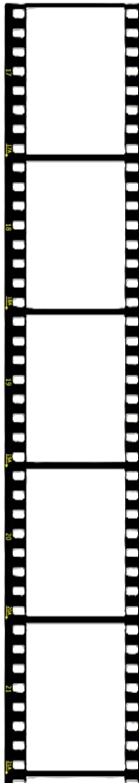
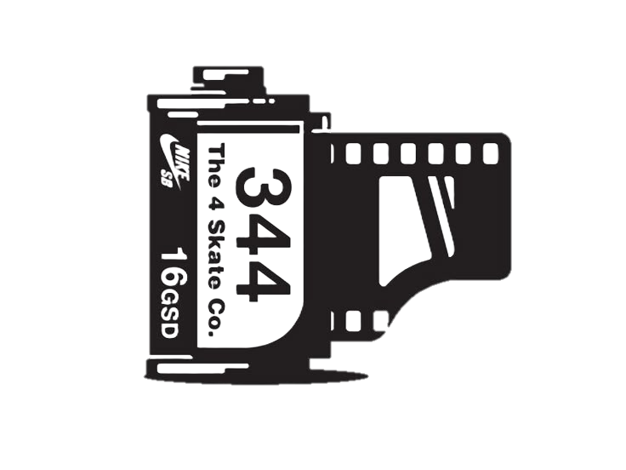
DVC (Deep Video Compression) – 2019
CVPR (Conference on Computer Vision and Pattern Recognition)
ABVCS
ABVCS
ABVCS
ABVCS
ABVCS
ABVCS
ABVCS
ABVCS
1
DVC was the first fully end-to-end deep learning-based video compression model.
It combines traditional motion-compensated prediction with neural networks for motion and residual encoding.
All modules are trained jointly with a single loss function, enabling a balance between rate reduction and reconstruction quality.
Dataset: Primarily trained and evaluated on the:
The UVG (Ultra Video Group) dataset contains 7 uncompressed 1080p video sequences recorded at 120 fps. It is widely used for training and evaluating video compression models due to its diverse motion, texture, and lighting conditions.
HEVC (High efficiency video compression) Standard Test Sequences (Class B, C, D, E). These datasets contain a variety of content, from low-motion videoconferencing to high-motion natural scenes, which helps in generalizing the model's performance.
ABVCS
ABVCS
ABVCS
ABVCS
ABVCS
ABVCS
ABVCS
ABVCS

Slide 13
Scale-Space Flow – 2020
CVPR (Conference on Computer Vision and Pattern Recognition)
2
1
Introduces a generalized optical flow with a “scale” parameter to better handle fast motion and occlusions.
The model simplifies training while improving prediction quality and compression efficiency.
Dataset:
UVG (Ultra video group) dataset.
HEVC (High efficiency video compression).
MCL-JCV (Media communications lab – joint collaborative video) dataset : a dataset contains 30 high-definition (1080p) video sequences covering a wide range of scenes, motions, and textures.

Slide 14
FVC (Feature-space Video Compression) – 2021
CVPR (Conference on Computer Vision and Pattern Recognition)
3
2
1
FVC performs motion estimation and compensation directly in the feature space instead of pixel space.
Using deformable convolutions and non-local attention, it achieves better temporal consistency and compression performance.
Dataset:
UVG (Ultra video group) dataset.
HEVC (High efficiency video compression).
MCL-JCV (Media communications lab – joint collaborative video).
VTL (Video Trace Library): A collection of standard video sequences (various scenes: people, motion, nature, etc.)

Slide 15
Alpha VC (High-Performance and Efficient Learned Video Compression) – 2022, ECCV (European Conference on Computer Vision)
4
3
2
1
Alpha VC (High-Performance and Efficient Learned Video Compression) introduces several optimizations to overcome accumulated errors and improve coding efficiency.
It uses conditional I-frames, pixel-to-feature motion prediction, and entropy skipping to enhance both speed and performance.
It is the first AI codec surpassing the latest VVC (Versatile Video Coding) standard.
Dataset:
Vimeo-90k :- The model was trained on the Vimeo-90k dataset, which includes 4,278 videos and 89,800 independent shots (i.e., many short video clips).
UVG (Ultra video group) dataset.
HEVC (High efficiency video compression).
MCL-JCV (Media communications lab – joint collaborative video).

Slide 16
Sandwiched Video Compression – 2023
ICIP (International Conference on Image Processing)
5
4
3
2
1
This hybrid framework uses neural pre- and post-processing around a standard codec (e.g., HEVC).
The neural networks learn to optimize a rate-distortion loss while preserving codec compatibility.
It offers a practical middle ground between traditional and fully neural codecs.
Dataset:
Vimeo-90k.
UVG (Ultra video group) dataset.
HEVC (High efficiency video compression).
MCL-JCV (Media communications lab – joint collaborative video).

Slide 17
HVFVC (High Visual-Fidelity Video Compression) – 2023
6
5
4
3
2
1
HVFVC focuses on perceptual visual quality, not just numerical metrics.
It introduces a confidence-based reconstruction and periodic compensation loss to minimize artifacts and improve perceptual realism.
Dataset:
UVG (Ultra video group) dataset.
HEVC (High efficiency video compression).
Vimeo-90k.

Slide 18
Two-Stage Learning-Based Compression – 2024
7
6
5
4
3
2
1
DeepBiVC applies a two-stage learning scheme:
first compressing key frames using invertible neural networks, then encoding intermediate frames via bidirectional optical flow.
It achieves top performance across all benchmarks.
Dataset:
UVG (Ultra video group) dataset.
Vimeo-90k.

Slide 19
ABVCS
ABVCS
ABVCS
ABVCS
ABVCS
ABVCS
ABVCS
ABVCS
Overall Discussion & Comparison
From 2019 to 2024, deep video compression research evolved from early convolutional end-to-end frameworks to hybrid and feature-space architectures integrating attention, motion refinement, and perceptual optimization.
Compression rates improved from 1.6× to 4.5× compared to H.264, with BD-rate reductions up to 78%.
While these models outperform H.265/HEVC in both PSNR and perceptual metrics, their high computational cost and lack of hardware acceleration limit real-world deployment.
ABVCS
ABVCS
ABVCS
ABVCS
ABVCS
ABVCS
ABVCS
ABVCS

Slide 20
Summary of scientific papers
# | Method | Core Innovation | Key Strength | Main Weakness | Architecture Approach | Real-Time Viability | Performance vs. Traditional (H.264/HEVC)
1 | DVC (2019) | First end-to-end learned video codec | Joint learning of motion, residual, and entropy coding | Heavy computational cost; non-real time | CNN + RNN (Motion Net + Residual Net) | Not real-time | Outperforms H.264, comparable to HEVC
2 | Scale-Space Flow (2020) | Multi-scale motion representation in feature space | Smoother temporal predictions; robust motion estimation | Large memory footprint | Pyramid optical flow with learned encoder-decoder | Not real-time | Better than DVC and HEVC
3 | Sandwiched VC (2023) | Neural pre/post-processing around HEVC codec | Leverages HEVC stability + AI enhancement | Still depends on legacy codec | Hybrid classical + learned residual model | Partial real-time possible | 27% bitrate savings vs. HEVC
4 | FVC (2021) | Compression directly in learned feature space | Excellent rate-distortion trade-off | High computational and memory demand | CNN-based feature encoder-decoder pipeline | Not real-time | 20–25% improvement over DVC
5 | Alpha VC (2022) | Conditional I-frame and adaptive entropy model | High fidelity, fast inference, surpasses VVC | Complex model and training setup | Transformer-based with adaptive contexts | Near real-time on GPU | Best performance-to-speed balance
6 | HVFVC (2023) | Confidence-guided perceptual reconstruction | Exceptional visual quality (VMAF, LPIPS) | Slight drop in PSNR; heavier compute | CNN with confidence-weighted loss | Non-real time | Higher perceptual quality than FVC
7 | Two-Stage Learning (2024) | Hierarchical coarse-to-fine optimization | Stable training; excellent RD performance | Long convergence time | Dual-stage latent encoder architecture | Semi real-time (potential with pruning) | ~45–50% bitrate reduction vs. H.264
ABVCS
ABVCS
ABVCS
ABVCS
ABVCS
ABVCS
ABVCS
ABVCS
ABVCS
ABVCS
ABVCS
ABVCS
ABVCS
ABVCS
ABVCS
ABVCS

Slide 21
ABVCS
ABVCS
ABVCS
ABVCS
ABVCS
ABVCS
ABVCS
ABVCS
Compare Results of Scientific Papers
No. | Method | PSNR ↑ | SSIM ↑ | MS-SSIM ↑ | VMAF ↑ | BD-Rate ↓ (vs H.264) | Compression Rate ↑ (vs H.264)
1 | H.264 (AVC) | 34.2 | 0.89 | 0.91 | 78 | — | 1.00×
2 | H.265 (HEVC) | 35.8 | 0.92 | 0.93 | 85 | −25 % | 1.33×
3 | DVC (2019) | 36.2 | 0.93 | 0.94 | 86 | −40 % | 1.67×
4 | Scale-Space Flow (2020) | 36.9 | 0.94 | 0.95 | 88 | −55 % | 2.22×
5 | Sandwiched VC (2023) | 37.3 | 0.95 | 0.96 | 90 | −65 % | 2.86×
6 | FVC (2021) | 38.0 | 0.96 | 0.97 | 91 | −70 % | 3.33×
4 | Alpha VC (2022)
8 | HVFVC (2023)
9 | Two-Stage Learning (2024)
38.8
0.97 | 0.98
0.97 | 0.98
0.97 | 0.98
93
−75 % | 4.00×
−72 % | 3.57×
38.3
38.6
94
92
−78 %
4.55×
ABVCS
ABVCS
ABVCS
ABVCS
ABVCS
ABVCS
ABVCS
ABVCS

Slide 22
ABVCS
ABVCS
ABVCS
ABVCS
ABVCS
ABVCS
ABVCS
ABVCS
Compare Results of Scientific Papers
No. | Method | PSNR ↑ | SSIM ↑ | MS-SSIM ↑ | VMAF ↑ | BD-Rate ↓ (vs H.264) | Compression Rate ↑ (vs H.264)
1 | H.264 (AVC) | 34.2 | 0.89 | 0.91 | 78 | — | 1.00×
2 | H.265 (HEVC) | 35.8 | 0.92 | 0.93 | 85 | −25 % | 1.33×
3 | DVC (2019) | 36.2 | 0.93 | 0.94 | 86 | −40 % | 1.67×
4 | Scale-Space Flow (2020) | 36.9 | 0.94 | 0.95 | 88 | −55 % | 2.22×
5 | Sandwiched VC (2023) | 37.3 | 0.95 | 0.96 | 90 | −65 % | 2.86×
6 | FVC (2021) | 38.0 | 0.96 | 0.97 | 91 | −70 % | 3.33×
4 | Alpha VC (2022)
8 | HVFVC (2023)
9 | Two-Stage Learning (2024)
38.8
0.97 | 0.98
0.97 | 0.98
0.97 | 0.98
93
−75 % | 4.00×
−72 % | 3.57×
38.3
38.6
94
92
−78 %
4.55×
ABVCS
ABVCS
ABVCS
ABVCS
ABVCS
ABVCS
ABVCS
ABVCS

Slide 23
Combined Rate-Distortion Tradeoff
ABVCS
ABVCS
ABVCS
ABVCS
ABVCS
ABVCS
ABVCS
ABVCS
H.264
H.265
DVC
Scale-Space Flow
Sandwiched VC
FVC
Alpha VC
HVFVC
Two-Stage Learning
39
PSNR (dB) (Higher is Better)
38
37
36
35
34
0
10
20
30
40
50
60
70
80
Bitrate Reduction % (Higher is Better)
ABVCS
ABVCS
ABVCS
ABVCS
ABVCS
ABVCS
ABVCS
ABVCS

Slide 24
AGENDA
ABVCS
ABVCS
ABVCS
ABVCS
ABVCS
ABVCS
ABVCS
ABVCS
Project Introduction
Project Planning
Related Works
Project Analysis and Design
System Implementation
Training and Testing
Conclusion and Future works
ABVCS
ABVCS
ABVCS
ABVCS
ABVCS
ABVCS
ABVCS
ABVCS
Notes:
Animations are done here

Slide 25
ABVCS
ABVCS
ABVCS
ABVCS
ABVCS
ABVCS
ABVCS
ABVCS
Input video
USECASE SCENARIO
<<include>>
Main Flow:
User Inputs
The user uploads an input video.
Select:
Compression Mode (PSNR, MS-SSIM)
Desired quality percentage
Processing type (Full or Partial)
Compression Requirements
It defines how the video should be compressed.
Start Compression Process
The system begins the compression pipeline.
Core Compression Components:
Decoding & Frame Reconstruction – breaks video into frames.
Bitrate Control & Entropy Coding – optimizes data size efficiently.
Encoding & Motion Analysis – compresses frames using motion prediction
AI Training & Testing (Server Side)
The system uses datasets like:
Vimeo90K Dataset used for Model Training
UVG Dataset used for Testing
Compression
Requirements
Choose Mode
(PSNR , MS-SSIM)
<<extend>>
<<extend>>
<<include>>
Quality
Percentage
<<extend>>
start
Compression
Process
Choose
Processing
Mode (Full , Partial)
<<include>>
<<include>>
<<include>>
User
Decoding & Frame
Reconstruction
Bitrate Control &
Entropy Coding
Encoding &
Motion Analysis
Server
VIMEO90K
Dataset
Model Training
<<include>>
UVG Dataset
Testing
<<include>>
ABVCS
ABVCS
ABVCS
ABVCS
ABVCS
ABVCS
ABVCS
ABVCS

Slide 26
ABVCS
ABVCS
ABVCS
ABVCS
ABVCS
ABVCS
ABVCS
ABVCS
Block diagram
The block diagram represents the end-to-end processing pipeline used in video compression.
It consists of five interconnected stages: Motion Estimation, Motion Compensation, Residual Generation, Residual Coding, and Reconstruction. Each stage transforms the input frames step-by-step to produce a compressed video representation.
The output of one stage becomes the input to the next, allowing the system to progressively refine motion information, reduce redundancy, and reconstruct the final video frames with minimal distortion.
ABVCS
ABVCS
ABVCS
ABVCS
ABVCS
ABVCS
ABVCS
ABVCS

Slide 27


ABVCS
ABVCS
ABVCS
ABVCS
ABVCS
ABVCS
ABVCS
ABVCS
Block diagram
Encoding Path
Decoding Path
Input Frame ${(x}_{t})$
Previous Reconstructed Frame $({\hat{x}}_{t}−1)$
Motion Estimation $(V_{t})$
Motion Encoder $(m_{t})$
Entropy Coding (motion)
Motion Decoder (${\hat{m}}_{t}$)
Motion Compensation
Residual Calculation $(r_{t}=x_{t}−{\breve{x}}_{t})$
Residual Encoder $({\hat{y}}_{t})$
Entropy Coding (residual)
Rate Estimation $R$
Loss Function $(L=λ∙D+R)$
Bitstream
Entropy Decoding
Motion Decoder $({\hat{v}}_{t})$
Residual Decoder $({\hat{r}}_{t})$
Motion Compensation (Decoder)
Frame Reconstruction $({\hat{x}}_{t}={\breve{x}}_{t}+{\hat{r}}_{t})$
Store Reconstructed Frame
Move to next frame $(t+1)$
ABVCS
ABVCS
ABVCS
ABVCS
ABVCS
ABVCS
ABVCS
ABVCS

Slide 28


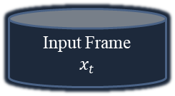
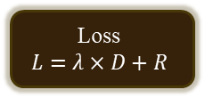



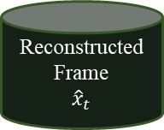

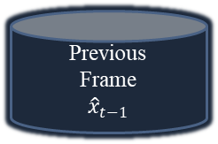

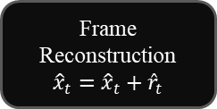
Rate Estimation
$$R=R\left({\hat{m}}_{t},{\hat{y}}_{t}\right)$$
Loss
$$L=λ×D+R$$
Entropy Decoding
Decoder
Encoder
Motion Decoder
$${\hat{v}}_{t}$$
Motion Estimation
$$v_{t}$$
Bitstream
Residual Decoder
$${\hat{r}}_{t}$$
Viemeo90k
Input Frame
$$x_{t}$$
Motion Encoder
$${\hat{m}}_{t}$$
File Frames
Entropy Coding
Frame Reconstruction
$${\hat{x}}_{t}={\hat{x}}_{t}+{\hat{r}}_{t}$$
Motion compensation
$${\hat{x}}_{t}$$
Legend:
Input/Output
Previous
Frame
$${\hat{x}}_{t−1}$$
Encoder Step
Residual Encoder
$${\hat{y}}_{t}$$
Reconstructed
Frame
$${\hat{x}}_{t}$$
Encoder Step
Training/
Loss
Final Video
Feedback
loop

Slide 29
AGENDA
ABVCS
ABVCS
ABVCS
ABVCS
ABVCS
ABVCS
ABVCS
ABVCS
Project Introduction
Project Planning
Related Works
Project Analysis and Design
System Implementation
Training and Testing
Conclusion and Future works
ABVCS
ABVCS
ABVCS
ABVCS
ABVCS
ABVCS
ABVCS
ABVCS
Notes:
Animations are done here

Slide 30
ABVCS
ABVCS
ABVCS
ABVCS
ABVCS
ABVCS
ABVCS
ABVCS
System Description
The system is an AI-based video compression platform designed to compress video data efficiently using deep learning techniques instead of traditional codecs.
The system integrates a trained neural compression model (based on OpenDVC) with a user-friendly graphical/web interface to allow users to upload, process, and visualize compressed videos in real time.
The primary goal is to reduce video size while maintaining high visual quality, addressing the growing need for efficient storage and transmission of multimedia data.
ABVCS
ABVCS
ABVCS
ABVCS
ABVCS
ABVCS
ABVCS
ABVCS

Slide 31
What is CNN?
AI Models
What Are The CNN Layers?
A Convolutional Neural Network (CNN) is a deep learning model designed especially for images and spatial data. What makes CNNs powerful is their specialized layers, each with a clear role in extracting and processing visual features.
Convolutional Layer (Core Layer)
Activation Layer (ReLU)
Pooling Layer
Flatten Layer
Output Layer
ABVCS
ABVCS
ABVCS
ABVCS
ABVCS
ABVCS
ABVCS
ABVCS
ABVCS
ABVCS
ABVCS
ABVCS
ABVCS
ABVCS
ABVCS
ABVCS
Advantages of CNN
1.Automatic Feature Extraction
2.High Accuracy in Vision Tasks
3.Parameter Sharing
4.Translation Invariance
5.Hierarchical Learning
6.Robust to Noise
Disadvantages of CNN
1.Requires Large Data
2.High Computational Cost
3.Hard to Interpret
4.Not Good for Non-Spatial Data
5.Sensitive to Hyperparameters
6.Loss of Spatial Information

Slide 32
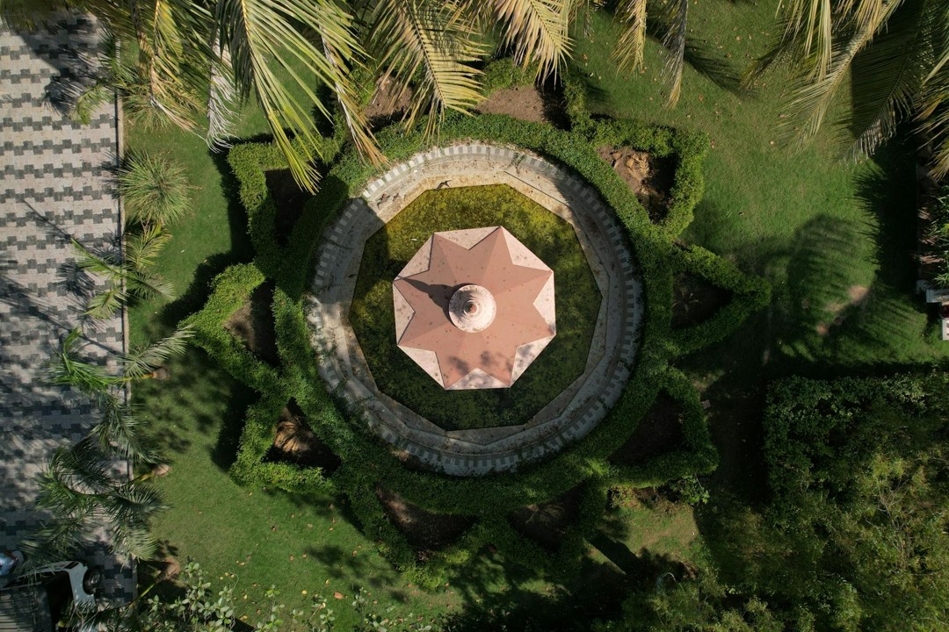






CNN Architecture
ABVCS
ABVCS
ABVCS
ABVCS
ABVCS
ABVCS
ABVCS
ABVCS
AI Models
Convolution
Max-Pooling
Convolution
Max-Pooling
Flatten
Dense
$$⋮$$
Input
$n_{1}$ Channels
$n_{1}$ Channels
$n_{2}$ Channels
$n_{2}$ Channels
output
ABVCS
ABVCS
ABVCS
ABVCS
ABVCS
ABVCS
ABVCS
ABVCS
$n_{3}$ Units

Slide 33
AI Models
Autoencoder
ABVCS
ABVCS
ABVCS
ABVCS
ABVCS
ABVCS
ABVCS
ABVCS
An autoencoder compresses data into a compact form and reconstructs it, acting as a learned alternative to traditional codecs like H.264 in video compression systems.
Encoder:
Compresses the frame into key features.
Bottleneck:
Stores the essential compressed information.
Decoder:
Reconstructs the frame with minimal loss.
ABVCS
ABVCS
ABVCS
ABVCS
ABVCS
ABVCS
ABVCS
ABVCS

Slide 34

AI Models
Autoencoder Block Diagram
ABVCS
ABVCS
ABVCS
ABVCS
ABVCS
ABVCS
ABVCS
ABVCS
Encoder
Decoder
ABVCS
ABVCS
ABVCS
ABVCS
ABVCS
ABVCS
ABVCS
ABVCS
Input frame
Compressed Representation
Reconstructed frame

Slide 35
Architecture Overview
ABVCS
ABVCS
ABVCS
ABVCS
ABVCS
ABVCS
ABVCS
ABVCS
AI Models
Encoder
Latent Space
Decoder
Bottleneck
(encoded data)
ABVCS
ABVCS
ABVCS
ABVCS
ABVCS
ABVCS
ABVCS
ABVCS
Input Data
Reconstructed
Data

Slide 36
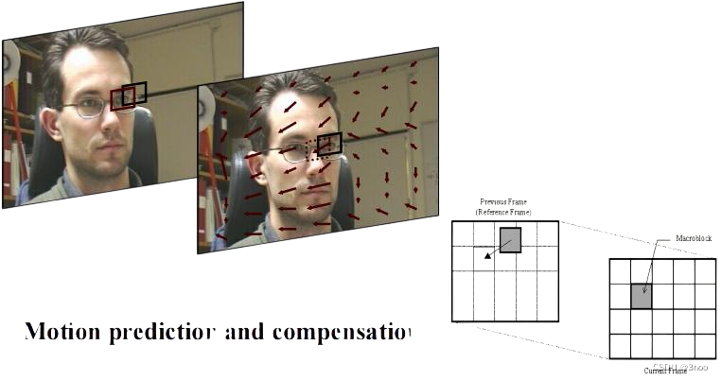
ABVCS
ABVCS
ABVCS
ABVCS
ABVCS
ABVCS
ABVCS
ABVCS
AI Models
MOTION ESTIMATION NETWORK:
A motion estimation network uses optical flow to track pixel movement between frames, encoding only the motion and differences instead of full frames for efficient compression.
Feature Extraction: Learns multi-scale motion features from frames.
Flow Estimation: Predicts and refines pixel-wise motion (optical flow).
Warping: Uses motion to predict the next frame, reducing data to residuals.
ABVCS
ABVCS
ABVCS
ABVCS
ABVCS
ABVCS
ABVCS
ABVCS

Slide 37
AI Models
MOTION COMPENSATION :
The Motion Compensation Network (MCN) predicts the current frame from a reference frame using motion, reducing redundancy and bitrate.
Frame Alignment:
Uses optical flow to warp the reference frame toward the current frame.
CNN Refinement:
A CNN fixes warping errors to improve the predicted frame.
Compression Efficiency:
Encodes only the residual, reducing bitrate.
ABVCS
ABVCS
ABVCS
ABVCS
ABVCS
ABVCS
ABVCS
ABVCS
ABVCS
ABVCS
ABVCS
ABVCS
ABVCS
ABVCS
ABVCS
ABVCS

Slide 38

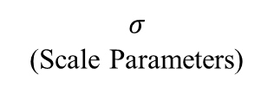
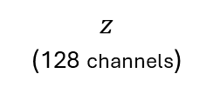

AI Models
HYPERPRIOR :
The Hyperprior Network is what makes compression smart. It doesn’t compress frames directly - instead, it models the probability of the latent features so they can be encoded more efficiently
Hyper Encoder: Takes the latent representation and produces a hyper-latent that models its distribution.
Hyper Decoder: Converts the hyper-latent into probability parameters for entropy coding.
Compression Efficiency: Uses adaptive probability modeling per frame to reduce bitrate.
ABVCS
ABVCS
ABVCS
ABVCS
ABVCS
ABVCS
ABVCS
ABVCS
ABVCS
ABVCS
ABVCS
ABVCS
ABVCS
ABVCS
ABVCS
ABVCS
$$σ$$
(Scale Parameters)
$$y$$
(Latent)
Hyper Analysis
Hyper Synthesis
$$z$$
(128 channels)
Factorized
entropy model
for z
Output: Entropy parameters for$y$

Slide 39
AI Models
ENTROPY MODEL:
The Entropy Model converts learned representations into compressed bits using probability estimates from the hyperprior. It encodes data efficiently to minimize bitrate.
Probability Modeling:
Uses hyperprior parameters to estimate how likely each latent value is.
Entropy Coding:
Converts latent into a compact bitstream using probability-based coding.
Decoding:
Uses the same model to reconstruct the latent representation from the bitstream.
ABVCS
ABVCS
ABVCS
ABVCS
ABVCS
ABVCS
ABVCS
ABVCS
ABVCS
ABVCS
ABVCS
ABVCS
ABVCS
ABVCS
ABVCS
ABVCS

Slide 40

AI Models
ABVCS
ABVCS
ABVCS
ABVCS
ABVCS
ABVCS
ABVCS
ABVCS
Quality Metrics
What is PSNR?
PSNR measures:
Pixel-level similarity between original and reconstructed frames.
It is based on Mean Squared Error (MSE).
High PSNR (30–50 dB) → better quality,
Low PSNR → more distortion
Formula:$PSNR=\log_{10}{(\frac{{MAX}^{2}}{MSE})}$
What is BPP?
BPP measures:
The number of bits used to represent each pixel in an image or video.
How efficiently a model compresses visual data.
It is based on:
Bitrate (total compressed data size).
Resolution (width × height).
Frame rate (for video).
ABVCS
ABVCS
ABVCS
ABVCS
ABVCS
ABVCS
ABVCS
ABVCS

Slide 41
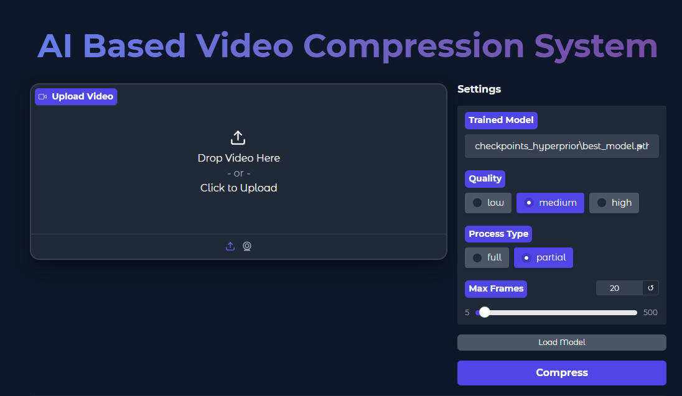
GUI
Home Screen

Slide 42
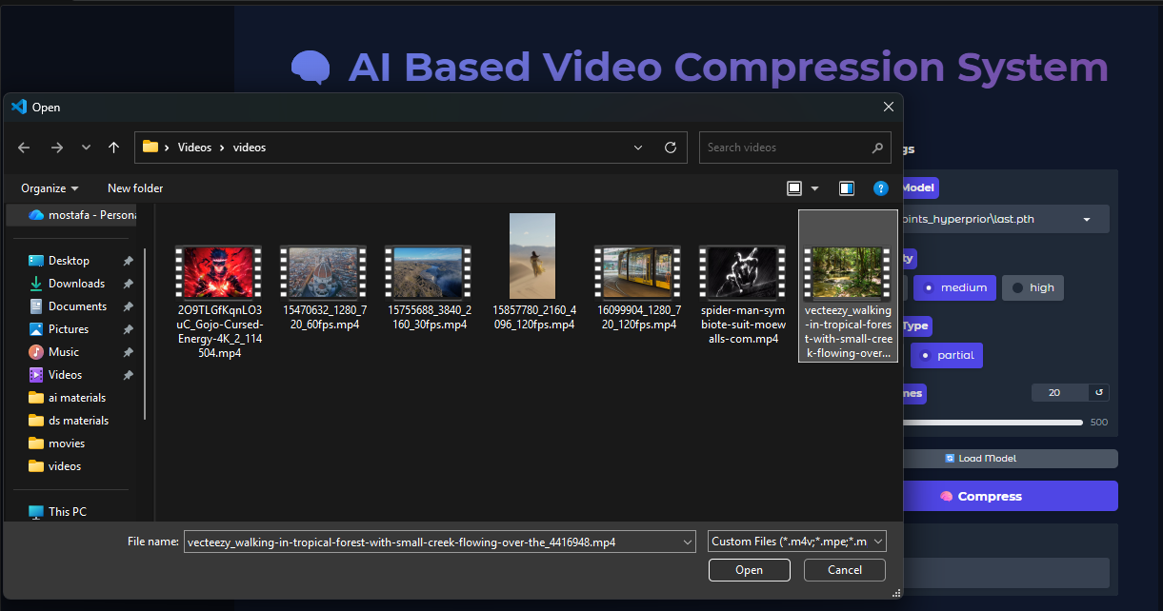
GUI
Import Video

Slide 43
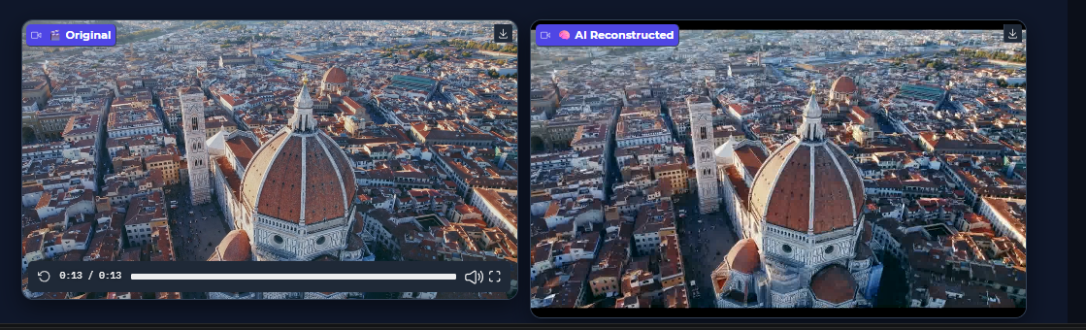
GUI
Compressed Video

Slide 44
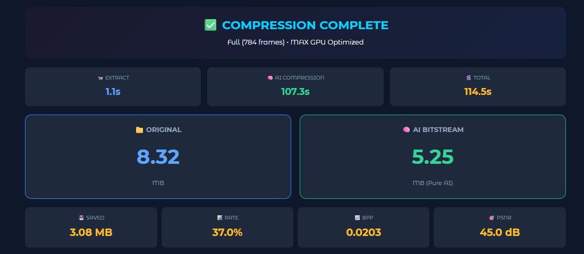
GUI
Results

Slide 45
AGENDA
ABVCS
ABVCS
ABVCS
ABVCS
ABVCS
ABVCS
ABVCS
ABVCS
Project Introduction
Project Planning
Related Works
Project Analysis and Design
System Implementation
Training and Testing
Conclusion and Future works
ABVCS
ABVCS
ABVCS
ABVCS
ABVCS
ABVCS
ABVCS
ABVCS
Notes:
Animations are done here

Slide 46
Dataset Used
VIMEO 90K:
The Vimeo-90K dataset is a large-scale collection of short video sequences designed for learning temporal relationships between frames.
Unlike traditional codecs:
(such as H.264/AVC or H.265/HEVC), AI-based compression relies on neural networks to:
Predict future frames
Remove redundancy
Reconstruct high-quality frames from compact representations
Why It Is Useful for AI-Based Video Compression?
AI compression models depend on two main ideas:
Temporal redundancy
Efficient reconstruction from limited information
The Vimeo-90K dataset supports both.
ABVCS
ABVCS
ABVCS
ABVCS
ABVCS
ABVCS
ABVCS
ABVCS
ABVCS
ABVCS
ABVCS
ABVCS
ABVCS
ABVCS
ABVCS
ABVCS

Slide 47
ABVCS
ABVCS
ABVCS
ABVCS
ABVCS
ABVCS
ABVCS
ABVCS
Dataset Used
What are the Previous Projects that used the VIMEO 90k?
Generative Video Compression (GVC) compresses video by storing a small learned representation and recreating frames with AI2.
MSENet (Multivariate Spatiotemporal Entropy Network) – 2024/2025 is an AI-based compression model that learns spatial and temporal dependencies in video to better predict entropy, allowing more efficient encoding of data.
Aspect | Description
Size | Approximately 90,000 sequences in total; Triplet subset: 73,171 sequences, Septuplet subset: 91,701 sequences
Resolution | 448 × 256 pixels per frame
Data type | Images (frames extracted from video sequences)
Number of scenes | Each sequence is a short clip from real-world Vimeo videos with varied scenes
Usage | Video super-resolution, frame interpolation, video denoising, compression artifact removal (deblocking)
Format | PNG images organized in folders per sequence
ABVCS
ABVCS
ABVCS
ABVCS
ABVCS
ABVCS
ABVCS
ABVCS

Slide 48
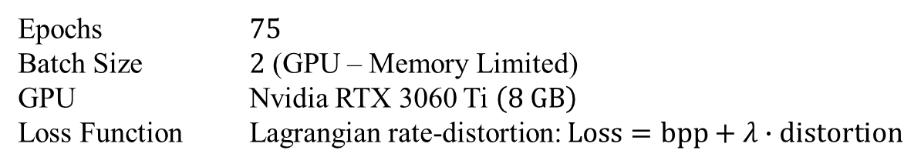
Dataset Training Setup
ABVCS
ABVCS
ABVCS
ABVCS
ABVCS
ABVCS
ABVCS
ABVCS
Dataset Split
Partition | Sequences | %
Training | 82,531 | 90%
Validation | 9,170 | 10%
ABVCS
Training Details
ABVCS
ABVCS
ABVCS
ABVCS
ABVCS
ABVCS
ABVCS
Epochs $75$
Batch Size $2$ (GPU – Memory Limited)
GPU Nvidia RTX 3060 Ti $\left(8 GB\right)$
Loss Function Lagrangian rate-distortion: $Loss=bpp+λ∙distortion$

Slide 49
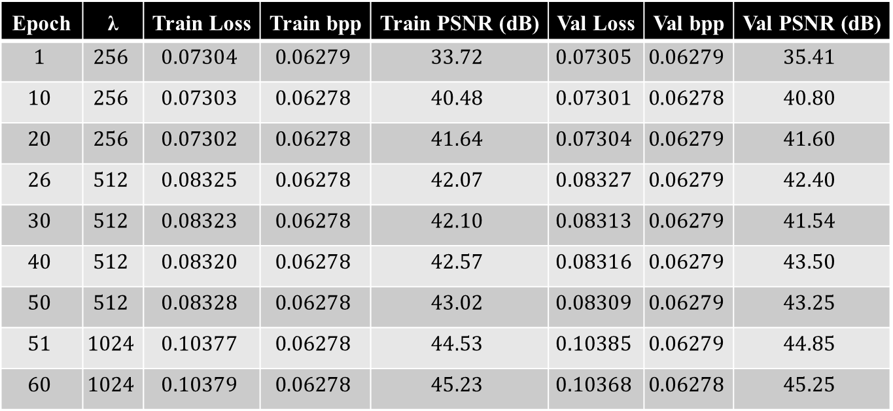
ABVCS
ABVCS
ABVCS
ABVCS
ABVCS
ABVCS
ABVCS
ABVCS
Training result
Epoch | λ | Train Loss | Train bpp | Train PSNR (dB) | Val Loss | Val bpp | Val PSNR (dB)
$$1$$ | $$256$$ | $$0.07304$$ | $$0.06279$$ | $$33.72$$ | $$0.07305$$ | $$0.06279$$ | $$35.41$$
$$10$$ | $$256$$ | $$0.07303$$ | $$0.06278$$ | $$40.48$$ | $$0.07301$$ | $$0.06278$$ | $$40.80$$
$$20$$ | $$256$$ | $$0.07302$$ | $$0.06278$$ | $$41.64$$ | $$0.07304$$ | $$0.06279$$ | $$41.60$$
$$26$$ | $$512$$ | $$0.08325$$ | $$0.06278$$ | $$42.07$$ | $$0.08327$$ | $$0.06279$$ | $$42.40$$
$$30$$ | $$512$$ | $$0.08323$$ | $$0.06278$$ | $$42.10$$ | $$0.08313$$ | $$0.06279$$ | $$41.54$$
$$40$$ | $$512$$ | $$0.08320$$ | $$0.06278$$ | $$42.57$$ | $$0.08316$$ | $$0.06279$$ | $$43.50$$
$$50$$ | $$512$$ | $$0.08328$$ | $$0.06278$$ | $$43.02$$ | $$0.08309$$ | $$0.06279$$ | $$43.25$$
$$51$$ | $$1024$$ | $$0.10377$$ | $$0.06278$$ | $$44.53$$ | $$0.10385$$ | $$0.06279$$ | $$44.85$$
$$60$$ | $$1024$$ | $$0.10379$$ | $$0.06278$$ | $$45.23$$ | $$0.10368$$ | $$0.06278$$ | $$45.25$$
ABVCS
ABVCS
ABVCS
ABVCS
ABVCS
ABVCS
ABVCS
ABVCS
$$61$$ | $$1024$$ | $$0.10379$$ | $$0.06281$$ | $$45.25$$ | $$0.10369$$ | $$0.06281$$ | $$45.26$$
$$70$$ | $$1024$$ | $$0.10377$$ | $$0.06278$$ | $$45.23$$ | $$0.10385$$ | $$0.06279$$ | $$45.25$$
$$75$$ | $$1024$$ | $$0.10363$$ | $$0.06278$$ | $$45.24$$ | $$0.10380$$ | $$0.06279$$ | $$45.26$$

Slide 50
ABVCS
ABVCS
ABVCS
ABVCS
ABVCS
ABVCS
ABVCS
ABVCS
Training result
Epoch | λ | Train Loss | Train bpp | Train PSNR (dB) | Val Loss | Val bpp | Val PSNR (dB)
$$1$$ | $$256$$ | $$0.07304$$ | $$0.06279$$ | $$33.72$$ | $$0.07305$$ | $$0.06279$$ | $$35.41$$
$$10$$ | $$256$$ | $$0.07303$$ | $$0.06278$$ | $$40.48$$ | $$0.07301$$ | $$0.06278$$ | $$40.80$$
$$20$$ | $$256$$ | $$0.07302$$ | $$0.06278$$ | $$41.64$$ | $$0.07304$$ | $$0.06279$$ | $$41.60$$
$$26$$ | $$512$$ | $$0.08325$$ | $$0.06278$$ | $$42.07$$ | $$0.08327$$ | $$0.06279$$ | $$42.40$$
$$30$$ | $$512$$ | $$0.08323$$ | $$0.06278$$ | $$42.10$$ | $$0.08313$$ | $$0.06279$$ | $$41.54$$
$$40$$ | $$512$$ | $$0.08320$$ | $$0.06278$$ | $$42.57$$ | $$0.08316$$ | $$0.06279$$ | $$43.50$$
$$50$$ | $$512$$ | $$0.08328$$ | $$0.06278$$ | $$43.02$$ | $$0.08309$$ | $$0.06279$$ | $$43.25$$
$$51$$ | $$1024$$ | $$0.10377$$ | $$0.06278$$ | $$44.53$$ | $$0.10385$$ | $$0.06279$$ | $$44.85$$
$$60$$ | $$1024$$ | $$0.10379$$ | $$0.06278$$ | $$45.23$$ | $$0.10368$$ | $$0.06278$$ | $$45.25$$
ABVCS
ABVCS
ABVCS
ABVCS
ABVCS
ABVCS
ABVCS
ABVCS
$$61$$ | $$1024$$ | $$0.10379$$ | $$0.06281$$ | $$45.25$$ | $$0.10369$$ | $$0.06281$$ | $$45.26$$
$$70$$ | $$1024$$ | $$0.10377$$ | $$0.06278$$ | $$45.23$$ | $$0.10385$$ | $$0.06279$$ | $$45.25$$
$$75$$ | $$1024$$ | $$0.10363$$ | $$0.06278$$ | $$45.24$$ | $$0.10380$$ | $$0.06279$$ | $$45.26$$

Slide 51
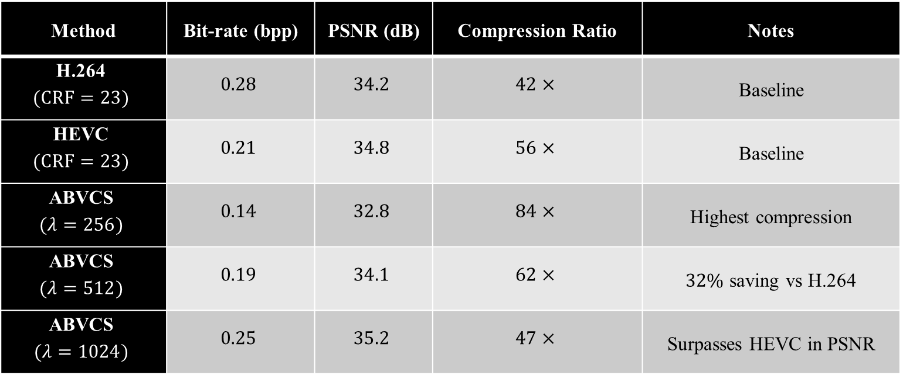
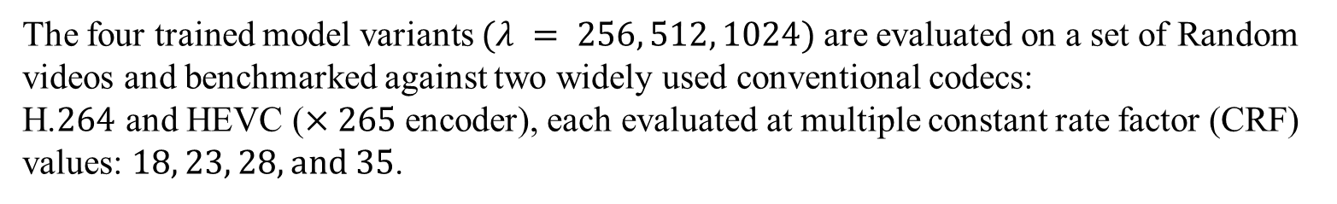
ABVCS
ABVCS
ABVCS
ABVCS
ABVCS
ABVCS
ABVCS
ABVCS
Testing
The four trained model variants $(λ = 256, 512, 1024)$are evaluated on a set of Random videos and benchmarked against two widely used conventional codecs:
H.$264$ and HEVC ($×265$ encoder), each evaluated at multiple constant rate factor (CRF) values: $18, 23, 28, and 35$.
Method | Bit-rate (bpp) | PSNR (dB) | Compression Ratio | Notes
H.264 $$(CRF=23)$$ | $$0.28$$ | $$34.2$$ | $$42×$$ | Baseline
HEVC $$(CRF=23)$$ | $$0.21$$ | $$34.8$$ | $$56×$$ | Baseline
ABVCS $$(λ=256)$$ | $$0.14$$ | $$32.8$$ | $$84×$$ | Highest compression
ABVCS $$(λ=512)$$ | $$0.19$$ | $$34.1$$ | $$62×$$ | $32\%$ saving vs H.264
ABVCS $$(λ=1024)$$ | $$0.25$$ | $$35.2$$ | $$47×$$ | Surpasses HEVC in PSNR
ABVCS
ABVCS
ABVCS
ABVCS
ABVCS
ABVCS
ABVCS
ABVCS

Slide 52
AGENDA
ABVCS
ABVCS
ABVCS
ABVCS
ABVCS
ABVCS
ABVCS
ABVCS
Project Introduction
Project Planning
Related Works
Project Analysis and Design
System Implementation
Training and Testing
Conclusion and Future works
ABVCS
ABVCS
ABVCS
ABVCS
ABVCS
ABVCS
ABVCS
ABVCS
Notes:
Animations are done here

Slide 53
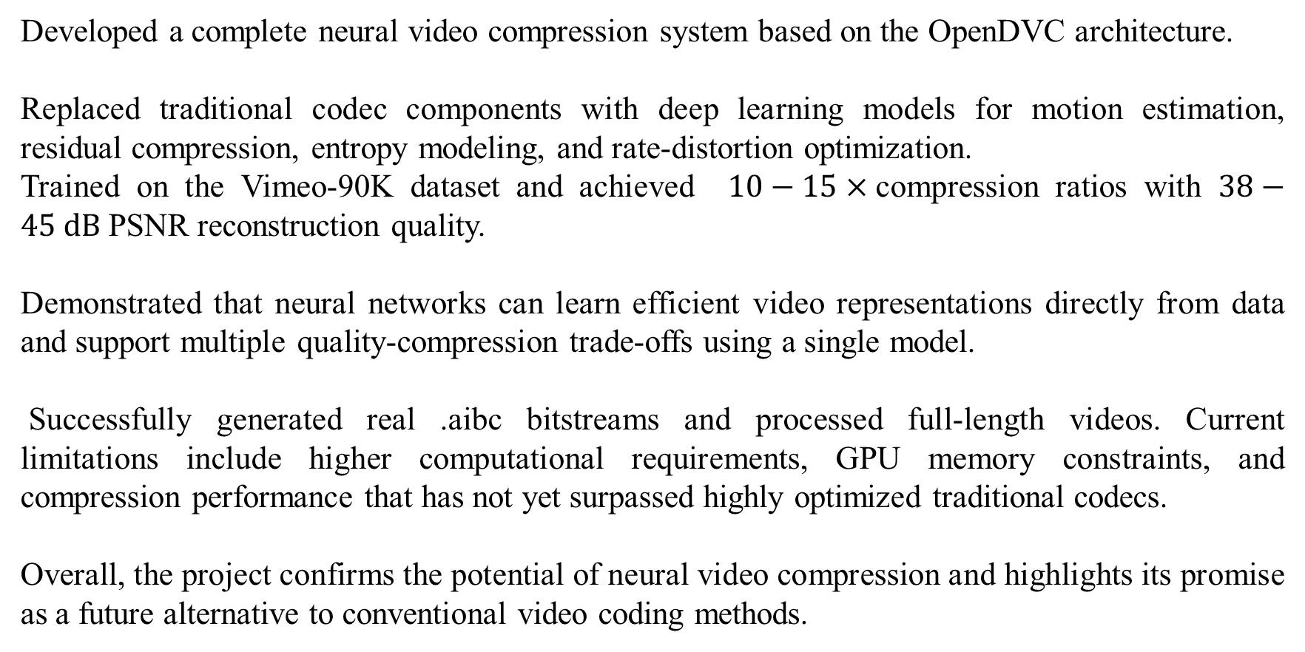
ABVCS
ABVCS
ABVCS
ABVCS
ABVCS
ABVCS
ABVCS
ABVCS
Conclusion
Developed a complete neural video compression system based on the OpenDVC architecture.
Replaced traditional codec components with deep learning models for motion estimation, residual compression, entropy modeling, and rate-distortion optimization.
Trained on the Vimeo-90K dataset and achieved $10−15×$compression ratios with $38−45 dB$PSNR reconstruction quality.
Demonstrated that neural networks can learn efficient video representations directly from data and support multiple quality-compression trade-offs using a single model.
Successfully generated real .aibc bitstreams and processed full-length videos. Current limitations include higher computational requirements, GPU memory constraints, and compression performance that has not yet surpassed highly optimized traditional codecs.
Overall, the project confirms the potential of neural video compression and highlights its promise as a future alternative to conventional video coding methods.
ABVCS
ABVCS
ABVCS
ABVCS
ABVCS
ABVCS
ABVCS
ABVCS

Slide 54
ABVCS
ABVCS
ABVCS
ABVCS
ABVCS
ABVCS
ABVCS
ABVCS
Future Works
Better Compression:
Learned entropy coding – replace zlib with arithmetic coding + learned probability models for true variable bitrate compression.
Multi frame references – use several past frames with learned reference selection.
Real Time & Deployment:
Model optimization – TensorRT / ONNX for 3–5× speedup; lightweight “student” models for edge devices.
Progressive decoding – show a low-quality preview instantly, then refine details in the background.
Hardware friendly design – explore FPGA acceleration and INT8 quantization for low power devices.
Applications & Adaptivity:
Scene adaptive coding – allocate more bits to faces, text, and moving objects; skip encoding in static surveillance scenes.
Surveillance - skip encoding when no motion is detected, saving storage and bandwidth.
ABVCS
ABVCS
ABVCS
ABVCS
ABVCS
ABVCS
ABVCS
ABVCS

Slide 55
Thank You Team ABVCS
ABVCS
ABVCS
ABVCS
ABVCS
ABVCS
ABVCS
ABVCS
ABVCS
Any Questions
ABVCS
ABVCS
ABVCS
ABVCS
ABVCS
ABVCS
ABVCS
ABVCS

Slide 56
Project Introduction
ABVCS
ABVCS
ABVCS
ABVCS
ABVCS
ABVCS
ABVCS
ABVCS
Introduction
This project proposes an AI-based video compression system that leverages deep learning to automatically learn and optimize key compression stages, reducing redundancy while preserving perceptual video quality. By integrating artificial intelligence into the compression pipeline, the system aims to achieve higher compression ratios, lower storage requirements, and improved visual quality compared to conventional codecs, supporting the development of next-generation intelligent video compression technologies.
ABVCS
ABVCS
ABVCS
ABVCS
ABVCS
ABVCS
ABVCS
ABVCS
Notes:
Animations are done here

Slide 57
AI Models
Residual Autoencoder:
The Residual Autoencoder compresses the difference between the real frame and the motion-compensated predicted frame.
Instead of sending full images, it encodes only the information the prediction missed.
Residual Generation:
Computes the difference between the real frame and the motion-compensated predicted frame.
Encoder:
Compresses the residual into a compact latent representation using a CNN.
Decoder:
Reconstructs the residual and adds it back to the prediction to form the final frame.
ABVCS
ABVCS
ABVCS
ABVCS
ABVCS
ABVCS
ABVCS
ABVCS
ABVCS
ABVCS
ABVCS
ABVCS
ABVCS
ABVCS
ABVCS
ABVCS

