Slide 1



Agenda
WELCOME
To our project
team
Data Cleansing
Agenda
Insights
Data Exploration
Data Modeling
DAX
TMBD 5000 Movies Dataset

Slide 2




01
02
03
04
Team
team
team
Marwan Diab
Moaz Abdulfattah
Mostafa EL-araby
Ibrahim Emara

Slide 3
Introduction
Data Exploration
TMBD 5000 Movies Dataset

Slide 4






Data
Null Columns
TMBD 5000 Movies and TMBD 5000 Credits.
Movie id, crew, Home Page, overview, Release date, run time, tag line.
Movies table
ZEROS
(4804 rows, 20 columns) and (id) column is unique.
Revenue (90), Run time (35) many of them are 0 in all columns, Vote avg (63), Vote Count (62).
Data Exploration
Credits table
General
(4814 rows, 5 columns) and (movie id) column is unique.
Revenue (90) – (1449 < 1000$), 2017 only have one movie.
Time Frame
From 1916 : 2017.

Slide 5
Data Cleansing
TMBD 5000 Movies Dataset

Slide 6


1
2
Error !
Drop Columns
Appeared in 3-rows, the problem is overview column, we Split it from the table, and add it with id in a separate column, then merge it with the fact with id.
Home Page (3091 nulls), original title, character, credit id, gender, department .
Data Cleansing

Slide 7
Data Modeling
TMBD 5000 Movies Dataset

Slide 8
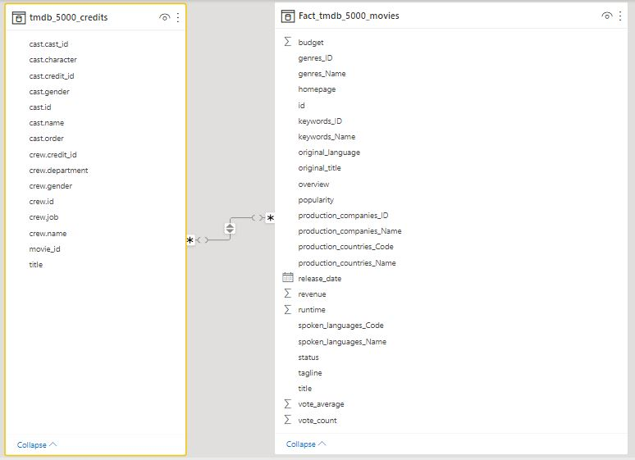
Default Model
Modeling

Slide 9
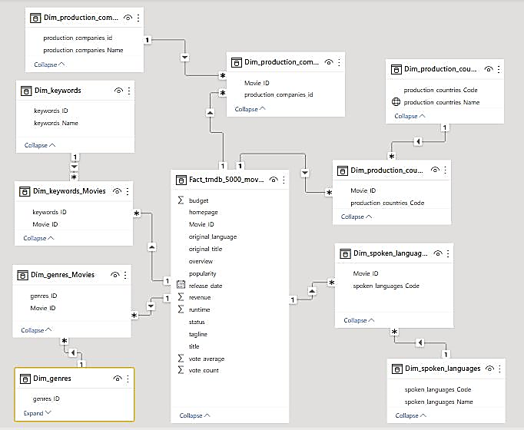
First Try
Modeling

Slide 10
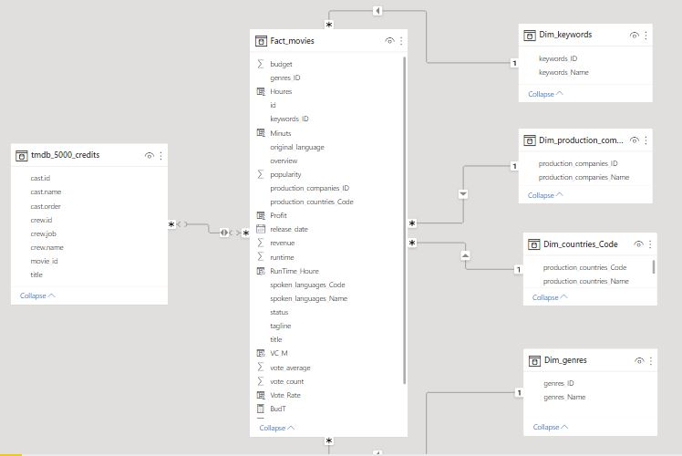
Second Try
Modeling

Slide 11
DAX
TMBD 5000 Movies Dataset

Slide 12
New Columns
1- Profit:
2- run time per hours:
Data Manipulation

Slide 13

Vote Rate
We can use the average ratings of the movie as the score but using this won't be fair enough.
So, we'll be using IMDB's weighted rating (WR) which is given as:
Vote Rate
Data Manipulation
v is the number of votes for the movie.
m is the minimum votes required to be listed in the chart.
R is the average rating of the movie.
C is the mean vote across the whole report.

Slide 14
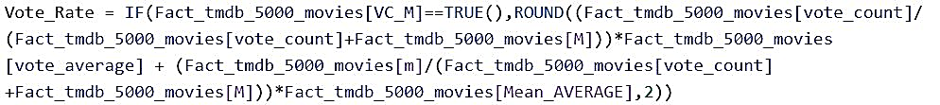
Vote Rate Measures
Data Manipulation

Slide 15
Measures
1- Budget: to calculate only distinct values.
2- Revenue: to calculate only distinct values.
Data Manipulation

Slide 16
Insights
TMBD 5000 Movies Dataset

Slide 17
Average Run time decreasing over the years.
Warner Bros has the highest number of movies.
The most country producing movies is USA.
Woman Director is the most common keyword in the movies.
Data Exploration
Drama is The most genres has movies.
2009 has the highest number of movies (247).

Slide 18
Carlos movie has the highest Running time.
Pirates of the Caribbean has the highest budget.
Samuel L. Jackson is most actor appeared in movies.
Avatar is the highest revenue and Profit movie.
Data Exploration
Steven Spielberg is the highest director has movies.
Minions is the most popular
Movie.

