Slide 1
Deep Scoring: A New Method for Information Fusion
Navdeep Bajwa, Mohammad Azim, and Aqib Abass
Fordham University
Department of Computer and Information Science

Slide 2
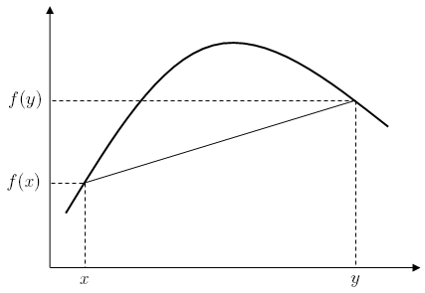
INTRODUCTION
This project aims to create a new and powerful method to ensemble not only model or features but scoring systems in general
The ‘Deep’ in deep scoring is the ability to improve at each layer. Just as many of the other graph based algorithms have the ability to represent the data better at each layer.
Deep Scoring moves toward the fourth paradigm by fusing information systems
Utilizes Combinatorial Fusion, Notions of Diversity, Combining Groups of Scores and Ranks
Mixed group combination create convex functions that attain better results than linear combinations
Many weighted layers that, when combined, outperform even the best metrics
Via: https://upload.wikimedia.org/wikipedia/commons/7/73/ConcaveDef.png

Slide 3
METHODS
Participants and Task
Data was collected by Dr. Schweikert working alongside Dr. Shimojo of the California Institute of Technology.
The data included 720 trials from 720 different individuals performing a cognitive task. The task involved measuring subject’s eye movements during the presentation of two faces
These measures were: Duration (of gaze) in the last 200ms of trial (A), total duration (B), gaze count (C), interest sustainability (D), and region change (E). Each measure is referred to as its letter for the remainder of the study.
The subjects preference (left or right face) were also recorded and stores in an excel file. This file was used as a test set
Data Preprocessing and the Model
Dataset was received with each scoring system (A-E) normalized from 0 to 1 using max-min normalization
Model was evaluated with Precision
Not a classification task, it’s generalized to combining scoring systems

Slide 4
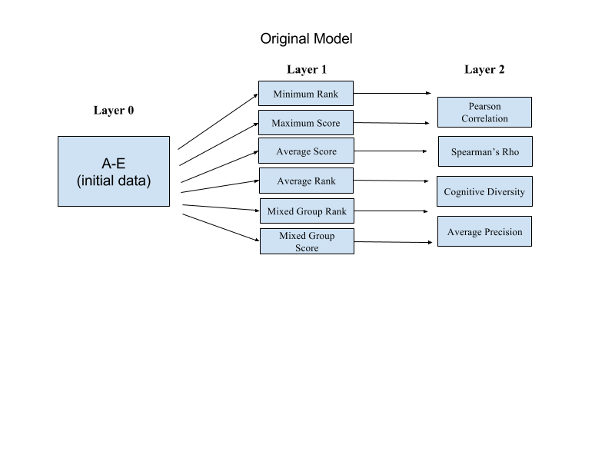
First Model
L1 Combination Layer
L2 Diversity Layer
Each layer is its self a scoring system with rank and score functions
Aim to improve accuracy at each layer then iterate back and forth until convergence

Slide 5
METHODS
L1 Explained
Mixed Group Scores/Ranks
The first novel metric extracted from the dataset was mixed group rank. It goes through every row and takes a takes a weighted combination from the combinatorial space to create one score. It should lead to a convex function that outperforms most linear combination scoring system.
MinRank/MaxScore, AvgRank/AvgScore
These are just conventional linear combinations but it uses both ranks and scores, which surprisingly varies a lot. Min rank takes minimum ranks for each row, MaxS dos the inverse for Score. AverageR/S are averaging each instance of both models.

Slide 6
METHODS
L2 Explained
Correlation and Rho
We aimed to incorporate some form of diversity measurement, i.e inverse of correlation and Rho (rank correlation) to see if it we’ll perform better with that weight
Cognitive Diversity and performance
Cognitive Diversity is another ways to measure diversity that is data independent. Performance was just thrown in to check a conventional approach. As long as it can guide a strategic way to improve.

Slide 7
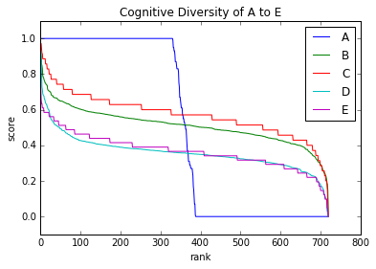
METHODS
Hsu Cognitive Diversity
A measure of how different metrics think.
What distinguishes deep scoring from deep learning
The technique plots ranks verse scores for each scoring system, and utilizes the distance between two functions as the cognitive diversity of the system. It is illustrated below:
For this study, cognitive diversity for the array of six functions was written as follows:
def cogdiversity(array1, array2): # ordered normalized array
size = len(array1)
sqr_dif = 0
for i in range(0, size):
sqr_dif += (array1[i]-array2[i])**2
cog_div = ((sqr_dif)**(1/2))/size
return cog_div
This measure was normalized by dividing each average by the sum of all average diversities.

Slide 8
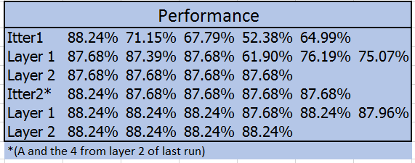
Performance

Slide 9
Model Improvement
Combinatorial Fusion Layer (Second model)
Average Combinatorial Fusion
Given the first layer’s failure to surpass the best performing single model, combinatorial fusion was applied.
What is it?
An average combination for all in the combinatorial space ie. [A, B, C,…,[AB],[AC]…[ABCDE]]
Precision was calculated at different precisions levels #of positive cases, 300, 200, and 100.
31 possible scoring systems each was evaluated at every precision level.
The systems were numbered and specific outperforming models are notated beneath figures 4 and 5.

Slide 10
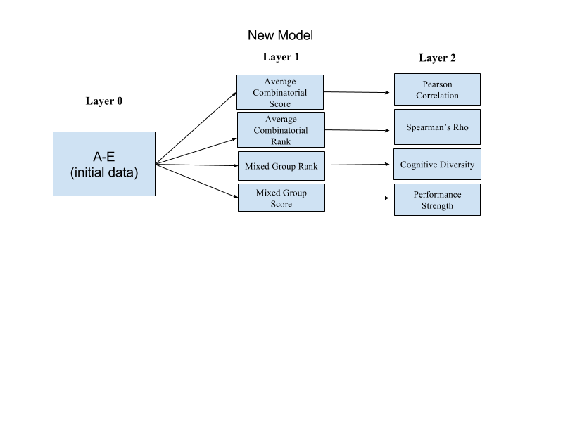
METHODS
After fusion, two scoring systems (AD, and ADE) were determined to outperform the best system (A) at precisions 300 and higher.
Initial model was thus recalculated at precision 300 to determine which scoring systems could outperform A
New model was formulated, but has yet to be run.

Slide 11
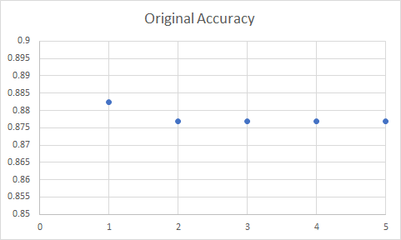
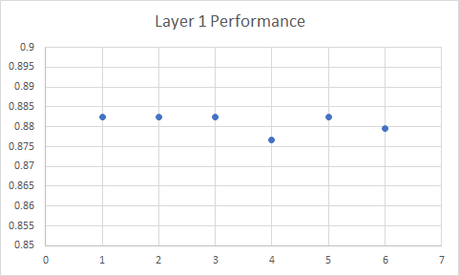
RESULTS (P@357)
Fig. 1 - Original Accuracies of Dataset (1-5 correlate to A-E). A performed highest at .88 accuracy. This was the bar for combinations to beat.
Fig. 2 - Performance of each scoring system within layer 1. 1-6 correlate to min. Rank, max score, average score, average rank (lower), mixed group rank, and mixed group score (lower), respectively. Minimum rank, max score, average score, and mixed group rank converged on A’s performance (.8852)

Slide 12
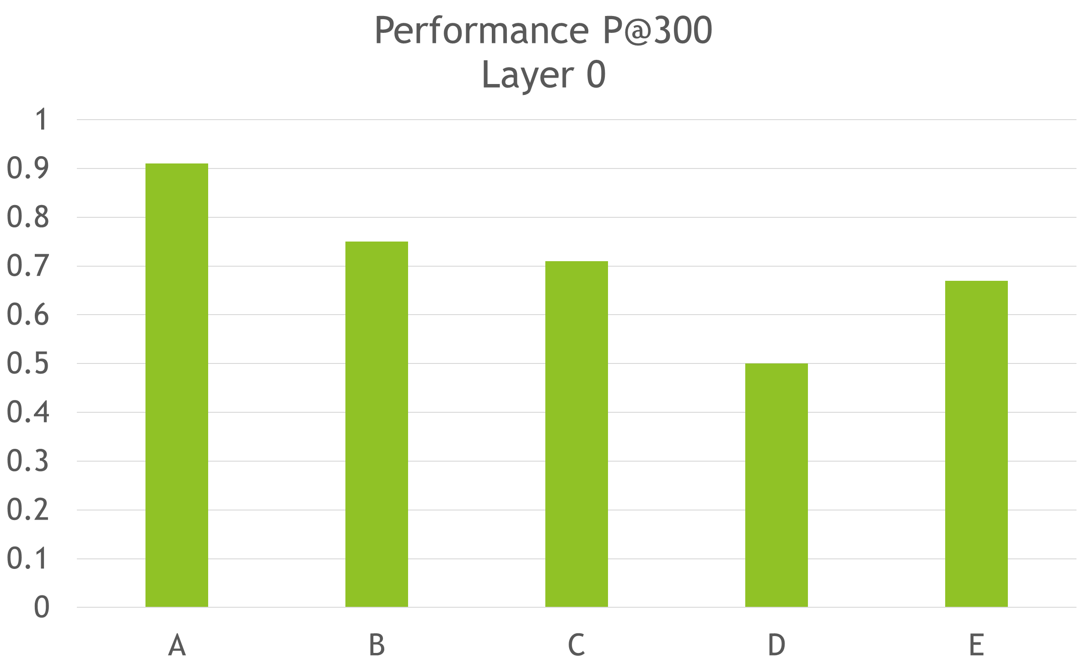
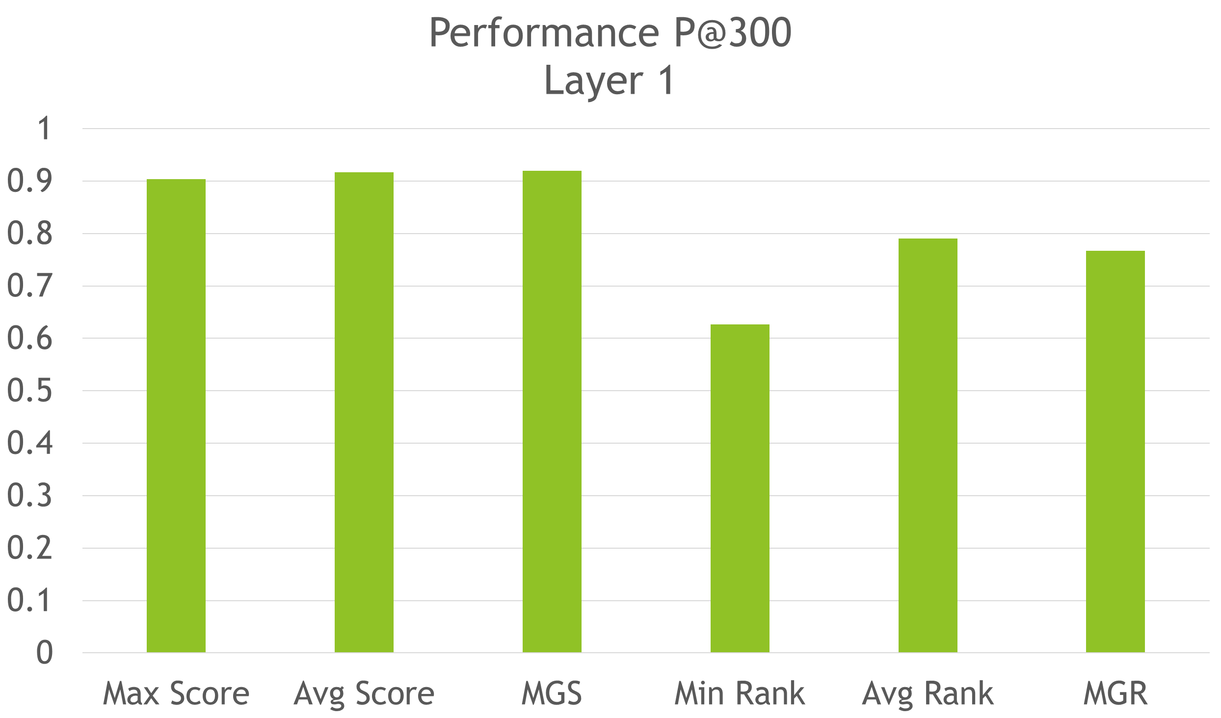
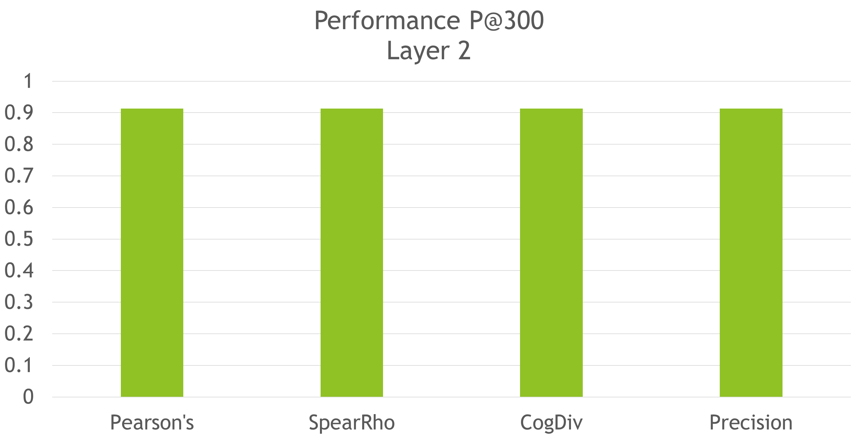
RESULTS (P@300)
MGS, and AvgScore outperformed A with performance of .92

Slide 13
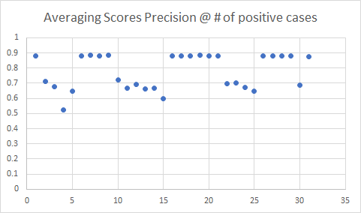
RESULTS (fusion)
Fig. 3 - Average precision for total positive cases of each combination (357). Combinations of AC, AE, and ACD converged on performance of A alone (performance = .8852). Labeled here as 7, 9, and 19 respectively.

Slide 14
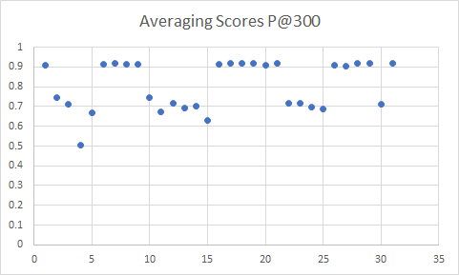
RESULTS (fusion)
Fig. 4- Average Scores at Precision 300. Combination of AB, AC, AD, AE, ABC, ABD, ABE, ACD, ADE, ABDE, ACDE, and ABCDE all significantly outperformed A. Labeled here as 6,7,8,9,16,17,18,19,21,28,29, and 31 respectively. AD and ADE highest with .92 precision.

Slide 15
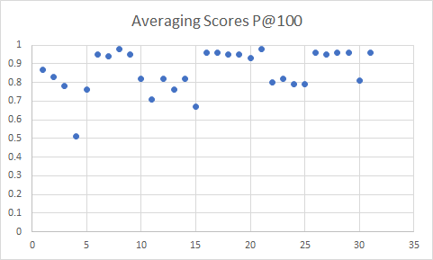
RESULTS (fusion)
Figure 5- Average Scores at Precision 100. Combination of AB, AC, AD, AE, ABC, ABD, ABE, ACD, ACE, ADE, ABCD, ABCE, ABDE, ACDE, and ABCDE all outperformed A with AD and ADE having highest performance (precision@100 = .98). Values indexed here as 6,7,8,9,16,17,18,19,20,21,26,27,28,29, and 31 respectively.

Slide 16
Future Improvements
The initial deep scoring model only succeeded in matching the performance of A (the top metric). Combinatorial fusion of layer 0 models alone, however, provided several scoring systems that outperformed A.
Moving forward, deep scoring models should first apply combinatorial fusion analysis, then run many diverse systems of weights in order to extract the best features.
The success of the Average Combinatorial Fusion inspired the though or doing the same for Mix Group Rank and Score

Slide 17
Idea
Input L0
A
.
.
.
E
Itter 2
Input L0
Average Combinatorial Fusion Score/Rank
Models
A…N (auto select based on performance)
Min/Max Combinatorial Fusion Score/Rank
Models
A…N (auto select based on performance)

Slide 18
DISCUSSION
Of highly diverse systems, where at least one performs well, seemed to outperform the best model most consistently.
Combinations of highly diverse systems, where at least one performs well, seemed to outperform the best model most consistently.
Performances increased significantly when stricter rules (in terms of precision) were applied to the model.
Future studies will use deep scoring on new datasets at various measurement

Slide 19
REFERENCES
C. Schweikert, S. Shimojo and D. F. Hsu, "Detecting preferences based on eye
movement using combinatorial fusion," 2016 IEEE 15th International Conference on Cognitive Informatics & Cognitive Computing (ICCI*CC), Palo Alto, CA, USA, 2016, pp. 336-343. doi: 10.1109/ICCI-CC.2016.7862057
Chen, L. F., Liao, H. Y. M., Ko, M. T., Lin, J. C., & Yu, G. J. (2000). A new LDA-based
face recognition system which can solve the small sample size problem. Pattern
recognition, 33(10), 1713-1726.
Hsu, D. F., Chung, Y. S., & Kristal, B. S. (2006). Combinatorial fusion analysis: methods and practices of
combining multiple scoring systems. In Advanced Data Mining Technologies in Bioinformatics (pp.
32-62). IGI Global.
Hsu, D. F., Kristal, B. S., & Schweikert, C. (2010, August). Rank-score characteristics
(RSC) function and cognitive diversity. In International Conference on Brain Informatics (pp. 42-54). Springer Berlin Heidelberg.
Hsu, D.F, & Taksa, I. (2005). Comparing rank and score combination methods for data fusion in information
retrieval. Information retrieval, 8(3), 449-480.
Liu, H., Wu, Z., & Hsu, D. F. (2012, March). Combination of multiple retrieval systems
using rank-score function and cognitive diversity. In Advanced Information
Networking and Applications (AINA), 2012 IEEE 26th International Conference on IEEE.
(pp. 167-174).
Full code available at: https://github.com/moazim1993/Deep-Scoring-Project

