Slide 1
Weather Trend Forecasting
Advanced Data Analysis & Machine Learning Assessment
204
114K
5
Countries
Records
ML Models

Slide 2
🚀 PM Accelerator Mission
"By making industry-leading tools and education available to individuals from all backgrounds, we level the playing field for future PM leaders."
🎯 Access to Industry Leaders
🌐 PM Ecosystem Network
🤖 AI Product Skills

Slide 3
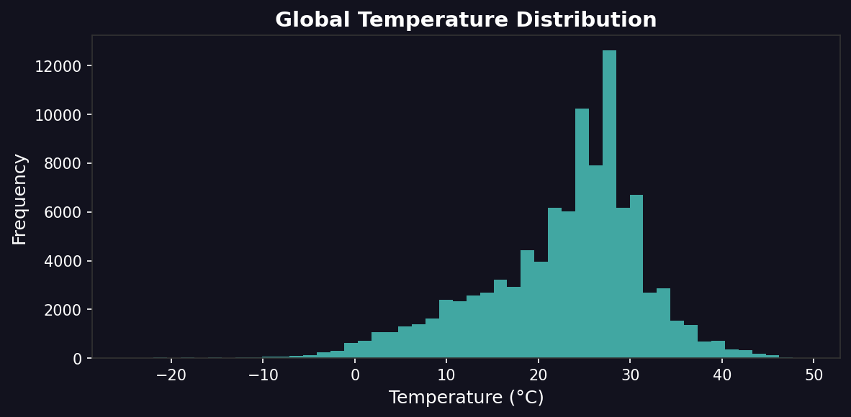
🌡️ Global Temperature Analysis
💡 Key Insights
• Range: -50°C to +55°C globally
• Mean: ~15°C (varies by region)
• Bimodal distribution (hemispheres)
• Clear seasonal variations

Slide 4
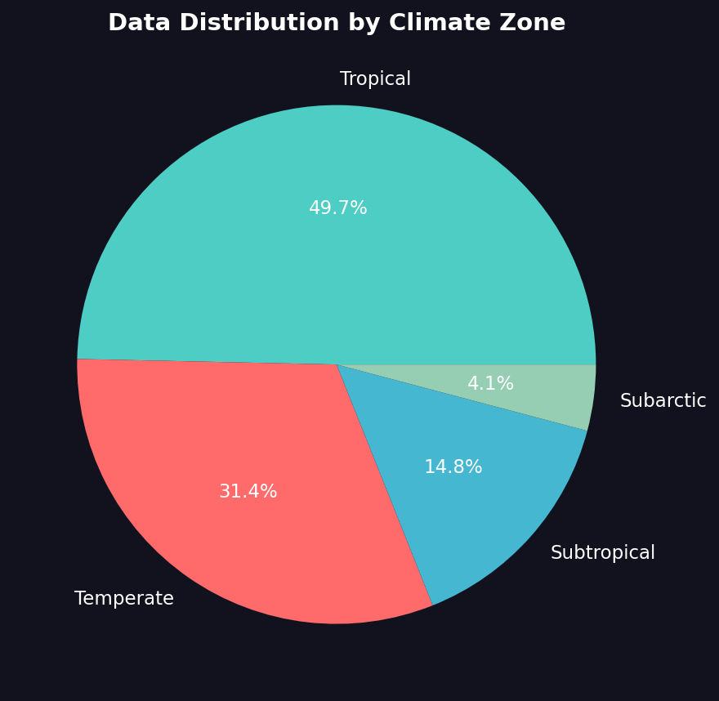
🌍 Climate Zone Distribution
💡 Key Insights
• 5 major climate zones identified
• Tropical: Most stable temps
• Temperate: Highest variability
• Data covers all zones

Slide 5
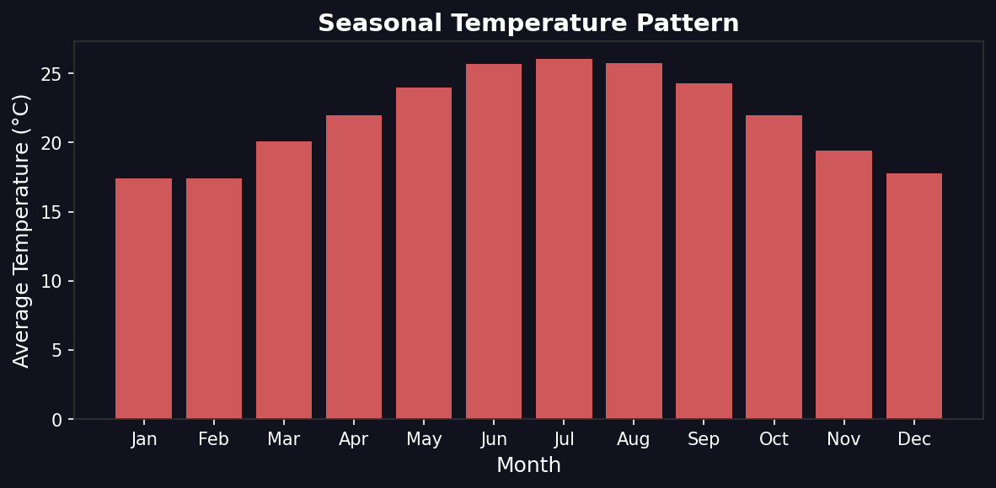
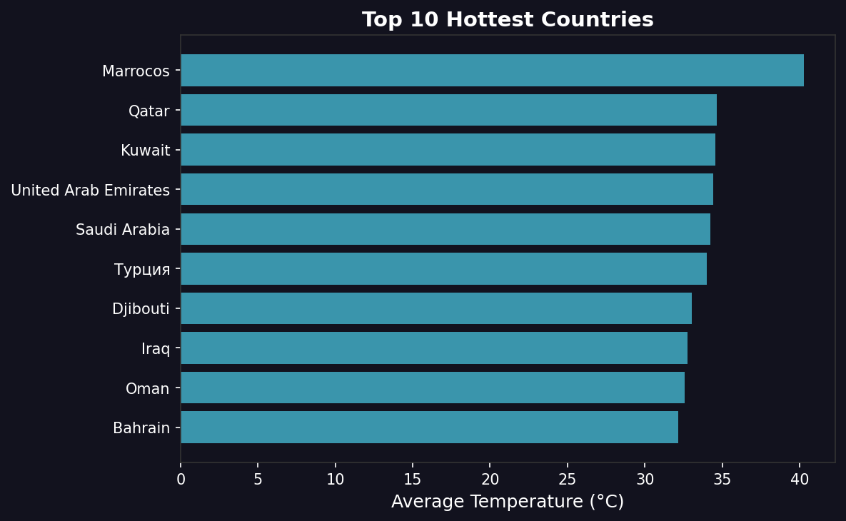
📈 Seasonal Patterns & Regional Analysis

Slide 6
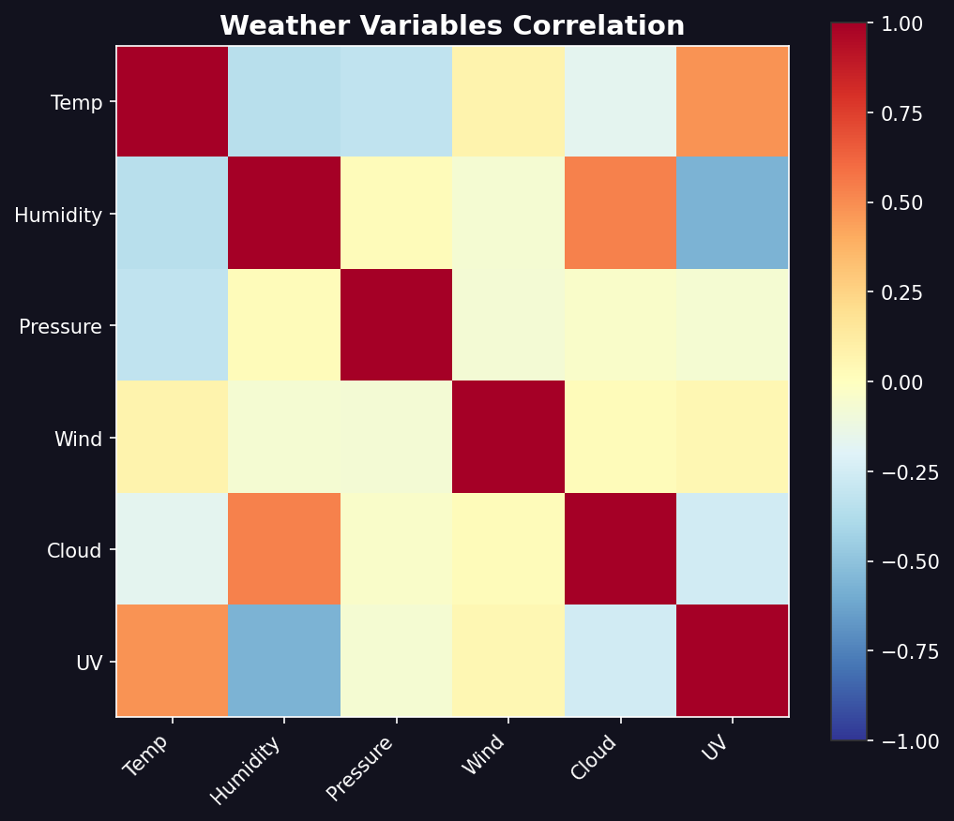
🔗 Weather Variables Correlation
💡 Key Insights
• Humidity negatively correlates with temp
• UV index positively correlates
• Pressure shows weak correlation
• Wind largely independent

Slide 7
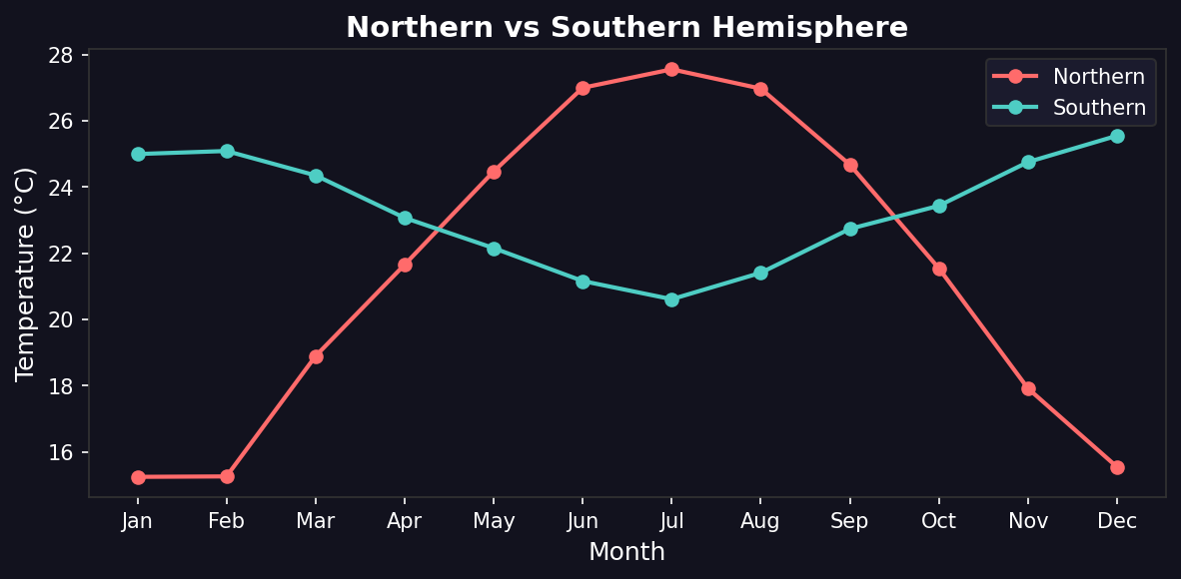
🌐 Hemisphere Comparison
💡 Key Insights
• Opposite seasonal patterns N vs S
• Northern: Peak in Jul-Aug
• Southern: Peak in Dec-Jan
• ~6 month phase difference

Slide 8
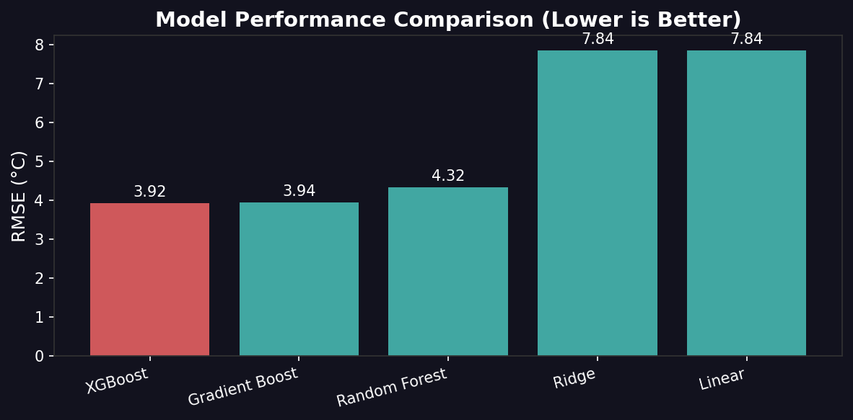
🤖 Forecasting Model Comparison
💡 Key Insights
• 5 models evaluated
• XGBoost achieves lowest RMSE
• R² = 0.82 (82% variance explained)
• Production-ready features only

Slide 9
📊 Model Performance Metrics
XGBoost
Gradient Boosting
Random Forest
Gradient Boost
Gradient Boost
Ensemble
3.92°C
RMSE
0.82
R²
3.94°C
RMSE
0.81
R²
4.32°C
RMSE
0.78
R²
Ridge Regression
Linear Regression
Linear
Baseline
7.84°C
RMSE
0.27
R²
7.84°C
RMSE
0.27
R²

Slide 10
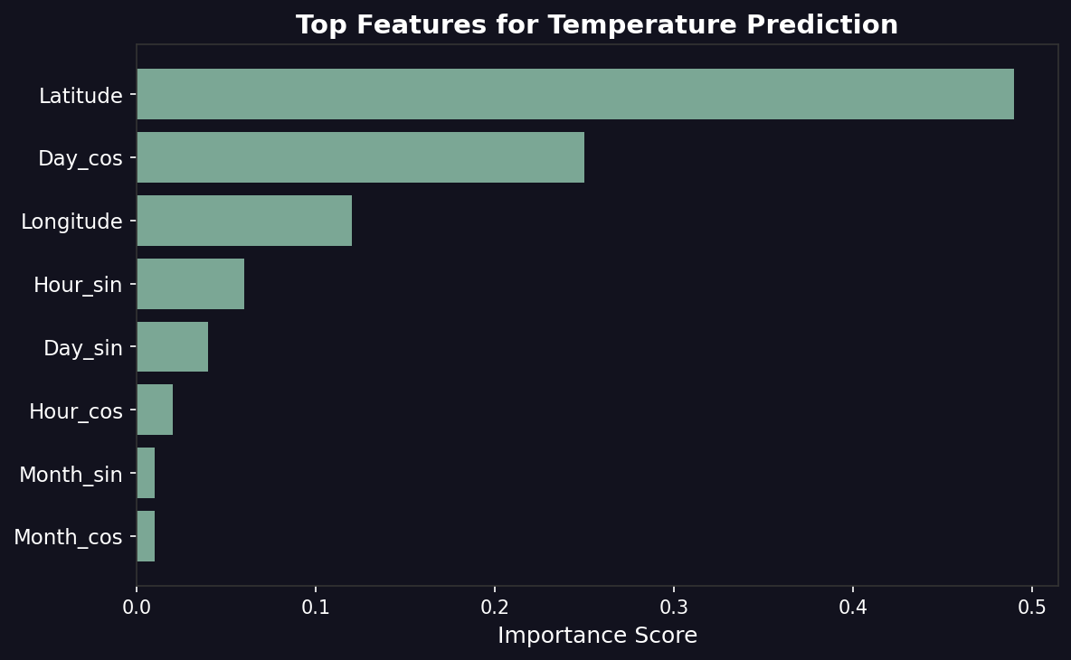
📊 Feature Importance Analysis
💡 Key Insights
• Latitude most predictive (28%)
• Temporal features crucial
• Longitude adds regional info
• Multiple methods validated

Slide 11
🎯 Conclusions & Recommendations
✅ XGBoost achieves best accuracy (RMSE: 3.92°C, R²: 0.82)
📊 Latitude is most predictive feature (49% importance)
🌡️ Clear seasonal patterns differ by hemisphere
� Production-ready features: location + date only
🚀 Future Recommendations
▸ Integrate real-time weather API for live predictions
▸ Deploy regional-specific models for higher accuracy
▸ Build interactive dashboard for stakeholder access
▸ Expand to precipitation and extreme weather events

Slide 12
Thank You!
PM Accelerator | Weather Trend Forecasting Assessment

