Slide 1






Bugs pay for days of steady reservoir releases to reduce costs to hydropower customers and sustain funds to maintain infrastructure
David E. Rosenberg
Moazzam Rind
david.rosenberg@usu.edu
rosenberg.usu.edu
Aden Arnold Rosenberg
Jan. 3, 2023
Notes:
Clayton Palmer
Craig Ellsworth
Ted Kennedy

Slide 2
Key Ideas
Bug flows lower revenue => Time & Stress
2. Move days of steady flows to Spring/Fall months.
3. Create ecosystem fund to pay for releases that help bugs.
Negative Feedback
Revenue
Pay down debt
Raise energy
costs
Bug flows
Notes:
Moazzam and I set out to quantify how increasing the number of days of steady releases from Glen Canyon Dam that allow aquatic invertebrates to lay and hatch eggs from 0 to 30 days per month reduced hydropower revenues.
3 key ideas emerged from our work.
I will first share the key ideas. Then show some of our work that supports each idea. I will finish with next steps.

Slide 3
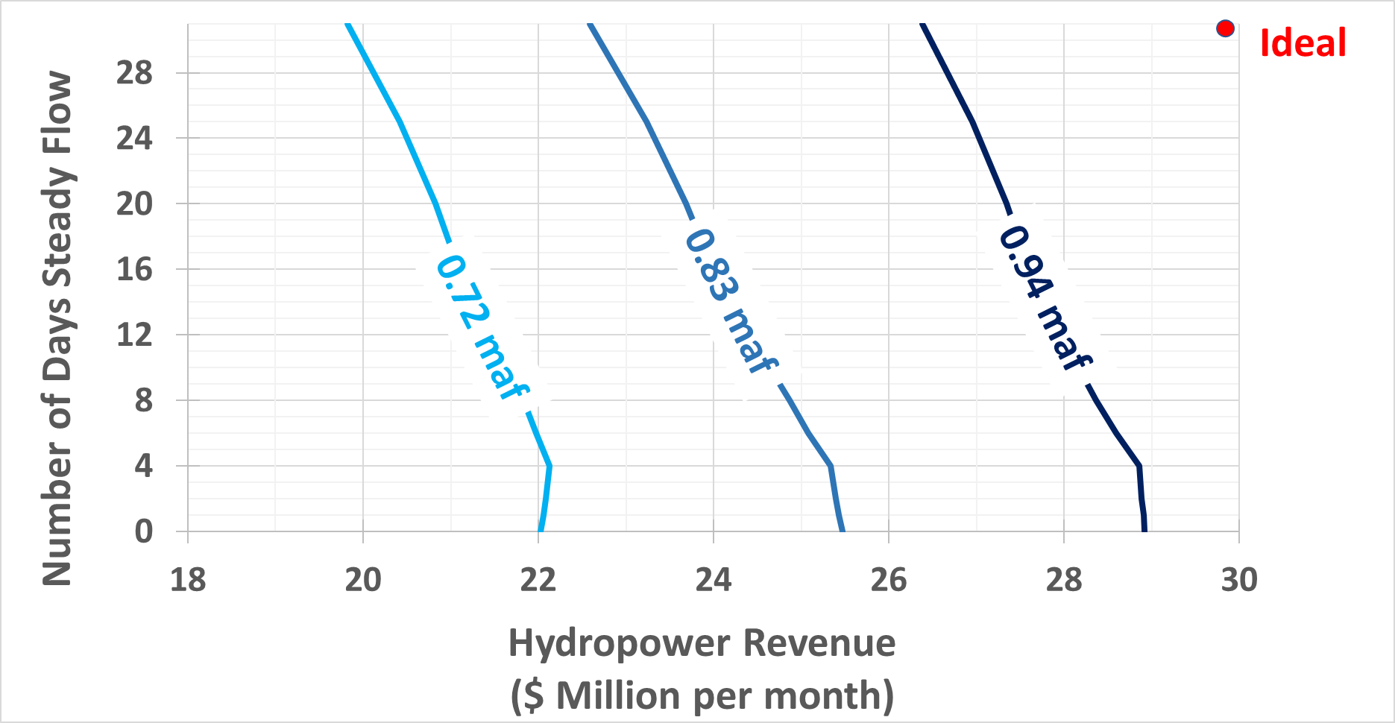
Idea 1. Quantify Hydropower – Bug conflict (August)
Loss
MAX Revenue
for Steady Days, Month, Monthly release volume
2 flow patterns, 3 day-types, 2 periods per day-type.
12 choices per month. Compare to 720 hourly choices.

Slide 4
Idea 2. Shift Days of Steady Releases to Spring/Fall Months Revenue loss ($ million)

Slide 5
Idea 3. Create Eco Budget, Let Ecologists pick Months & No. of Days Revenue loss ($ million)

Slide 6
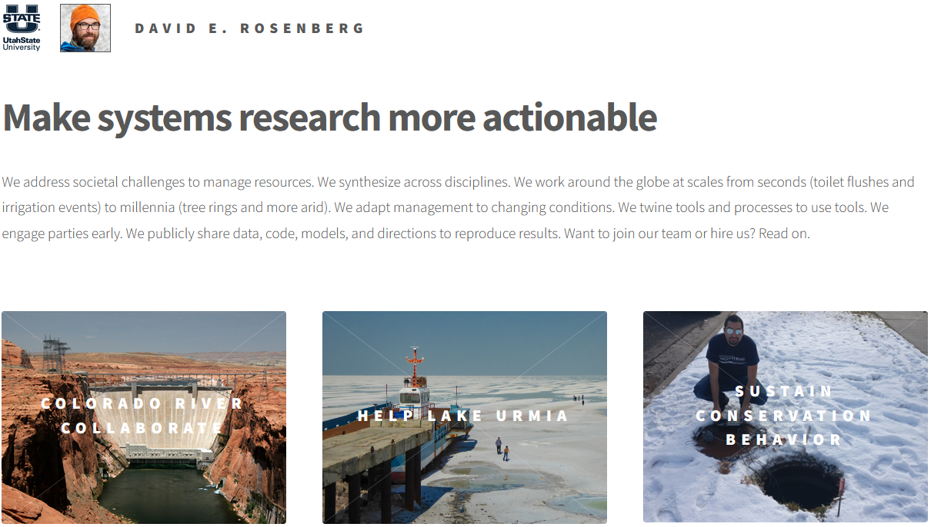

Next Steps
More at http://rosenberg.usu.edu
Present to TWG
Update energy prices
Validate with GT-Max
May also help move sediment and control invasive fish
Reduce stress, increase collaboration
david.rosenberg@usu.edu

Slide 7
Revenue
Eco fund
Pay down debt
Low-cost energy
Bug flows

Slide 8
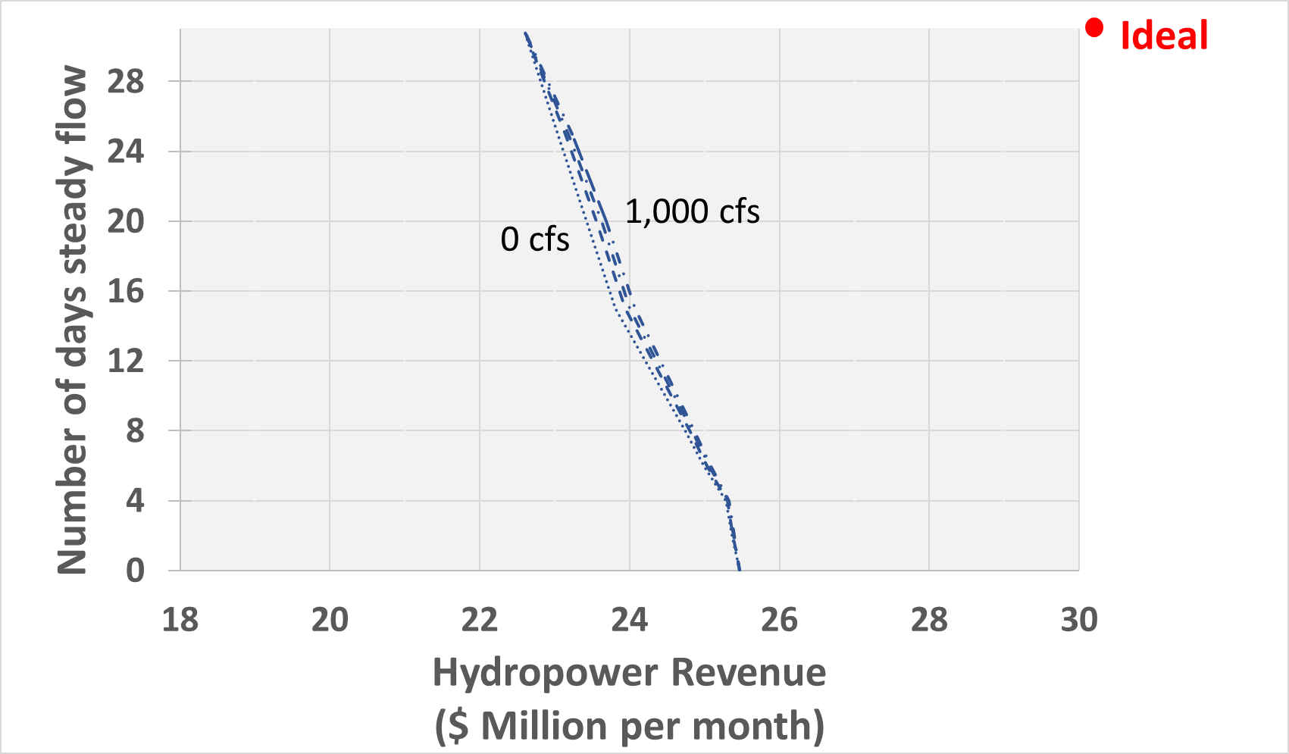
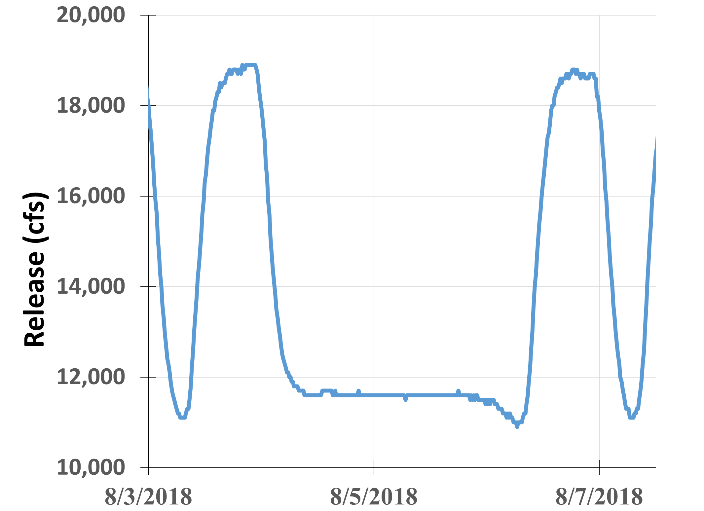
Flow offset => point of collaboration
0.83 maf per month

