Slide 1


Hydrologic modeling for Yakima River Watershed using HEC-HMS
By:
Moazzam Ali Rind
CE-550 Hydrclimatology
Semester Project

Slide 2
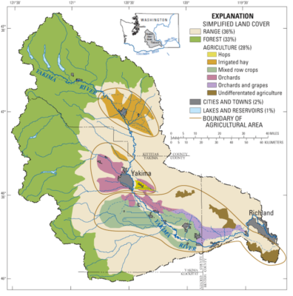
Stream flow input is necessary for Water Resource Management
Gauge measurements are time and space limited.
Yakima River Basin is a huge watershed located in Central Washington, USA.
Key agricultural basin of Washington
Approx.1000 sq. miles fertile land.
Roughly 300,000 people are linked to Yakima River Basin
75% of nation’s hop annual production
Also famous for apples, cherries, pears, wine, grapes, hay, beef cattle and dairy production.
Importance
https://transect-of-the-americas.wsu.edu/yakima/

Slide 3
Number of hydraulic structures (reservoirs, canals, water supply, etc.) are located in the basin
For optimal operations, estimation of stream flows is keen.
Changes in Weather by Climate change and variation in land-use practices had made the system water yield susceptible.
Therefore, its necessary to develop a rainfall-runoff model which can accept all those changes and predicts the outflow of the system (Objective)
Objectives

Slide 4
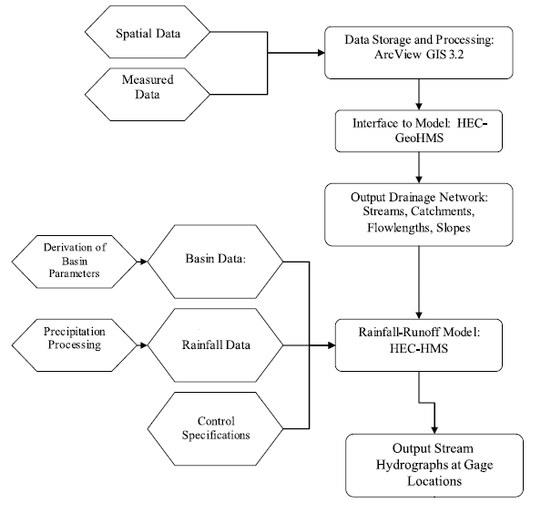
ArcGIS
Methods
Ntoanidis, Lazaros. (2015). INTERCOMPARISON OF THE LUMPED VERSUS SEMI-DISTRIBUTED HEC - HMS HYDROLOGICAL MODEL IN THE KALAMAS RIVER BASIN. 10.13140/RG.2.1.3428.7526

Slide 5
Data Inputs
Digital Elevation Model (SRTM 30 m)
Soil data (USDA- NRCS)
Land-use (NLCD 2019)
Precipitation (gridded daily data from PRISM)
Temperature (gridded daily data from PRISM)
Methods used:
Loss: SCS-Curve number
Transform: SCS-Unit hydrograph
Baseflow: Constant monthly (calibration parameter)
Routing: Muskingum
Process ignored:
Evaporation and transmission losses.
Simulation:
Daily time-step computation for a water year
WY 2017 as used for Calibration and WY 2018 for Validation (pending)
Method

Slide 6
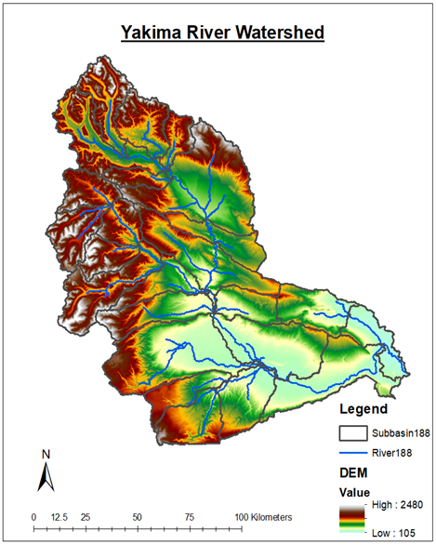
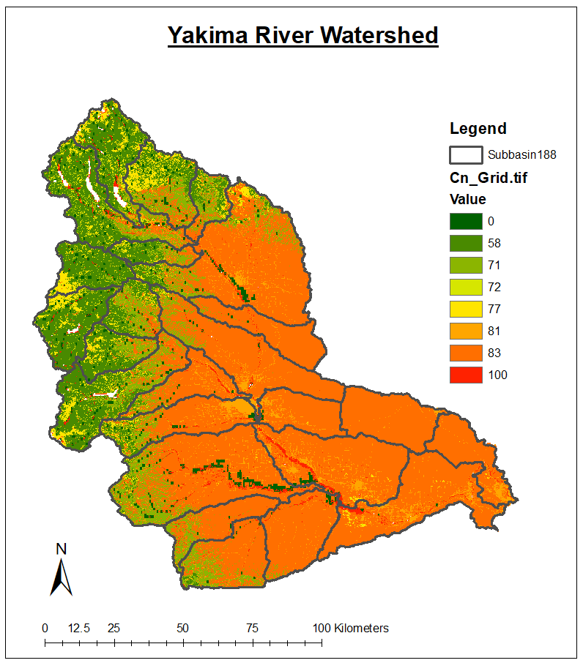
Results
Notes:
58 = Thin Forest
77 = Forest
100 = Water
81 =urban area.
83 = Range land and grain crops
0 = no runoff

Slide 7
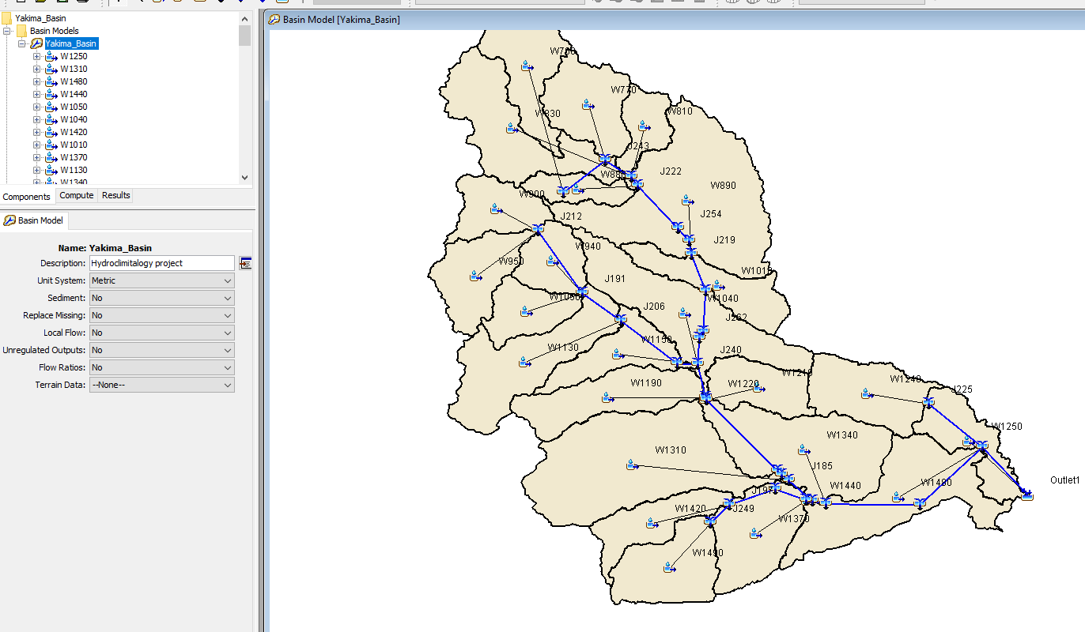
Results

Slide 8
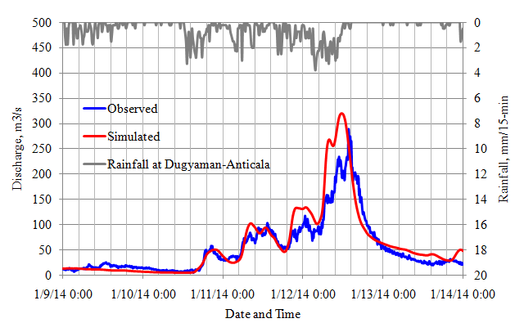
Expected Results
Results
Just for illustration

Slide 9
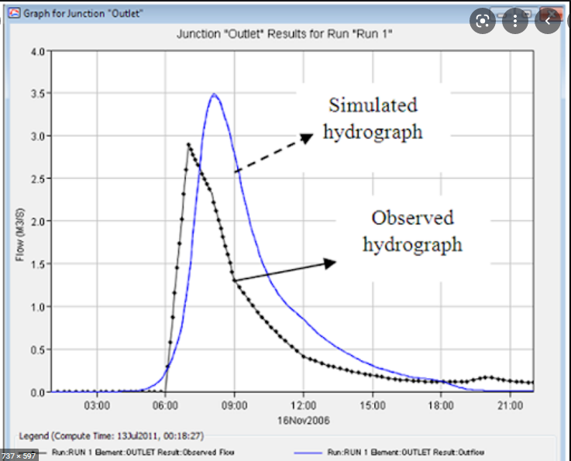
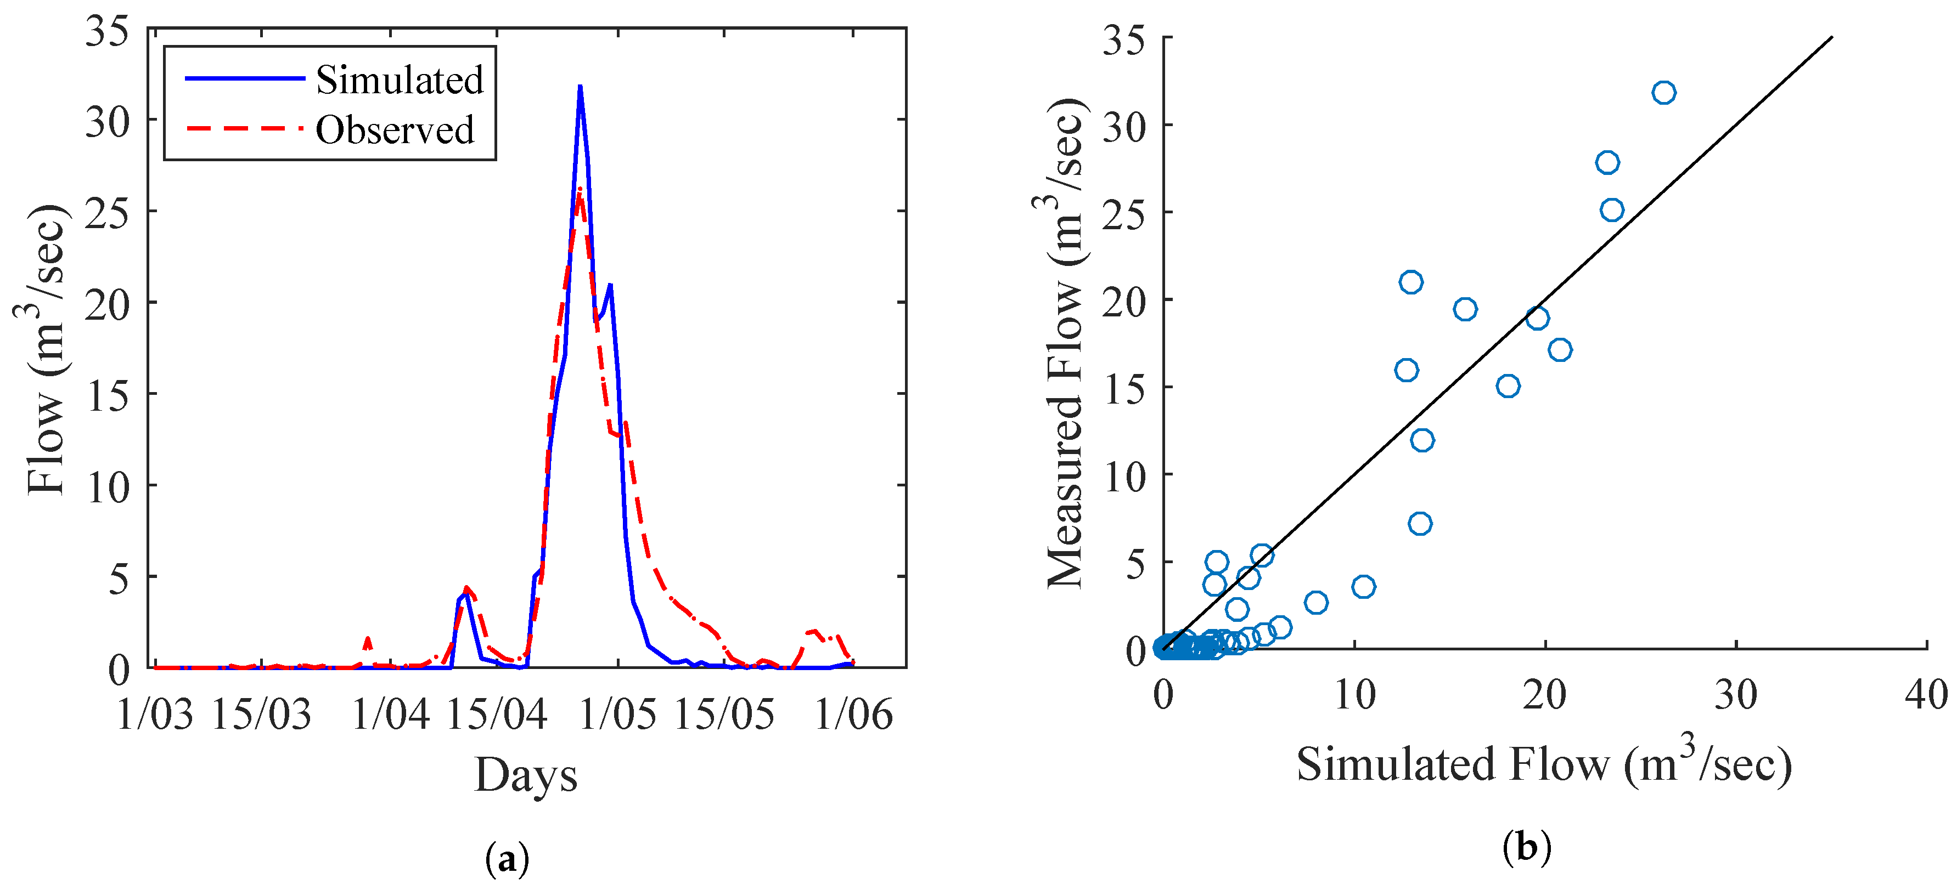
Expected Results
Note:
At the moment results for my study are in the air.
The base model has been developed but it requires some tuning to crunch the numbers.
Number generated at the moment doesn’t make sense.
Under development
Results
Just for illustration

Slide 10
Can be used to predict changes in stream flows due to climate change.
Planning and operations of hydraulic structures
Impact of snow melt season change on water resources
Guide for new water allocation policies.
Impacts of land-use changes on water resources.
Planning of location and capacity of new hydraulic structures.
Revision of current water policies in the area.
Applications

Slide 11
Calibration and validation of the model is pending.
There are two many diversions in the watershed and its difficult to select a single location for calibration and validation
Snow melt analysis
Base flow induction
Parameters used in some of the methods need calibration at sub-watershed level.
This model can be expanded to include future precipitation and temperature prediction and estimate the runoff under different scenarios.
Currently stuck with application of gridded temperature and precipitation data.
Future Work

Slide 12
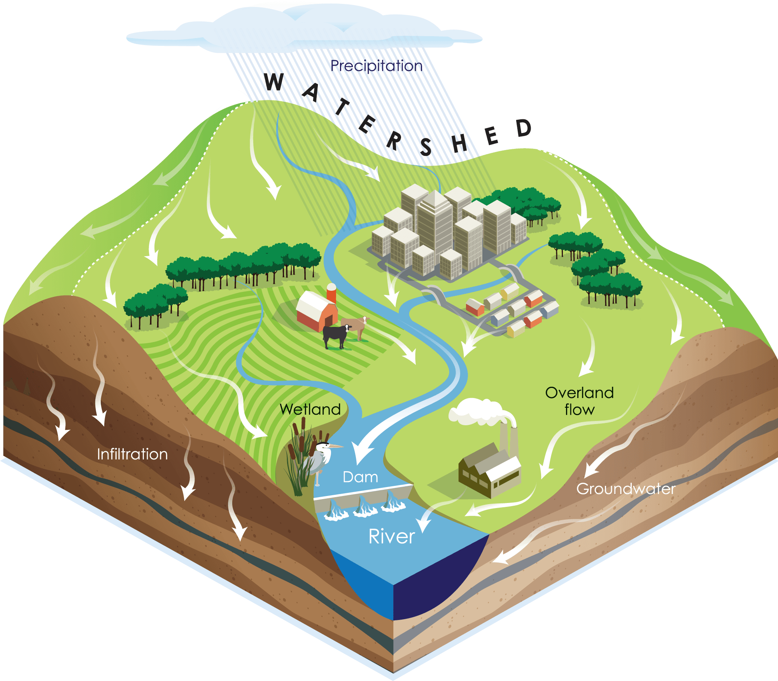
Happy to answer your questions??

