Slide 1
A brief history of Internet surveillance policy: and what may happen next…
Caspar Bowden
(Director www.fipr.org 1998-2002)
[these are author’s personal views]
CCC Finowurt
13th August 2011

Slide 2
(selective) chronology of privacy regulation
1765: UK Entick vs. Carrington (no “general warrants”)
1791: US 4th Amendment (ditto + need probable cause)
1948: UNDHR (“no arbitrary…interference” + right to protection)
1950: ECHR Art.8 (ditto)
1970: 1st DP law in Hesse (Germany)
1973: 1st national DP law in Sweden
1974: US Privacy Act (only public sector)
1978: French DP law
1980: OECD guidelines
1981: Council of Europe Convention 108
1983: German census decision (“information self-determination”)
1984: UK DP law
1995: EU Data Protection Directive
2011-: consultations on new EU DP framework
2012-: new US Federal law (DoC green paper, FTC consultation)?

Slide 3
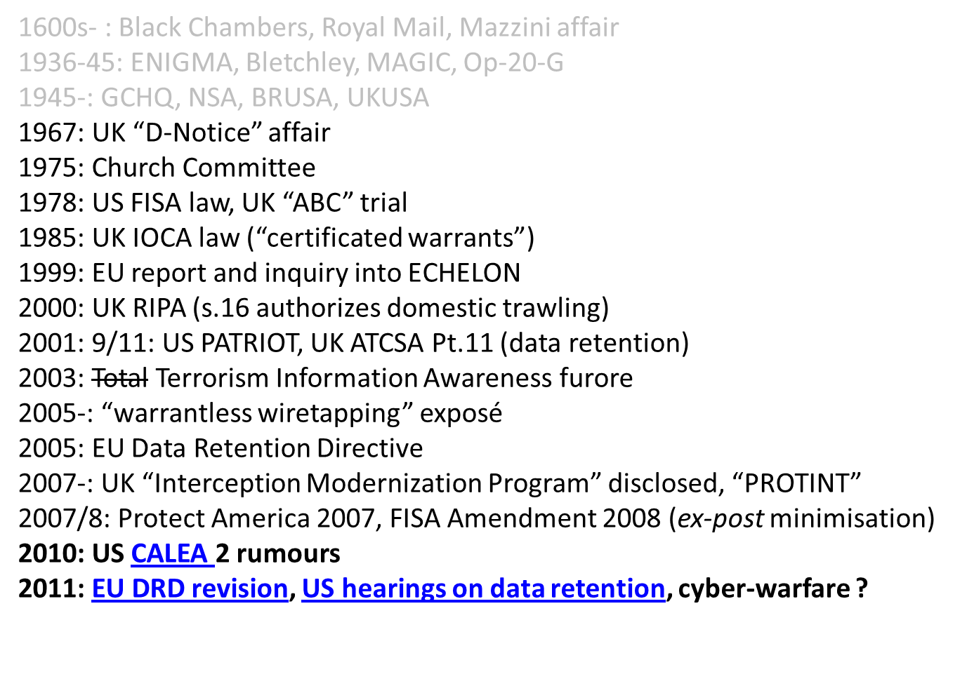
(selective) chronology of covert mass-surveillance

Slide 4
Why worry ?
….and why is this interesting ?
formulation of constitutional and human rights predated Internet mass-surveillance
sharp techno-legal dilemmas/dichotomies
  encryption key escrow vs. reverse burden-proof
  surveillance by design vs. privacy by design
  traffic data retention vs. data preservation
sudden new phenomena
  social networks, location/mobile platforms,
  CLOUD COMPUTING
normal democratic checks-and-balances don’t work for covert surveillance policymaking
  knowledge is power – rule-of-law may be bypassed
  expedient reliance on private organisations

Slide 5
UK law on Internet surveillance
Interception of Communications Act 1985 (IOCA)
  forced by Malone vs. UK 1985 ECtHR
Regulation of Investigatory Powers Act (RIPA) 2000
  Pt.1.Ch1 – interception of content (“tapping”)
  Pt.1.Ch2. – access to comms data ( = traffic + subscriber + location)
  Pt.3 – decryption powers (dormant until 2007)
  Pt.4 – “oversight” and complaints
9/11 !
Anti-Terrorism Crime and Security Act 2001
  Pt.11 – 1st primary legislation on Data Retention in world?
Wireless Telegraphy Act (lots of revisions since WW1!)
  authorizes larges scale GSM SIGINT within UK from aircraft?
  ECHR compliant ?

Slide 6
RIPA 2000 Pt.1 – Interception warrants
S.5 - “domestic warrant” – targeted at individual
  one warrant – many copies for ISPs/telcos - maintain “black-boxes” tapping whole stream
  purposes: serious crime, “safeguarding economic and nat.sec”
  authorization: signed by Secretary of State (political minister)
  for communications starting/ending inside UK (??)
  intelligence/security + police, military, customs agencies
S.8(4) - “certificated warrant” (trawling) – targeted at search “factors”
  might utilize ISPs/telcos “black boxes” or other means (direct access to cables?)
  for international communications” – beginning/ending outside UK
  same purposes – but performed by GCHQ
  “factors” described very generally – combo of traffic analysis + keywords + AI
    ECHELON was in 1970s !
“oversight” – Interception Commissioner
  one retired senior judge + some assistants
  about 6 agencies for interception, hundreds for comms data
  never written report with significant criticism since 1985 (secret annex?)
  ~ 2500 interception warrants, ~ 500,000 comms data
    no breakdown (or mention!) of trawling warrants or traffic data (vs. subscriber account lookup)
Investigatory Powers Tribunal (IPT)
  accept any complaints about infringement of human rights in connection with RIPA
  Panel of retired judges, senior lawyers – security vetted
  Kafka-esque secret proceedings, no challenging or exposure of evidence to complainants

Slide 7
RIPA 2000 – domestic mass-surveillance warrants (?)
Section 16(3) – bizarre triple negative wording
  appears to authorize a 3rd type of warrant
    allows GCHQ to “look inwards” at UK domestic communications for 3 months at a time
  Mysterious doctrine of “overlapping warrants”
    Invented by first IoCC in 1986 (Irish terrorism)
    no statutory basis
  debate in House of Lords 2000
    S.16(3) not replacement for overlapping ??
    letter to Opposition saying would be illegal to circumvent need for domestic warrant
    …but suppose domestic warrant “impractical”
    plenty of loopholes in interaction of 3+ clauses
    IoCC is judge-and-jury of (secret) interpretation – no caselaw!
  Could this law be used for mass-surveillance of social networks (press speculation after UK riots, but….)

Slide 8
U.S. Protect America Act 2007 and FISA Amendment Act 2008
Scandal of “warrantless wiretapping”: 2005-2008
  AT&T technician discovered much US Internet traffic being tapped, triaged, diverted to National Security Agency
  FISA 1978 required “minimization” of intrusion on US persons
  To and fro saga of US Administration officials being kept in dark, refusing to re-authorize “Terrorist Surveillance” programs
FISA Court had rejected major authorization circa 2005: President of Court withheld facts from other judges (!)
  substance of argument about how hard NSA had to work to prevent collection of data of “U.S. persons”
  Protect America Act changed to doctrine of minimize-use-not-collection. FISA Court now “approves” policy of ODNI
FISAAA 2008 s.1881 authorizes surveillance of “foreign political associations” of non-US persons, and expressly includes Cloud Computing ("remote computing services“)

Slide 9
Questions
Would it be lawful under ECHR to provide different privacy protection according to nationality (cf. FISA) ?
How does EU law handle the boundary between “national security” and (former “3rd pillar”) “law enforcement” regarding competences/subsidiarity?
Does EU Data Protection law prohibit or allow intrusions into confidentiality of (a) communications and (b) personal data, under “national security” apparatus of another country?
  Hint: Safe Harbor, “model clauses”, DPD exemptions ?

Slide 10
What are pseudonymous data?
  A pseudonym is an identifier of a subject, in our setting of sender and recipient, other than one of the subject’s real names
    Anonymity, Unlinkability, Unobservability, Pseudonymity, and Identity Management – A Consolidated Proposal for Terminology Hansen and Pfitzmann
  Whereas anonymity and accountability are the extremes with respect to linkability to subjects, pseudonymity is the entire field between and including these extremes. Thus, pseudonymity comprises all degrees of linkability to a subject. Ongoing use of the same pseudonym allows the holder to establish or consolidate a reputation.
    PRIME space (Dresden Course)
  a transaction is pseudonymous in relation to a particular party if the transaction data contains no direct identifier for that party, and can only be related to them in the event that a very specific piece of additional data is associated with it. The data may, however, be indirectly associated with the person, if particular procedures are followed, e.g. the issuing of a search warrant authorising access to an otherwise closed index
    Introduction to Dataveillance and Information Privacy, and Definitions of Terms, Roger Clarke, 1997-

Slide 11
EU Data Protection Directive EC 95/46
Article 2
  (a) 'personal data' shall mean any information relating to an identified or identifiable natural person ('data subject'); an identifiable person is one who can be identified, directly or indirectly, in particular by reference to an identification number or to one or more factors specific to his physical, physiological, mental, economic, cultural or social identity;
The central question: Identifiable by whom?
Recital 26
  Whereas the principles of protection must apply to any information concerning an identified or identifiable person; whereas, to determine whether a person is identifiable, account should be taken of all the means likely reasonably to be used either by the controller or by any other person to identify the said person; whereas the' principles of protection shall not apply to data rendered anonymous in such a way that the data subject is no longer identifiable.
Q. “means” – must refer to legal methods as well as statistical methods?
  Otherwise passport/health-insurance/credit-card numbers would not be personal data (in themselves)
Q. “means likely reasonably to be used” – must refer to the method not the individual person?
  Because otherwise implies a person can be deprived of ECHR Art.8 privacy rights because in a minority!
Q. “or by any other person” – seems to imply that the following rider “whereas…rendered anonymous” has to be understood as anonymous with respect to “any other person”, not merely with respect to the putative data controller?
Conclusion: if identification might likely reasonably occur by lawful process or statistical means (but even if only happens to a minority of individuals) it is personal data.

Slide 12
Key escrow policy UK 1995-1998
CESG (defensive arm of GCHQ) proposed “Cloud Cover” 1995+
  peculiar algorithm JMW removes need for “escrow database”
  Cloud Cover escrowed signature keys (never clear if beyond HMG)!
  UK shopped around in US – no support
1997 (pre-election) consultation on “Licensing of Trusted Third Parties”
  McGuffin was if want to be licensed TTP, must escrow decryption keys
  comp.sci term TTP became synonymous with key-escrow
  unlicensed not prohibited, but no legal umbrella
    proposed “presumption of validity” for signatures from licensed TTPs
      at that time, seemed plausible and subtle strategem to coerce escrow adoption
    (actual UK transposition of e-Sig abandoned entirely – no special status at all)
  no understanding that self-signed keys for encryption work just fine!
  summary of consultation “massaged” responses to disguise public hostility to key escrow
  new UK government reversed ostensible no-escrow policy within 3 months
    series of civil society meetings: “Scrambling for Safety”
EU sinks escrow policy by decoupling CSPs from licensing in e-Sig Dir.
  industry mobilized, policy failing in U.S, finally died in U.K. late ’98
  (FIPR established May 1998)

Slide 13
Power to demand key/passphrase
Why this is a sharp dilemma
  Sergienko 1996 says not self-incrimination…
    Because key no direct “testimonial value” (for RIPA case see here)
  “Mute of Malice” – better analogy?
“key escrow” – huge issue in Internet civil society ‘94-98
  PGP and hounding of Phil Zimmermann
RIP 2000 UK civil society campaign
  1000 news articles, 15 broadsheet editorials
  …briefed 100 journalists in 6 months
  unusually well-informed debate in House of Lords
  crucial amendment nullifying lost in HoL by one vote!
  …mainstream TV and Radio wouldn’t touch (mostly)
Lots of material at www.fipr.org/rip/
  But many dead links ☹

Slide 14
How does RIPA Pt.3 work ?
  Section 49 Notice -
  for prevention/detection of any crime etc.
  from same authority as “underlying” power to access data (search warrant/interception warrant etc.)
  may demand plaintext or key-to-ciphertext
  may include secrecy order (indefinite ?)
  may be prosecuted for failure to comply
    2 years
    5 years for terrorism (2006)/child protection (2007)
Are terrorists using encryption ?
  Yes (reports suggest – amateurish “tradecraft”)
Is RIPA Pt.3 causing miscarriages of justice ?
  Likely (schizophrenic + “55 character” passphrase)

Slide 15
crypto for lawyers - digression
symmetric key – like a password on a spreadsheet – how send to receiver?
asymmetric crypto aka “public key” (invented by GCHQ 1973?, before US 1977)
  means a published key can encrypt (but not decrypt), a (different) “private” key decrypts
  “solves” (ha!) key distribution problem
  if you think you have understood 1st time, probably you haven’t!
hybrid crypto
  session key: choose symmetric key at random
  encrypt message with session key, encrypt session key with PK
  best of both worlds – speed of symmetric, power of PK
digital signature
  PK operations are “commutative” – i.e. D(E(x)) = E(D(x)) = x
  what if try other way: encrypt with “private key”, decrypt with “public key” (weird!)
  sort of proves sender must know private key – like a seal (not a signature!)
  PKI - “public key infrastructure”
    using digital signatures to create a hierarchy of keys “certified” by “authorities”
    X.509 – designed for hierarchical (mostly military) organizations (doesn’t have to be that way – viz. PGP)
    PKI – doesn’t mean a “public infrastructure for keys”
Steganography (Trimethius “de re Steganographia”, WW2 crates of watches)
  encrypted data “looks” random => random data can hide encrypted data
  any data that is compressible contains “arbitrariness” (redundancy) that can be used to hide encrypted data
  “the steganographer will always get through” – if enough cover traffic
  any original analog content that has been digitized (but hard to do properly – anti-stego)

Slide 16
RIP Bill amended in House of Lords
1st concession: must prove once had key
2nd concession: no corporate criminal liability
  stops “key escrow by intimidation”
3rd concession – “session key will suffice”
…final concession: reversing the reversal?
  if “adduce sufficient evidence to raise the issue”, burdens flips back onto prosecution to prove defendant lying, beyond reasonable doubt
  what will suffice?
    no idea 2000-2011.
    case of Oliver Drage (2010)

Slide 17
Anatomy of VAMP-ware
(Virus Ate My Password)
Moriarty wants to frame Alice
  Infect A’s machine with memory-resident code
  Malware
    Waits until A using machine
    uses buffer-stuffing or standard API to change key/password
    Phones home to M when successful
    Deletes itself from memory
  Moriarty arranges tip-off to law-enforcement
  A arrested, machine seized, key demanded
  No forensic traces of malware on A’s machine
    Traces that key was changed – but A was using at the time
  S.49 notice is served
  Plead VAMP at trial
  What “evidence” can Alice adduce?
M can use to blackmail A?

Slide 18
Questions
Is there any satisfactory previous analogy for the situation of using unbreakable digital encryption?
how might the police show, beyond reasonable doubt, that a defendant is lying about not knowing a key ?....
is the power to demand a key, with a reversal of the burden of proof, compliant with ECHR?

Slide 19
2001 ATCSA Pt.11 – Data Retention
UK’s PATRIOT Act (“christmas tree”)
  provided for “voluntary” retention by ISPs/telcos
  reserve power to compel if no co-operation
  no publication of private govt./industry co-operation agreements
  same definitions as RIPA Pt.2 (access to data)
    RIPA fight restricted defn. traffic to exclude browsed URLs!
Unprecedentedly long argument between Lords and Commons (ping-pong)
  Amendment won (!) to limit purposes to those “directly or indirectly” related to terrorism
  wording bungled inexplicably (Bismarck/sausages)
    not strong enough to have legal effect
UK began lobbying for EU-wide retention (ECHR?)

Slide 20
Data Retention Directive 15th March 2006 (EC 06/24)
  Recital 3: Articles 5, 6 and 9 of Directive 2002/58/EC lay down the rules applicable to the processing by network and service providers of traffic and location data generated by using electronic communications services. Such data must be erased or made anonymous when no longer needed for the purpose of the transmission of a communication, except for the data necessary for billing or interconnection payments.
  Recital 9: …. Because retention of data has proved to be such a necessary and effective investigative tool for law enforcement in several Member States, and in particular concerning serious matters such as organised crime and terrorism, it is necessary to ensure that retained data are made available to law enforcement authorities for a certain period, subject to the conditions provided for in this Directive. The adoption of an instrument on data retention that complies with the requirements of Article 8 of the ECHR is therefore a necessary measure.
  Article 5 - Categories of data to be retained
  1. Member States shall ensure that the following categories of data are retained under this Directive:
  (a) data necessary to trace and identify the source of a communication:…
  (2) concerning Internet access, Internet e-mail and Internet telephony:
    (i) the user ID(s) allocated;
    (ii) the user ID and telephone number allocated to any communication entering the public telephone network;
    (iii) the name and address of the subscriber or registered user to whom an Internet Protocol (IP) address, user ID or telephone number was allocated at the time of the communication;
  (b) data necessary to identify the destination of a communication:…
  (2) concerning Internet e-mail and Internet telephony:
    (i) the user ID or telephone number of the intended recipient(s) of an Internet telephony call;
    (ii) the name(s) and address(es) of the subscriber(s) or registered user(s) and user ID of the intended recipient of the communication;
  (c) data necessary to identify the date, time and duration of a communication:…
  (2) concerning Internet access, Internet e-mail and Internet telephony:
    (i) the date and time of the log-in and log-off of the Internet access service, based on a certain time zone, together with the IP address, whether dynamic or static, allocated by the Internet access service provider to a communication, and the user ID of the subscriber or registered user;
  => If the purpose (inter alia) of data retention is to identify users from IP addresses, it would be perverse to regard IP addresses as non-identifiable and hence not personal data !

Slide 21
Romanian DRD decision (2009)
(not on grounds of proportionality)
The obligation to retain… as an exception or a derogation from the principle of personal data protection and their confidentiality, empties, through its nature, length and application domain, the content of this principle... it is unanimously recognized in the ECHR jurisprudence…that the signatory member states… have assumed obligations to ensure that the rights guaranteed by the Convention are concrete and effective, not theoretical and illusory… the continuous retention of personal data transforms… the exception… into an absolute rule. The right appears as being regulated in a negative manner, its positive role losing its prevailing role
…the continuous limitation of the privacy right… makes the essence of the right disappear… mass users of the public electronic communication services or networks, are permanent subjects to this intrusion into their exercise of their private rights to correspondence and freedom of expression, without the possibility of a free, uncensored manifestation, except for direct communication, thus excluding the main communication means used nowadays.
…justified use… is not the one that in itself harms in an unacceptable way the exercise of the right to privacy or the freedom of expression, but rather the legal obligation with a continuous character, generally applicable, of data retention… regardless of whether they have committed penal crimes or not or whether they are the subject of a penal investigation or not, which is likely to overturn the presumption of innocence and to transform a priori all users of electronic communication services or public communication networks into people susceptible of committing terrorism crimes or other serious crimes.
…the continuous character of the obligation to retain the traffic and localization data… is unconstitutional in its entirety…

Slide 22
Divergences
US
no 4th Amendment for traffic data
“3rd party doctrine” – LEA access to private-sector data without court order
right to be let alone + “reasonable expectation of privacy”
vertical privacy laws, no private-sector subject access by right
constitutional rights for US persons
“warrantless wiretapping” 2001-?
  FISA Amendment 2008 legitimized ex-post filtering out of US persons
  Catch-22 on civil redress
irreversible shift to “national surveillance state” ? (Balkin 2008)
mantra: “control usage not collection”
data-mining programs reported to Congress, but complexity trumps transparency
Europe
traffic data protected (Malone v. UK ECHR 1984)
+ve duty to minimize infringement of broad concept of “private life”, privacy as human dignity
collection of data engages privacy (Rotaru/Amann ECHR), indiscriminate collection deprecated (Marper)
horizontal Data Protection law, comprehensive subject access right
human rights independent of nationality
national security (mostly) exempt from DP law
Parliamentary and judicial oversight murky at best
EU/member-state boundary of “national security” clear as mud (ECHELON/Prum/PNR/SWIFT/DRD)

Slide 23

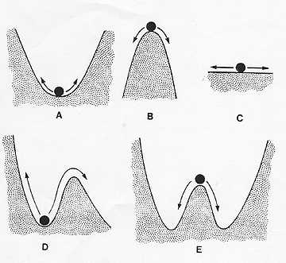
A question of balance ?
…the cliché of first resort…
…how is the balance point decided…
…and what kind of stability?
A = Stable equilibrium.
B = Unstable equilibrium.
C = Neutrally stable equilibrium.
D = Metastable equilibrium.
E = Metastable equilibria with multiple stable states.
http://classes.entom.wsu.edu/529/Stability.htm

Slide 24
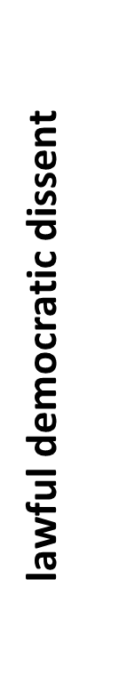
Slippery slope
…of two kinds…
D = Metastable equilibrium.
if surveillance power increases beyond a critical point, lawful democratic dissent is chilled
intelligentsia will not risk “getting their name on a list”
MORE INSIDIOUS EFFECT THAN “PANOPTIC” CONFORMITY OF OVERT SURVEILLANCE
B = Unstable equilibrium. The ball moves away from its equilibrium when disturbed.
intensity of surveillance in society

