Slide 1
第5章 高级SQL

Slide 2
概要
编程语言中使用SQL
存储函数和存储过程
触发器
递归查询
先进的聚合功能

Slide 3
作业
5-8
5-9
5-10
5-11
5-15
5-22
5-23
5-24

Slide 4
编程语言中使用SQL
数据库程序员必须使用通用编程语言，原因至少有两个
并不是所有的查询都可以用SQL表示，因为SQL没有提供通用语言的全部表达能力。
非声明性操作——例如打印报告、与用户交互或将查询结果发送到图形用户界面——不能在SQL中执行。

Slide 5
编程语言中使用SQL（续）
从通用编程语言中访问SQL有两种方法
通用程序——可以使用一组函数与数据库服务器连接和通信
嵌入式SQL——提供了一种程序与数据库服务器交互的方法。
SQL语句在编译时被转换为函数调用。
在运行时，这些函数调用使用提供动态SQL工具的API连接到数据库。

Slide 6
JDBC

Slide 7
JDBC
JDBC是用于与支持SQL的数据库系统通信的Java API。
JDBC支持查询和更新数据以及检索查询结果的各种特性。
JDBC还支持元数据检索，比如查询数据库中存在的关系以及关系属性的名称和类型。
与数据库通信的模型:
打开一个连接
创建一个“statement”对象
使用statement对象执行查询，以发送查询并获取结果
异常机制处理错误

Slide 8
JDBC Code
public static void JDBCexample(String dbid, String userid, String passwd)
{
try (Connection conn = DriverManager.getConnection( "jdbc:oracle:thin:@db.yale.edu:2000:univdb", userid, passwd);
Statement stmt = conn.createStatement(); )
{
… Do Actual Work ….
}
catch (SQLException sqle) {
System.out.println("SQLException : " + sqle);
}
}
NOTE: Above syntax works with Java 7, and JDBC 4 onwards. Resources opened in “try (….)” syntax (“try with resources”) are automatically closed at the end of the try block

Slide 9
JDBC Code for Older Versions of Java/JDBC
public static void JDBCexample(String dbid, String userid, String passwd)
{
try {
Class.forName ("oracle.jdbc.driver.OracleDriver");
Connection conn = DriverManager.getConnection( "jdbc:oracle:thin:@db.yale.edu:2000:univdb", userid, passwd);
Statement stmt = conn.createStatement();
… Do Actual Work ….
stmt.close();
conn.close();
}
catch (SQLException sqle) {
System.out.println("SQLException : " + sqle);
}
} NOTE: Class.forName is not required from JDBC 4 onwards. The try with resources syntax in prev slide is preferred for Java 7 onwards.

Slide 10
JDBC Code (Cont.)
Update to database
try { stmt.executeUpdate( "insert into instructor values('77987', 'Kim', 'Physics', 98000)"); } catch (SQLException sqle) { System.out.println("Could not insert tuple. " + sqle); }
Execute query and fetch and print results
ResultSet rset = stmt.executeQuery( "select dept_name, avg (salary) from instructor group by dept_name"); while (rset.next()) { System.out.println(rset.getString("dept_name") + " " + rset.getFloat(2)); }

Slide 11
JDBC 分节
连接数据库
向数据库系统发送SQL语句
异常和资源管理
检索查询的结果
Prepared Statements
可调用语句
元数据功能
其他功能
使用Python访问数据库

Slide 12
JDBC 代码详情
Getting result fields:
rs.getString(“dept_name”) and rs.getString(1) equivalent if dept_name is the first argument of select result.
Dealing with Null values
int a = rs.getInt(“a”);
if (rs.wasNull()) Systems.out.println(“Got null value”);

Slide 13
Prepared Statement
PreparedStatement pStmt = conn.prepareStatement( "insert into instructor values(?,?,?,?)"); pStmt.setString(1, "88877"); pStmt.setString(2, "Perry"); pStmt.setString(3, "Finance"); pStmt.setInt(4, 125000); pStmt.executeUpdate(); pStmt.setString(1, "88878"); pStmt.executeUpdate();
警告:当从用户处获取输入并将其添加到查询时，总是使用预处理语句
永远不要通过拼合字符串来创建查询
"insert into instructor values(' " + ID + " ', ' " + name + " ', " + " ' + dept name + " ', " ' balance + ')“
如果名字是“D'Souza”?

Slide 14
SQL 注入
假设我们构造一个查询使用
"select * from instructor where name = '" + name + "'"
假设用户输入一下内容，替代姓名:
X' or 'Y' = 'Y
结果集变为:
"select * from instructor where name = '" + "X' or 'Y' = 'Y" + "'"
which is:
select * from instructor where name = 'X' or 'Y' = 'Y'
用户甚至使用：
X'; update instructor set salary = salary + 10000; --
Prepared stament 内部使用: "select * from instructor where name = 'X\' or \'Y\' = \'Y'
始终使用prepared statements ，将用户输入作为参数

Slide 15
Metadata Features
ResultSet metadata
E.g.after executing query to get a ResultSet rs:
ResultSetMetaData rsmd = rs.getMetaData();
for(int i = 1; i <= rsmd.getColumnCount(); i++) {
System.out.println(rsmd.getColumnName(i));
System.out.println(rsmd.getColumnTypeName(i));
}
How is this useful?

Slide 16
Metadata (Cont)
Database metadata
DatabaseMetaData dbmd = conn.getMetaData();
// Arguments to getColumns: Catalog, Schema-pattern, Table-pattern, // and Column-Pattern // Returns: One row for each column; row has a number of attributes // such as COLUMN_NAME, TYPE_NAME // The value null indicates all Catalogs/Schemas. // The value “” indicates current catalog/schema // The value “%” has the same meaning as SQL like clause
ResultSet rs = dbmd.getColumns(null, "univdb", "department", "%");
while( rs.next()) {
System.out.println(rs.getString("COLUMN_NAME"),
rs.getString("TYPE_NAME");
}
And where is this useful?

Slide 17
Metadata (Cont)
Database metadata
DatabaseMetaData dbmd = conn.getMetaData();
// Arguments to getTables: Catalog, Schema-pattern, Table-pattern, // and Table-Type // Returns: One row for each table; row has a number of attributes // such as TABLE_NAME, TABLE_CAT, TABLE_TYPE, .. // The value null indicates all Catalogs/Schemas. // The value “” indicates current catalog/schema // The value “%” has the same meaning as SQL like clause // The last attribute is an array of types of tables to return. // TABLE means only regular tables
ResultSet rs = dbmd.getTables (“”, "", “%", new String[] {“TABLES”});
while( rs.next()) {
System.out.println(rs.getString(“TABLE_NAME“));
}
And where is this useful?

Slide 18
Finding Primary Keys
DatabaseMetaData dmd = connection.getMetaData(); // Arguments below are: Catalog, Schema, and Table // The value “” for Catalog/Schema indicates current catalog/schema // The value null indicates all catalogs/schemas ResultSet rs = dmd.getPrimaryKeys(“”, “”, tableName); while(rs.next()){ // KEY_SEQ indicates the position of the attribute in // the primary key, which is required if a primary key has multiple // attributes System.out.println(rs.getString(“KEY_SEQ”), rs.getString("COLUMN_NAME"); }

Slide 19
Transaction Control in JDBC
By default, each SQL statement is treated as a separate transaction that is committed automatically
bad idea for transactions with multiple updates
Can turn off automatic commit on a connection
conn.setAutoCommit(false);
Transactions must then be committed or rolled back explicitly
conn.commit(); or
conn.rollback();
conn.setAutoCommit(true) turns on automatic commit.

Slide 20
Other JDBC Features
Calling functions and procedures
CallableStatement cStmt1 = conn.prepareCall("{? = call some function(?)}");
CallableStatement cStmt2 = conn.prepareCall("{call some procedure(?,?)}");
Handling large object types
getBlob() and getClob() that are similar to the getString() method, but return objects of type Blob and Clob, respectively
get data from these objects by getBytes()
associate an open stream with Java Blob or Clob object to update large objects
blob.setBlob(int parameterIndex, InputStream inputStream).

Slide 21
JDBC Resources
JDBC Basics Tutorial
https://docs.oracle.com/javase/tutorial/jdbc/index.html

Slide 22
SQLJ
JDBC is overly dynamic, errors cannot be caught by compiler
SQLJ: embedded SQL in Java
#sql iterator deptInfoIter ( String dept name, int avgSal);
deptInfoIter iter = null;
#sql iter = { select dept_name, avg(salary) from instructor
group by dept name };
while (iter.next()) {
String deptName = iter.dept_name();
int avgSal = iter.avgSal();
System.out.println(deptName + " " + avgSal);
}
iter.close();

Slide 23
ODBC

Slide 24
ODBC
Open DataBase Connectivity (ODBC) standard
standard for application program to communicate with a database server.
application program interface (API) to
open a connection with a database,
send queries and updates,
get back results.
Applications such as GUI, spreadsheets, etc. can use ODBC

Slide 25
Embedded SQL
The SQL standard defines embeddings of SQL in a variety of programming languages such as C, C++, Java, Fortran, and PL/1,
A language to which SQL queries are embedded is referred to as a host language, and the SQL structures permitted in the host language comprise embedded SQL.
The basic form of these languages follows that of the System R embedding of SQL into PL/1.
EXEC SQL statement is used in the host language to identify embedded SQL request to the preprocessor
EXEC SQL <embedded SQL statement >;
Note: this varies by language:
In some languages, like COBOL, the semicolon is replaced with END-EXEC
In Java embedding uses # SQL { …. };

Slide 26
Embedded SQL (Cont.)
Before executing any SQL statements, the program must first connect to the database. This is done using:
EXEC-SQL connect to server user user-name using password;
Here, server identifies the server to which a connection is to be established.
Variables of the host language can be used within embedded SQL statements. They are preceded by a colon (:) to distinguish from SQL variables (e.g., :credit_amount )
Variables used as above must be declared within DECLARE section, as illustrated below. The syntax for declaring the variables, however, follows the usual host language syntax.
EXEC-SQL BEGIN DECLARE SECTION}
int credit-amount ;
EXEC-SQL END DECLARE SECTION;

Slide 27
Embedded SQL (Cont.)
To write an embedded SQL query, we use the
declare c cursor for <SQL query>
statement. The variable c is used to identify the query
Example:
From within a host language, find the ID and name of students who have completed more than the number of credits stored in variable credit_amount in the host langue
Specify the query in SQL as follows:
EXEC SQL
declare c cursor for select ID, name from student where tot_cred > :credit_amount
END_EXEC

Slide 28
Embedded SQL (Cont.)
The open statement for our example is as follows:
EXEC SQL open c ;
This statement causes the database system to execute the query and to save the results within a temporary relation. The query uses the value of the host-language variable credit-amount at the time the open statement is executed.
The fetch statement causes the values of one tuple in the query result to be placed on host language variables.
EXEC SQL fetch c into :si, :sn END_EXEC
Repeated calls to fetch get successive tuples in the query result

Slide 29
Embedded SQL (Cont.)
A variable called SQLSTATE in the SQL communication area (SQLCA) gets set to '02000' to indicate no more data is available
The close statement causes the database system to delete the temporary relation that holds the result of the query.
EXEC SQL close c ;
Note: above details vary with language. For example, the Java embedding defines Java iterators to step through result tuples.

Slide 30
Updates Through Embedded SQL
Embedded SQL expressions for database modification (update, insert, and delete)
Can update tuples fetched by cursor by declaring that the cursor is for update
EXEC SQL
declare c cursor for select * from instructor where dept_name = 'Music' for update
We then iterate through the tuples by performing fetch operations on the cursor (as illustrated earlier), and after fetching each tuple we execute the following code:
update instructor set salary = salary + 1000 where current of c

Slide 31
Functions and Procedures

Slide 32
Functions and Procedures
函数和过程允许“业务逻辑”存储在数据库中，并从SQL语句中执行。
它们可以由SQL的过程性组件或外部编程语言(如Java、C或c++)定义。
这里给出的语法是由SQL标准定义的。
大多数数据库实现了这种语法的非标准版本。

Slide 33
Declaring SQL Functions
Define a function that, given the name of a department, returns the count of the number of instructors in that department.
create function dept_count (dept_name varchar(20)) returns integer begin declare d_count integer; select count (* ) into d_count from instructor where instructor.dept_name = dept_name return d_count; end
The function dept_count can be used to find the department names and budget of all departments with more that 12 instructors.
select dept_name, budget from department where dept_count (dept_name ) > 12

Slide 34
Table Functions
The SQL standard supports functions that can return tables as results; such functions are called table functions
Example: Return all instructors in a given department
create function instructor_of (dept_name char(20))
returns table (
ID varchar(5), name varchar(20), dept_name varchar(20), salary numeric(8,2))
return table (select ID, name, dept_name, salary from instructor where instructor.dept_name = instructor_of.dept_name)
Usage
select * from table (instructor_of ('Music'))

Slide 35
SQL Procedures
The dept_count function could instead be written as procedure:
create procedure dept_count_proc (in dept_name varchar(20), out d_count integer) begin
select count(*) into d_count from instructor where instructor.dept_name = dept_count_proc.dept_name
end
The keywords in and out are parameters that are expected to have values assigned to them and parameters whose values are set in the procedure in order to return results.
Procedures can be invoked either from an SQL procedure or from embedded SQL, using the call statement.
declare d_count integer; call dept_count_proc( 'Physics', d_count);

Slide 36
SQL Procedures (Cont.)
Procedures and functions can be invoked also from dynamic SQL
SQL allows more than one procedure of the so long as the number of arguments of the procedures with the same name is different.
The name, along with the number of arguments, is used to identify the procedure.

Slide 37
Language Constructs for Procedures & Functions
SQL supports constructs that gives it almost all the power of a general-purpose programming language.
Warning: most database systems implement their own variant of the standard syntax below.
Compound statement: begin … end,
May contain multiple SQL statements between begin and end.
Local variables can be declared within a compound statements
While and repeat statements:
while boolean expression do
sequence of statements ;
end while
repeat
sequence of statements ;
until boolean expression
end repeat

Slide 38
Language Constructs (Cont.)
For loop
Permits iteration over all results of a query
Example: Find the budget of all departments declare n integer default 0; for r as select budget from department where dept_name = 'Music' do set n = n + r.budget end for

Slide 39
Language Constructs – if-then-else
Conditional statements (if-then-else)
if boolean expression then statement or compound statement elseif boolean expression then statement or compound statement else statement or compound statement end if

Slide 40
Example procedure
Registers student after ensuring classroom capacity is not exceeded
Returns 0 on success and -1 if capacity is exceeded
See book (page 202) for details
Signaling of exception conditions, and declaring handlers for exceptions
declare out_of_classroom_seats condition declare exit handler for out_of_classroom_seats begin … end
The statements between the begin and the end can raise an exception by executing “signal out_of_classroom_seats”
The handler says that if the condition arises he action to be taken is to exit the enclosing the begin end statement.

Slide 41
External Language Routines
SQL allows us to define functions in a programming language such as Java, C#, C or C++.
Can be more efficient than functions defined in SQL, and computations that cannot be carried out in SQL\can be executed by these functions.
Declaring external language procedures and functions
create procedure dept_count_proc(in dept_name varchar(20), out count integer) language C external name '/usr/avi/bin/dept_count_proc' create function dept_count(dept_name varchar(20)) returns integer language C external name '/usr/avi/bin/dept_count'

Slide 42
External Language Routines (Cont.)
Benefits of external language functions/procedures:
more efficient for many operations, and more expressive power.
Drawbacks
Code to implement function may need to be loaded into database system and executed in the database system’s address space.
risk of accidental corruption of database structures
security risk, allowing users access to unauthorized data
There are alternatives, which give good security at the cost of potentially worse performance.
Direct execution in the database system’s space is used when efficiency is more important than security.

Slide 43
Security with External Language Routines
To deal with security problems, we can do on of the following:
Use sandbox techniques
That is, use a safe language like Java, which cannot be used to access/damage other parts of the database code.
Run external language functions/procedures in a separate process, with no access to the database process’ memory.
Parameters and results communicated via inter-process communication
Both have performance overheads
Many database systems support both above approaches as well as direct executing in database system address space.

Slide 44
Triggers

Slide 45
Triggers
触发器是系统在修改数据库后自动执行的一条语句。
为了设计一个触发机构，我们必须:
指定执行触发器的条件。
指定触发器执行时要采取的操作。
触发器在SQL:1999中被引入到SQL标准中，但在更早的时候就被大多数数据库支持使用非标准语法。
这里说明的语法可能不能在你的数据库系统上完全工作;检查系统手册

Slide 46
Triggering Events and Actions in SQL
Triggering event can be insert, delete or update
Triggers on update can be restricted to specific attributes
For example, after update of takes on grade
Values of attributes before and after an update can be referenced
referencing old row as : for deletes and updates
referencing new row as : for inserts and updates
Triggers can be activated before an event, which can serve as extra constraints. For example, convert blank grades to null.
create trigger setnull_trigger before update of takes referencing new row as nrow for each row when (nrow.grade = ' ') begin atomic set nrow.grade = null; end;

Slide 47
Trigger to Maintain credits_earned value
create trigger credits_earned after update of takes on (grade) referencing new row as nrow referencing old row as orow for each row when nrow.grade <> 'F' and nrow.grade is not null and (orow.grade = 'F' or orow.grade is null) begin atomic update student set tot_cred= tot_cred + (select credits from course where course.course_id= nrow.course_id) where student.id = nrow.id; end;

Slide 48
Statement Level Triggers
Instead of executing a separate action for each affected row, a single action can be executed for all rows affected by a transaction
Use for each statement instead of for each row
Use referencing old table or referencing new table to refer to temporary tables (called transition tables) containing the affected rows
Can be more efficient when dealing with SQL statements that update a large number of rows

Slide 49
When Not To Use Triggers
触发器以前用于以下任务
汇总数据维护(如各部门工资总额)
通过将更改记录到特殊关系(称为更改或增量关系)来复制数据库，并使用一个单独的进程将更改应用到副本
现在有更好的方法:
今天的数据库提供内置的物化视图工具来维护汇总数据
数据库为复制提供内置支持
在许多情况下，可以使用封装设施代替触发器
定义更新字段的方法
作为更新方法的一部分而不是通过触发器执行操作

Slide 50
When Not To Use Triggers (Cont.)
触发器意外执行的风险，例如，当
从备份副本中加载数据
在远程站点复制更新
可以在这些操作之前禁用触发器执行。
其他有触发因素的风险:
导致触发触发器的关键事务失败的错误
级联执行

Slide 51
Recursive Queries

Slide 52
Recursion in SQL
SQL:1999 permits recursive view definition
Example: find which courses are a prerequisite, whether directly or indirectly, for a specific course with recursive rec_prereq(course_id, prereq_id) as ( select course_id, prereq_id from prereq union select rec_prereq.course_id, prereq.prereq_id, from rec_rereq, prereq where rec_prereq.prereq_id = prereq.course_id ) select ∗ from rec_prereq;
This example view, rec_prereq, is called the transitive closure of the prereq relation

Slide 53
The Power of Recursion
Recursive views make it possible to write queries, such as transitive closure queries, that cannot be written without recursion or iteration.
Intuition: Without recursion, a non-recursive non-iterative program can perform only a fixed number of joins of prereq with itself
This can give only a fixed number of levels of managers
Given a fixed non-recursive query, we can construct a database with a greater number of levels of prerequisites on which the query will not work
Alternative: write a procedure to iterate as many times as required
See procedure findAllPrereqs in book

Slide 54
The Power of Recursion
Computing transitive closure using iteration, adding successive tuples to rec_prereq
The next slide shows a prereq relation
Each step of the iterative process constructs an extended version of rec_prereq from its recursive definition.
The final result is called the fixed point of the recursive view definition.
Recursive views are required to be monotonic. That is, if we add tuples to prereq the view rec_prereq contains all of the tuples it contained before, plus possibly more

Slide 55
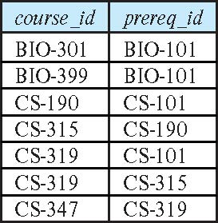
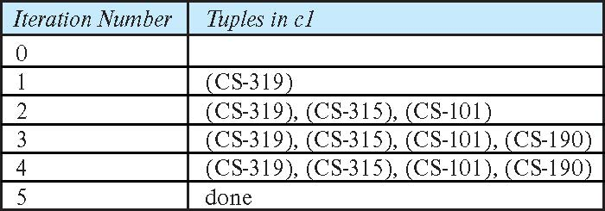
Example of Fixed-Point Computation

Slide 56
Advanced Aggregation Features

Slide 57
Ranking
排序是根据特定的顺序进行的。
假设我们有一个关系student_grades(ID, GPA)，给出每个学生的平均绩点
找出每个学生的名次。
select ID, rank() over (order by GPA desc) as s_rank from student_grades
需要一个额外的order by子句来将它们按顺序排列
select ID, rank() over (order by GPA desc) as s_rank from student_grades order by s_rank
排名可能会有差距:例如，如果两个学生有相同的最高GPA，都是排名1，下一个排名是3
dense_rank不留下间隙，所以下一个密集秩是2
Notes:
57

Slide 58
Ranking
可以使用基本的SQL聚合来进行排序，但是结果查询的效率非常低
select ID, (1 + (select count(*) from student_grades B where B.GPA > A.GPA)) as s_rank from student_grades A order by s_rank;
dense_rank 怎么处理？
select ID, (1 + (select count(distinct B.gpa) from student_grades B where B.GPA > A.GPA)) as s_rank from student_grades A order by s_rank;

Slide 59
Ranking (Cont.)
可以在数据分区内进行排序。
“找出每个系内学生的排名。”
select ID, dept_name, rank () over (partition by dept_name order by GPA desc) as dept_rank from dept_grades order by dept_name, dept_rank;
多个rank子句可以出现在一个选择子句中。
在按子句/聚合应用分组之后，进行排序
可以用来查找top-n结果吗
比许多数据库支持的限制n子句更通用，因为它允许每个分区内的top-n

Slide 60
Ranking (Cont.)
怎么用普通SQL实现分区排名？
select ID, select count(*) + 1 from student_grades B where B.GPA > A.GPA where a.dept_name = b.dept_name) as s_rank from student_grades A order by s_rank;

Slide 61
Ranking (Cont.)
Other ranking functions:
percent_rank (within partition, if partitioning is done)
cume_dist (cumulative distribution)
fraction of tuples with preceding values
row_number (non-deterministic in presence of duplicates)
SQL:1999允许用户首先指定空值或最后指定空值
select ID, rank ( ) over (order by GPA desc nulls last) as s_rank from student_grades
Notes:
61

Slide 62
Ranking (Cont.)
对于给定的常数n，对函数ntile(n)进行排序，将每个分区中的元组按照指定的顺序进行排序，并将它们划分为n个具有相同数量元组的桶。
E.g.,
select ID, ntile(4) over (order by GPA desc) as quartile from student_grades;
Notes:
62

Slide 63
Windowing
用于平滑随机变量
例如，移动平均值:“给定每个日期的销售额，计算每个日期当天、前一天和第二天的销售额平均值。”
Window specification in SQL:
Given relation sales(date, value)
select date, sum(value) over (order by date rows between 1 preceding and 1 following) from sales
Notes:
63

Slide 64
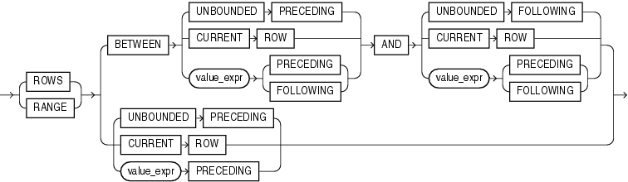
Windowing
Examples of other window specifications:
rows between unbounded preceding and current row
rows unbounded preceding
range between 10 preceding and current row
All rows with values between current row value –10 to current value
range interval 10 day preceding （oracle不支持）
Not including current row
Notes:
64

Slide 65
Windowing (Cont.)
分类窗口滑动
例如，给定一个关系事务(account_number, date_time, value)，其中value对于存款为正，对于取款为负
“查找每个账户上的每次交易后的总余额”
select account_number, date_time, sum (value) over (partition by account_number order by date_time rows unbounded preceding) as balance from transaction order by account_number, date_time
Notes:
65

Slide 66
OLAP

Slide 67
Data Analysis and OLAP
联机分析处理(OLAP)
数据的交互式分析，允许数据以不同的方式在线汇总和查看(可以忽略不计的延迟)
可以建模为维度属性和度量属性的数据称为多维数据。
测量属性
测量一些值
可以被聚合
例如，销售关系的数量列
维度属性
定义用于查看度量属性(或其聚合)的维度
例如，销售关系的物品名称、颜色和大小列

Slide 68
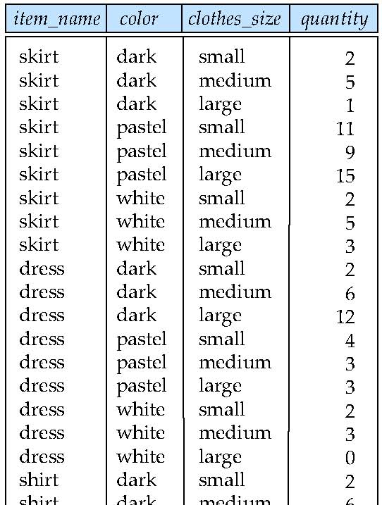
Example sales relation
...
...
...
...
...
...
...
...

Slide 69
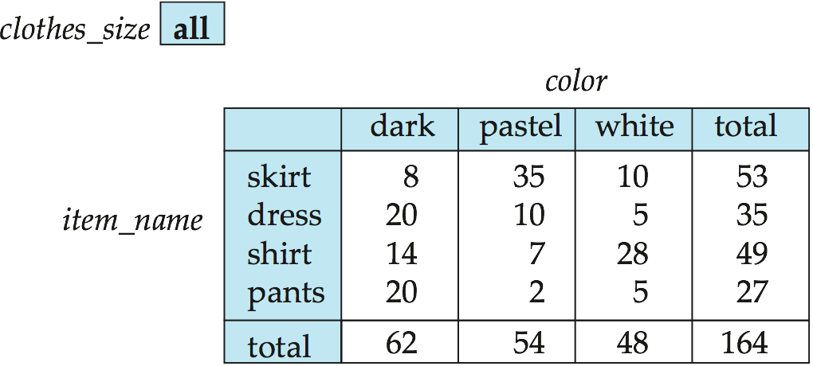
Cross Tabulation of sales by item_name and color
上面的表格是一个交叉制表(交叉制表)的例子，也被称为数据透视表。
其中一个维度属性的值形成行标题
另一个维度属性的值形成列标题
其他维度属性列在顶部
单个单元格中的值是指定该单元格的维度属性值的(聚合)。

Slide 70
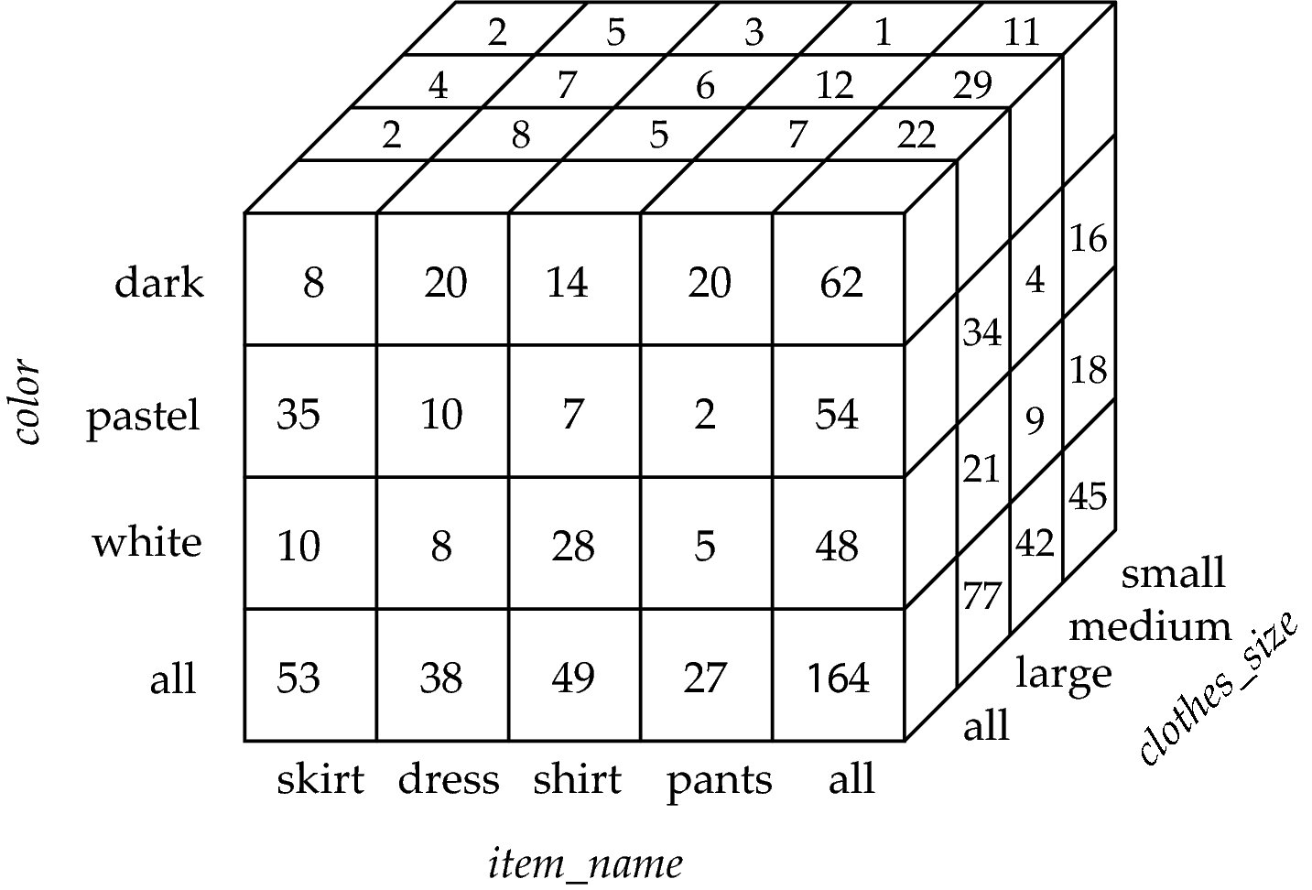
Data Cube
数据多维数据集是跨制表符的多维泛化
可以有n个维度;下面是3个
交叉表可以用作数据多维数据集的视图

Slide 71
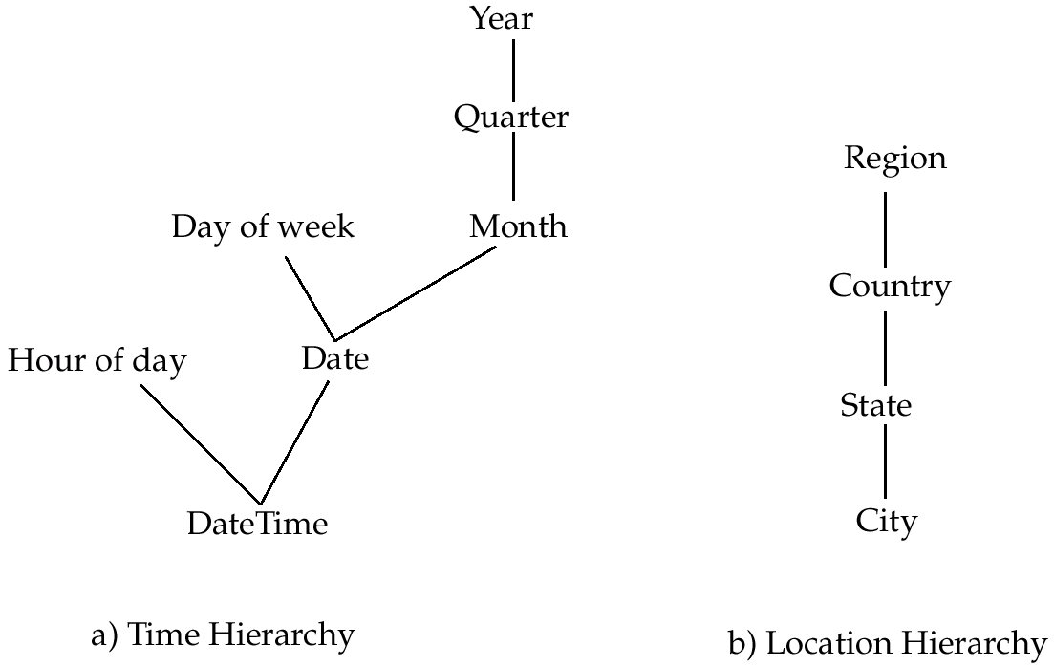
Hierarchies on Dimensions
维度属性的层次结构:允许以不同的详细级别查看维度
例如，维度DateTime可用于按天、日、周、月、季或年的小时进行聚合

Slide 72
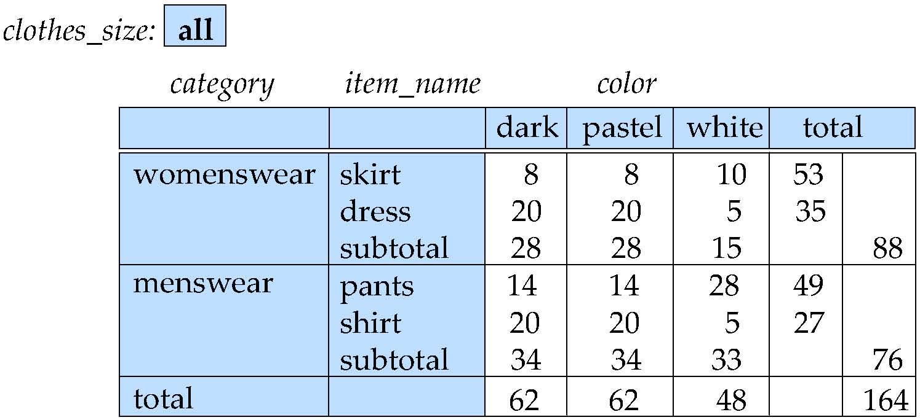
Cross Tabulation With Hierarchy
Cross-tabs can be easily extended to deal with hierarchies
Can drill down or roll up on a hierarchy

Slide 73
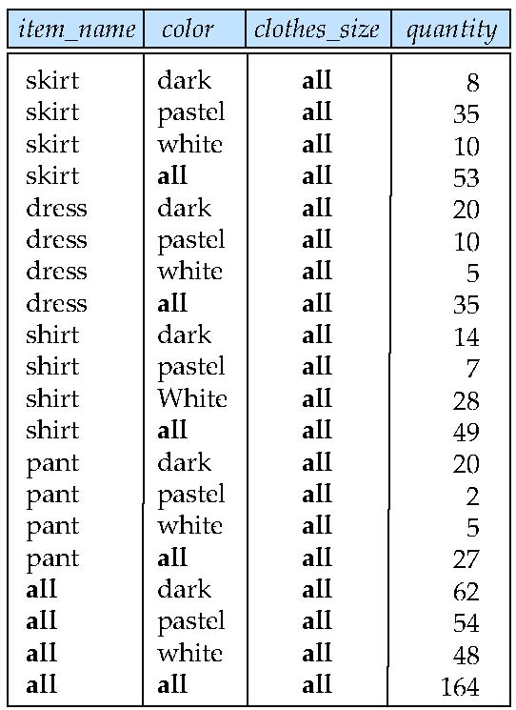
Relational Representation of Cross-tabs
Cross-tabs can be represented as relations
We use the value all is used to represent aggregates.
The SQL standard actually uses null values in place of all despite confusion with regular null values.

Slide 74
Extended Aggregation to Support OLAP
The cube operation computes union of group by’s on every subset of the specified attributes
Example relation for this section sales(item_name, color, clothes_size, quantity)
E.g., consider the query
select item_name, color, size, sum(number) from sales group by cube(item_name, color, size)
This computes the union of eight different groupings of the sales relation:
{ (item_name, color, size), (item_name, color), (item_name, size), (color, size), (item_name), (color), (size), ( ) }
where ( ) denotes an empty group by list.
For each grouping, the result contains the null value for attributes not present in the grouping.
Notes:
74

Slide 75
Online Analytical Processing Operations
Relational representation of cross-tab that we saw earlier, but with null in place of all, can be computed by
select item_name, color, sum(number) from sales group by cube(item_name, color)
The function grouping() can be applied on an attribute
Returns 1 if the value is a null value representing all, and returns 0 in all other cases.
select item_name, color, size, sum(number), grouping(item_name) as item_name_flag, grouping(color) as color_flag, grouping(size) as size_flag, from sales group by cube(item_name, color, size)
Notes:
75

Slide 76
Online Analytical Processing Operations
Can use the function decode() in the select clause to replace such nulls by a value such as all
E.g., replace item_name in first query by decode( grouping(item_name), 1, ‘all’, item_name)
Notes:
76

Slide 77
Extended Aggregation (Cont.)
The rollup construct generates union on every prefix of specified list of attributes
E.g.,
select item_name, color, size, sum(number) from sales group by rollup(item_name, color, size)
Generates union of four groupings:
{ (item_name, color, size), (item_name, color), (item_name), ( ) }
Rollup can be used to generate aggregates at multiple levels of a hierarchy.
E.g., suppose table itemcategory(item_name, category) gives the category of each item. Then
select category, item_name, sum(number) from sales, itemcategory where sales.item_name = itemcategory.item_name group by rollup(category, item_name)
would give a hierarchical summary by item_name and by category.
Notes:
77

Slide 78
Extended Aggregation (Cont.)
Multiple rollups and cubes can be used in a single group by clause
Each generates set of group by lists, cross product of sets gives overall set of group by lists
E.g.,
select item_name, color, size, sum(number) from sales group by rollup(item_name), rollup(color, size)
generates the groupings
{item_name, ()} X {(color, size), (color), ()}
= { (item_name, color, size), (item_name, color), (item_name), (color, size), (color), ( ) }
Notes:
78

Slide 79
Online Analytical Processing Operations
Pivoting: changing the dimensions used in a cross-tab is called
Slicing: creating a cross-tab for fixed values only
Sometimes called dicing, particularly when values for multiple dimensions are fixed.
Rollup: moving from finer-granularity data to a coarser granularity
Drill down: The opposite operation - that of moving from coarser-granularity data to finer-granularity data

Slide 80
OLAP Implementation
The earliest OLAP systems used multidimensional arrays in memory to store data cubes, and are referred to as multidimensional OLAP (MOLAP) systems.
OLAP implementations using only relational database features are called relational OLAP (ROLAP) systems
Hybrid systems, which store some summaries in memory and store the base data and other summaries in a relational database, are called hybrid OLAP (HOLAP) systems.

Slide 81
OLAP Implementation (Cont.)
Early OLAP systems precomputed all possible aggregates in order to provide online response
Space and time requirements for doing so can be very high
2^{n} combinations of group by
It suffices to precompute some aggregates, and compute others on demand from one of the precomputed aggregates
Can compute aggregate on (item_name, color) from an aggregate on (item_name, color, size)
For all but a few “non-decomposable” aggregates such as median
is cheaper than computing it from scratch
Several optimizations available for computing multiple aggregates
Can compute aggregate on (item_name, color) from an aggregate on (item_name, color, size)
Can compute aggregates on (item_name, color, size), (item_name, color) and (item_name) using a single sorting of the base data

Slide 82
End of Chapter 5

