Slide 1
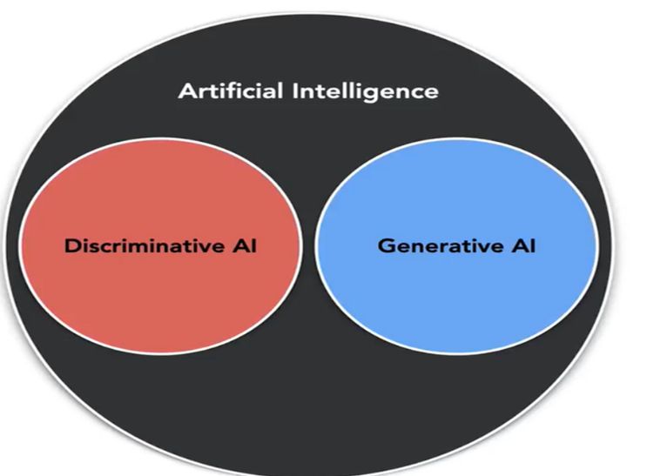
Notes:
Ai models can be categorized through their functions as Discriminative and Generative. First one is using historical data for future output. Text of customer reviews of a restaurant, a Discriminative AI can label the text as good, neutral or bad
So it is like ML type. Generative AI use input text and generate new content, LLM is this type of models.
Generative AI refers to artificial intelligence systems that can create new content such as text, images, music, or data based on patterns learned from training data, while Discriminative AI focuses on classifying or categorizing existing data by learning to distinguish between different classes or categories. Generative AI models, such as GPT or DALL-E, learn the full data distribution, meaning they understand how features relate to each other and can produce new, similar data samples. Common applications include text generation, image creation, music composition, and synthetic data generation.
Discriminative AI, (they discriminate one class from another) in contrast, focuses solely on differentiating or categorizing inputs by learning decision boundaries between classes. Algorithms such as logistic regression, support vector machines, and neural networks are used to solve tasks like spam detection, image recognition, sentiment analysis, and medical diagnosis, relying heavily on well-labeled datasets. Rather than modeling the entire data distribution

Slide 2
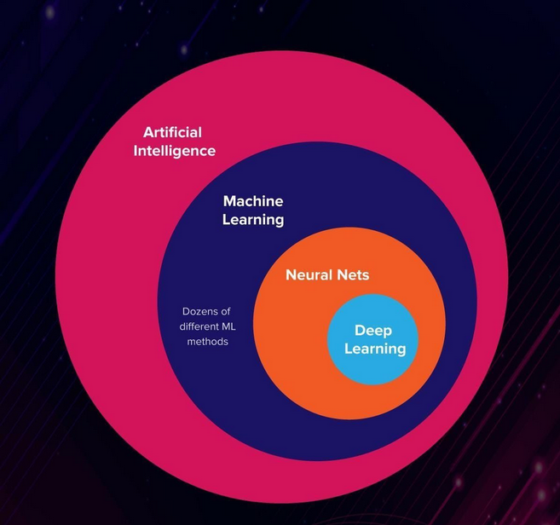

Slide 3
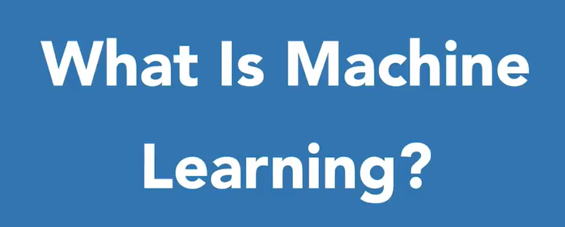

Slide 4
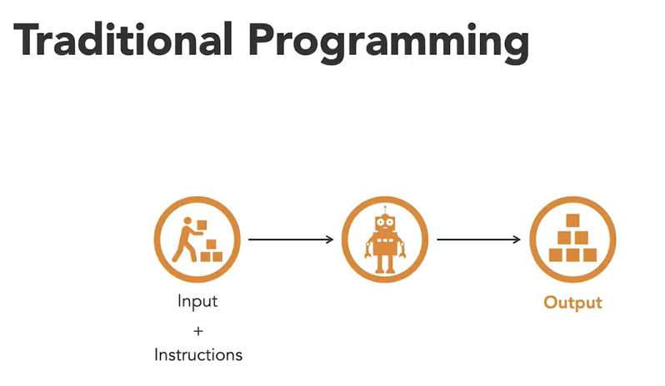
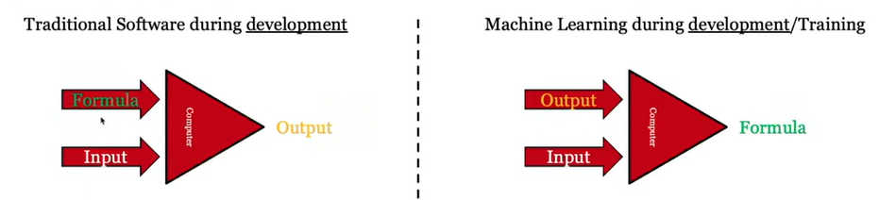
Notes:
Machine Learning:ML teaches the systems to think and understand like humans by learning from the data

Slide 5
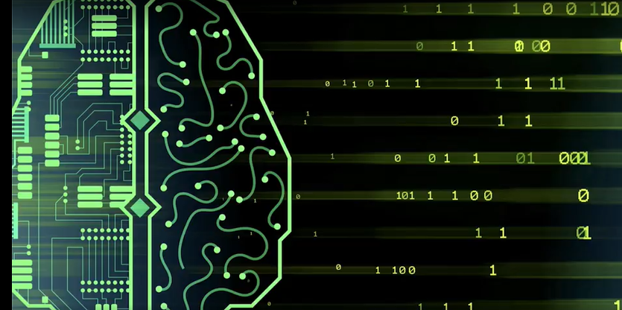
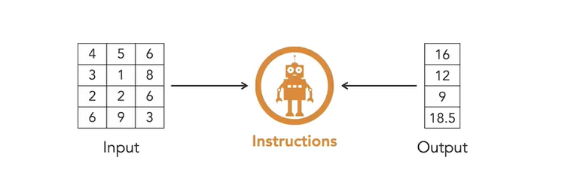
Arthur Samul: 1959 can Machine learns?
Can machines figure out the mathematical operations needs to calculate output from input values

Slide 6
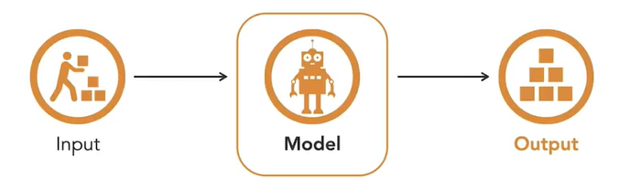

Slide 7
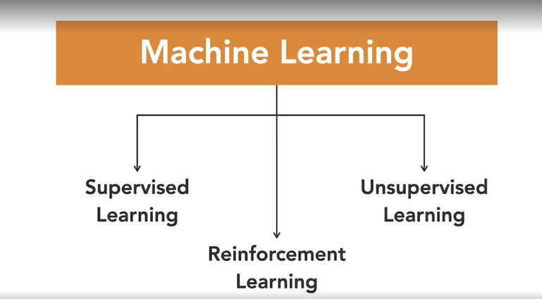
After training the model to calculate the output then by applying the required input then machines can estimate the output, this is what we call it supervised learnings. In Unsupervised learning We give the data and the machines identify any hidden pattern or relationship in the data. This type is reinforcement learning which the agent get positive respond when answer right
Notes:
Supervised Learning: Trains models on labeled data to predict or classify new, unseen data.
Unsupervised Learning: Finds patterns or groups in unlabeled data, like clustering or dimensionality reduction.
Reinforcement Learning: Learns through trial and error to maximize rewards, ideal for decision-making tasks.

Slide 8
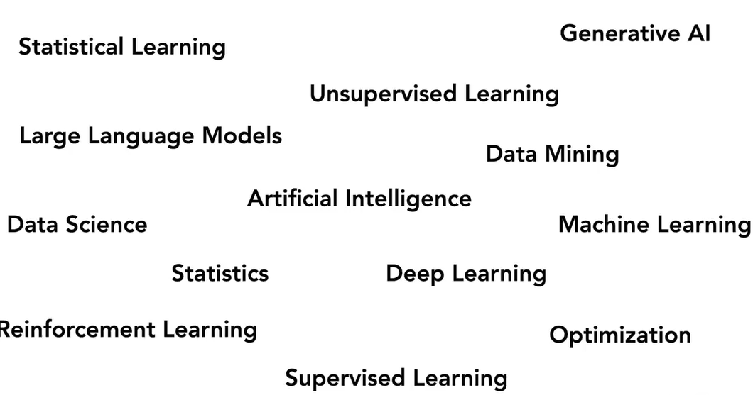
Are they the same? For ML we predict future outcome based on past, for statistical modeling we mostly concern with relationship between variables, this is inference: what happened to variable B as a result of variable A

Slide 9
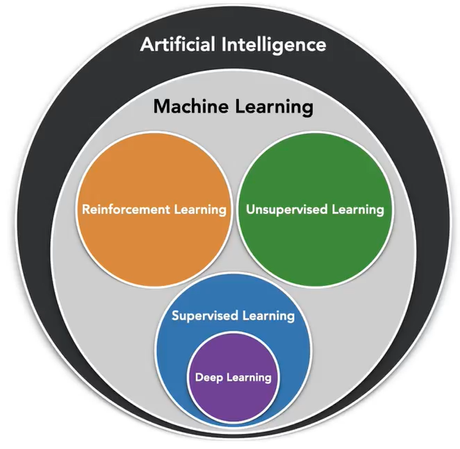
Deep Learning: is one of many ML approaches and is supervised learning. ML is not the same thing as AI, it is a subfield of AI, so all ML is AI but not all AI is ML

Slide 10
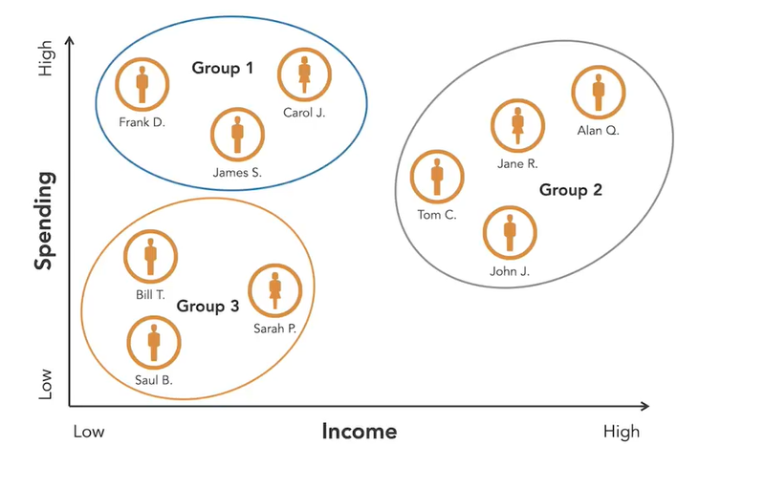
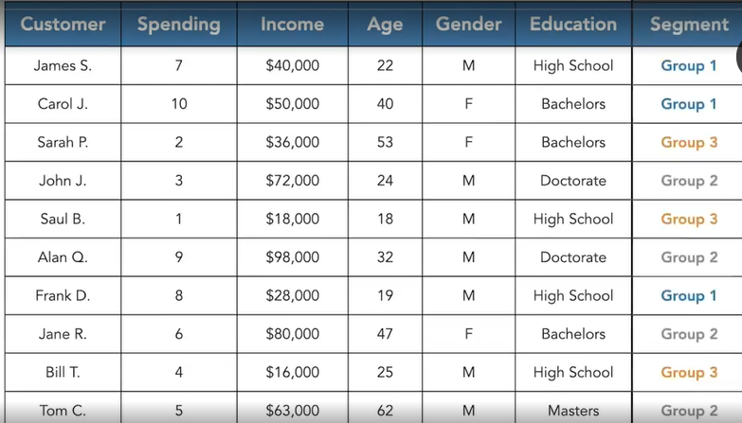
Unsupervised learning is the process of building a descriptive model so in this way the models are used to summarize and group unlabeled data. So we group or segment groups based on similarities. There is no rule to say output s right or wrong.

Slide 11
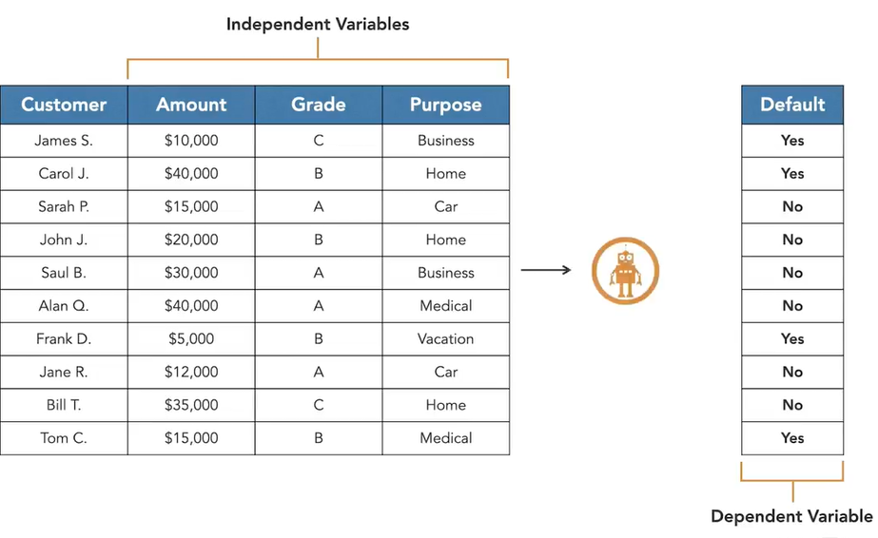
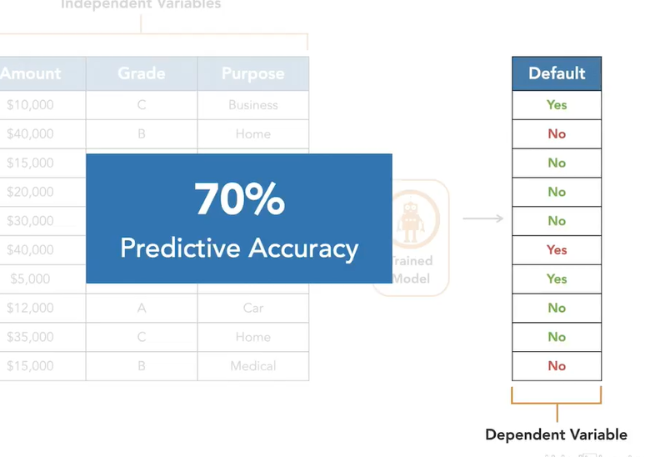
Yield is TASK
Independent variables:
LAI,
fertilizer,
density,
temperature
Shelf life (days)
pH level
Storage temperature (°C)
Humidity (%)
Packaging material type (plastic, glass, etc.)
Presence of preservatives (yes/no)
Fat content (%)
Sugar content (%)
Bacterial count (CFU/ml)
Light exposure (lux)
Initial viscosity
Give loan or not?

Slide 12
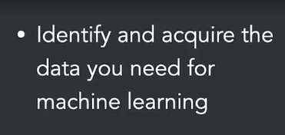
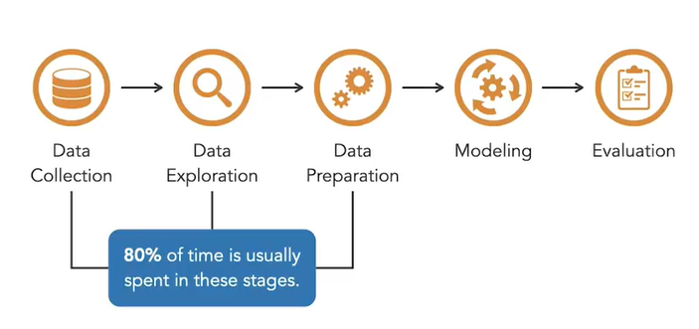
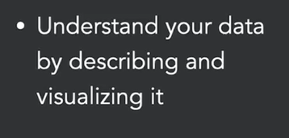
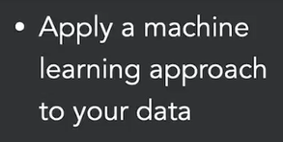
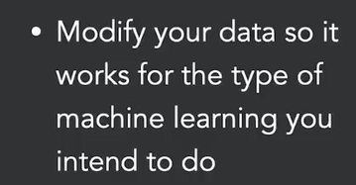
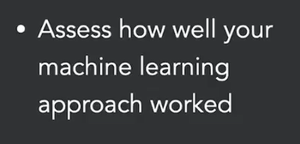
What greens do we need to make salad?
Now mixing the ingredients to make salad and use more or less from some of the ingredients
How many rows and col, what type of data? missing? Inconsistency, duplicate? outliers
We taste the salad, needs more spice or less?
ground truth accuracy, Relevant data, quantity, Variability
Data preparation. Data quality: noisy, balance, missing, normalizing

Slide 13
Python
Pandas: series, DataFrame
Exploration: shape, description, categorical or numeric features, dimensionality of data, Summarize data
Is there a pattern in missing values? use “median”?
Dependent variable does not have a uniform distribution, so we have class imbalance, what to do:
X = df[‘col’].isnull()
Df(X) = shows rows with missing values.
Df.dropna()?
Df = df.dropna(subset = [‘col1’, ‘col2’], how=‘all’)
Removes all missing rows for those two columns.
Or drop columns with missing values:
Df.dropna(axis=1)
we can also use “fillna” method.

Slide 14
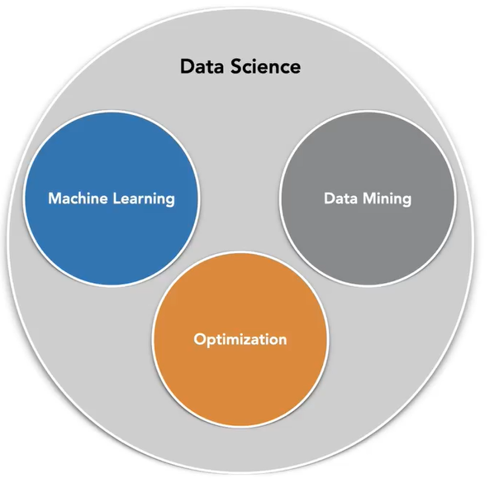
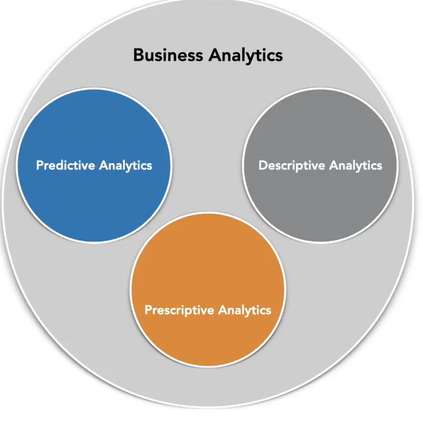
Contrast: Ml prioritize “predictive analytics”, Data mining as “descriptive analytics, optimization as “prescriptive analytics”. We use descriptive to identify patterns in historical data, “predictive analytics” to predict future outcomes, and prescriptive analytics to get a recommendation

