Slide 1
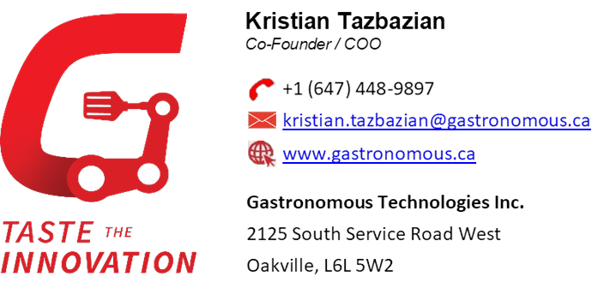




Slide 3
Coordinated multi-disciplinary teams to develop autonomous commercial equipment for Quick Service Restaurants (QSRs) to reduce food waste and energy by over 20% and exceed throughput targets across North America
Developed Product Data Management tool to design and manage over 200 mechanical components, including detailed engineering drawings and assembly plans for the production of pilot and alpha builds
Identified various National Sanitation Foundation (NSF) specifications governing the design of commercial food equipment to ensure the product will meet QSRs’ food safety standards ahead of the mass production stage
Investigated and applied cost-effective and reliable design choices in 3D modelling of various sheet metal, cast and machined components, minimizing lead times and costs associated with prototyping
Spearheaded Gantt chart planning and delegated tasks to accelerate growth of the startup, leading to developing a working pilot from a concept within 4 months in a fast-growing industry

Slide 4

Led technical development and integration of numerous camera and sensor systems across all production-level projects improving self-driving vision accuracy and reliability in humid and snowy climates
Conducted simulation studies (OPTIS & CATIA) by visualizing camera field-of-view to propose placement & lookvector, which optimized machine learning computer vision algorithm, aesthetics, and electromechanical integration
Communicated and calculated in-depth RSS tolerance analysis of mating components and requirements for GD&T to international suppliers ensuring products can be mass-manufactured with a defect rate less than 0.001%

Slide 5

Created CAD designs & drawings to assist in the manufacturing of tooling for military-grade imaging systems
Designed an adaptor to streamline the testing process of the camera and IR payload rotation system; implementing a running tolerance fit and material choice to achieve the desired functionality of the adaptor
Invented, simulated, and tested a compact, low-cost shelving system to increase work order efficiency and reduce wasted space on the shop floor by over 40%

Slide 6

Led technical development and integration of numerous camera and sensor systems across all production-level projects improving self-driving vision accuracy and reliability in humid and snowy climates
Conducted simulation studies (OPTIS & CATIA) by visualizing camera field-of-view to propose placement & lookvector, which optimized machine learning computer vision algorithm, aesthetics, and electromechanical integration
Communicated and calculated in-depth RSS tolerance analysis of mating components and requirements for GD&T to international suppliers ensuring products can be mass-manufactured with a defect rate less than 0.001%

