Slide 1
Scorecard Data Analysis
Mobashshir Alam

Slide 2
Data Overview
There are a total of 7703 Institutes in the given scorecard data set,10%
of which are in California.
Quite a few have a lot of Null data in most of the fields which requires
to narrow the number of Institutes that can be used to derive trends.
Most of my conclusions are based on predominantly/completely Bachelor’s
Degree or above awarding Institutes.
The trends try to cover as much of different statistically important and
diverse features from the data as possible.

Slide 3
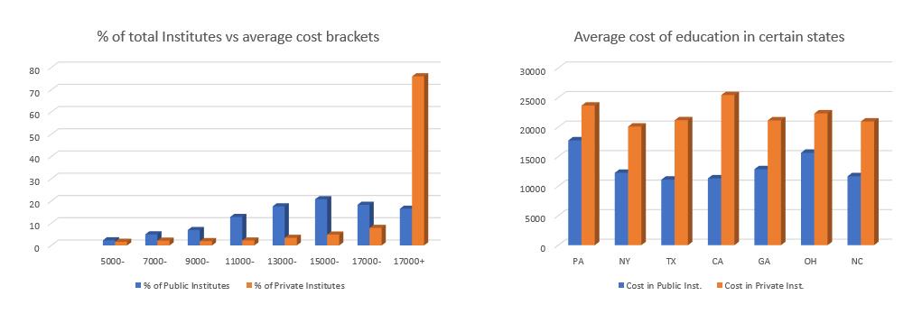
Cost of Education – Public vs Private
The graphs clearly show the huge disparity between the cost of education in the public and private institutes.
Certain states have private education nearly twice as costly as public education.

Slide 4
Distribution by Ownership
California has the highest number of for profit institutions among all the states
having nearly 13% of all for profit institutes.
New York has the highest percentage ~10% of all non profit private Institutes
among all the states.
Texas has the highest percentage ~7% of all Public institutes in all of America.

Slide 5
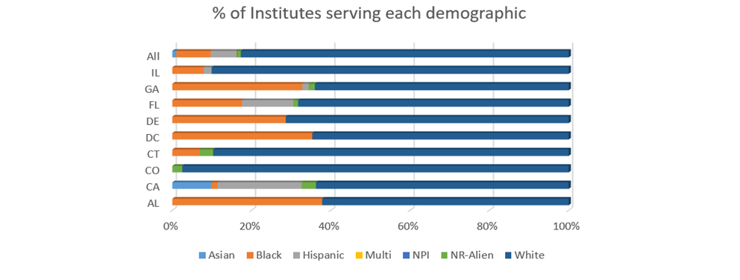
Distribution by Race and State
Most states have nearly 60% of their institutes having a White majority population.
Alabama, DC and Georgia have nearly 30% institutes which have majorly Black population.
California and Florida are the only states with noticeable Hispanic major Institutes.

Slide 6
Top25 SAT percentile across Texas cities for specific degrees
City in Texas | Degree Type | MEAN 25 PERCENTILE SAT
Austin | Education | 440
 | Engineering | 570
 | English Literature | 510
 | Social Sciences | 360
Dallas | Education | 431
 | Liberal Arts | 483
 | Social Sciences | 495
Houston | Education | 470
 | Engineering | 680
 | Liberal Arts | 360
 | Social Sciences | 460
This table can be mainly used by students who have a SAT
score but are not sure about the probability of getting into
Degrees of their choice in particular cities.
A score of 500, a student is more probable to get into
either education, liberal arts or social sciences in Dallas
but will probably have a hard time trying to get into
Engineering in Austin or Houston.
Top 25 percentile SAT scores is better than using the average
SAT scores as the average can be very skewed due to low SAT
scores requirement for certain degree types.

Slide 7
Thank you

