Slide 1
AI PROJECT INTELLIGENCE PLATFORM
Development of AI-Driven Enterprise Project Intelligence and Risk Management Platform
From project documents to predictive risk intelligence and actionable decisions
Batch 1
Guided by: Ms. Mousami Shrivastava

Slide 2


THE CHALLENGE & OUR APPROACH
The problem & our solution
The Problem
Our Solution
Scattered project information across files & tools
Late risk identification, after damage is done
Schedule delays with no early warning
Dependency & vendor bottlenecks
Poor visibility into overall project health
Documents + Project Data
↓
AI Analysis
↓
Risk & Schedule Prediction
↓
Dependency & Health Analysis
↓
RAG Assistant
↓
Recommendations
One platform converts scattered project information into actionable project intelligence.
2

Slide 3








HOW IT WORKS
End-to-end project intelligence workflow
→
→
→
UPLOAD
EXTRACT
DOMAIN
PREDICT
PDF / DOCX / CSV / TXT
Scope, tasks, milestones, risks
IT / Non-IT workflow
Risk, probability, delay
↓
→
→
→
ANALYZE
EXPLAIN
ASSIST
ACT
CPM, dependencies, health
Risk factors, model output
RAG project assistant
Recommendations
3

Slide 4




CAPABILITIES
Six modules, one connected platform
Document Intelligence
Risk Intelligence
Schedule Intelligence
PDF / DOCX / CSV / TXT → structured project information
Risk level, probability, score and contributing risk factors
Deadline forecasting and delay prediction
Dependency Intelligence
Scenario Simulation
AI Project Assistant
Critical path, bottlenecks and task dependencies
“What happens if budget, resources or timeline change?”
RAG-based Q&A grounded in your own project documents
All six modules feed a single Recommendations engine and Project Health Dashboard.
4

Slide 5
UNDER THE HOOD
IT vs. Non-IT — model intelligence
IT PROJECTS — Risk Score Prediction
NON-IT — Risk Classification (XGBoost)
Task: Regression on a continuous risk score · Models: XGBoost & CatBoost
Inputs: progress, budget, resources, testing, security, dependencies, weather · Task: Classification
Metric | XGBoost ★ Deployed | CatBoost
RMSE | 3.8612 | 3.3006
MAE | 3.0586 | 2.6257
R² | 0.9618 | 0.9721
95.96%
0.9451
94.40%
94.62%
Accuracy
F1-Score
Recall
Precision
ROC-AUC: 0.9939 · Threshold: 0.48
NON-IT — Delay Prediction (Random Forest)
By risk category (CatBoost benchmark, RMSE / MAE)
Critical (n=19,267)
3.69 / 2.93
Inputs: progress, budget, resources, testing, bugs, dependencies, weather, productivity · Task: Regression
High (n=54,759)
3.38 / 2.70
Medium (n=90,001)
3.18 / 2.53
1.39 days
1.90 days
0.8617
Low (n=35,973)
3.27 / 2.60
MAE
RMSE
R²
Output: expected launch delay in days
5

Slide 6
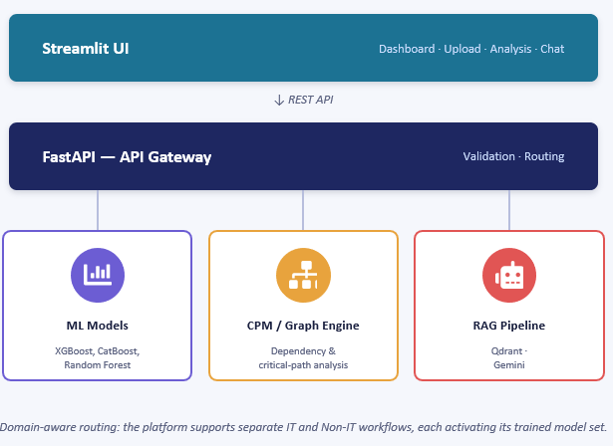
SYSTEM DESIGN
System architecture
WHY FASTAPI?
Exposes ML, analytics & data as REST APIs
Validates every request with Pydantic
Separates UI from ML / business logic
Enables independent scaling & deployment
Auto-generates Swagger / OpenAPI docs
TECH STACK
UI
Streamlit
Backend
FastAPI
ML
XGBoost, CatBoost, RF
RAG
Gemini, Qdrant
Data
Pandas, NumPy
Graph
NetworkX
Database
SQLite / PostgreSQL
FastAPI is the service layer that exposes ML, analytics and backend operations to the Streamlit UI through REST APIs.
6

Slide 7


DATA & MODEL VALIDATION
Dataset & model validation
200,000
33
4
40,000
Model Selection
Project Records
Raw Features
Risk Categories
Held-out Test
IT: XGBoost & CatBoost benchmarked → XGBoost deployed
Non-IT: XGBoost → risk classification
Non-IT: Random Forest → delay prediction
Risk Category Distribution (n = 200,000)
IT reports R² (regression); Non-IT reports classification accuracy. The 80.4% below is the final, leakage-free validation figure — Slide 5 shows per-model benchmarking accuracy on the deployed classifiers.
Medium
90,001
High
54,759
Low
35,973
Validation Discipline
Critical
19,267
99.7% (rejected — outcome-variable leakage) → 80.4% (validated — forecast-time features only)
Data quality: 0 missing values · 0 duplicate rows · 0 duplicate project IDs
Known limitation: Critical-risk recall (67.6%) needs improvement — targeted for the next validation phase.
7

Slide 8
BRINGING IT TOGETHER
AI Project Assistant (RAG) & Conclusion
Project Document
Predict
Understand
↓
Text Extraction
AI-based project risk and delay prediction
Document intelligence, dependencies & RAG
↓
Chunking
↓
Simulate
Act
Embeddings
What-if project scenarios
Risk-driven recommendations
↓
Vector Store (Qdrant)
FUTURE SCOPE
↓
Enterprise Tool Integration — Jira, Azure DevOps and MS Project sync
Real-Time Monitoring — Continuous risk, schedule and dependency tracking
Advanced Critical-Risk Detection — Cost-sensitive and class-balancing approaches
Deeper Explainable AI — Per-project SHAP-based prediction explanations
Enterprise-Scale Deployment — Cloud infrastructure, autoscaling and CI/CD
Relevant Context
↓
Gemini
↓
Grounded Answer
The risk model predicts project risk; RAG answers questions using the project's own uploaded documents.
“From scattered project information to actionable project intelligence.”
8

Slide 9
Project Demonstration

Slide 10
THANK YOU

